Slide 1



WIPO TRAINING FOR TRAINERS PROGRAMME ON IP ASSET MANAGEMENT BY SMEs
WIPO TRAINING FOR TRAINERS PROGRAMME ON IP ASSET MANAGEMENT BY SMEs
IP LAW AND ADMINISTRATION IN MALAYSIA
RASHIDAH RIDHA SHEIKH KHALID
LEGAL OFFICER
22 FEBRUARY 2011
INTELLECTUAL PROPERTY CORPORATION OF MALAYSIA (MyIPO)
INTELLECTUAL PROPERTY CORPORATION OF MALAYSIA (MyIPO)

Slide 2
WIPO TRAINING FOR TRAINERS PROGRAMME ON IP ASSET MANAGEMENT BY SMEs
INTELLECTUAL PROPERTY (IP) REGIME
G. Bruce Doern 1999, in his book entitled “Global change and intellectual property agencies” pointed out that
“… IP Office fundamentally exist to give practical expression to the central IP policy trade off.
In an overall sense this means regulating and administering a trade-off between protecting creations and inventions of the mind and dissemination such creations for the broader good of society.”
INTELLECTUAL PROPERTY CORPORATION OF MALAYSIA (MyIPO)

Slide 3

INTELLECTUAL PROPERTY (IP) REGIME
In an exchange for an individual’s creation, the government gives the monopoly protection for a limited time

Slide 4
Brief history of Intellectual Property Corporation of Malaysia (MyIPO)
A statutory body known as the Intellectual Property Corporation of Malaysia (MyIPO) was established pursuant to the Intellectual Property Corporation of Malaysia Act 2002 [Act 617]

Slide 5
Brief history of Intellectual Property Corporation of Malaysia (MyIPO)
WIPO TRAINING FOR TRAINERS PROGRAMME ON IP ASSET MANAGEMENT BY SMEs
WIPO TRAINING FOR TRAINERS PROGRAMME ON IP ASSET MANAGEMENT BY SMEs
The Intellectual Property Office
  MyIPO is a government agency.
  Organized as a semi-autonomous body,
  Able to recruit and train staff on its own terms, manage its own finance.
  Judicially autonomous.
    Decisions of the Office to grant, refuse or revoke IPR or to resolve disputes between parties are quasi-judicial decisions and not administrative.
    Office must be free from interference and answerable only to courts.
INTELLECTUAL PROPERTY CORPORATION OF MALAYSIA (MyIPO)
INTELLECTUAL PROPERTY CORPORATION OF MALAYSIA (MyIPO)

Slide 6
Brief history of Intellectual Property Corporation of Malaysia (MyIPO)
WIPO TRAINING FOR TRAINERS PROGRAMME ON IP ASSET MANAGEMENT BY SMEs
WIPO TRAINING FOR TRAINERS PROGRAMME ON IP ASSET MANAGEMENT BY SMEs
MyIPO was corporatised on 3 March 2003. An agency set up under the Ministry of Domestic Trade, Co-operatives and Consumerism (MDTCC)
Prior to March 2003, IP laws in Malaysia were administered by the Intellectual Property Division of the Ministry of Domestic Trade and Consumer Affairs (MDTCA)
INTELLECTUAL PROPERTY CORPORATION OF MALAYSIA (MyIPO)
INTELLECTUAL PROPERTY CORPORATION OF MALAYSIA (MyIPO)

Slide 7
Brief history of Intellectual Property Corporation of Malaysia (MyIPO)
WIPO TRAINING FOR TRAINERS PROGRAMME ON IP ASSET MANAGEMENT BY SMEs
WIPO TRAINING FOR TRAINERS PROGRAMME ON IP ASSET MANAGEMENT BY SMEs
MyIPO has no enforcement mechanism
  Criminal IP cases
Enforcement of criminal IP cases is within the jurisdiction of the Enforcement Division of the MDTCC, whereby the Enforcement Officers would take the necessary action upon receiving complaints from the IP owner.
Criminal sanctions for IP infringement are available under the Copyrights Act 1987 for cases of piracy and the Trade Descriptions Act 1972 for cases of counterfeiting.
INTELLECTUAL PROPERTY CORPORATION OF MALAYSIA (MyIPO)
INTELLECTUAL PROPERTY CORPORATION OF MALAYSIA (MyIPO)

Slide 8
Brief history of Intellectual Property Corporation of Malaysia (MyIPO)
WIPO TRAINING FOR TRAINERS PROGRAMME ON IP ASSET MANAGEMENT BY SMEs
WIPO TRAINING FOR TRAINERS PROGRAMME ON IP ASSET MANAGEMENT BY SMEs
Civil IP cases
Infringement of IP is pursued personally by the IP owner
As IP is a private right, IPR in Malaysia is enforceable by the owner of the IP, instituting legal proceedings against a person who has infringed his/her IPR. In all IP laws of Malaysia, it contain a provision for the IP owner to commence legal action for infringement of his/her IPR in the High Court. Generally, the remedies available to the IP owner are such as injunctions, damages or accounts of profits, delivery up etc.
However, for purposes of Border Measures, application for objection of importation for trade mark and copyright shall be made to MyIPO
INTELLECTUAL PROPERTY CORPORATION OF MALAYSIA (MyIPO)
INTELLECTUAL PROPERTY CORPORATION OF MALAYSIA (MyIPO)

Slide 9
Brief history of Intellectual Property Corporation of Malaysia (MyIPO)
WIPO TRAINING FOR TRAINERS PROGRAMME ON IP ASSET MANAGEMENT BY SMEs
WIPO TRAINING FOR TRAINERS PROGRAMME ON IP ASSET MANAGEMENT BY SMEs
Initially, MyIPO exists to provide rights to intellectual property. Its integral role is to administer intellectual property law, primarily on the following issues:-
i). as a custodian of the IP on behalf of the Government of Malaysia;
ii). Granting patents and patent examination process;
iii). registering trademarks and industrial designs;
iv). Copyright protection to copyright owners;
v). role of intermediary interest (IP agents);
vi). IP awareness campaign- Individual inventors, R&D in universities, government agencies etc
INTELLECTUAL PROPERTY CORPORATION OF MALAYSIA (MyIPO)
INTELLECTUAL PROPERTY CORPORATION OF MALAYSIA (MyIPO)

Slide 10
Brief history of Intellectual Property Corporation of Malaysia (MyIPO)
WIPO TRAINING FOR TRAINERS PROGRAMME ON IP ASSET MANAGEMENT BY SMEs
WIPO TRAINING FOR TRAINERS PROGRAMME ON IP ASSET MANAGEMENT BY SMEs
With the rapid global trend, IP landscape has taken a new leap and there is calling to the IP office to cater to all these new changes that is taking place.
The role of the IP office is no longer confine to just providing protection of IP, but the IP dissemination role of MyIPO now central to a more effective mode of delivery to national economy and societies whom have not tap the IP rights to the fullest.
INTELLECTUAL PROPERTY CORPORATION OF MALAYSIA (MyIPO)
INTELLECTUAL PROPERTY CORPORATION OF MALAYSIA (MyIPO)

Slide 11
WIPO TRAINING FOR TRAINERS PROGRAMME ON IP ASSET MANAGEMENT BY SMEs
IP ADMINISTRATION : THE ROLE OF MyIPO AT PRESENT
Granting patent and patent examination process
Registering trademarks and ID
Copyright protection
provide voluntary notifications, dissemination of knowledge to the appropriate copyright users, compliance issues
Technology enabled filings and processing of applications
Better enhancement of technology enabled filings
efficient pendency performance
efficient pendency performance
IP awareness campaign
to continue the IP awareness campaign and focus on SME etc
Introducing IP monetization
INTELLECTUAL PROPERTY CORPORATION OF MALAYSIA (MyIPO)

Slide 12
National Intellectual Property Policy (NIPP)
WIPO TRAINING FOR TRAINERS PROGRAMME ON IP ASSET MANAGEMENT BY SMEs
WIPO TRAINING FOR TRAINERS PROGRAMME ON IP ASSET MANAGEMENT BY SMEs
April 2007 Government initiative for the National Intellectual Property Policy
“POLICY STATEMENT”
The main purpose of the National Intellectual Policy (NIPP) is to harness intellectual property (IP) as a new engine of growth for the enhancement of economic and social prosperity.
The NIPP focuses on maximizing the contribution of IP in accelerating the socio-economic and technological development through the creation of an environment that encourages continuous creation of IP, provides a high standard IP protection system, promotes exploitation of commercially potential IP, fosters development of the supporting industries and builds human resource capability to successfully implement the policy.
The importance of IP to economic growth has long been recognized. In the current knowledge-based economy, IP is a valuable economic asset as well as a critical business tool that provides competitiveness. Managing and harnessing IP strategically is the gateway to enhance Malaysia’s long-term competitiveness in the Knowledge economy.
INTELLECTUAL PROPERTY CORPORATION OF MALAYSIA (MyIPO)
INTELLECTUAL PROPERTY CORPORATION OF MALAYSIA (MyIPO)

Slide 13
National Intellectual Property Policy (NIPP)
WIPO TRAINING FOR TRAINERS PROGRAMME ON IP ASSET MANAGEMENT BY SMEs
WIPO TRAINING FOR TRAINERS PROGRAMME ON IP ASSET MANAGEMENT BY SMEs
Objectives of the NIPP
  Highest Standard of IP Protection
  Promotion of IP-generated Activities
  Promotion of Commercial Exploitation of IP
  Development of IP Management Capabilities
  Development of Infrastructure for IP Transaction
  Protection of National IP Interest
  Human Resource Development and Public Awareness
Promotion of Foreign Investment & Technology Transfer
INTELLECTUAL PROPERTY CORPORATION OF MALAYSIA (MyIPO)
INTELLECTUAL PROPERTY CORPORATION OF MALAYSIA (MyIPO)

Slide 14
IP COURTS IN MALAYSIA
WIPO TRAINING FOR TRAINERS PROGRAMME ON IP ASSET MANAGEMENT BY SMEs
WIPO TRAINING FOR TRAINERS PROGRAMME ON IP ASSET MANAGEMENT BY SMEs
Establishment of IP Court in Malaysia
Malaysia launched the IP Court in July 2007
  Reason : The concern for the high rising number of piracy of copyrighted materials and counterfeiting of goods in Malaysia
  15 Sessions Courts known as “Sessions Court (Intellectual Property)” in each state and one in Putrajaya
6 High Courts “High Court (Intellectual Property)” in Kuala Lumpur, Selangor, Johor, Perak, Sabah and Sarawak
INTELLECTUAL PROPERTY CORPORATION OF MALAYSIA (MyIPO)
INTELLECTUAL PROPERTY CORPORATION OF MALAYSIA (MyIPO)

Slide 15
IP COURTS IN MALAYSIA
WIPO TRAINING FOR TRAINERS PROGRAMME ON IP ASSET MANAGEMENT BY SMEs
WIPO TRAINING FOR TRAINERS PROGRAMME ON IP ASSET MANAGEMENT BY SMEs
On 6 June 2007, the Government of Malaysia approved the establishment of 15 Sessions Courts and 6 High Courts for purposes of hearing only IP cases. These IP Courts was officially established on 17 July 2007. The Sessions Court (IP) hears only criminal IP matters, whereas the High Court (IP) hears civil cases on IP, appeals from the decisions of the respective Registrars and criminal IP appeals from the decisions of the Sessions Court (IP). With the establishment of IP Courts in Malaysia, IP cases can now be heard and disposed off in an expedient and expeditious manner.
INTELLECTUAL PROPERTY CORPORATION OF MALAYSIA (MyIPO)
INTELLECTUAL PROPERTY CORPORATION OF MALAYSIA (MyIPO)

Slide 16
IP COURTS IN MALAYSIA
WIPO TRAINING FOR TRAINERS PROGRAMME ON IP ASSET MANAGEMENT BY SMEs
WIPO TRAINING FOR TRAINERS PROGRAMME ON IP ASSET MANAGEMENT BY SMEs
Malaysia’s seriousness and commitment in protecting IP rights of IP owners
Establishment of IP Court would further enhance the Malaysian economic growth and social development as a whole
Public in general would be more appreciative of the importance of IP
Owners of the IPs, would be encouraged to be more innovative and creative in wanting to create more IPs and thereafter, proceed to commercialize their IPs as a means of wealth creation
INTELLECTUAL PROPERTY CORPORATION OF MALAYSIA (MyIPO)
INTELLECTUAL PROPERTY CORPORATION OF MALAYSIA (MyIPO)

Slide 17

IP ADMINSTRATION: TAX INCENTIVES
WIPO TRAINING FOR TRAINERS PROGRAMME ON IP ASSET MANAGEMENT BY SMEs
WIPO TRAINING FOR TRAINERS PROGRAMME ON IP ASSET MANAGEMENT BY SMEs
In some countries, activities related to innovation innovation and/or R&D can lead to tax incentives, especially with regard to corporate income taxes. For instance, companies may have the freedom to amortize expenses related to these activities or to deduct part of them from the tax base. Intellectual property tax advantages also exist when revenue is obtained from copyright, patents, designs, trade secrets or layouts, since this income is tax-exempt in many cases.
In Malaysia, there is an initiative by the Income Tax Department of the Ministry of Finance to allow such advantages to take place in Malaysia for software transactions.
INTELLECTUAL PROPERTY CORPORATION OF MALAYSIA (MyIPO)
INTELLECTUAL PROPERTY CORPORATION OF MALAYSIA (MyIPO)

Slide 18
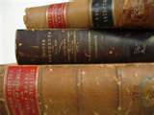

WIPO TRAINING FOR TRAINERS PROGRAMME ON IP ASSET MANAGEMENT BY SMEs
IP LEGISLATIONS
INTELLECTUAL PROPERTY CORPORATION OF MALAYSIA (MyIPO)

Slide 19

WIPO TRAINING FOR TRAINERS PROGRAMME ON IP ASSET MANAGEMENT BY SMEs
IP Legislations
Legislations that govern IP rights in Malaysia:-
Trade Marks Act 1976
Patents Act 1983
Copyright Act 1987
Industrial Designs Act 1996
Geographical Indication Act 2000
Layout Design and Integrated Circuit Act 2000
INTELLECTUAL PROPERTY CORPORATION OF MALAYSIA (MyIPO)

Slide 20
Trade Marks Act 1976
TM is governed by the Trade Marks Act 1976 [Act 175] (TMA) (came into force on 01/09/83) and the Trade Marks Regulations 1997 (came into force on 01/12/97)
The TMA replaces the Trade Marks Ordinance 1950
The TMA has been amended 3 times via the Trade Marks (Amendment) Act (TMAA):-
  TMAA 1994 (01/12/97): Compliance with TRIPS Agreement, introduction of service marks, trade mark registration period increased to 10 years and renewable for additional periods of 10 years
  TMAA 2000 (01/08/01): Deletion of Part A and Part B, protection of well-known marks and border measures
  TMAA 2002 (03/03/03): Establishment of MyIPO
WIPO TRAINING FOR TRAINERS PROGRAMME ON IP ASSET MANAGEMENT BY SMEs
INTELLECTUAL PROPERTY CORPORATION OF MALAYSIA (MyIPO)

Slide 21



Trade Marks Act 1976
A mark used or proposed to be used in relation to goods/services for purpose of indicating a connection in the course of trade between the goods/services and the person providing such goods/service
Registrability criteria of a TM:-
  Name represented in a special manner or Signature
  Invented word or word having no direct reference to the character of goods/services
  Distinctive mark
WIPO TRAINING FOR TRAINERS PROGRAMME ON IP ASSET MANAGEMENT BY SMEs
INTELLECTUAL PROPERTY CORPORATION OF MALAYSIA (MyIPO)

Slide 22
Trade Marks Act 1976
Non-registrable TMs
  A geographical name
  Causes deception or confusion to the public
  Contrary to law, scandalous or offensive
  Prejudicial to the interest or security of nation
  Identical or similar to a well-known mark
  Identical or similar to a registered TM
Priority Date : 6 months
Duration : An initial period of ten years and renewable for further periods of 10 years
WIPO TRAINING FOR TRAINERS PROGRAMME ON IP ASSET MANAGEMENT BY SMEs
INTELLECTUAL PROPERTY CORPORATION OF MALAYSIA (MyIPO)

Slide 23
Patents Act 1983
Patent is governed by the Patents Act 1983 [Act 291] (PA) and the Patents Regulations 1986 (came into force on 01/10/86)
The PA replaces the Registration of UK Patents Act 1951
The PA has been amended 3 times via the Patents (Amendment) Act (PAA):-
  PAA 2002 (03/03/03) : Establishment of MyIPO
  PAA 2003 (14/08/03) : Duration of patent – 15 years from date of grant to 20 years from date of filing
  & (20/04/06) : certain information of patent application is made available to the public after 18 months
  PAA 2006 (16/08/06) : Patent Co-operation Treaty
WIPO TRAINING FOR TRAINERS PROGRAMME ON IP ASSET MANAGEMENT BY SMEs
INTELLECTUAL PROPERTY CORPORATION OF MALAYSIA (MyIPO)

Slide 24

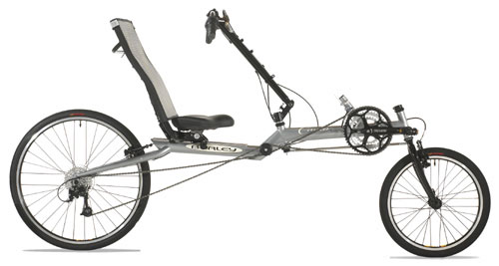
Patents Act 1983
Invention :
An idea of an inventor which permits in practice the solution to a specific problem in the field of technology
Patent is granted to an invention :-
  New/ Novel
  Involves an inventive step
  Industrially applicable
Product or process
WIPO TRAINING FOR TRAINERS PROGRAMME ON IP ASSET MANAGEMENT BY SMEs
INTELLECTUAL PROPERTY CORPORATION OF MALAYSIA (MyIPO)

Slide 25
Patents Act 1983
Non-patentable invention
  Discoveries, scientific theories & mathematical methods
  Plant or animal varieties
  Schemes or methods of doing business or playing games
  Methods of treatment of human or animal body by surgery/therapy and diagnostic methods practiced on human/animal body
Priority Date : 12 months
Duration: 20 years from the filing date of . the application
WIPO TRAINING FOR TRAINERS PROGRAMME ON IP ASSET MANAGEMENT BY SMEs
INTELLECTUAL PROPERTY CORPORATION OF MALAYSIA (MyIPO)

Slide 26
Copyright Act 1987
The CA has been amended 4 times via the Copyright (Amendment) Act (CAA):-
  CAA 1990 (01/10/90) : Berne Convention, derivative works and computer programs
  CAA 1996 (01/09/99): licensing scheme and body, prohibition of dual protection on copyright and industrial designs, power of Tribunal to refer to High Court
  CAA 1997 (01/04/99) : increment of penalty for offence
  CAA 2002 (03/03/03) : Establishment of MyIPO
WIPO TRAINING FOR TRAINERS PROGRAMME ON IP ASSET MANAGEMENT BY SMEs
INTELLECTUAL PROPERTY CORPORATION OF MALAYSIA (MyIPO)

Slide 27


Copyright Act 1987
Protection given to :-
  Literary works
  Musical works
  Artistic works
  Films
  Sound Recordings
  Broadcasts
  Performers
WIPO TRAINING FOR TRAINERS PROGRAMME ON IP ASSET MANAGEMENT BY SMEs
INTELLECTUAL PROPERTY CORPORATION OF MALAYSIA (MyIPO)

Slide 28
Copyright Act 1987
No registration
But MyIPO will accept on basis of voluntary notification (after the new amendments of the Act)
Duration : life of author + 50 years thereafter (Literary, Musical & Artistic Works) and 50 years after first published/made/given (film, sound recording/broadcast/performers)
WIPO TRAINING FOR TRAINERS PROGRAMME ON IP ASSET MANAGEMENT BY SMEs
INTELLECTUAL PROPERTY CORPORATION OF MALAYSIA (MyIPO)

Slide 29
Industrial Designs Act 1996
ID is governed by the Industrial Designs Act 1996 [Act 552] and the Industrial Designs Regulations 1999 (came into force on 01/09/99)
Replaces the UK Designs (Protection) Act 1949
The IDA has been amended twice via the Industrial Designs (Amendment) Act (IDAA):-
  IDAA 2000 (15/08/00): Insertion of Section 13A to exclude extension of industrial designs applied to layout-designs of integrated circuits
  IDAA 2002 (03/03/03) :Incorporate provisions on establishment of MyIPO
WIPO TRAINING FOR TRAINERS PROGRAMME ON IP ASSET MANAGEMENT BY SMEs
INTELLECTUAL PROPERTY CORPORATION OF MALAYSIA (MyIPO)

Slide 30

Industrial Designs Act 1996
Industrial design (ID): features of shape, configuration, ornaments when applied onto an article, appeals to the eyes
To obtain registration an ID must be new/novel in Malaysia
Duration : 15 years from the filing date
WIPO TRAINING FOR TRAINERS PROGRAMME ON IP ASSET MANAGEMENT BY SMEs
INTELLECTUAL PROPERTY CORPORATION OF MALAYSIA (MyIPO)

Slide 31
Layout-Designs and Integrated Circuits Act 2000
Layout-design (LD):
3-dimensional disposition however expressed, of the elements of an integrated circuits (IC)
Integrated Circuits (IC):
a product with an active element and some interconnections integrally formed on a piece of material, which is intended to perform an electronic function
No registration
Duration : 10 years from the date the LD is first commercially exploited or 15 years after the date of creation
WIPO TRAINING FOR TRAINERS PROGRAMME ON IP ASSET MANAGEMENT BY SMEs
INTELLECTUAL PROPERTY CORPORATION OF MALAYSIA (MyIPO)

Slide 32
WIPO TRAINING FOR TRAINERS PROGRAMME ON IP ASSET MANAGEMENT BY SMEs
Layout-Designs and Integrated Circuits Act 2000
LD of IC is governed by the Layout-Designs of Integrated Circuits Act 2000 [ Act 601]
(Came into force on 15/08/00)
INTELLECTUAL PROPERTY CORPORATION OF MALAYSIA (MyIPO)

Slide 33



WIPO TRAINING FOR TRAINERS PROGRAMME ON IP ASSET MANAGEMENT BY SMEs
PROTECTION OF INTELLECTUAL PROPERTY
Geographical Indications Act 2000
An indication which represents the geographical place of the sources where a given characteristics or qualities of the product has some significant.
Must be new in Malaysia
Protection is indefinite (subject to renewal)
Duration : 10 years (from the filing date)
Non-registrable GI:-
  Contrary to public order or morality
  GIs - ceased to be protected in their territory of origin
  GIs - fallen into disuse in their territory of origin
  Registered GI in Malaysia
  Sarawak Pepper, Sabah Tea, Tenom Coffee, Borneo Virgin Coconut Oil and Sabah Seaweed
Sarawak Pepper
Perbadanan Harta Intelek Malaysia (MyIPO)

Slide 34
WIPO TRAINING FOR TRAINERS PROGRAMME ON IP ASSET MANAGEMENT BY SMEs
PROTECTION OF INTELLECTUAL PROPERTY
Geographical Indications Act 2000
Governed by the Geographical Indications Act 2000 [Act 602] (GIA) and Geographical Indications Regulations 2001 (came into force on 15/08/01)
The GIA has been amended only once via the Geographical (Amendment) Act 2002 (03/03/03) to incorporate provisions on agency and establishment of MyIPO
Sarawak Pepper
Perbadanan Harta Intelek Malaysia (MyIPO)

Slide 35
WIPO TRAINING FOR TRAINERS PROGRAMME ON IP ASSET MANAGEMENT BY SMEs
DEVELOPMENT OF IP IN MALAYSIA
The growing influence of the World Trade Organization under the provisions of the TRIPS agreement have begun to affect significantly the relationship between WIPO and WTO. These influence together with the industry driven was the underlying factor that shape up our IP legislations in Malaysia to the current trend in the international arena:-
For example:
Copyright Law (WIPO Internet treaties)
Patents Law (public health)
INTELLECTUAL PROPERTY CORPORATION OF MALAYSIA (MyIPO)

Slide 36
INTERNATIONAL IP TREATIES
WIPO TRAINING FOR TRAINERS PROGRAMME ON IP ASSET MANAGEMENT BY SMEs
WIPO TRAINING FOR TRAINERS PROGRAMME ON IP ASSET MANAGEMENT BY SMEs
Malaysia is a member country to the following international IP treaties :-
  PARIS CONVENTION 1883 (01/01/89)
  WIPO CONVENTION 1967 (01/01/89)
  BERNE CONVENTION 1886 (01/10/90)
  TRIPS AGREEMENT (01/01/95)
  PATENT CO-OPERATION TREATY 1970 (16/08/06)
  NICE AGREEMENT 1957 (28/09/07)
  VIENNA AGREEMENT 1973 (28/09/07)
INTELLECTUAL PROPERTY CORPORATION OF MALAYSIA (MyIPO)
INTELLECTUAL PROPERTY CORPORATION OF MALAYSIA (MyIPO)

Slide 37
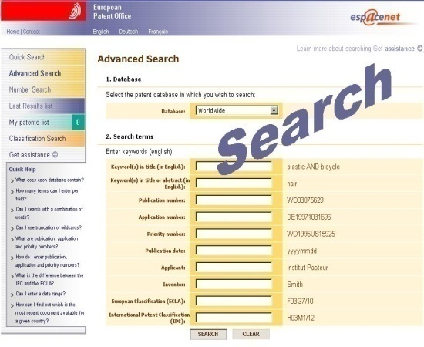
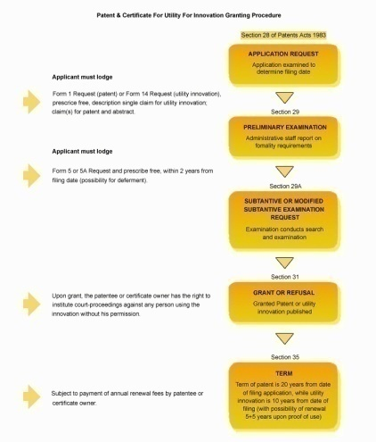
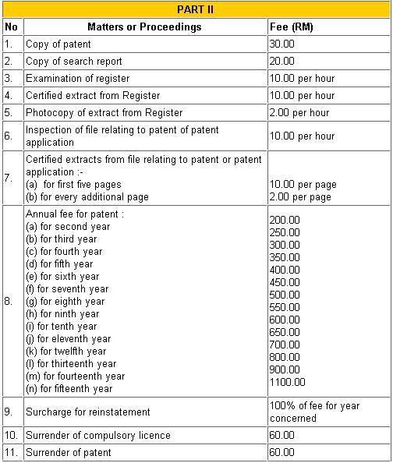
WIPO TRAINING FOR TRAINERS PROGRAMME ON IP ASSET MANAGEMENT BY SMEs
IP MANAGEMENT
Pre registration/development
Search
Patent search or trademark search to avoid the
duplication of work or “reinventing the wheel”
Registerability of the mark or design
Patentability of the invention
Eg. Method for doing business is not patentable
Preparation of documents for registration
Mark or design
Patent Drafting for patent specification
Patent attorney/agent or expert (special skills in
patent drafting)
INTELLECTUAL PROPERTY CORPORATION OF MALAYSIA (MyIPO)

Slide 38
WIPO TRAINING FOR TRAINERS PROGRAMME ON IP ASSET MANAGEMENT BY SMEs
IP MANAGEMENT
Registration
Filing application (mark, design, patent specification, forms and fees)
Communication with the IP Office (amendments, correspondence)
Post Registration
Maintenance of IP : Annual fees
Utilization/exploitation of IP
INTELLECTUAL PROPERTY CORPORATION OF MALAYSIA (MyIPO)

Slide 39

WIPO TRAINING FOR TRAINERS PROGRAMME ON IP ASSET MANAGEMENT BY SMEs
IP MANAGEMENT
Common filing mistakes.
Some pitfalls in filings of trade marks.
Sample No.1
SECTION 10(1)(c) TMA 1976
SECTION 10(1)(d) TMA 1976
SECTION 10(1)(e) TMA 1976
SPECIFICATION OF SERVICES :
ALL ENGINEERING SERVICES, DESIGN, ENGINEERING DRAFTING, CONSTRUCTION DRAFTING, ARCHITECTURE, CONSULTANCY RELATED TO PRECAST CONCRETE; ALL INCLUDED IN CLASS 42.
INTELLECTUAL PROPERTY CORPORATION OF MALAYSIA (MyIPO)

Slide 40



NON-REGISTRABLE TRADE MARK
REGULATION 13(1)(b) TMR 1997
SPECIFICATION OF GOODS:
BATIK SARONG TEXTILES; ALL INCLUDED IN CLASS 24.
SECTION 10(1)(c) TMA 1976
SECTION 10(1)(d) TMA 1976
SECTION 10(1)(e) TMA 1976
SPECIFICATION OF GOODS:
COFFEE, TEA, COCOA, SUGAR, RICE, FLOUR AND PREPARATIONS MADE FROM CEREALS, BREAD, PASTRY AND CONFECTIONERY, ICES, HONEY, YEAST, BAKING-POWDER; ALL INCLUDED IN CLASS 30.
REGULATION 14(b) TMR 1997
SPECIFICATION OF GOODS:
CLOTHING, FOOTWEAR, HEADGEAR; ALL INCLUDED IN CLASS 25.

Slide 41
WIPO TRAINING FOR TRAINERS PROGRAMME ON IP ASSET MANAGEMENT BY SMEs
IP MANAGEMENT
Common filing mistakes.
Some pitfalls in Patent filings.
One invention for an application. Sometimes the office receives more than one invention
Claims that are too narrow or too broad
technical features of claims and abstract not followed by reference science
Abstract not followed by the most illustrative drawings. Eg. “Figure 1”
INTELLECTUAL PROPERTY CORPORATION OF MALAYSIA (MyIPO)

Slide 42
Some pitfalls in Patent filings
Forms statement justifying applicants rights to patents not included [It is a requirement but usually Applicant never send upon filing of patent applications]
Measurements terminology and unit weights are not express in the matrix system. [Must use cm not inches, temperature in Celsius not Fahrenheit ]
Field line
If you want to file your own application without using patent agent, to make sure that you use the correct format for patent specification. Join the Drafting course for Patents

Slide 43
43

Slide 44
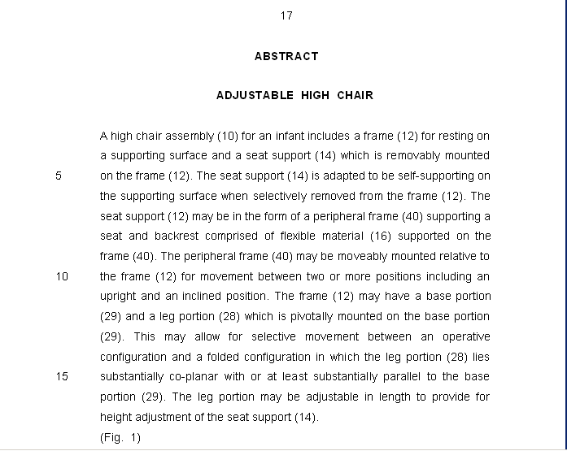
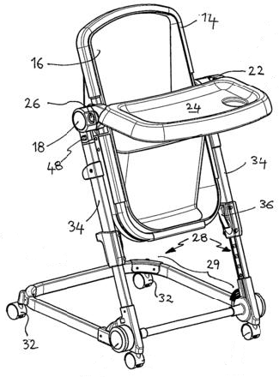
1/1
Fig. 1
44

Slide 45

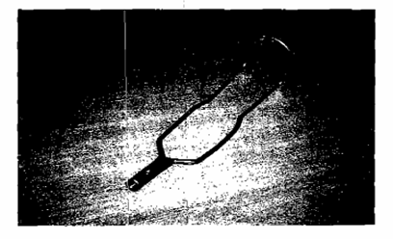
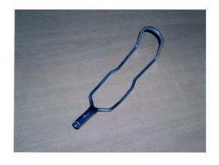
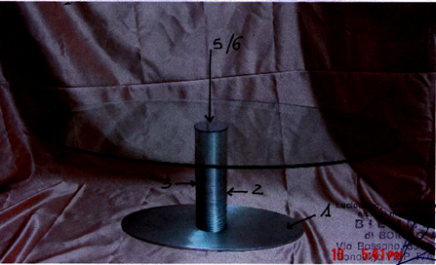
Some pitfalls in filings Industrial Design
Example of representation filed
Rejected
Accepted
Source: OHIM slide presentation

Slide 46
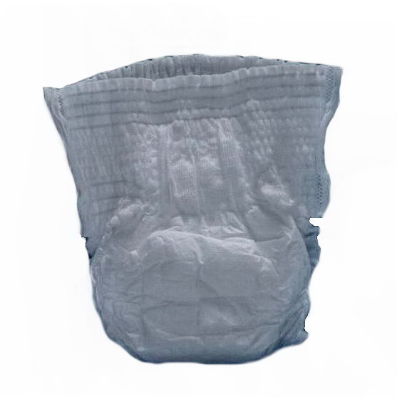
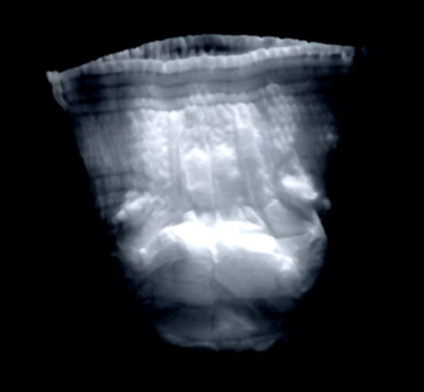
WIPO TRAINING FOR TRAINERS PROGRAMME ON EFFECTIVE IP ASSET MANAGEMENT BY SMEs
Example of representation filed
Rejected
Accepted
07-00003-0101
MY 07-00003-0101

Slide 47
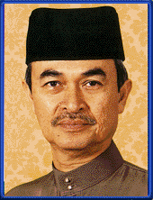

WIPO TRAINING FOR TRAINERS PROGRAMME ON EFFECTIVE IP ASSET MANAGEMENT BY SMEs
CONCLUDING REMARKS
Quotes from the famous
“Intellectual Property is the current economic spinner”
Y.A.B Dato’ Seri Abdullah Hj. Ahmad Badawi,
Former Prime Minister of Malaysia during the
National Intellectual Property Day 2005
“I believe in intellectual property. In my view, it’s the foundation of world economies, and certainly the foundation upon which Sun Microsystems was built.”
Jonathan I. Schwartz,
President and COO of Sun Microsystems (1994)
INTELLECTUAL PROPERTY CORPORATION OF MALAYSIA (MyIPO)

Slide 48
WIPO TRAINING FOR TRAINERS PROGRAMME ON EFFECTIVE IP ASSET MANAGEMENT BY SMEs
If you don’t create
You don’t innovate
You will evaporate!!!
INTELLECTUAL PROPERTY CORPORATION OF MALAYSIA (MyIPO)

Slide 49
WIPO TRAINING FOR TRAINERS PROGRAMME ON EFFECTIVE IP ASSET MANAGEMENT BY SMEs
Thank You
Email: rashidah@myipo.gov.my
INTELLECTUAL PROPERTY CORPORATION OF MALAYSIA (MyIPO)

