Slide 1
http://xellectip.com

Slide 2

IP Asset Management: IP Audit and IP Due Diligence
KACST
WORLD INTELLECTUAL PROPERTY ORGANIZATION
WIPO TRAINING OF TRAINERS PROGRAM
ON EFFECTIVE INTELLECTUAL PROPERTY ASSET MANAGEMENT BY SMALL AND MEDIUM-SIZED ENTERPRISES IN DUBAI
Riyadh, Jan 29 to Feb 2, 2010
Rachna Singh Puri
Xellect IP Solutions, India
www.xellectip.com

Slide 3

Seven Rays of IP Exclusivity™

Slide 4

IP ASSET MANAGEMENT
Systematic management of different IP Assets that protect one or more product lines or business aspects
It is the quantification of previously mysterious IP efforts, enabling measurement and objective evaluation of investment scenarios

Slide 5
IP Audits
  A systematic review of the IP assets owned, used or acquired by a business to:
  uncover under-utilized IP assets
  identify any threats to a company’s bottom line

Slide 6
WHAT of IP Audit
Review of
company’s IP assets
all Agreements
relevant policies
compliance procedures

Slide 7
TYPES OF AUDITS
General Purpose Audit
The as-is scenario at the present state of time
At the time of introducing new process, policy, management change
Periodic updates

Slide 8
GENERAL PURPOSE IP AUDIT
Record the IP assets in use and those not in use
Use is by own business or by others
Any infringement risks by you on others assets or by others on your assets
Streamline actions for all of the above in light of business strategy

Slide 9
FOCUS AUDITS
For Specific purpose such as
- personnel turnover
- Foreign IP Filings
- Compliance on information from third parties
- Changes in IP Law & Practice
- Preparation for litigation

Slide 10
EVENT DRIVEN IP AUDIT
Value and Risk of a part or all of company’s IP Assets or IP portfolio
WHEN : At the time of M&A, buying/selling a business or investment, IP Transfer/Licensing, Launch of a new product
Nature and Scope of IP assets is assessed
  Ownership
  Infringement or freedom to operate

Slide 11
IP ANALYSES AS DUE DILIGENCE
Offensive/Defensive Reviews:
  Invalidity
  Freedom-to-Operate
  Infringement
  Enforcement
  Patentability
  Others…

Slide 12
DUE DILIGENCE - RECORD OF INVENTION
Important to establish inventorship
Dated to establish date of invention in US
Proof of diligence in following up of invention
Precise record of observations
Objective assessment of results
Avoid negative characterizations
No erasures
  Strike through mistakes and rewriting
Each page signed by a witness
  Witness not associated with the project
  Capable of understanding the invention
Clear indication of page experiment continues from and page experiment continues to

Slide 13

Due Diligence-Enforcement
Identify infringing parties after thorough analysis
Notify the alleged infringer - polite, friendly and firm
  Notification clearly delineates the nature of infringement
  Several rounds of talks and negotiations may ensue
Injunction may be filed to cease any production with immediate effect
If proved, can be used to obtain triple damages plus legal expenditure

Slide 14
Due Diligence - External Parties
Third parties may need to be engaged occasionally to:
Exploit 3rd party’s expertise in a research area
Utilize critical resources unavailable in-house
Obtain unbiased 3rd party results for processes developed in-house
Engage contractors or contracting services

Slide 15
Due Diligence - Agreements
Necessary while dealing with external parties
  Limit information while giving or receiving only a need-to-know basis
  Treat information provided with caution
  Mark information appropriately before giving
Needs to be appropriately drafted to invoke sufficient protection
  Scope of protection and each parties’ obligations need to be clearly specified
  Periodically reviewed
Various situations demand different types of agreements

Slide 16
Types of Agreements
  Non-Disclosure Agreements (NDA)
  Confidentiality Disclosure Agreements (CDA)
  Joint Disclosure Agreements (JDA)
  Research Agreements
  Consulting Agreements
  Technology Transfer Agreements
  Government Contracts
  …

Slide 17
IP AVANT™
The due diligence to inculcate a strong IP culture across the organization
To recognize any IP generated within the organization
To obtain adequate protection for all IP created in a timely manner
To avoid incurring great expenses at a later stage due to ignorance, negligence or oversight
To maximize the utilization of IP assets, thus ensuring vital resources are not wasted

Slide 18
Benefits for SMEs
Based on the outcome of the audits and diligence, businesses can:
evolve informed strategies that will maintain and improve the company’s market position
Be confident of their position in wrongful infringement actions
Ensure all the IP assets are adding value to the business

Slide 19
“If you don’t measure it, you can’t manage it”
KACST
WORLD INTELLECTUAL PROPERTY ORGANIZATION

Slide 20
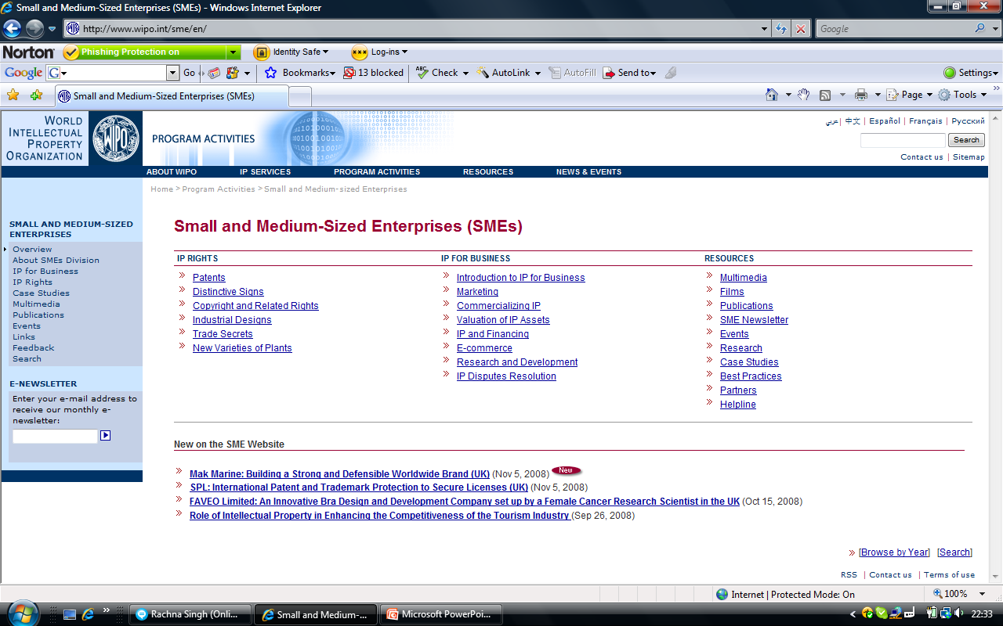
WIPO RESOURCES FOR SMEs

