Slide 1
New and improved activities of supporting SMEs –
efficient technology transfer
Joanna Nyga
Magdalena Maciejska-Szlaps
Patent Office of the Republic of Poland
Rome, October 2010

Slide 2
Factors of Production for an Innovation Economy
Source: http://www.ingenesist.com

Slide 3
What is the most important?
Efficient technology transfer

Slide 4
IP Education
IP Education
Students
Teachers
R&D staff
IP Profesionals
SME’s

Slide 5
IP Education
Nearly 2 million students at 445 universities and higher schools (130 public)
past
Subject „Intellectual property” optionally introduced to curriculum – individual decision of particular university
present
Since academic year 2008/2009 (according to the Regulation by the Ministry of Science and Higher Education) universities obligatory introduce a subject devoted to intellectual property protection into the curricula of first degree studies.
Number of IP lecture hours:
First degree studies (BA) – 1 year - 4 hour introductory training
3 year - 15 hours (1 semester)
Second degree studies (MA) – 15 hours (1 semestrer) tailored for specific faculties
PhD studies – 10 hours

Slide 6
IP Education
Under the patronage
of the Patent Office of the Republic of Poland
2008
Consortium of four universities has been established
Goal: creation of postgraduate studies to train lecturers of the subject „Intellectual property protection”
2009-2010
Preparation of:
- program of postgraduate studies (220 hours of training)
training materials
October 2010
Start of the postgraduate studies for IP protection lecturers

Slide 7
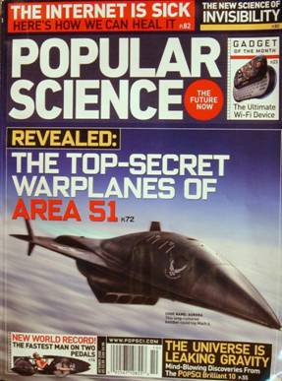
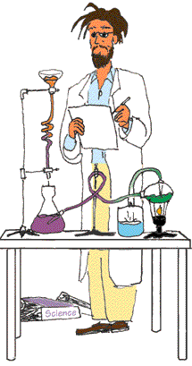
Awareness of R&D staff
1.
Patent Office
1
2
Protection of own research outcome – source of competitive advantage and additional founds (royalties)
2.

Slide 8
Awareness of R&D staff
Each grant application concerning R&D project should obligatory have a world state of art search report attached
Increased:
quality of patents
number of applications
Avoidance of duplication of results

Slide 9
What are we doing now…
Popularization of IP knowledge
Conferences and seminars for IP professionals, R&D specialist and SME’s
Special dedicated trainings – made by experts and for experts
PPO’s publications

Slide 10
What are we doing now…
Cooperation with:
Polish Chamber of Commerce
Polish Agency for Enterprise Development
Polish Federation of Engineering Associations
Ministry of Economy and Ministry of Science and Higher Education
Best Polish Universities, Politechnics and R&D Institutes

Slide 11
Our goals and plans for future…
Popularization of IP knowledge
- conferences, seminars, workshops
- PPO’s publications
- creation of knowledge portal - as a part of PPO’s new website
- IP Panorama implementation
Special trainings dedicated to SME’s
Exchanging good practices and experiences with IP professionals, R&D specialist and SME’s
Improvement of data bases access

Slide 12
Thank you for your attention!

