Slide 1
http://xellectip.com

Slide 2


Shaping Business Strategy Through Competitive Intelligence
WORLD INTELLECTUAL PROPERTY ORGANIZATION
WIPO TRAINING OF TRAINERS PROGRAM
ON EFFECTIVE INTELLECTUAL PROPERTY ASSET MANAGEMENT BY SMALL AND MEDIUM-SIZED ENTERPRISES IN DUBAI
Dubai, December 19 to 23, 2010
Strategic Use of Intellectual Property Information
Rachna Singh Puri
Xellect IP Solutions, India
www.xellectip.com

Slide 3
The IP Cycle
IP ASSETS
UTILIZING
Capturing
CREATIVE EFFORT
PROCURING
IP PROTECTION
A synergistic and cyclic process

Slide 4
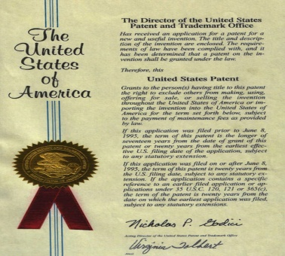




IP Assets
Trade Secrets
Patents
Trademarks
Distinctive signs used to differentiate between identical or similar goods
Any new and useful process, machine, article, or compositions
Copyrights
Designs
All forms of expression and production
in the literary, scientific and artistic domain
Concern the Ornamental, Aesthetic, Usability, Ergonomic aspects

Slide 5
Role of IP
Business Growth
Bridging this Gap
Technology/Innovation
Legal Protection

Slide 6
Time Periods for Different Forms of IP
20 years
Patents
1 5 years
5 0 y e a r s
F o r e v e r
Industrial Designs
Copyrights
Trademarks

Slide 7
Why Search Patent Databases?
With more than 800,000 patents granted annually around the globe, of which an estimated 70 percent of the information in patent documents is not available elsewhere they offer a wealth of information, such as information on the state-of-the-art, which can help an enterprise to avoid wasting resources
From: www.wipo.int

Slide 8
Analyses of Patent Literature
Search & Analyses geared towards:
  Research Direction
  Product Launches and Sales
  Licensing
  Litigations
  Mergers & Acquisitions
  Other Partnerships
Patenting Strategy
  Filings
    Blocking filings around competitors’ patents
    Fencing filings around core technology
  Invalidation & Infringement
  Enforcement

Slide 9
Patent Analyses
Claims define scope of invention
Description and Drawings describe the invention
Patent is analyzed with respect to claims and description
  Landscape
  Invalidation
  Freedom to Operate (Practice) /Clearance
  Patentability

Slide 10
Types of Landscapes
Technology trends
  Provides the direction in which technology is moving towards (e.g. Materials used as filaments in light bulbs)
  Useful for predicting next generation products and processes
  Also can predict maturation of technology
Competitive landscape
  Provides a competitors’ direction in a technical field
  Used for predictive purposes as well
  Enables strategizing of business/research program
Chronological trends
  Provides direction a technology Is headed (e.g. Light bulb over the years)
  Similar to technology trend

Slide 11

Freedom-to-Operate
Advantageously done at an early stage- prior to product launch, or even research stage to avoid any legal action
Product and all its components are adequately covered in claims of one or more patents
Product and all its components are
  Not claimed in a patent owned by another
  The patent is still not active
  The patent is granted in a territory different from where the product is sold
NOTE: Products or its components NOT CLAIMED in a patent are available for practice

Slide 12
Patentability
Done to assess novelty of claims over all prior art
Preferably, a set of claims is drafted and all prior art analyzed in light of drafted claims
Prior art includes printed and non-printed publication
Both claims and descriptions of patents need to be looked at

Slide 13
Filing Strategies
APPLICATIONS*
At any stage of technology development, any inventor can file patents/utility models/designs
Improvements
Basic Patent
*: Some jurisdictions may not consider only uses/applications of known compositions/methods as patentable subject matter

Slide 14
IP Procurement
Fencing
Blocking
Features
Features
Colour
More
Features
Colour
More
Features
Core Technology
Or
Product
Competitor’s
Technology
Or
Product
Increments
Shape
Shape
Finish
Finish
Size
Size
Protects Core Technology
  Increases Brand Value
  Enhances product portfolio and versatility
  Excludes others from practicing
  Ensures others cannot prevent YOU from practicing
  Prevent Competition from expanding portfolio
  Unless YOU are suitably remunerated
  Extra Expenditure of Resources
  Force a rethink of strategy

Slide 15
Identifying Potential Commercializing Entities
Conduct Competitive Intelligence
Find synergistic partners for:
  Research collaboration
  Manufacturing
  Marketing
Points to consider:
  Technology
  Market
  Customer needs

Slide 16
Value Transference
  The premeditated use of multiple intellectual property regimes at specific points across the product lifecycle, in order to realize sustainable differentiation
As defined by James Conley, Clinical Professor at both the Kellogg School of Management and the McCormick School of Engineering at Northwestern University

Slide 17
How to Achieve
Using patents early in the lifecycle to secure functional differentiations (at or near product launch)
  such as any new and useful technologies (utility patents)
  and/or unique ornamental attributes (design patents/industrial designs)
But focus of the functional differentiation is not sustainable
  Limited by lifeterm offered by the protection sought
Thus, building an association between patented aspects & a non-functional cognitive touch point is critical
  Design elements central to the cognitive touch point are then secured with a registered trademark.
    E.g. Shape, Color, Sound
Carefully orchestrated advertising builds the association in the consumer’s mind to complete the strategy
REMEMBER
Trademarks can last indefinitely if used properly, and hence sustain the competitive advantage

Slide 18
Value Transference
Success in a crowded technology and market area- Digital Music Players

Slide 19

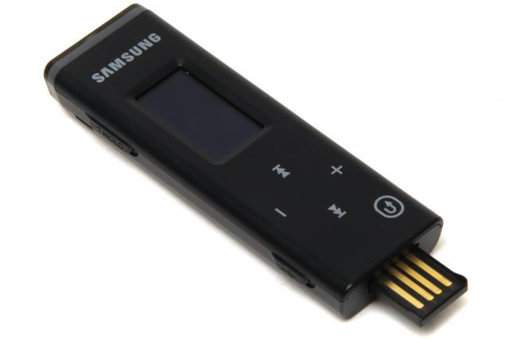
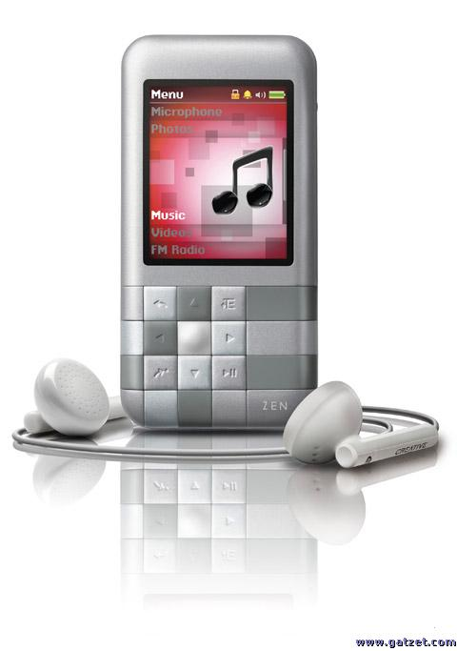
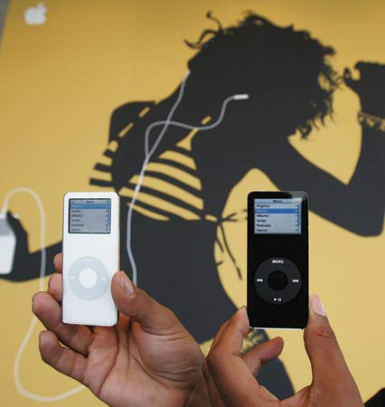
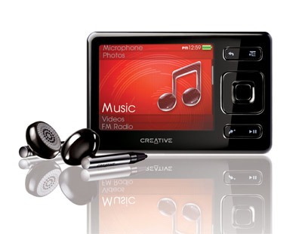
Popular Technology
Images obtained from various copyrighted sources, to which it is attributed. No liability or ownership of material is warranted by the use of these images
Logos and names of products are trademarks and copyrights owned by the corresponding businesses and corporations

Slide 20
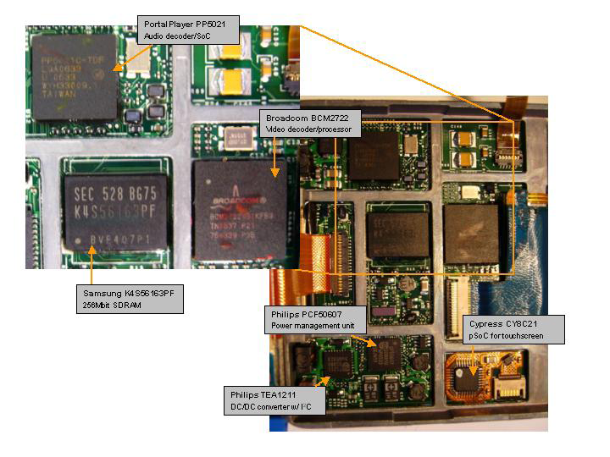
Recognize this Product?
Source: Jefferies & Co., Inc.

Slide 21
A Typical MP3 player’s Components
Components of a typical product & the corresponding manufacturers
Company | Description
Toshiba | 30GB 1.8" HDD
PortalPlayer | Decoder/SoC
Broadcom | Video decoder/processor
Samsung | SDRAM - 256Mbit
Wolfson Microelectronics | Audio codec
Linear | USB Power Manager/Li-Ion Battery charger
National | Step Down Switching Regulator
Philips | DC/DC converter with I ²C Interface
Silicon Storage Technology | Parallel Flash - 8Mbit
Philips | Power Management Unit
Cypress | PSoC Mixed Signal Controller - Touch Pad
A Veritable List of Who’s Who in High-Tech Hardware Industry
Source: Jefferies & Co., Inc.

Slide 22

Strategy
Crowded product & technology area
Several players
Sourced in components
Focused on look, feel &
use aspects

Slide 23
Market Share of iPod®
Year-wise Growth in Market Share in Units Sold
2004 | 56%
2005 | 72%
2006 | 72%
2007 | 70%
Source: http://apple20.blogs.fortune.cnn.com/2008/01/29/beyond-the-incredible-shrinking-ipod-market/

Slide 24
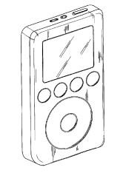
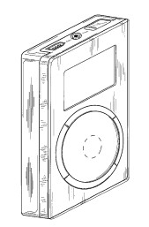

Exclusivity in a Crowded Area
Several Utility Patents
D497,618
D472,245
Went through the whole process of examination, rejection/granting, invalidation & litigation
And Others…
Trademarks
In recent years, trademarks have been granted for such things as product shapes, colors and scents
3-D Shape

Slide 25
Granting of Unusual Trademark
Apple's capping piece in a multiyear marketing and legal campaign that pushed intellectual property rights to new competitive advantage for the company
Source: http://online.wsj.com/article/SB121018802603674487.html

Slide 26

Key Elements to Success
Great Design
  clean white-and-chrome "bathtub" look
Identified Critical Design Elements
Secured Legal Protection
Leveraged the monopoly offered
Built an excellent Brand Identity

Slide 27
Implementing an IP Strategy
Are you using IP strategically:
  Are you pursuing a systematic strategy to exploit the commercial benefits of your IP?
  Have you understood how the exploitation of your IP relates to other complementary business assets that may be critically needed?
  How is your R&D focus aligned to your IP strategy and to your commercial goals?
  How do the financial plans for managing your IP relate to your overall financial and business goals?
  How determined are you to extract (further) revenue from your IP?
  How are you leveraging your IP to develop new relationships and business partnerships?
Understand the legal scope of the IP rights :
  What level of practical protection does your IP have in a given business environment?
  Can you operate in the market without infringing the IP rights of other market participants?
  How likely is it that competitors will legally steal your ideas or creative expression or find legitimate ways to circumvent your IP and thereby effectively free ride on your creativity and innovation?
  What is the risk of pirates and/or counterfeiting negatively impacting your market share, and to what extent?
Source: www.wipo.int

Slide 28
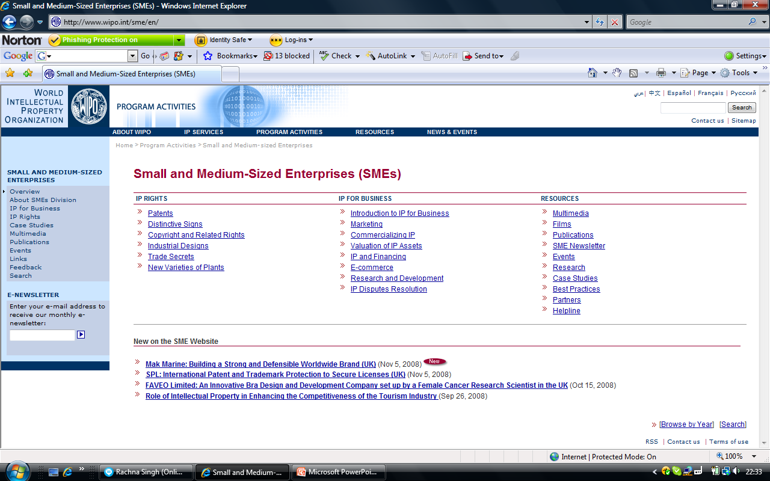
WIPO RESOURCES FOR SMEs

