Slide 1

PCT Statistics
PCT Working Group
Tenth Session
Geneva
May 8 to 12, 2017

Slide 2
Outline
PCT Application Filings
PCT National Phase Entries
Receiving Offices
International Authorities

Slide 3
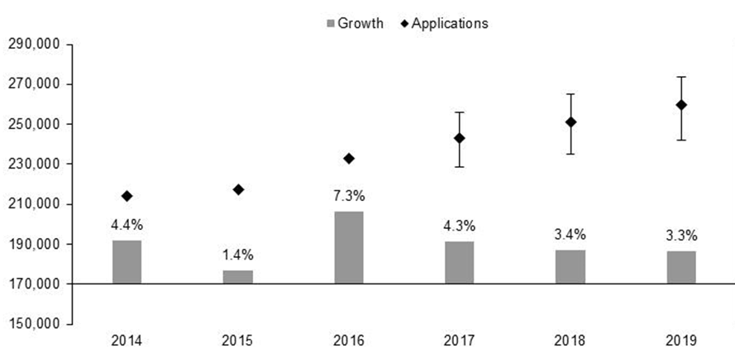
PCT Application Filings
259,600
251,200
243,000
233,000
217,233
214,322
Source: Economics and Statistics Division, WIPO

Slide 4
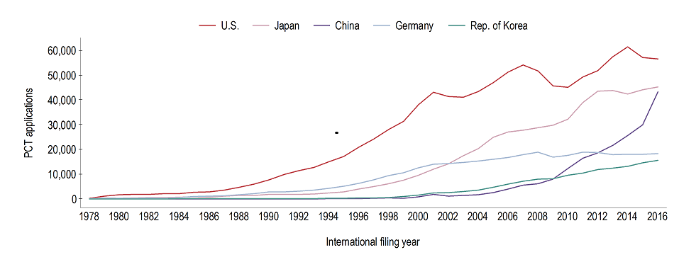
Filing Trends for Top 5 Origins
Source: WIPO Statistics Database, April 2017

Slide 5
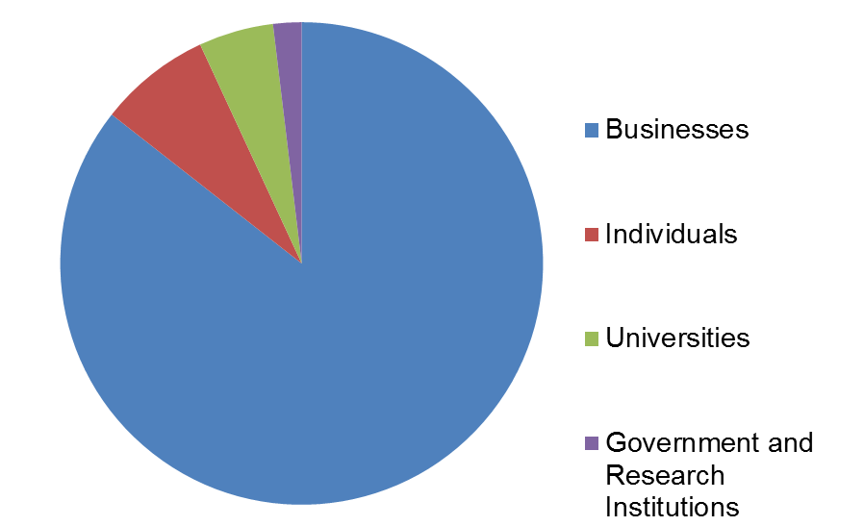
Distribution of PCT Applicants in 2016
Top Applicants
Businesses: ZTE Corporation – 4,123 applications published
Universities: University of California – 434 applications published
Government and Research Institutions: Commissariat à l’Energie Atomique
et aux Energies Alternatives – 329 applications published

Slide 6
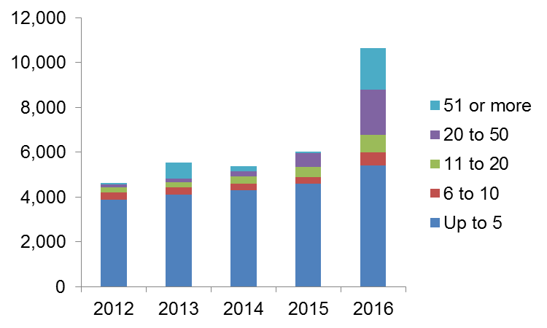
Applications Claiming Eligibility for
90% Fee Reduction
Number of reductions
granted to same applicant
Number of applications claiming eligibility for 90% fee reduction rose from 6,041 to 10,631 (+76%)
between 2015 and 2016

Slide 7
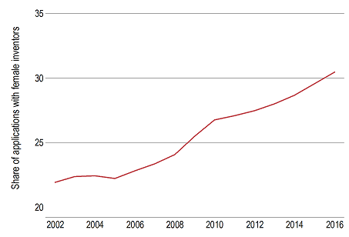
PCT Applications by Gender
Source: WIPO Statistics Database, April 2017
Around 30.5% (+0.9%) of PCT applications in 2016 included female inventors. In academia, women are among the inventors in more than half of applications.

Slide 8
Main Fields of Technology in 2016
Main Fields of Technology by Percentage of Total
  Digital Communication 17,776 applications (8.5%)
  Computer Technology 17,115 applications (8.2%)
  Electrical Machinery 14,468 applications (6.9%)
Largest increases:
  Control: 21.5%
  Medical Technology: +12.8%
  Optics: +12.7%
  Digital Communication: +10.7%
Largest decreases:
  Engines, pumps, turbines: -9.6%
  Mechanical elements:
  -2.9%
  Civil engineering: -1.7%
  Electrical machinery:
  -1.3%
Source: WIPO Statistics Database, April 2017

Slide 9
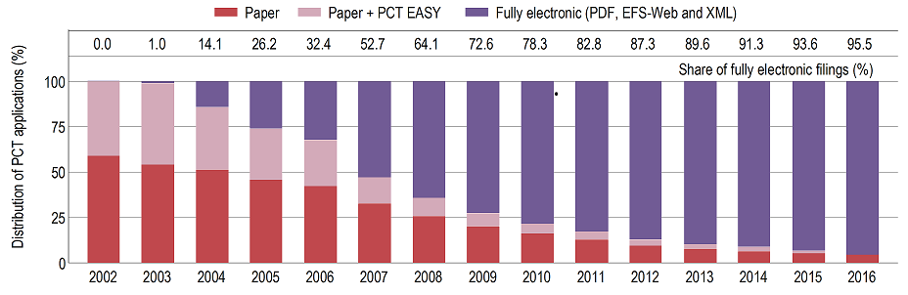
PCT Applications by Medium of Filing
Source: WIPO Statistics Database, April 2017
Distribution in 2016: 4.5% paper, 95.5% fully electronic (PDF 66.2%, XML 29.3%)

Slide 10
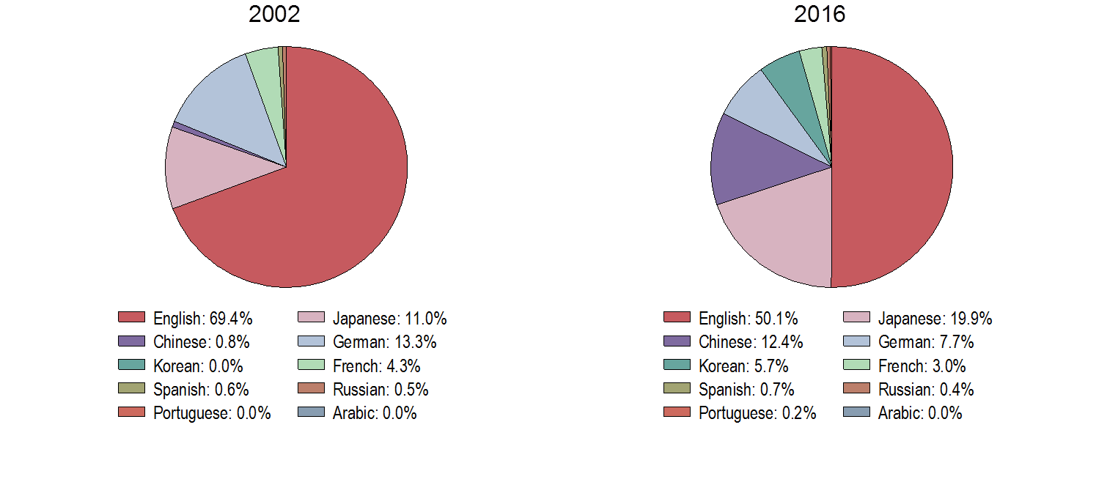
PCT Applications by Publication Language
Source: WIPO Statistics Database, April 2017
Half of all PCT applications were published in English, one fifth were published in Japanese

Slide 11
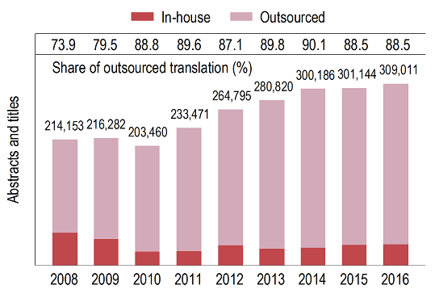
Translations of Abstracts and Titles
309,011 abstracts and titles were translated – 88.5% outsourced
97,721 search and preliminary examination reports were translated – 97.4% outsourced

Slide 12
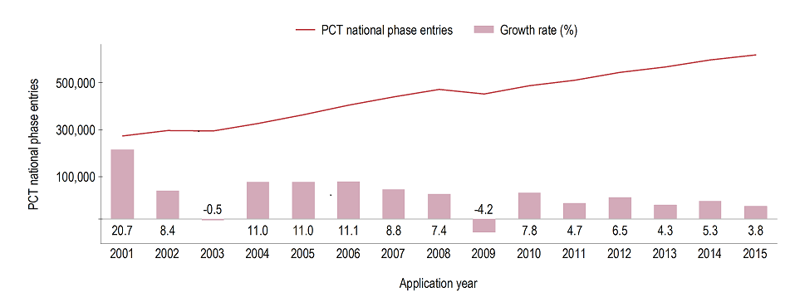
PCT- National Phase Entries
Source: WIPO Statistics Database, April 2017
618,500 national phase entries estimated for 2015 (+3.8%). About 84% of the total are non-resident national phase entries.

Slide 13
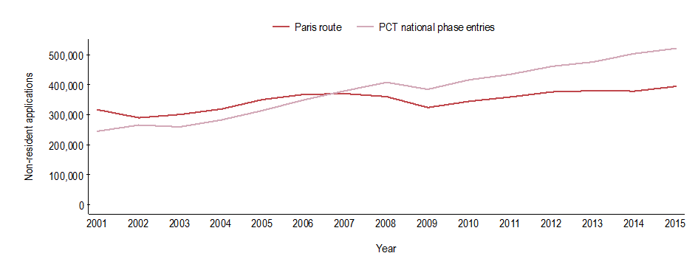
Non-Resident Applications by Filing Route
Source: WIPO Statistics Database, April 2017
521,000 non-resident national phase entries (+3.6%), 393,700 non-resident Paris-route filings (+4.0%) in 2015
57% of all non-resident applications filed through PCT

Slide 14
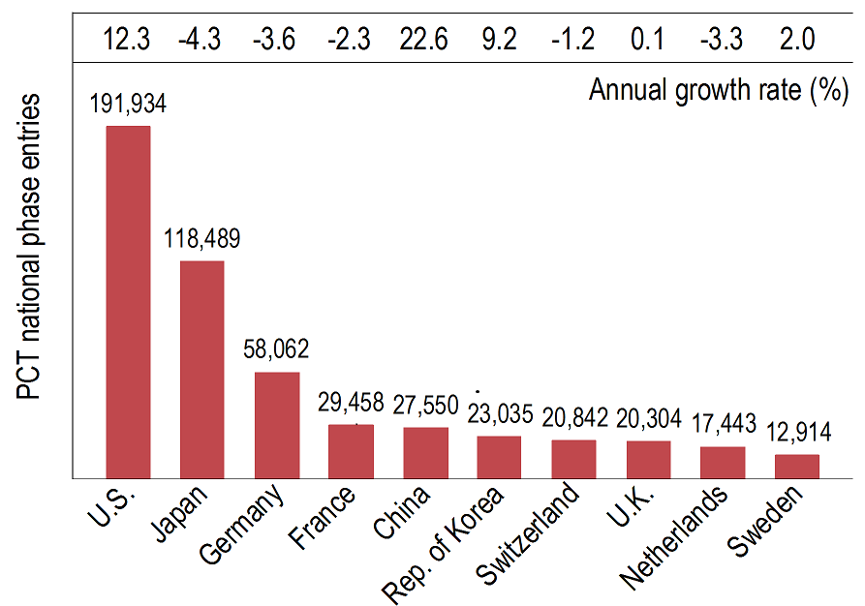
National Phase Entries for Top 10 Origins
Source: WIPO Statistics Database, April 2017
United States of America (191,934, +12.3%), Japan (118,439, -4.3%) and Germany (58,062, -2.3%) had highest number of NPEs
Fastest growth rate for China (+22.6%)

Slide 15
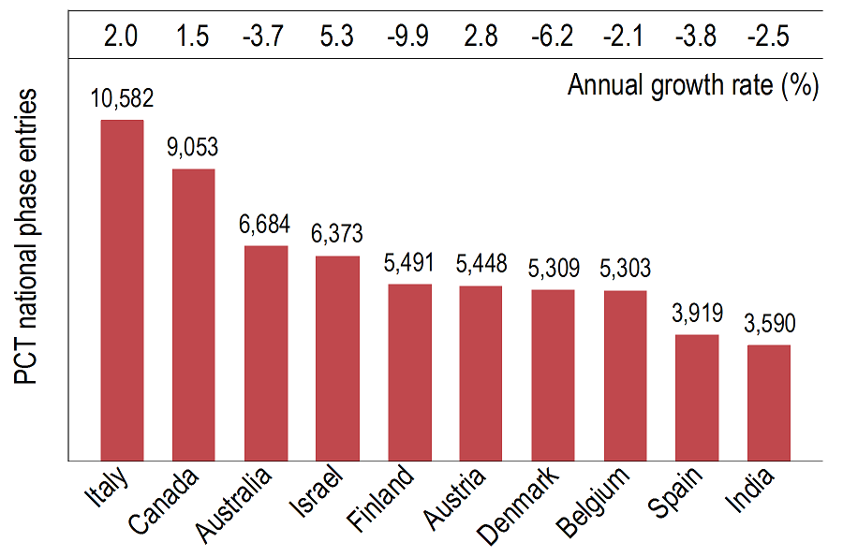
National Phase Entries for Next 10 Origins
Source: WIPO Statistics Database, April 2017
11 of the top 20 origins had a decrease in PCT national
phase entries

Slide 16
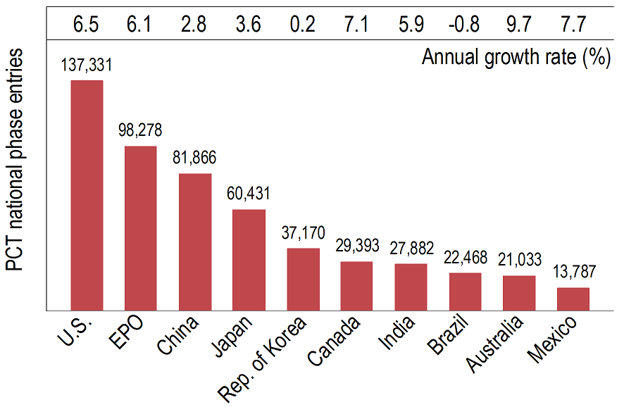
PCT NPEs for Top 10 Offices in 2015
Source: WIPO Statistics Database, April 2017
USPTO had most NPEs in 2015 (137,331 representing 22.2% of all NPEs)
Highest growth among top 10 Offices: Australia (+9.7%), Mexico (+7.7%) and Canada (+7.1%)

Slide 17
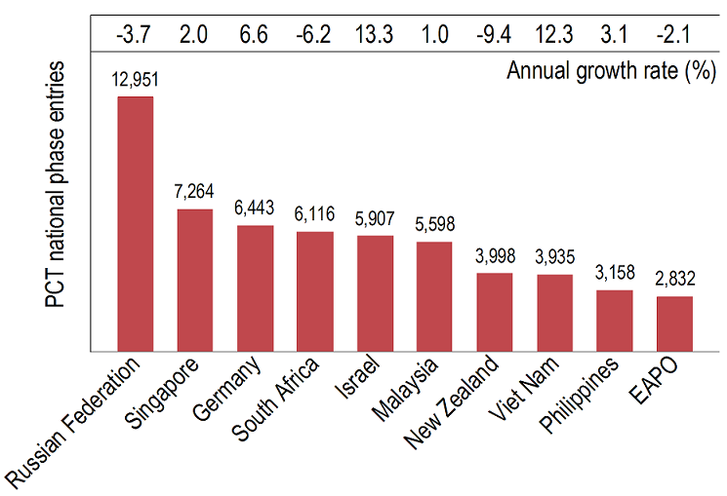
PCT NPEs for Next 10 Offices in 2015
Source: WIPO Statistics Database, April 2017
Highest growth among next 10 Offices: Israel (+13.3%),
Viet Nam (+12.3%) and Germany (6.6%)

Slide 18
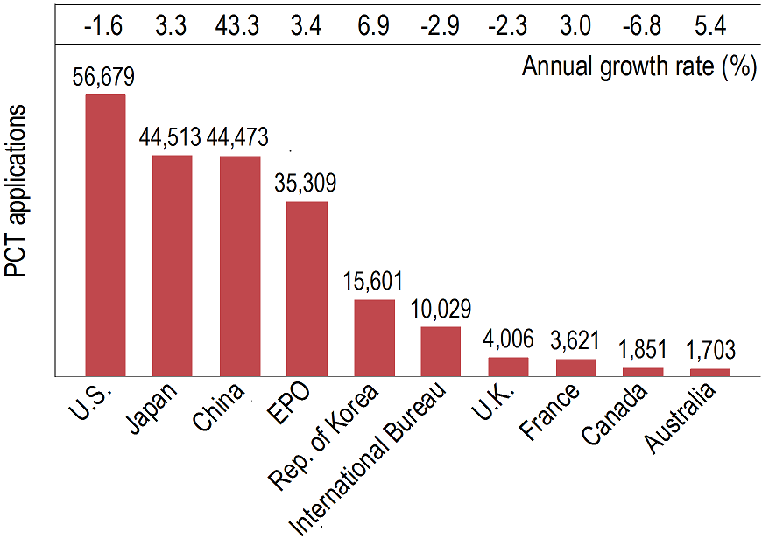
PCT Applications for Top 10 Receiving Offices in 2016
Source: WIPO Statistics Database, April 2017
Top 10 receiving Offices received 93.6% of all PCT applications filed in 2016

Slide 19
PCT Applications for Next 10 Receiving Offices in 2016
Highest growth rates in 2016 for Turkey (+15.1%), Russian Federation (+9.0%) and India (+8.1%)

Slide 20
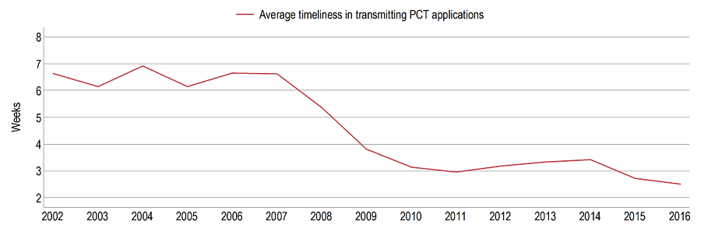
Receiving Offices: Timeliness of Transmitting PCT Applications to the IB
Source: WIPO Statistics Database, April 2017
Average transmission time between international filing date and date the IB received the application decreased for second year in a row (shortest time since 2001)
94.8% of PCT applications transmitted to IB within 4 weeks
in 2016 (93.4% in 2015)

Slide 21
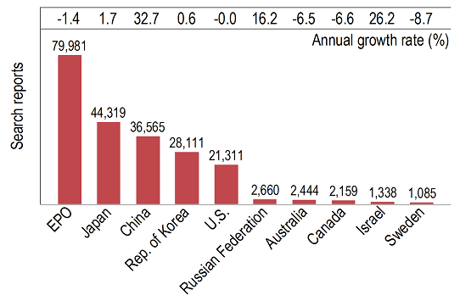
Search Reports established by International Searching Authority (1)
Source: WIPO Statistics Database, April 2017

Slide 22
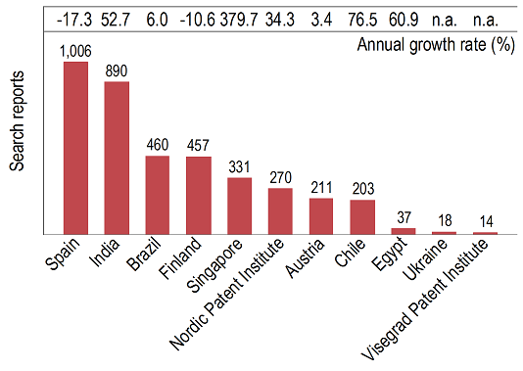
Search Reports established by International Searching Authority (2)
Source: WIPO Statistics Database, April 2017
Ukraine and Visegrad Patent Institute started operations
in 2016

Slide 23
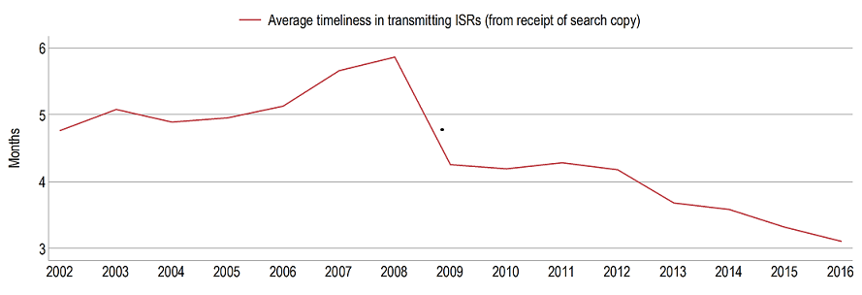
Average Timeliness in Transmitting ISRs to the IB from Date of Receipt of Search Copy
Source: WIPO Statistics Database, April 2017
Average timeliness in transmitting ISRs to the IB was about 3.1 months - shortest time since 2001
80.4% of PCT applications transmitted to IB within 3 months from date of receipt of search copy (76.3% in 2015)
96.2% of all international publications published with
ISR (93.4% in 2015)

Slide 24
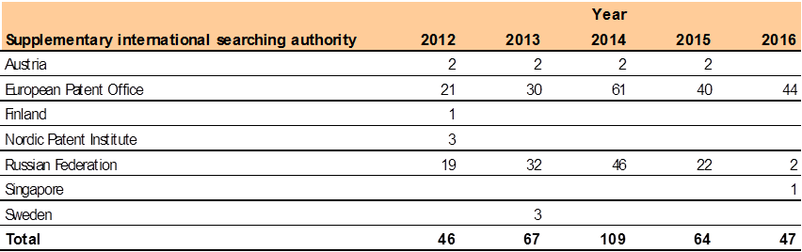
Supplementary International Search Requests
Source: WIPO Statistics Database, April 2017
Supplementary International Search Requests fell for second consecutive year
The EPO accounted for 93.6% of requests for supplementary international search in 2016

Slide 25
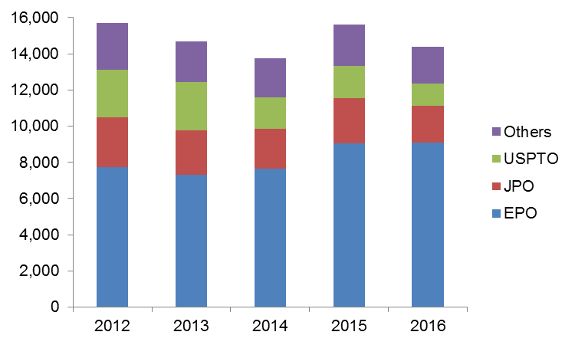
IPRPs (Chapter II) by International Preliminary Examination Authority
Source: WIPO Statistics Database, April 2017
Reports established by IPEA fell by 7.9% in 2016 to 14,395
85.8% of IPRPs (Chapter II) were produced by the EPO,
the JPO or the USPTO

Slide 26
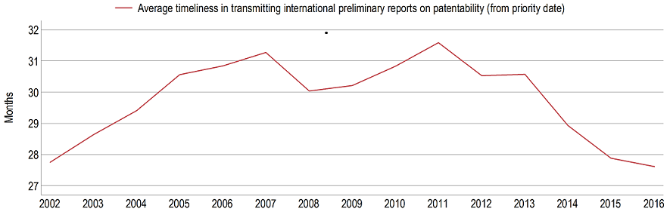
Average Timeliness in Transmitting IPRPs
Source: WIPO Statistics Database, April 2017
Average time in transmitting IPRPs fell to 27.6 months in 2016
85.8% of all IPRPs were transmitted to the IB within 28 months of priority date (80.4% in 2015)

Slide 27
Further information:
2017 PCT Yearly Review
The International Patent System
WIPO Publication No. 901E/2017
World Intellectual Property Indicators 2016
WIPO Publication No. 941E/2016
WIPO IP Statistics Data Center
http://www.wipo.int/ipstats/en/

