Slide 1
PCT Statistics Meeting of International Authorities Twenty-Eighth Session
Geneva March 24 to 26, 2021

Slide 2
Outline
International Filings
Data for 2020
Medium of Filing
National Phase Entries
International Authorities
International Search
Supplementary International Search
International Preliminary Examination

Slide 3
PCT Filings in 2020
275,900 international applications filed in 2020 (+4.0%)
Top 5 countries: China (68,720 +16.1%), United States of America (59,230 +3%), Japan (50,520 -4.1%), Republic of Korea (20,060 +5.2%) and Germany (18,643 -3.7%)
Top filer: Huawei Technologies (5,464)
Top educational institution filer: University of California (559)
More information in Press Release (March 2, 2021) and Interactive Charts
Source: WIPO Economics and Statistics Division. February 2021

Slide 4
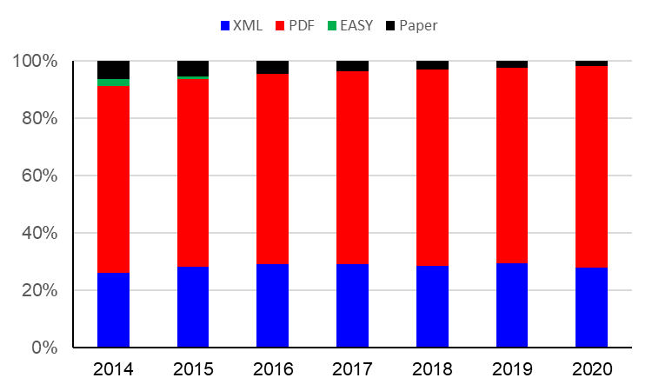
Medium of Filing
Filing medium distribution for 2020 (2019): 70.3% (68.2%) PDF, 28.0% (29.5%) XML, 1.7% (2.3%) Paper
In 2020, PDF filings rose by 12,203 in 2020, XML filings fell by 1,454, Paper filings fell by 1,556
Source: WIPO statistics database. March 2021

Slide 5
Receiving Offices receiving the most Paper Filings in 2020
2.1%
Percentages show proportion of applications received on paper at that receiving Office
61.9%
0.49%
0.62%
1.3%
19.3%
0.76%
8.2%
9.1%
7.1%
4,641 applications received on paper in 2020 (1,7% of total filings) – down from 6,197 in 2019
These 10 Offices account for 69.5% of paper filings
Source: WIPO statistics database. March 2021

Slide 6
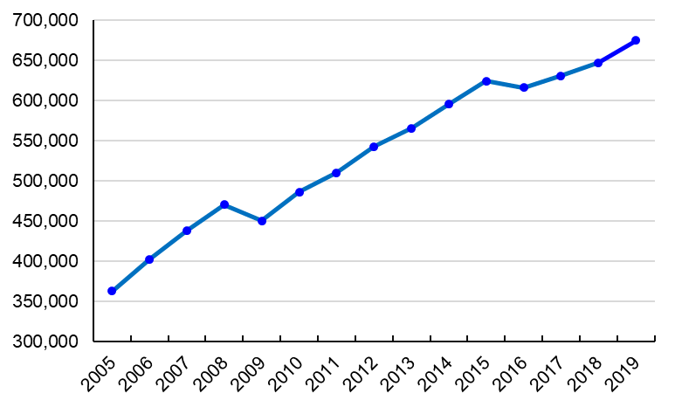
PCT National Phase Entries
675,200 total national phase entries in 2019 (+4.3%) 563,500 non-resident national phase entries in 2019 (+4.5%) PCT system accounted for 56.7% of all non-resident filings in 2019 (57.0% in 2018)
Source: WIPO statistics database. March 2021

Slide 7
International Authorities
International Search Reports
Distribution by International Authority
Timeliness of Transmission to International Bureau
Supplementary International Search Reports
International Preliminary Examination Reports
Distribution by International Authority
Timeliness of Transmission to International Bureau

Slide 8
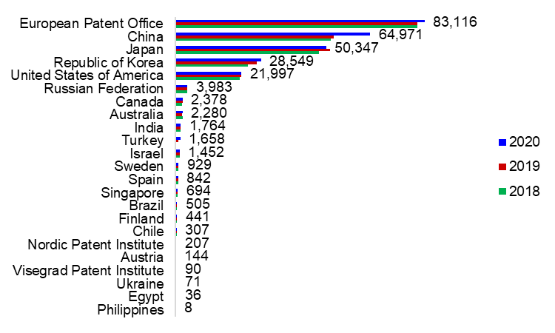
Distribution of ISRs established by ISA
IP5 Offices produce 93.3% of International Search Reports
Data based on international filing year of application
Source: WIPO statistics database. March 2021

Slide 9
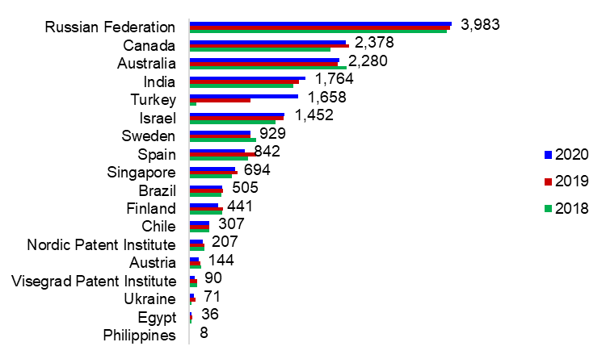
Distribution of ISRs established by ISA (excluding IP5 Offices)
Data based on international filing year of application
Source: WIPO statistics database. March 2021

Slide 10
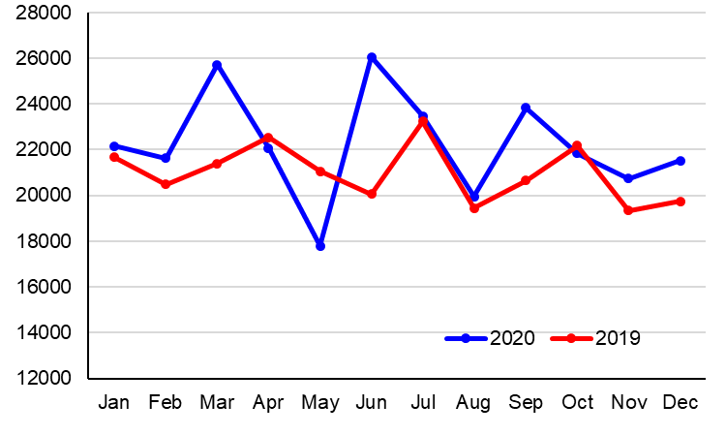
ISRs transmitted to International Bureau each month for 2019 and 2020
Source: WIPO statistics database. March 2021.

Slide 11
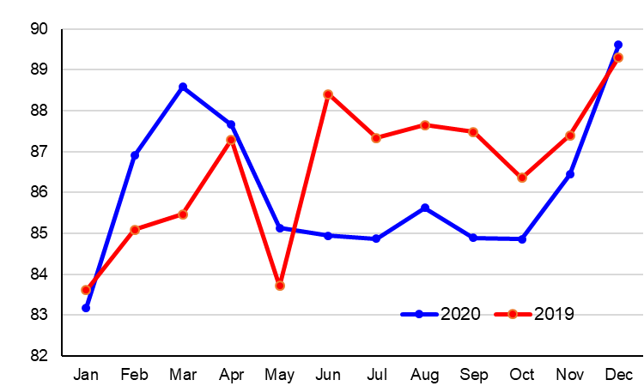
Percentage ISRs Transmitted within 3 months from Date of Receipt of Search Copy for 2019 and 2020
Percentage
2019 Total 86.6%
2020 Total 86.1%
Source: WIPO statistics database. March 2021. Excludes cases where Rule 42 time limit of 9 months from priority date applies.

Slide 12
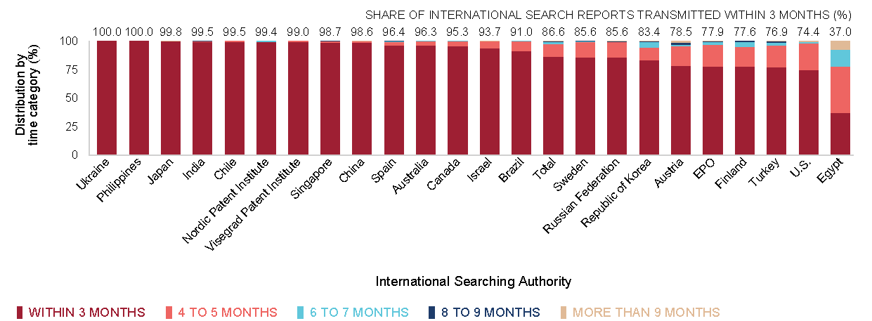
Timeliness in Transmitting ISRs to the IB measured from Date of Receipt of Search Copy by ISA for 2019
Provisional share transmitted within 3 months for 2020
100
99.7
100
98.7
98.5
98.7
94.1
86.1
99.1
65.7
78.1
68.9
0
81.4
99.0
93.5
96.0
96.3
91.4
84.2
87.6
76.4
63.3
17.6
Source: WIPO statistics database. March 2020 and March 2021. Excludes cases where Rule 42 time limit of 9 months from priority date applies.

Slide 13
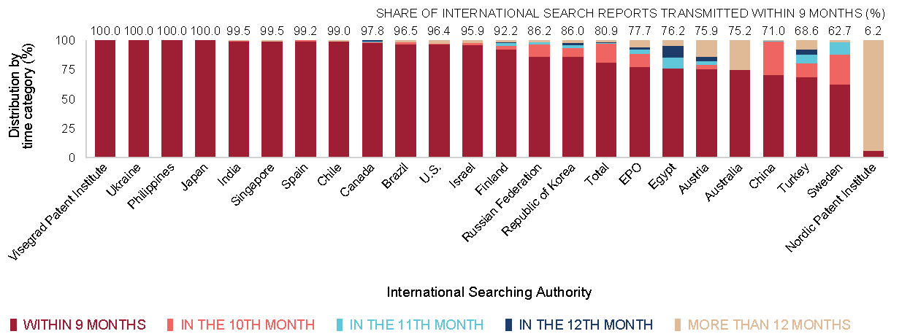
Timeliness in Transmitting ISRs to the IB measured from Priority Date by ISA for 2019
Provisional share transmitted within 9 months for 2020
91.0
100
95.7
98.4
95.7
96.0
98.9
91.1
78.2
56.4
66.5
52.9
100
99.9
100
100
95.5
95.9
99.5
79.2
73.7
80.4
67.0
50.0
Source: WIPO statistics database. March 2020 and March 2021. Excludes cases where Rule 42 time limit of 3 months from date of receipt of search copy applies.

Slide 14
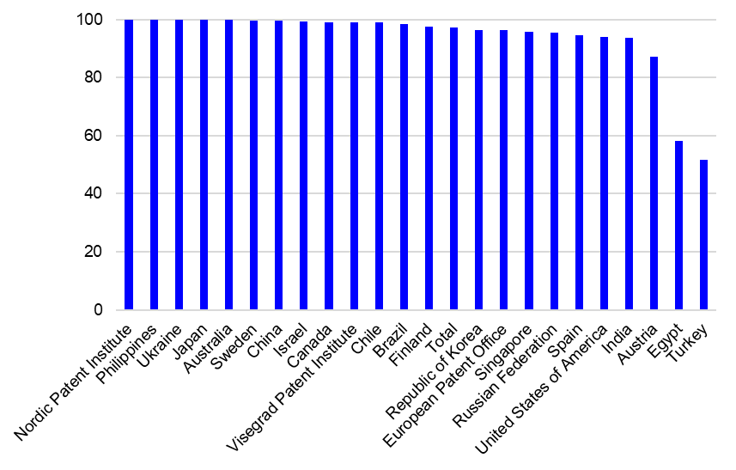
PCT A1 Publication Percentage by ISA in 2020
Percentage of A1 Publications = 97.3% (97.2% in 2019)
Source: WIPO statistics database. March 2021

Slide 15
Supplementary International Search Requests
 | 2015 | 2016 | 2017 | 2018 | 2019 | 2020
Austria | 2 |  | 1 | 1 | 2 | 2
European Patent Office | 40 | 44 | 40 | 54 | 94 | 50
Nordic Patent Institute |  |  |  |  | 2 | 1
Russian Federation | 22 | 3 | 6 |  | 3 | 1
Singapore |  | 1 |  | 3 | 4 | 2
Sweden |  |  |  | 3 | 1 | 1
Turkey |  |  |  | 1 | 2 | 1
Ukraine |  |  | 2 | 1 | 4 | 1
Visegrad Patent Institute |  |  |  |  | 2 | 1
Total | 64 | 48 | 49 | 63 | 114 | 60
Source: WIPO statistics database. March 2021

Slide 16
International Preliminary Examination Reports by IPEA
 | 2016 | 2017 | 2018 | 2019 | 2020 | 2020 (%) | 2019 (%)
Australia | 599 | 545 | 590 | 530 | 484 | 4.78 | 4.86
Austria | 5 | 9 | 3 | 7 | 8 | 0.08 | 0.06
Brazil | 47 | 50 | 66 | 61 | 72 | 0.71 | 0.56
Canada | 231 | 213 | 172 | 168 | 172 | 1.70 | 1.54
Chile | 5 | 8 | 16 | 12 | 10 | 0.10 | 0.11
China | 382 | 316 | 397 | 471 | 419 | 4.13 | 4.32
Egypt |  | 1 | 2 | 3 | 6 | 0.06 | 0.03
European Patent Office | 9072 | 8358 | 7700 | 6045 | 5436 | 53.64 | 55.42
Finland | 60 | 76 | 66 | 55 | 63 | 0.62 | 0.50
India | 25 | 28 | 41 | 89 | 67 | 0.66 | 0.82
Israel | 81 | 98 | 68 | 88 | 77 | 0.76 | 0.81
Japan | 2019 | 1945 | 2128 | 1945 | 1817 | 17.93 | 17.83
Nordic Patent Institute | 31 | 32 | 36 | 27 | 37 | 0.37 | 0.25
Republic of Korea | 209 | 162 | 135 | 130 | 106 | 1.05 | 1.19
Russian Federation | 71 | 51 | 50 | 57 | 36 | 0.36 | 0.52
Singapore | 26 | 106 | 111 | 93 | 91 | 0.90 | 0.85
Spain | 60 | 47 | 41 | 37 | 62 | 0.61 | 0.34
Sweden | 206 | 134 | 127 | 88 | 77 | 0.76 | 0.81
Turkey |  |  | 4 | 18 | 45 | 0.44 | 0.17
Ukraine |  | 4 | 7 | 7 | 8 | 0.08 | 0.06
United States of America | 1226 | 1059 | 990 | 971 | 1037 | 10.23 | 8.90
Visegrad Patent Institute |  | 3 | 6 | 5 | 5 | 0.05 | 0.05
Total | 14355 | 13245 | 12756 | 10907 | 10135
IPRP (Chapter II) reports issued fell by 7.1% between 2019 and 2020, and by 29% since 2016
Source: WIPO statistics database. March 2021

Slide 17
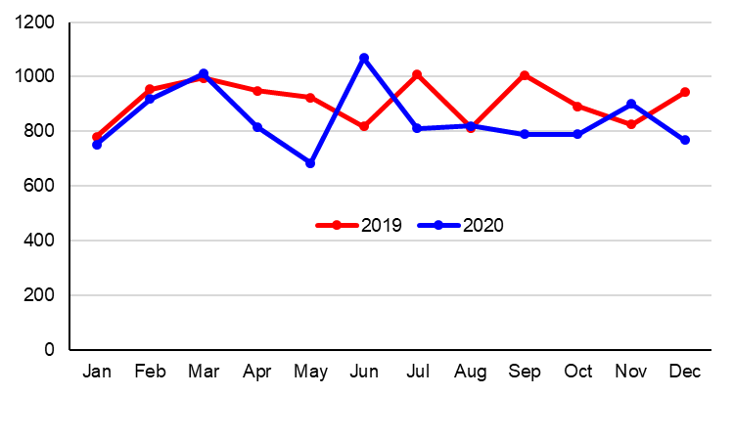
IPERs transmitted to International Bureau each month for 2019 and 2020
Source: WIPO statistics database. March 2021.

Slide 18
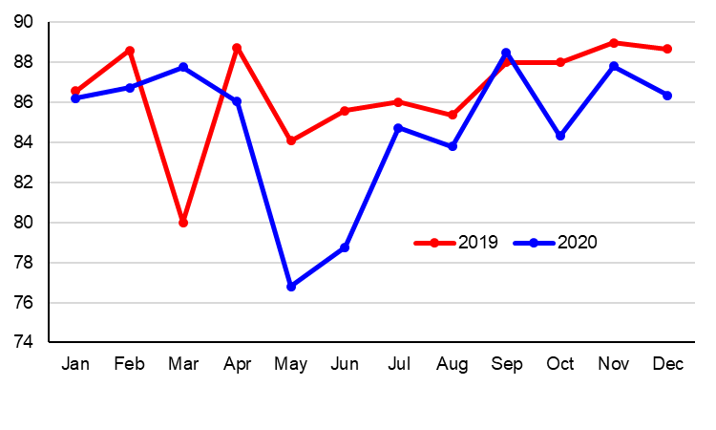
Percentage IPERs Transmitted within 28 months from the Priority Date for 2019 and 2020
2019 Total 86.5%
2020 Total 84.8%
Percentage
Source: WIPO statistics database. March 2021.

Slide 19
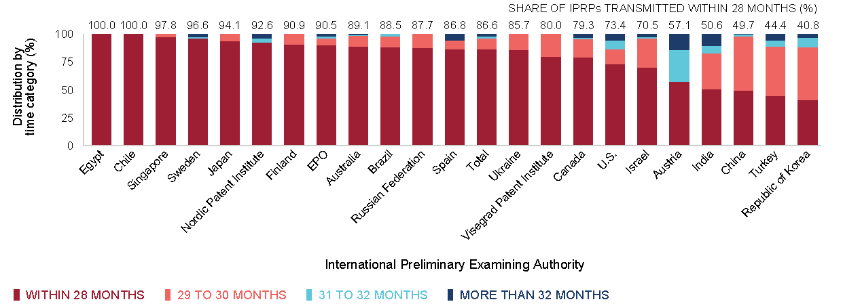
Timeliness in transmitting IPRPs by IPEA in 2019
Provisional share transmitted within 28 months for 2020
33.3
98.9
94.3
79.4
92.1
94.4
84.8
80.0
68.6
25.0
51.8
34.0
90.0
92.2
73.0
87.9
87.5
93.5
100
87.2
67.5
88.1
42.2
Timeliness calculated as time elapsed between priority date and date on which International Bureau received IPRP from IPEA
Source: WIPO statistics database. March 2020 and March 2021

Slide 20
Further information:
2020 PCT Yearly Review
The International Patent System
WIPO Publication No. 901E/2020
2020 World Intellectual Property Indicators
WIPO Publication No. 941E/2020
WIPO IP Statistics Data Center
http://www.wipo.int/ipstats/en/

