Slide 1
INAPI’s
Quality Management System
Cairo, February 2019

Slide 2
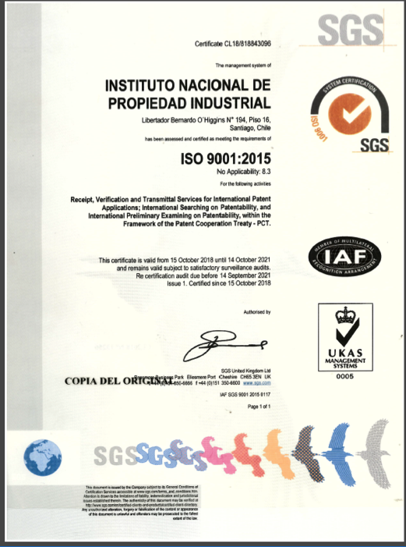
Quality Management System (QMS)
• Certified under ISO 9001:2008 in 2015
• Certified under ISO 9001:2015 in 2018
• Current ISO-certified processes
• PCT Receiving Office
• International search and examination

Slide 3
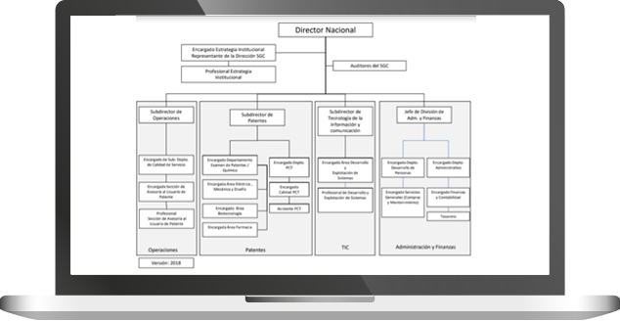
Quality Management System (QMS)

Slide 4
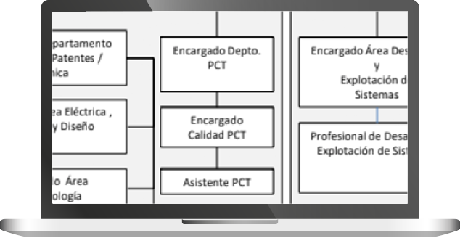
Quality Management System (QMS)

Slide 5
Quality Management System (QMS)
Quality is a part of INAPI's strategic objectives.
“Assure quality of services offered by INAPI in the international IP system and representing the country in international negotiations and forums in the IP scope.”.
Quality Policy
Generates the necessary conditions to satisfy the user's requirements and stakeholders by the timely identification of their needs in concordance with the legal and normative requirements by the following commitments:

Slide 6
Quality Management System (QMS)
Our commitments:
Timely and effective management of applications according to the national and international laws, regulations and guidelines that rule them.
Knowing our users' perception and other stakeholders on the services provided keeping an effective communication to contribute to their satisfaction improvement.
Continuous improvement of the processes.
Developing our staff's skills and competencies.

Slide 7
Quality Management System (QMS)
Quality based in the PDCA Cycle
Strategic planning
Strategic processess
Objectives
Products
Actions planning
Communications/updates
Operations
Training
PLAN
DO
ACT
CHECK
Internal/ external Audit
Quality feedback
Indicators outcomes
Adjusting risk matrix
Improving
processes/ procedures/guidelines
Relevant activities priorization
(resources)

Slide 8
Quality in Processing and timeliness
• QMS Google site
• Training of staff members as internal auditors in global
certified audit institutions.
• Creation of mechanisms for tracking of use of time in
PCT activities (RO, ISA, IPEA)
• Setting up of indicators based on complying with the
due dates and reliability of our services.

Slide 9
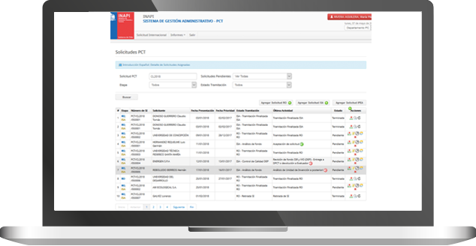
Quality in Processing and timeliness
Sistema de Gestión Administrativo Procesos PCT (SGA)
(Custom Administrative Management System Software)

Slide 10
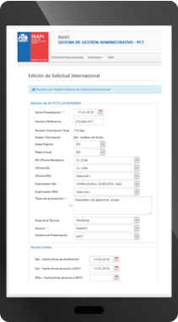
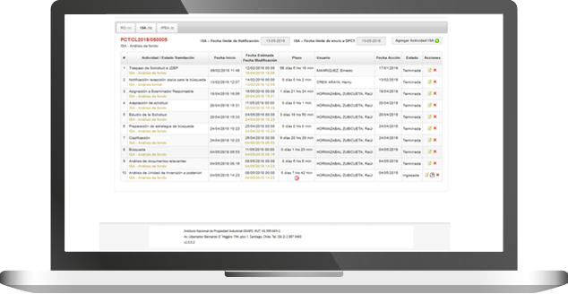
Quality in Processing and timeliness
Sistema de Gestión Administrativo Procesos PCT (SGA)

Slide 11
Quality in Processing and timeliness
Sistema de Gestión Administrativo Procesos PCT (SGA)
Advantages for examiners:
• Availability of information and due dates for delivering every product.
• Transparency of the process and real-time information.
• Availability of the last version of PCT forms to download.
• Pre-filling of forms to avoid transcription errors.

Slide 12
Quality in Examination
• Training of examiners in the use of databases
• Use of standardized clauses.
• Examination Manual available for Examiners.
• Self-assessment, Substantive and formal check of every
form drafted (ISA, WO/ISA, WO/IPEA, PCT/ISA/206, IPRP,
among others) before issuing to applicant and WIPO.
• Three levels of technical assessment while drafting PCT
products.

Slide 13
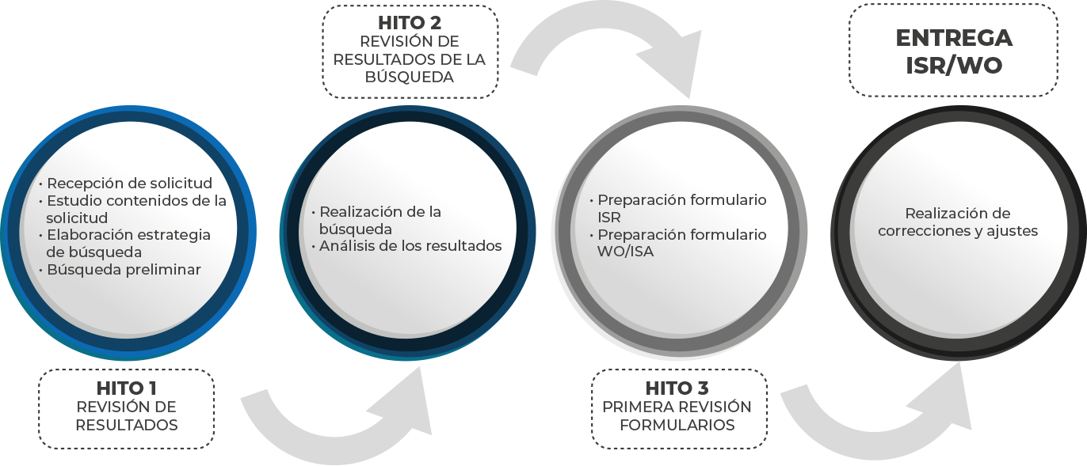
Quality in Examination
• Progress milestones
Examiner without much experience in ISA/IPEA tasks

Slide 14
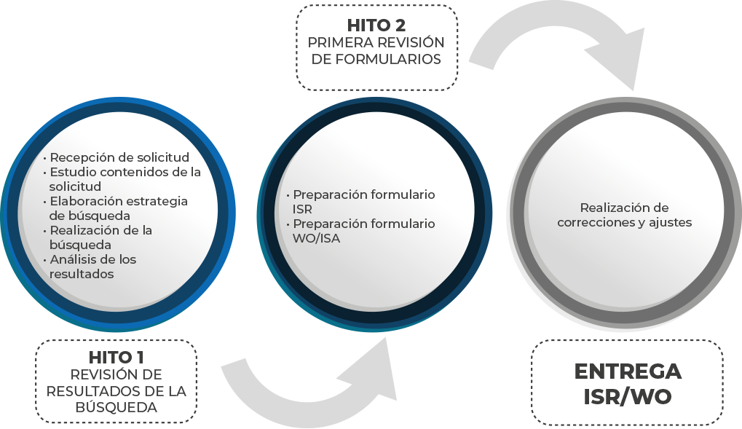
Quality in Examination
• Progress milestones
More experienced examiners

Slide 15
Quality in Examination
Progress milestones
• When examiners are considered as self-sufficient, they have
only one milestone for reviewing of the properly filled-out
forms.
• If the performance of an examiner proves to be sufficient, this
examiner can be released from these milestones. However, they
can request meetings to clarify questions or consult particular
criteria for some points of the analysis.

Slide 16
Feedback from users
• Meetings with agents.
• Monthly satisfaction survey for all applications
with their ISRs submitted within that period.
• Open door policy for communicating with our
users about ISA/IPEA administrative consults.

Slide 17
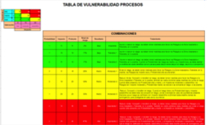
Risk Management
• National methodology based on COSO Model and
ISO 31000.
• Preliminary probability rating and impact value
establish the vulnerability of the process.
• Yearly SWOT analysis (Top Management Review).
• Continuous assessment during planning and
operation

Slide 18
INAPI as ISA/IPEA
Our Outcomes
• 100% of the ISR/WO delivered on time.
ISRs/WO ISAs issued within 16 months from first filing
99% (856)
IPRP issued within 28 months
100% (33)
100% (857)
ISRs/WO ISAs issued within 3 months from 202 form/9 months from first filing

Slide 19
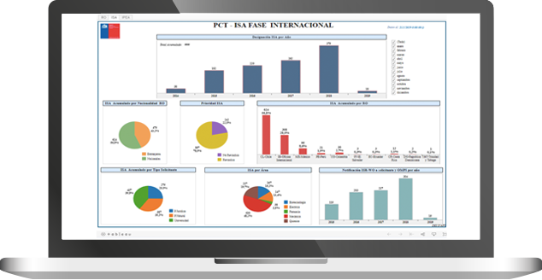
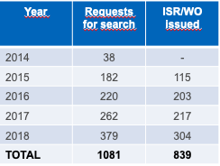
INAPI as ISA/IPEA
Our Outcomes
• Sustained increase in requests for international
searches.

Slide 20
INAPI as ISA/IPEA
Our Outcomes
• Positive opinion from our users.
• Excellency of service for public institutions award
in 2016 and finalist in 2017 and 2018.
• Successful transition to ISO 9001:2015 and
broadening of its scope to include the ISA/IPEA
processes.

Slide 21
Thank you
pct [at] inapi [dot] cl

