Slide 1
Flash news: families, CPC and more
Online
February
2020
Iustin Diaconescu - Head of Patent Database Section
Sandrine Ammann - Marketing & Communications Officer

Slide 2
Raise your hand only if you can hear me otherwise please send me a message using the Questions box

Slide 5
Questions/concerns
patentscope@wipo.int

Slide 7
Agenda
Families
CPC
Japanese collection
PubChem
Tips for the new interface
PATENTSCOPE forum & webinars
Q&A session

Slide 9
Families in PATENTSCOPE a
PCT applications + national phase entries a
1st filing – PCT – national phase entries a
US Provisional – PCT a

Slide 10
Families in PATENTSCOPE x
2 first filings – PCT – national phase entry x
US provisional – nonprovisional – PCT x
Chain of provisional/nonprovisional – PCT x
Republications = one single record

Slide 11
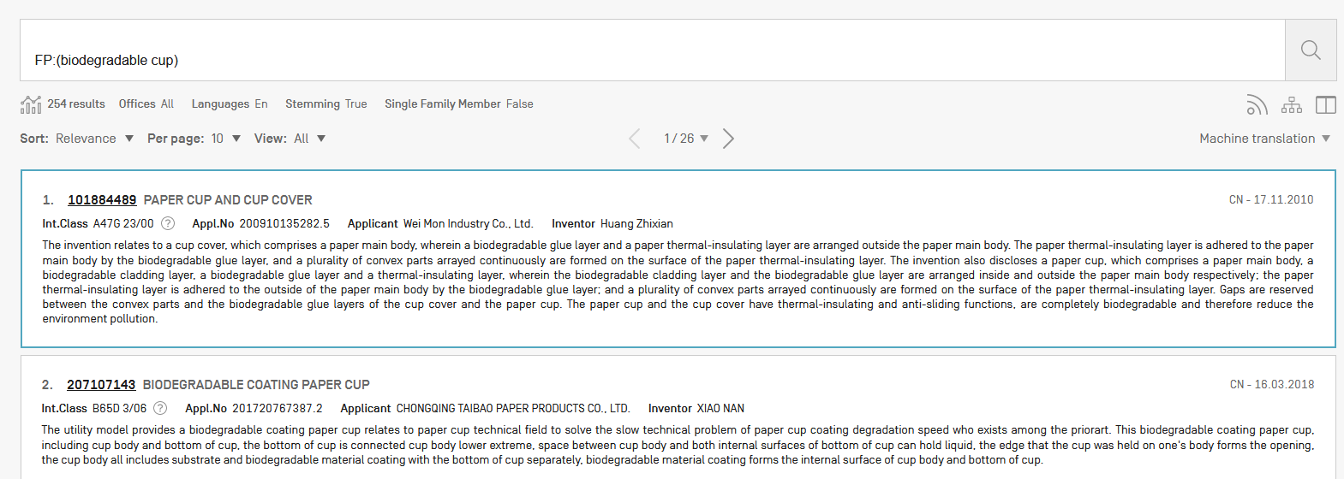

Slide 12
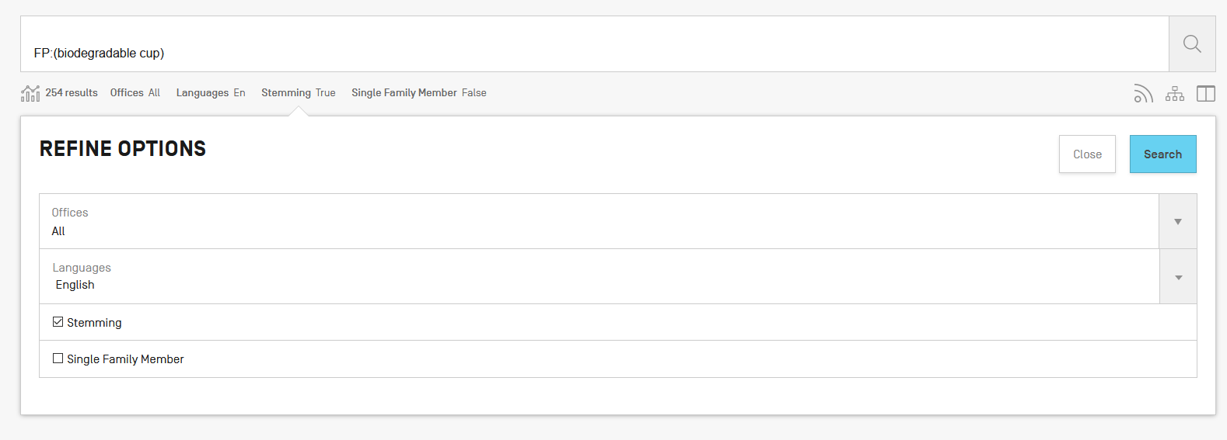

Slide 13
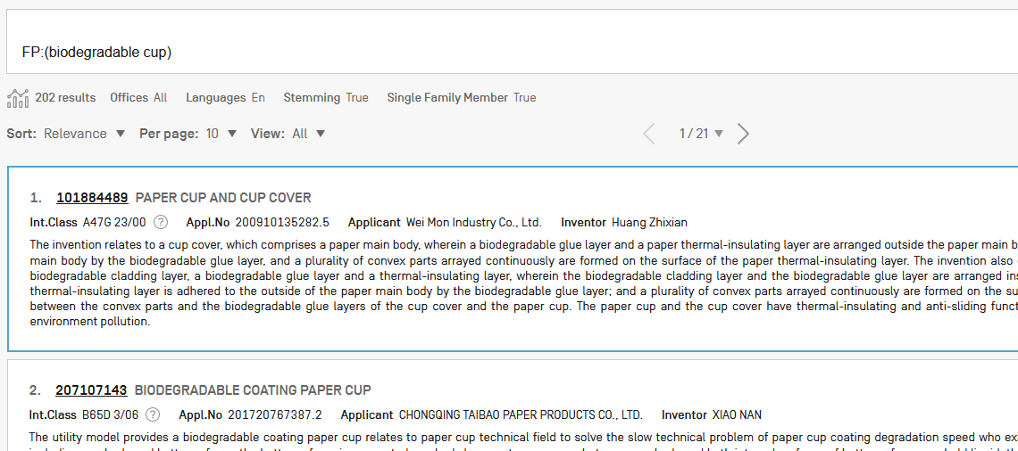

Slide 14
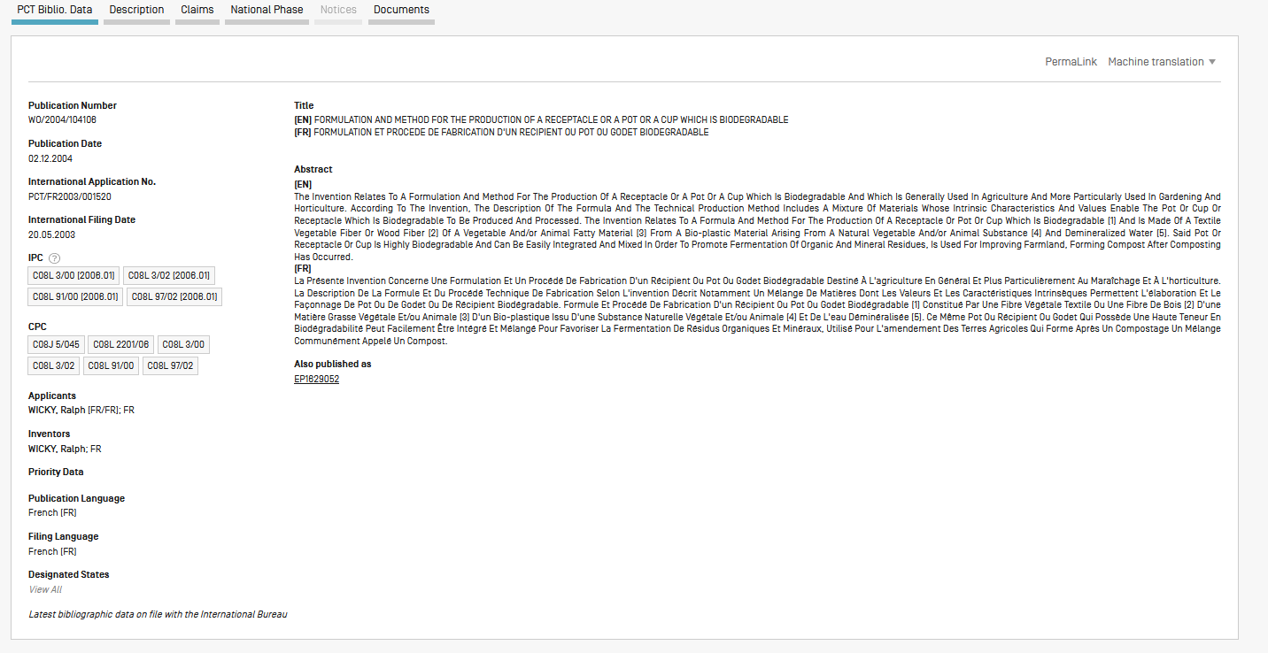

Slide 15
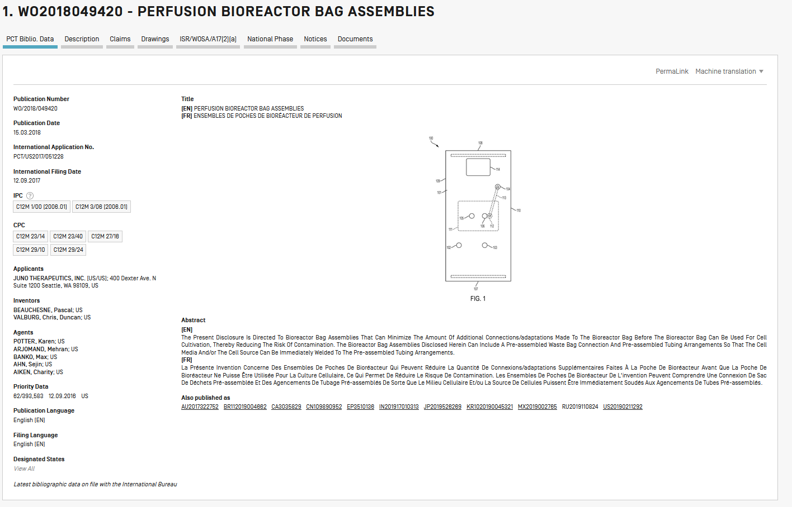

Slide 16
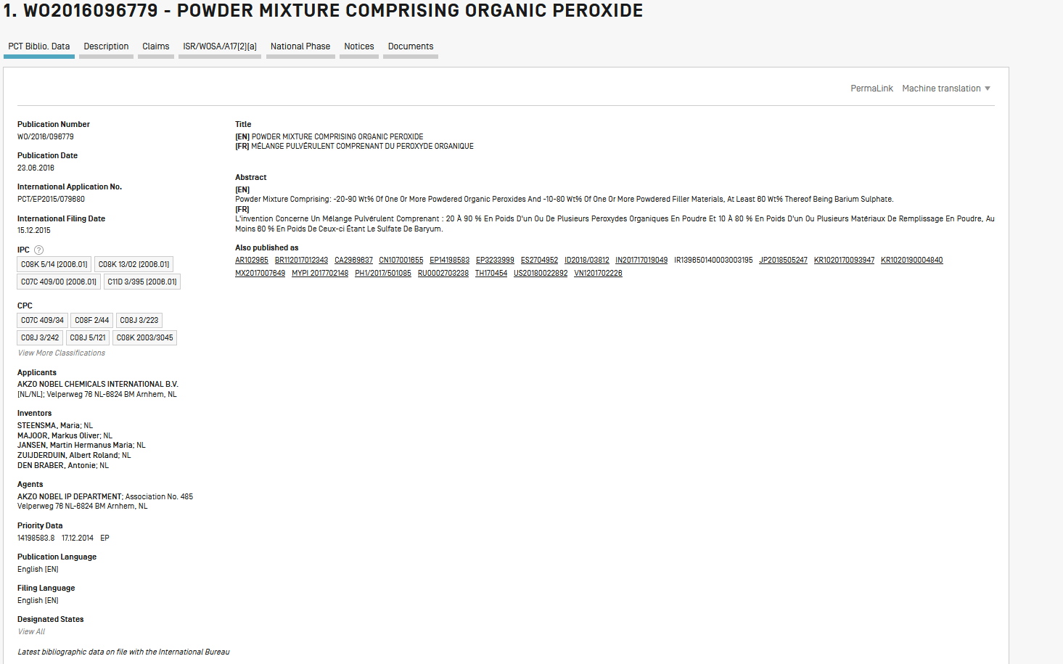

Slide 17
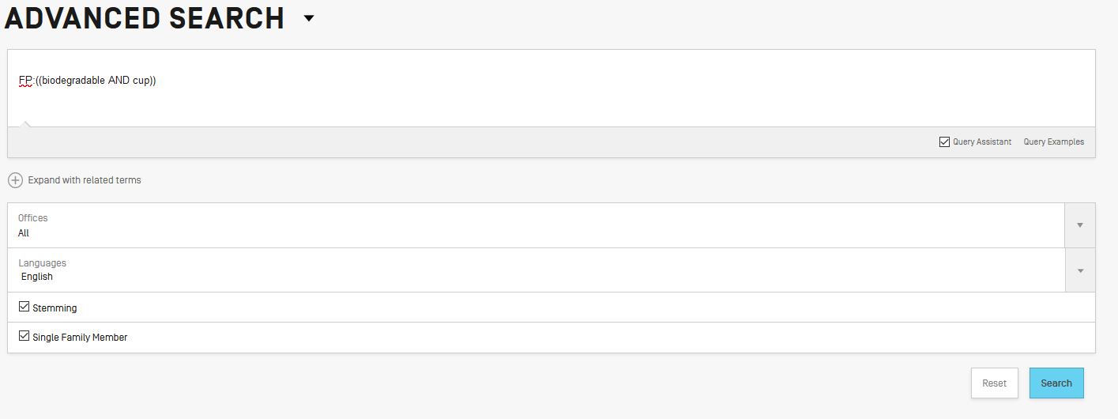

Slide 18
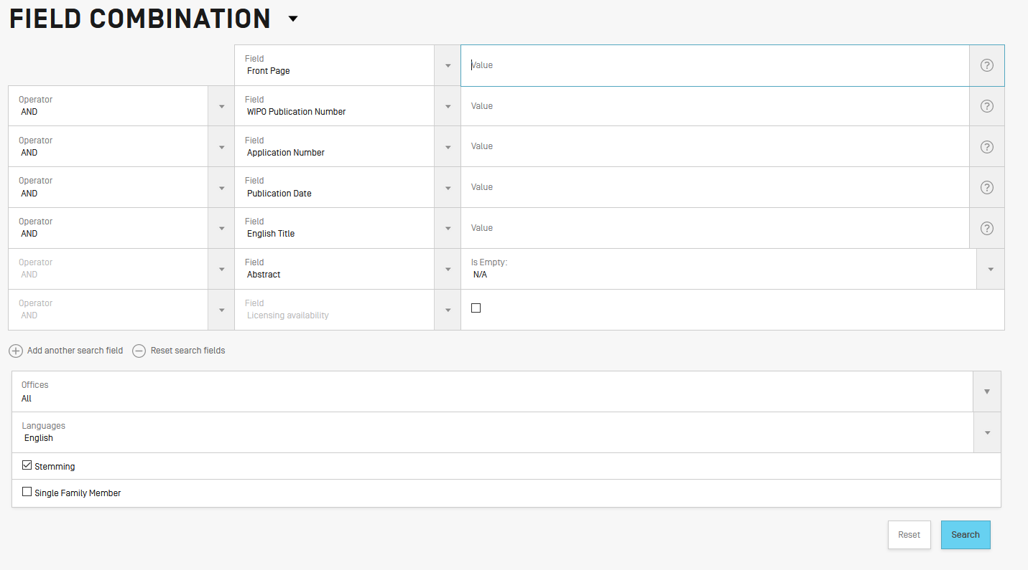

Slide 19
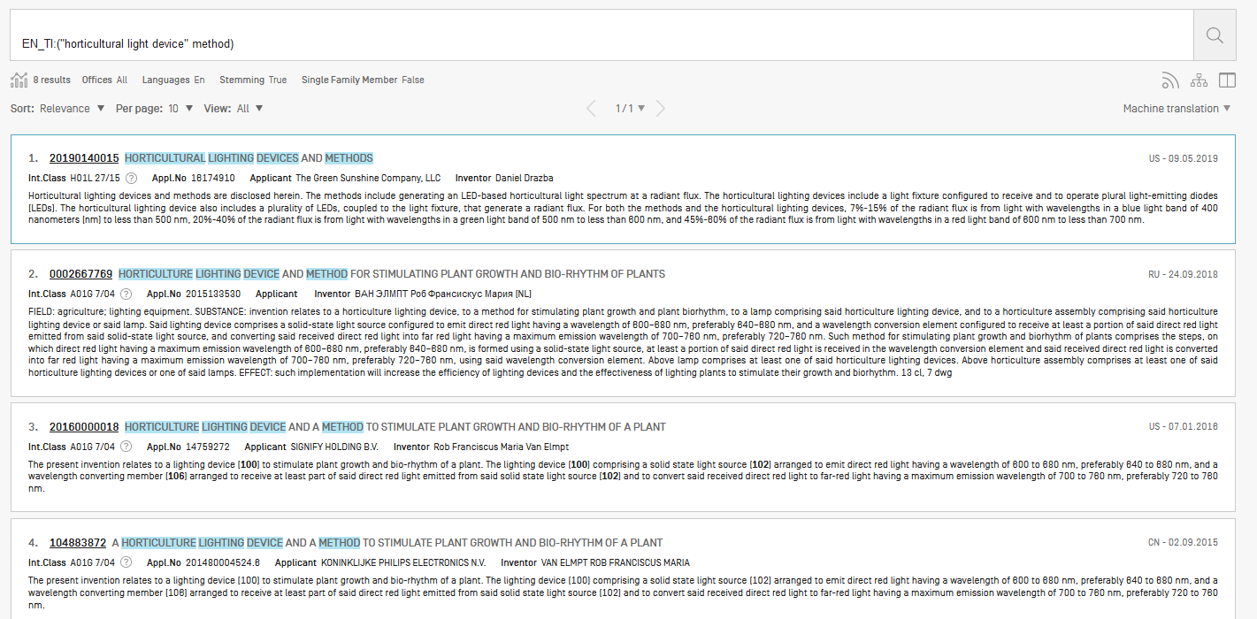

Slide 20
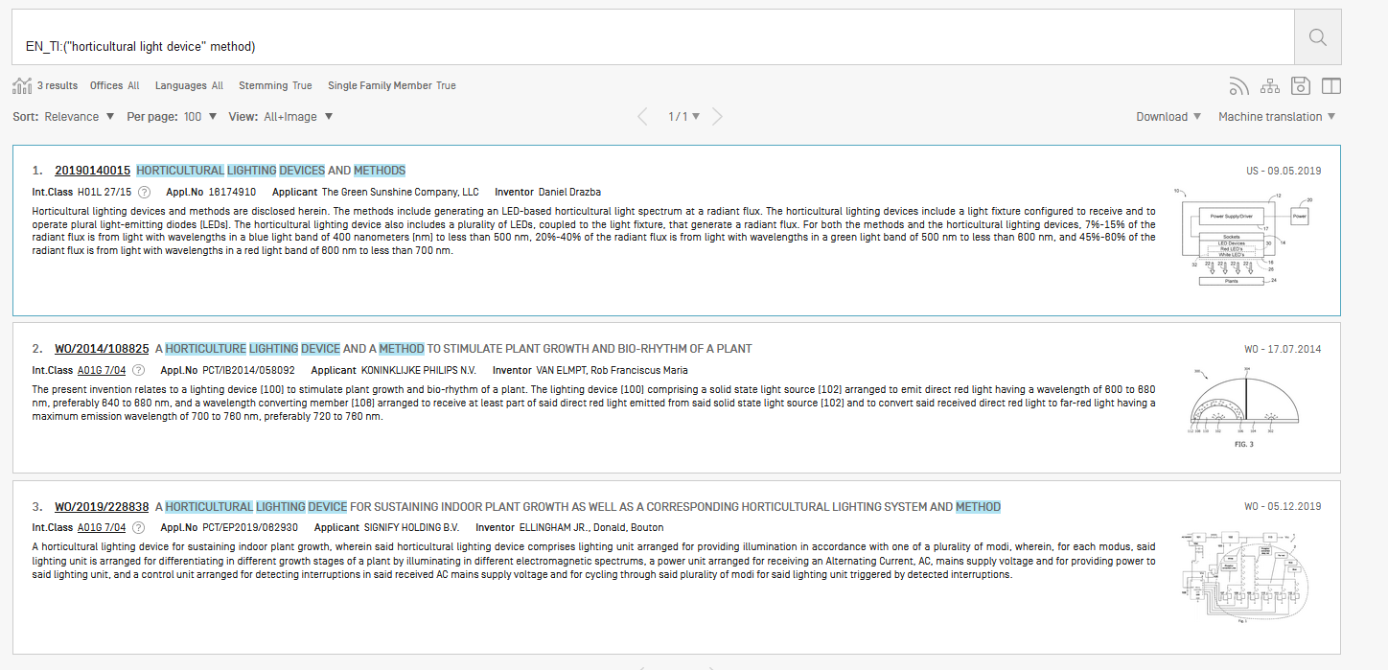

Slide 21
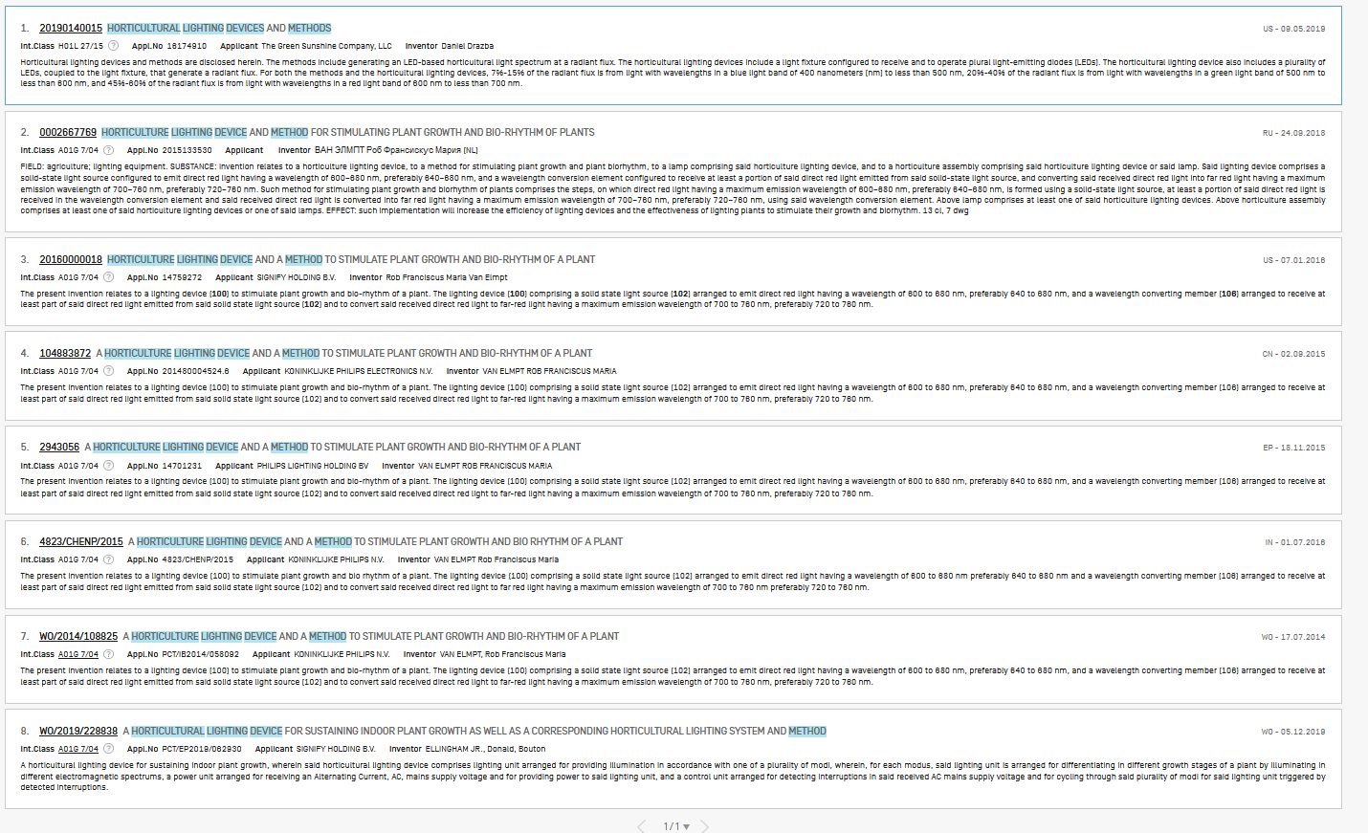
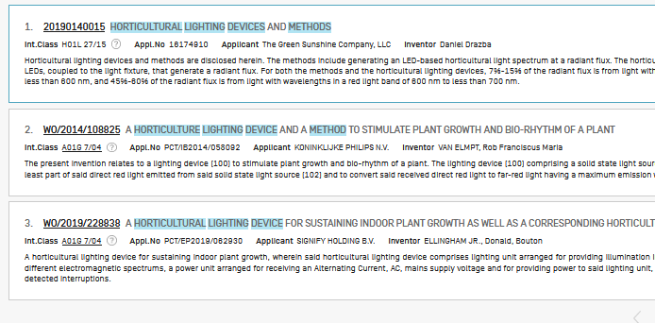

Slide 22
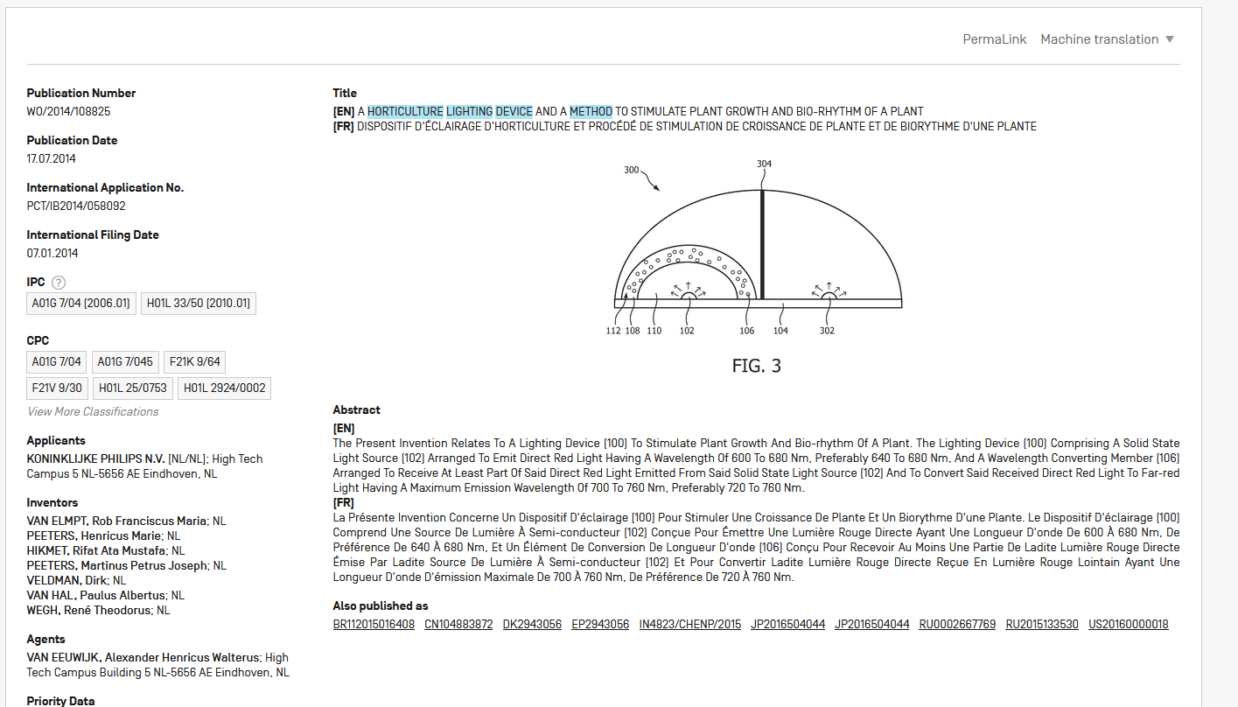

Slide 23
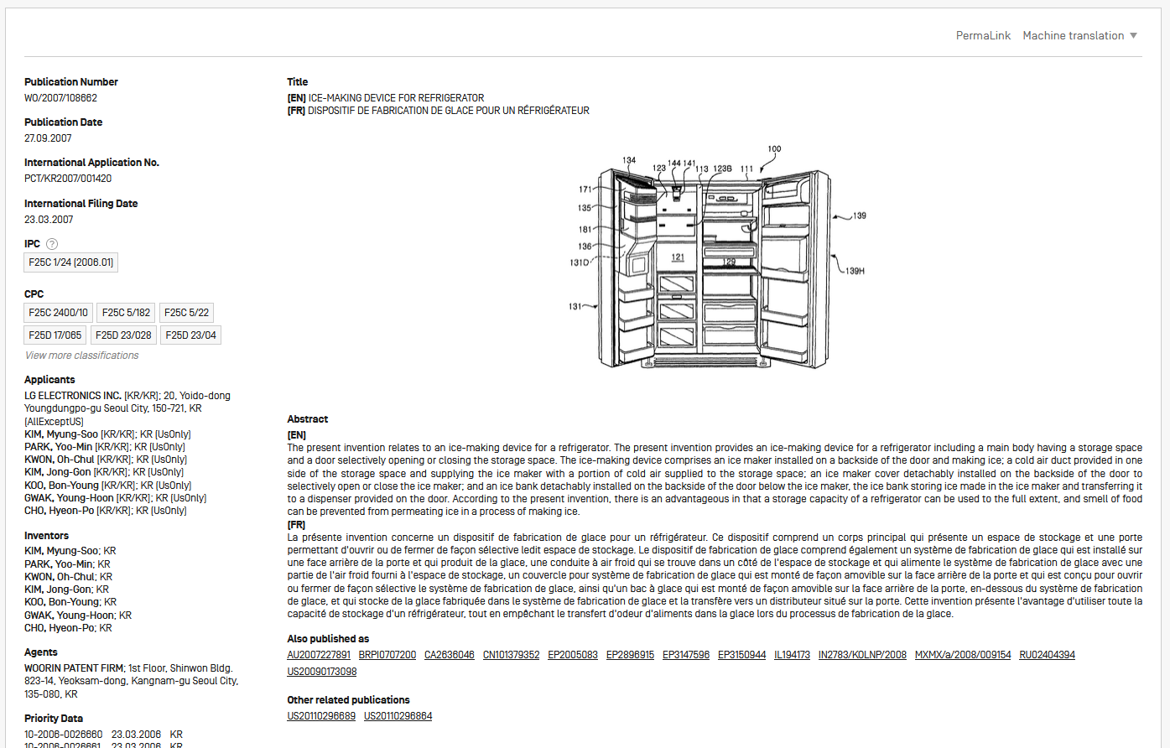

Slide 24
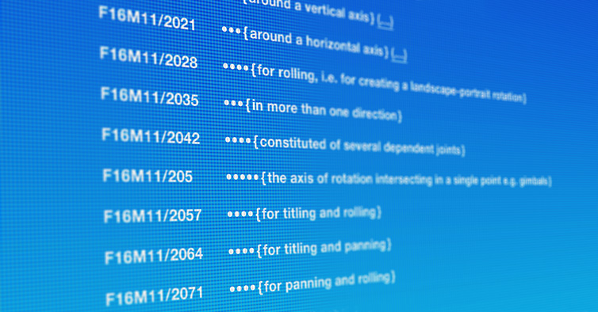
Source: https://www.cooperativepatentclassification.org/index

Slide 25
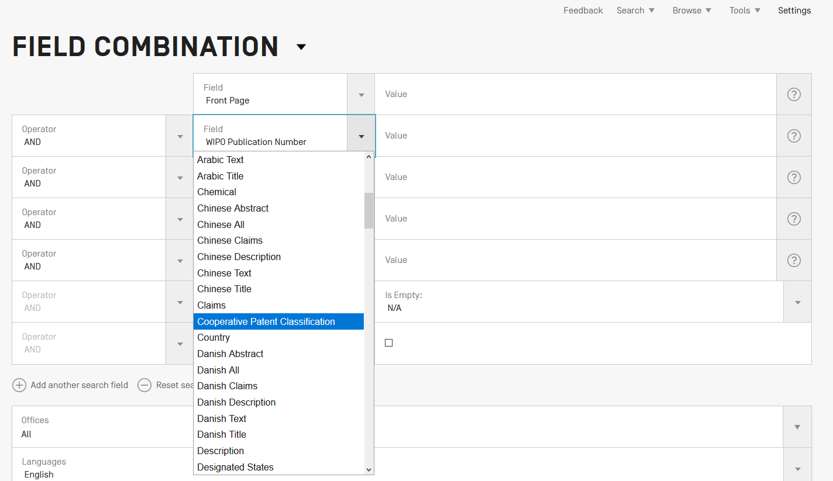

Slide 26
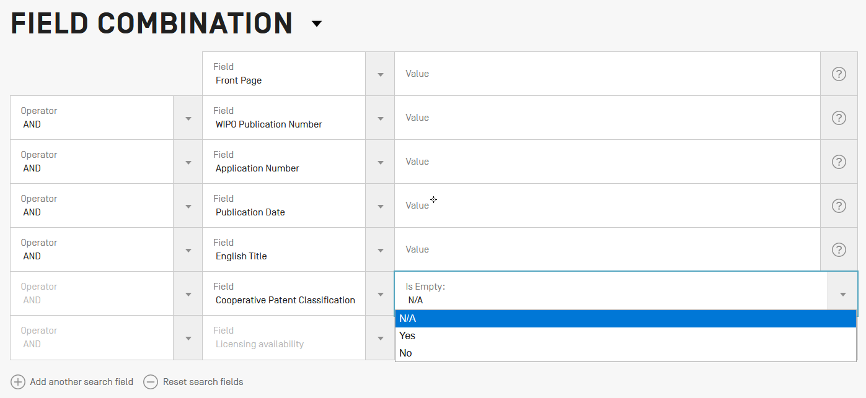

Slide 27
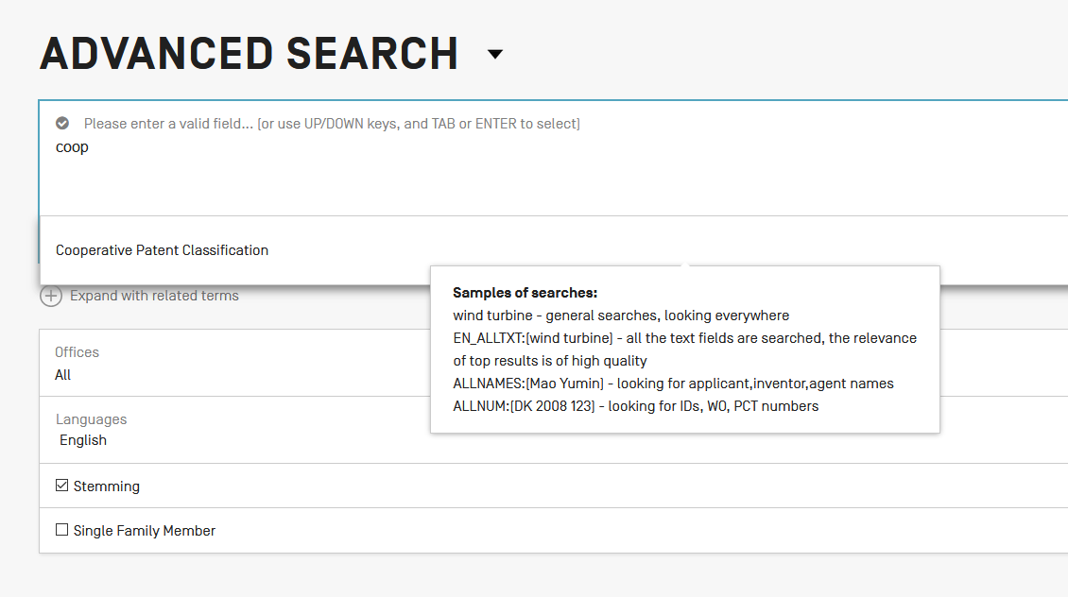

Slide 29
Collections - coverage
CPC imported from DocDB for PCT applications
52 national collections (IP5 + 47)

Slide 31
Field: classif
Union of CPC + IPC
To cover old and new documents

Slide 32
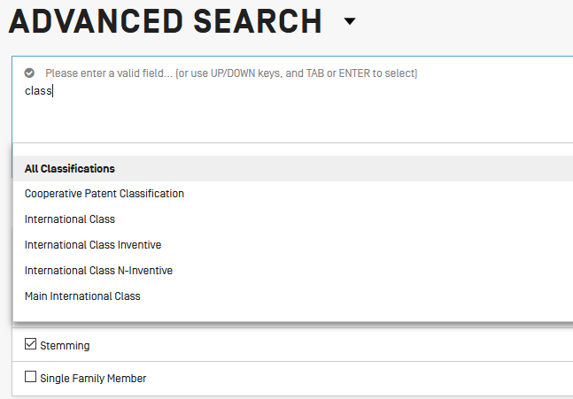

Slide 33
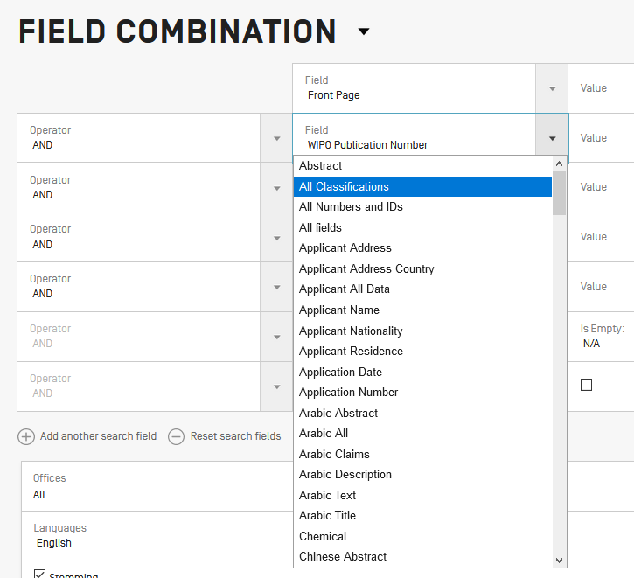

Slide 35
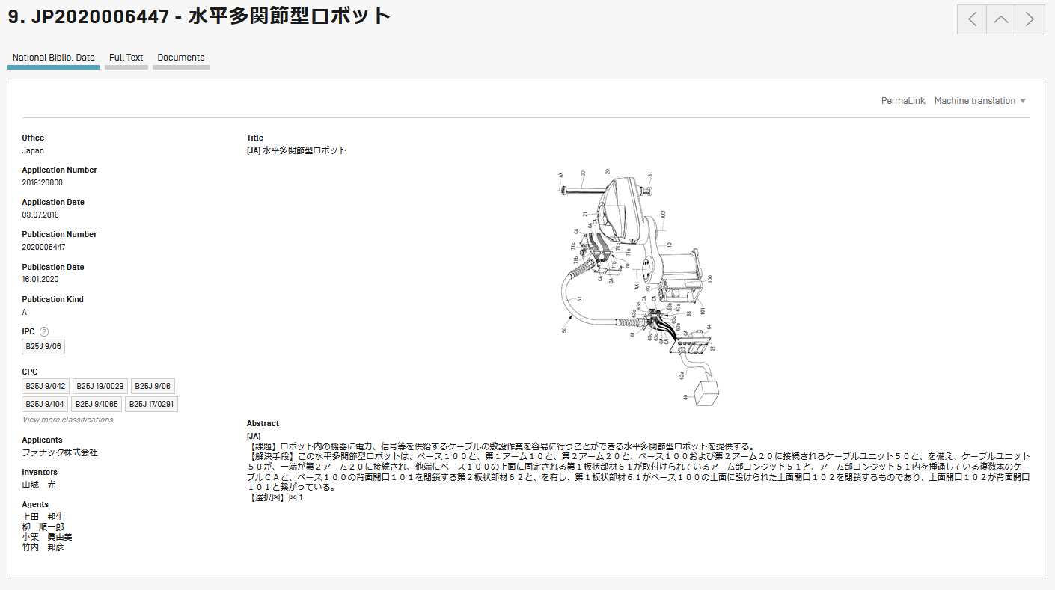

Slide 37
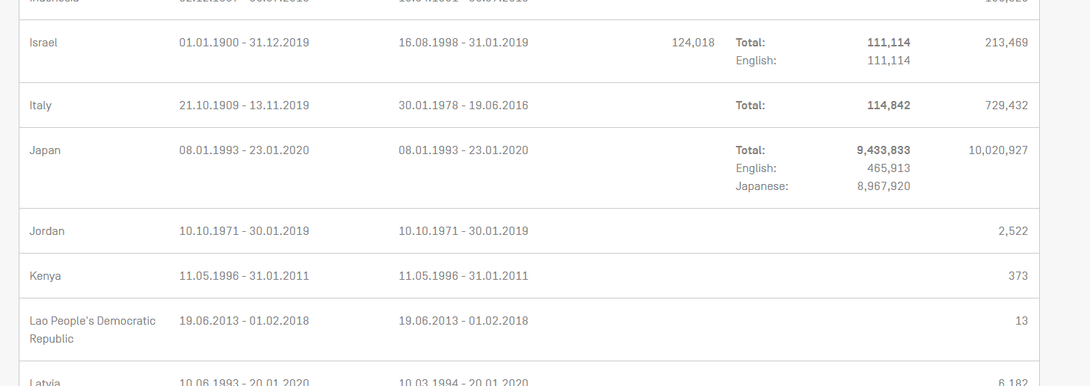

Slide 39
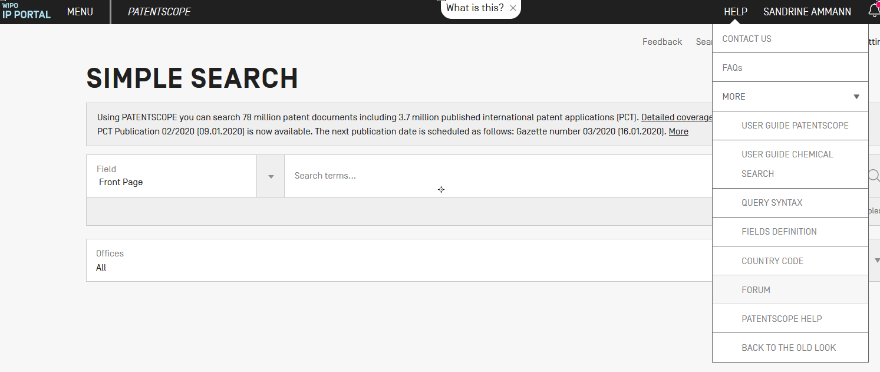

Slide 40
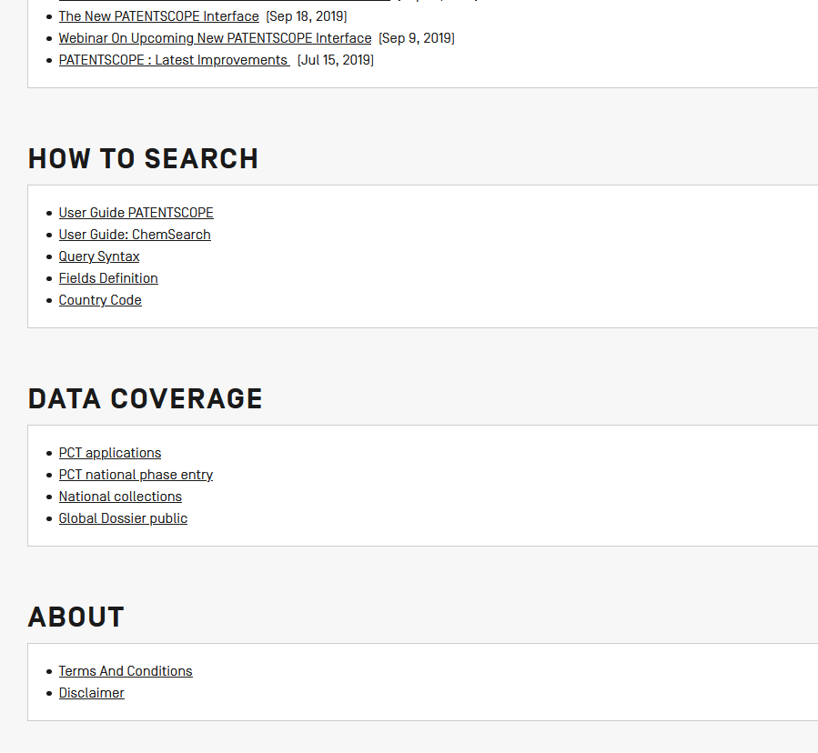

Slide 41
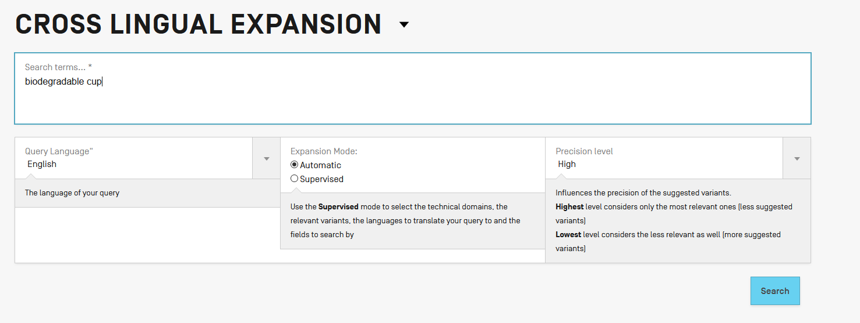

Slide 42
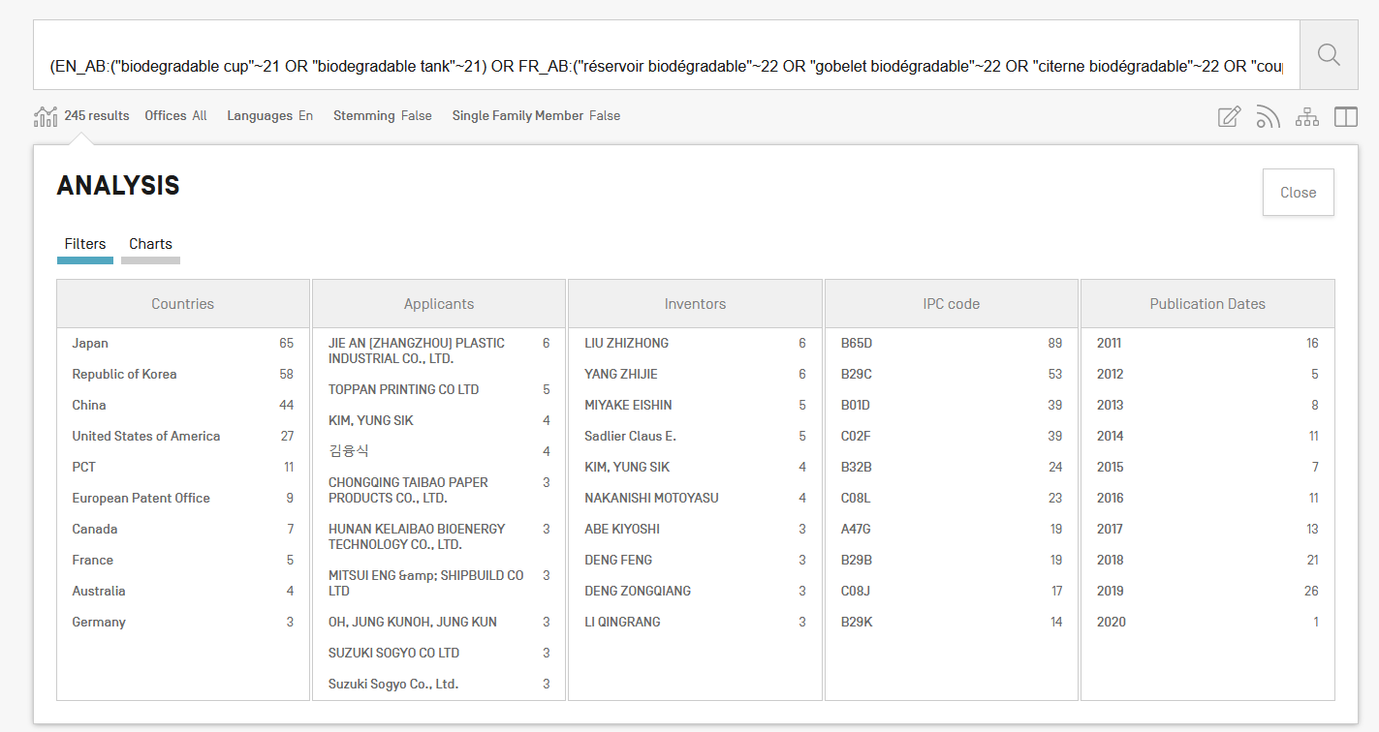

Slide 43
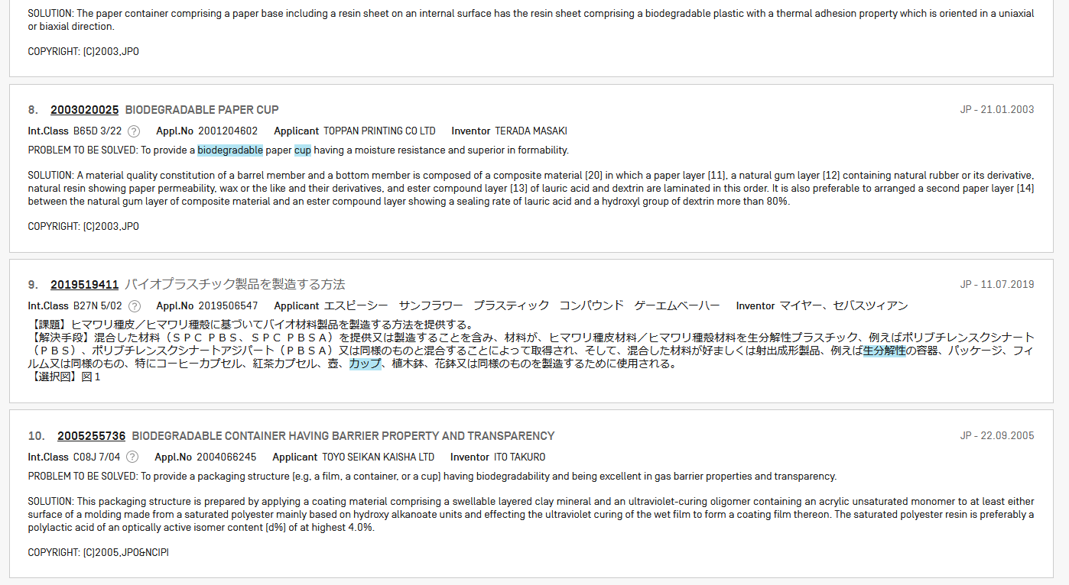

Slide 44
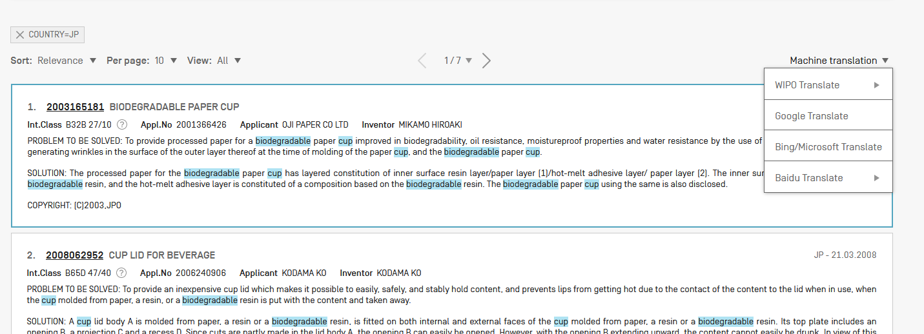

Slide 45
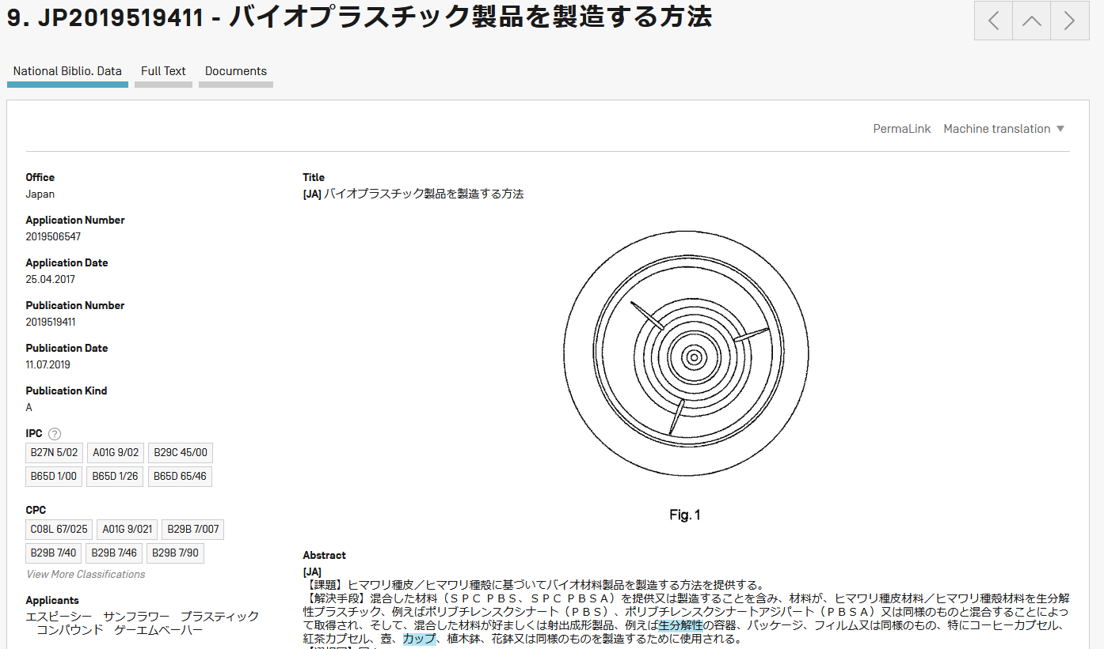

Slide 46
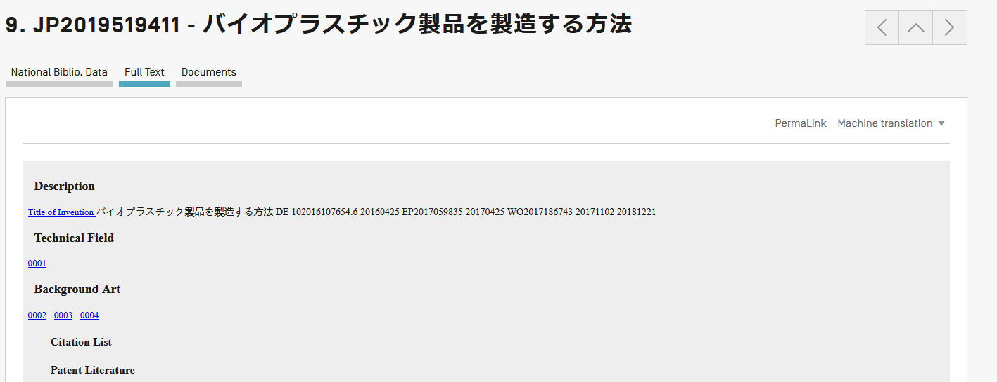

Slide 49
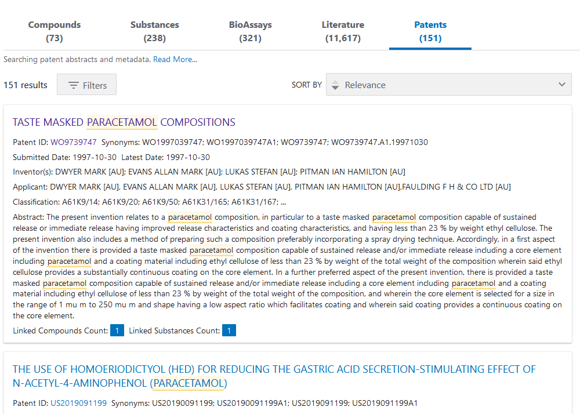

Slide 50
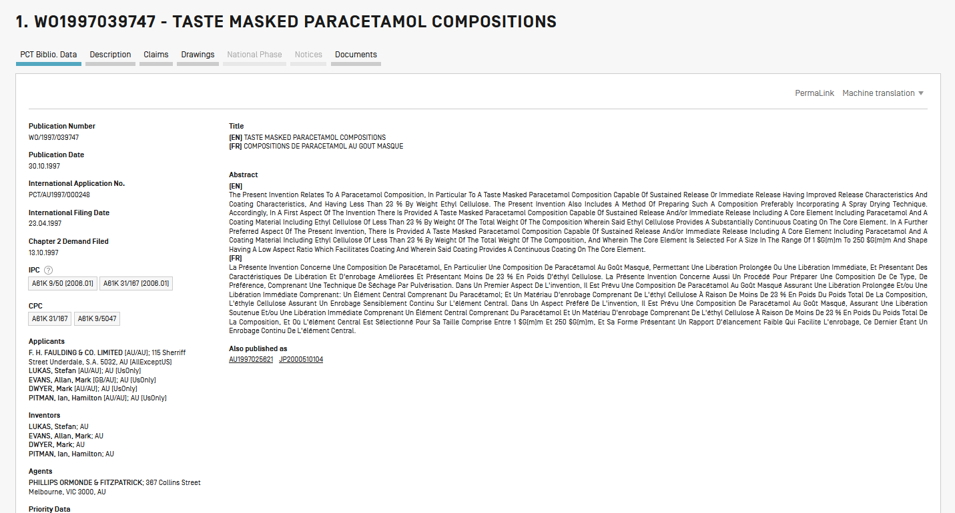

Slide 52
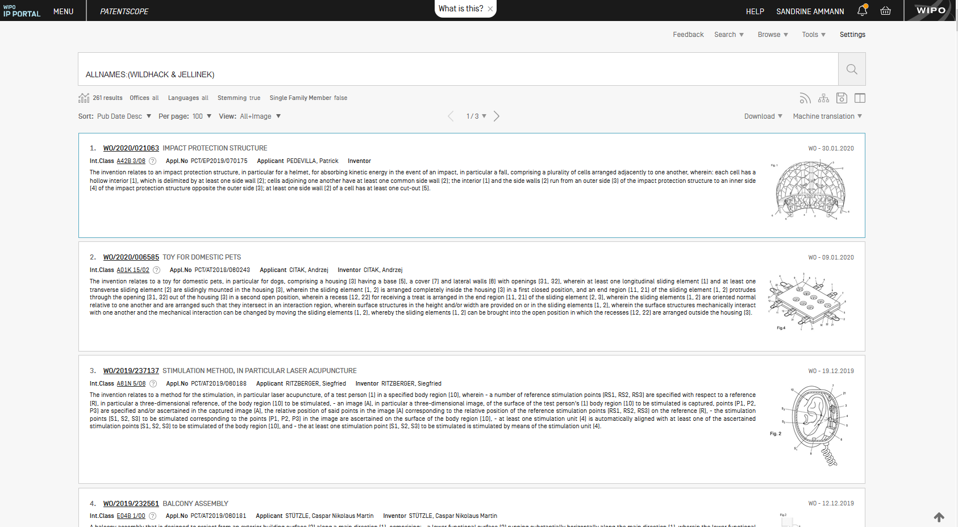
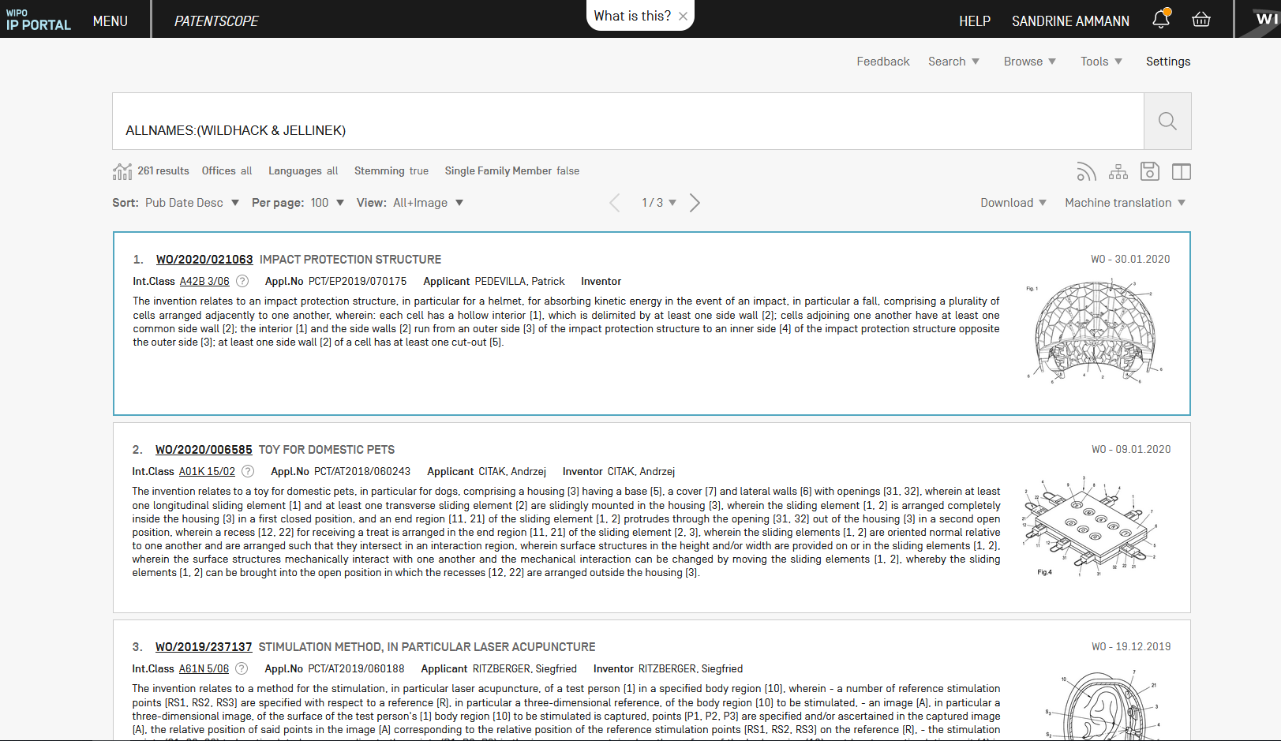
80% zoom

Slide 53
Stemming over wildcard
mirco???? over mirco*

Slide 54
Improved stemming
Arabic, Bulgarian, Danish, Estonian, German, Greek, Indonesian, Italian, Romanian, Spanish, Swedish

Slide 55
patentscope@wipo.int

Slide 56
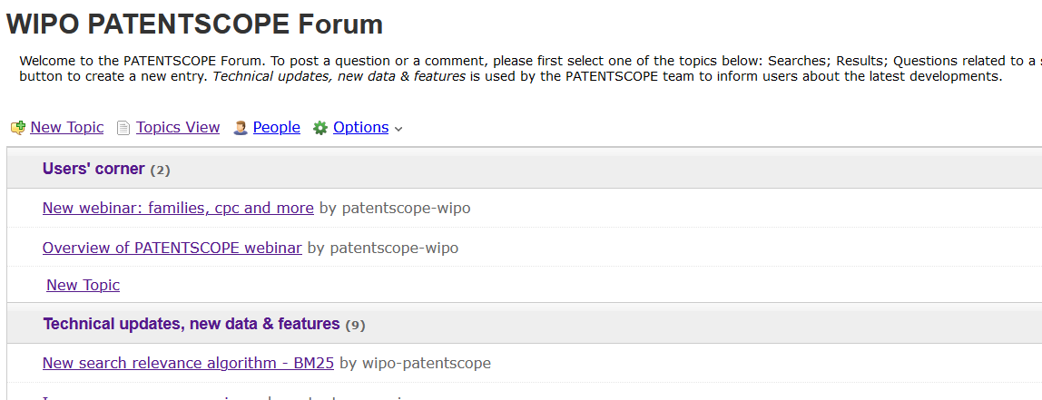
New in 2020!

Slide 58
Next webinar
PATENTSCOPE for beginners
February 16 or 18
To register: https://attendee.gotowebinar.com/rt/3103569885139805708

Slide 59
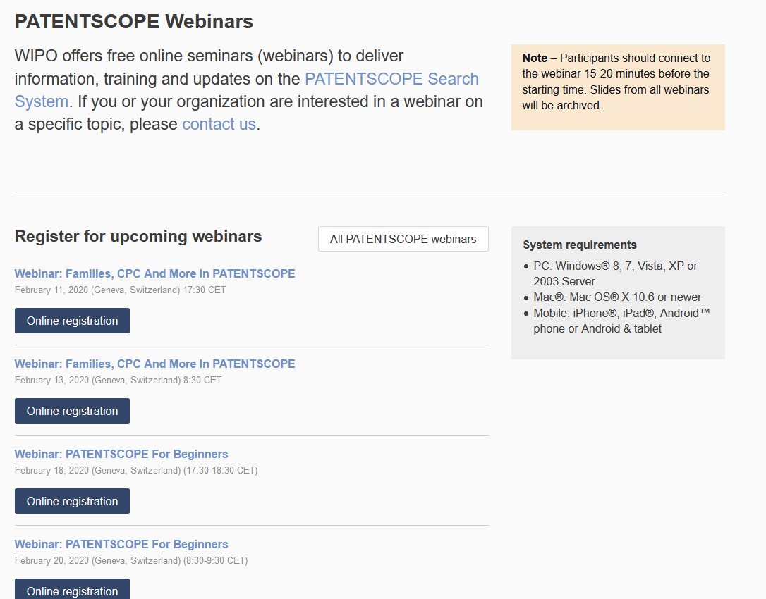
wipo.int/patentscope/en/webinar

Slide 60
Global Brand Database, Global Design Database
Webinars:
https://www.wipo.int/reference/en/branddb/webinar/index.html
https://www.wipo.int/reference/en/designdb/webinar/index.html

Slide 62
patentscope@wipo.int

