Slide 1
How to read you search results in PATENTSCOPE
Web
July
2019
Sandrine Ammann
Marketing & Communications Officer

Slide 2
Agenda
What’s news
Search result list
Quiz
Q&A

Slide 3
What’s new? In Septembre 2019

Slide 4
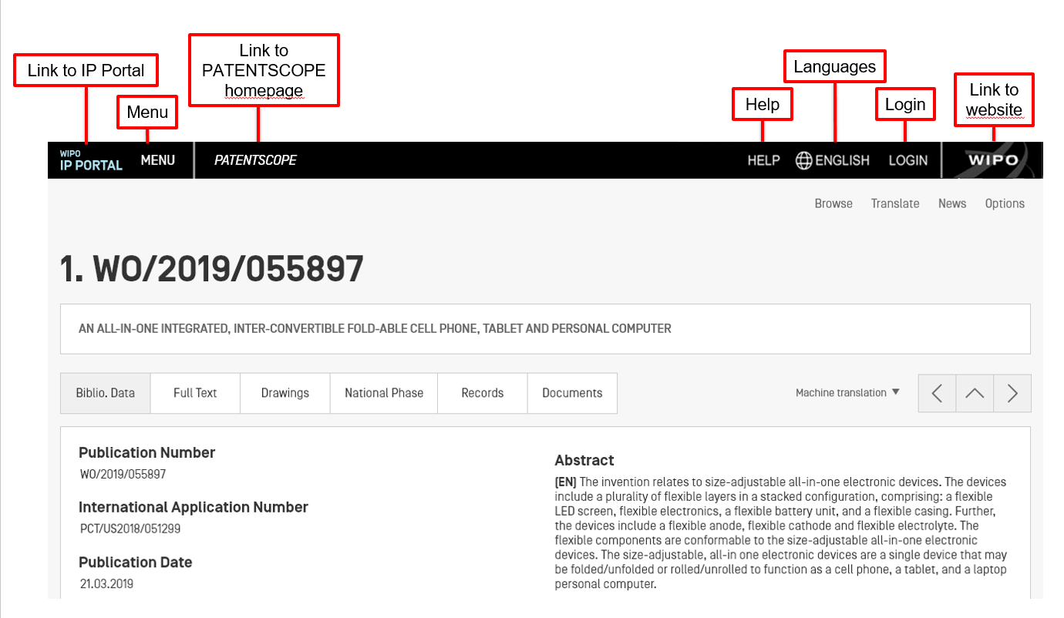

Slide 5
Search results list

Slide 6
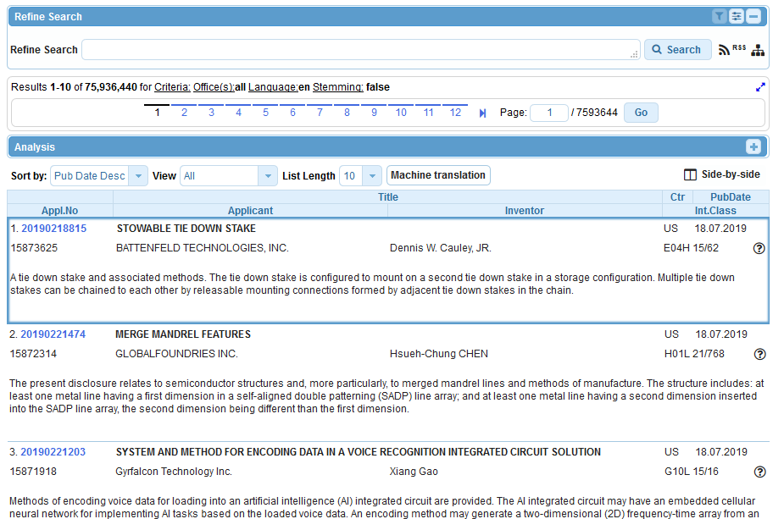

Slide 7
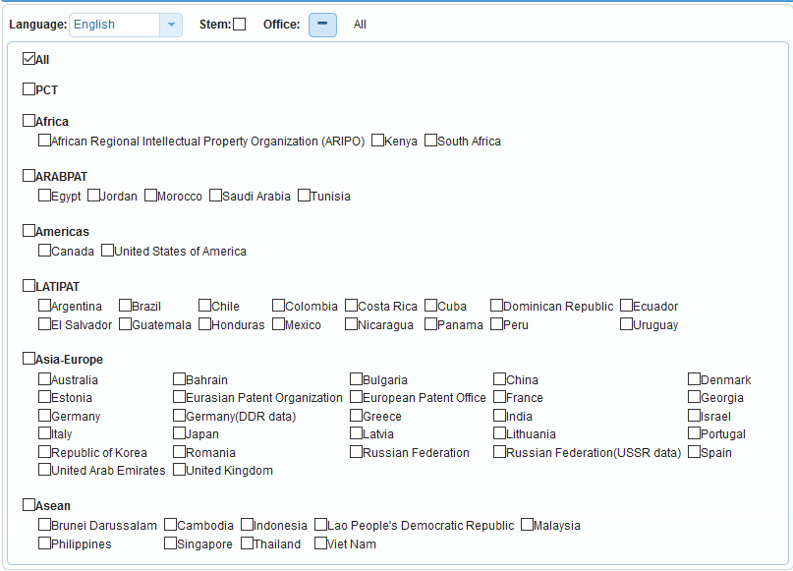
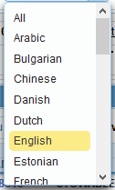
The first box

Slide 8
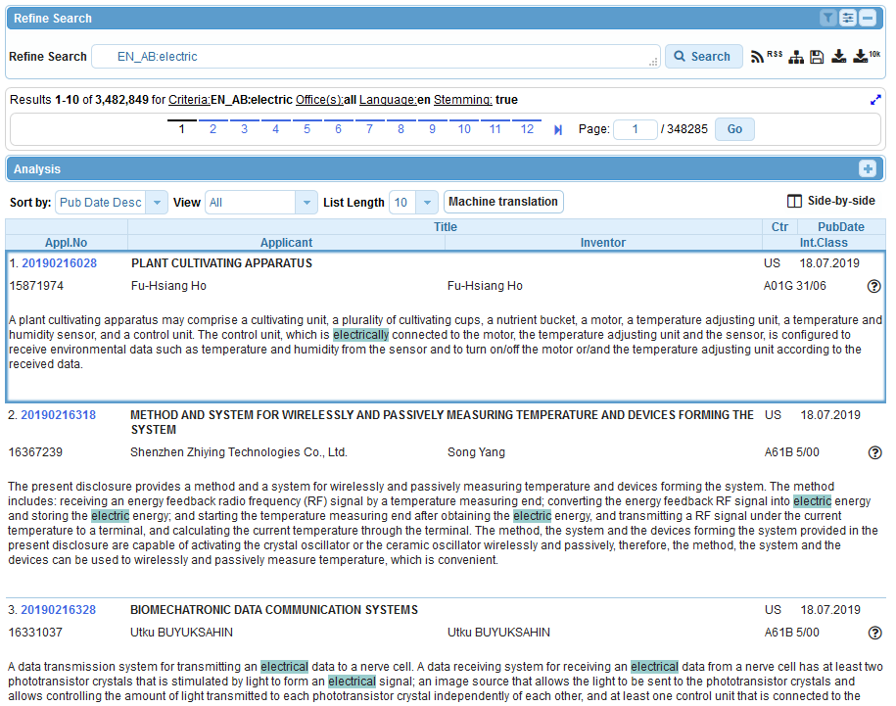

Slide 10
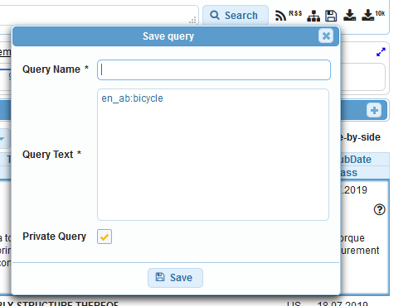
Save your query

Slide 11
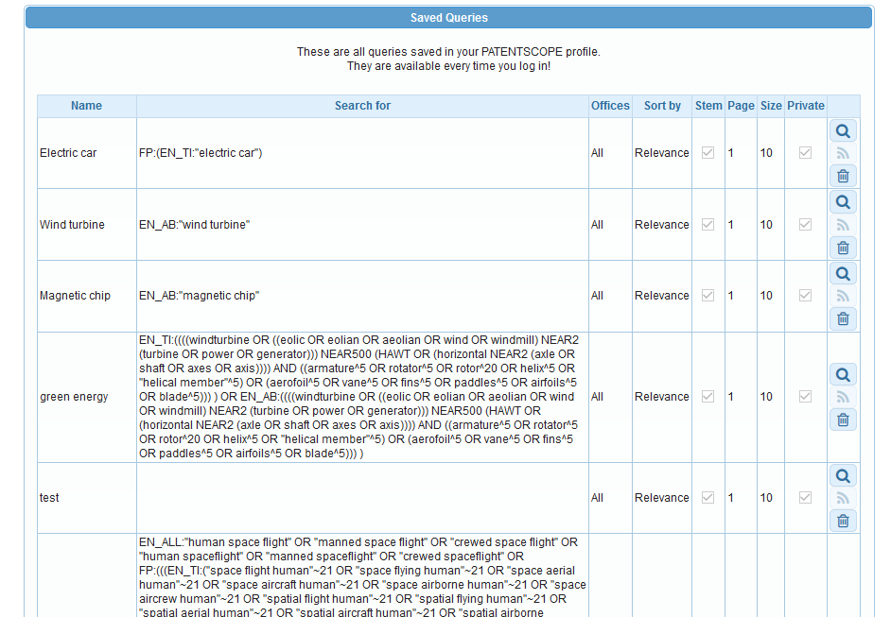
RSS feed

Slide 12
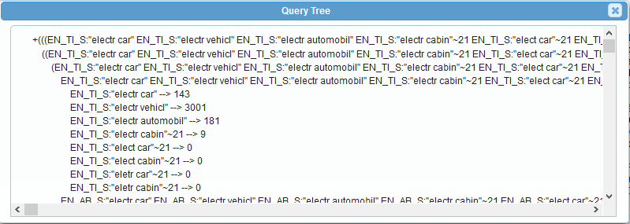
Query tree

Slide 13
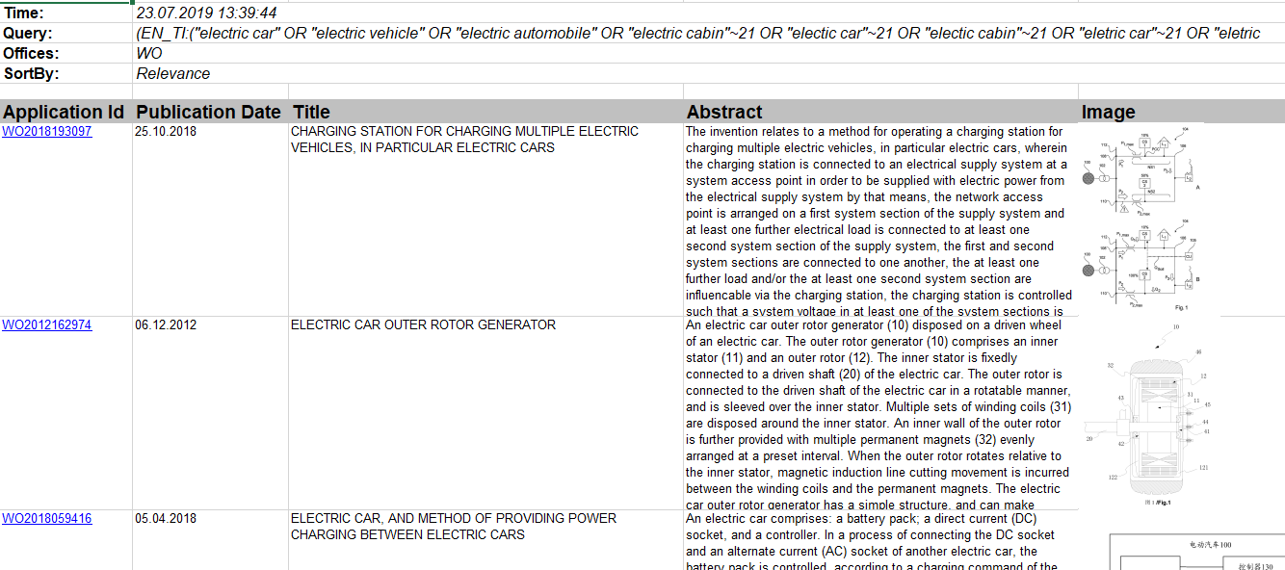
Downloading

Slide 14
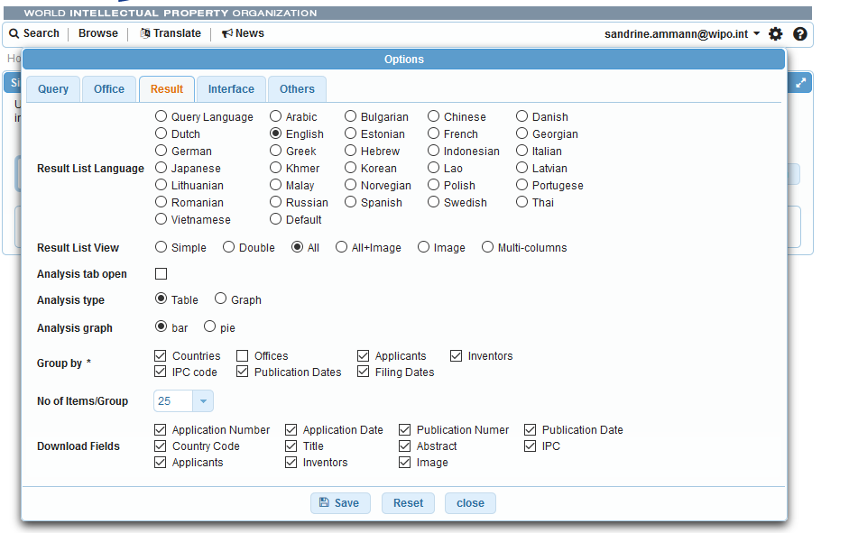

Slide 15
Analysis bar

Slide 16
Anlysis bar

Slide 17
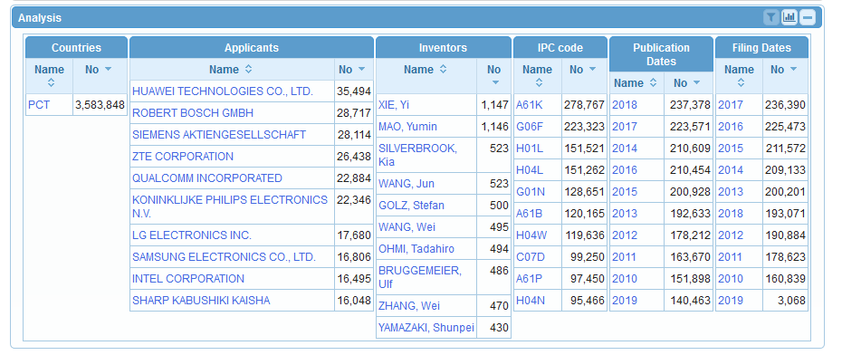

Slide 18
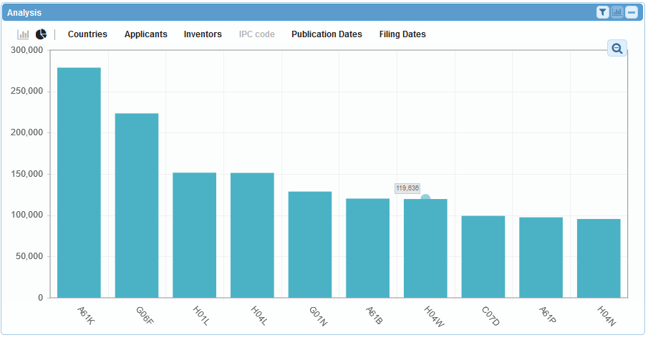

Slide 19
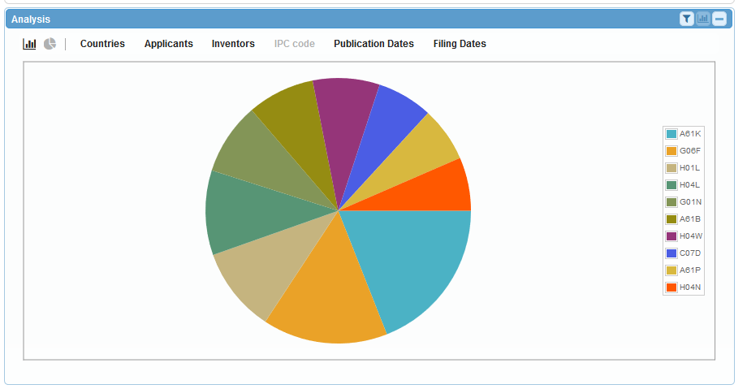

Slide 21
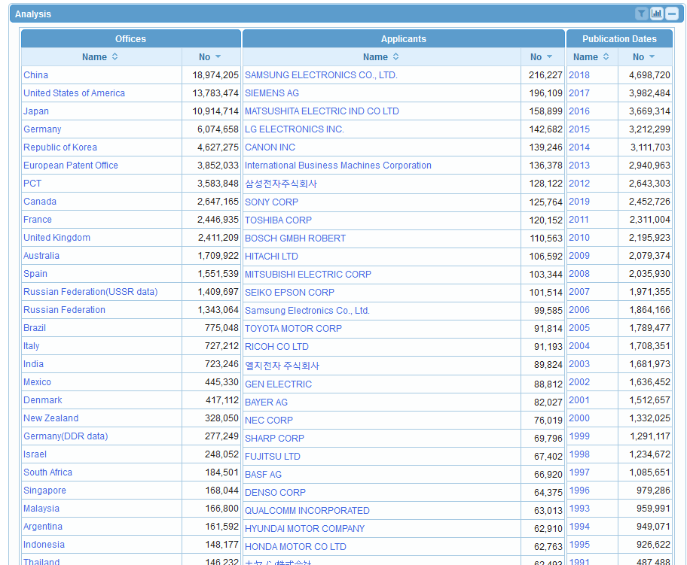

Slide 22
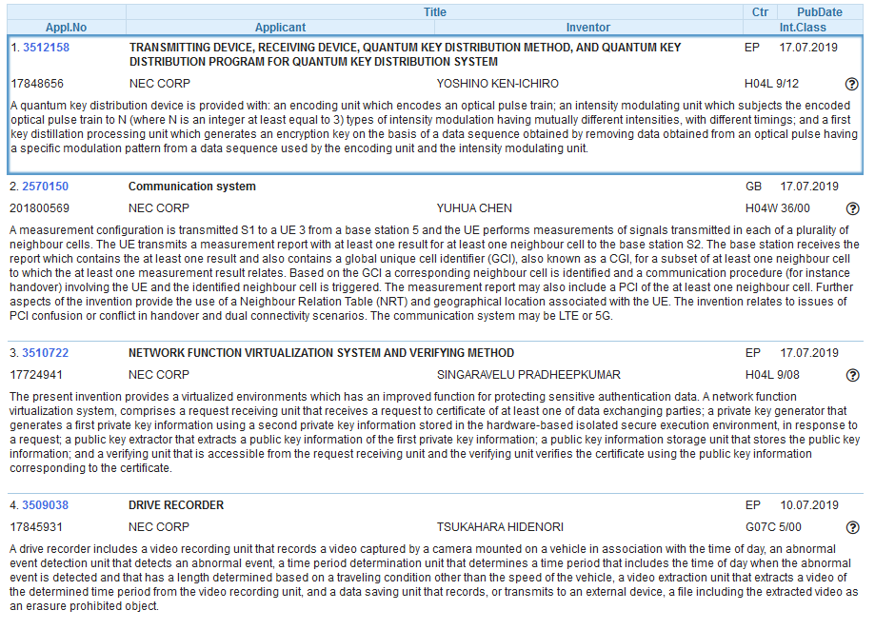

Slide 25
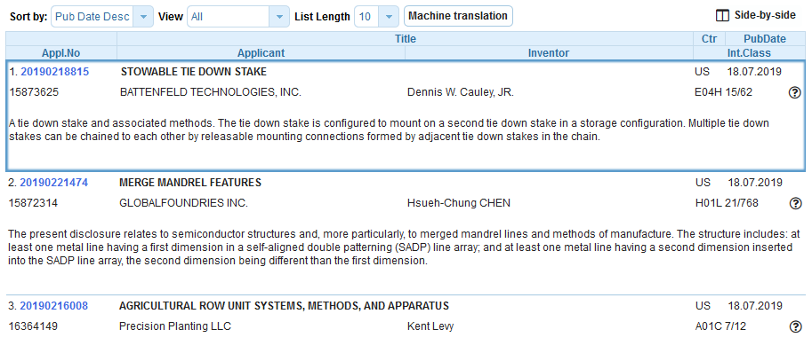
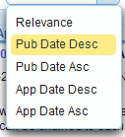
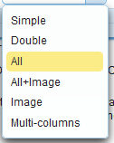

Slide 26
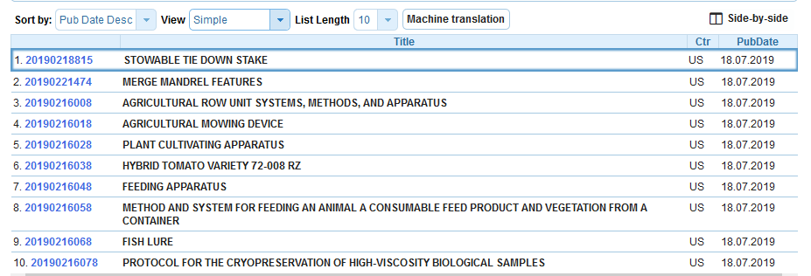
Simple view

Slide 27
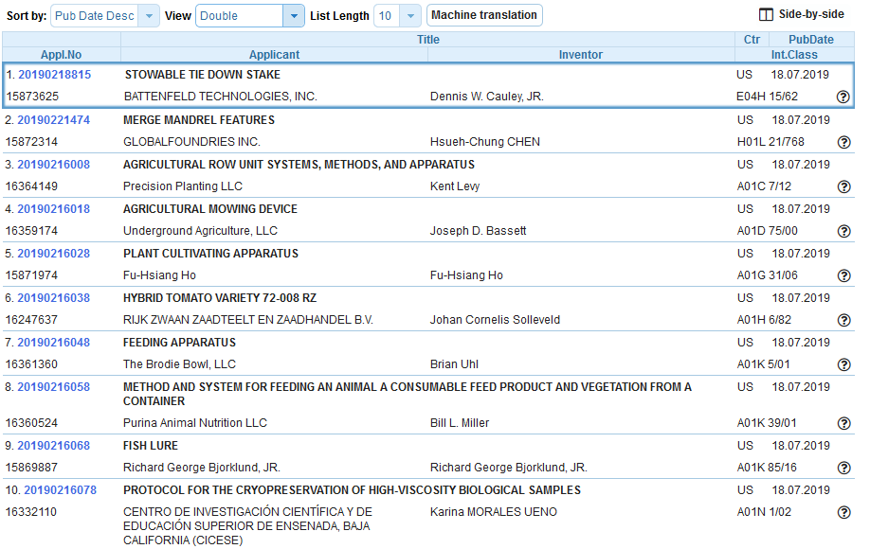
Double view

Slide 28
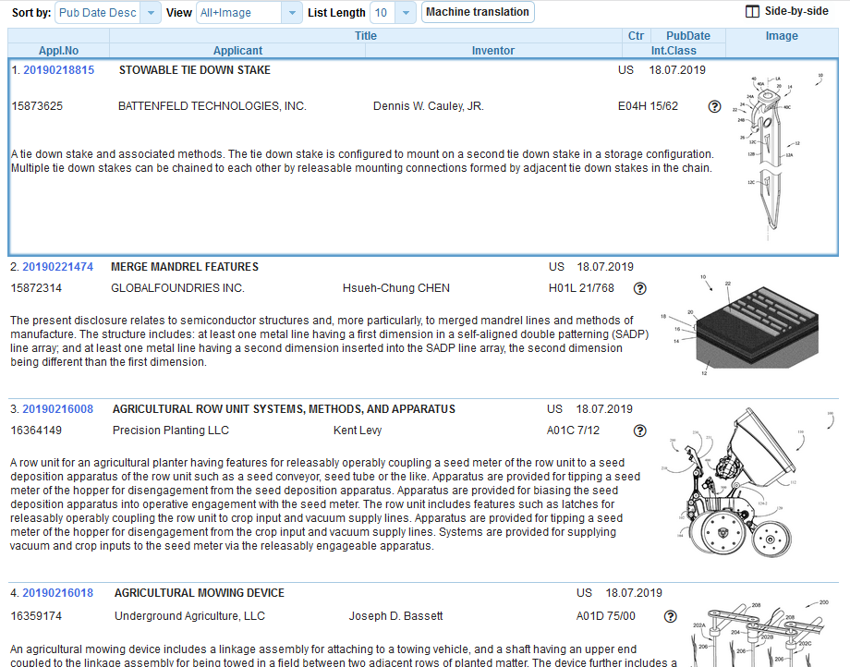
All +image view

Slide 29
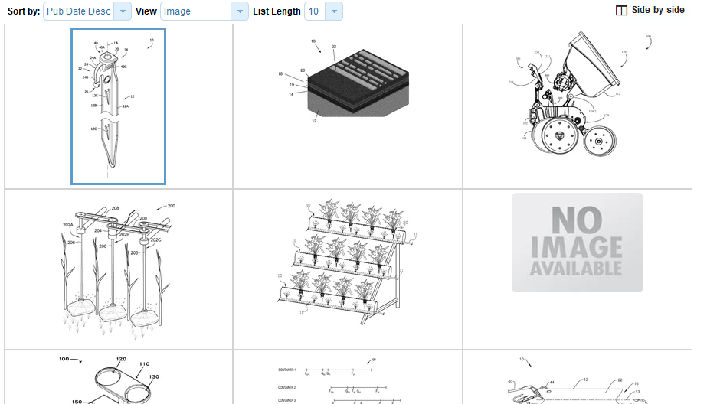
Image view

Slide 30
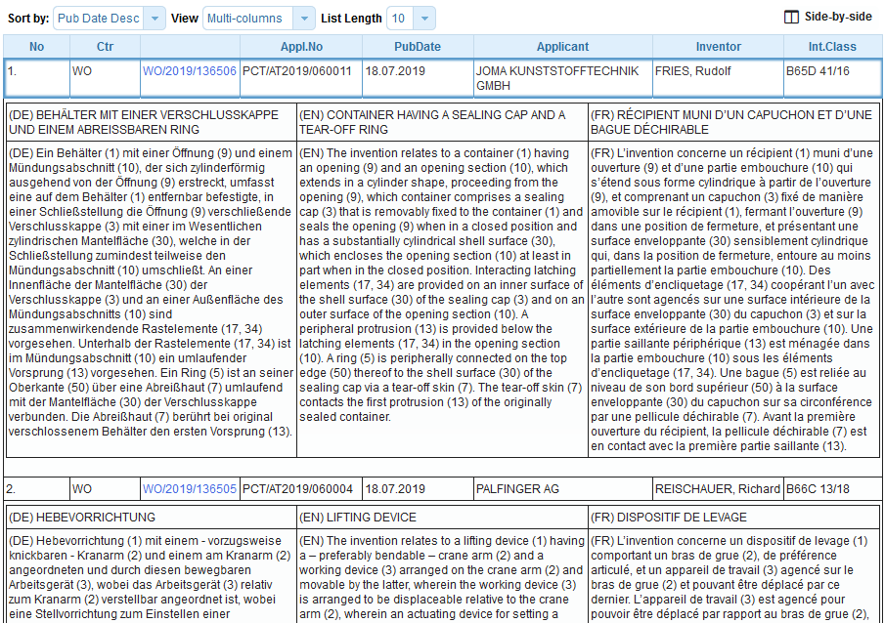
Multi-columns view

Slide 32
Multi-columns view

Slide 33
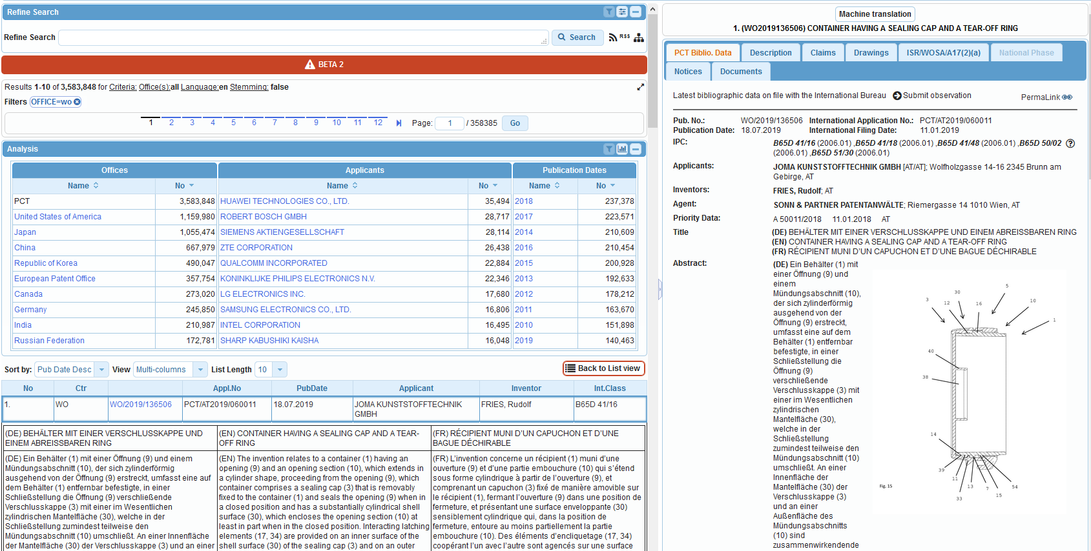

Slide 34
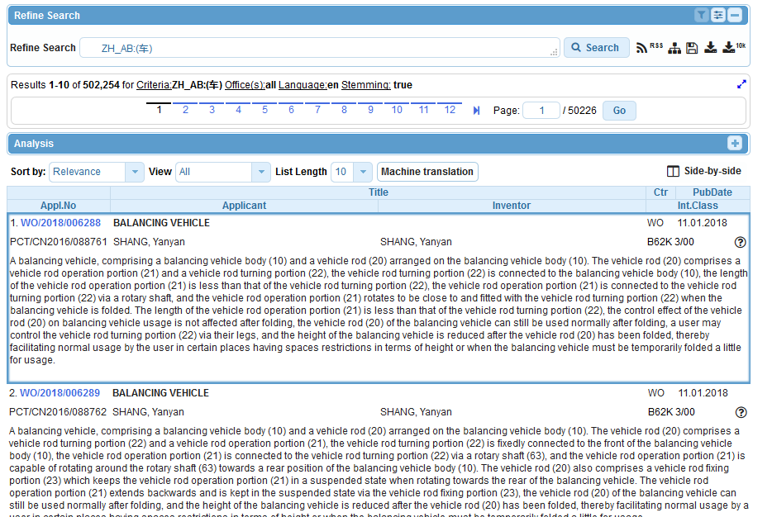
Languages

Slide 35
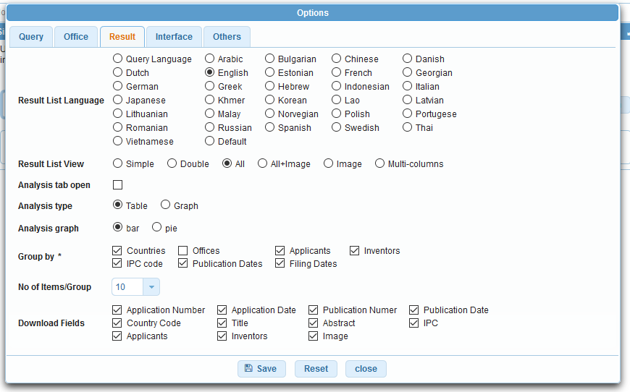

Slide 36
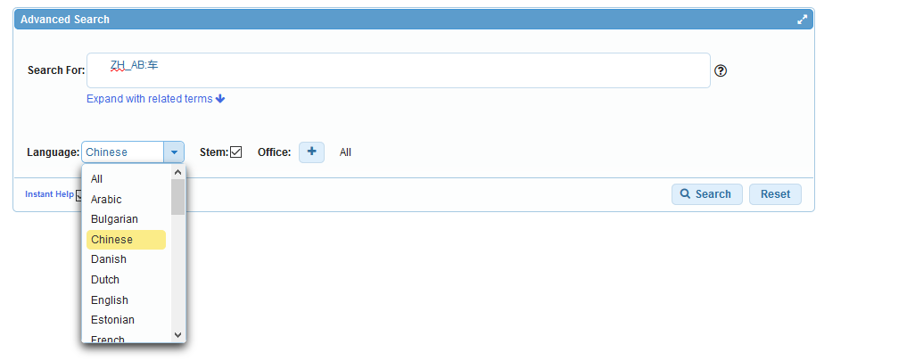

Slide 37
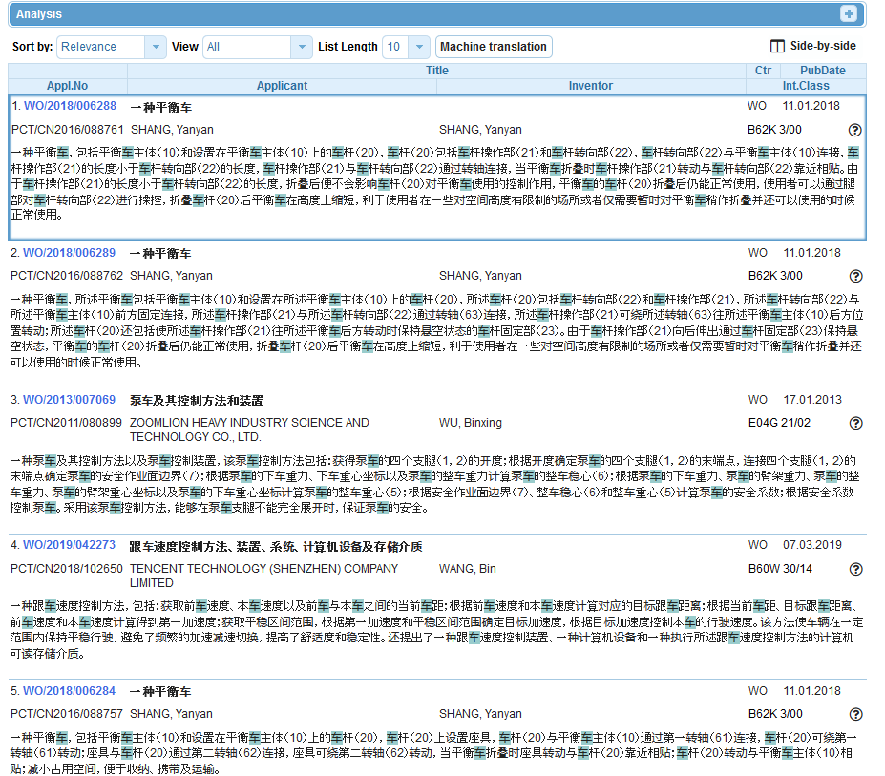

Slide 38
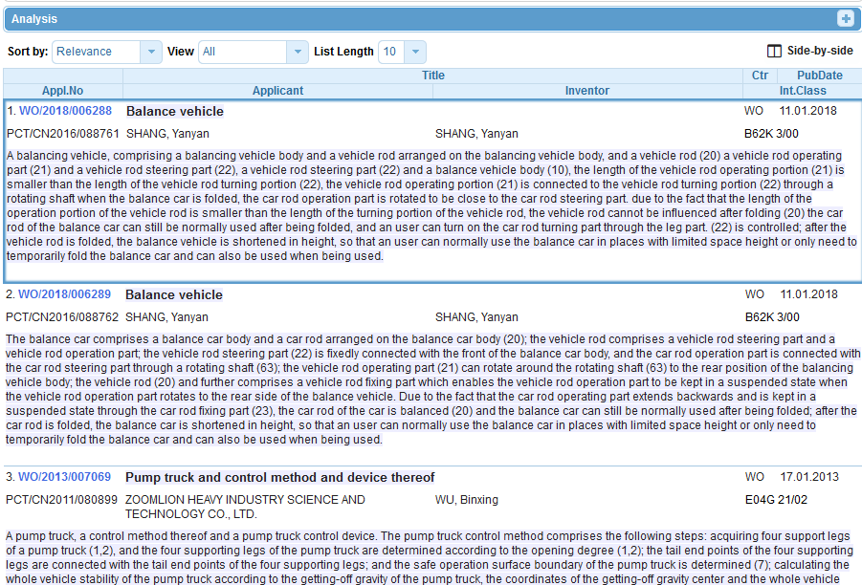

Slide 40
Q1: How can you increase the number of items shown in the analysis bar?
A
By clicking on the different columns
B
It is not possible
C
Options menu

Slide 41
Q1: How can you increase the number of items shown in the analysis bar?
A
By clicking on the different columns
B
It is not possible
C
Options menu

Slide 42
Q2: How can you translate into Chinese your result list?
A
CLIR
B
WIPO Translate

Slide 43
Q2: How can you translate into Chinese your result list?
A
CLIR
B
WIPO Translate

Slide 44
patentscope@wipo.int

Slide 45
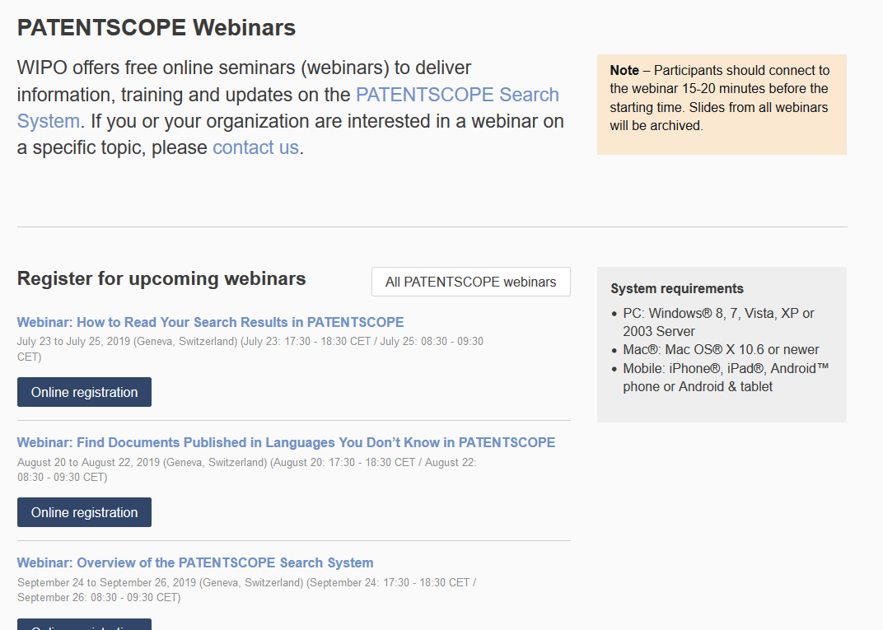
Future/past webinars:
wipo.int/patentscope/en/webinar

Slide 46
Next webinar
Find documents published in languages you don’t know in PATENTSCOPE
August 20 at 5:30 pm
https://attendee.gotowebinar.com/rt/8768434103741781507
August 22 at 8:30 am
https://attendee.gotowebinar.com/rt/8768434103741781507

Slide 47
Global Brand Database: webinar
How to read, save & share your results in the Global Brand Database
August 13 at 5:30pm CET
https://attendee.gotowebinar.com/register/2906774888388206850
August 15 at 12:30pm AEST
https://attendee.gotowebinar.com/register/2811369169201072140

Slide 48
Global Design Database: webinar
How to read, save & share your results in the Global Design Database
August 27 at 5:30pm CET
https://attendee.gotowebinar.com/register/7193558519342710018

Slide 50
Q: Does the search result list contain only patents or other types of documents?
It contains different types of documents, for example, published PCT applications, as well as granted patents, etc.
Q: Can I find patent families from the result list?
Family information is only available in the bibliographic data information in opened documents under «Also published as».
Q: Is it possible to merge documents from the same family in the results?
No, not currently.

Slide 51
Q: Are there any plans to introduce search history?
You can access, once logged-in, your session queries in your account. To combine those, just copy and paste them and add the necessary operators.
Q: How can I save my search queries?
Once logged-in, click on this icon:

Slide 52
Q: Can I export the graphs?
No, but you can copy and paste them.
Q: Can I download the claim?
In the Documents tab, you can download the document.
Q: How can we download multiple publications in one go?
Such a feature is not available.

Slide 53
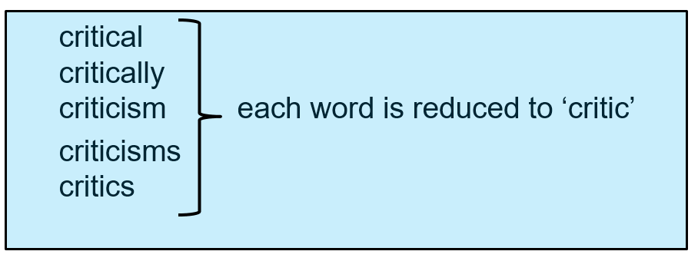
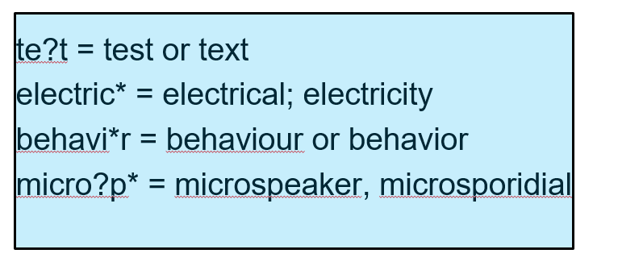
Q: Is stemming and truncation the same?
No, stemming removes common ending of words:
whereas truncation allows you to replace one or more letters

Slide 54
Q: How to search for different word spellings: American vs British English?
You should use a wildcard when multiple spelling variants are known: color vs. colour
Q: How can I search foreign words such as those containing ä, ö etc. in German?
You should use a wildcard when there is uncertainty related to foreign words: University vs Universität

Slide 55
Q: Is it possible to translate Korean patents?
Yes the machine translation button is available in the different tabs of the documents.
Q:Where can I find legal status?
The national phase entry provides information related to the legal status.
Q: How can I search a specific word?
You can enter you word in the different search interfaces available in the Search menu

Slide 56
Q: How can we find search field?
A list of the search fields is available in the Help menu, under How to search, Field definition. You can also type your field of interest, PATENTSCOPE will make suggestions in a drop-down menu from which you can select it and then it will be converted into a field code:

Slide 57
Q: How can I search patents in languages other than English? Can I search by English keywords or keywords in original language?
You can search in all the filing languages of the documents contained in PATENTSCOPE, such as Arabic, Bulgarian, Cambodian, Chinese, Danish, English, Estonian, French, German, Greek, Hebrew, Italian, Japanese, Korean, Laotian, Portuguese, Romanian, Russian, Spanish, Thai and Vietnamese.

Slide 58
patentscope@wipo.int

