Slide 1
PATENTSCOPE for experts
Cyber world
April
2019
Sandrine Ammann
Marketing & Communications Officer

Slide 2
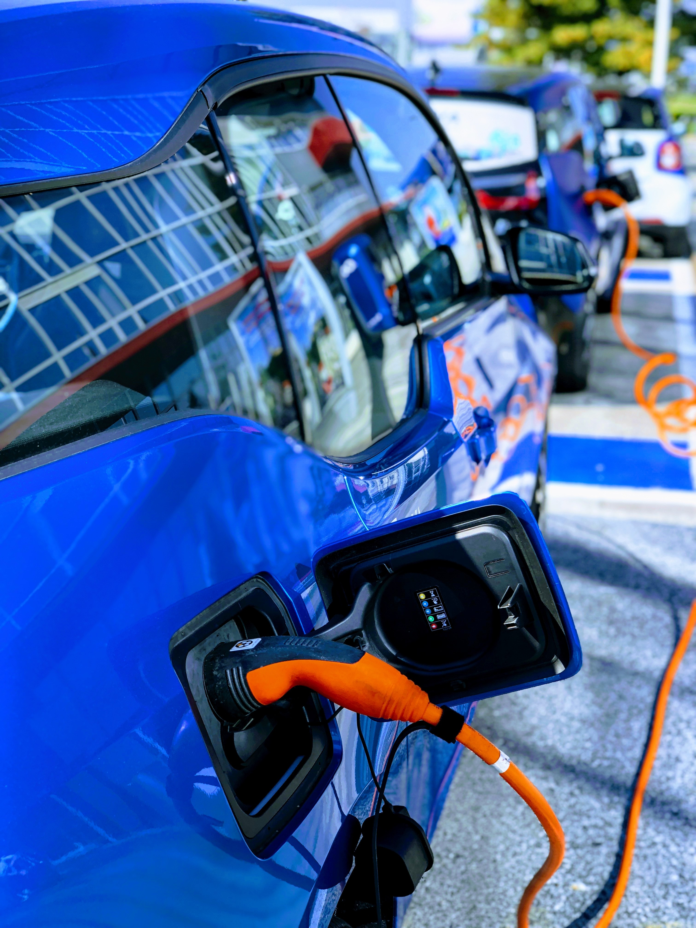
Case study
Electric car
after 2015
Chinese national collection
0 knowledge of Chinese language

Slide 3
Search strategy: notepad
Notes:
CTR: abbreviation for country
In the advanced search start typing or go the [help]->[How to Search] -> [Fields definition]

Slide 4
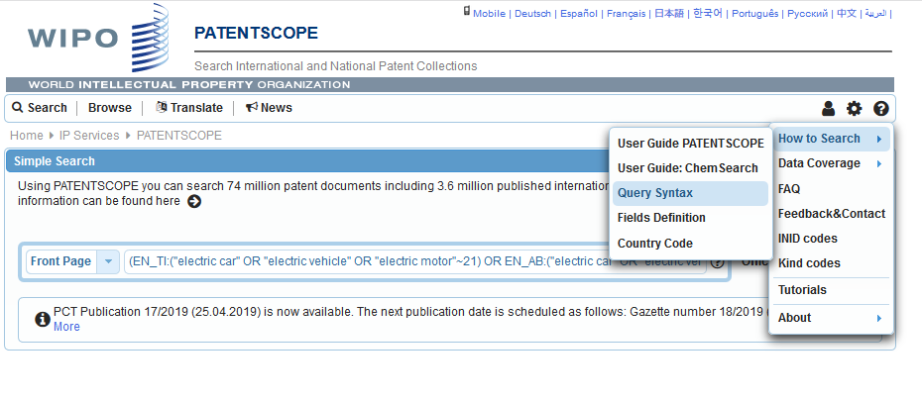
Search strategy: fields

Slide 5
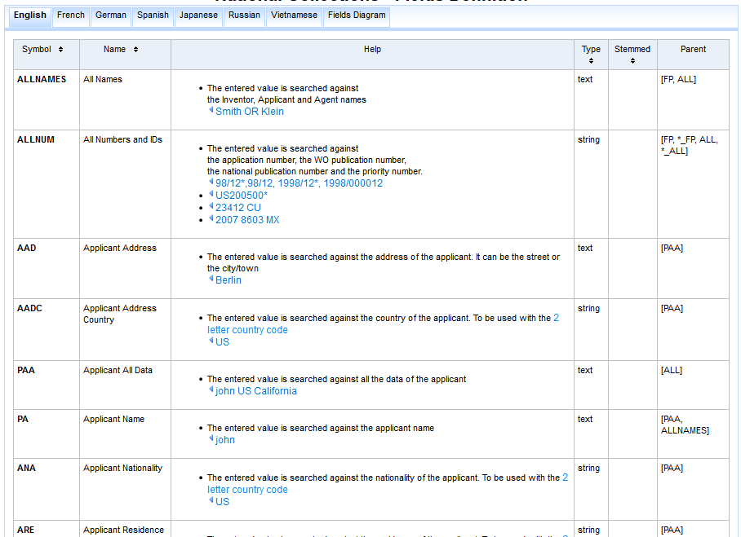
Search strategy: fields

Slide 6
Search strategy: syntax

Slide 7
Search strategy
Documents from the Chinese National Collection
CTR: CN
Documents published after 2015
DP: [2015 TO 2019]
Documents relating to electric car
ZH_CL:( (electric) NEAR10 (car))
Notes:
DP: abbreviation for Publication Date
In the advanced search start typing or go the [help]->[How to Search] ->[Query syntax]

Slide 8
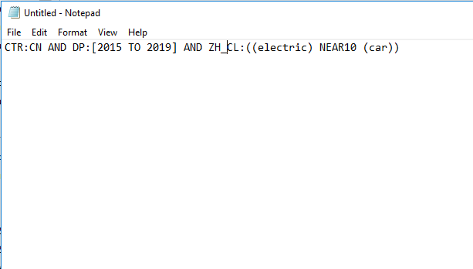
Search strategy: query

Slide 9
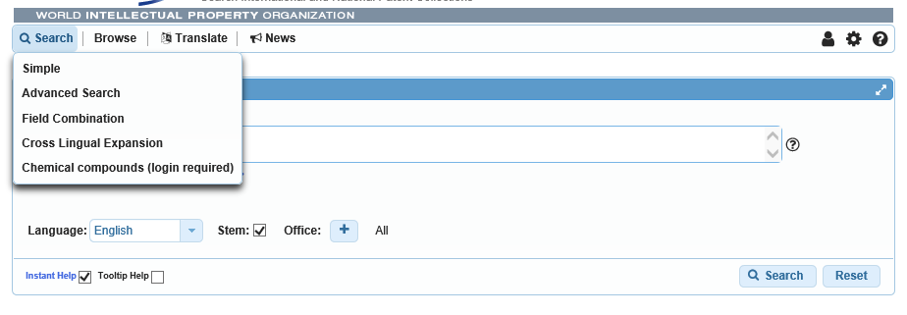
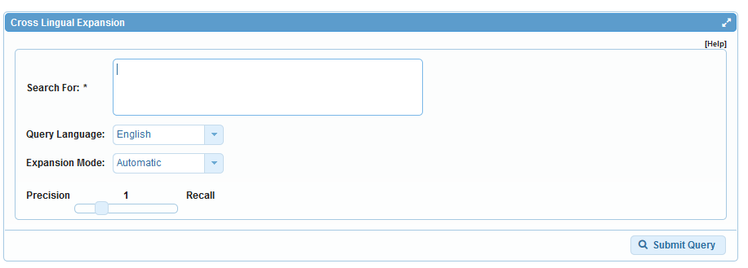
Search strategy: CLIR

Slide 10
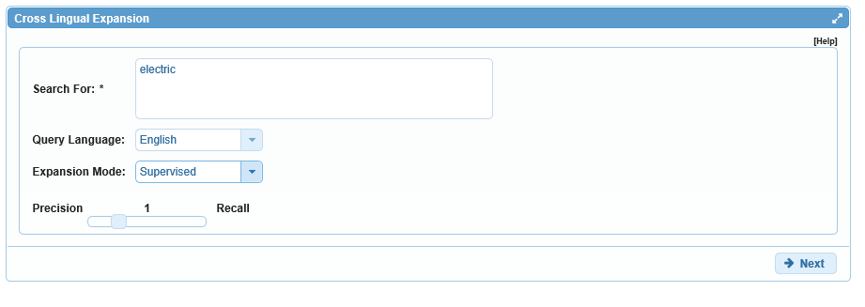
Search strategy: keywords

Slide 11
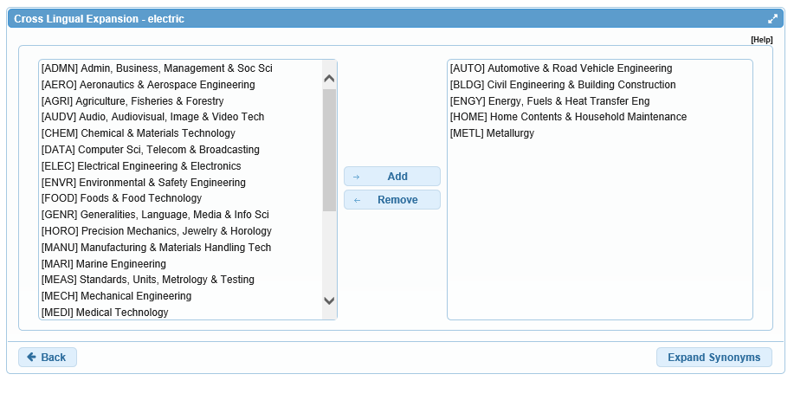
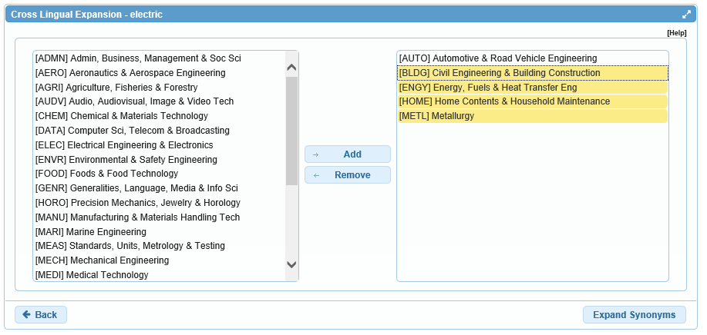
Search strategy: technical domains
Notes:
There are 30 technical domains that have been derived from the international patent classification
Gum:
Medical term is a flesh inside the mouth
Herbology or gardening: sticky substance that oozes out of some trees
it can also mean glue, or chewing substance

Slide 12
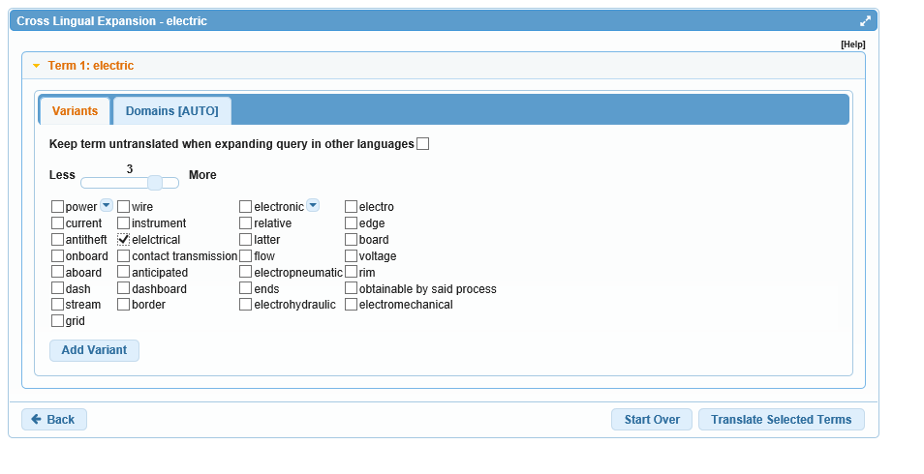
Search strategy: variants
Notes:
Use the slider to display less or more variants
Biomakers is a misspelling that was found in the patent corpus

Slide 13
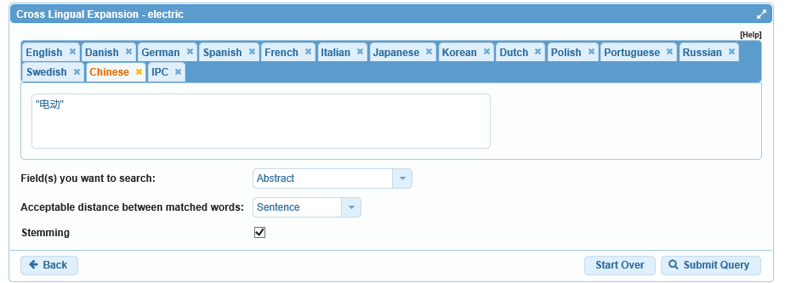
Search strategy: copy
Notes:
The system shows you the selected terms in 13 different languages
Copy the Japanese translation and copy them in your strategy

Slide 14
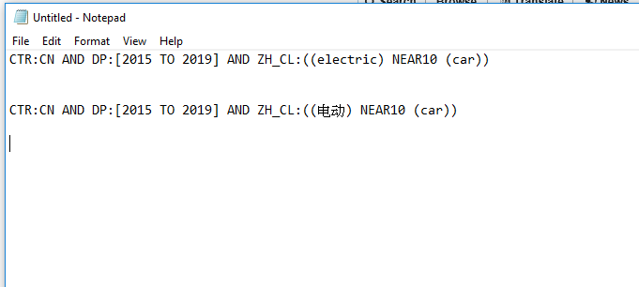
Search strategy: notepad

Slide 15
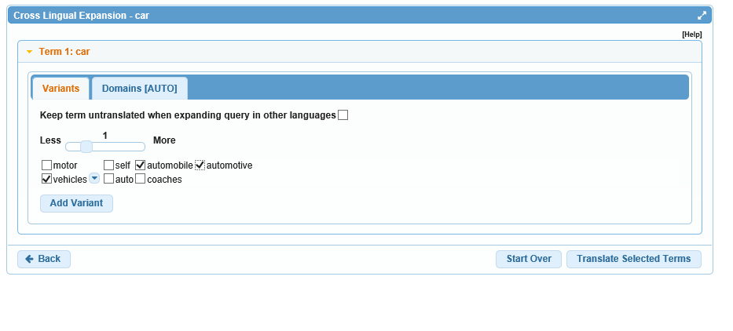
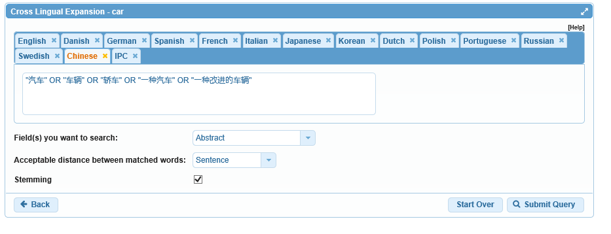
Search strategy: CLIR for car

Slide 16
Search strategy: replace

Slide 17
Search strategy: copy query & search

Slide 18
Search strategy: copy query & search

Slide 19
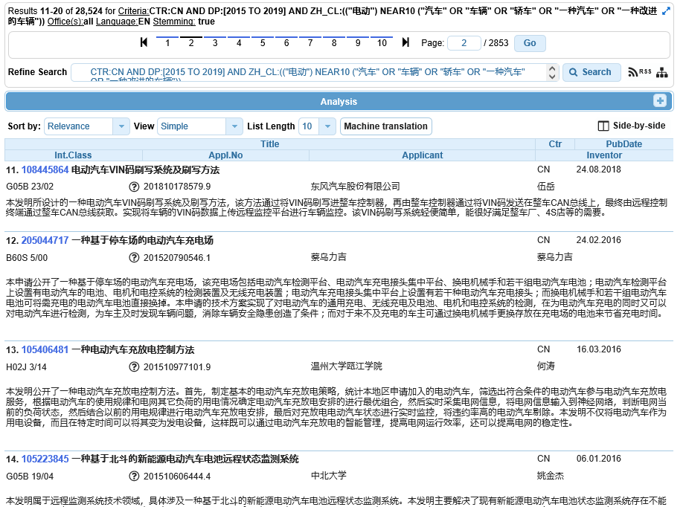
Search strategy: results
Notes:
You can sort the result by different criteria
The latest abstract in the results might not have been translated into English yet

Slide 20
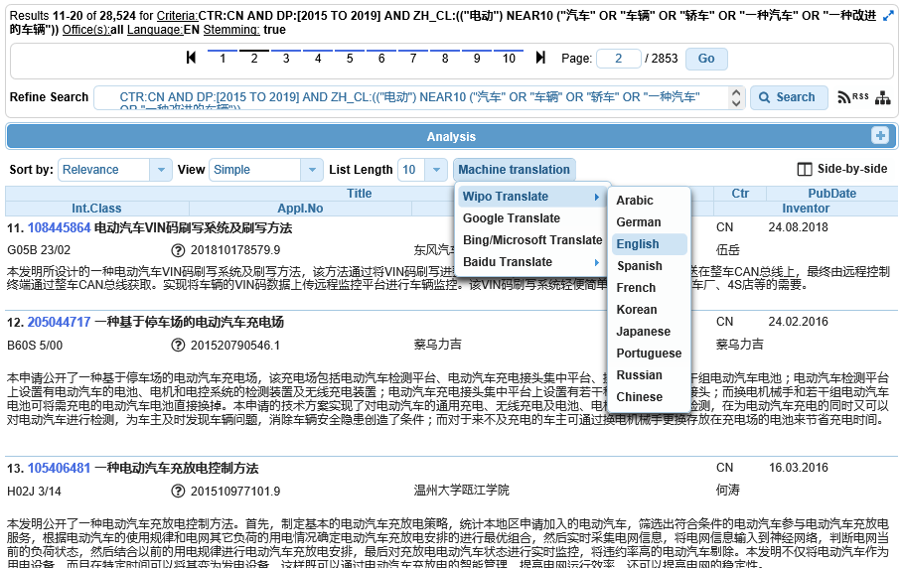
Search strategy: translation

Slide 21
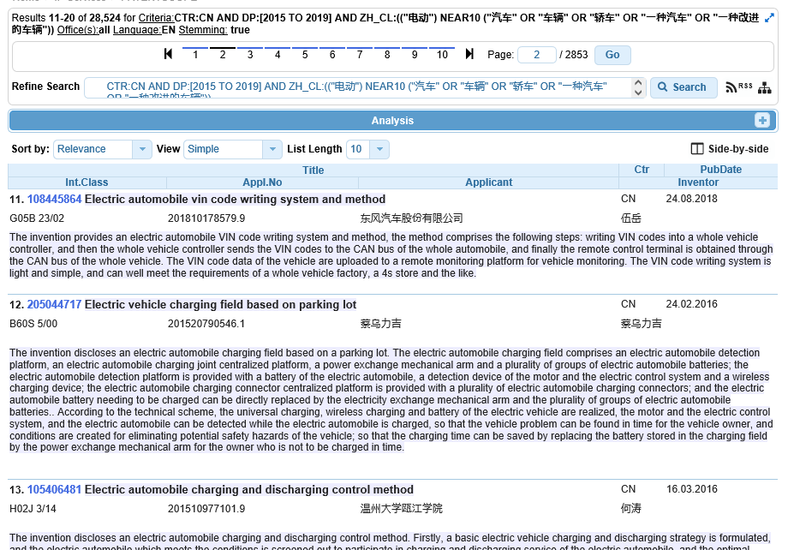
Search strategy: translation

Slide 22
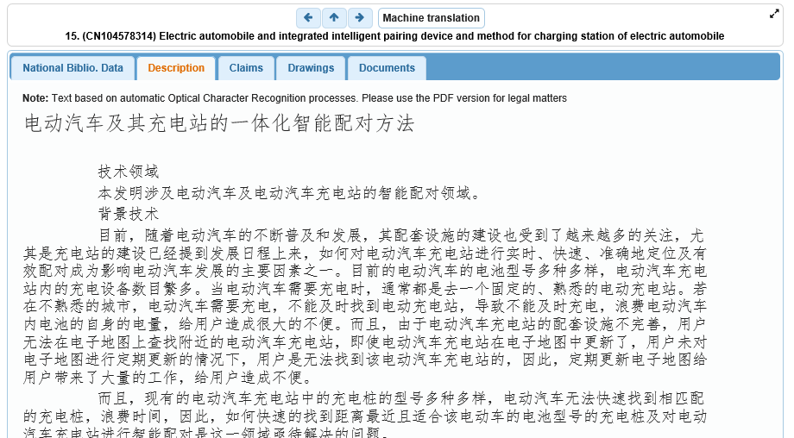
Search strategy: documents

Slide 23
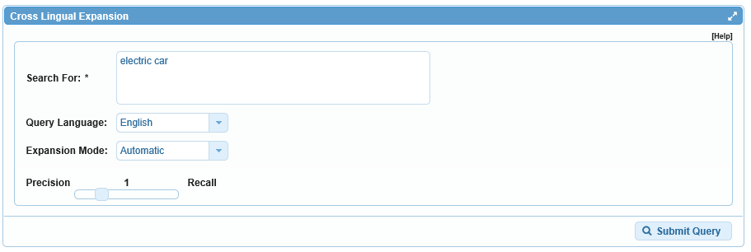
1 step alternative: all keywords
Notes:
Automatic means the system decides by itself the variant and the keywords as well as the translation in all languages

Slide 24
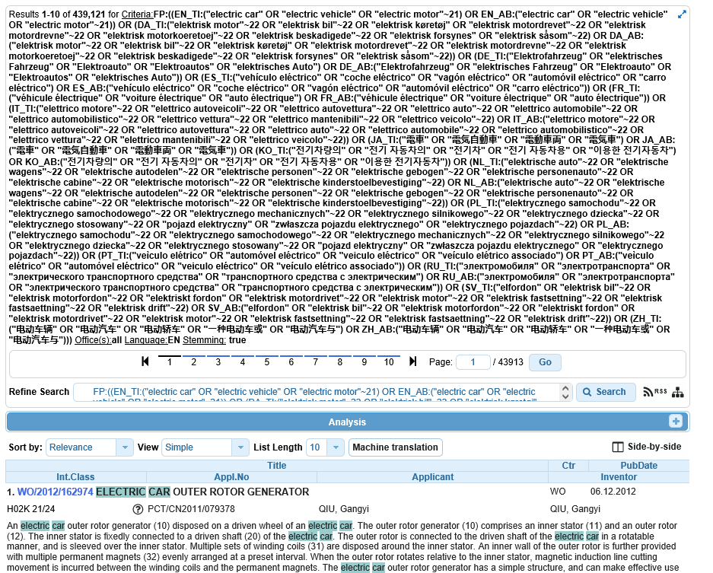
1 step alternative
Notes:
Query looking for the concepts in titles and abstract in 14 different languages

Slide 25
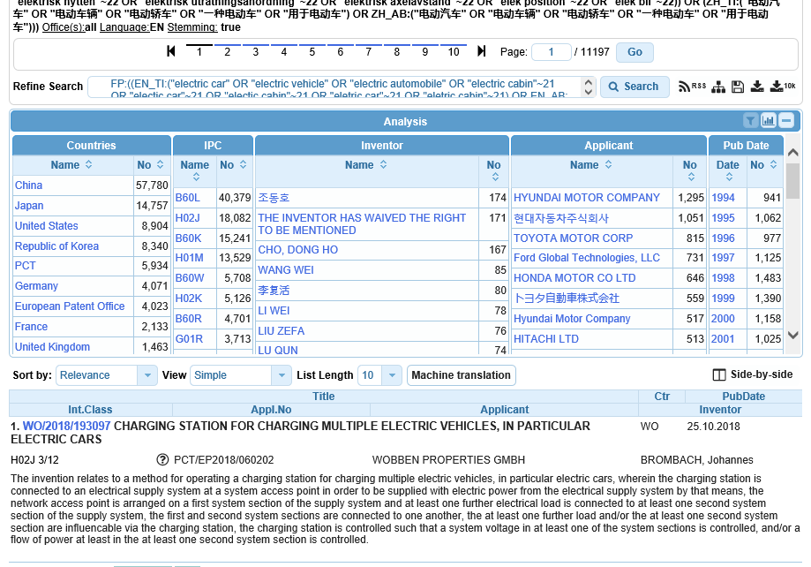
Results Analysis + download
Notes:
Top 10 patent collections
Distribution over the last 10 years
You can export the first 10’000 result to excel to be analyze by your favorite BI tool (if you are logged in)

Slide 26
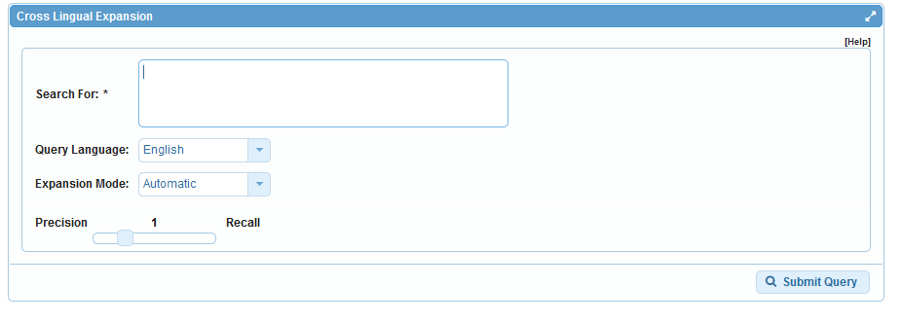
Search interfaces

Slide 27
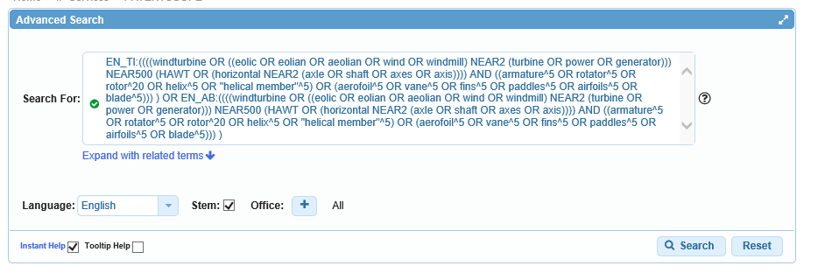

Slide 29
News

Slide 30
New collection

Slide 31
Next collections
Latvia
Letonia

Slide 32
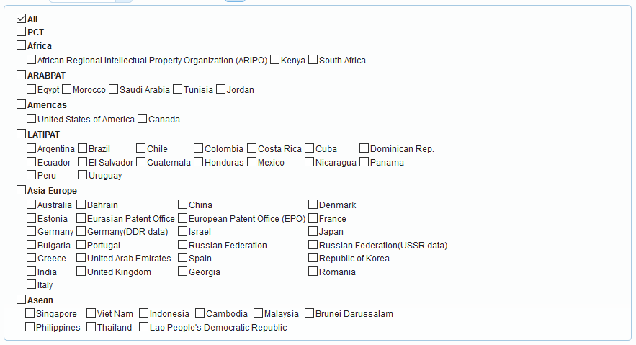
National/regional collections vs national phase entries

Slide 33
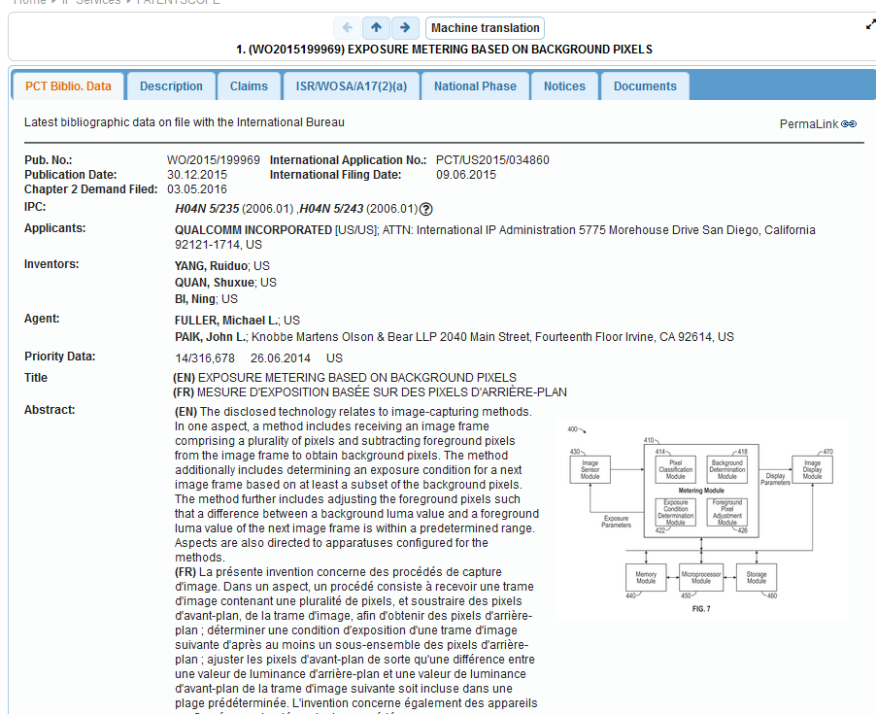
Search reports
Notes:
International Search Report
Written Opinion of the International Search Authority
Article 17.2

Slide 34
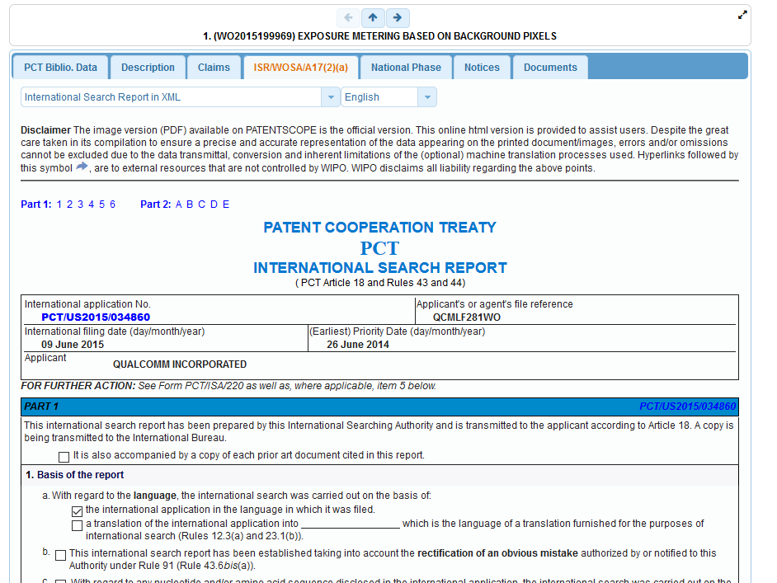

Slide 35
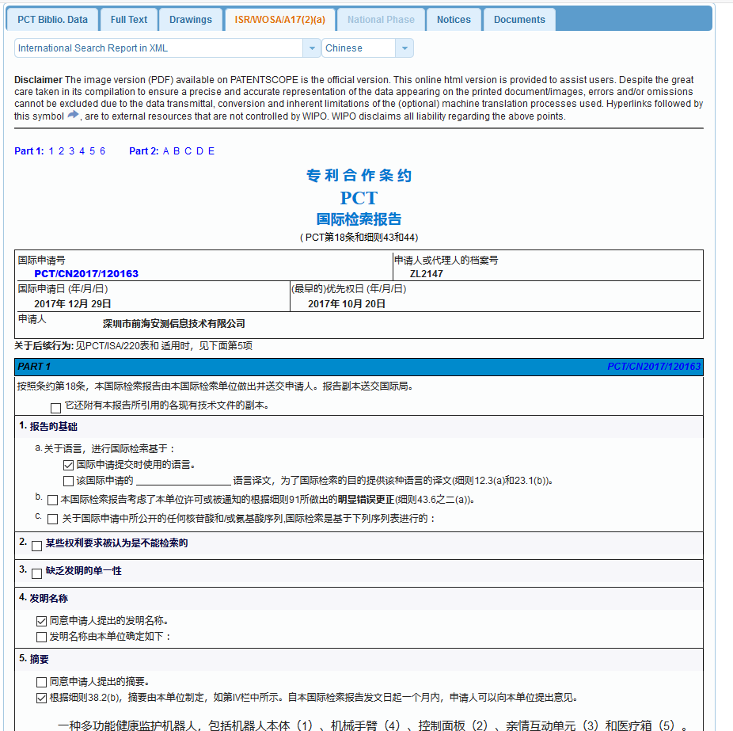

Slide 36
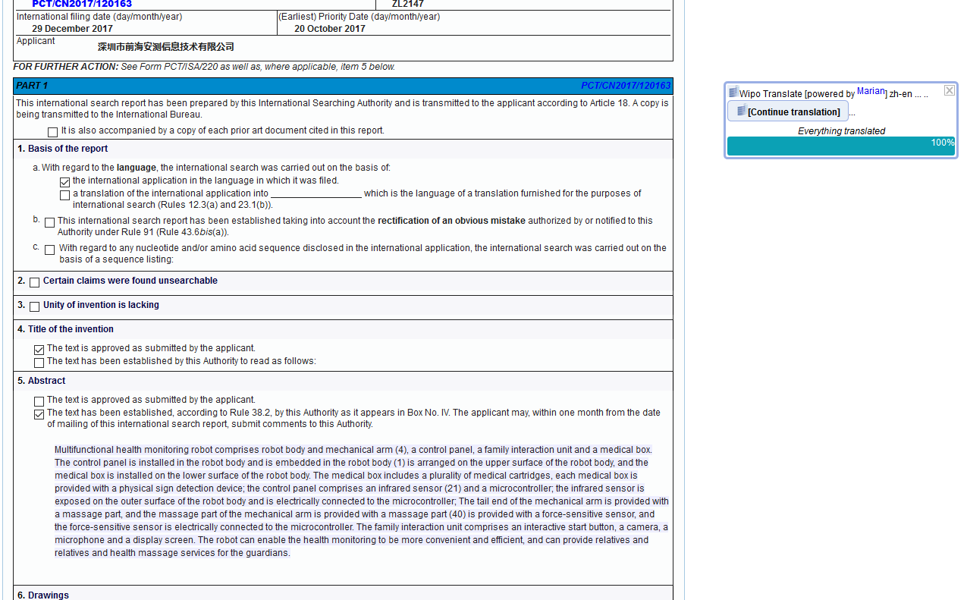

Slide 37
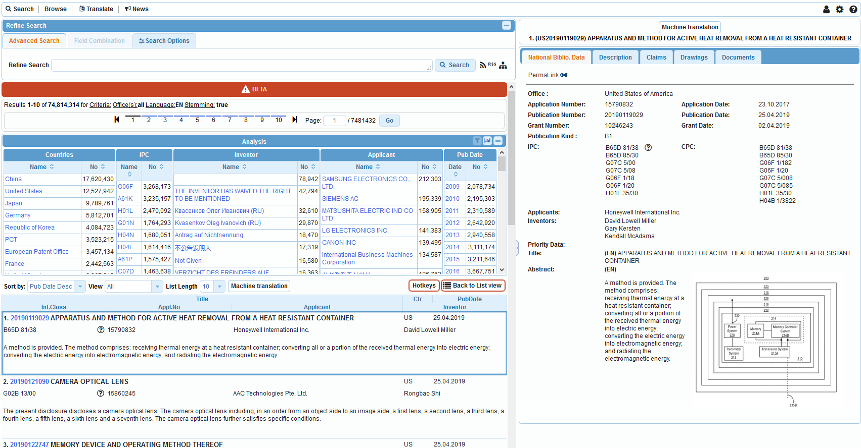
Side-by-side

Slide 39
Q1: Using the PATENTSCOPE account, can you download the entire result list?
A
No
B
Yes

Slide 40
Q1: Using the PATENTSCOPE account, can you download the entire result list?
A
No
B
Yes

Slide 41
Q 2: if you would like to find synonyms and translation of your search which tool should you use?
A
CLIR
B
WIPO Translate

Slide 42
Q 2: if you would like to find synonyms and translation of your search which tool should you use?
A
CLIR
B
WIPOTranslate

Slide 43
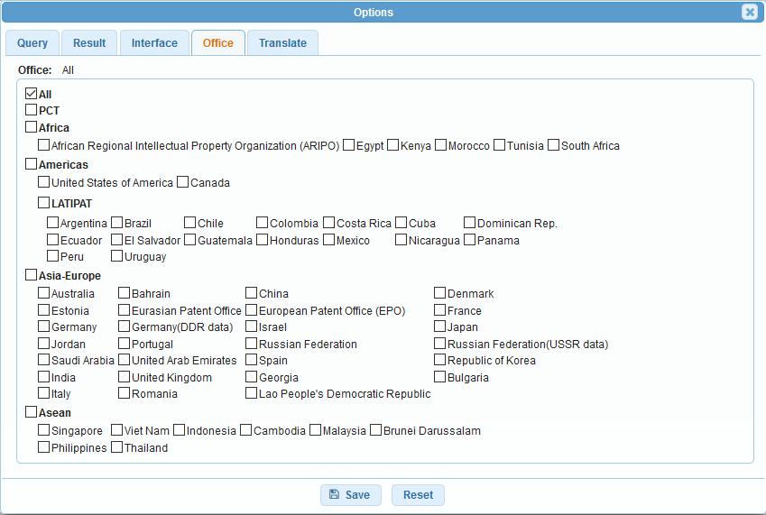
Q3: which data are you selecting here?
A
PCT national phase
B
National/regional collections

Slide 44
Q3: which data are you selecting here?
A
PCT national phase
B
National/regional collections

Slide 45
Next webinar: May 21 or 23
Translation tools
To register:
https://attendee.gotowebinar.com/rt/1857184387006862083

Slide 46
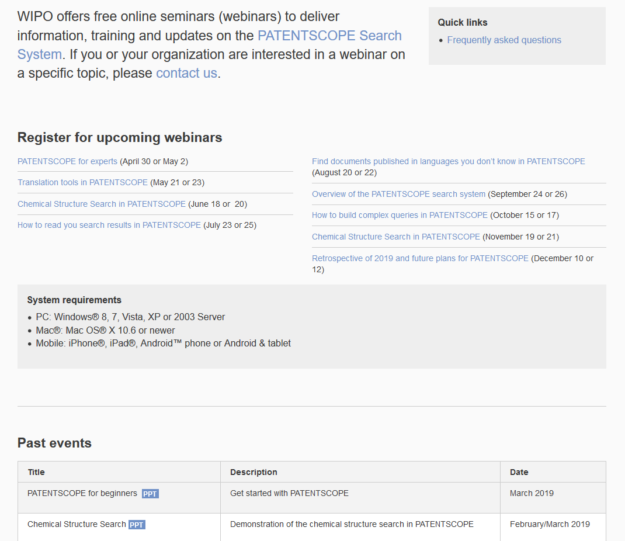
Future/past webinars:
wipo.int/patentscope/en/webinar

Slide 47
Global Design Database: webinar
How to perform a search
May 3 @ 5:30pm CET
https://attendee.gotowebinar.com/register/1932484440876267010

Slide 48
Global Brand Database: webinar
Image searching
May 1 @ 5:30pm CET
https://attendee.gotowebinar.com/register/1932484440876267010

Slide 49
patentscope@wipo.int

Slide 51
patentscope@wipo.int

