Slide 1
The results list and analysis tools in the PATENTSCOPE search
March
2014
Sandrine Ammann
Marketing & Communications Officer

Slide 2


To the PATENTSCOPE search system webinar
Search results list & analysis tools

Slide 3
Agenda
Results list
Analysis tools
Q&A

Slide 4
New field: TPO
TPO:1 and OF:WO
All PCT applications containing third party observations which can be found as a document in the Document List tab.

Slide 5
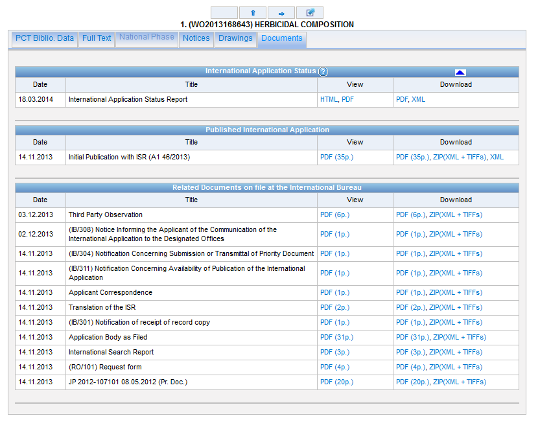

Slide 6
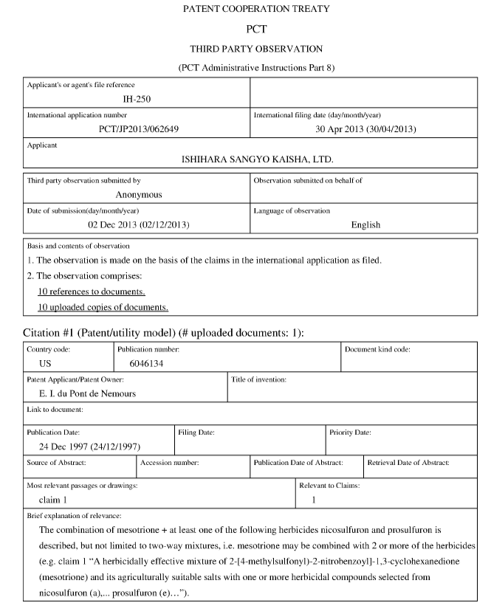

Slide 7

Search results list

Slide 8
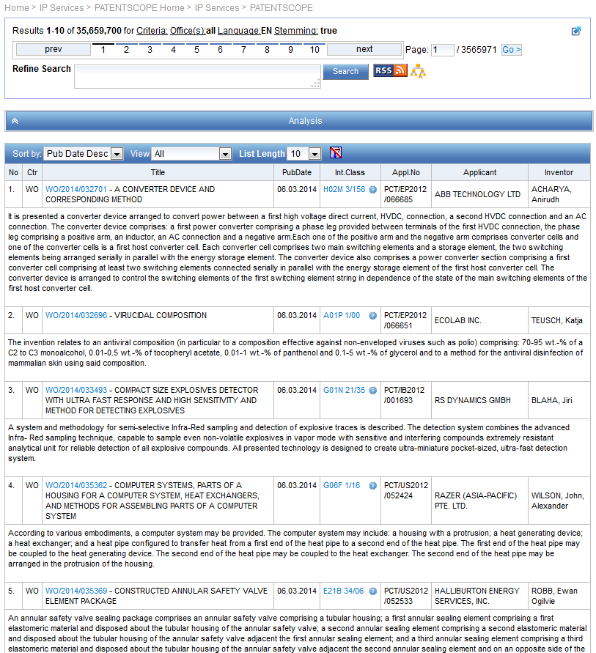
Search result list

Slide 9
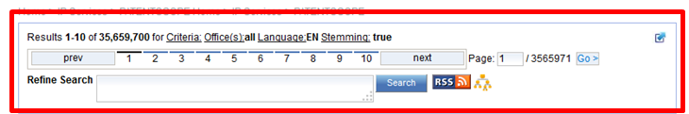

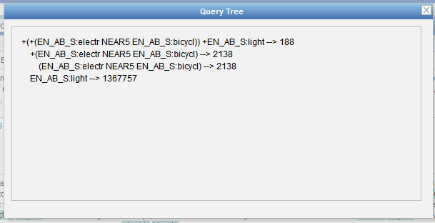

Slide 10
Stemming
Process that removes common ending from words by English Snowball algorithm
electric¦al = electric
electric¦ity = electric
electron¦ics = electron
More accurate results than wildcards:
elect* electoral, etc.

Slide 11
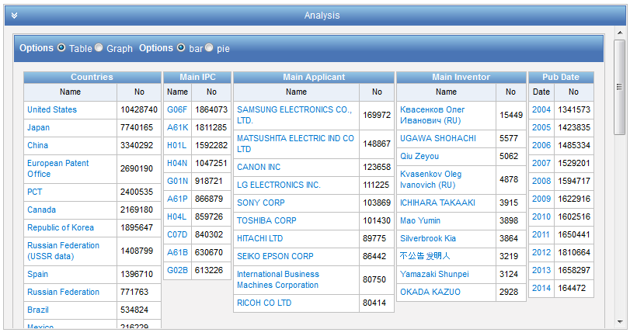

Slide 12
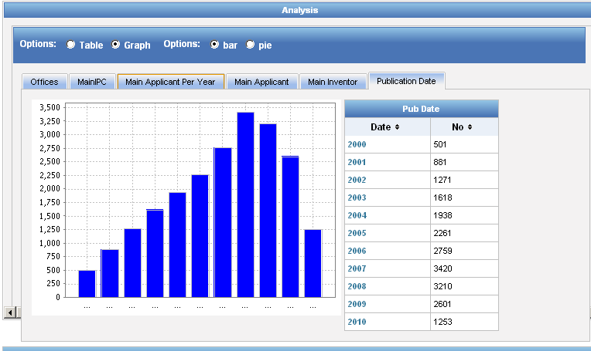
Display options: table/graph –bar/pie

Slide 13
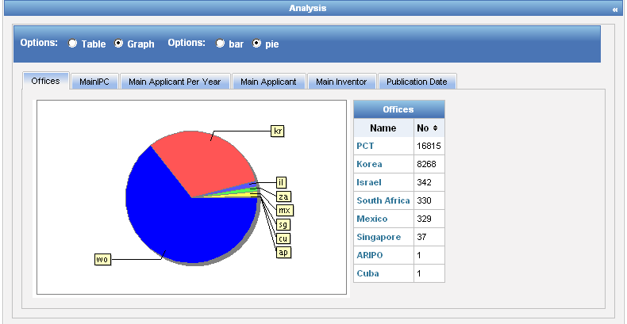
Display options: table/graph –bar/pie
Notes:
13
In both bar and pie options, the tabs allow you to see the information graphically for the Offices, Main IPC, Main Applicant, Main Inventor and Publication Date.
The charts can be saved in GIF format for inclusion in documents or reports by right-clicking in a corner of the image and selecting “Copy image” or “Save image”.

Slide 14
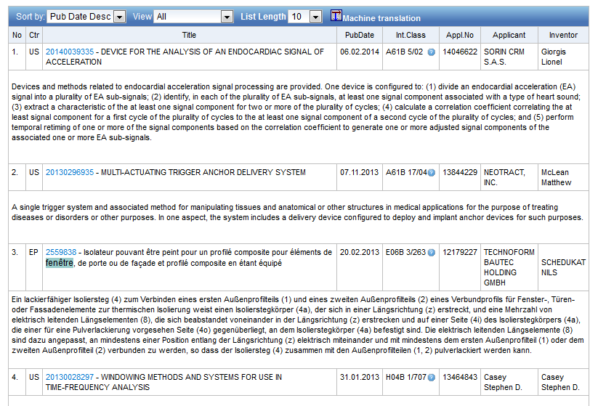
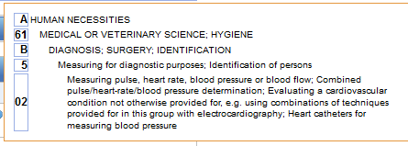

Slide 15


Options

Slide 16
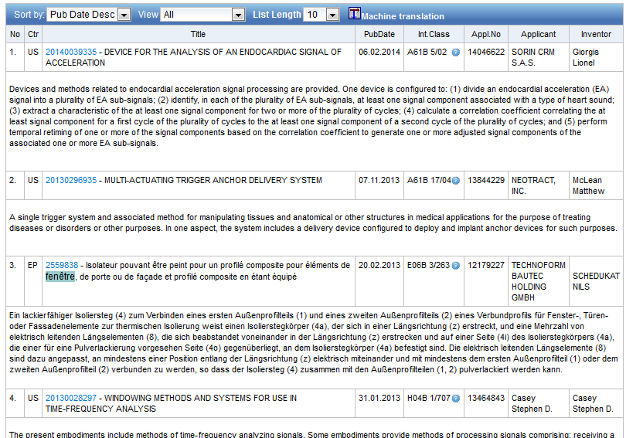

Slide 17
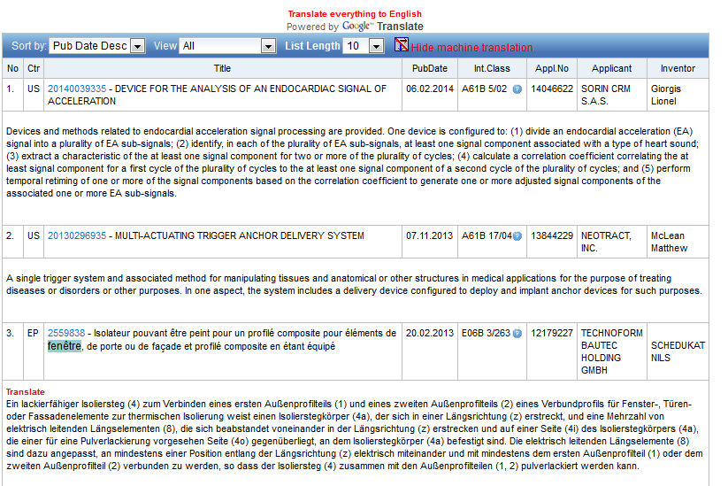


Slide 18

Options

Slide 19
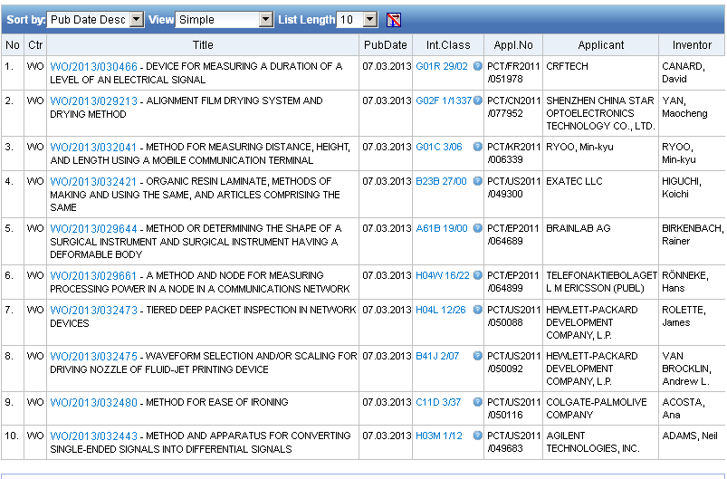
View: simple

Slide 20
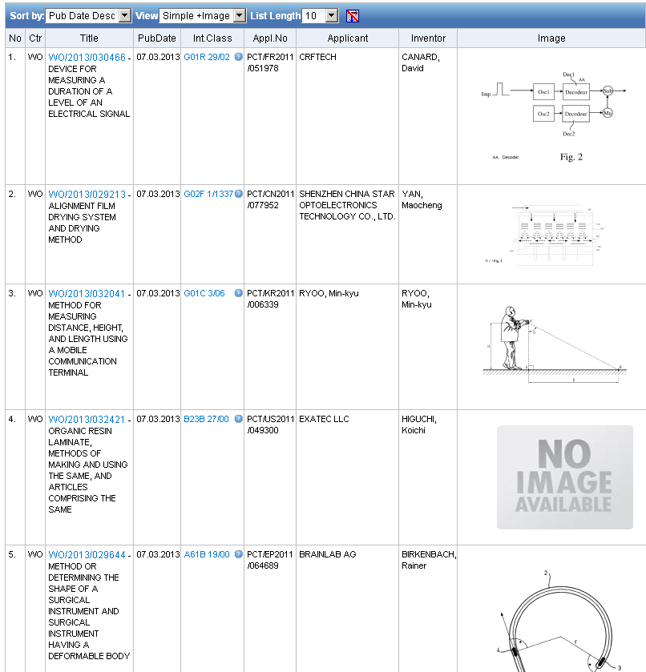
View: simple + image

Slide 21
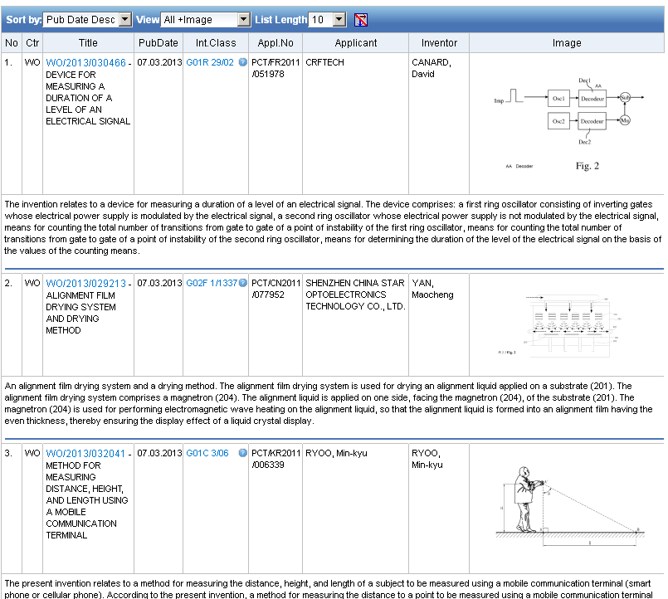
View: all + image

Slide 22
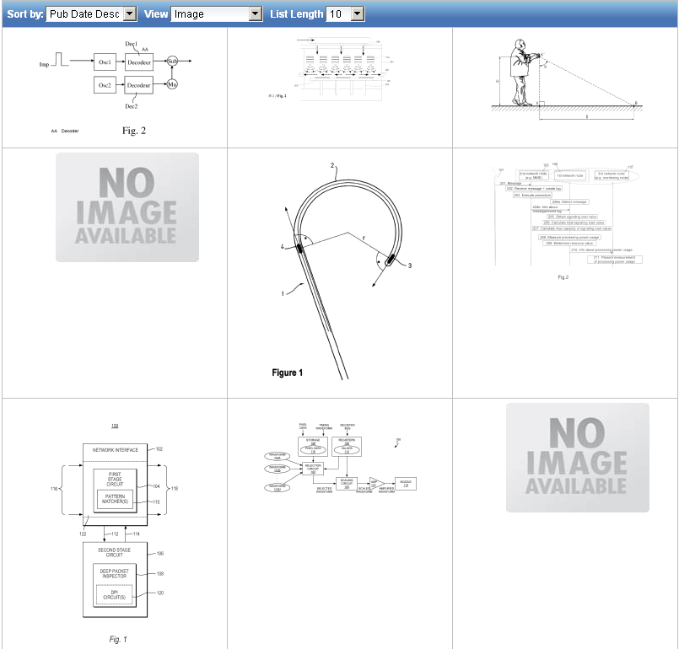
View: image

Slide 23
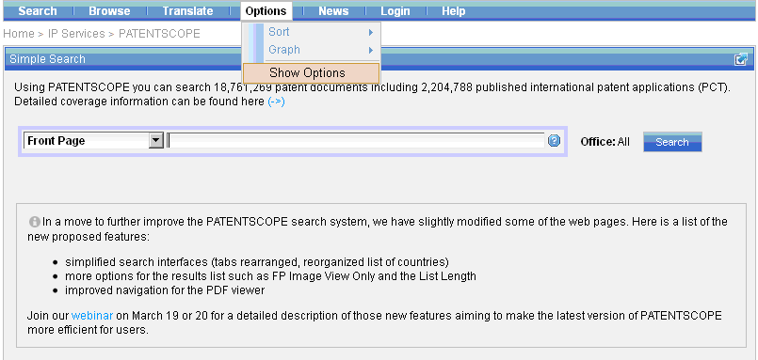
More customization options

Slide 24
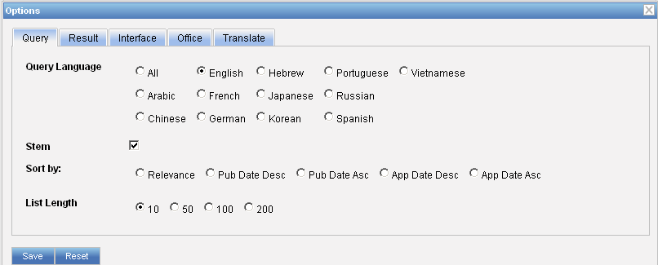
Options: query

Slide 25
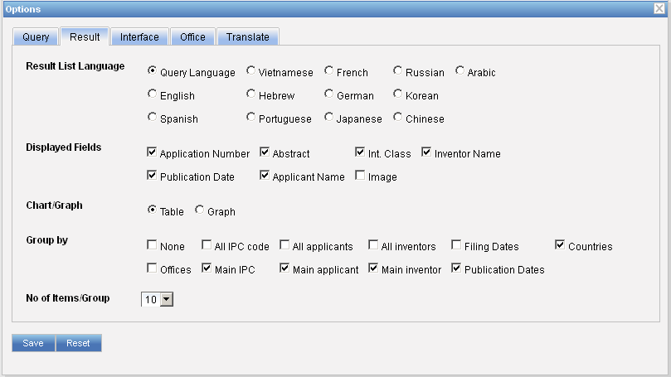
Options: result

Slide 26
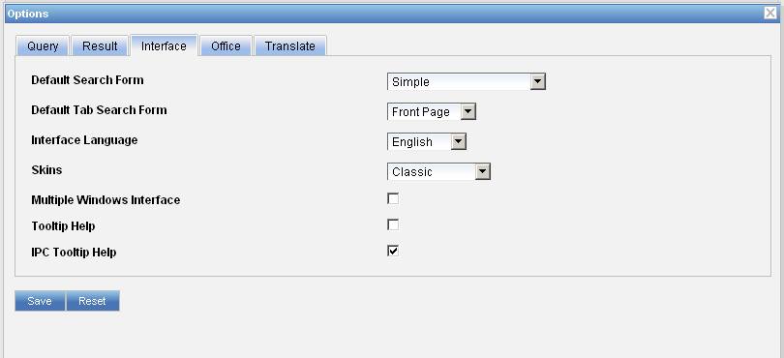
Options: interface

Slide 27
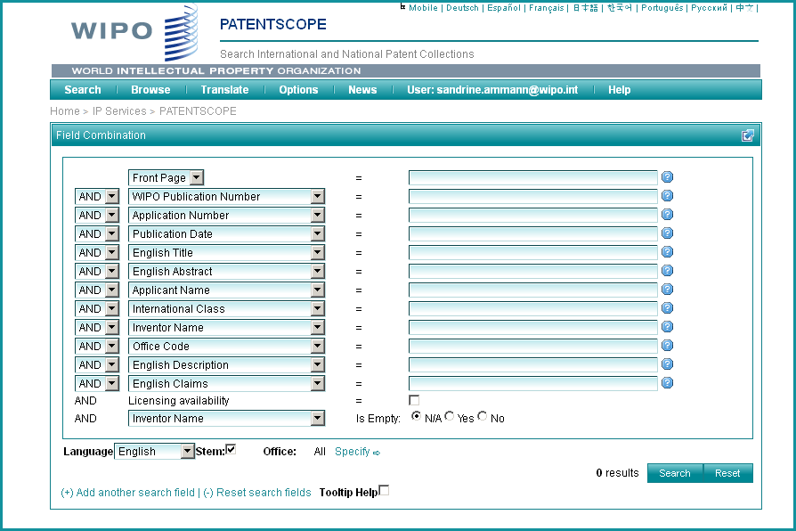

Slide 28
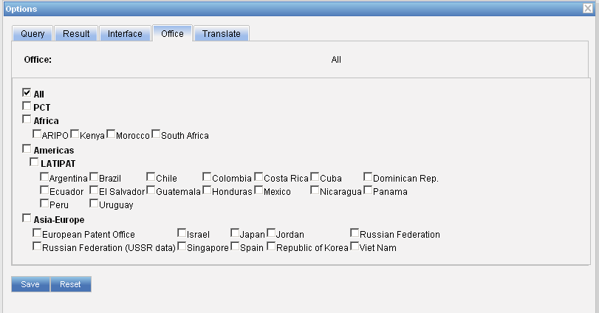
Options: office

Slide 29
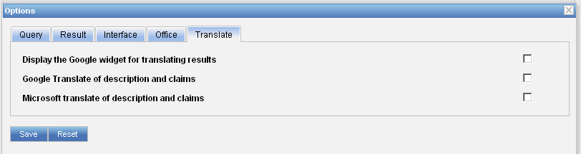
Options: translate

Slide 30
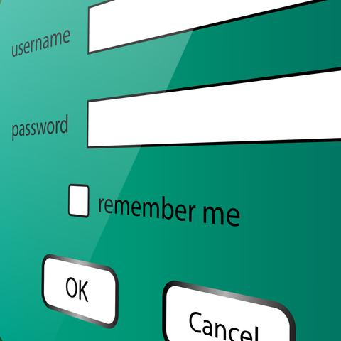
PATENTSCOPE account

Slide 31
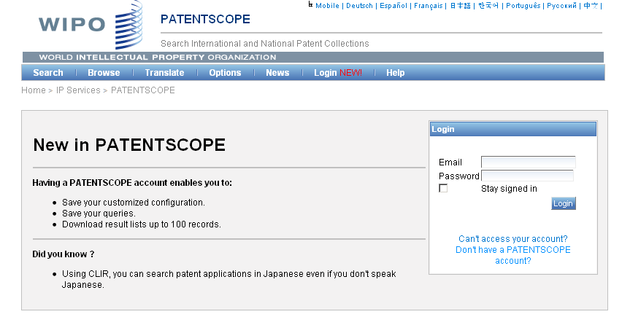
Notes:
Why would users create an account?
1
2
3
Here at the bottom you see the Did you know question referring to CLIR this leans me to our main focus in 2011 which is

Slide 32
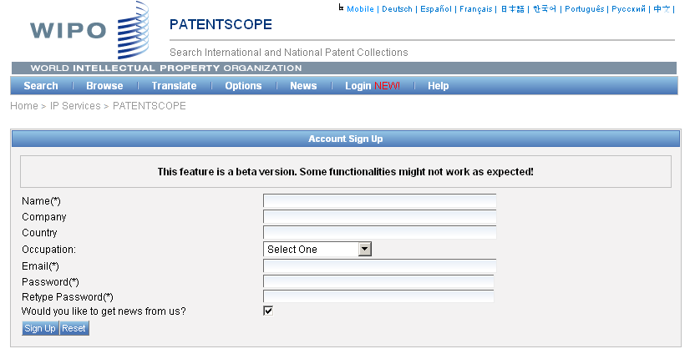
Signing up

Slide 33
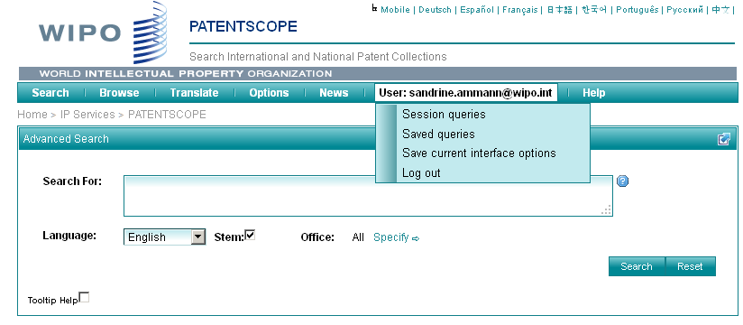
Once logged-in

Slide 34
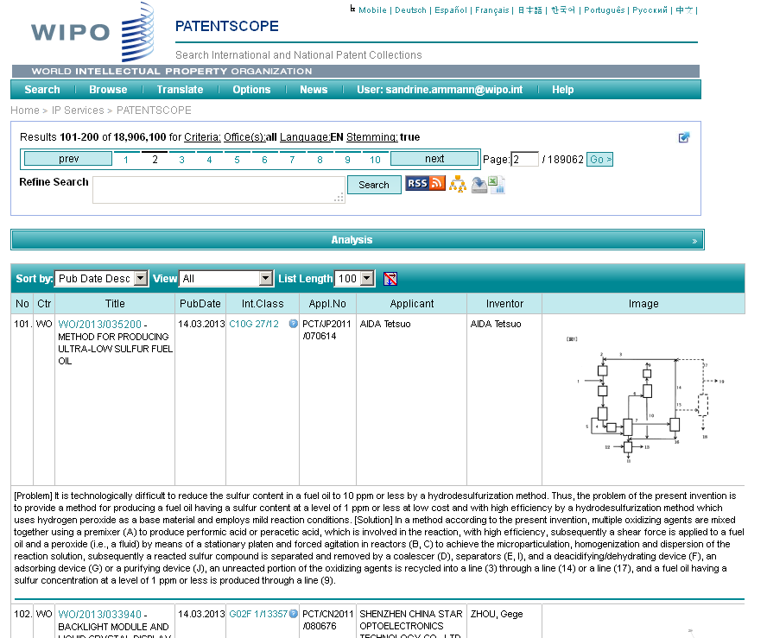
Downloading the results/Saving the query

Slide 35
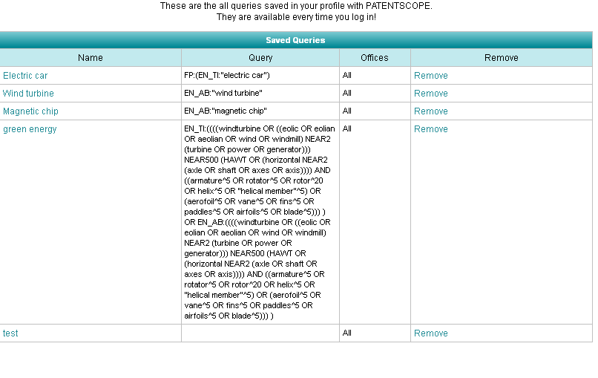
Saving a query

Slide 36
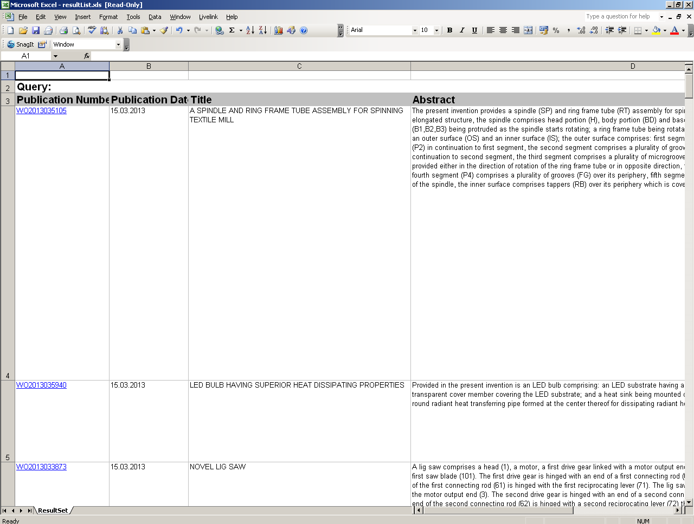

Slide 37

Analysis tools

Slide 38

Statistics in the Browse by week
Beta version
Idea:
  Show global trends
    Main/new actors

Slide 39
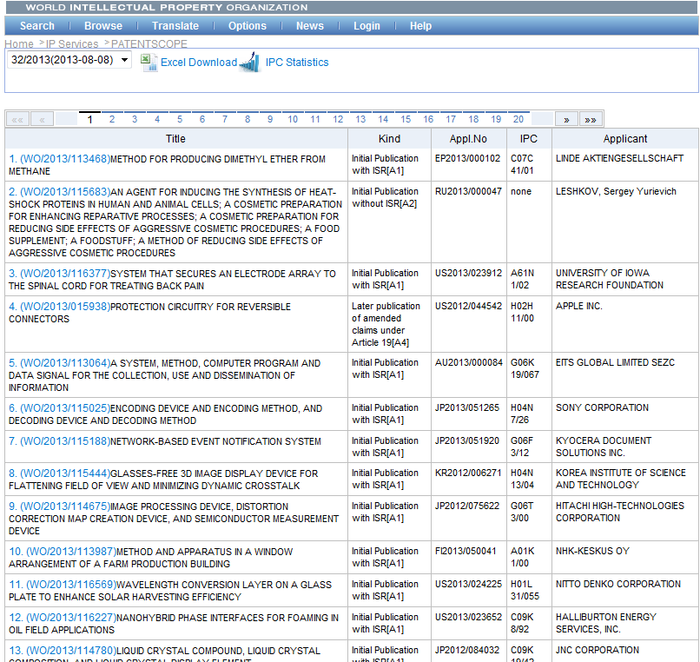

Slide 40
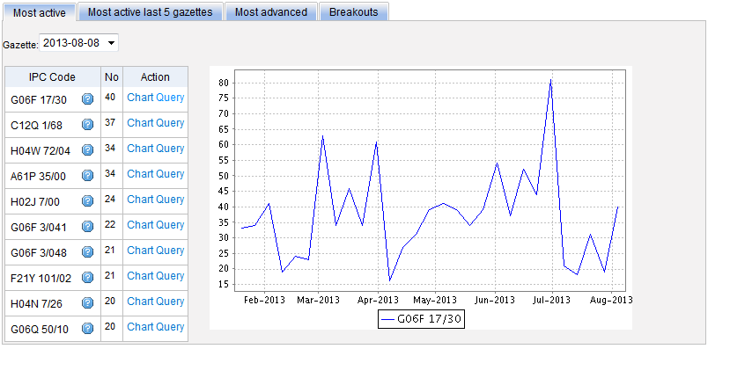
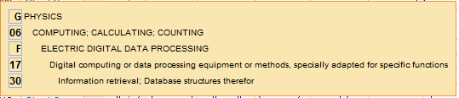
Most active

Slide 41
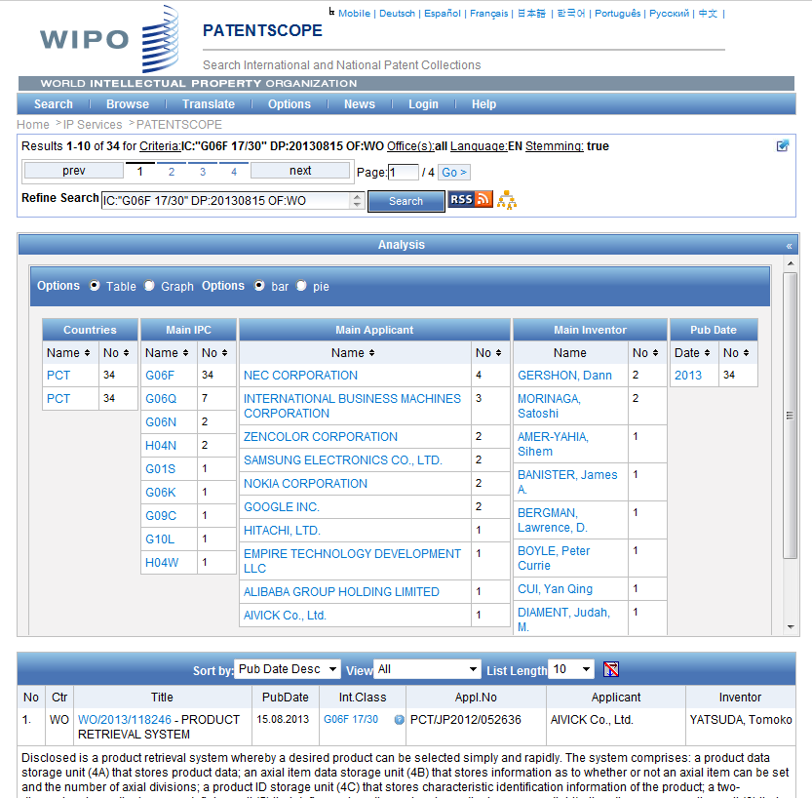

Slide 42
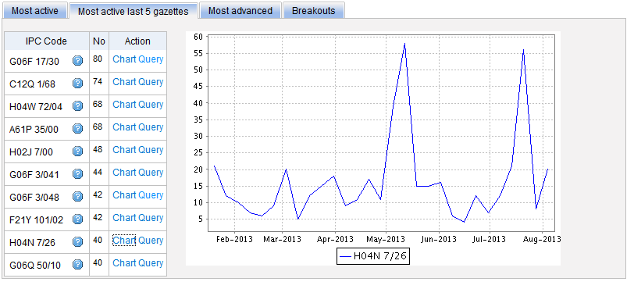
Most active last 5 gazettes

Slide 43
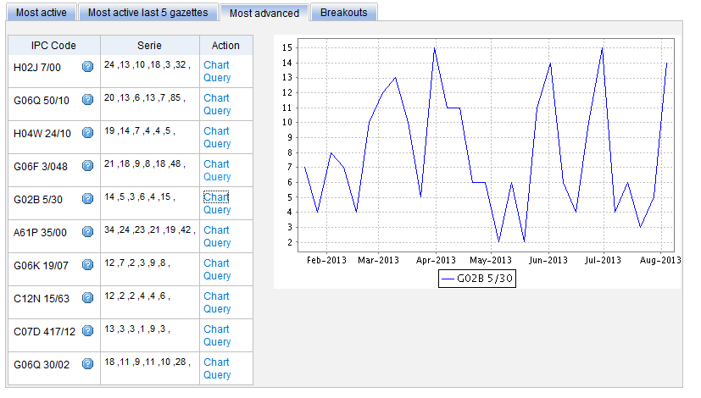
Most advanced

Slide 44
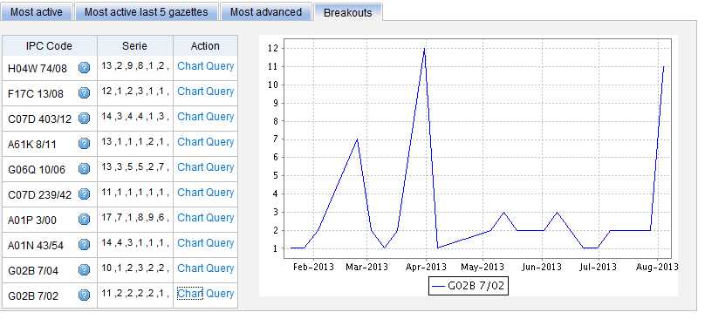
Breakouts

Slide 45

IPC
IPC
Green
Inventory

Slide 46
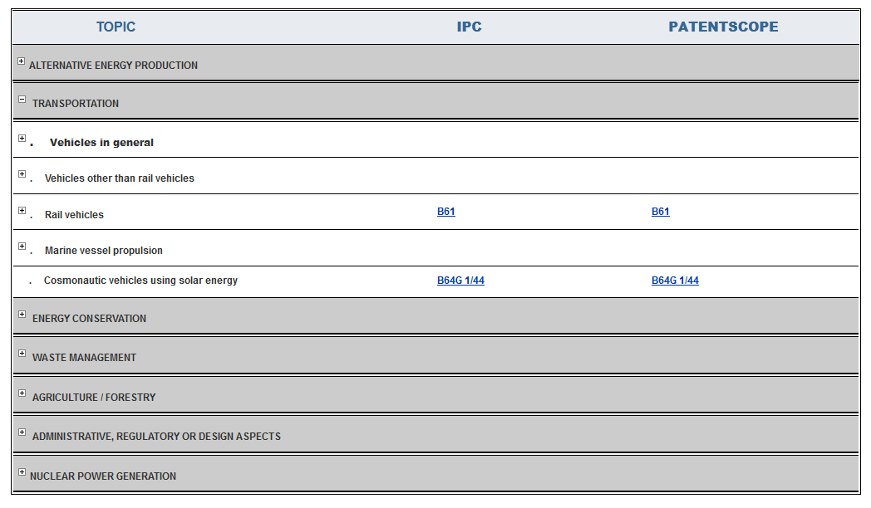
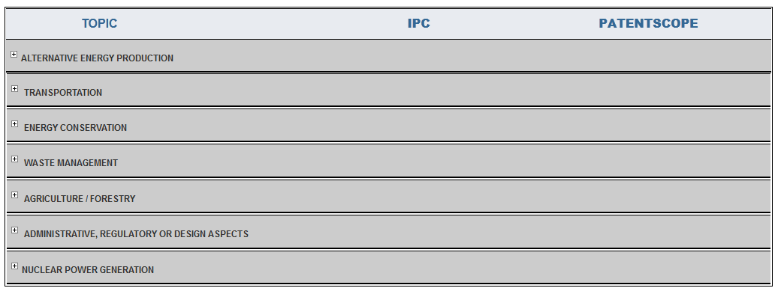

Slide 47
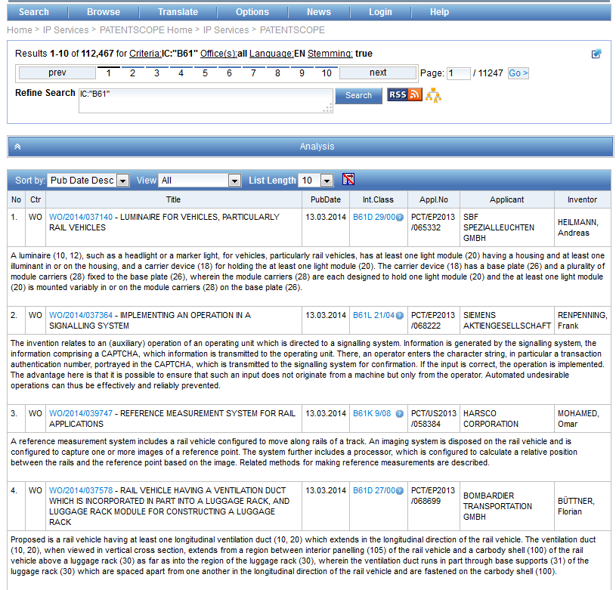

Slide 48


Slide 49
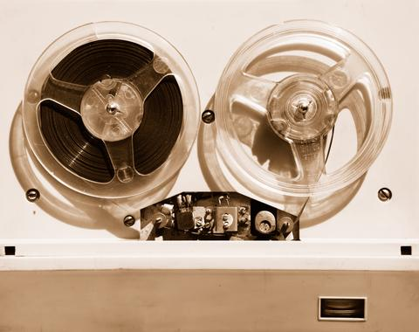

Slides and recording
+
www.wipo.int/patentscope/en/webinar/index.html

Slide 50
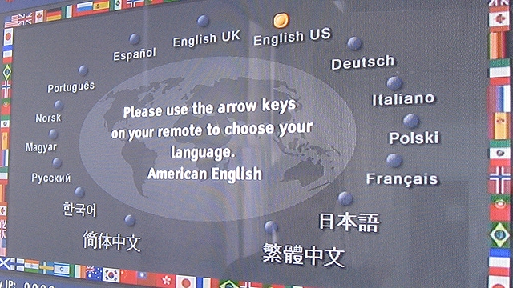
Next webinar: CLIR on April 15 & 17
Dates: April 15 and 17
Topic: CLIR

Slide 51
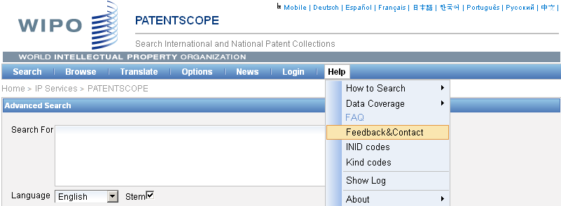

patentscope@wipo.int

Slide 52

mulțumesc
mulțumesc

