Slide 2
USPTO Green Technology Initiatives
Rahul Das
USPTO
Office of Policy and International Affairs
December 13, 2022

Slide 3
Tackling the climate crisis
The Biden administration has made fighting climate change a top priority.
The Inflation Reduction Act of 2022, signed by President Joe Biden on August 16, 2022, is the largest ever commitment of federal funds to combat climate change in U.S. history. It includes almost $370 billion in tax incentives aimed at reducing carbon emissions, enhancing energy efficiency, and accelerating the country’s energy transition away from fossil fuels.
President Biden has also issued numerous executive orders addressing climate change.

Slide 4
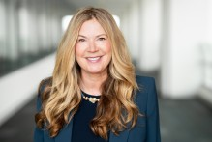
USPTO – WIPO Green partnership
In July, 2022, the USPTO officially became a technology partner of WIPO GREEN.
“By becoming a WIPO GREEN partner, the USPTO joins the effort to help companies, communities, and individuals from around the world identify innovative green technologies and who is producing and selling them,” said Kathi Vidal, Under Secretary of Commerce for Intellectual Property and Director of the USPTO.“

Slide 5
USPTO Climate Change Mitigation Pilot Program
The USPTO Climate Change Mitigation Pilot Program, launched in June, 2022, accelerates the examination of qualifying applications involving greenhouse gas reduction technologies and grants them special status.
The program aligns with and supports Executive Order 14008, dated January 27, 2021, and is part of the USPTO’s longstanding efforts to mitigate climate change.

Slide 6
USPTO Climate Change Mitigation Pilot Program
The USPTO will accept up to 1,000 qualifying applications until June 5, 2023, subject to its discretion to terminate sooner.

Slide 7
Petition to make special
A petition to make special (PTMS) is a formal request submitted to the United States Patent and Trademark Office (USPTO) asking that a patent application be examined ahead of the other pending applications in the same technological art.
Under this expedited review, a patent application that would normally take several years to prosecute can be prosecuted to final disposition (e.g., allowance) in as little as twelve months.

Slide 8
Special status until first action
Qualifying applications accepted into this pilot will be advanced out of turn until the first office action on the merits.
For qualifying applications, the applicant does not incur the petition to make special fee and is not required to satisfy the other requirements of the accelerated examination program.

Slide 9
Eligible applications
This pilot program is open to:
Non-continuing original utility nonprovisional applications; and
Original utility nonprovisional applications that claim the benefit of the filing date under 35 U.S.C. 120, 121, 365(c), or 386(c) of only one prior application that is either a nonprovisional application or an international application designating the United States.
Claiming the benefit of one or more prior provisional applications or claiming a right of foreign priority under to one or more foreign applications will not affect eligibility for this pilot program.

Slide 10
Eligible applications
Applications must contain one or more claims to a product or process that mitigates climate change by reducing greenhouse gasses - these technologies are those within the Cooperative Patent Classification (CPC) subclasses Y02 (TECHNOLOGIES OR APPLICATIONS FOR MITIGATION OR ADAPTATION AGAINST CLIMATE CHANGE) and include:
Controlling, reducing, and preventing anthropogenic emissions of greenhouse gasses
Capturing, storing, sequestering, and disposing of greenhouse gasses
Climate change mitigation in housing, appliances, end-user applications, information and communication, production of goods, transportation, wastewater treatment and management, and electrical power generation and transmission
Adapting to the adverse effects of climate change in human, industrial (including agricultural), and economic activities
The failure to be classified in those subclasses wouldn’t exclude the application per se from the program.

Slide 11
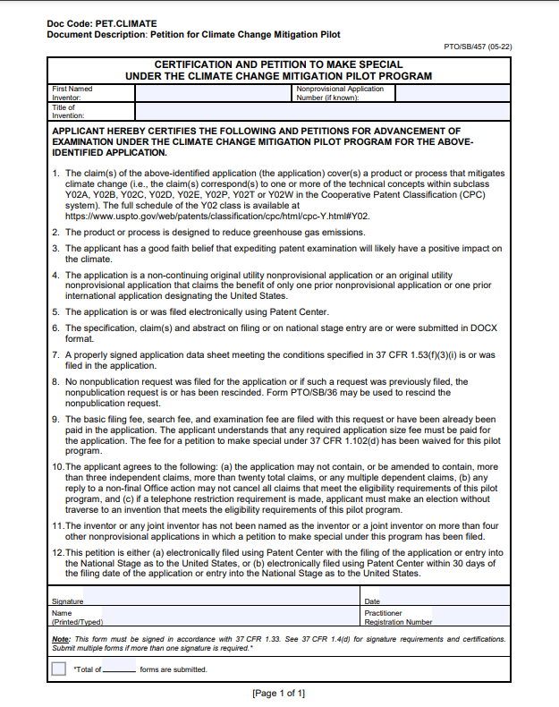
Program to date
171 applications received
97 applications granted special status
1 application allowed!
(as of November 30, 2022)

Slide 12
Patents for Humanity: Clean energy technologies
The USPTO intends to launch a Patents for Humanity: Clean energy technologies awards competition, a green technology–focused version of the USPTO’s highly successful Patents for Humanity awards competition, in 2023.
Patents for Humanity is the United States Patent and Trademark Office's (USPTO) awards competition recognizing innovators who use game-changing technology to meet global humanitarian challenges.

