Slide 1
Performing effectives searches in the Global Design Database
Internet
July
2019
Sandrine Ammann
Marketing & Communications Officer

Slide 2
Click the Raise hand button if you hear me otherwise send me a message please!

Slide 5
Questions/concerns
gbd@wipo.int

Slide 6
Agenda
Interface:
Coverage
Search features
Filter features
Results
Menus
Webinars
Q&A

Slide 7
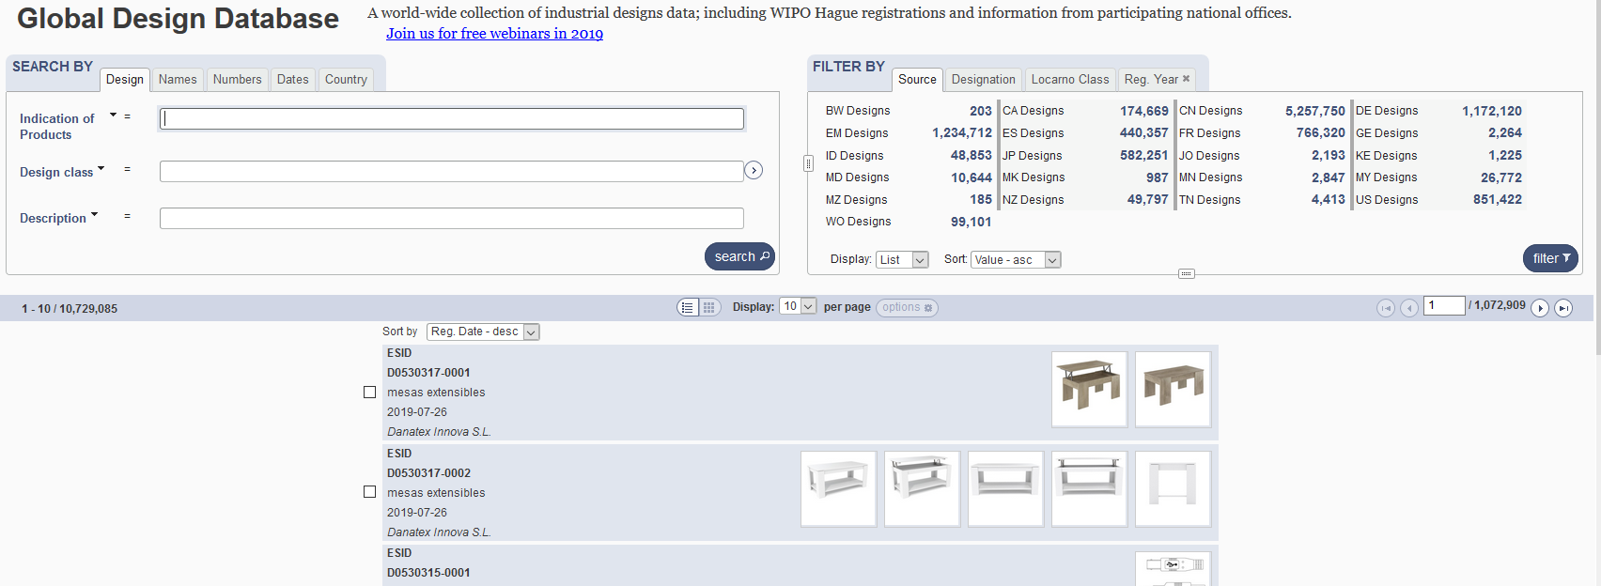
The Global Design Database

Slide 8
Combining many search criterias
Design Apple
2 Locarno classifications: 20 & 25
2 registration years: 2017 & 2016
No need to build complex queries

Slide 9
2 steps
1
2
- Design Apple
- 2 Locarno classifications: 20 & 25
-2 registration years: 2017 & 2016

Slide 10
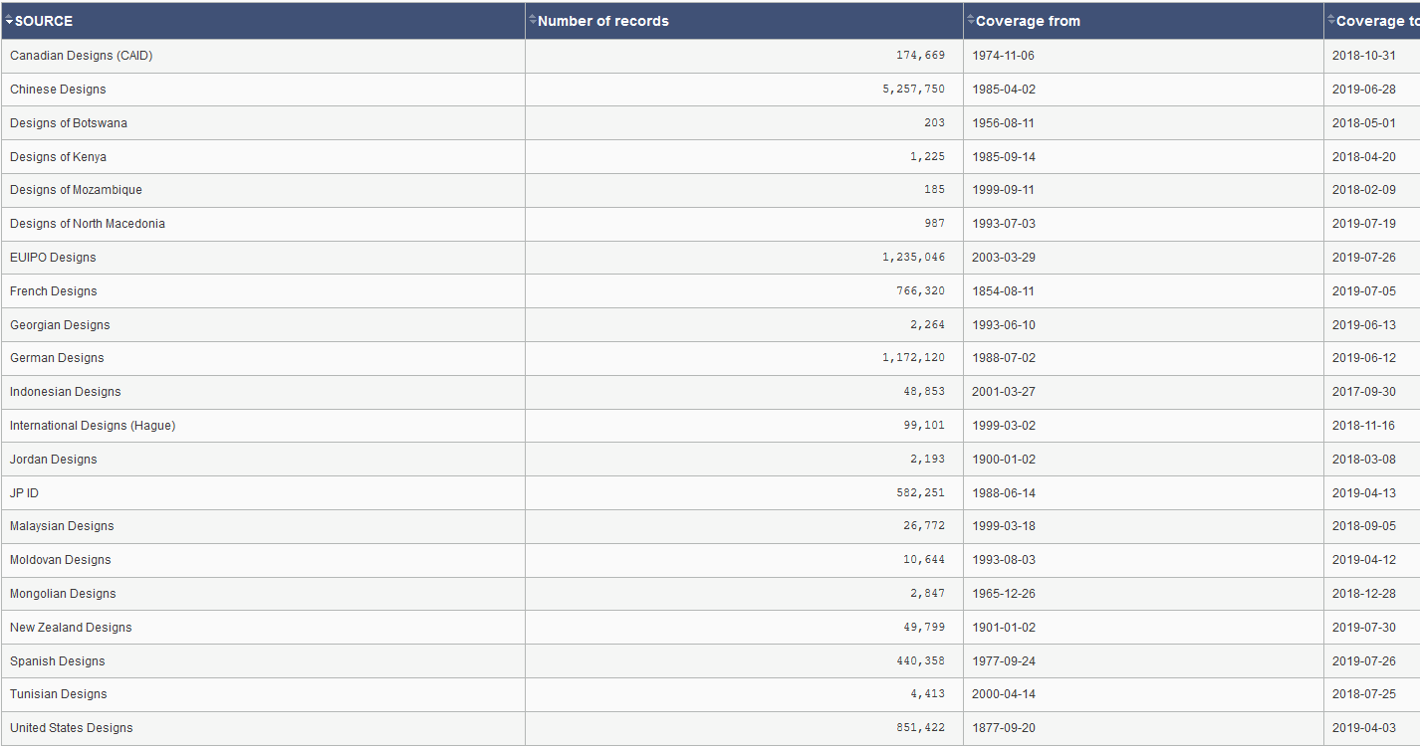
Coverage
http://www.wipo.int/designdb/en/designdb-help.jsp#db

Slide 11
Coverage

Slide 12
Coverage: new

Slide 13
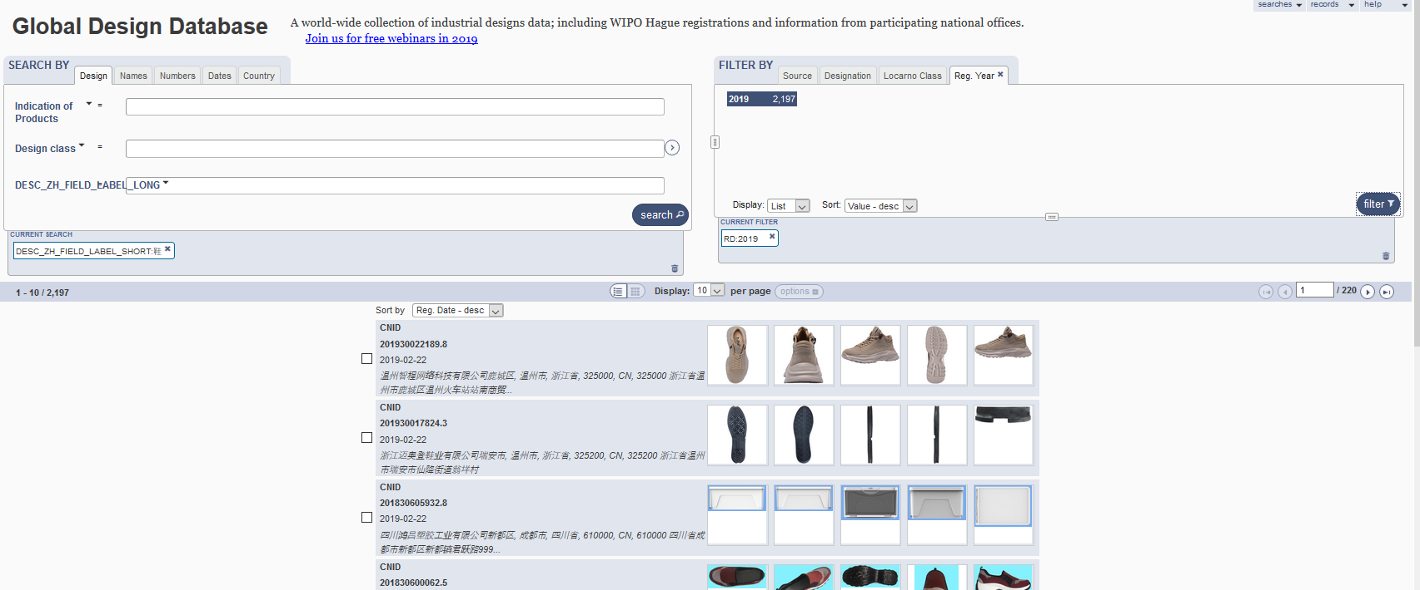
5
1
2
3
4

Slide 14
1

Slide 15
Boolean, proximity, operators, fuzzy

Slide 16
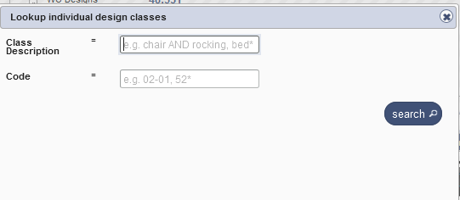
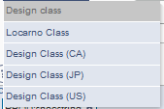
Search by design

Slide 17
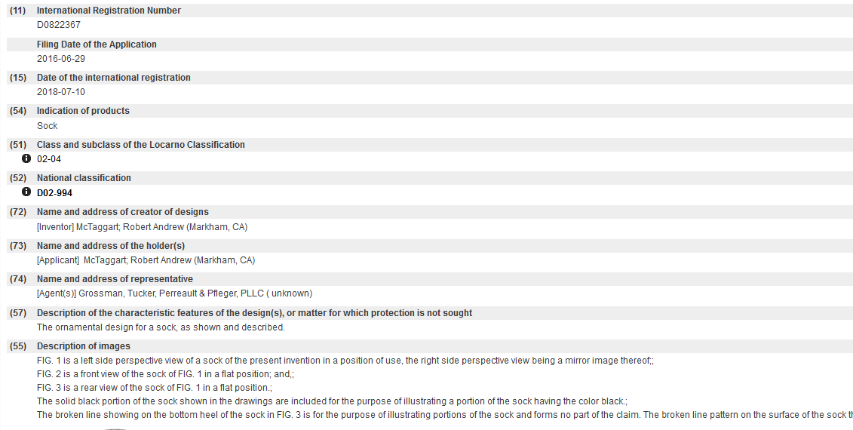
Indication of production/Description

Slide 19
Search by Description JA

Slide 20
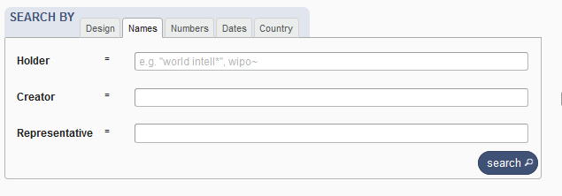
Search by name

Slide 21
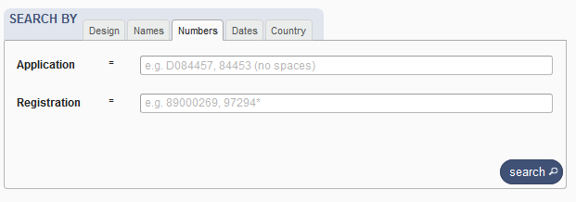
Search by numbers

Slide 22
Search by dates

Slide 23
Search by country

Slide 24
2

Slide 25
Filter by

Slide 26
Filter by Source

Slide 27
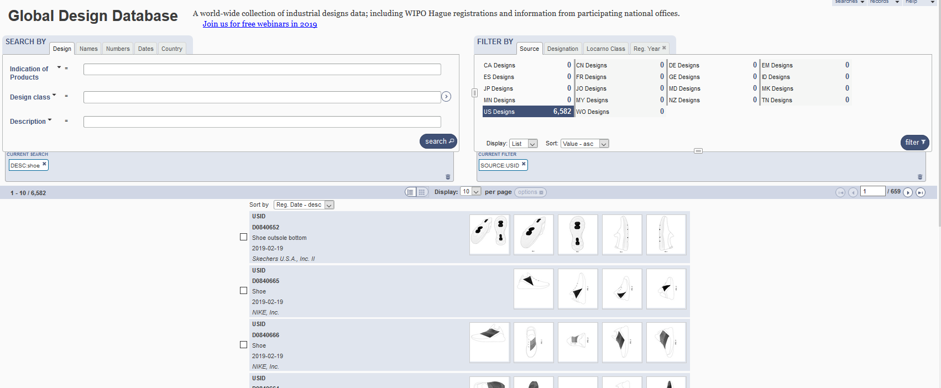

Slide 28
Filter by Designation

Slide 29
Filter by Locarno Class

Slide 30
Filter by Registration Year

Slide 31
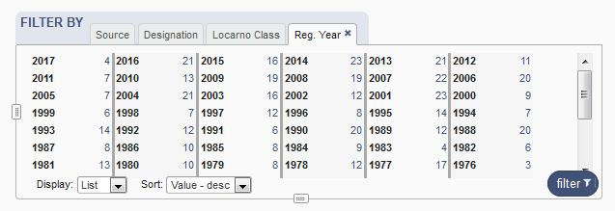
Options

Slide 32
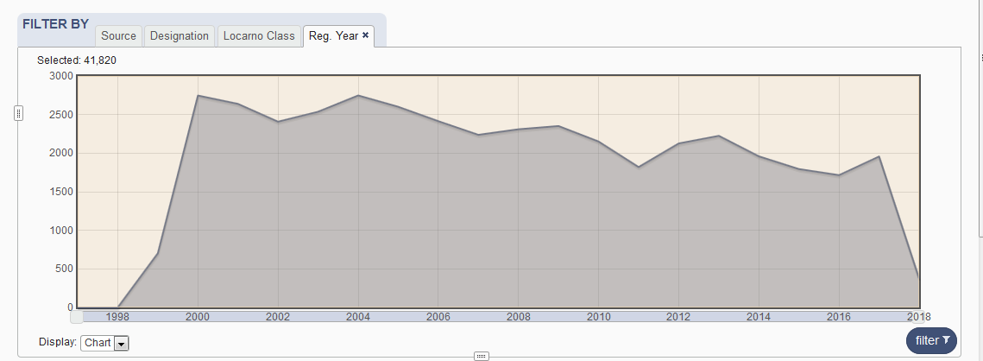

Slide 33
3
3
3

Slide 35
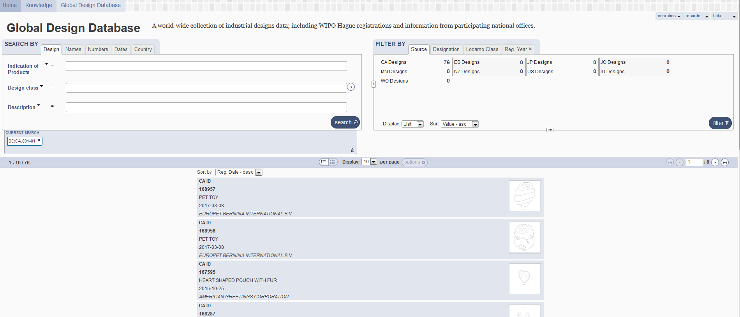
Result list
4

Slide 36
2 parts

Slide 37
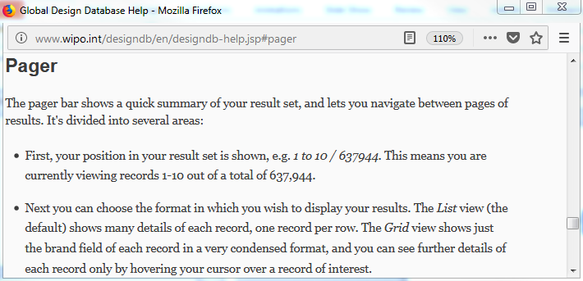
Pager bar

Slide 38
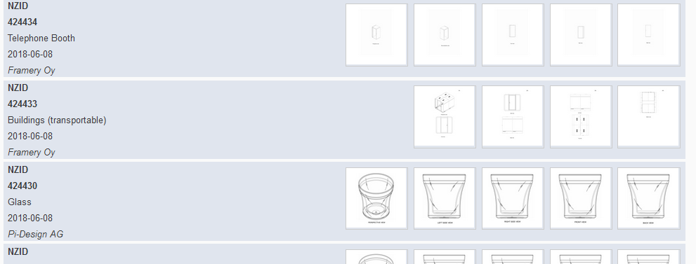
Display

Slide 39
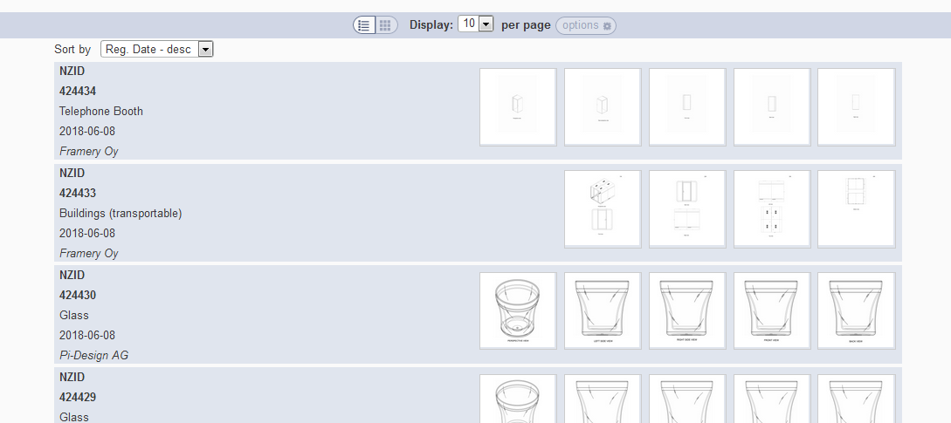
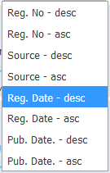
Grid view
Notes:
In case the design has multi models (hauge, new Zealand…), we show the images of every model
In case the design has one model (france, spain…), we should the first 5 images of the model

Slide 40
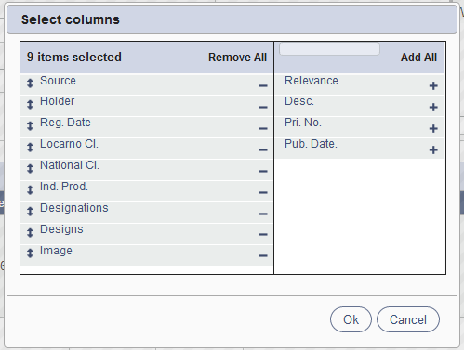
List view

Slide 41
Columns customized

Slide 42
2 parts

Slide 43
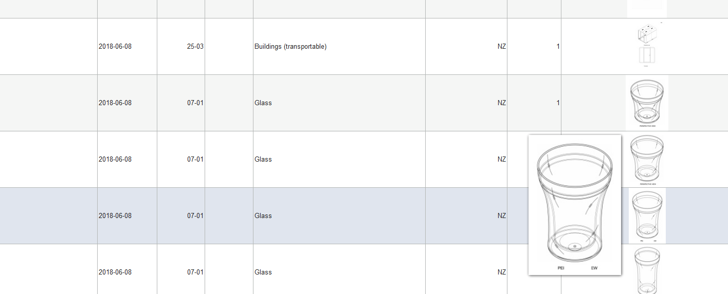

Slide 44
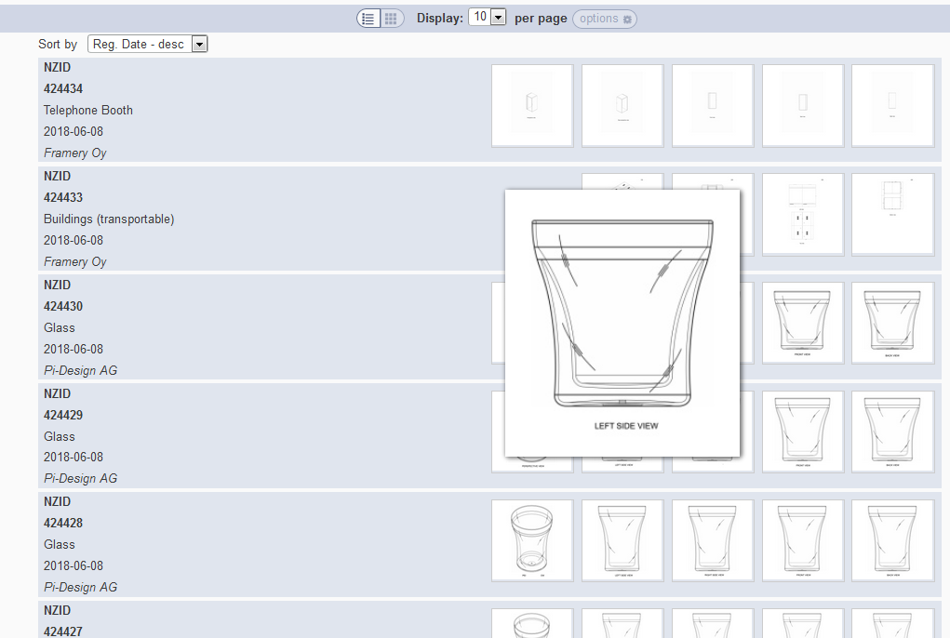

Slide 45
Back button/link

Slide 46
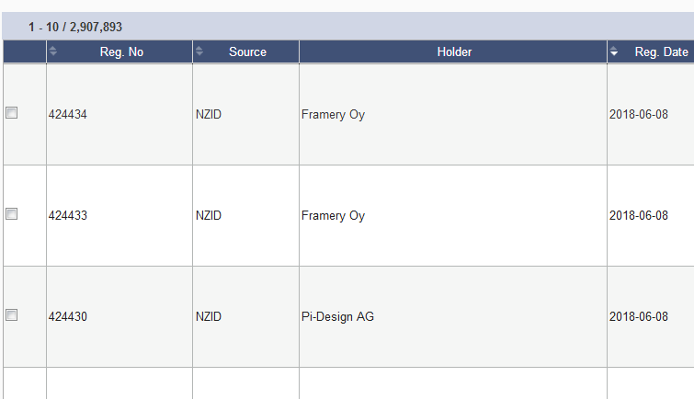
Options: checkbox

Slide 47
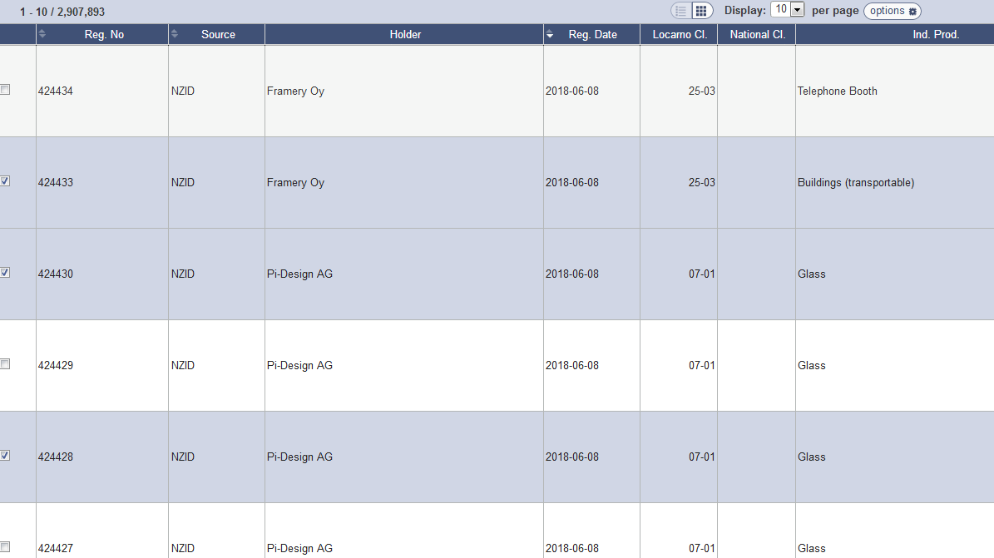

Slide 48
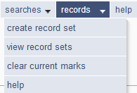

Slide 49
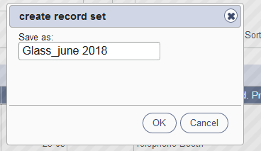
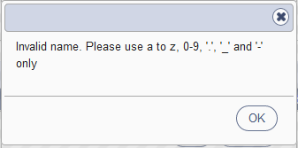
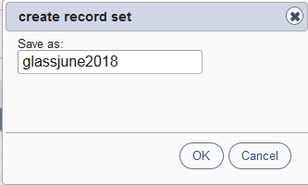
Save a record set

Slide 50
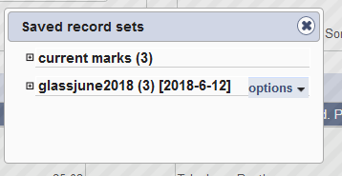
Record sets/current designs

Slide 51
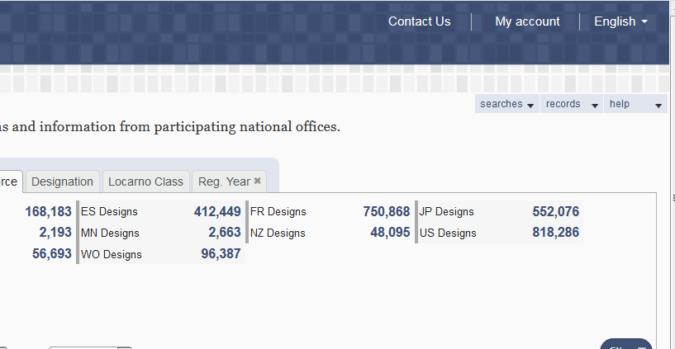
My account

Slide 52
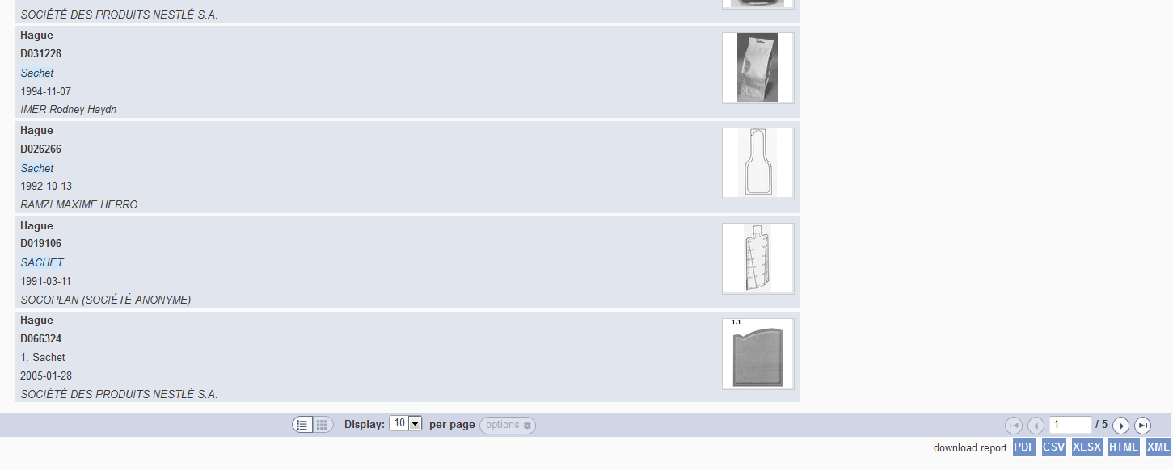
Download reports

Slide 53
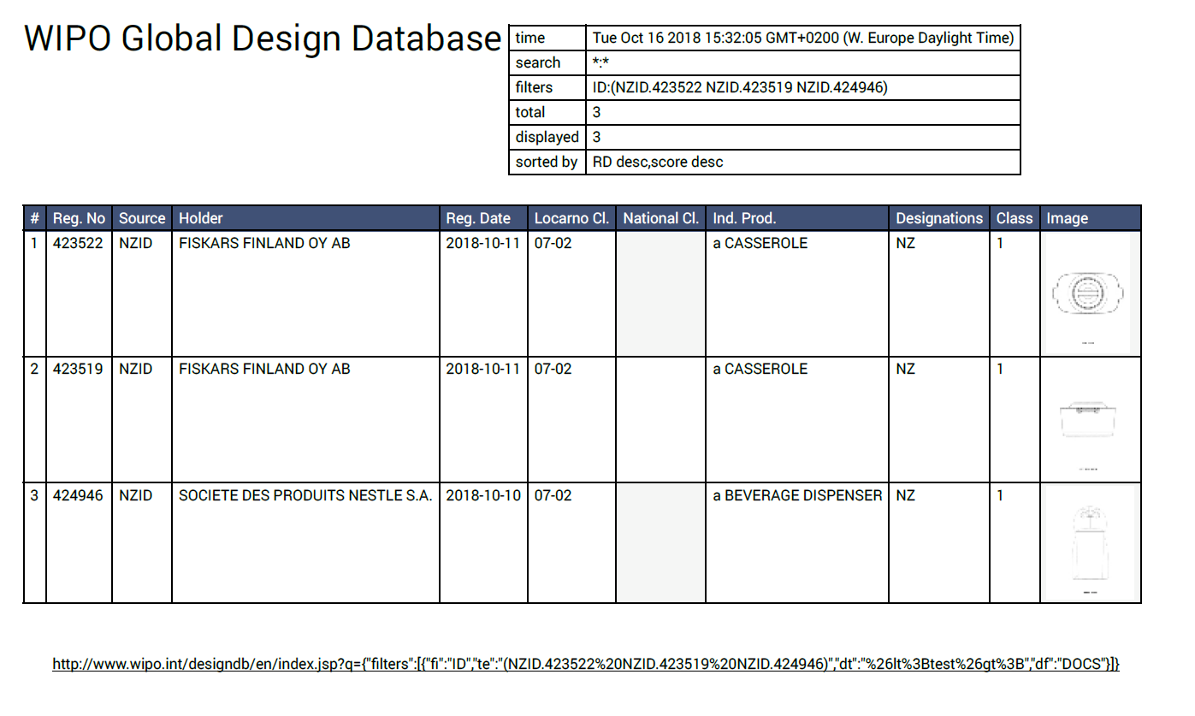

Slide 54
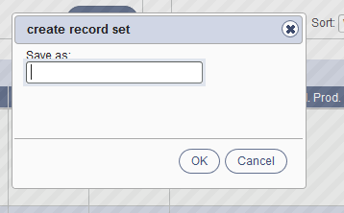
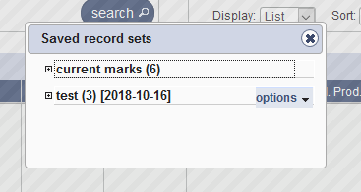

Slide 55
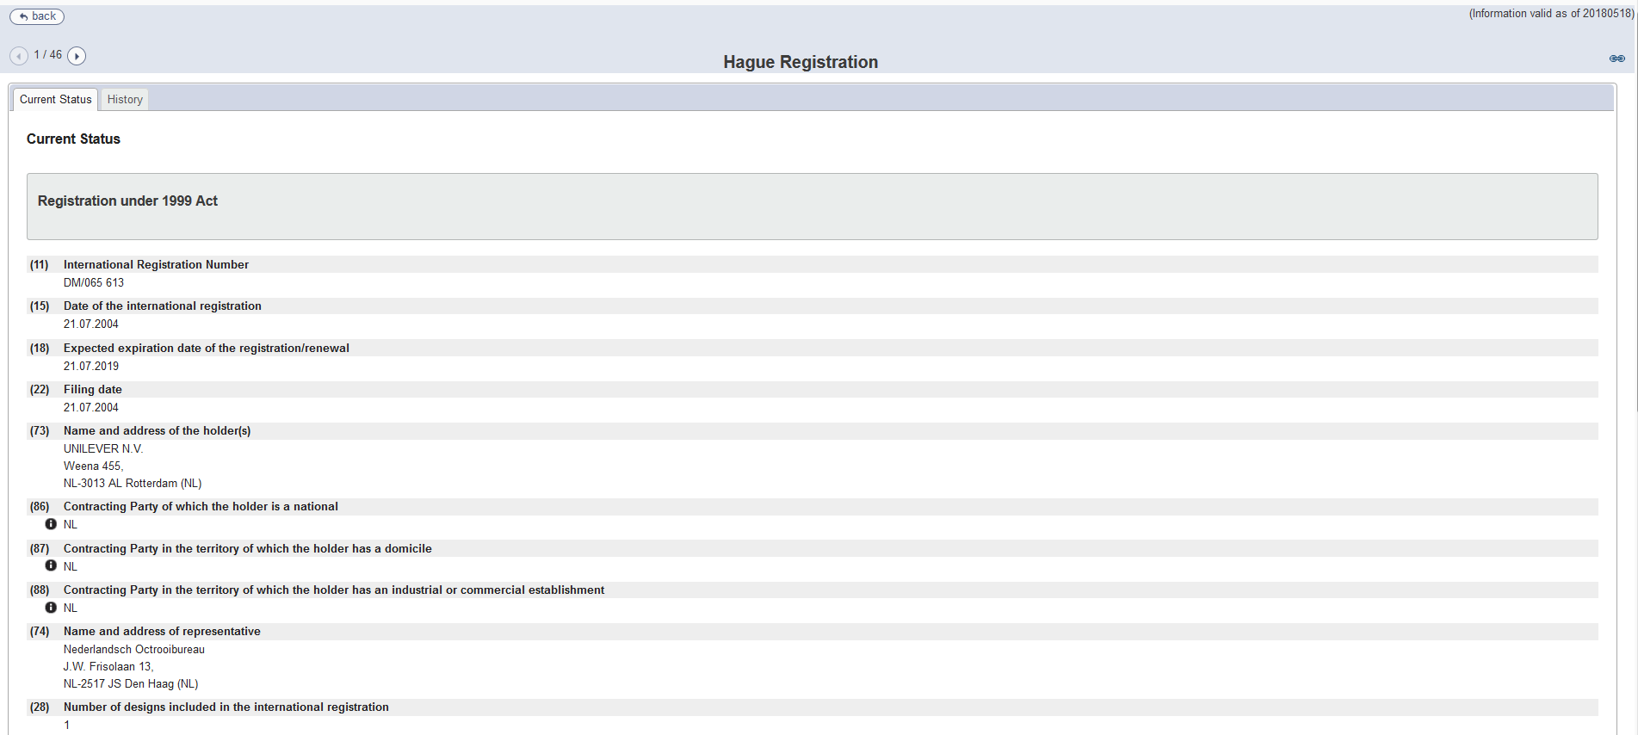
Individual record

Slide 56
5

Slide 58
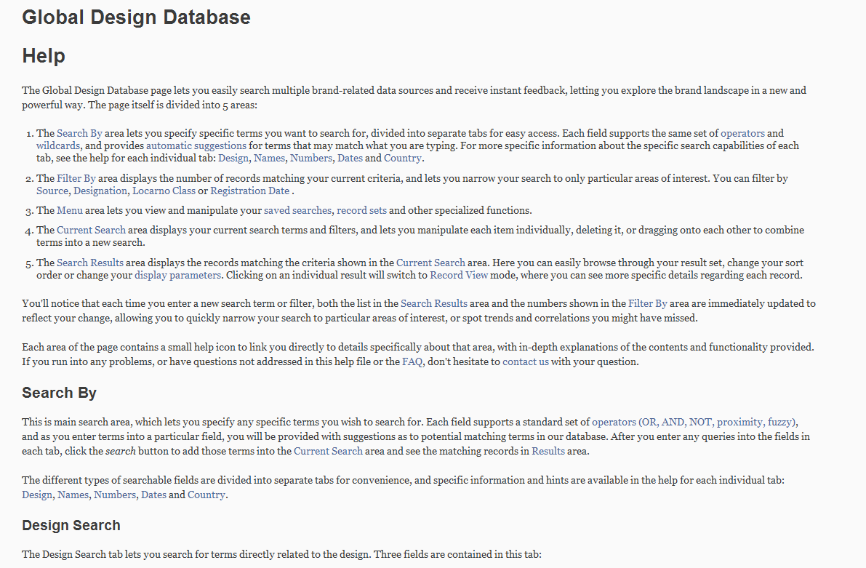
Help

Slide 59
Plans for the future
Add more collections

Slide 60
Webinars

Slide 61
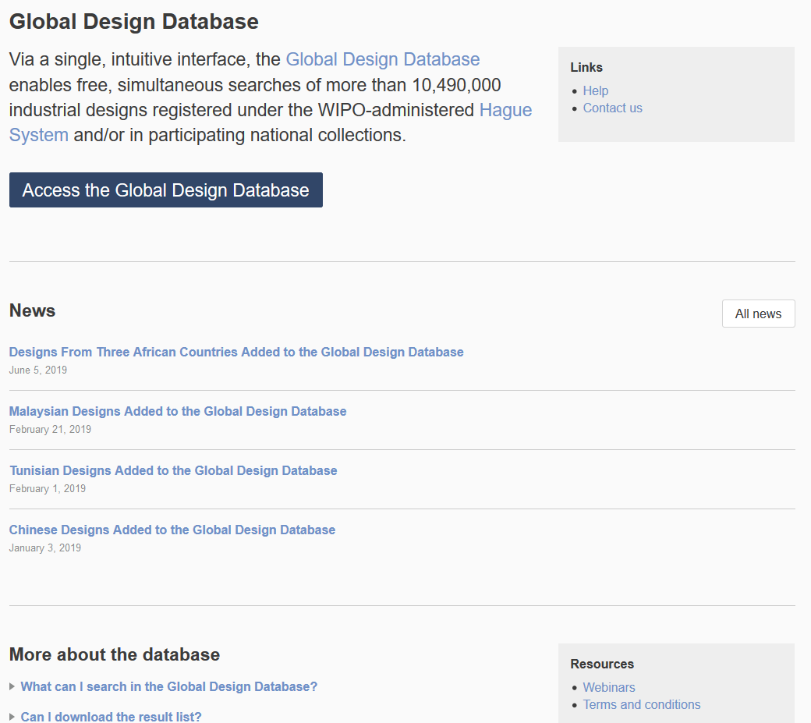

Slide 62
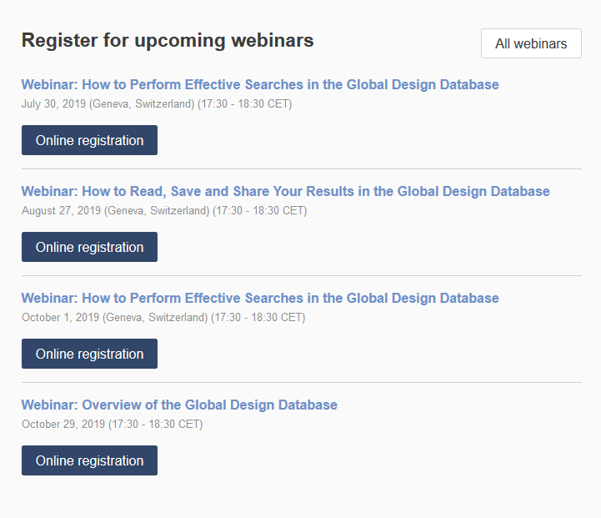

Slide 63
Global Brand Database: webinar
How to read, save & share your results
August 13 at 5:30 PM CET
https://attendee.gotowebinar.com/register/2906774888388206850
August 15 at 12:00 PM AEST
https://attendee.gotowebinar.com/register/2811369169201072140

Slide 64
PATENTSCOPE webinar
Find documents published in languages you don’t know
August 20 or 22 at 5.30PM or 8:30 AM
https://attendee.gotowebinar.com/rt/8768434103741781507

Slide 65
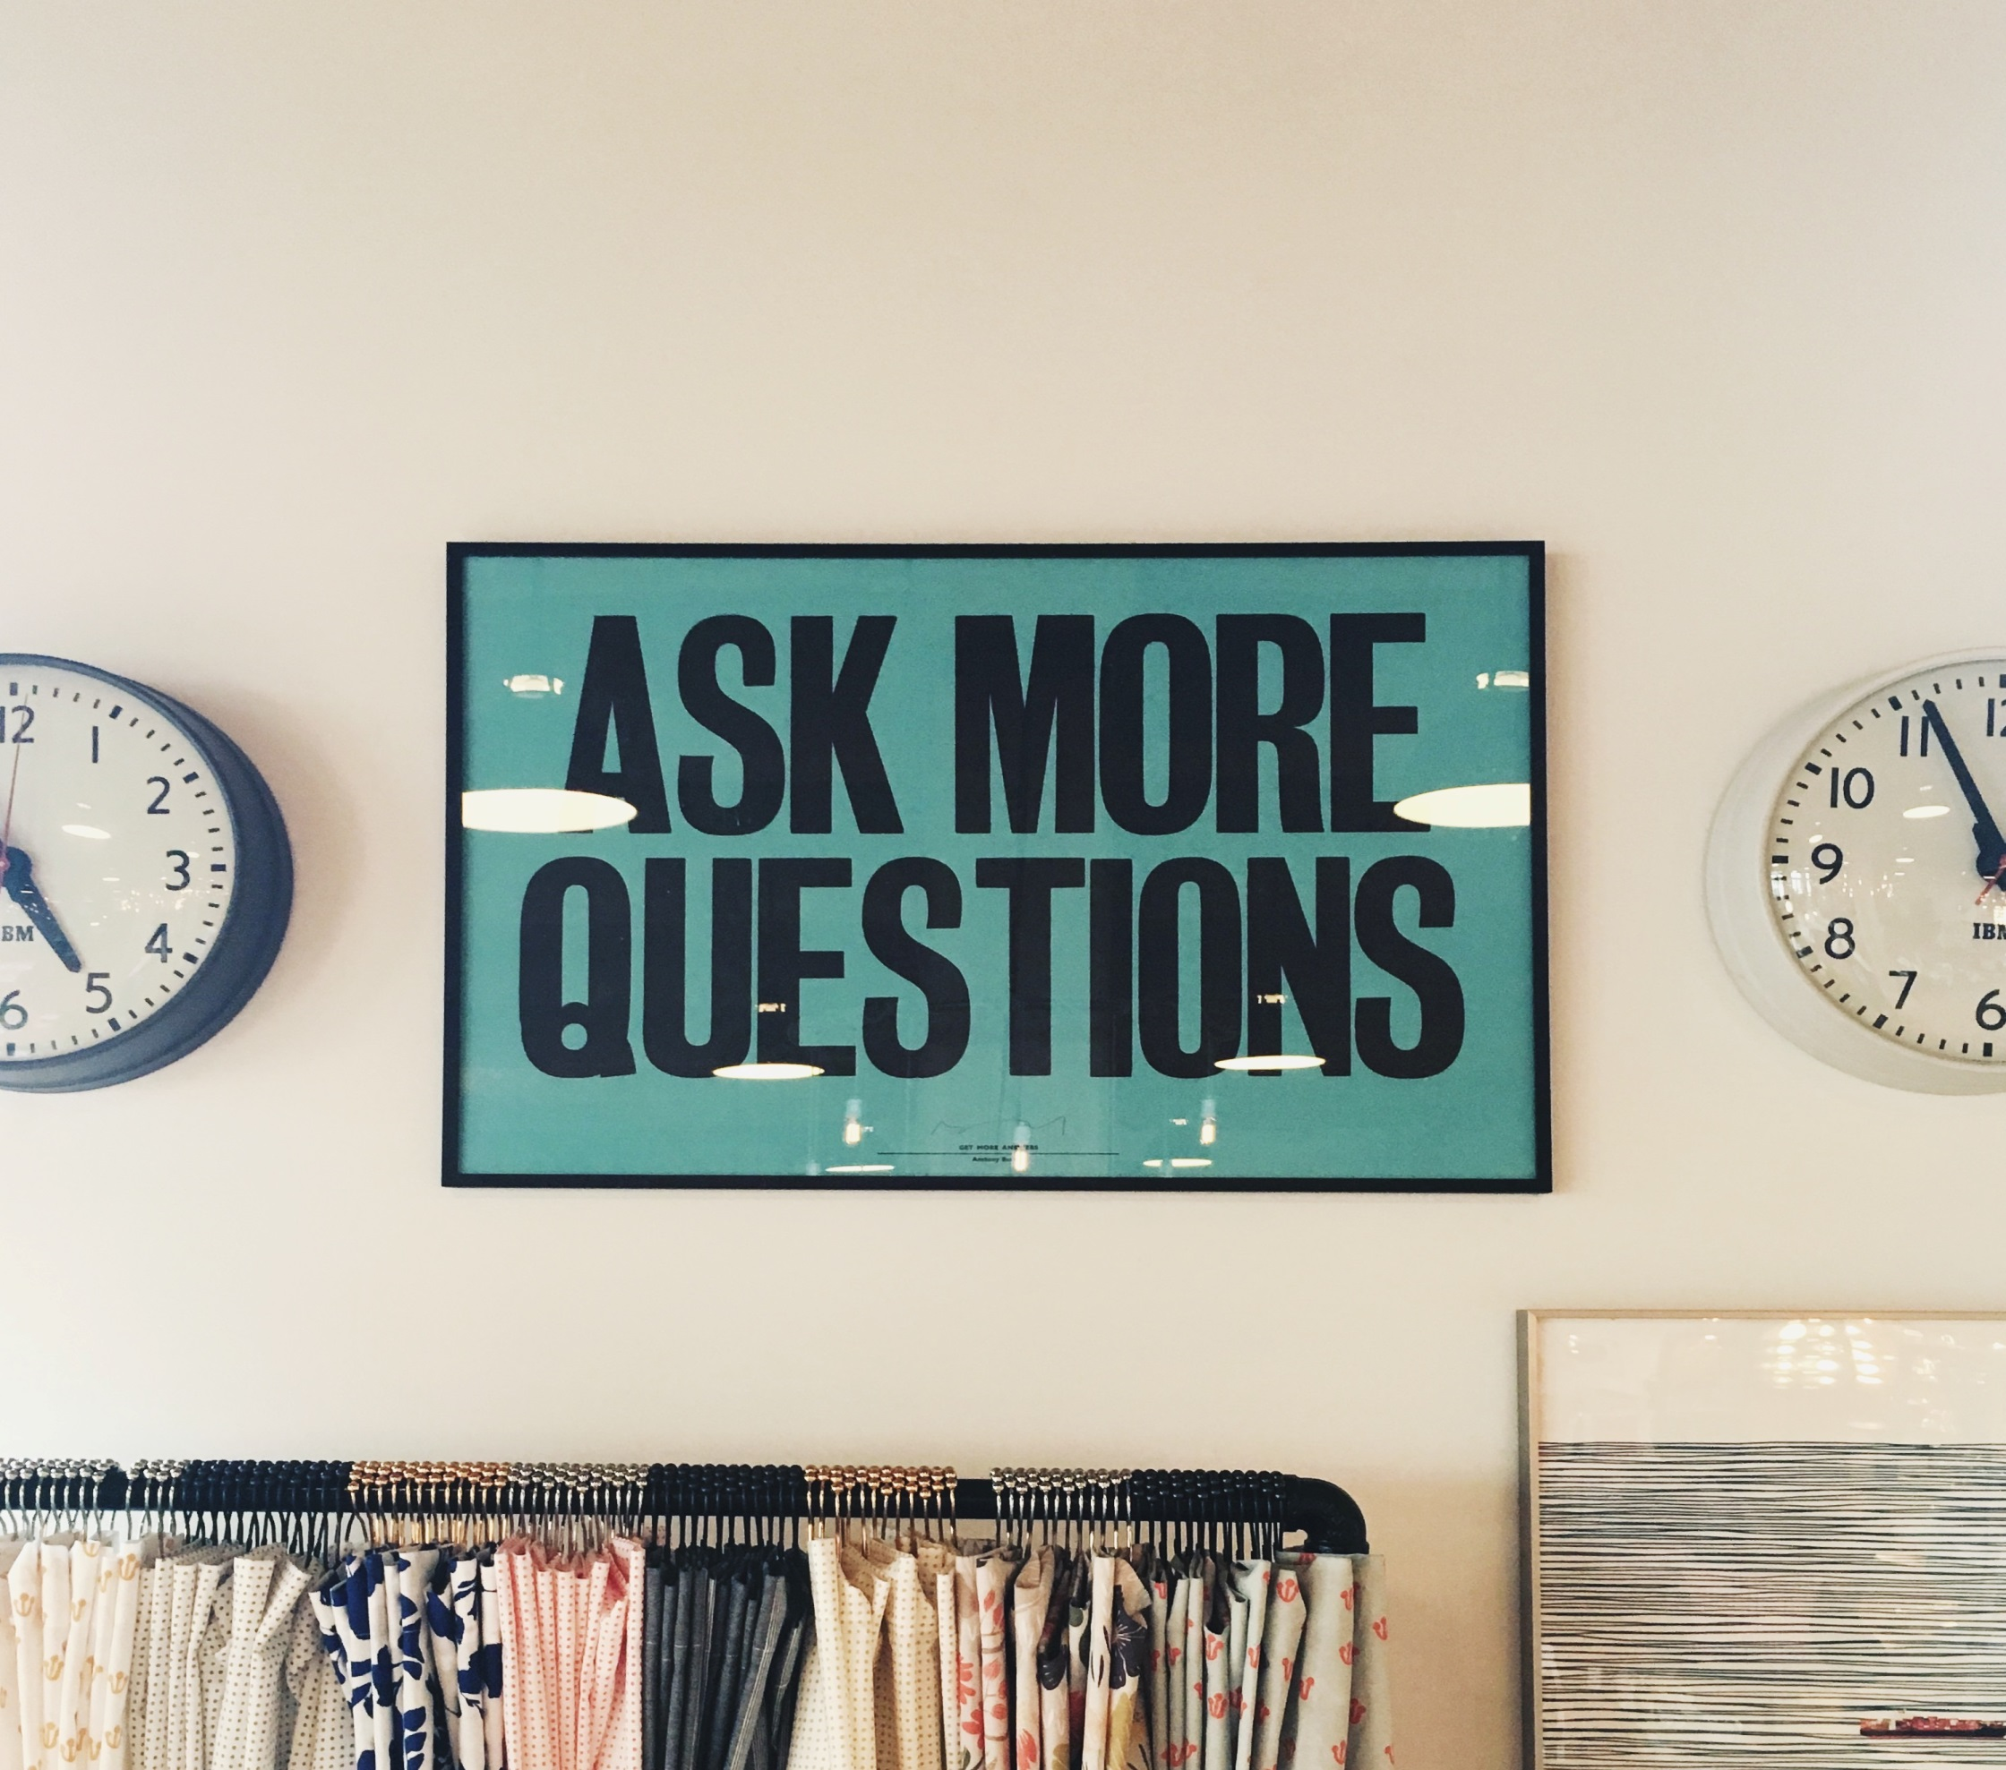

Slide 66
mulțumesc
mulțumesc
gbd@wipo.int

