Slide 1
Vienna Classification Assistant
Cyberworld
12 August
2020
Sandrine Ammann
Marketing & Communications Officer

Slide 2
Click this button if you can hear my voice and see my screen

Slide 5
Questions/concerns
vienna_classificator@wipo.int

Slide 7
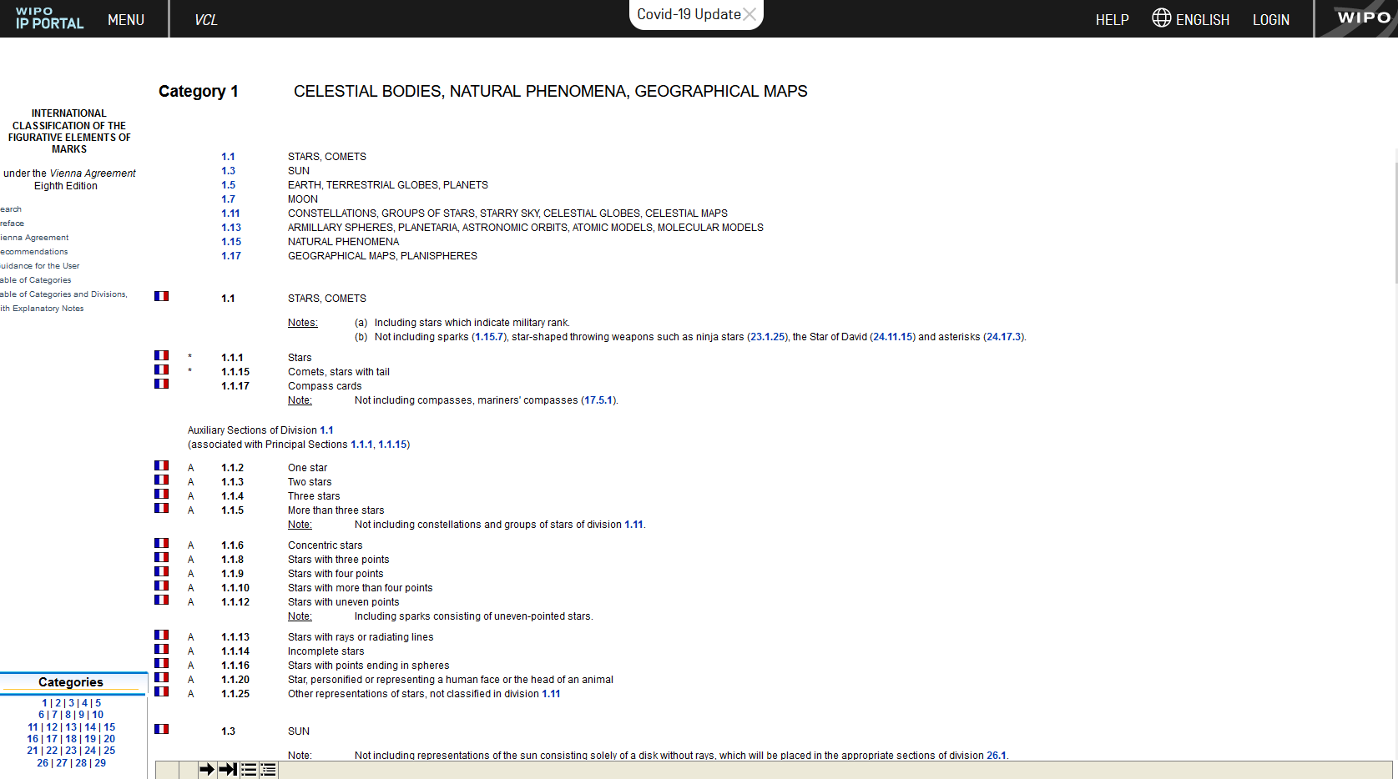

Slide 8
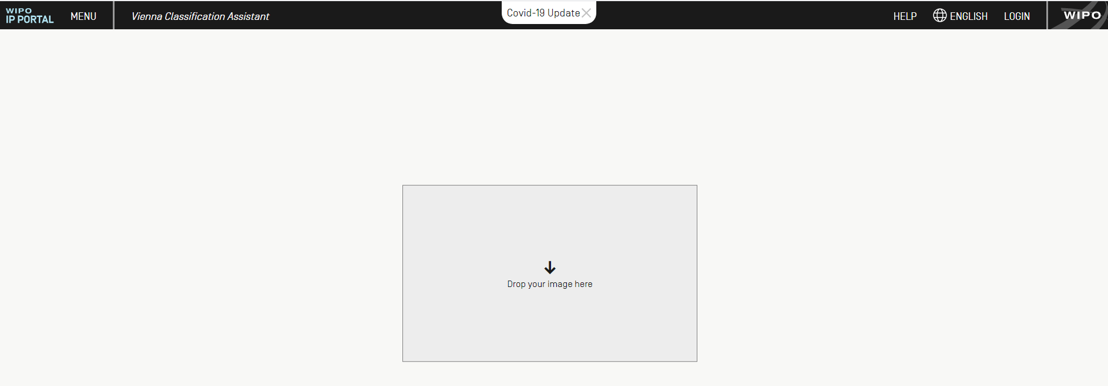
Vienna Classification Assistant
https://www3.wipo.int/bnd-api/vienna-classification-assistant/

Slide 9
Example

Slide 10
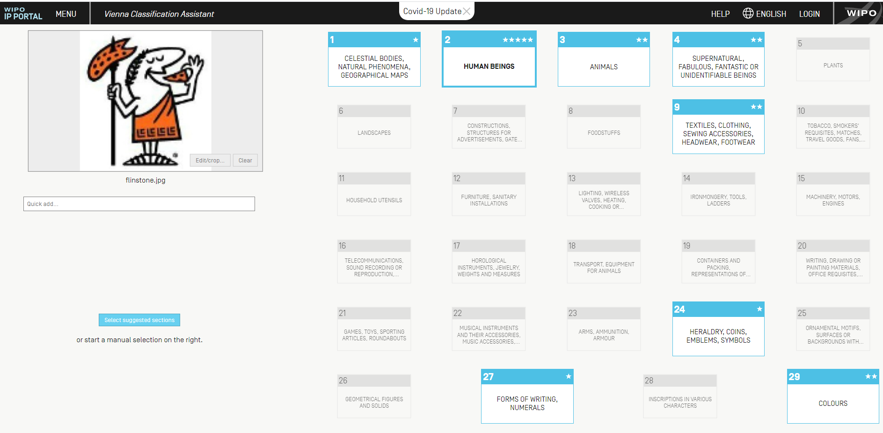

Slide 11
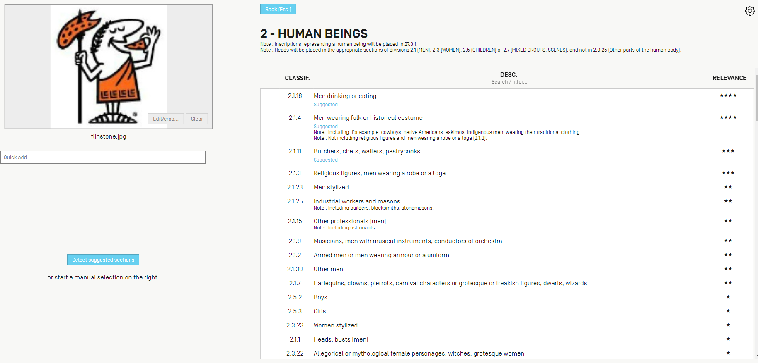

Slide 12
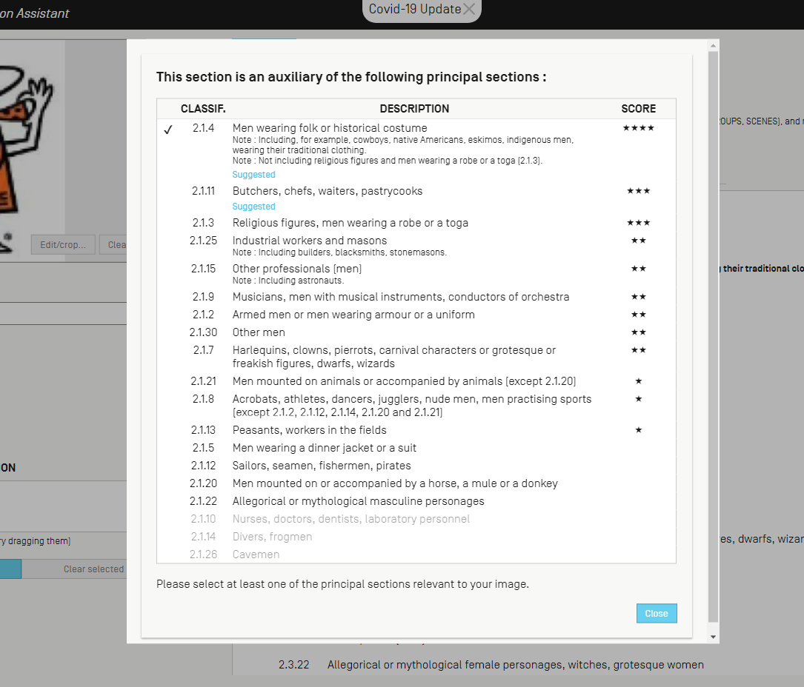

Slide 13
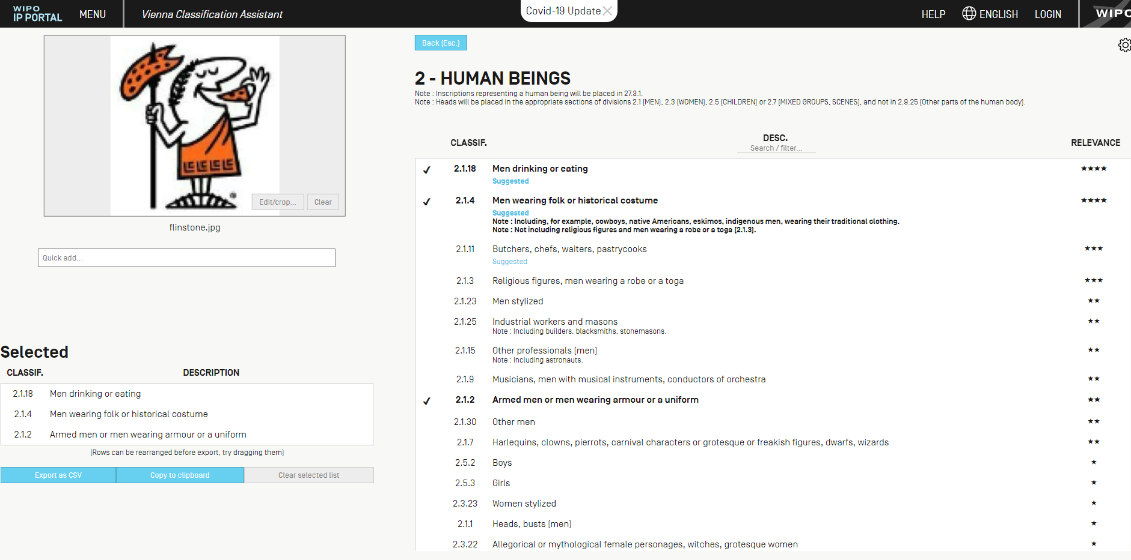

Slide 15
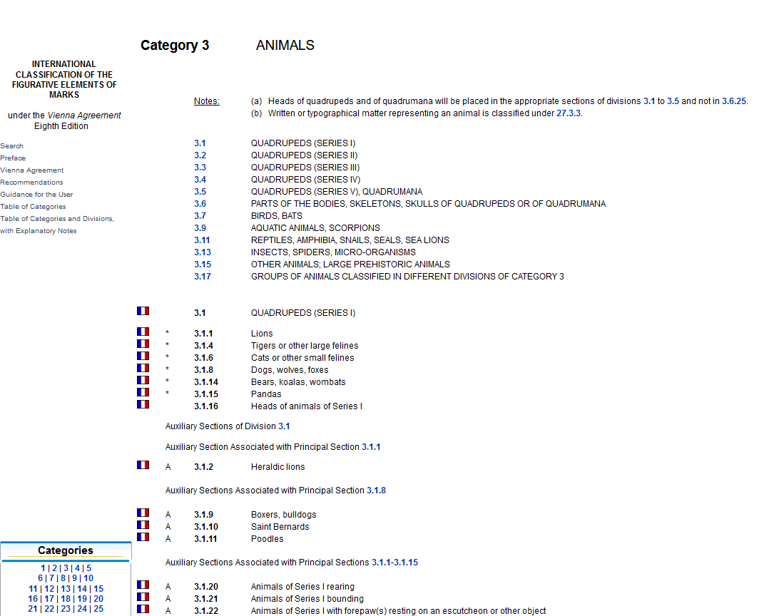

Slide 17
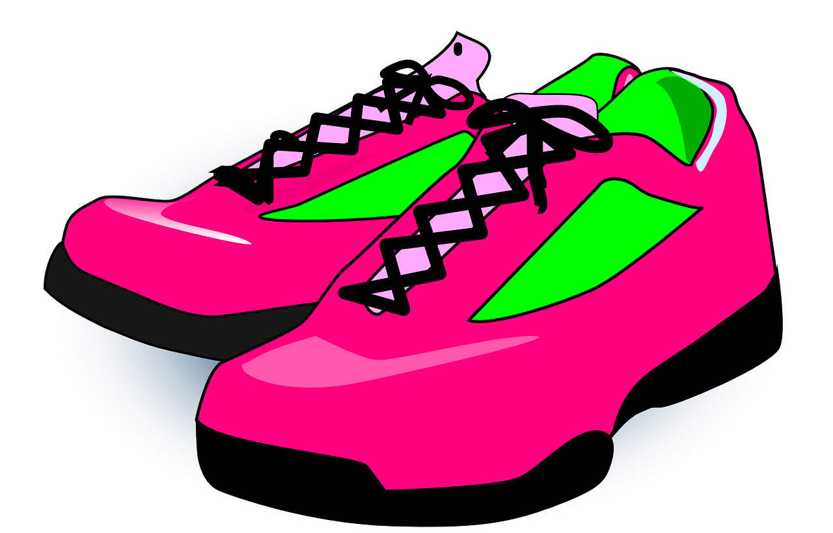

Slide 19
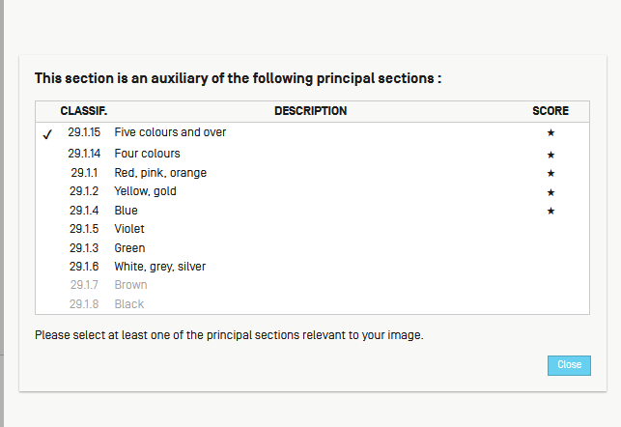

Slide 23
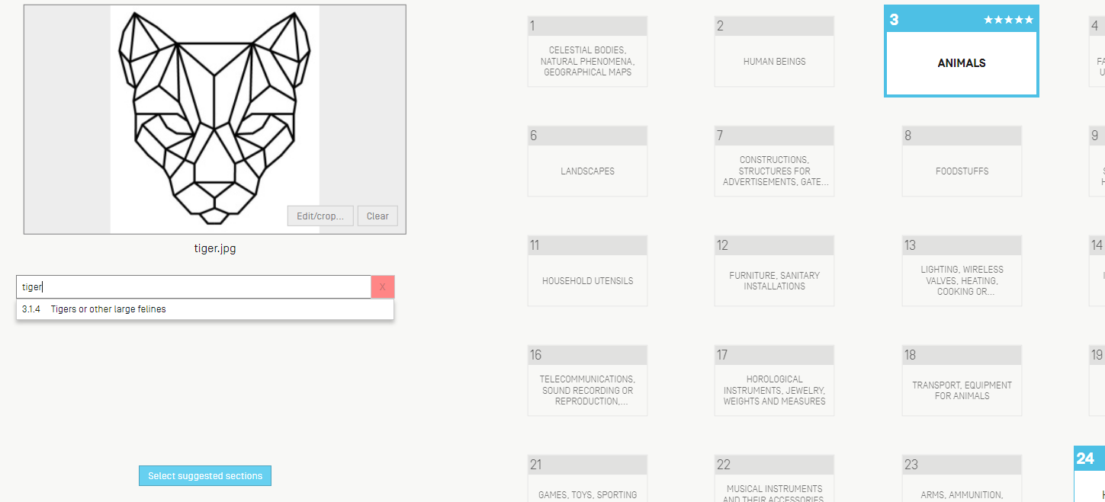
Quick-add

Slide 24
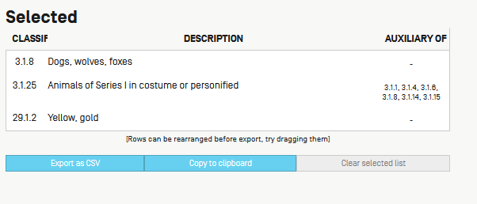
Export/copy

Slide 25
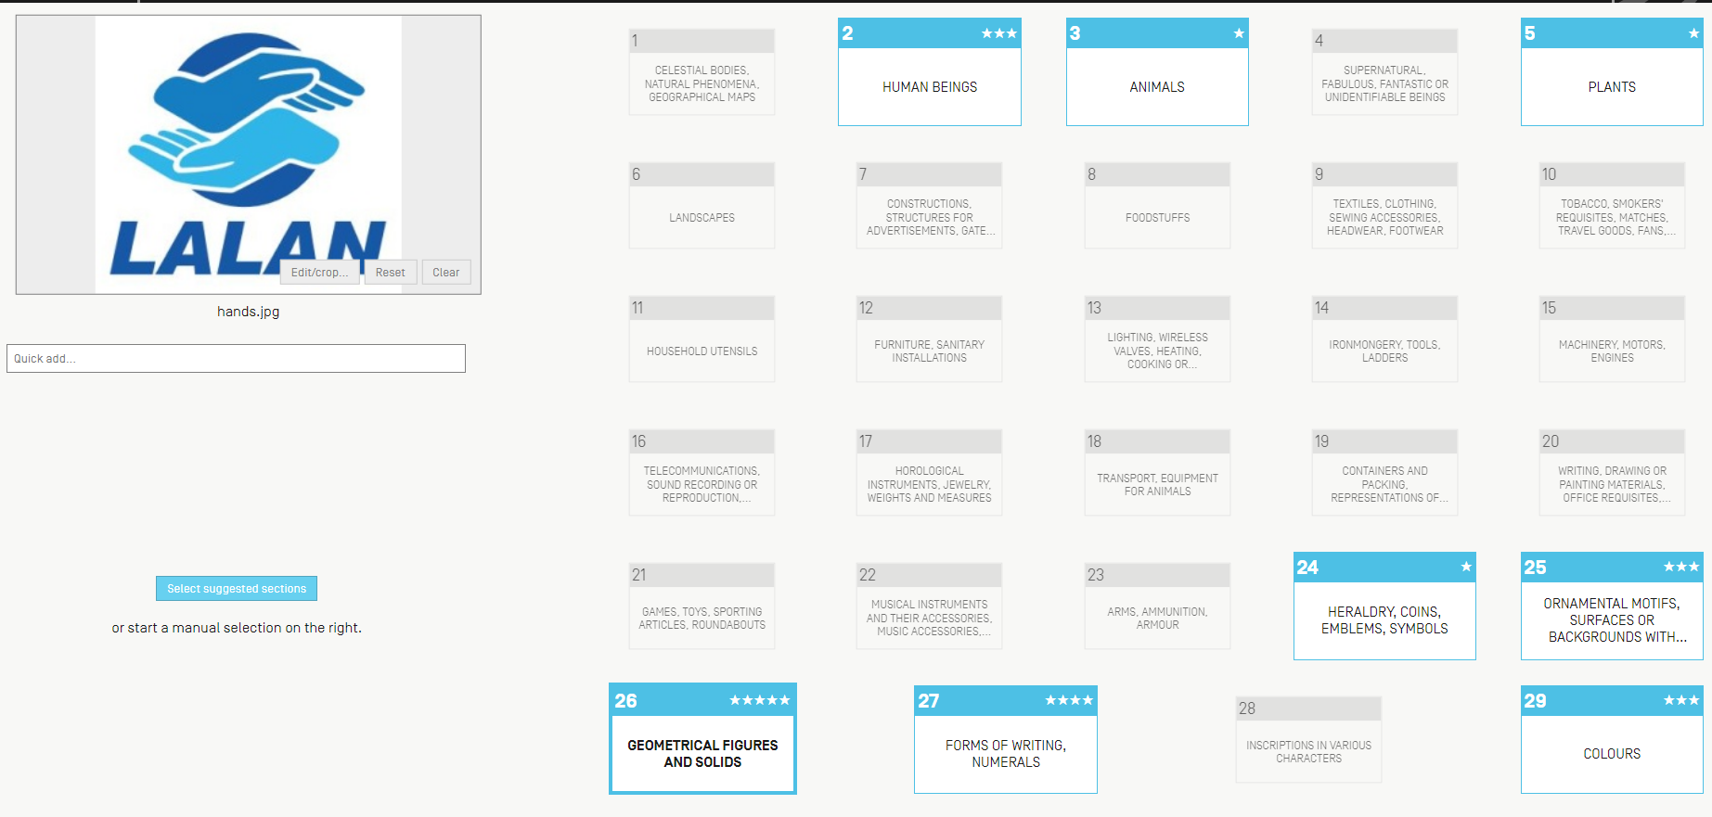
Image editing

Slide 26
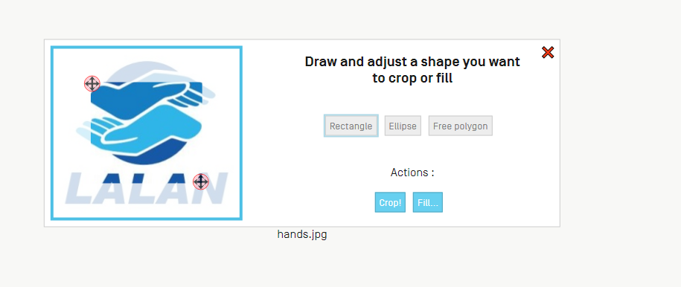

Slide 27
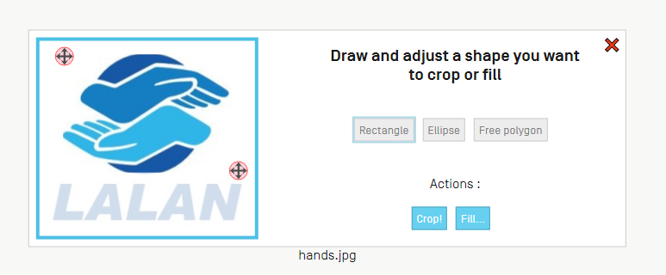
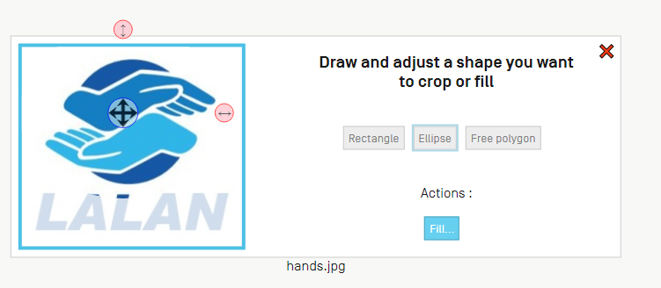
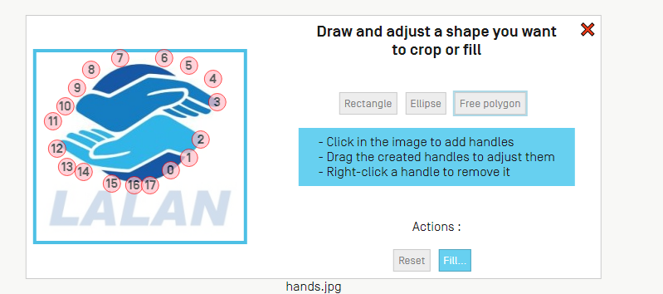

Slide 28
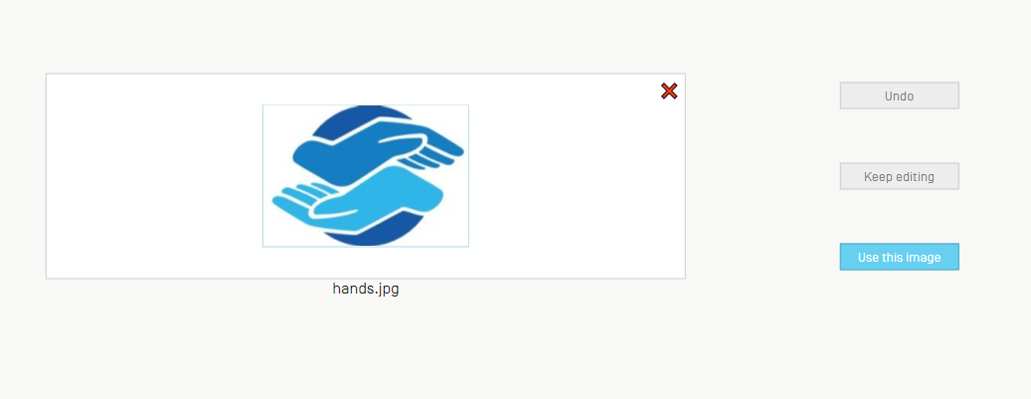
Notes:
Once cropped, just use the use this image button

Slide 29
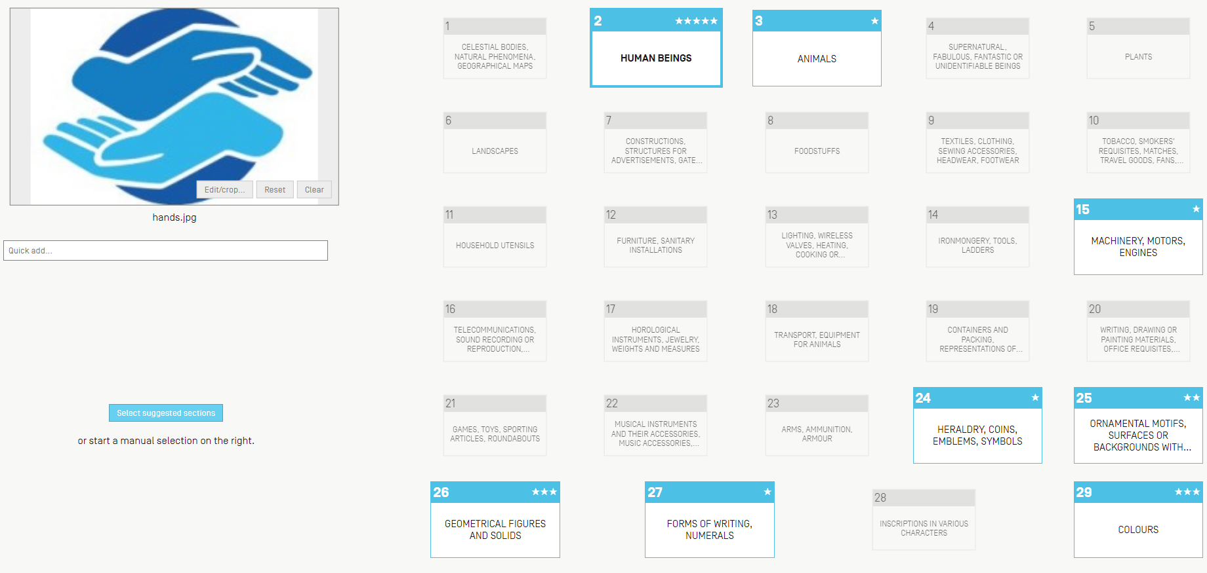
Notes:
Now you see that with this new image the most relevant classification changed: from geometrical figures and solids to human beings

Slide 30
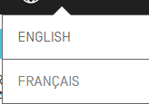
Languages

Slide 31
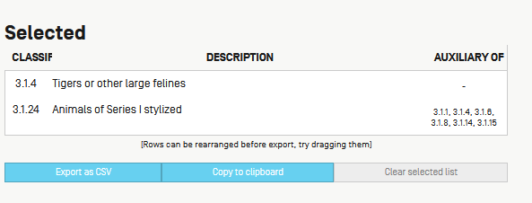

Slide 32
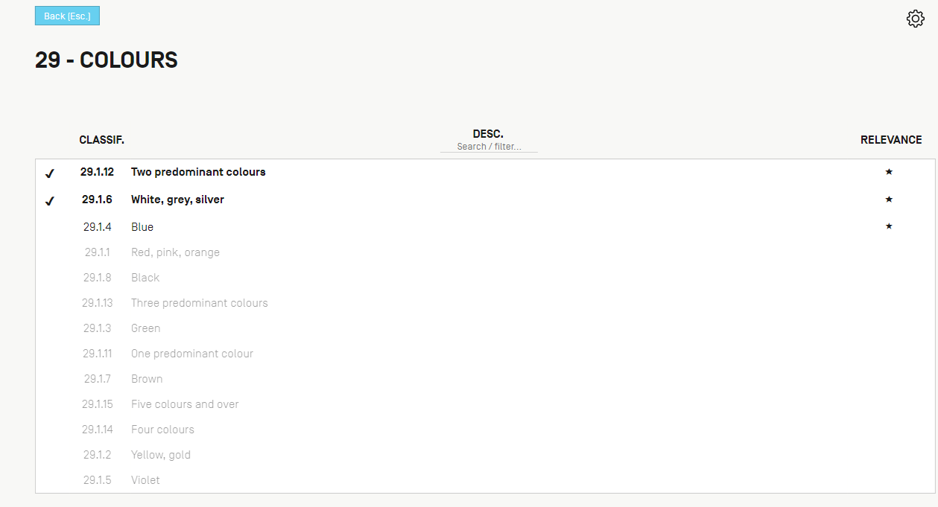
Options

Slide 34
Options

Slide 37
vienna_classificator@wipo.int
Notes:
If you have any questions and/or feedback, please contact us at

