Slide 1
Does IP Have Gender?
Dan L. Burk
University of California, Irvine

Slide 2
Levels of Bias
De jeure discrimination
De facto discrimination
Social bias
Embedded legal bias

Slide 3
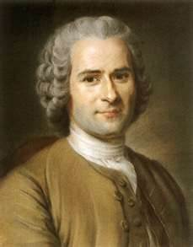
Historical
“Women, in general, possess no artistic sensibility . . . nor genius . . . Women’s writings are as cold and pretty as women.”
-- Jean-Jacques Rousseau, 1758

Slide 4
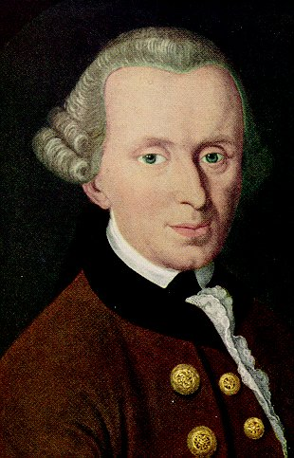
Historical
“Deep meditation and a long-sustained reflection are noble but difficult and do not well befit a person in whom unconstrained charms should show nothing else than a beautiful nature . . . [they]
destroy the merits
that are proper to
her sex.”
-- Immanuel Kant, 1764

Slide 5
Historical
Propriety of Inventing
Anonymous/Pseudonymous
Coverture
Male property
Male authority
Cost of Patenting
Examiner Disdain

Slide 6
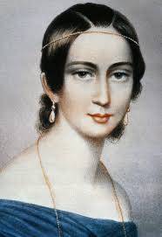
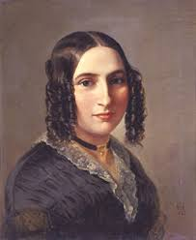
Historical
Copyright
“Arts” and “Crafts” (Wright, 1986)
Authorship
Pseudonymity
Clara Schumann
Fanny Mendelssohn

Slide 7
Historical
“From my knowledge of Fanny I should say that she has neither inclination nor vocation for authorship. She is too much all that a woman ought to be for this. She regulates her house, and neither thinks of the public nor of the musical world, nor even of music at all, until her first duties are fulfilled. Publishing would only disturb her in these, and I cannot say that I approve of it.”
– Felix Mendelssohn, 1836

Slide 8
US Data
A. Kahler, 2011
18.0% Patent Attorneys
26.1% Patent Agents
10.9 % patents (USPTO 2002)
Hunt et al., 2012
7.5% of patents
5.5% commercialized patents
2.7 % GDP difference

Slide 9
EPO Applications
 | 1991 % | 1996 % | 2001 % | 2005 %
ESP | 7.5 | 9.3 | 11.1 | 14.2
FRA | 6.0 | 7.5 | 9.9 | 10.2
DEN | 5.0 | 8.7 | 8.1 | 8.2
AUS | 4.4 | 6.1 | 12.2 | 8.1
USA | 6.3 | 7.7 | 8.8 | 8.2
SWE | 5.2 | 4.8 | 6.7 | 8.6
ITA | 4.9 | 5.1 | 6.7 | 7.6
GBR | 4.0 | 5.7 | 6.2 | 6.7
SUI | 1.6 | 3.3 | 5.7 | 5.9
GER | 2.4 | 3.2 | 4.5 | 4.9

Slide 10
EPO Technologies 2003-05
 | SUI | GER | ESP | FRA | GBR | ITA | USA
Pharmaceutical | 18.9 | 19.4 | 26.4 | 32.9 | 16.2 | 28.3 | 18.8
Polymers | 6.1 | 5.5 | 11.4 | 8.9 | 5.4 | 7.9 | 8.4
Electronics | 2.7 | 3.8 | 8.8 | 10.3 | 5.0 | 9.7 | 6.5
Optics | 9.9 | 4.6 | 10.2 | 10.3 | 7.5 | 5.6 | 6.3
Computers | 4.0 | 2.9 | 1.1 | 6.3 | 2.7 | 5.0 | 6.7
Telecomm | 1.6 | 2.3 | 8.5 | 8.2 | 3.8 | 8.2 | 6.5
Machine tools | 1.6 | 0.9 | 0 | 4.0 | 1.5 | 0.8 | 3.5

Slide 11
Female Inventors - Chile
Year | Chile % | USPTO % | PCT %
2005 | 10.4 | 10 | 5
2006 | 9.8 | 10 | 0
2007 | 14 | 7 | 25
2008 | 5.8 | 15 | 13.3
2009 | -- | 11 | --
2010 | -- | 25 | --

Slide 12
Life Sciences
Ding et al., 2006
PhDs obtained 1967-95
Female scientists: 5.65%
Male scientists: 13%
Gender gap at all career levels
Controlling for other variables: 40%

Slide 13
Life Sciences
Whittington & Smith-Doerr, 2005
U.S. Patents 1963-99
30% of male, 14% of female
Across all cohorts
Academic: 23% of male, 10 % of female
Industry: 52% of male, 36% of female
Similar citation impact
Similar originality

Slide 14
Ethnography
Thinking about Commercialization
Promoting Research Projects
Access to Social Networks
Access to Venture Capital
Invitation to Commercial Participation

Slide 15
Power Relations
“[F]eminist inquiry is about understanding how things work, who is in the action, what might be possible, and how worldly actors might somehow be accountable to and love each other less violently.”
-- Donna Haraway, 2003

Slide 16
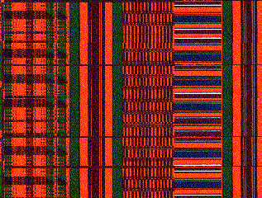
Ghanan Textiles
Kente cloth
Traditional knowledge
Machine-made cloth
TK protection law
Boatang (2011)

Slide 17
Adapting Law
Patenting Standard
Inventive Step/Obviousness
PHOSITA
“Skilled Man”
Woman of Ordinary Skill
Reasonable woman metric
Reasonable child, Reasonable physician

Slide 18
Thank You
Questions Welcome

