Slide 1
WIPO Global Databases
Seminar on WIPO Services and Initiatives
Christophe Mazenc
Head of Global Databases Service
Global Infrastructure Sector (GIS)
Copenhagen
September 6, 2013

Slide 2
Global Databases, Tools, and Platform for IP business
PATENTSCOPE
Global Brand Database
WIPO Lex
WIPO IPAS
WIPO DAS
WIPO CASE
WIPO RE:SEARCH
WIPO Development Matchmaking Database
WIPO GREEN

Slide 3
PATENTSCOPE
2.2 million PCT data (first publish, high quality full text)
30 million records (from 30 countries or regions)
Full text search
Cross Lingual Information Retrieval (CLIR)
Machine translation tools (Google, Microsoft, WIPO’s TAPTA)
Analysis and graphical presentation

Slide 4
PATENTSCOPE
600’000 unique visitors per quarter
2.7 million visits in Q2 2013
700’000 downloaded documents per month
Denmark ranked 38 in countries most using PATENTSCOPE with 770 unique users having at least performed a patent search in Q2 2013

Slide 5
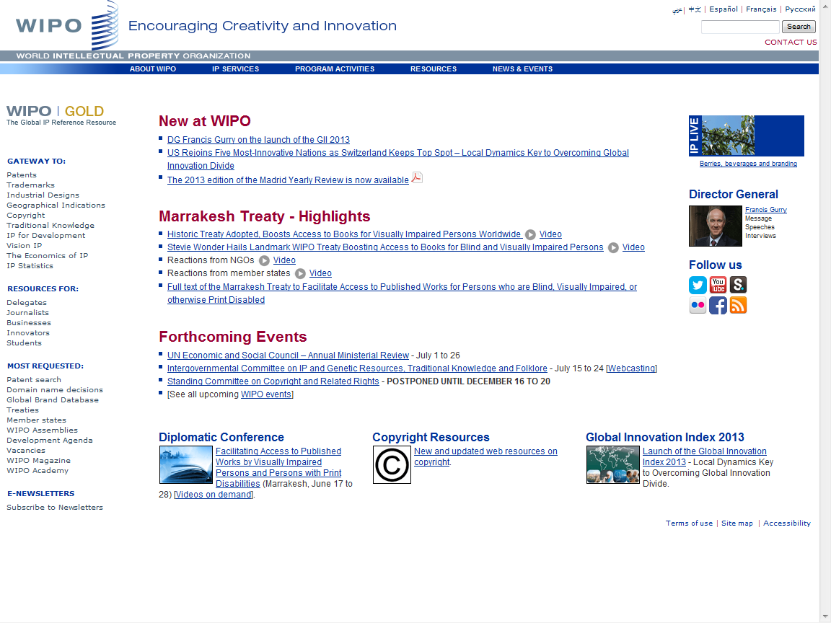

Slide 6
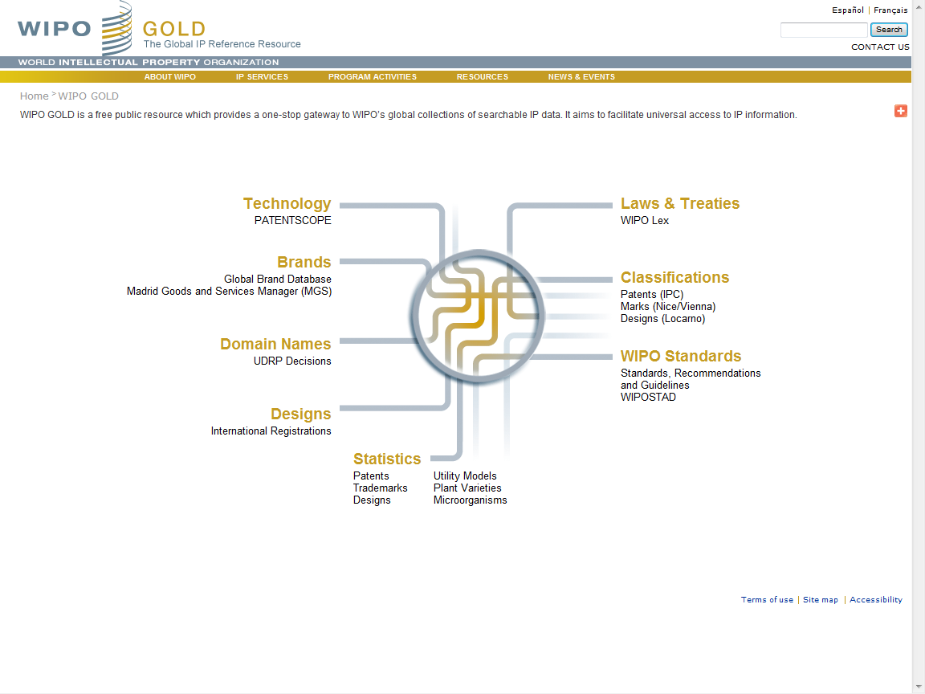

Slide 7
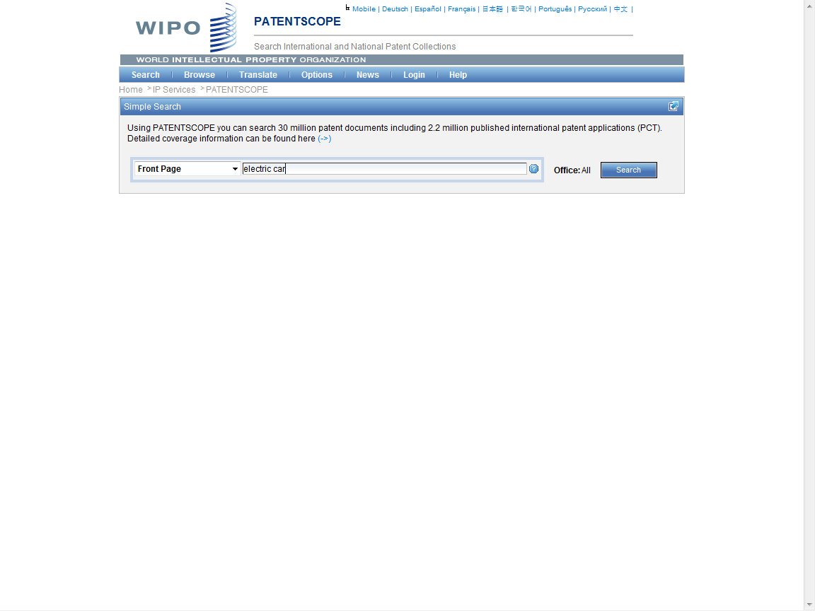

Slide 8
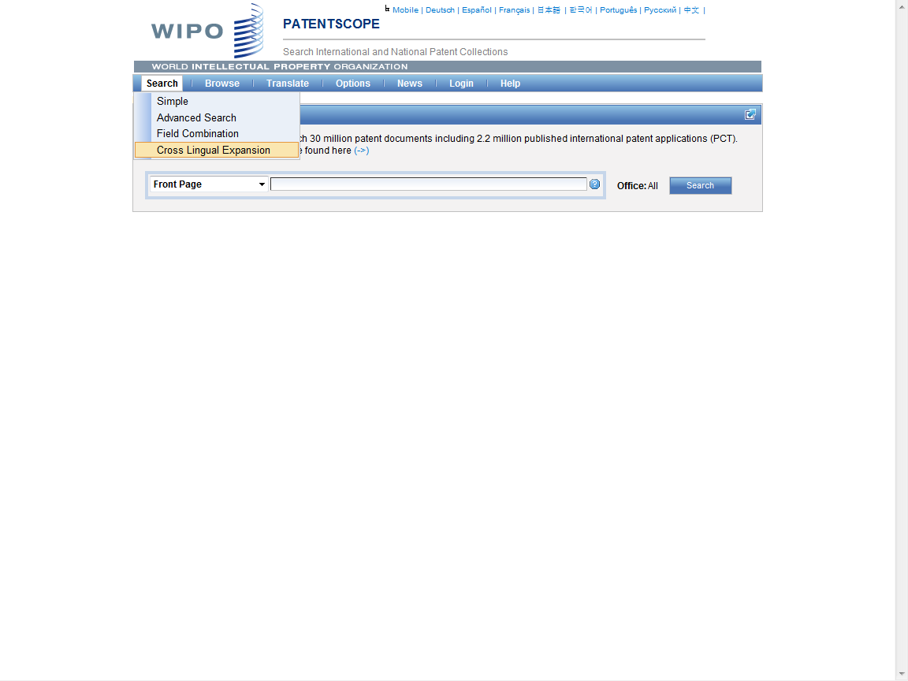

Slide 9
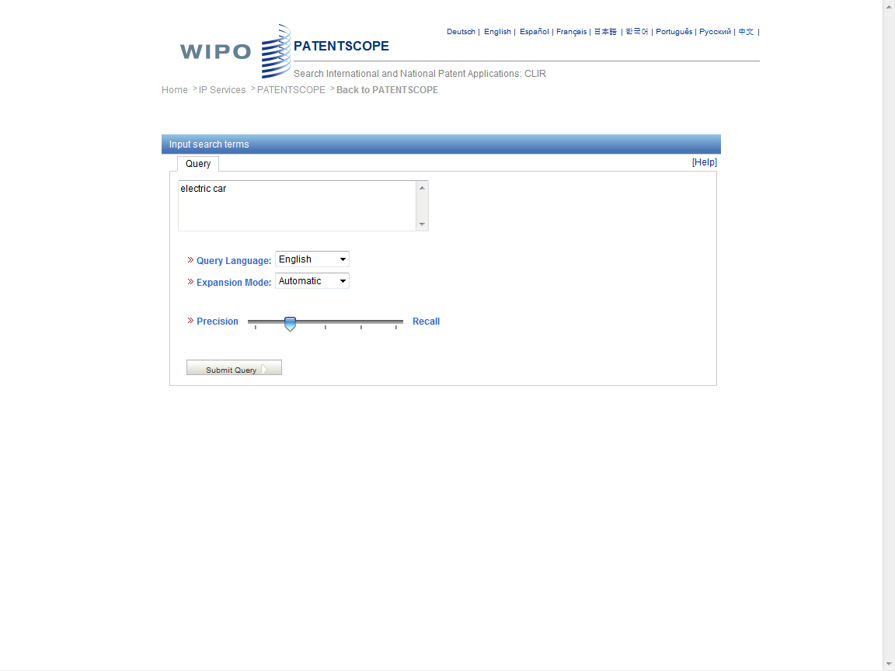

Slide 10
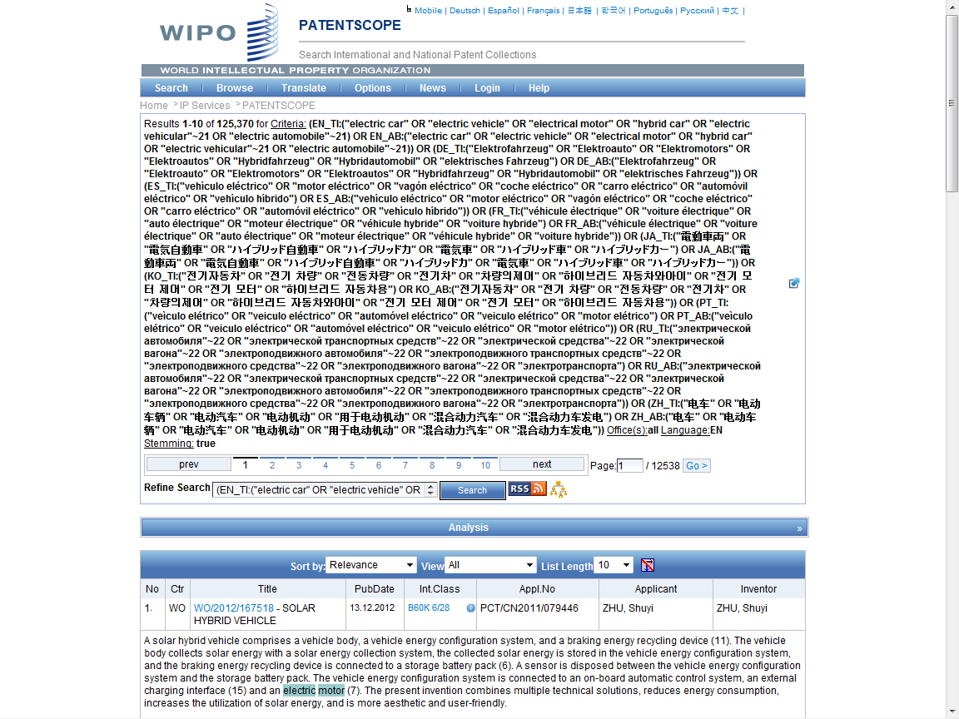
Search Query

Slide 11
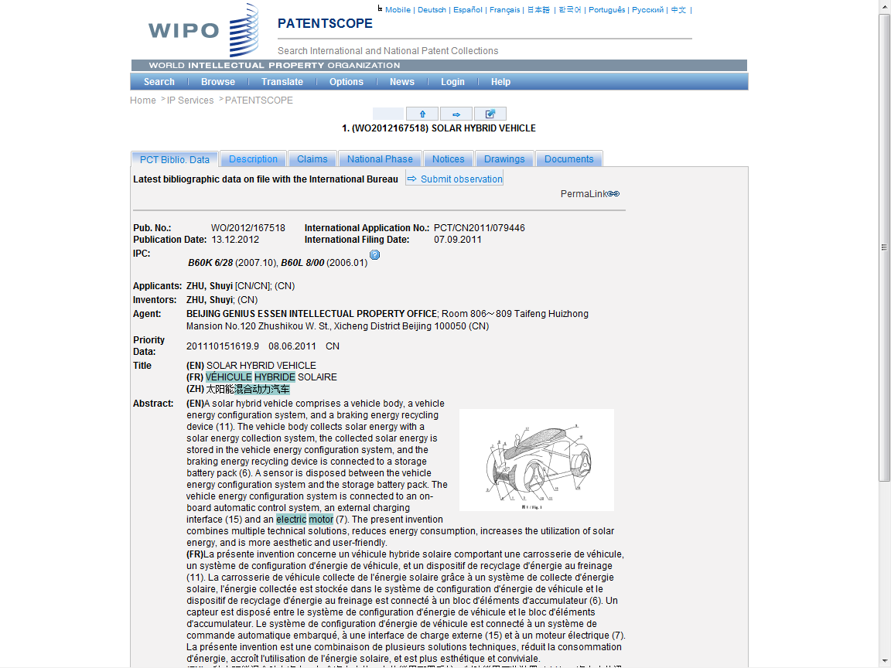

Slide 12
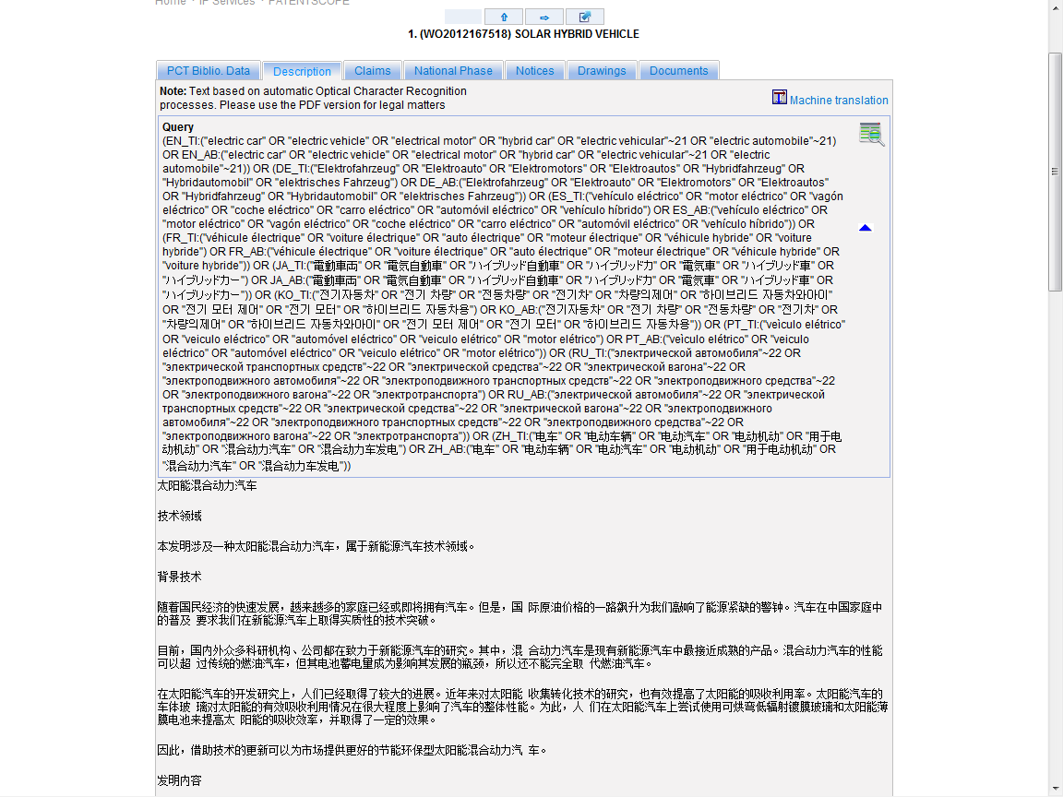
??

Slide 13
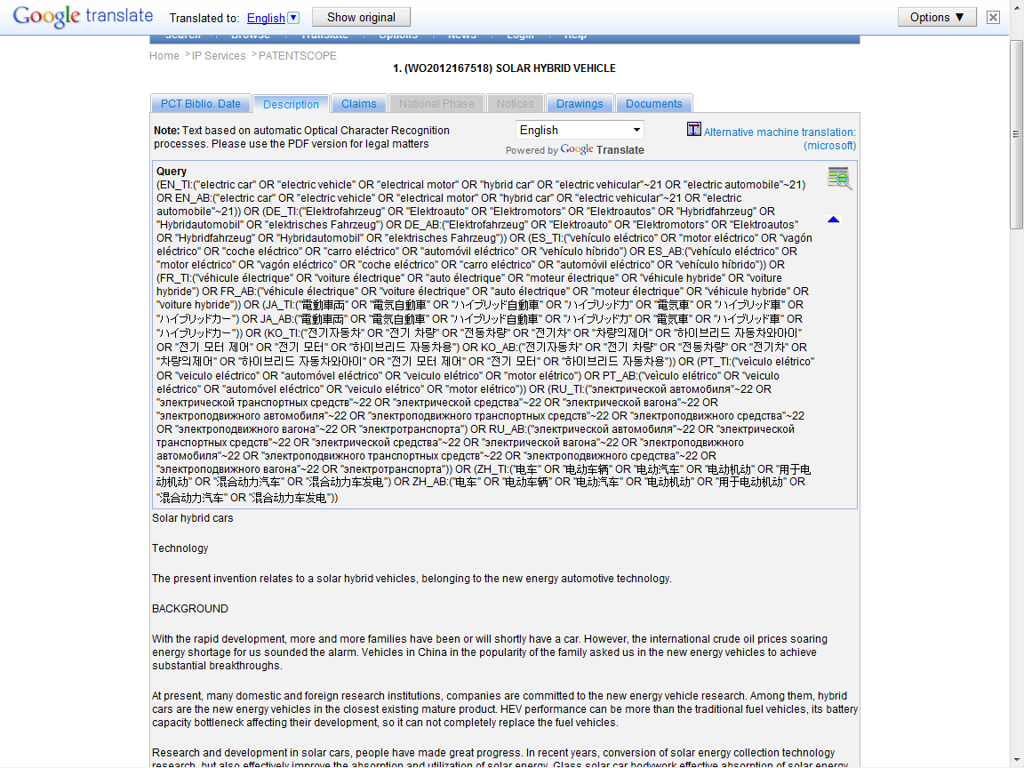

Slide 14
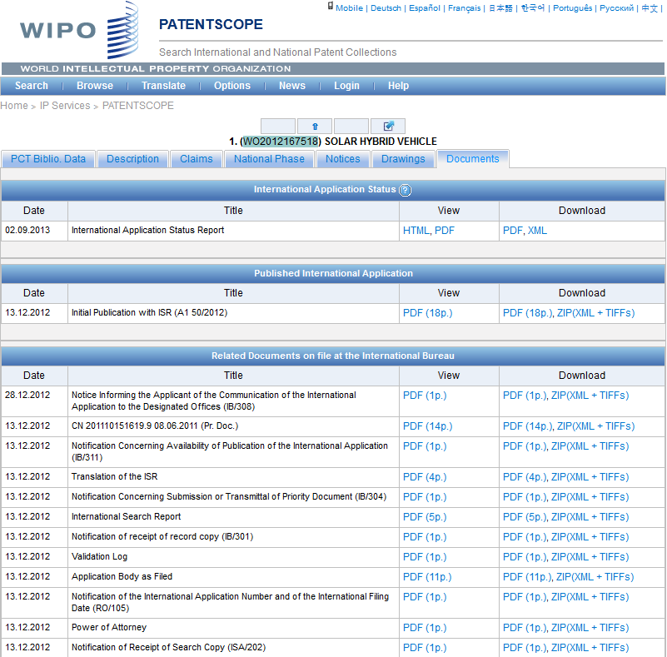

Slide 15
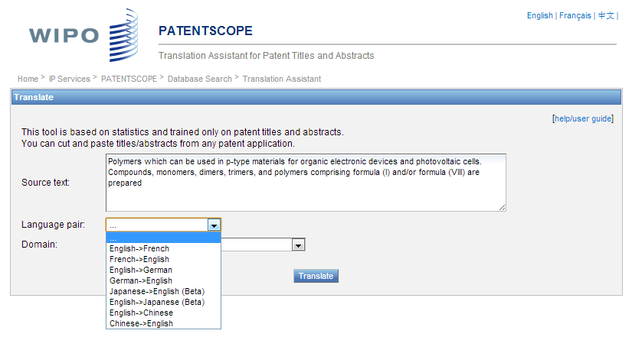
TAPTA

Slide 16
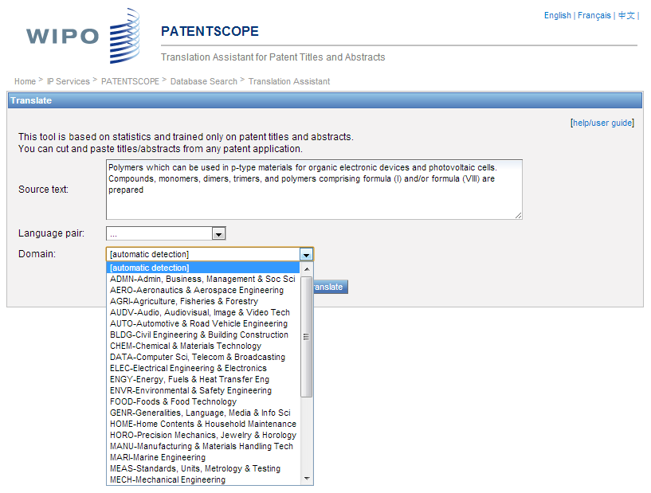

Slide 17
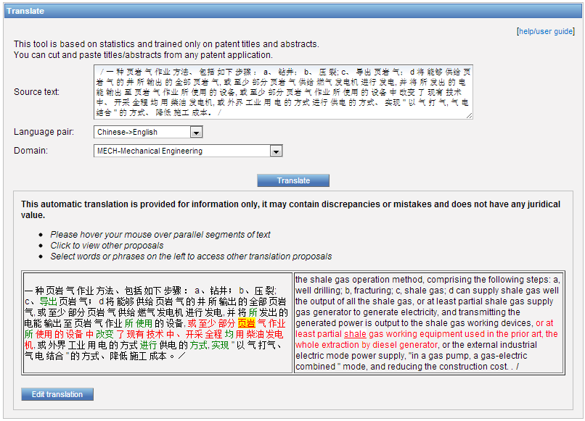

Slide 18
Global Databases, Tools, and Platform for IP business
PATENTSCOPE
Global Brand Database
WIPO Lex
WIPO IPAS
WIPO DAS
WIPO CASE
WIPO RE:SEARCH
WIPO Development Matchmaking Database
WIPO GREEN

Slide 19
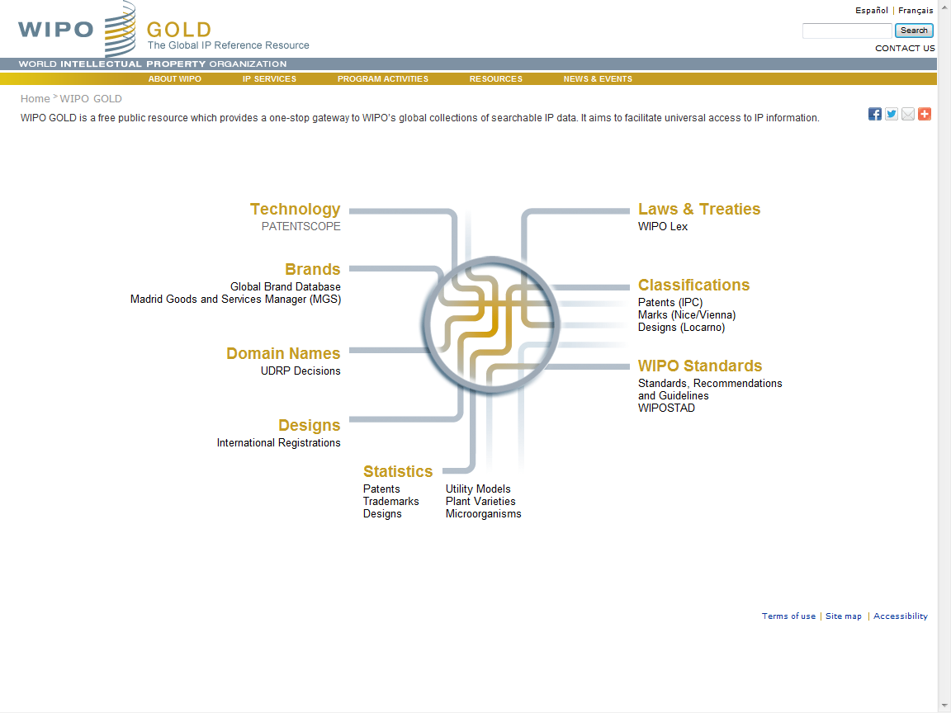

Slide 20
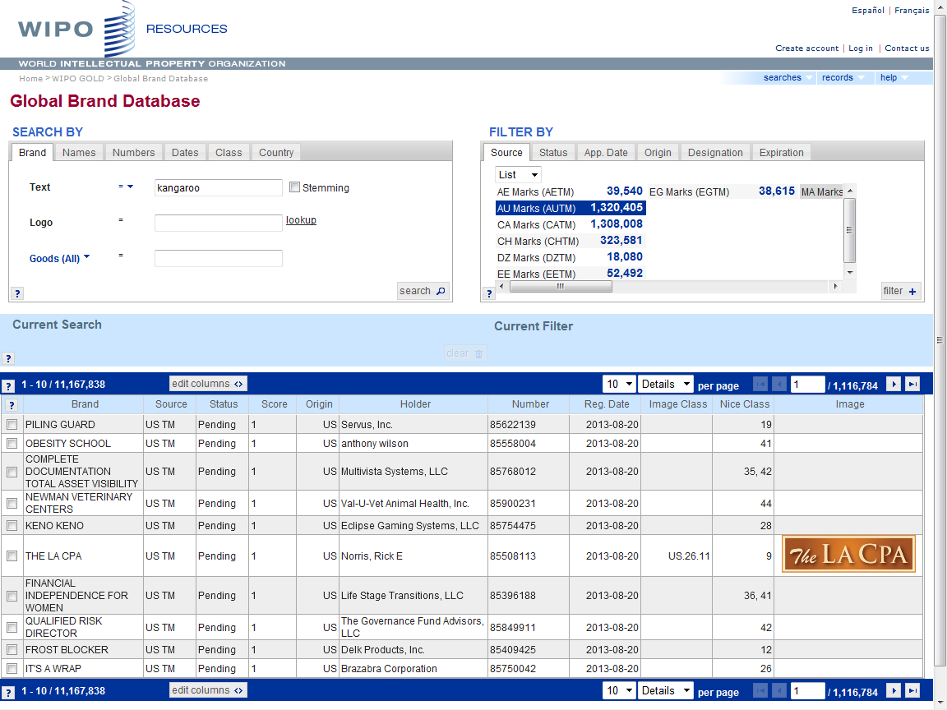

Slide 21
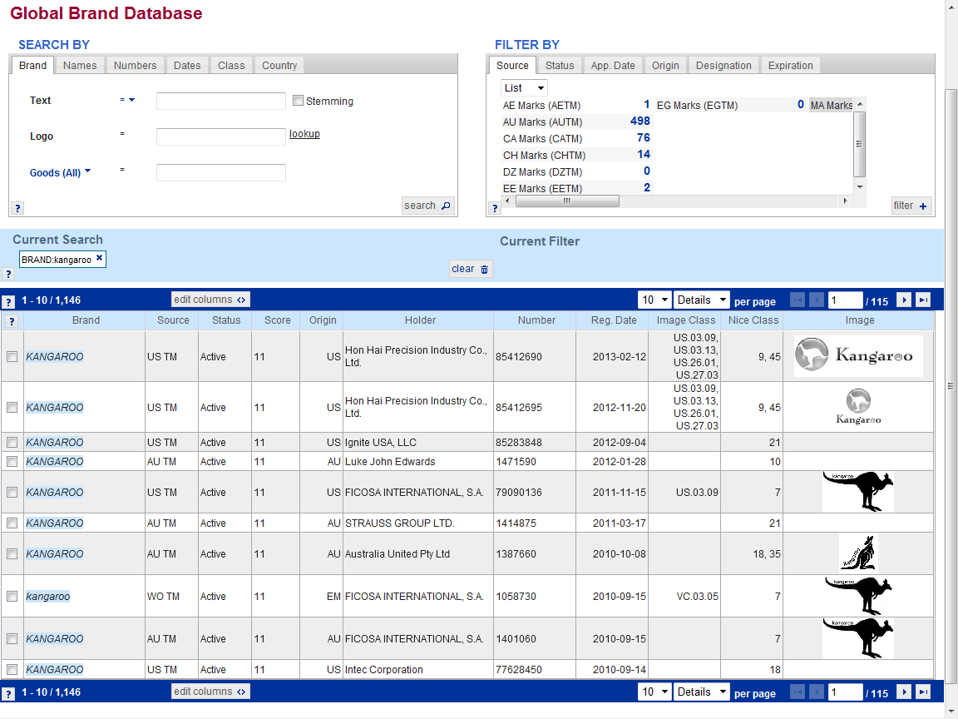

Slide 22
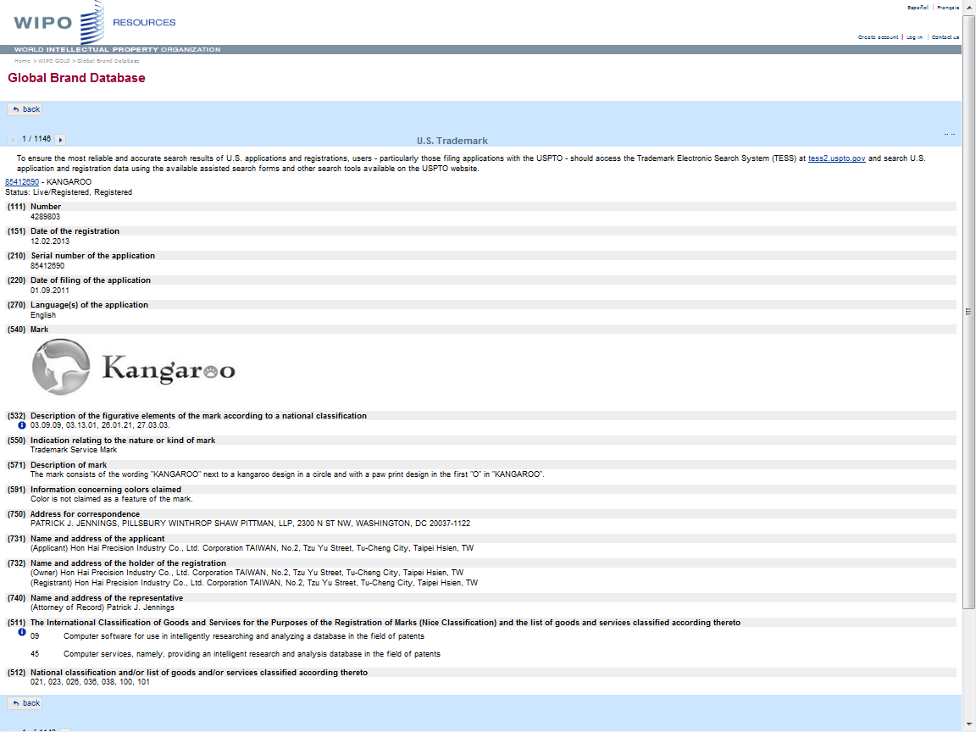

Slide 23
Global Databases, Tools, and Platform for IP business
PATENTSCOPE
Global Brand Database
WIPO Lex
WIPO IPAS
WIPO DAS
WIPO CASE
WIPO RE:SEARCH
WIPO Development Matchmaking Database
WIPO GREEN

Slide 24
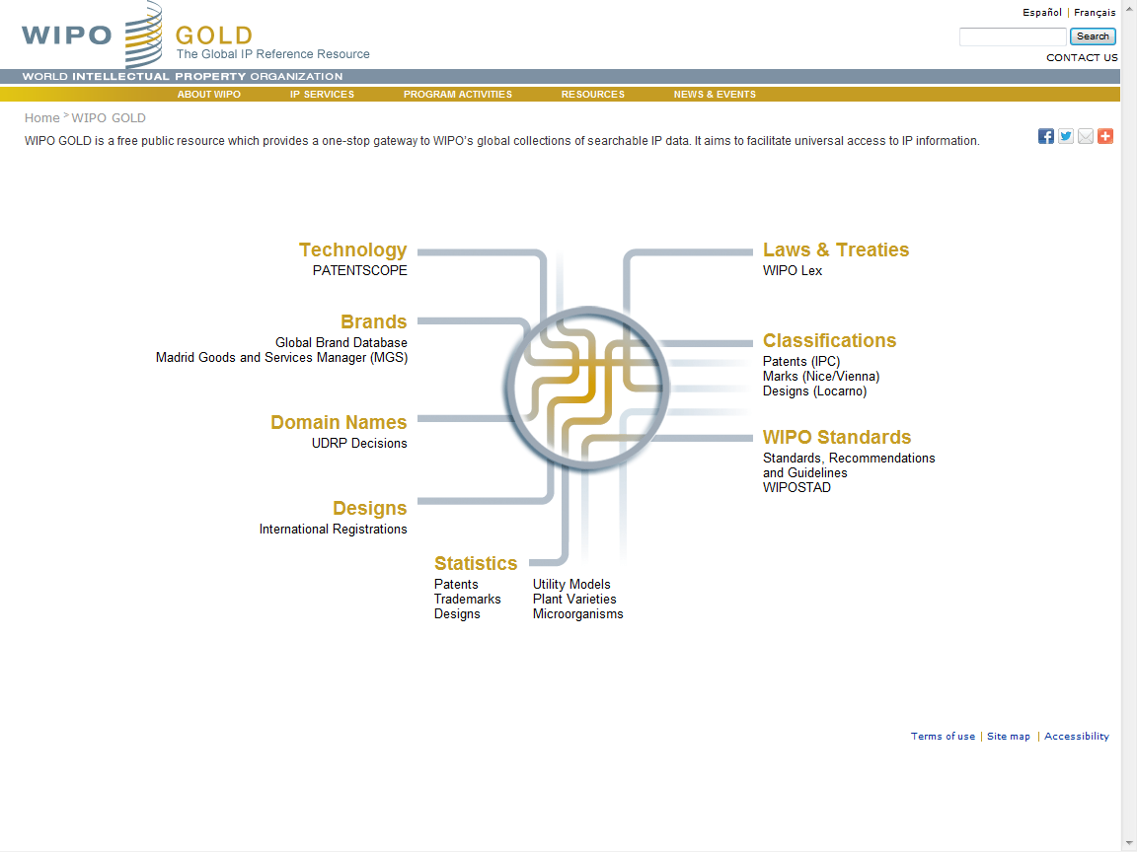

Slide 25
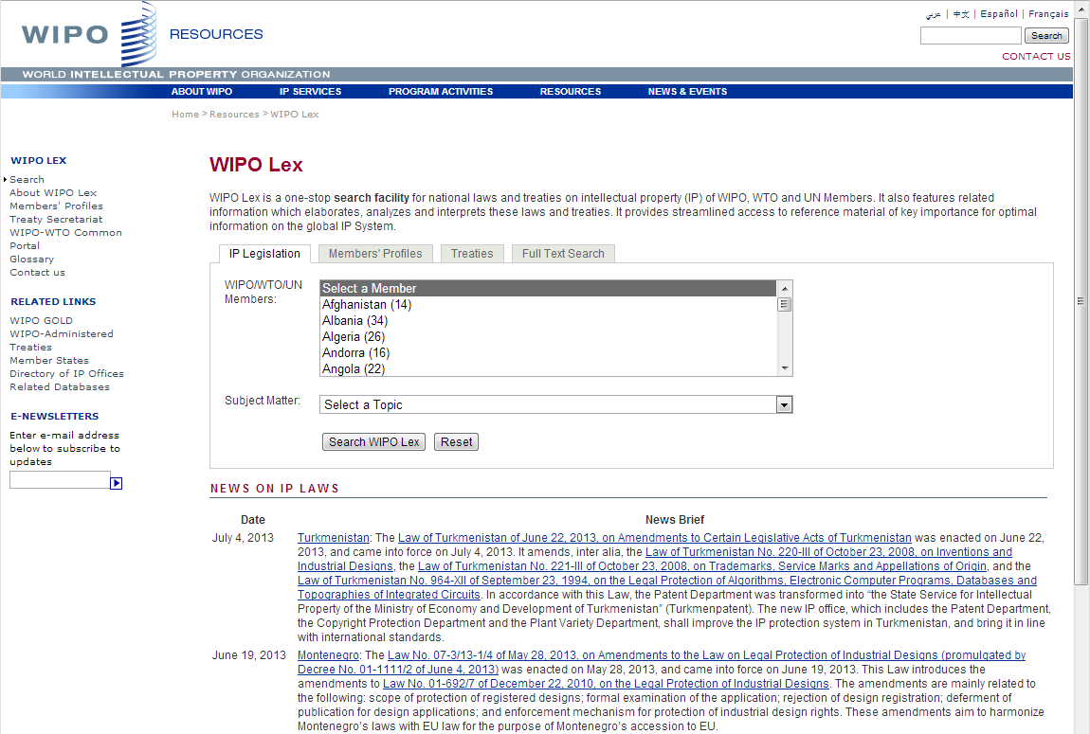

Slide 26
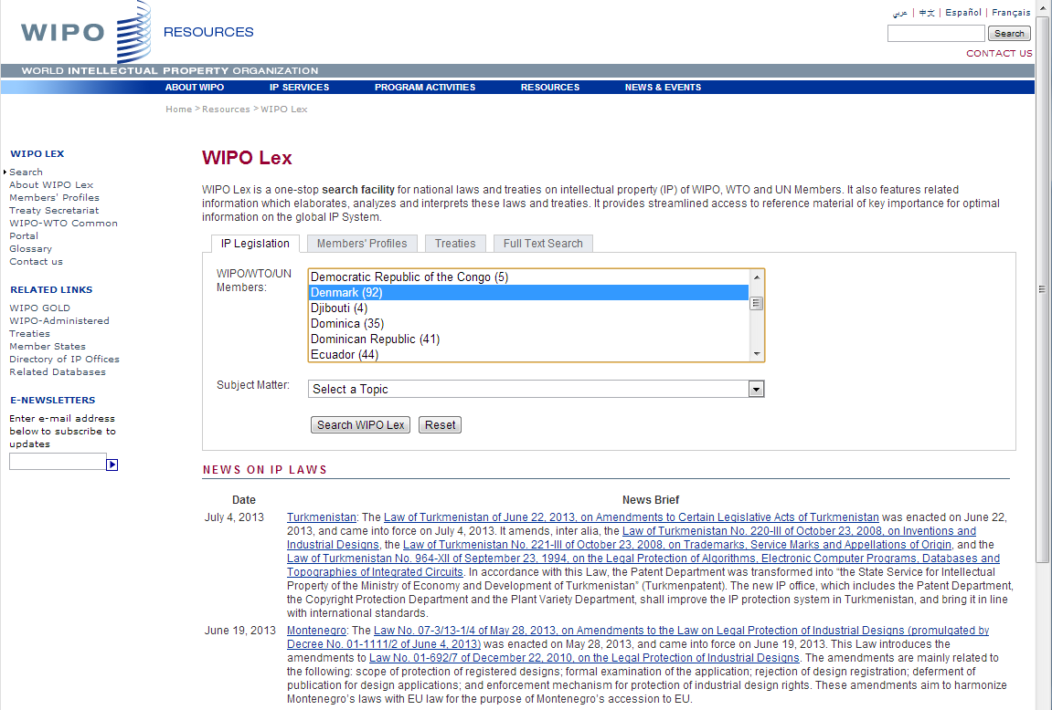

Slide 27
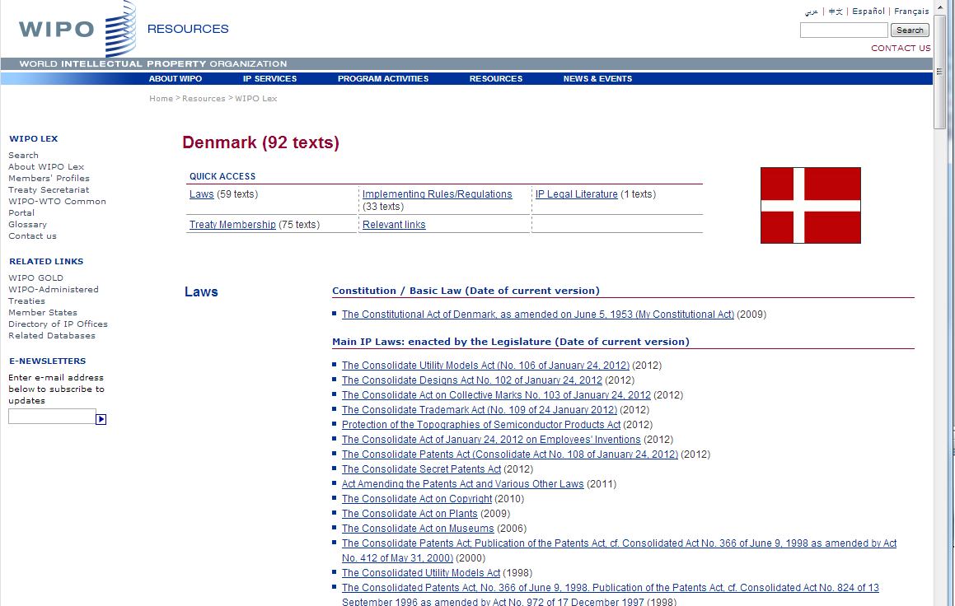

Slide 28
Global Databases, Tools, and Platform for IP business
PATENTSCOPE
Global Brand Database
WIPO Lex
WIPO IPAS
WIPO DAS
WIPO CASE
WIPO RE:SEARCH
WIPO Development Matchmaking Database
WIPO GREEN

Slide 29
IPAutomation System (IPAS)
A flexible, modular system that can be customized to individual industrial Property (IP) offices to automate their IP business and administrative processes from application reception to registration, including post-registration actions such as amendments, assignment, renewals, annuities, etc.
Covers management of trademarks, patents and industrial designs
Used by 55 IP offices

Slide 30
Global Databases, Tools, and Platform for IP business
PATENTSCOPE
Global Brand Database
WIPO Lex
WIPO IPAS
WIPO DAS
WIPO CASE
WIPO RE:SEARCH
WIPO Development Matchmaking Database
WIPO GREEN

Slide 31
WIPO Digital Access System
DAS (Digital Access System) used by 11 IPOs
- A System that allows IPOs and applicants to securely exchange or submit a digital copy of priority documents to multiple IPOs

Slide 32
Why use DAS?
APPLICANTS | OFFICES
Easy Simply ask the office of first filing to add the priority document into the system, and request offices of second filing to use the service for obtaining access. | Easy No or reduced need to prepare, check or scan certified copies on paper; No need to deal with different transmission and document formats; No need to establish secure connections to multiple offices.
Secure Use of an access code to authorize access; Documents exchanged via secure channels; Service hosted and administered by WIPO. | Secure Documents exchanged via secure channels; Service hosted and administered by WIPO.
Quick No need to provide a certified copy of a priority document separately to each office of second filing. | Valuable Automate the exchange of documents with other offices; Offer a new service at low cost for local applicants wishing to file applications in other countries.
Inexpensive No need to pay for multiple copies of paper priority documents; No charges by WIPO. Offices can charge, but it is expected that most will not. | Inexpensive Simple service delivered through channels already existing at most automated offices.

Slide 33
Global Databases, Tools, and Platform for IP business
PATENTSCOPE
Global Brand Database
WIPO Lex
WIPO IPAS
WIPO DAS
WIPO CASE
WIPO RE:SEARCH
WIPO Development Matchmaking Database
WIPO GREEN

Slide 34
WIPO-CASE
“Centralized Access to Search and Examination Reports”
Started with an initiative of IP Australia and the Vancouver Group (AU, CA, UK)
Online patent work-sharing platform for patent examiners worldwide
IPOs can enhance quality and efficiency of patent examination
CASE will be linked to Open Portal Dossier of IP5 to become the Global Portal Dossier
How will it work?

Slide 35
WIPO-CASE (continued)
The System functions to:
Search by patent number and retrieve simple results or a list of patent family members.
View bibliographic data, citation data (if available) and lists of documents available for each patent record.
View and/or download the available documents.
Subscribe to notifications of updates to a given patent record.
-> will be linked to OPD of IP5 -> “Global Dossier”

Slide 36
“World Patent Office” on Global Dossier Platform
(WIPO-CASE, OPD and PATENTSCOPE)
PATENT
SCOPE
Public Users
(including IP office users)
Examiner of IP5 Office not participating in WPO/CASE
OPD
Feed dossier information that
OPD/CASE Offices agree to publish
Public Domain
OPD
Not accessible to the public and for PTO official use only
WIPO CASE
IPAS+
CASE depositary
System
Examiner of CASE participating office
Examiner of IP5 Office participating in WPO/CASE
CASE depositary Office using IPAS
CASE depositary Office using own EDMS
E.g. Australia

Slide 37
Global Databases, Tools, and Platform for IP business
PATENTSCOPE
Global Brand Database
WIPO Lex
WIPO IPAS
WIPO DAS
WIPO CASE
WIPO RE:SEARCH
WIPO Development Matchmaking Database
WIPO GREEN

Slide 38

WIPO RE:SEARCH
Sharing Innovation in the Fight Against Neglected Tropical Diseases
Mission:
Aims to accelerate the discovery and product development of medicines, vaccines, and diagnostics to develop new solutions for people affected by neglected tropical diseases, tuberculosis and malaria, by making intellectual property and know-how available to the global health research community.

Slide 39
WIPO RE:SEARCH
Sharing Innovation in the Fight Against Neglected Tropical Diseases
Means / Results
A Global Database and Platform to bridge partners to use IP (including know-how and data) to facilitate R&D on neglected tropical diseases, tuberculosis, and malaria (http://www.wipo.int/research/en/search/).
A partnership hub
Over 60 partners (pharmaceutical industry, research institutes such as NIH, Universities)
As of July 2013, 25 license agreements concluded

Slide 40
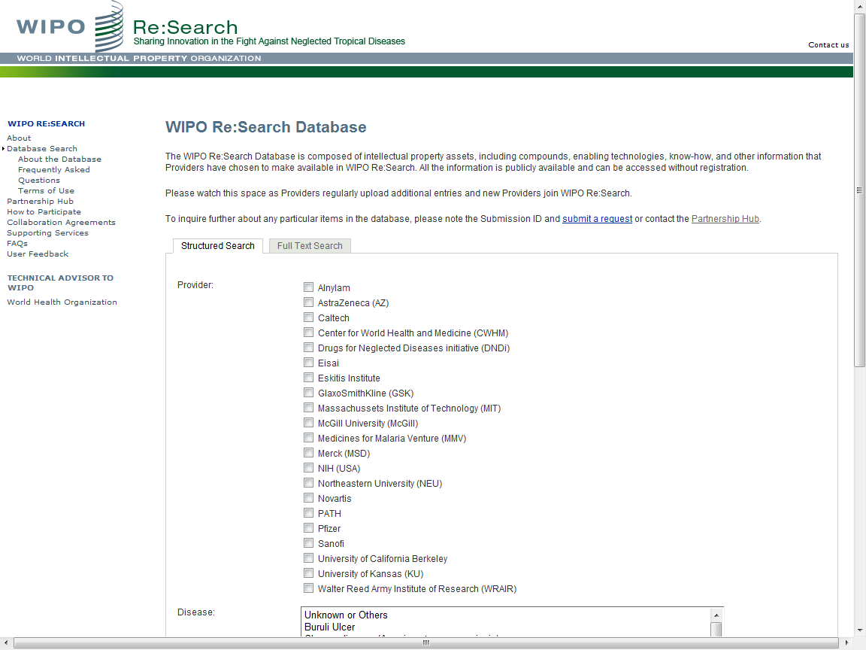

Slide 41
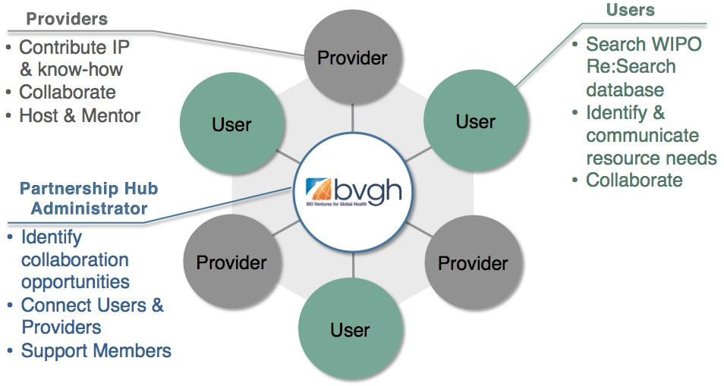
WIPO RE:SEARCH
Sharing Innovation in the Fight Against Neglected Tropical Diseases

Slide 42













WIPO RE:SEARCH
Sharing Innovation in the Fight Against Neglected Tropical Diseases
Get involved:
As a user
As a provider
As a supporter
(Adhere to Guiding principles, contact email: re_search@wipo.int)
…

Slide 43
Global Databases, Tools, and Platform for IP business
PATENTSCOPE
Global Brand Database
WIPO Lex
WIPO IPAS
WIPO DAS
WIPO CASE
WIPO RE:SEARCH
WIPO Development Matchmaking Database
WIPO GREEN

Slide 44
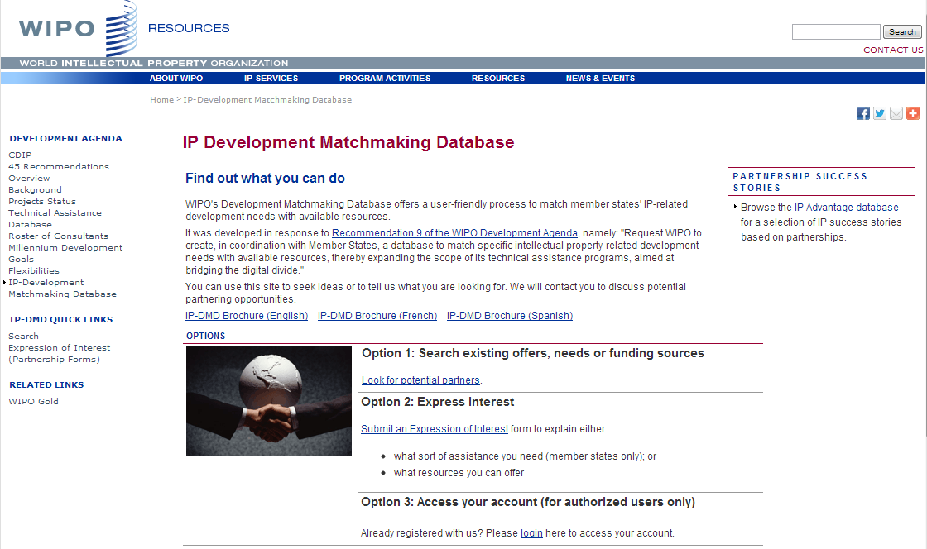

Slide 45
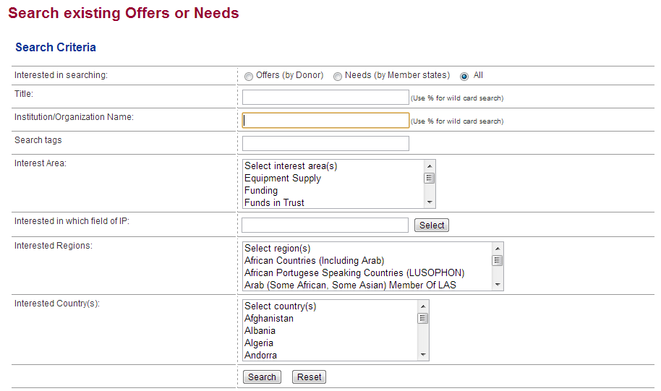

Slide 46
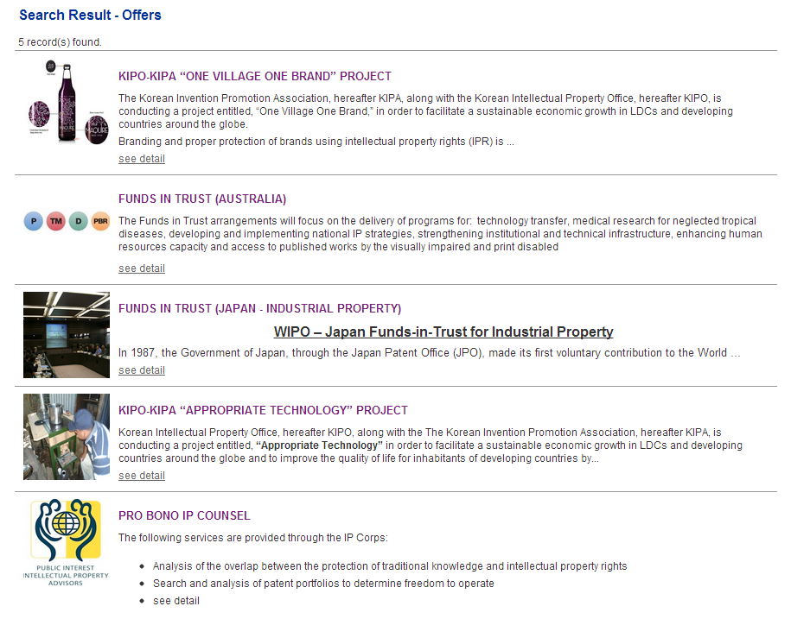

Slide 47
Global Databases, Tools, and Platform for IP business
PATENTSCOPE
Global Brand Database
WIPO Lex
WIPO IPAS
WIPO DAS
WIPO CASE
WIPO RE:SEARCH
WIPO Development Matchmaking Database
WIPO GREEN

Slide 48

An interactive marketplace that connects green technology providers and those seeking innovative solutions to combat environmental challenges.

Slide 49
Two Principal Components:
The WIPO GREEN DATABASE, freely accessible, offers a broad listing of
  Needs for products, processes, know how transfer, collaboration and finance
  Products, services and intellectual property assets
The WIPO GREEN NETWORK connects green technology providers and seekers, catalyzes mutually beneficial commercial transactions and offers other resources and services.

Slide 50
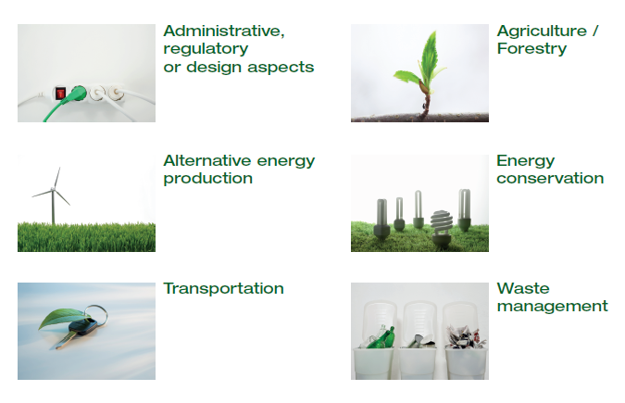
Six Areas of Green Technology Markets

Slide 51
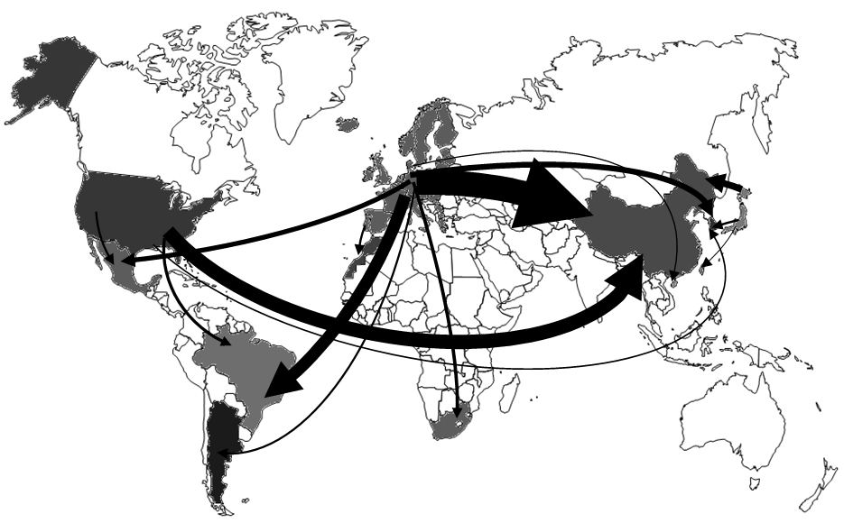
The Challenge
International Transfer of wind power technology, 1988-2007,
OECD 2010

Slide 52













Providers
Seekers

Slide 53

Get Involved
Become a Partner and shape the further development of WIPO GREEN
Register to:
    communicate your green innovation and technology needs
    advertise your inventions, technologies, products and services
    connect with the innovation and business communities globally

Slide 54
Visit the Pilot Version
www.wipo.int/green
wipo.green@wipo.int
Tel.: +41 22 338 9500

Slide 55
Vision
WIPO Global Databases and Platforms will promote global partnerships among multiple stakeholders
DB, Tools, Platforms need to be easy to search, most updated, interactive/dynamic, multilingual, and robust

Slide 56
Thank You!
www.wipo.int
“CONTACT US” Web Site at
http://www.wipo.int/contact/en/

