Slide 1
New Tools for Users:
Contact Hague Service
Hague Member Profile Database
Ms. Marlene Haustein-Csordas
Information Assistant Hague Development and Promotion Section The Hague Registry
Geneva,
July 19, 2018

Slide 2
Overview
I. Contact Hague Service
Components
Benefits
Future Developments
II. Hague Member Profiles
Looking Inside
Future Portal and Multiple New Features
Further Developments
Notes:
My presentation this morning comprises two parts: Contact Hague Service and Hague Member Profiles.

Slide 3
Contact Hague: http://www.wipo.int/hague/en

Slide 4
Components - Ticket Workflow
Notes:
Ticket is generated an acknowledgement of receipt and message ID.
Modules include a customer and agent module. Agent can view the tickets in the queues and manage internally
Some tools include: lock , reserve, move, priority, answer, note., select access rights.

Slide 5
Components –Ticket History
Notes:
As mentioned briefly, once a ticket is within WINS, we can

Slide 6
Ticket Workflow
Notes:
At the heart of the agent’s module is a dashboard which provides a screen of activity and preprogrammed queues with an icon bar for quick searches, sorting and reports but other tools linked to a ticket such as access rights, lock, move, note and split and FAQ -the tool for predefined answers or templates. This new tool presents many opporunities.

Slide 7
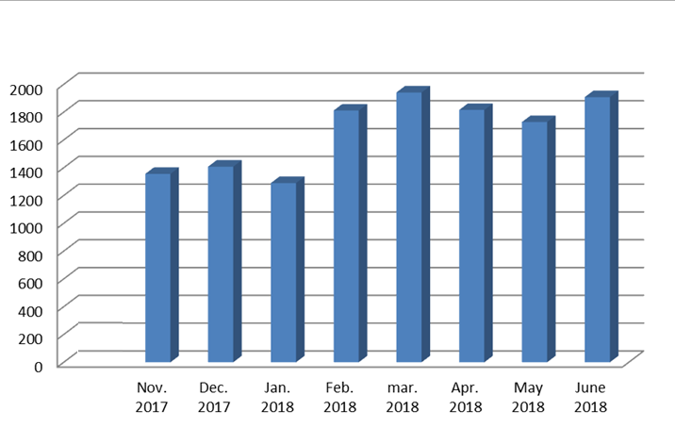
Contact Hague Volume
Notes:
Since its launch in late October 2017.

Slide 8
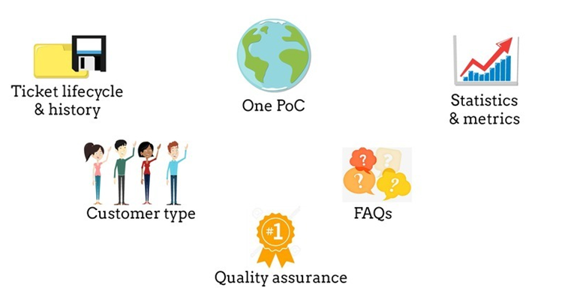
Benefits
Notes:
Tool for all stakeholders, it is easy to use and provides customized screens per user and furthermore provides simplified web access. It covers all communicaiton channels, phone calls emails, WIPO web contact page and web customer module. WINS allow us to consult customer type and ticket lifecycle, generate new FAQs, statistics and performance metrics and derive more BI, through being more responsive and while aiming to achieve quality standards are enhanced adn to really understand the customer, and as well to improve quality processes to provide an efficient and dedicated service by channelling internally, becoming more connected and more responsive. The internal highway will be evermore interconnected to improve the customer journey.

Slide 9
Future Developments
Expand Contact Hague
One-stop-service
Surveys
Notes:
Because of this we have a knock-on effect on our Operating procedures which are being further developed and in other parts of WIPO as well which we have found to have been really positive and effective.

Slide 10
II. Hague Member Profiles
www.wipo.int/hague/en/members
http://www.wipo.int/hague/en/members

Slide 11
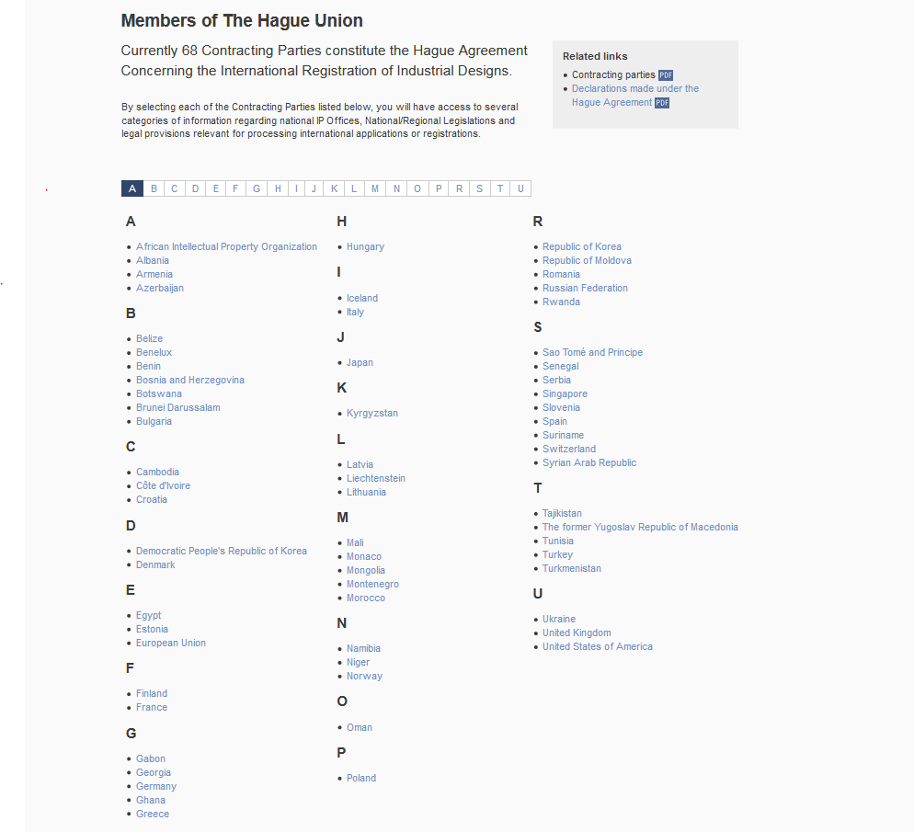
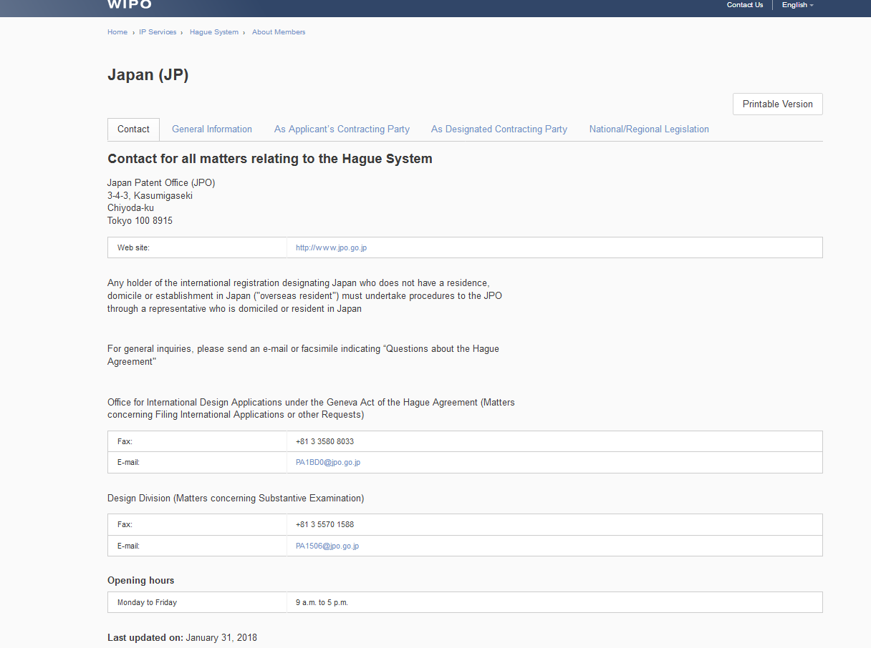
Current portal - Frontpage
Notes:
Within this portal you have access to a wealth of exclusive content provided in collaboration with our Member Offices and free of charge.

Slide 12
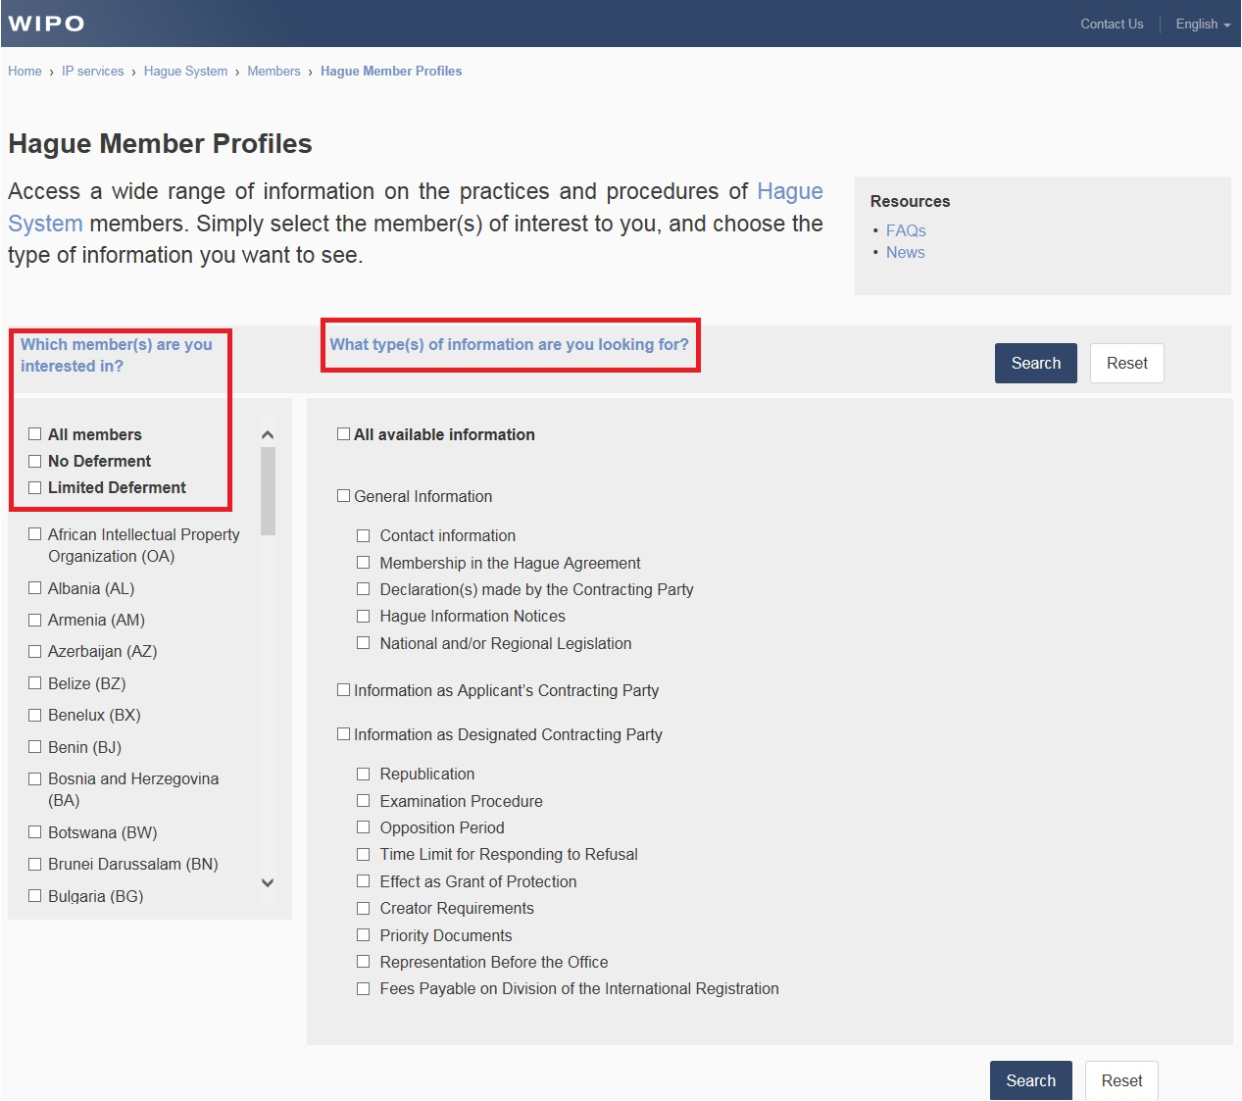
Future portal – Frontpage Multiple new features
Notes:
The objective of this work is to enhance searchable features through offering new functions and more granularity. The deployment of this portal will emcompass our aim to deliver an accessible and yet cost-effective resource.
Choose the market of interest and select or determine the subtopic. Several filters will narrow down the results too.

Slide 13
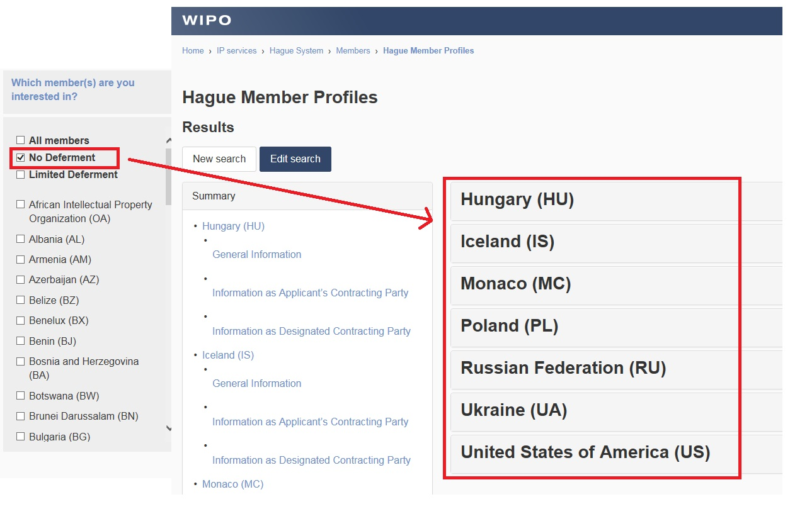
Search Member CPs where you want to stay ahead of the competition

Slide 14
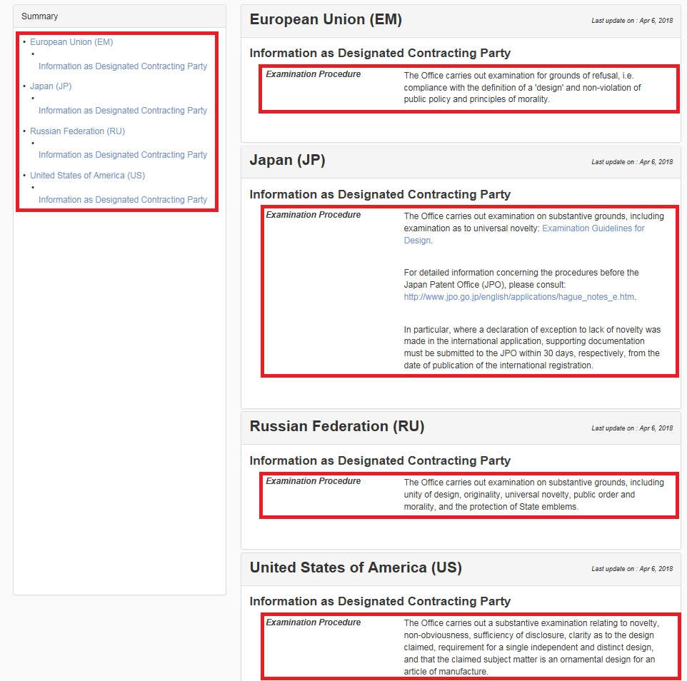
Assess grounds of examination for specific CPs prior to filing
Notes:
Your results page is separated into a summary on the left with the search results on the right. As in this example, if you select more than one Member market in Step 1 the results will appear in alphaetical order on the right.

Slide 15
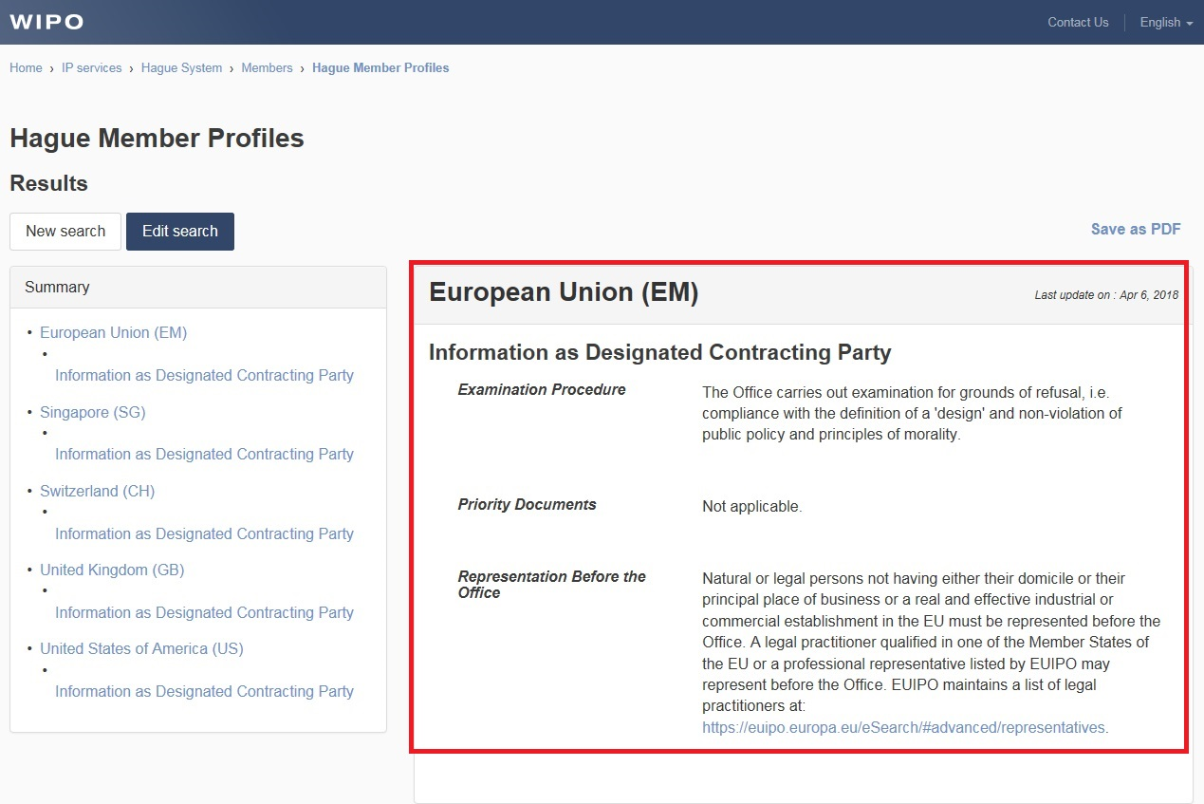
Consult the procedures for filing priority documents
Notes:
You may want to edit your search to select certain elements or to remove them to generate a new report. To undertake a new search, click on reset.
You can save your research as a PDF file.

Slide 16
Further Developments
Rollout in 3rd quarter of 2018, replaces current version
Quick Start Guide
Feedback mechanism
Continue to populate the resource with new functionalities
Notes:
Our aim is to l

Slide 17
Thank you… http://www.wipo.int/contact/en/hague
Notes:
If you have any questions, please do not hesitate to approach me during coffee break or lunch.

