Slide 1
Update on Investments
WO/PBC/36
Geneva
May 2023

Slide 2
Global Markets – A tepid recovery across most asset classes, so far
THE END OF NEGATIVE INTEREST RATES IN SWITZERLAND
After more than a decade of low interest rates, major central banks adopted restrictive monetary policies to face inflationary pressures.
In Sep 22, the Swiss National Bank ended its negative interest policy
Rising interest rates resulted in negative returns on almost all investment categories.
MARKETS HAVE RECOVERED IN 2023 (so far)
Higher interest rates on cash and traditionally high quality bonds make it easier for investors to achieve positive nominal returns.
HEADWINDS PERSIST
Slowdown in global growth and potential recession.
Stress from banking turmoil and risk of global contagion.
Asset Class Returns (%)* | 04.2023 | 2022
EQUITIES
Switzerland | 9.7 | -16.5
Europe | 11.1 | -12.6
North America | 4.7 | -17.9
Japan | 2.5 | -15.0
Emerging Markets | -1.1 | -18.5
GOVERNMENT BONDS
Switzerland | 5.6 | -17.0
CREDIT
Senior Loans | 2.5 | -4.3
Emerging Market | 1.0 | -20.3
REAL ESTATE
Swiss Funds | 1.2 | -15.2
* - returns in Swiss francs

Slide 3
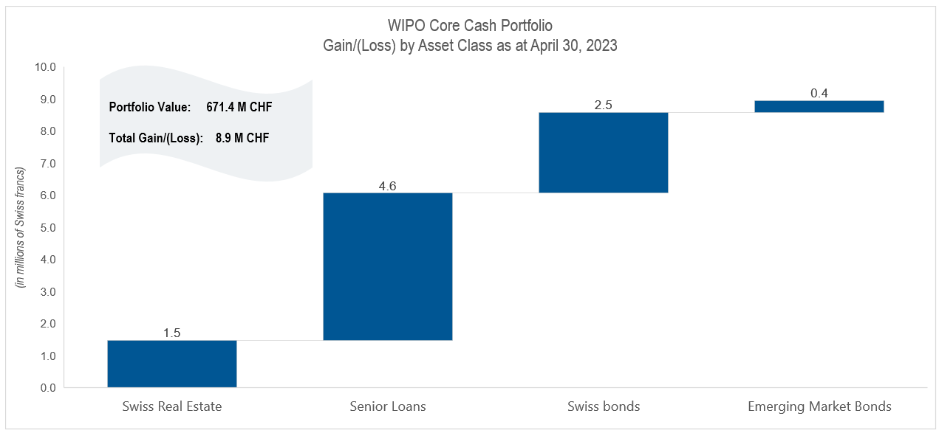
Short-term volatility is expected, but the portfolios are resilient
Investment Performance (%) | Jan-Apr 2023 | 2022 | 5-year | Since Inception
WIPO Core Cash | 1.3 | -9.4 | 1.0 | 0.6
Benchmark Return | 1.2 | -9.5 | 1.2 | 0.8
Relative Return | 0.1 | 0.1 | -0.2 | -0.2

Slide 4
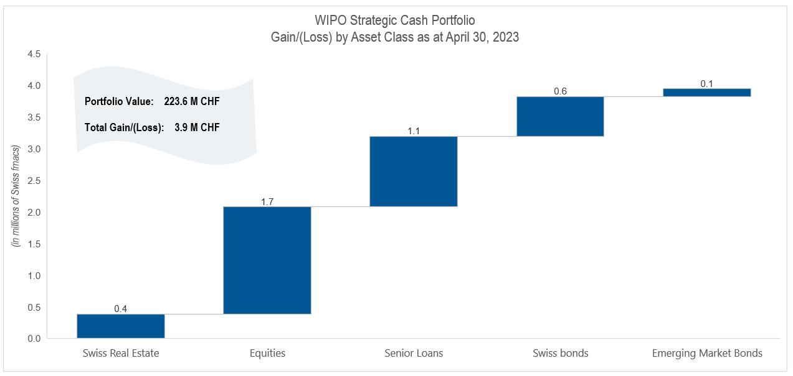
Short-term volatility is expected, but the portfolios are resilient
Investment Performance (%) | Jan-Apr 2023 | 2022 | 5-year | Since Inception
WIPO Strategic Cash | 1.9 | -11.1 | 1.5 | 1.2
Benchmark Return | 1.8 | -11.0 | 1.7 | 1.3
Relative Return | 0.1 | -0.1 | -0.2 | -0.1

Slide 5
Investments are for medium and long-term, and our focus remains on the objective
CORE CASH TARGET RETURN
The current investment strategy was developed in 2017, when capital preservation and achieving a positive return was challenging due to negative interest rates applied on cash and high quality bonds denominated in Swiss francs;
Investments in the Core Cash portfolio are diversified into global assets including bonds and Swiss real estate. Despite difficult financial market conditions in 2022, the investment strategy had met its objective and delivered a positive return over a 5 year horizon;
With the end of negative interest rates in Swiss francs, a strategy to reduce volatilty in the portfolio is underway;
The portfolio is likely to continue delivering a positive return in the future given the rise in interest rates.

Slide 6
Investments are for medium and long-term, and our focus remains on the objective
STRATEGIC CASH TARGET RETURN
Investments in the Strategic Cash portfolio are diversified into global assets including bonds, equities and Swiss real estate. Despite difficult financial market conditions in 2022 , the Strategic Cash investments are on track to achieve their long-term investment target of 2% return and to fully fund WIPO’s long-term employee benefit liability over a 20 year period.
The coverage ratio of the long-term employee benefit liability is at 70% as of Q1, 23.

Slide 7
Strong governance framework embedded in the investment process
WIPO Advisory Committee on Investments (ACI) provides advice in respect of the investment of the Organization’s funds pursuant to the Financial Regulations and Rules. This advice covers matters such as the contents of the investment policy, strategy, asset allocation, appropriate performance benchmarks and investment guidelines.
WIPO Risk Management Committee has established a strong risk culture and sets the risk appetite commensurate to achieving WIPO’s investment objectives.
The External and Internal Auditors provide an independent audit function and validation of internal controls related to investment processes and reporting.
The Independent Advisory Oversight Committee (IAOC) serves in an independent expert advisory capacity and provides oversight on investment activities.
WIPO Member States provide authority to the Secretariat to make investments in accordance with WIPO’s policy on investments.
WIPO Member States
Independent Advisory Oversight Committee (IAOC)
WIPO Risk Management Committee
External & Internal Auditors
WIPO Advisory Committee on Investments
WIPO Investments

