Slide 1
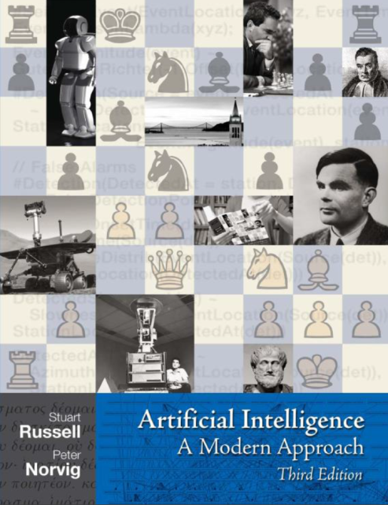
Gyudong HAN
KIPO
Republic of Korea
1
What do you think AI is?
John McCarthy coined the term AI
“the science and engineering
of making intelligent machines”.
What is it?
AI, difficult to define
Thinking Humanly or Rationally
Acting Humanly or Rationally
AI effect: Concept of AI has changed over time
Once something becomes commonplace, it's demystified. And it doesn't feel like intelligence.
* https://www.artificial-solutions.com/blog/homage-to-john-mccarthy-the-father-of-artificial-intelligence
* “Artificial Intelligence A Modern Approach” 3rd Edition 1~2page, Stuart Russell, Peter Norvig, Prentice Hall
* AI effect http://www.businessinsider.com/misconception-artificial-intelligene-2015-10

Slide 2
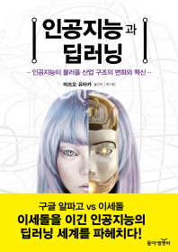
2
2
Levels of AI
1
[Level 1] Simple control program
Advertise a simple control program of a machine
as “AI applied” (washing machine, vacuum cleaner)
[AI and Deep Learning]
[Level 2] Complex control program
The relationship of input and output is large and complex
(traditional puzzle game, expert system with knowledge base)
[Level 3] AI with Machine Learning
The performance of level 2 machine can be improved to level 3
by machine learning . But feature extraction is done by human
[Level 4] AI with Deep Learning
The input features are extracted not by human but by machines
* “인공지능과 딥러닝”, 마쓰오 유타카, 동아 엠엔비 [“AI and deep learning”, Yutaka Matsuo, Donga M&B]

Slide 3
1. In what level?
2. What’s the quality?
3. Oneself or with other help
03
2
3
Where to apply?
1
Customer Service
Chabot, Voice-based customer service system
Classification
Patent, Trademark, Design
Patent Prior art Search
Automatic search system
Image Search
Trademark, Design
Patent drawing
Machine Translation
Neural Machine Translation (NMT)
Other areas
STT, OCR
Formality check

