Slide 1
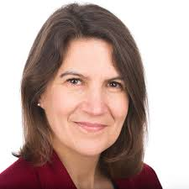
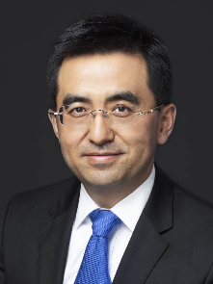
PATENT PANEL (1)
Ms. Belinda Gascoyne, Senior IP Law Counsel, IBM - Europe, Middle East & Africa, London
Mr. Zhixiang Liang, Vice President and General Counsel, Baidu, Beijing

Slide 2


PATENT PANEL (2)
Mr. Toshimoto Mitomo, Corporate Executive, Executive Vice President, Sony Corporation, Tokyo
Mr. Beat Weibel, Chief IP Counsel, Siemens AG, Munich

Slide 3
Background Information on AI
AI systems can be viewed primarily as learning systems.
Machine Learning (ML): how a machine can learn to solve a task from examples of input and expected output, without being explicitly programmed how to do so in a step-by-step sequence of instructions (vs the traditional work to program a machine).
The two main areas: Neural Network (NN) and Deep Learning (DL).

Slide 4
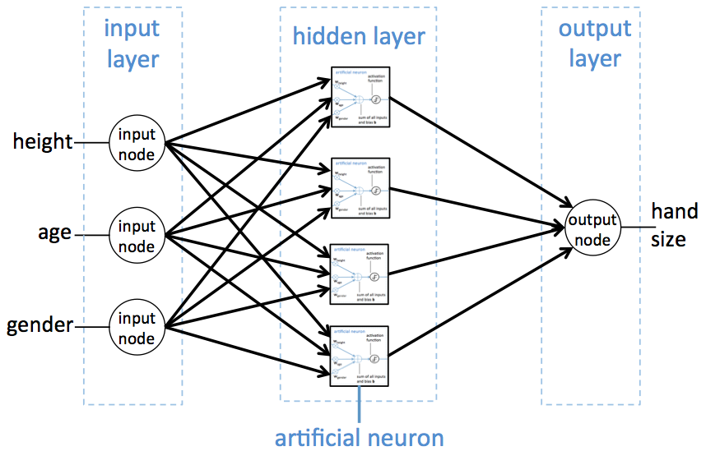
Neural Network / Deep Learning

Slide 5
Where Does Innovation Take Place Today in Deep Neural Networks?
Training data
Computational power
Application
Neural network architecture
Robustness
Notes:
Training data: As training volume is the most impactful factor in DL, innovating on how to best create, exploit or reduce datasets for particular applications is a major challenge;
Computational power: More computational power leads in practice to better models. A lot of efforts in ML are focusing on hardware and software optimization;
Application: AI technologies can be applied to multiple fields for performing various functions. What are the problems and new functional tasks where Deep Learning can be successful? How to integrate efficiently these techniques into larger applications?
Neural network architecture: In practice, different types of hidden layers exist, with different properties, like Recursive Neural Networks adapted to sequential data (speech recognition, translation, etc.), or Convolutional Neural Networks more adapted to object recognition in images. Designing the best Deep NN architecture is complex, because it depends on the task, the nature of the data, the domain and on the amounts of available training data.
Robustness: Deep Neural Network can be relatively easily fooled by adversarial attacks, where a second Deep NN is competing against a first one to identify its weaknesses. The safety and reliability of such ML systems will be critical in the next years.
Researchers design patch to make people ‘virtually invisible’ to AI detectors, April 2019. https://www.computerworld.com.au/article/660283/researchers-design-patch-make-people-virtually-invisible-ai-detectors/.

Slide 6
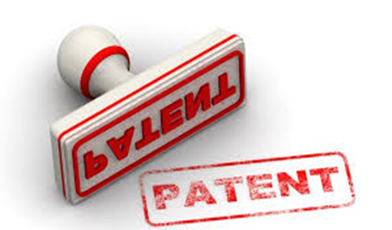
PATENT PROTECTION OF AI-RELATED INVENTIONS
It is worth considering how the patent system might impact advances in AI:
new inventions on the core AI technology itself;
new inventions that incorporate the AI technology (for example, a translation device incorporating AI deep learning, and a medical device for diagnosing a specific disease); and
new inventions created with the assistance of the AI technology (for example, a new material found with the assistance of the AI technology).

Slide 7

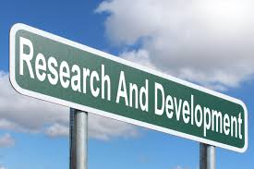
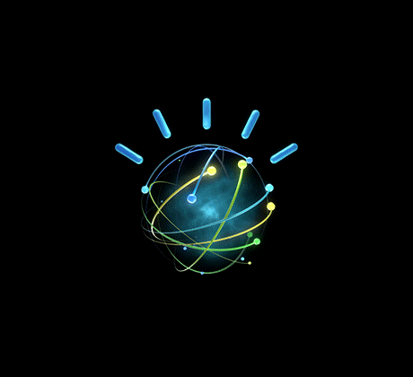
AI is no longer the future – it is here now
Natural machine interfaces can give (wrong) appearance development is easy
Generally, today’s IP laws do not contemplate machines as authors or inventors
Development is expensive, high risk and rapid, but still a long way from truly autonomous machines… or are we?
Less time than we thought!

Slide 8
Inventorship of AI-created inventions
  Should we be able to name AI as an inventor? ‘DABUS’ inventions eg GB1816909.4 (+ EP, US)
  USPTO has issued a Federal Register Notice seeking comments on AI inventions/patents – Deadline Oct 11 2019
Excluded subject matter/inventive step
  EPO Guidelines (Nov 2018): G-II, 3.3 mathematical methods (AI/machine learning inventions)
  Computer implemented simulations: G1/19 EBA referral
  US “Alice’ challenges and Section 101 reforms
  JPO exam guidance updated (Jan 2019) Infringement
  Infringement by an AI system – who is liable?
I

Slide 9
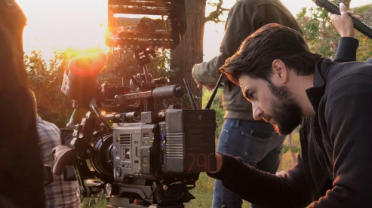
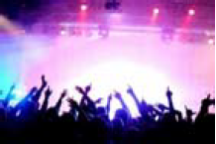
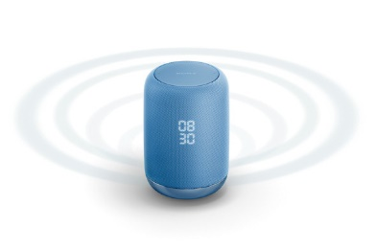
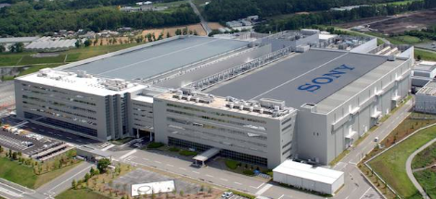
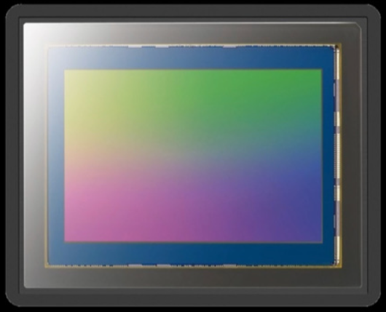
AI for Sony
Accelerated by AI
Contents
Contents
Enhanced by AI
Service
Service
Products
Empowered by AI
Products
Manufacturing
Improved by AI
Manufacturing
Components
AI Ethics
Reinforced by AI

Slide 10
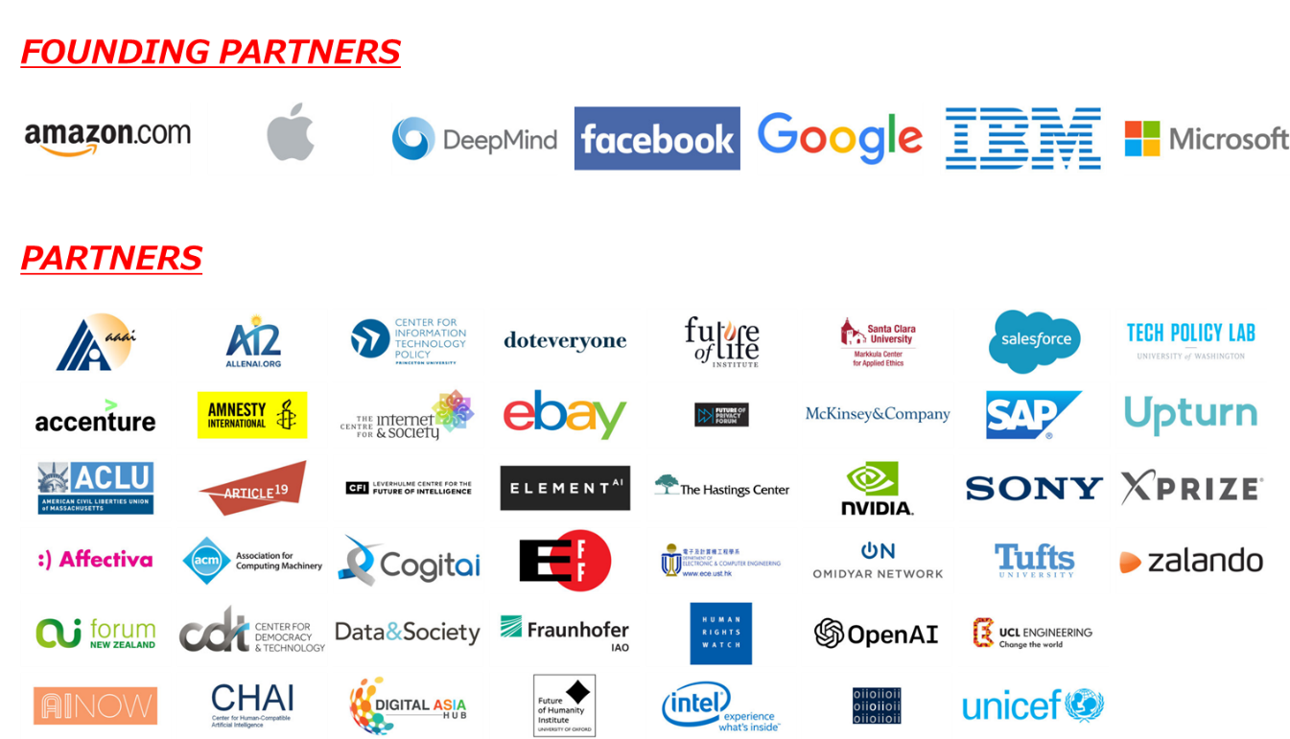
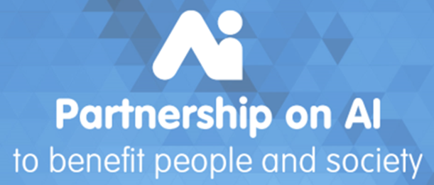
Partnership on AI
Goals
Develop and Share Best Practices
Advance Public Understanding
Provide an Open and Inclusive Platform for Discussion and Engagement
Identify and Foster Aspirational Efforts in AI for Socially Beneficial Purposes

Slide 11
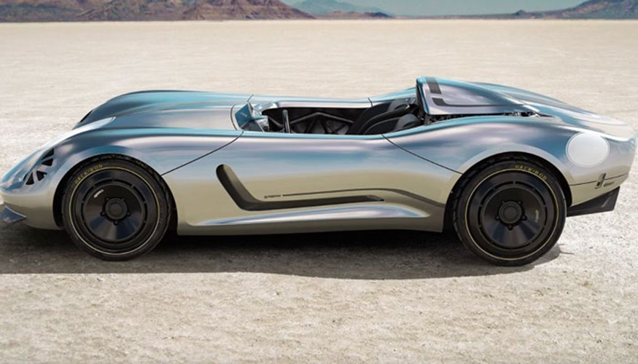
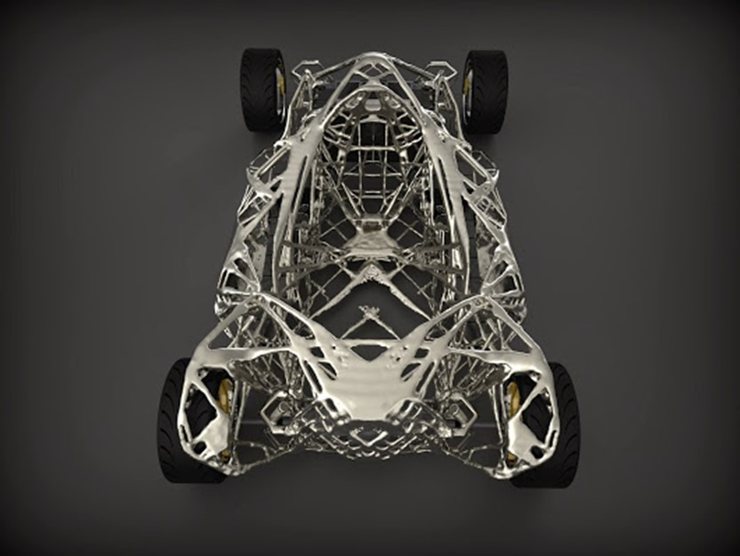

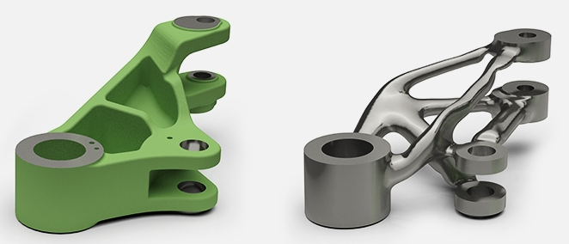
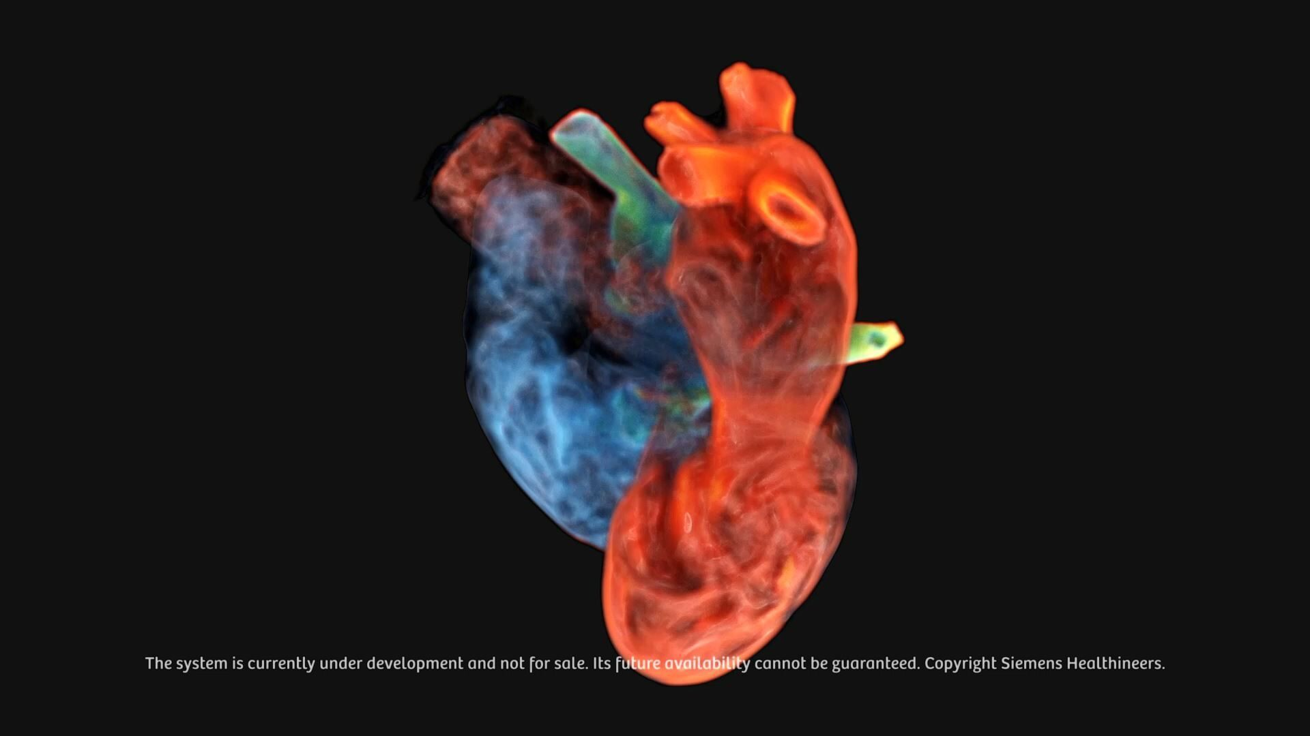
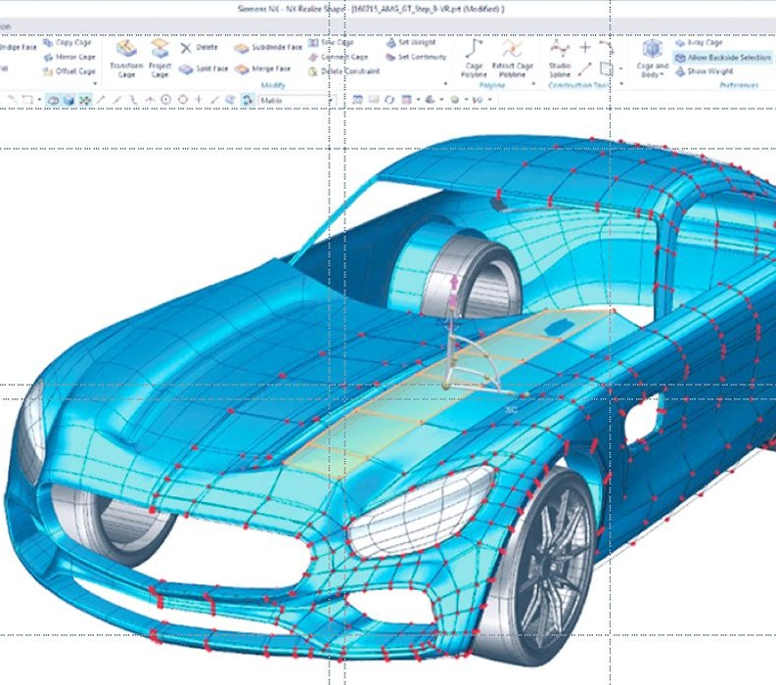
AI Created Inventions - Digital Inventor
Computer-Implemented Simulations – Digital Twin

Slide 12
Are the current patent law and patentability guidelines appropriate for protecting and using AI-related inventions?
Is there a need for special rules on patentability criteria for AI inventions?
Examination Guidelines of IPOs; are they coherent, or is there a need for international convergence?
Are patent systems fast enough to respond to the speed of open science and open innovation in the AI field?
What challenges do we have for enforcement and licensing of AI patents? Do we need digital procedures with digital evidence?
What are the challenges facing global management of AI patents in different jurisdictions
What problems remain unresolved?
Notes:
Beat.- Is there a need for special rules on patentability criteria for AI inventions?
Belinda.- Examination Guidelines of IPOs; are they coherent, or is there a need for international convergence?
Zhixiang.- Are patent systems fast enough to respond to the speed of open science and open innovation in the AI field?

Slide 13
Are the current patent law and patentability guidelines appropriate for protecting and using AI-related inventions?
What challenges do we have for enforcement and licensing of AI patents? Do we need digital procedures with digital evidence?
What are the challenges facing global management of AI patents in different jurisdictions?
What problems remain unresolved?
Notes:
Beat.- What challenges do we have for enforcement and licensing of AI patents?
Toshimoto.- What are the challenges facing global management of AI patents in different jurisdictions
Belinda, Zhixiang, and Toshimoto.- What problems remain unresolved?

Slide 14
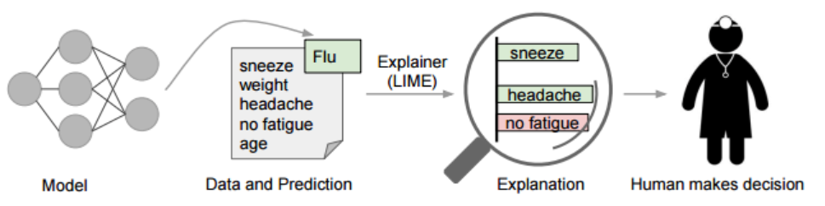
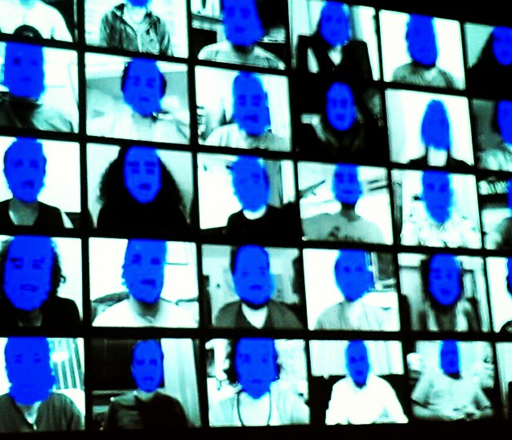
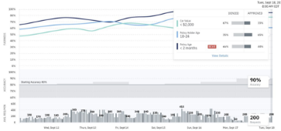
AI Ethics－FAT (Fairness, Accountability, and Transparency）
Fairness
Accountability
Transparency
Non-discriminatory AI model
based on nationality, gender,
religion, creed, etc. and
Data for AI without bias
Explainable AI, AI’s Accountability
for Human, and AI Engineer’s
Accountability for the society
Traceable & Verifiable AI for
input / output and judgement
by AI
■Fairness:
■Accountability: Explaining reason for predicted result (diagnosis) by AI
MIT pointed out that a face recognition system of a company may have a bias in recognition of gender
AI
Misrecognition rate of the company’s system:
・Misrecognition rate of 19% Woman to Man
・Misrecognition rate of 31% Woman with dark skin to Man
(See: https://arxiv.org/pdf/1602.04938.pdf)
■Transparency：
If compliance with laws and rules such as GDPR are required, below will have to be considered.
・Verifiability and traceability
・Re-examination of its accuracy
・Performance of AI model
・Bias of AI’s data, etc.
「Source] https://www.flickr.com/photos/sheilascarborough/16836491502
【IBM Open Source】

Slide 15
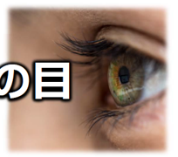
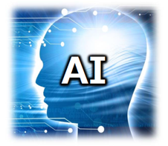


AI for AI – Biggest Paradigm Shift since Image Sensor Development
AI will go beyond human capability.
In the future, AIs are expected to communicate each other by Data,
which cannot be understood by human.
Human
Eyes
Image
Data
Recognize by Image
Recognize by Data

