Slide 1
Andrés Guadamuz
Proprietary, Free and Open Source Software (FOSS), and Mixed Platforms
SCRIPT Centre for Research in IP and Technology Law, Edinburgh, UK

Slide 2
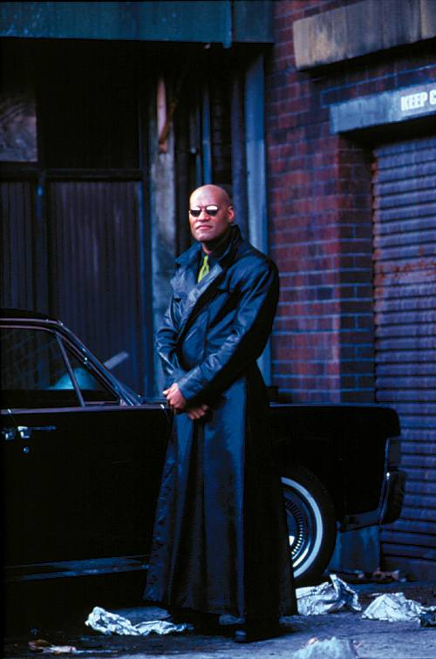

Slide 3
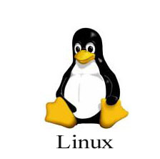
FOSS as a business model

Slide 4
The boundaries are blurring

Slide 5
Software Industry

Slide 6
Software ecology

Slide 7
2006 Software Industry
Market: | Amount
Worldwide Spending on Information Technology, Information Services and Communications | $3.10 trillion USD
Worldwide Hardware, Software and Computer Services Spending | $1.53 trillion USD
Worldwide software revenue | $394 billion USD
Worldwide Software Spending | $317 billion USD
Worldwide Video Game Industry Revenues | $30.0 billion USD
US Software sales | $127.5 billion USD
UK games sales | £1.72 billion GBP
Open source software sales | $129.4 million USD
Games consoles sold (2007) | 75.9 million units

Slide 8
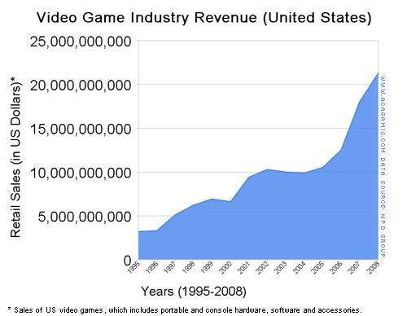
Games are serious business

Slide 9
The world…

Slide 10
Population…

Slide 11
Licence fee exports (2002)

Slide 12
Licence fee imports (2002)

Slide 13
Proprietary software licensing

Slide 14
Commercial and proprietary licensing
All rights reserved.
Grant of licence usually for installation and use.
National legislation may allow for decompilation for interoperability purposes.
Tried and tested production method.
May have higher entry barrier to market.

Slide 15
Introduction to Open Source

Slide 16
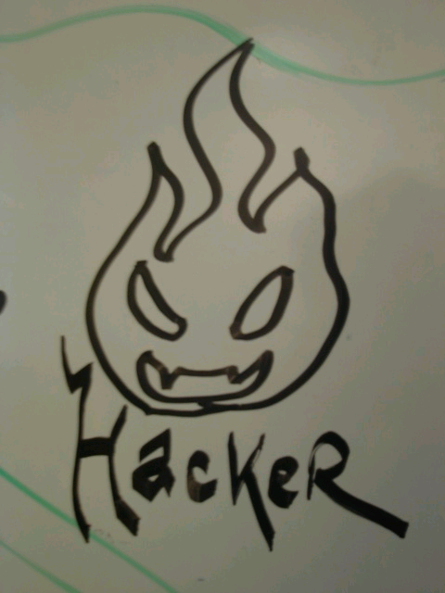
Hacker sharing ethics
"information-sharing is a powerful positive good, and that it is an ethical duty of hackers to share their expertise by writing free software and facilitating access to information and to computing resources wherever possible".
"Information increases in value by sharing it with other people. Data can be the basis for someone else's learning; software can be improved collectively“

Slide 17
Free Software
Movement created from the growing disillusionment by Richard Stallman with proprietary software.
Certain freedoms must be kept, particularly the freedom to access the source code.
Free in free software does not mean free as in having no price, but rather free as in “liberty”.
The freedom to run the program, for any purpose.
The freedom to study how the program works, and adapt it to your needs (access to the source code).
Freedom to redistribute copies.
The freedom to improve the program, and release improvements to the public, so that the whole community benefits.

Slide 18
Open Source Initiative
Open source is deemed less restrictive than FS.
There are hundreds of licences in existence.
Open Source Initiative (OSI) is a non-profit organisation that certifies OSS licences.
There are 58 approved OSS licences, this includes FS licences.

Slide 19
Definition of Open Source
Free Redistribution.
Source code will be made available for examination.
Must allow the development of derived works.
License may allow restrictions to changes to the original code if distributor assumes the responsibility of fixing bugs.
No Discrimination against persons or groups.
No Discrimination against fields of endeavour.
No need for additional licenses for other people who get software.
If software distributed within larger software bundle, the software will still be subject to the larger product license.
The license must not restrict other software within same distribution.

Slide 20
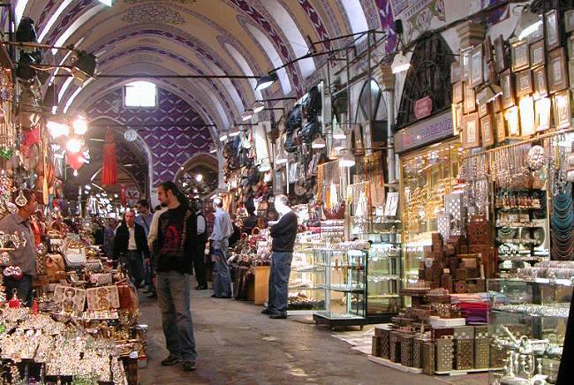
The Cathedral and the Bazaar

Slide 21
The Mosque and the Bazaar

Slide 22
The Temple and the Bazaar

Slide 23
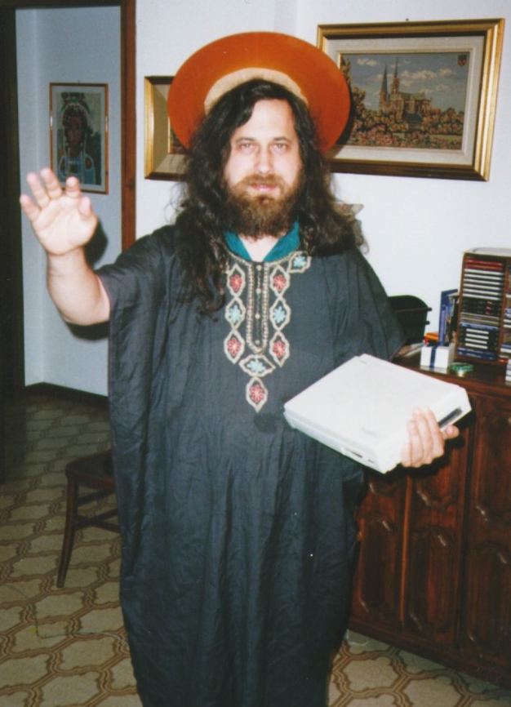
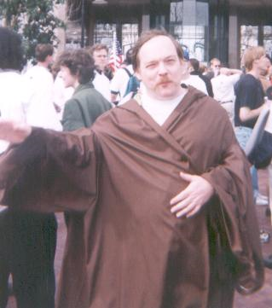
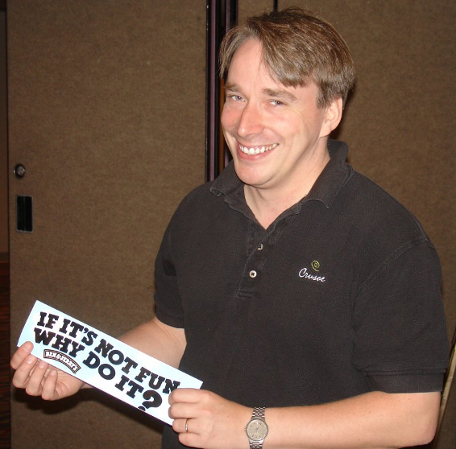
Three different takes on FLOSS

Slide 24
Lines of code
Operating System | Single Lines of Code (millions)
Windows 3.1 (1993) | 6
Linux Kernel (2006) | 5.2
Windows XP (2001) | 29
Windows Vista (2007) | 50
Debian 2.2 (2002) | 55
Mac OSX 10.4 (2006) | 86
Debian 4.0 (2007) | 213

Slide 25
Where does OSS come from?
Individuals | 61.2%
Companies | 19.2%
Universities | 5.6%
Foundations | 7.9%

Slide 26
Licensing Issues

Slide 27
Common elements in FOSS licences
Some rights reserved.
Grant of licence allows installation, use, reuse, publishing, decompilation, interoperability, etc.
Access to the source code is a must
Access to documentation is often encouraged.

Slide 28
Sharing
Create Modify Share

Slide 29
Closed derivatives
Create Modify Sell

Slide 30
Copyleft
Actually, it is not the opposite of copyright, in fact, it uses copyright for protection.
Copyleft is a licensing method by which the work is protected by copyright, but it will have a specific clause that allows a work to remain “open” through a share-alike or viral clause.
Openness in this context means that the original work and whatever derivatives must remain available to the public in one way or another.

Slide 31
Licence ecology

Slide 32
General Public License (GPL) v2
Drafted by Richard Stallman and Eben Moglen.
68% open source projects use the GPL.
It reads part ideological manifesto, part legal document.
Allows licensees to use and distribute the software.
Contains “viral” element, all works that are derived from the licence must be distributed with the GPL.

Slide 33
Copyleft clause in the GPL
“2(b) You must cause any work that you distribute or publish, that in whole or in part contains or is derived from the Program or any part thereof, to be licensed as a whole at no charge to all third parties under the terms of this License.”

Slide 34
GPL v3
It is longer, and more complex than its predecessor.
Take-up by developers has been slow.
It contains several controversial clauses:
Boosted viral clause (it now may apply to other software included with the GPL software).
Restricts the use of Technical Protection Measures.
Includes a patent licence.

Slide 35
The new viral clause
5.c) You must license the entire work, as a whole, under this License to anyone who comes into possession of a copy. This License will therefore apply, along with any applicable section 7 additional terms, to the whole of the work, and all its parts, regardless of how they are packaged. This License gives no permission to license the work in any other way, but it does not invalidate such permission if you have separately received it.”

Slide 36
BSD
Redistribution and use in source and binary forms, with or without modification, are permitted provided that the following conditions are met:
Redistributions of source code must retain the above copyright notice, this list of conditions and the following disclaimer.
Redistributions in binary form must reproduce the above copyright notice, this list of conditions and the following disclaimer in the documentation and/or other materials provided with the distribution.
Neither the name of the <ORGANIZATION> nor the names of its contributors may be used to endorse or promote products derived from this software without specific prior written permission.

Slide 37
European Public Licence (EUPL)
New copyleft licence from the European Union, released in 2007, and official language versions released in 2008.
All software funded by specific EU projects will be licensed under the EUPL.
Downstream compatible with the GPL: software released under the EUPL can be modified and distributed under the GPL.
Elegant, short and compatible with Civil Law traditions.

Slide 38
Legal issues

Slide 39
Enforcement
German court cases (GPL validity):
Sitecom (Munich)
Fortinet (Munich)
D-Link (Frankfurt)
SCO v IBM (copyright infringement)
Jacobsen v Katzer (contract formation)
Wallace v IBM (competition law)

Slide 40
Distribution chain
Author /
Owner
Licensee /
Derivative
Licensee /
User
Licensee /
Distributor
Derivative
User
User
Distributor
User
Derivative

Slide 41
Reality
Author

Slide 42
GPL v3 patent licence grant
“Each contributor grants you a non-exclusive, worldwide, royalty-free patent license under the contributor's essential patent claims, to make, use, sell, offer for sale, import and otherwise run, modify and propagate the contents of its contributor version.”

Slide 43
Licence complexity
More than 150 OSS-certified licences.
68% open source projects use the GPL.
Legitimacy, who can choose which licence is used?
Compatibility: distribution of software licensed under two or three different OSS licences.

Slide 44
Incompatibility issues
GPL may not be compatible with your licensing strategy.
Case Scenario 1: Using GPL’d software internally and to produce commercial applets does not require GPL redistribution.
Case Scenario 2: Using GPL’d code, changing it as part of a proprietary package requires that the software should be released under GPL.

Slide 45
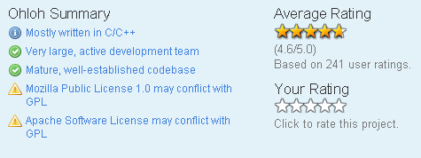
Ohloh

Slide 46
Open Source License Checker

Slide 47
Concluding…

Slide 48
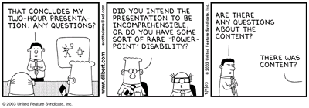
Questions?
a.guadamuz@ed.ac.uk

