Slide 1
How-to-use IPCRMS by Rapporteur
International Patent Classification Section
2019

Slide 2
What IPCRMS can do for Rapporteur?
Upload (import) or Download (export) tables used in IEF Annexes (schemes, RCLs, CRLs, NLR), in particular:
import scheme (both EN/FR ) from file or import CPC/FI;
import RCL from file and create corresponding amendments in the scheme;
import NLR from file, create corresponding amendments in the scheme and move references to definitions;
export IPC scheme with comments in a unified, IPCRMS-friendly form, in widely recognised DOCX file format;
export CRL in the form of IEF Annex and create corresponding scheme, definitions and catchwords amendments in the project;
import definitions from file.
Formal quality check draft proposals, e.g. symbol syntax, scheme hierarchy, RCL validation, ever used symbols, project overlap, cross-references, EN/FR structure alignment, etc.

Slide 3
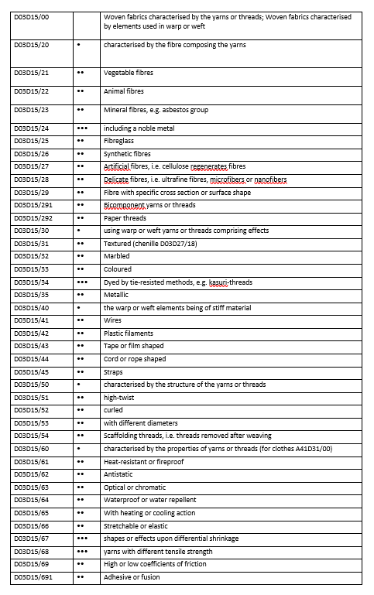
Scheme, RCL and NLR Import
FR
Scheme Table Import
IPC symbols, dots (or kind), titles
Creates new and modifies existing entries or amendments.
RCL Table Import
IPC source and target symbols + default transfer
Creates or modifies RCL and existing entries or amendments.
Old | New | Default transfer
F01L 9/00 | F01L 9/00, F01L 9/30 | F01L 9/00
F01L 9/02 | F01L 9/10, F01L 9/11 - F01L 9/18, F01L 9/30 | F01L 9/10
F01L 9/04 | F01L 9/20, F01L 9/21 - F01L 9/28, F01L 9/30 | F01L 9/20
Symbol | Reference | Category
A01N | C05G | INF
A01N 3/00 | A23B7/00 | INF
A01N 3/02 | A01G5/06 | RES
A01N 25/00 | D21H | INF
A01N 25/04 | A01N 25/16 | APP
A01N 25/12 | A01N 25/26 | INF
A01N 37/00 | A01N 53/00 | LIM
A01N 43/00 | A01N 37/00 | INF
A01N 43/00 | A01N 33/00-A01N 41/12 | RES
A01N 43/00 | A01N 53/00 | APP
A01N 47/00 | A01N 29/02 | LIM
NLR Table Import
IPC symbols of places and references + kind of references
Moves references to definitions.

Slide 4
Scheme, RCL and NLR Import Rules
DOCX file format;
table with three columns in the right order;
table is the first element in the file;
scheme table without heading, RCL and NLR tables with headings;
full IPC symbols (better) with a space after the subclass symbol, e.g. A01B 1/00;
entry kinds expressed by digits, dots or text (see the tables below);
entry titles and references expressed by standard alphanumerical characters;
references categorised by using abbreviations LIM, INF, APP and RES in NLR import;
track changes (better) accepted, crossed-out text (strikethrough) is supported;
not supported: empty rows or cells (except to express main group kind), merged or split cells or tables, multiple paragraphs in cells, nonstandard characters, images.
Dot in the table | Type
. | full stop
· | middle dot
⋅ | dot operator
∙ | bullet operator
• | bullet
‧ | hyphenation point
・ | KATAKANA MIDDLE DOT
･ | halfwidth katakana middle dot
ㆍ | Hangul letter araea
· | Greek ano teleia
Text in the table | Kind
Main group (or empty cell) | Main group
Note | Note
Guidance heading | Guidance heading
Subclass | Subclass
Subclass index | Subclass index
Class | Class
Subsection | Subsection
Section | Section

Slide 5
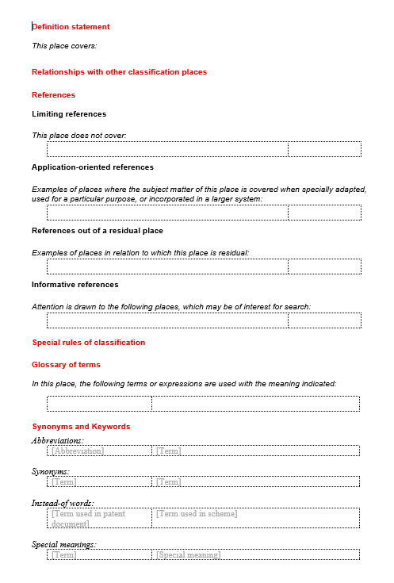
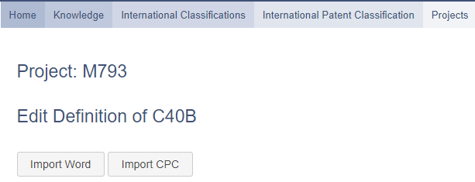
IPCRMS Definitions Import
Definitions Template Import
Use DOCX template for individual definition upload
Creates new or modifies existing definitions.
Template is included in the Guidelines for revision of the IPC
(click DOC icon to download IPCRMS-friendly DOCX format)

Slide 6
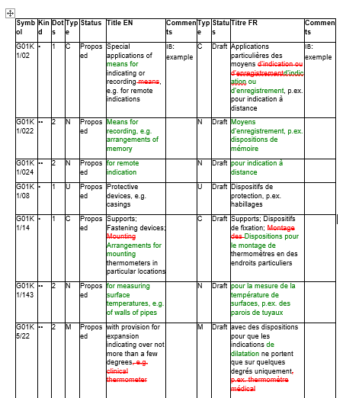
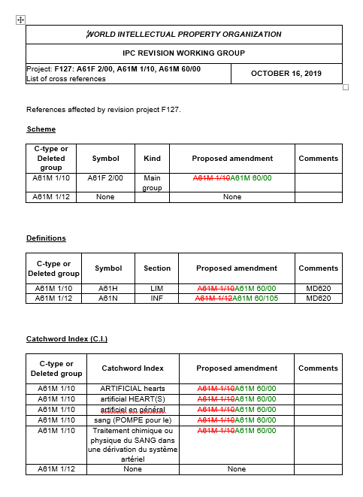
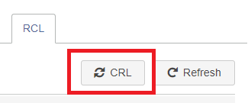
Export Scheme and CRL
Scheme Table Export with comments!
Unnecessary columns can be removed in an external text editor
Scheme can be used for comments or draft modifications and re-imported in IPCRMS.
CRL Tables Export with amendments!
One-click solution based on the RCL in IPCRMS
Exports a file and creates new or modifies existing scheme, definitions and catchwords entries or amendments.

Slide 7
When IPCRMS can be used
Contact the IB to get a temporary project name in IPCRMS.
Prepare your initial revision request with a help of IPCRMS, follow slides 10 to 20 how to prepare a scheme proposal in IPCRMS.
Export scheme from IPCRMS and use it as a technical part of IEF/IP5 Annex(es), e.g. under CE020 or IP5 project.
Initial idea to revise the IPC
(get your scheme proposal in IPCRMS-friendly table)
Contact the IB to get a temporary project name in IPCRMS or use an existing project.
Import your scheme from a table into IPCRMS and follow slides 10 to 20 how to prepare a scheme proposal in IPCRMS. The IB can help you to import your scheme!
Export scheme from IPCRMS and use it as a technical part of IEF/IP5 Annex(es), e.g. under CE020 or IP5 project.
Making an existing scheme proposal IPCRMS-friendly
(make your scheme proposal table IPCRMS-friendly)
Follow slides 10 to 20 how to technically prepare in IPCRMS scheme, RCL, CRL or NLR proposals that can be used as a technical part of IEF/IP5 Annex(es), before posting them on the IEF.
Please, introduce your proposals and their modifications in IPCRMS in order to keep it up-to-date with your proposals submitted on the IEF.
Having proposals in IPCRMS and IEF Annexes in IPCRMS-friendly format, can facilitate discussions of the RWG and make dealing with the workload more efficient.
Project in IPC revision phase
(benefit from unified IPCRMS-friendly formats)

Slide 8
Simple Rapporteur Workflow incl. IEF + IPCRMS
Initial idea IPC or IP5 phase
Want IPCRMS to help?
Yes
Contact IB and get a temporary project name
Have your scheme/RCL in a table already?
Yes
Import scheme/RCL in IPCRMS * see slides 10,11,13,16 IB can do it for you!
No
Optional
No
Post Annex CE020 on IEF
Export scheme/RCL CRL from IPCRMS*. see slide 12 and 18
Make/modify scheme RCL in IPCRMS* see slides 10 to 20
See and check your scheme in current IPC context*
RQ approved or F project?
Yes
IB creates a revision project on IEF/IPCRMS
Have your scheme/RCL/NLR in a table already?
Yes
Import scheme/RCL NLR in IPCRMS* see slides 10,11,13,16 IB can do it for you!
No
* as needed
No
No project
Export scheme/RCL CRL from IPCRMS* see slides 12 and 18
Make/modify scheme RCL in IPCRMS* see slides 10 to 20
See and check your scheme in current IPC context*
Yes
Post Annex on IEF under project file*
Update or modify scheme or RCL?
No
All adopted by WG?
Yes
Scheme adopted
No

Slide 9
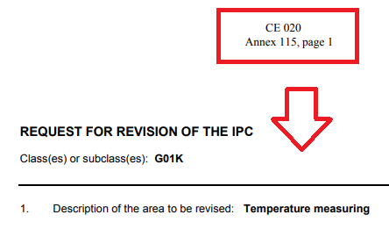
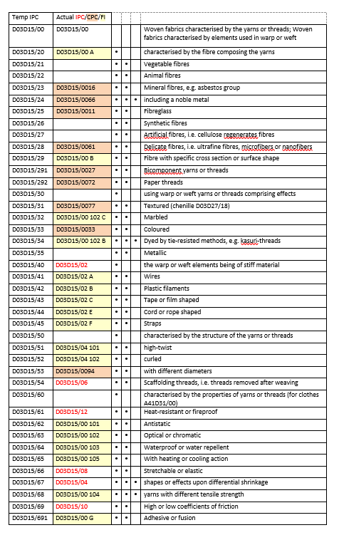
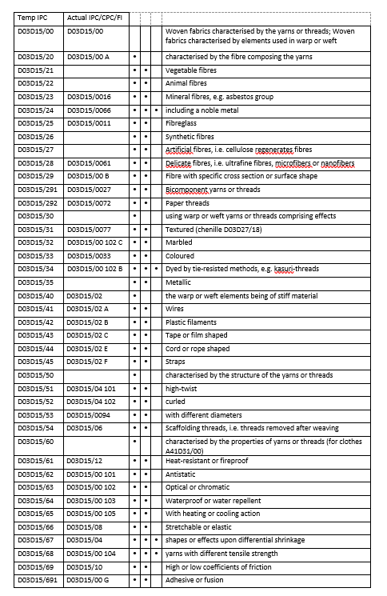
IPC Revision Request
Office submits a request under CE020
IB creates RQ project
(to be approved by offices)
IB creates C project
(after approval of the RQ by offices)
Have you started using IPCRMS yet?
Project | Subject | IPC | Tech. | Rap.
RQ035 | Temperature measuring | G01K | E | CA
Project | Subject | IPC | Tech. | Rap.
C497 | Temperature measuring | G01K | E | CA

Slide 10
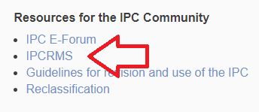
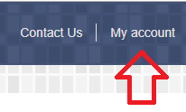
Open a project in IPCRMS
Click IPCRMS under the heading
Resources for the IPC Community
on the IPC Home Page
https://www.wipo.int/classifications/ipc/en/
Click My account on the right top of the application screen
Insert your Username and Password and click Login. If you do not have the username and password, please contact ipc.mail@wipo.int.
List of active projects is default in IPCRMS
TIP: Use Filter on the right side to find a project not displayed by default, click on the project name in the list to open the project.

Slide 11
Check and modify project parameters
Set IPC area
Check project info in Overview tab.
What is missing in this project overview? (see the answer below)
Open Scheme to Set IPC area, e.g. to cover the whole subclass or to add other places.
Subclass or group symbols in the IPC area make all their subdivisions displayed in scheme and definitions tabs.
Section, subsection and class symbols in IPC area make only their titles, related notes or indexes displayed.
Subject of the project and the co-rapporteur are missing in this project overview. Please inform the IB in such cases!
TIP: The IB manages tasks that are displayed on the right side and that may guide you to complete unfinished work in IPCRMS, e.g. „NLR to be removed“.

Slide 12
Scheme export
Get your scheme to work with offline in IPCRMS-friendly format that can be submitted to the IEF as a part of your proposal as well as re-imported to IPCRMS to keep it up-to- date with your proposal!
Switch to bilingual language view EN/FR, the scheme can be exported only from this view.
Click Original and ALL if you want to export all the current scheme entries in the IPC area concerned.
Click the printer icon to export the scheme displayed on the screen.
Use expand/collapse/toggle buttons to hide or unhide subgroups, Notes, Guidance headings or Subclass indexes.
Scheme is exported in a table as DOCX file format (Office Open XML standard).
Project view that enables scheme export
TIP: Export scheme from IPCRMS to prepare or further modify revision requests or proposals in IPCRMS-friendly format, IB can do it for you! Export your draft proposal from IPCRMS if exists from Draft view.

Slide 13
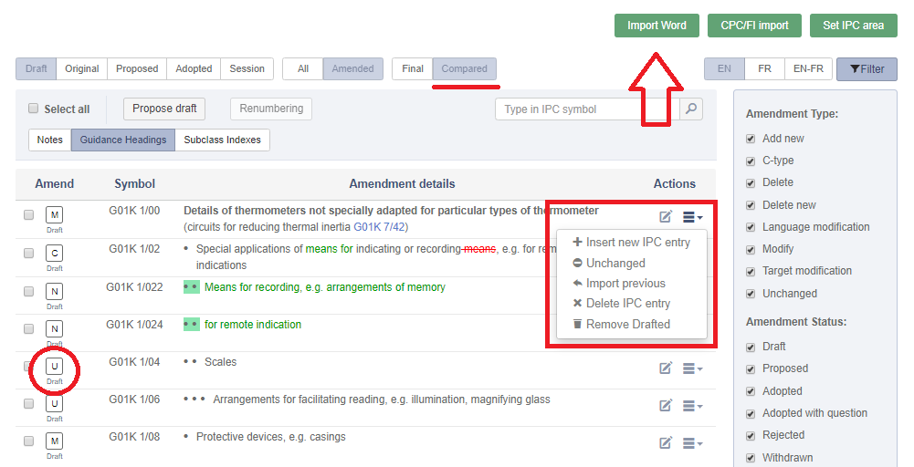
Scheme import from file - EN/FR
Import and its result in scheme view
Get your scheme into IPCRMS to keep it up-to-date with your proposal, modify scheme in IPCRMS and export modified scheme that can be again submitted to the IEF as a part of your proposal!
Symbols, dots or digits or other entry kind, e.g. Notes, and their titles can be imported from a table in Word file.
Click Import Word - green button to upload data from the same IPCRMS-friendly DOCX file format as exported from IPCRMS, e.g. with modifyed or new entries in the table.
Table must be the first element in the imported file, no empty rows before or in the table, no table header, track changes accepted, complete symbols with space after the subclass.
Import can recognise strikethrough, ^{superscript}, _{subscript}, underlined and italics, but not image.
TIP: Amendments created by import can be further modified by using Editor or More Actions. Make an amendment Unchanged if there is no title modification upon import from file!

Slide 14
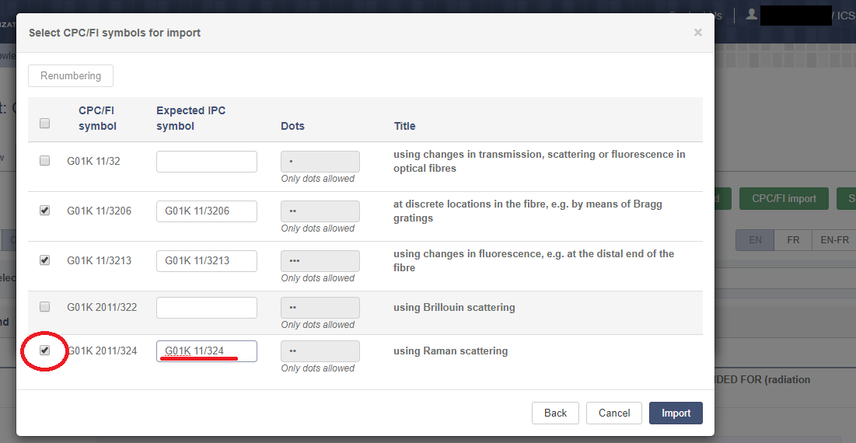
CPC/FI import
Import with direct CPC/FI renumbering
Get your scheme and definitions in IPCRMS with CPC/FI entries to keep it up-to-date with your proposal, modify scheme in IPCRMS and export modified scheme that can be again submitted to the IEF as a part of your proposal!
Click CPC/FI Import green button.
Select CPC or FI in the pop up window, insert a parent group of subgroups to be imported and click Get entries.
Tick symbols to be imported and modify (renumber) expected IPC symbols as needed directly in the pop up window (or after the import).
Click Import and modify created amendments manually by using Editor or More Actions, or export and modify them offline in a Word file and re-import again from that Word file.
.
TIPs: Individual CPC or FI entries can be imported if explicitely listed in the pop up and separated by commas. Keep original CPC numbering in connection with the scope of imported groups.

Slide 15
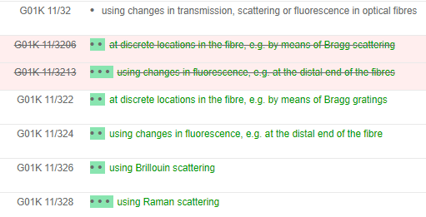
Scheme renumbering
Renumbering and its result in scheme view
Tick one symbol before and one after the range of groups to be renumbered.
Click Renumbering and get the symbols renumbered in a pop up window here the numers can be further modified manually as needed.
Start and subgroup symbols can be modified in the pop up, e.g. to extend the range for renumbering.
Only new groups can be renumbered, there must not be an existing symbol in the range for renumbering.
Only subgroups of the same main group can be used as start and end subgroups.
TIP: Create a temporary new group to be used as the end group in order to include the last new subgroup to renumbering if there is no other group between the last new subgroup and the next main group.

Slide 16
RCL import from file
Get your RCL with D and C-type amendments automatically created in IPCRMS to keep it up-to-date with your proposal, modify scheme in IPCRMS and export modified scheme that can be again submitted to the IEF as a part of your proposal!
Symbols can be imported from a table with header in Word file.
Click Import Word green button to upload data from the IPCRMS-friendly DOCX file format as you can get by copy and paste of the RCL from IPCRMS.
Table must be the first element in the imported file, e.g. no empty rows before or in the table, track changes accepted, complete symbols with space after the subclass.
The import can recognise C and D type items by presence or non-presence the symbols from the first column in the second column.
Import and its result in scheme view
Old | New | Default transfer
F01L 9/00 | F01L 9/00, F01L 9/30 | F01L 9/00
F01L 9/02 | F01L 9/10, F01L 9/11 - F01L 9/18, F01L 9/30 | F01L 9/10
F01L 9/04 | F01L 9/20, F01L 9/21 - F01L 9/28, F01L 9/30 | F01L 9/20
TIP: Amendments created by import can be further modified by using Editor or More Actions. Make an amendment Unchanged or removed draft amendment if necessary.

Slide 17
NLR import from file
Get your NLR with corresponding amendments automatically created in IPCRMS to keep it up-to-date with your proposal, modify scheme in IPCRMS and export modified scheme that can be again submitted to the IEF as a part of your proposal!
NLR can be imported from a table with header in Word file.
Click Import Word green button to upload data from the IPCRMS-friendly DOCX file format that corrsponds to the NLR template table.
Table must be the first element in the imported file, e.g. no empty rows before or in the table, track changes accepted, complete symbols with space after the subclass.
The import can recognise abbreviations LIM, INF, APP and RES in the third column.
Import and its result in scheme view
Symbol | Reference | Category
A01N | C05G | INF
A01N 3/00 | A23B7/00 | INF
A01N 3/02 | A01G5/06 | RES
A01N 25/00 | D21H | INF
A01N 25/04 | A01N 25/16 | APP
A01N 25/12 | A01N 25/26 | INF
A01N 37/00 | A01N 53/00 | LIM
A01N 43/00 | A01N 37/00 | INF
A01N 43/00 | A01N 33/00-A01N 41/12 | RES
TIP: Amendments created by import can be further modified by using Editor or More Actions. Make an amendment Unchanged or removed draft amendment if necessary.

Slide 18
CRL export and amendmedments
RCL view enables CRL export
Get your CRL from IPCRMS and corresponding amendments created automatically!
CRL exports a file with tables for the scheme, definitions and catchwords that can be used as an IEF annex and at the same time it creates new or modifies existing scheme, definitions and catchwords entries or amendments in IPCRMS.
Before CRL export, make the existing scheme, definitions and catchwords amendment in the project Proposed.
Amendments created by CRL export stay in Draft status, thus they can be easily recognised or filtered to be reviewed and modified or removed manually as needed.
TIP: Export scheme from IPCRMS to prepare or further modify revision requests or proposals in IPCRMS-friendly format, IB can do it for you! Export your draft proposal from IPCRMS if exists from Draft view.

Slide 19
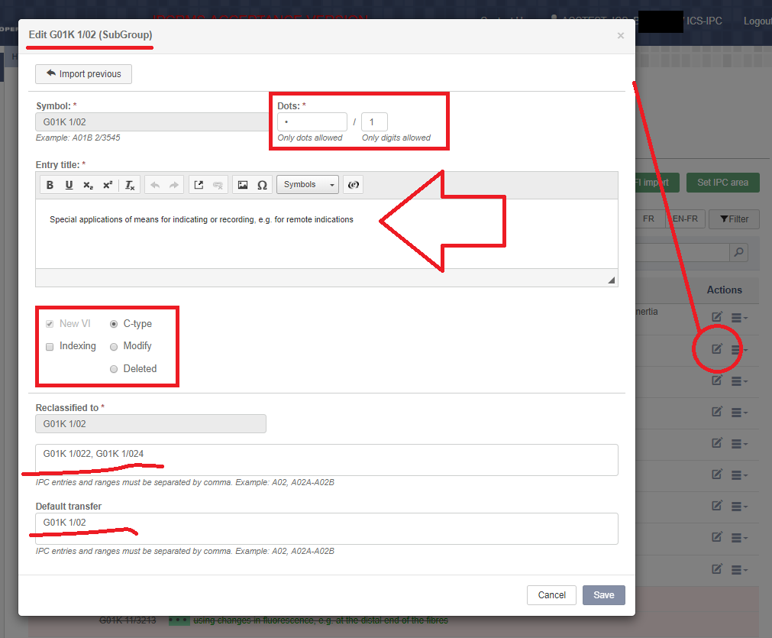
Modify, delete or make C-type amendments
Scheme entry Editor
Editor or More Actions buttons can be used to modify existing amendments, their titles, dots, etc.
Text in the titles can be formatted by using the icons above the text field, where special characters, chemical symbols, images or standard expressions for notes can be also inserted.
Check RCL tab and modify each scheme entry that appears in the RCL as needed by using Editor in Scheme tab, e.g. reclassification target groups, default transfer, transfer target groups, change C-type to M-type, etc.
Remove draft amendments by using More Actions if they are not needed. Removed draft amendments cannot be reverted but have to be recreated.
TIP: Delete C-type symbol from „Reclassified to“ if it is duplicated in the RCL; use Import previous in More Actions or in Editor to revert past proposed amendment to be used again; do not hesitate to contact the IB in case you need help.

Slide 20
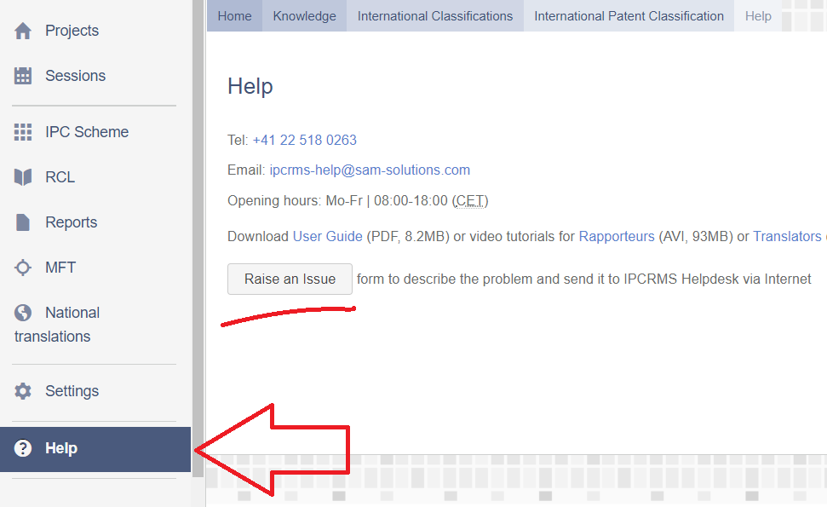
IPCRMS Help(desk)
Tel: +41 22 518 0263
Email: ipcrms-help@sam-solutions.com
Opening hours: Mo-Fr | 08:00-18:00 (CET)
Download User Guide (PDF, 8.2MB)
Video tutorials for Rapporteurs (AVI, 93MB) or Translators (AVI, 74MB) or about Session and Reports (AVI, 43MB)
Raise and issue by using a form to describe the problem and send it to IPCRMS Helpdesk via Internet:
https://www3.wipo.int/classifications/ipc/ipcrms/#/help

