Slide 1
Report on IPC-related IT systems
42th session of the IPC Revision Working Group
Geneva
November 5, 2019
Olivier Collioud, Project Officer

Slide 2
Agenda
IPCPUB
IPCWLM Project
IEF

Slide 3
IPCPUB
New version 8.0
Unified IP Portal navigation bar
New “IPC Home” and “Download” links
New “Search” tab (CE 51 decision)
New text formatting as from IPC 2020.01 Definitions (legacy Definitions unchanged)

Slide 4
IPCPUB
New version 8.0
RCL in PDF format (CE 51 decision)
Compilation of amendments with indication of changes in dots
IPCCAT cross lingual (using WIPOtranslate):
max 20 translations into EN per hour
EN + AR, DE, ES, FR, JA, KO, PT, RU and ZH

Slide 5
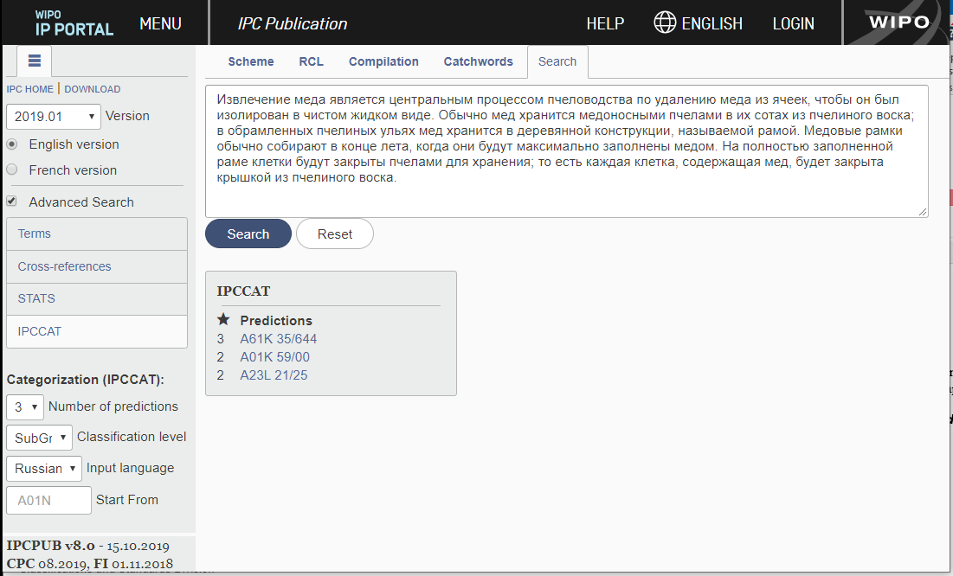
IPCPUB - IPCCAT cross lingual

Slide 6
IPCWLM project update
Status to date: Transition from IPCRECLASS to IPCWLMS
Phase 1: IPC Reclassification freeze from November 1 till December 15, 2019
Phase 2: IPC Reclassification using IPCWLMS from December 15, 2019

Slide 7
Evolution of the IPC reclassification cumulative backlog

Slide 8
IPC reclassification backlog status according to IPCWLMS

Slide 9
IPC-IEF
First step Toward integration into IPCRMS (CE 51 decision)
Technology alignment with IPCRMS
Minor changes in User Interface
Separation from IP5-E-forum

Slide 10
IT operations and support for IPC
Questions?
Thank you

