Slide 1

Recent Developments in the CPC
WIPO Fourth IPC WORKSHOP
Geneva, 20 February 2017

Slide 2
Agenda
CPC and National Offices
CPC coverage – Much more than EP and US documents and update
IT matters
CPC: Latest Status and Future Development
Geneva, 21 February 2017

Slide 3
CPC and National Offices
Geneva, 21 February 2017

Slide 4
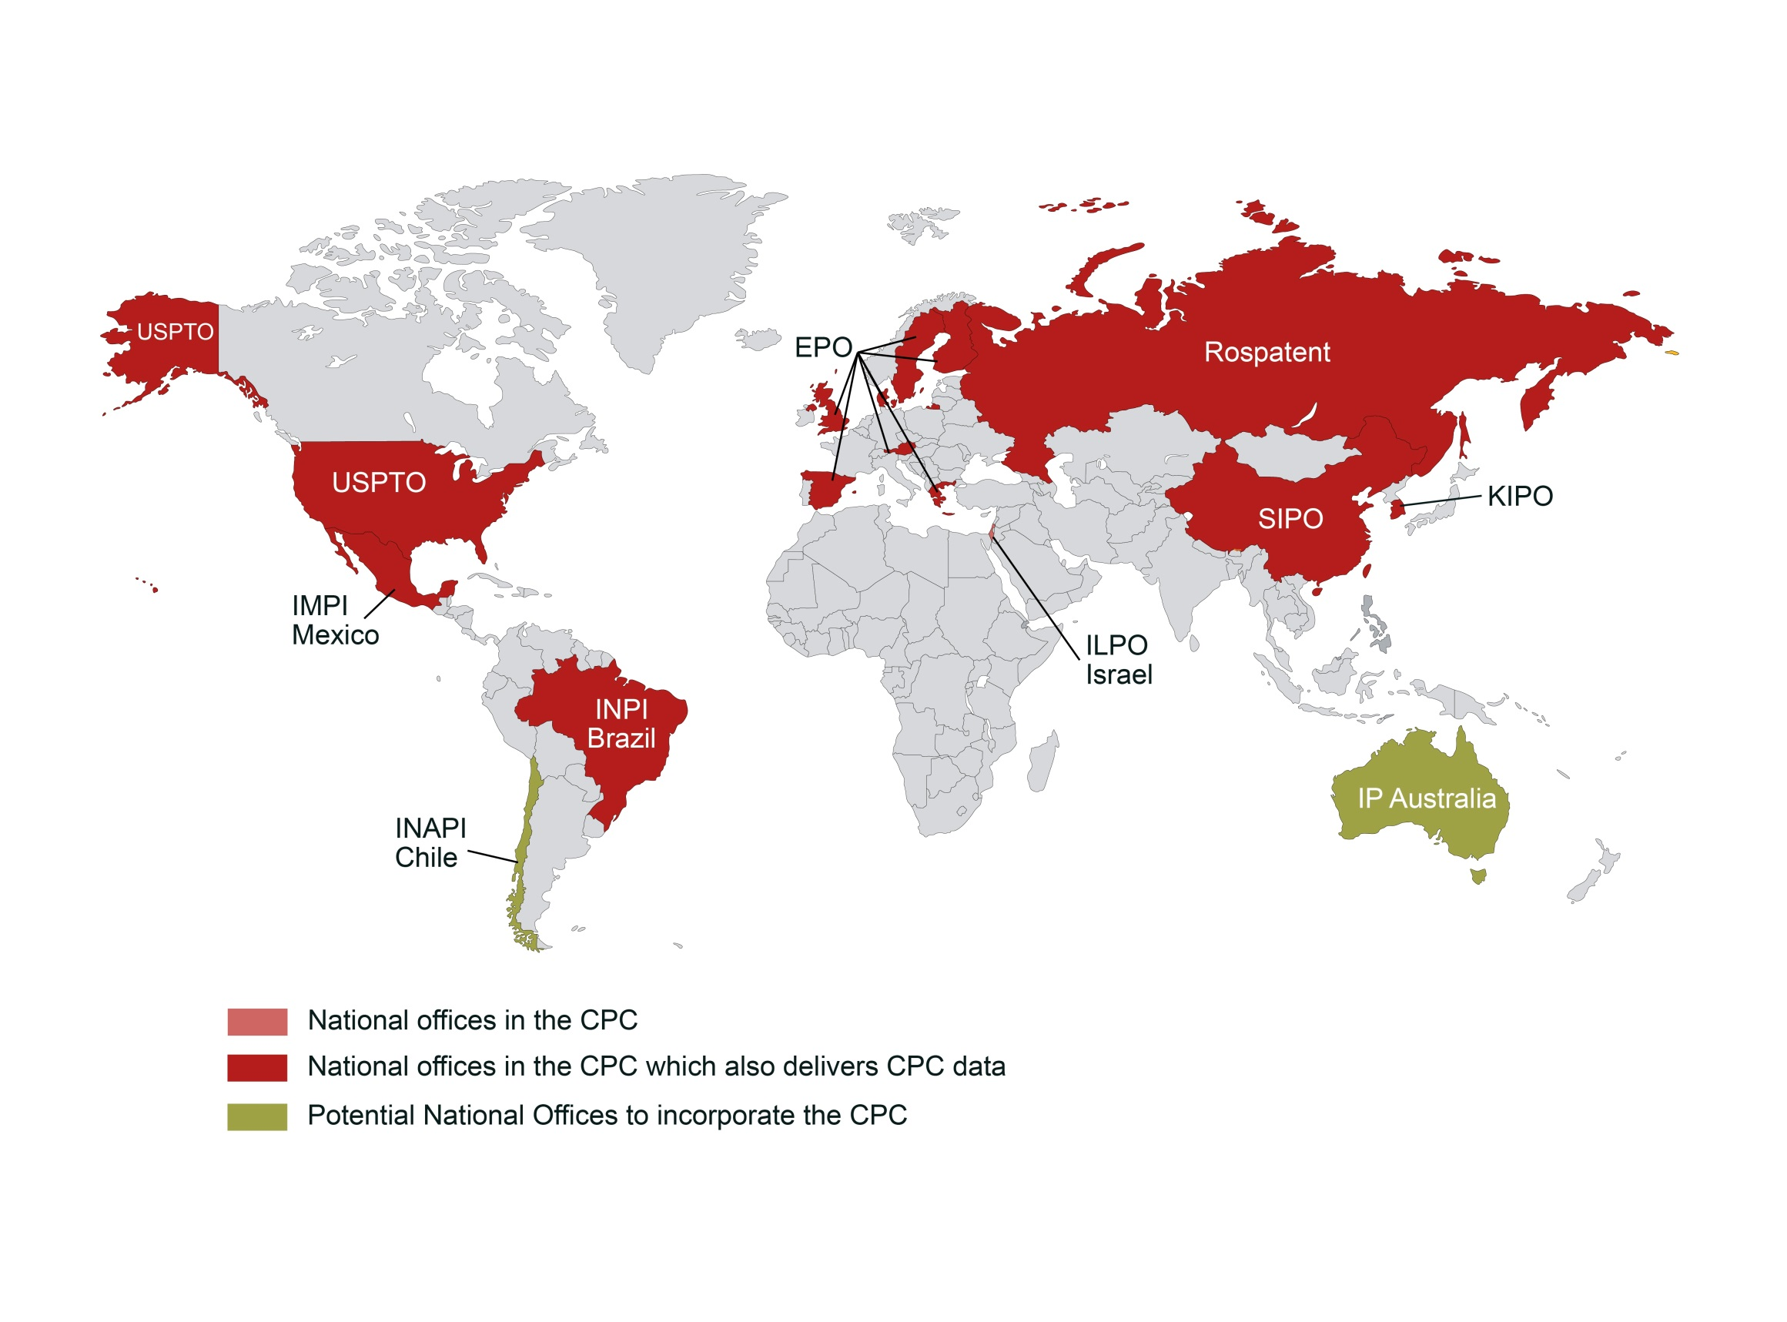
Around the world
EAPO
Geneva, 21 February 2017

Slide 5
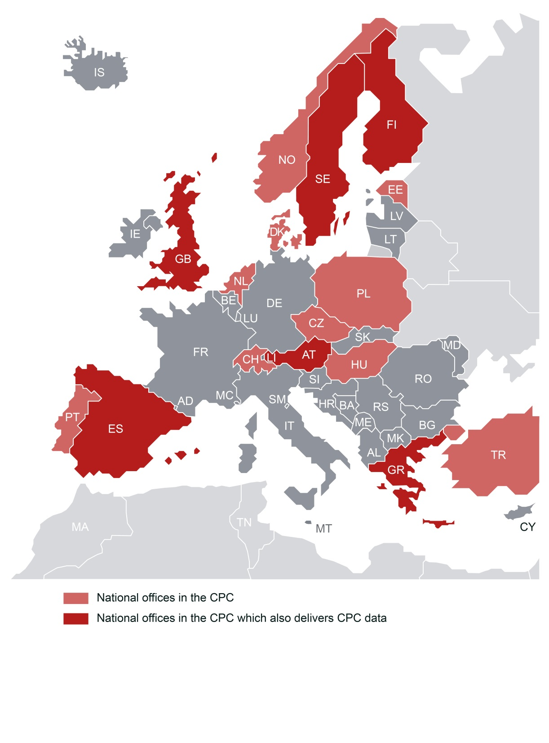
16 Offices within the European Patent Organisation
Furthermore, CPC is used for search by more than
45 Patent Offices and by more than 25 000 examiners
Geneva, 21 February 2017

Slide 6
CPC coverage -
Much more than EP & US documents...
Geneva, 21 February 2017

Slide 7
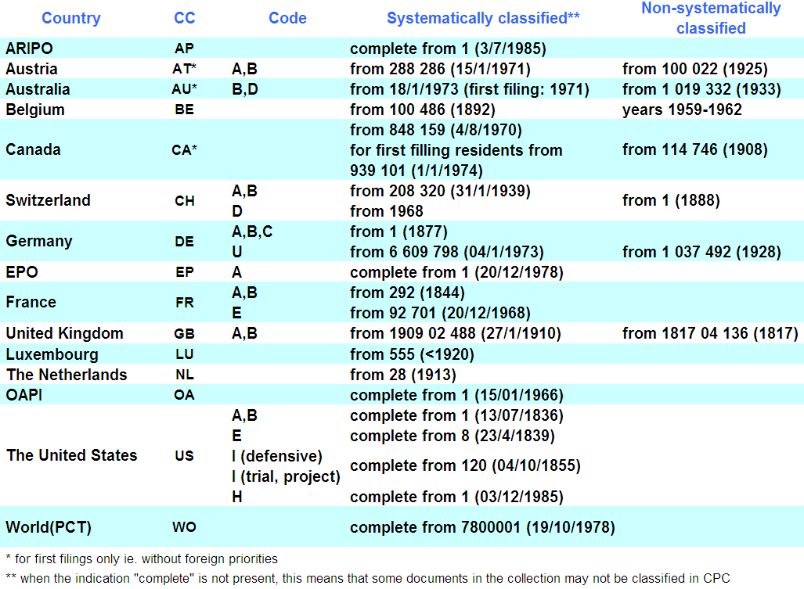
CPC documentation coverage
Geneva, 21 February 2017

Slide 8
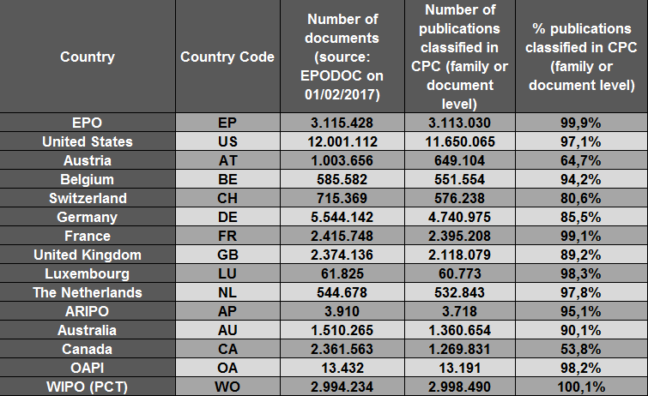
CPC Coverage (EPODOC, 1 February 2017)
Geneva, 21 February 2017

Slide 9
CPC Coverage of other patent collections (EPODOC, 1 February 2017)
Overall, 46.7 million documents classified in CPC
Geneva, 21 February 2017

Slide 10
Overview of CPC implementation (1/3)
Country | Front file national invention applications | CPC Printed? | CPC data delivered to the EPO | classification over whole CPC scheme | PCT applications | Backfile | Utility models
AUSTRIA | Yes (ECNO office) | No | Yes | yes | No | No | Yes
BRAZIL | 2014 | Yes | Yes | Currently partial coverage (from the 12 divisions trained out of 20 divisions of INPI incl. Utility Model division) | Yes (transmitted to WIPO in SR – data exchange with EPO to be defined) | Not yet - Under consideration | Yes (all)
CHINA | Yes, since 2014 | No | Yes | Partial from 2014 Over whole scheme since January 2016 | Under consideration | Under consideration | Under consideration
CZECH REPUBLIC | Yes | No | No | Yes | No (Only within VPI appl. as ISA) | No | Yes
EAPO | Yes, starting Jan 2019 | No | No | Limited to fields where advanced training provided | N/A | Yes, starting Jan 2020 | TBC
DENMARK | TBC | No | No | TBC | N/A | TBC | TBC
ESTONIA | Starting 2016 | No | No | Yes | Yes | No commitment | Yes
Geneva, 21 February 2017

Slide 11
Overview of CPC implementation (2/3)
Country | Front file national invention applications | CPC printed? | CPC data delivered to the EPO | classification over whole CPC scheme | PCT applications | Backfile | Utility models
FINLAND | Yes (ECNO office) | No | Yes | yes | TBC | No commitment | N/A
GREECE | 2015 | Yes | Yes | yes | N/A | No commitment | N/A
ISRAEL | Sept 2016 | No | Planned by the end of 2017 | TBC | TBC - Receiving classification data from USPTO(started at September 2016) | None | None
HUNGARY | TBC | No | No | TBC | N/A | TBC | TBC
KOREA | 2014 | No | Yes | Partial in 2014 (25 areas) Over whole scheme since January 2015 | Yes, since 7 June 2016. Way to exchange data to be defined | 2004 to 2014; done by end 2018 | N/A
MEXICO | yes | No | yes | yes | N/A | Expected to start in January 2017 subject to availability of resources | Yes (acc. to MoU)
NETHERLANDS | Expected in 2017 | No | No | yes | N/A | No commitment | N/A
Geneva, 21 February 2017

Slide 12
Overview of CPC implementation (3/3)
Country | Front file national invention applications | CPC printed? | CPC data delivered to the EPO | classification over whole CPC scheme | PCT applications | Backfile | Utility models
NORWAY | October 2015 | No | No | yes | N/A | Planned to start in 2018 | N/A
POLAND | TBC | No | No | TBC | N/A | TBC | TBC
PORTUGAL | March 2015 | No | No | yes | N/A | No commitment | N/A
RUSSIAN FEDERATION | January 2016 | Yes | Yes (May 2016) | yes | Yes for national ap / Not yet for international – delivery method to be defined | Under consideration | Yes
SPAIN | Yes (ECNO office) | No | Yes (2013) | yes | TBC | partially | N/A
SWEDEN | Yes (ECNO office) | No | Yes (2013) | yes | TBC | Yes (+ DPK) | N/A
SWITZERLAND | (expected) second half 2016 | No | No | yes | N/A | No commitment | N/A
TURKEY | Expected in 2017 | No | No | TBC | N/A | TBC | TBC
UNITED KINGDOM | CPC has been applied to all new applications from 28/10/2013 | No | Supplied weekly via ST36XML file (sent via FTP) | UK examiners classify in CPC across CPC sections A-H | When PCT applications enter the national phase, Examiners add CPC (and revise IPC) prior to republication. | CPC classification is not applied to the backfile | N/A
Geneva, 21 February 2017

Slide 13
IT matters
Geneva, 21 February 2017

Slide 14
OPS RESTful web services (classification)
  These provide access to the EPO's raw data via a standardised XML interface.
  The web services focussing on classification relate to:
  CPC Search
  CPC Media retrieval
  CPC Retrieval
  OPS - RESTFul
Geneva, 21 February 2017

Slide 15
CPC schema changes
Schema changes for the CPC scheme and definitions in November 2016 !!!
Impacted areas:
      References in Definitions
      Enhanced references in Scheme and Definitions
      Change in Synonyms and Keywords
Details were made available on www.cpcinfo.org in May 2016, to be effective as of the November 2016 CPC release
Geneva, 21 February 2017

Slide 16
CPC: Latest Status
Geneva, 21 February 2017

Slide 17
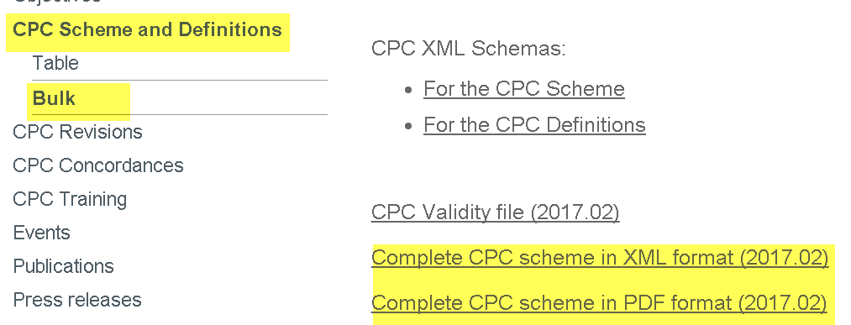
CPC Scheme and Definitions
http://www.cooperativepatentclassification.org/cpcSchemeAndDefinitions.html
www.uspto.gov/web/patents/classification/index.html
worldwide.espacenet.com/classification
Geneva, 21 February 2017

Slide 18
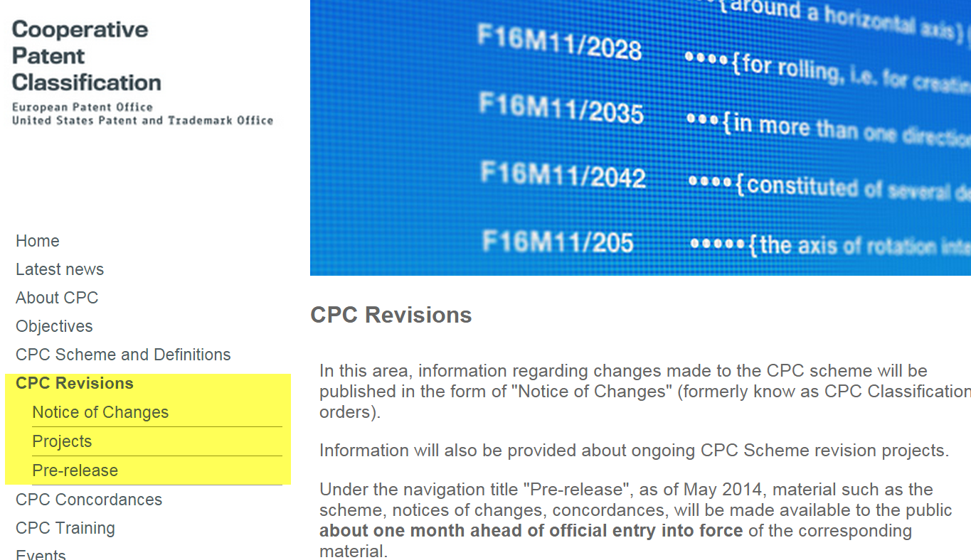

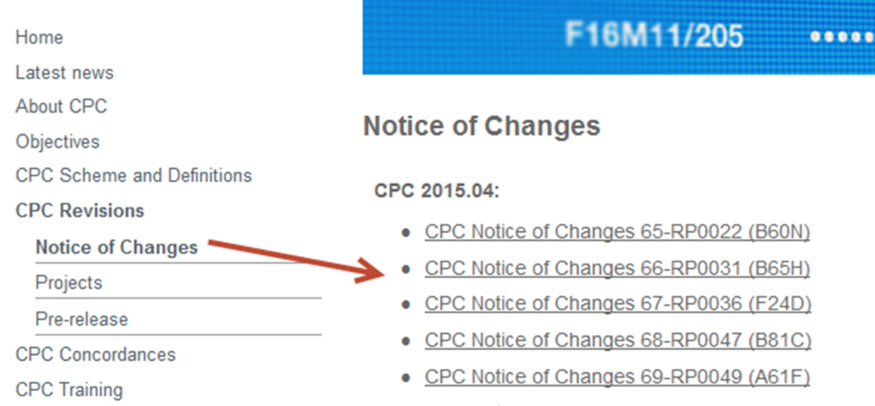
Published Notice of Changes in CPC:
Year | CPC Projects
 | Maintenance Projects (MP) | Revision Projects (RP) | Definition Projects (DP)
2017 | 12 | 17 | 01
2016 | 68 | 55 | 52
2015 | 16 | 57 | 21
2014 | 06 | 31 | 00
2013 | 03 | 09 | 00
http://www.cooperativepatentclassification.org/CPCRevisions/NoticeOfChanges.html
Geneva, 21 February 2017

Slide 19
CPC Scheme Releases
Four to five times per year
Announced on http://www.cooperativepatentclassification.org/CPCRevisions/prereleases.html
2017
1 January 2017
1 February 2017
1 May 2017
1 August 2017
Geneva, 21 February 2017

Slide 20
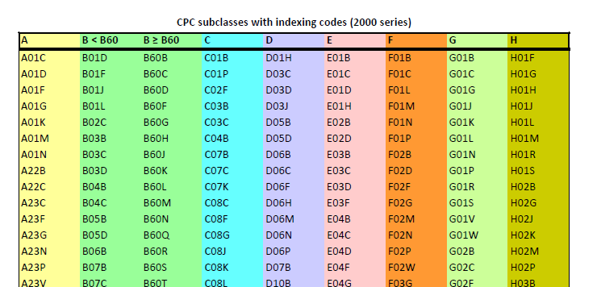
List of subclasses where 2000 series are used
Available on http://www.cooperativepatentclassification.org/index.html under Publications
Geneva, 21 February 2017

Slide 21
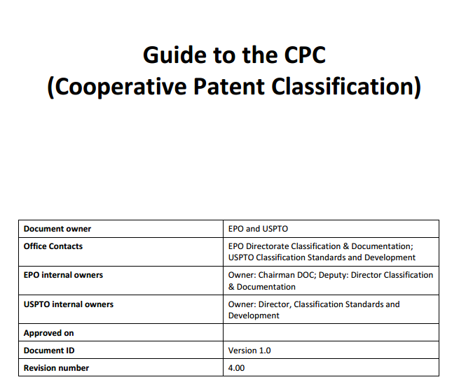
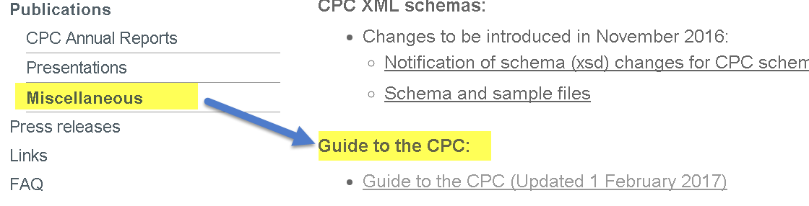
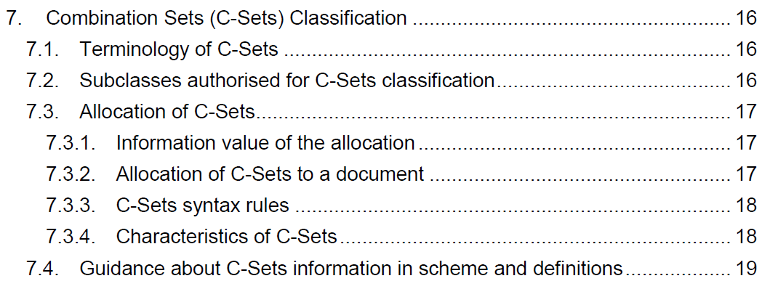
Guide to the CPC
New version of the CPC Guide available on http://www.cooperativepatentclassification.org/index.html since February 2017 under Publications (new section on C-Sets)
Geneva, 21 February 2017

Slide 22
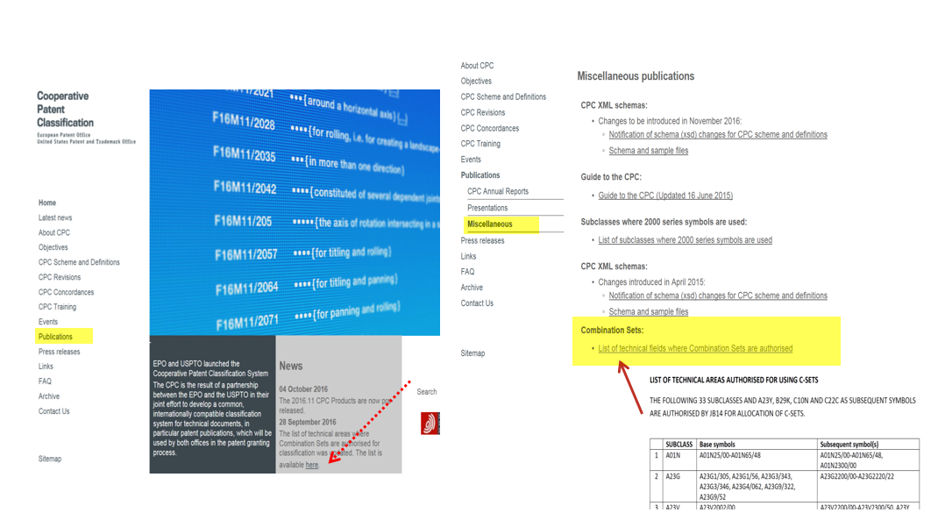
Combination Sets (C-Sets)
List of 37 subclasses where combination Sets are used in the CPC published:
http://www.cooperativepatentclassification.org/publications/CombiSetsListofFields.pdf
Geneva, 21 February 2017

Slide 23
Combination Sets actions-followed
Standardized wording for Notes in the Scheme signalling usage of C-Sets (in the places where C-Sets are used)
Standardized wording for Definitions specifying the usage of C-Sets (in the places where C-Sets are used)
In Q3 2017, clean up of not-anymore-authorized C-sets i.e. deletion of C-set and allocation of “split” symbols as single ones
  Example: current C-set “F04C2/18, A61B1/00” is not on the list of authorized ones. Will disappear but F04C2/18 as well as A61B1/00 will be allocated to the family as single symbols (if not already present)
Geneva, 21 February 2017

Slide 24
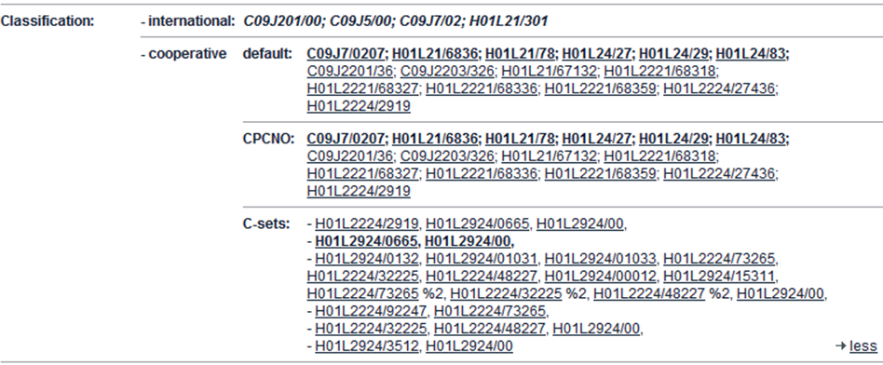
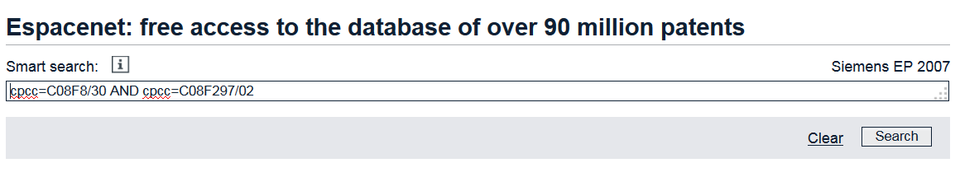
C-Sets from National Offices in Espacenet
(http://worldwide.espacenet.com)
Past:
only C-Sets from EPO/USPTO were displayed
C-Sets not searchable
Since 15 March 2016:
Also C-sets from CPCNO Offices are displayed ...
... and searchable in “Smart search” by using “cpcC”
Geneva, 21 February 2017

Slide 25
C-Set attributes in XML of CPC scheme
Starting with CPC release of February 2017, population of the XML attributes for CPC symbols as follows:
“@c-set-base-allowed” attribute from the authorised list set to “true”, all other symbols set to “false”
“@c-set-subsequent-allowed” attribute set to “false” for all “Y section” symbols. Set to “true” for all other symbols.
Geneva, 21 February 2017

Slide 26
  Future Developments
  Machine readable products
Geneva, 21 February 2017

Slide 27
CPC Products after CPC revisions
Products will be delivered in a machine-readable format, e.g. XML (available on http://www.cooperativepatentclassification.org/index.html;jsessionid=1pn6q6z70vchj)
      RCL (Revision Concordance List)
      CICL (CPC-to-IPC Concordance List)
      Validity File
→ Completed in January 2017
      CRL (Cross-Reference List)
      Compilation of changes
→ For later ...
Geneva, 21 February 2017

Slide 28

Geneva, 21 February 2017

Slide 29



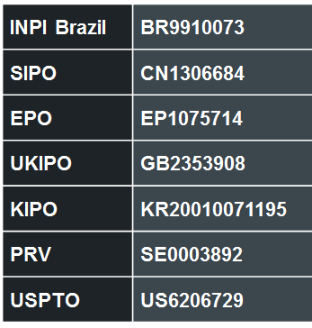
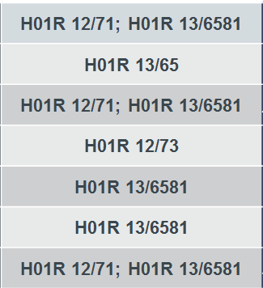
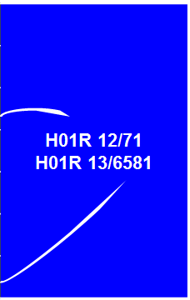
Current picture
document level
(CPCNO)
family level
(CPC)

Slide 30
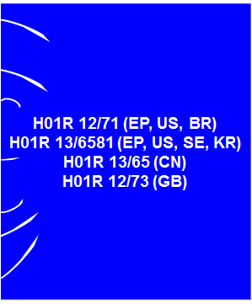
Future picture
family level
(CPC)
Expected by the end of 2018

Slide 31
Thank you for your attention!
www.cpcinfo.org
cpc@epo.org
cpc@uspto.gov
Geneva, 21 February 2017

