Slide 1
http://xellectip.com

Slide 2
WIPO-KIPO-KWIA
International Workshop For Women Inventors and Entrepreneurs 2010
Technology Licensing in a Strategic Partnership
Rachna Singh Puri
CEO, Xellect IP Solutions, India

Slide 3

GENERATING REVENUES FROM IPRs
Manufacturing and selling the end-product
Licensing the IP Rights
Selling the IP rights

Slide 4
Licensing- Out
Obtain the benefit of royalties for the remainder of the life of the IP
Slow incremental value for longer time period
Particularly useful if the company that owns the IP is not in a position to conduct business:
  at all
  in sufficient quantity to meet a given market need
  in a given geographical area

Slide 5
Licensing-In
Critical technology to help improve a product
To obtain a market niche- existing market
Access to new geographies and markets

Slide 6
Cross Licensing
Exchange of mutually beneficial IP assets – Both Licensing in and Licensing out
Provides a good bargaining position
Necessary sometimes to play in a market

Slide 7
Licensing Opportunities
Exclusive license: a single licensee has the right to use the IP, which cannot even be used by the owner
Sole license: a single licensee and the owner have the right to use the IP
Non-exclusive license: several licensees and the owner have the right to use the IP

Slide 8
Identifying Potential Commericalizing Entities
Conduct Competitive Intelligence
Find synergistic partners for:
  Research collaboration
  Manufacturing
  Marketing
Points to consider:
  Technology
  Market
  Customer needs
  Know-how transfer
  Due Diligence

Slide 9
Considerations for Negotiations
Subject Matter
Extent of Rights
Exclusivity
  Or Lack Thereof
  Most Favored Licensee
Territory
Sub-license
Improvements by
  Licensee
  Licensor
Technical Assistance
Financials
  Lump Sums
  Royalties
Financial Administration
Warranties
Anti-competitive Practices
Dispute Resolution
Early Termination Clause

Slide 10


Selling/Assigning
Permanently transfer ownership of the patent to another entity.
Receive an agreed-upon payment once, with no future royalties
Value obtained immediately, without having to wait any longer to realize that value progressively
Avoid any unforeseen risks that will reduce the value of the IP in the future

Slide 11
Case Study-1
An Individual Inventor’s Story

Slide 12
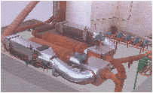
Inventor and Invention
Dr. Milind V. Rane - a professor at a premier institute in India and freelance consultant
During the course of his consultations, he conceived and developed the design for the Matrix Heat Recovery Unit (MHRU)
It can be used for recovering heat from hot gases and/or vapors from engines, generators, boilers or furnaces

Slide 13
Business Aspects…Partnership
M/s Unidyne Energy Environment Systems Pvt Ltd., a small-scale industry based in Mumbai, evinced interest in the invention.
An exclusive license was granted to Unidyne to manufacture and sell the MHRUs
Terms of agreement stated that the units to be sold as engine exhaust fired steam generators and water and thermic heaters
As per the agreement, a down payment was made at the time of signing and subsequent payments were made after achieving various milestones during the demonstration phases
The agreement stipulated a royalty rate of 4.5% of net sales for the inventor
Further, the costs of patent filing and maintenance were borne by the company

Slide 14
Win-Win Situation
For the Company, the agreement represented an important move as it enabled it to enhance its product portfolio and widen its technology and customer base
For the Inventor, the license provided a vehicle for the commercialization of the invention
Revenues generated from the down payment and the royalties fuelled the development of his other inventions

Slide 15
Case Study -2

Slide 16

The Inspiration
Mandy Haberman, a UK citizen and a mother witnessed a friend’s child spilling juice over a carpet
Instead of brooding over the clean-up involved, decided to solve the problem of leaking cups

Slide 17
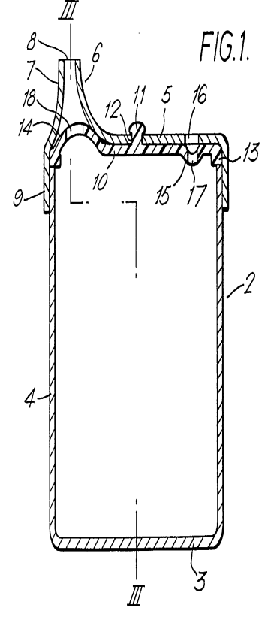
Solution
Her idea was to use a slit valve to control the flow of liquid through the spout of cup
In 1992, the first of many patents was filed (patent no. GB-B-2266045)
Additional patents both for the UK and overseas were later filed and granted

Slide 18
Licensing efforts…failure
Companies involved in manufacture of infants’/children’s products targeted
Prototypes of the innovative product were shown
No license was issued
Therefore, in 1996, Mandy Haberman collaborated with a marketing company that specialized in marketing such innovative products
Anywayup® cup started to sell in unprecedented numbers
60,000 units a week!!

Slide 19
Licensing efforts…success
Shortly after, a US company signed an exclusive USA licensing agreement
Anywayup® Cup was to be manufactured and sold under the TumbleMates brand
Over 10 million cups are now sold each year worldwide

Slide 20
Intellectual Property
If you Protect it….make it Work for you!!!

