Slide 1
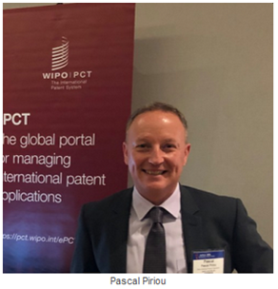
DAS – Digital Access Service

Slide 2
Content
What is DAS
Action with Office of First Filing (OFF)
Action with Office of Second Filing (OSF)
Using DAS with PCT and in other IP Areas
DAS Applicant Portal
Furnishing a P.doc when DAS cannot be used

Slide 3
What is DAS?
Electronic system allowing P.docs and similar documents to be securely exchanged between Participating IP Offices
Alternative to providing paper copies of P.docs
Safe, less expensive, no postal delays
For PCT applications, regional and national applications
Use with patents, utility models, industrial designs and trademarks
Office of First Filing (OFF) / Depositing Office: Office with which the earlier application was filed
Office of Second Filing (OSF) / Accessing Office: Office that retrieves the document

Slide 4
DAS Statistics
390,000+ documents exchanged in 2021
40% of all documents exchanged are P.docs for PCT international applications, transmitted to the IB as Office of Second Filing
Documents exchanged
95% Patents
4% Designs
1% Utility Models

Slide 5
DAS Participating Offices
DAS system started operation in 2009 with 7 Participating Offices
34 DAS Participating Offices as of May 2022
http://www.wipo.int/das/en/participating_offices.html
AR, AT, AU, BR, CA, CL, CO, CN, DK, EA, EE, EP, ES, FI, GB, GE, IB, IL, IN, JP, KR, LV, MA, MX, NL, NO, NZ, SE, US
Depositing Office only: IT, FR
Accessing Office only: BE, IE
Industrial Design Applications only: EUIPO
DAS User Documentation & FAQ
http://www.wipo.int/das/en/documentation.html
https://www.wipo.int/das/en/faq.html

Slide 6
Action with Office of First Filing (OFF)
Request OFF to deposit the earlier application into DAS
Check with OFF for procedures (e.g. fill in a form or check a box on the request for filing the ealier application)
Pay a fee if applicable
For US applications filed after 30 November 2015, entry into DAS is automatic except if applicant opts it out
For EP applications, automatic deposit into DAS if filed electronically

Slide 7
DAS Code
Once earlier application is registered, applicant receives a unique DAS Access Code (DAS Code)
DAS code is either made of 4 digits (e.g. 1234) and can also contain letters “A to F” (e.g. 8DE8)
DAS code of an earlier application registered in DAS can be re-used if this earlier application is claimed as a priority in another application

Slide 8
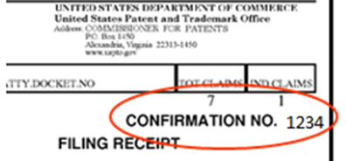
Who provides the DAS code? (1)
OFF: CN, EP, EUIPO, FI, JP, KR, NZ, US
Email from IB (no.reply@wipo.int)
OFF: AR, AU, AT, BR, CA, CL, CO, DK, EA, EE, ES, FR, GB, GE, IL, IN, IT, LV, MA, MX, NL, NO, SE
PCT RO/IB applications: PCT/RO/132
US applications: confirmation number on EFS-Web Electronic Acknowledgement Receipt

Slide 9
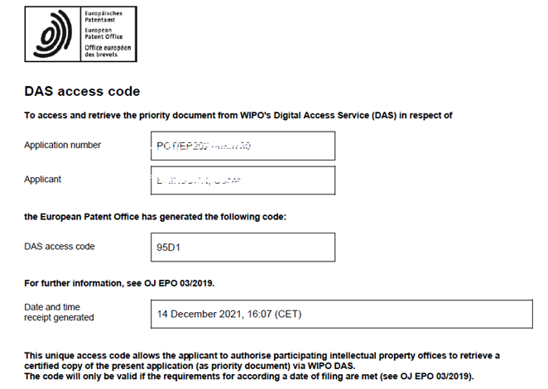
Who provides the DAS code? (2)
EP applications: acknowledgement receipt

Slide 10
Action with Office of Second Filing (OSF)
Applicant requests the OSF to retrieve the earlier application:
Check procedures with OSF
Provide DAS Code

Slide 11
P.docs Retrieval via DAS
Step 1: Applicant requests OFF (Depositing Office, e.g., national/regional Office or IB) to make a P.doc available in DAS
Step 2: DAS Code sent to applicant by the OFF (Depositing Office) or IB
Step 3: Applicant provides DAS Code to the OSF (Accessing Office) to retrieve the P.doc
No need to obtain and send multiple certified paper copies of an application

Slide 12
Using DAS with PCT
IB is considered as an OSF
Once earlier application is registered in DAS, the applicant requests the IB to retrieve it from DAS:
At the time of filing: indicating DAS Code on the PCT Request (RO/101)
After filing: via ePCT by submitting an online Action -Obtain priority document from DAS or using Upload Documents - General Correspondence

Slide 13
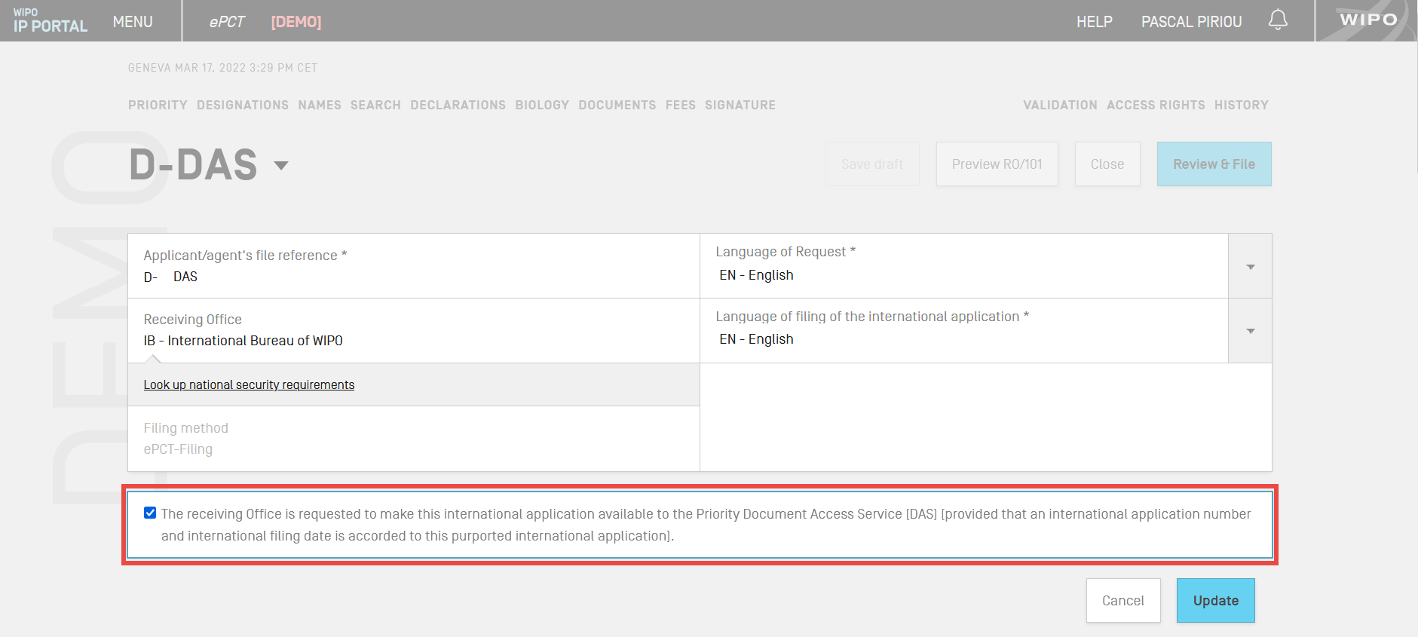
Make PCT application available in DAS
At the time of filing using ePCT, for ROs depositing PCT applications in DAS: AU, AT, BR, CA, CL, CO, DK, EP, IB
After filing and only for PCT RO/IB applications, using Action - Make international application available to DAS

Slide 14
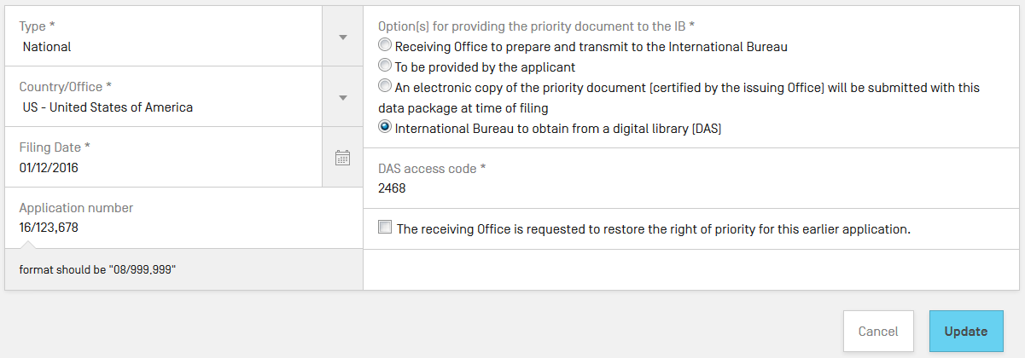
DAS request in ePCT at the time of filing
Select option for IB to obtain the P.doc from DAS, provided the OFF is a DAS Depositing Office
DAS Code is mandatory – document must be already available in DAS

Slide 15
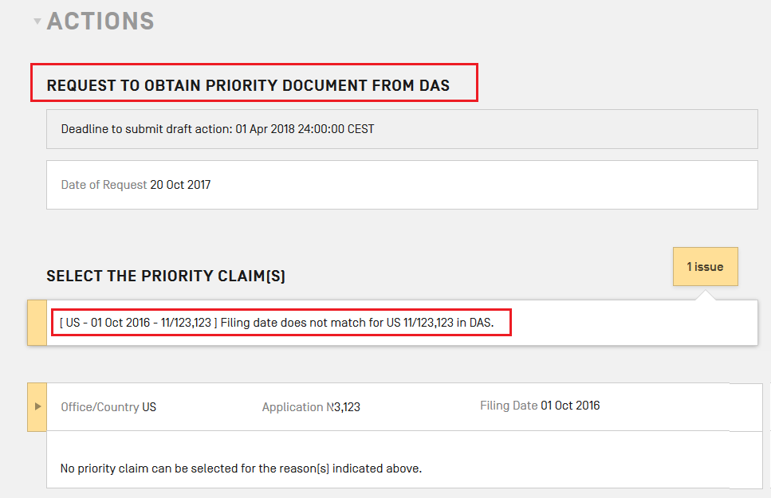
DAS request using ePCT after filing
Fully-automated ePCT Action: real time look-up in DAS validates the DAS Code and cross-checks priority data
Upload Documents - General Correspondence

Slide 16
Time limit to request use of DAS
PCT Rule 17.1(a): Time limit is considered to be met if a valid request is made to the IB before the date of international publication
IB retrieves the P.doc via DAS and sends form PCT/IB/304 as confirmation

Slide 17
DAS and Utility Models
OFF currently depositing utility models
AT, CL, CO, CN, DK, EE, ES, FI, FR, GE, IT, JP, KR, MX
OSF currently retrieving utility models
AT, AR, CL, CO, CN, DK, ES, FI, GE, IE, JP, KR, MX

Slide 18
DAS and Industrial Designs
As of 28 February 2018, it is possible to request DAS retrieval of P.docs in industrial design applications under Hague Agreement
OFF currently depositing design P.docs: AU, AT, BR, CA, CL, CO, CN, ES, EUIPO, FR, GE, IB, IL, IN, IT, JP, KR, MX, NO, US
OSF currently retrieving design P.docs: AU, AT, CA, CL, CO, CN, ES, EUIPO, GE, IE, IL, IN, JP, KR, MX, NO, US
For Hague related questions, contact Hague Customer Service: + 41 22 338 7575 or Contact Form

Slide 19
DAS and Trademarks
OFF currently depositing trademark applications
AU, AT, BR, FR, GE, IT, NO
OSF currently retrieving trademark applications
AU, AT, CO, GE, IE, NO
For Trademarks related questions, contact Madrid Customer Service: + 41 22 338 8686 or Contact Form

Slide 20
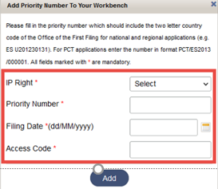
DAS Applicant Portal (1)
Allow users to track availability and view access history of P.docs by OSF
Sign in to WIPO Account: IP Portal > Patents > File & Manage > DAS for applicants or use the direct URL https://www3.wipo.int/dasapplicant
Add P.docs to DAS Workbench by providing IP Right type, Priority Number, Filing Date and Access Code

Slide 21
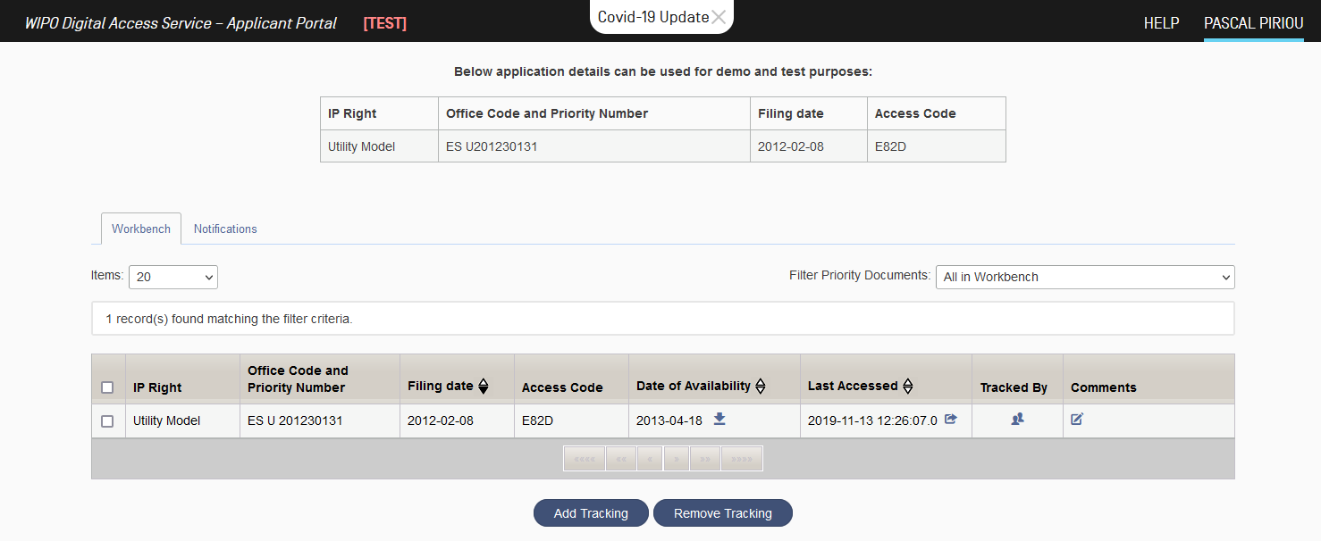
DAS Applicant Portal (2)
DAS Workbench

Slide 22
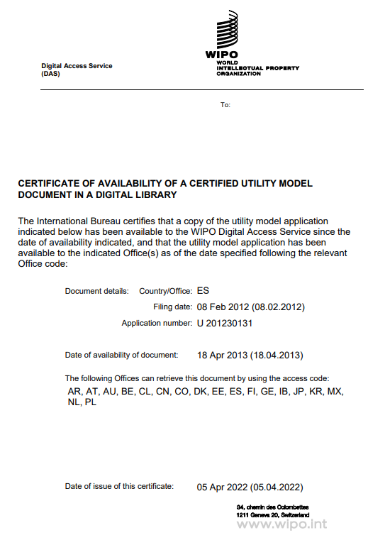
DAS Applicant Portal (3)
Certificate of Availability

Slide 23
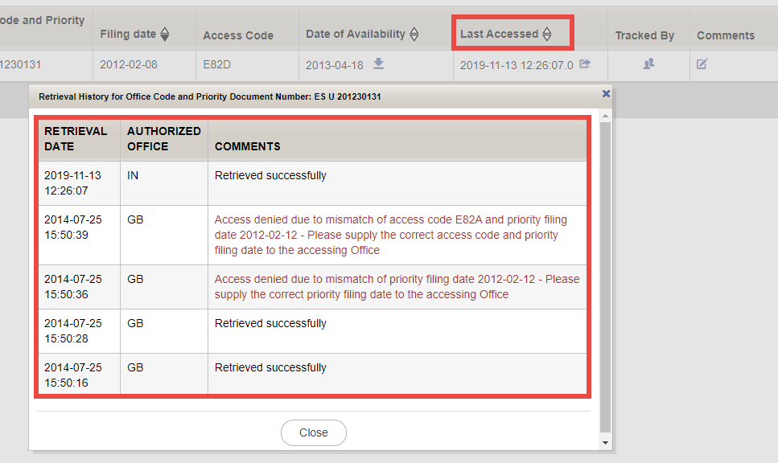
DAS Applicant Portal (4)
Last Accessed

Slide 24
Furnishing a P.doc under the PCT when DAS cannot be used (1)
Option 1: request the RO to prepare the P.doc and transmit it to the IB – if the earlier application was filed at the same Office (PCT Rule 17.1(b))
Option 2: Applicant sends the P.doc to the IB (PCT Rule 17.1(a))

Slide 25
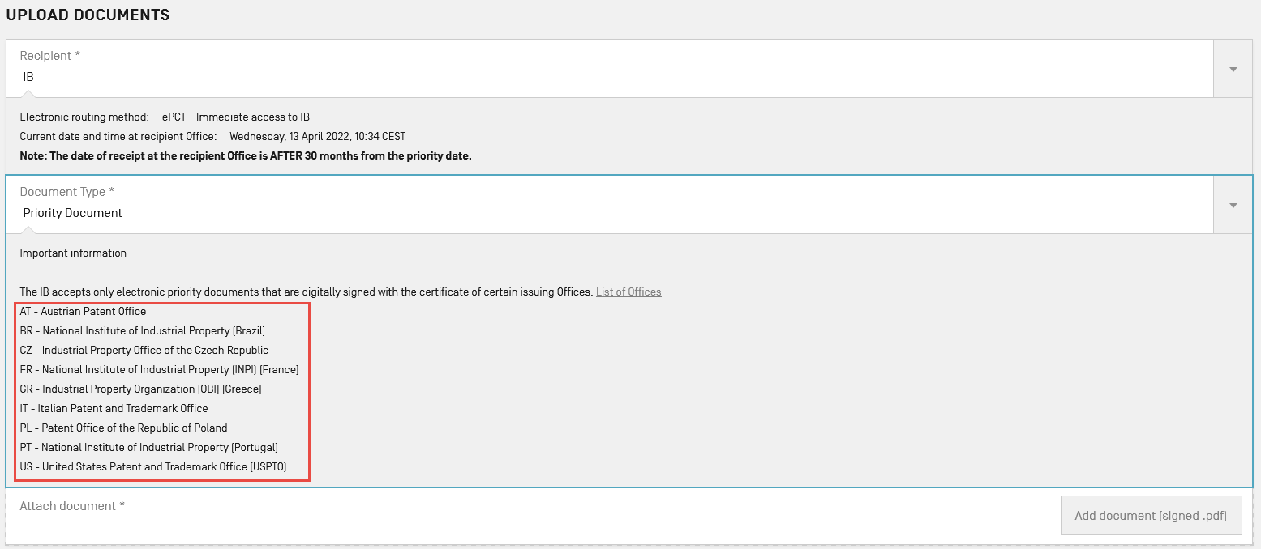
Furnishing a P.doc under the PCT when DAS cannot be used (2)
Option 3: Upload in ePCT digitally signed P.docs issued by AT, BR, CZ, FR, GR, IT, PL, PT or US

Slide 26
Terminology
DAS
P.doc
OFF
OSF
IP Right Type
Digital Access Service
Priority Document
Office of First Filing / Depositing Office
Office of Second Filing / Retrieving Office
Patent, Utility Model, Design, Trademark
Notes:
Example note 1

Slide 27
Contact Us
PCT Operations Customer Support Section
Tel: +41-22-338-9523
Email: pct.eservices@wipo.int
Live Chat & Web Contact Form available via FAQ answers
Monday to Friday, 9am-6pm Geneva time
Notes:
Example note 1

Slide 28
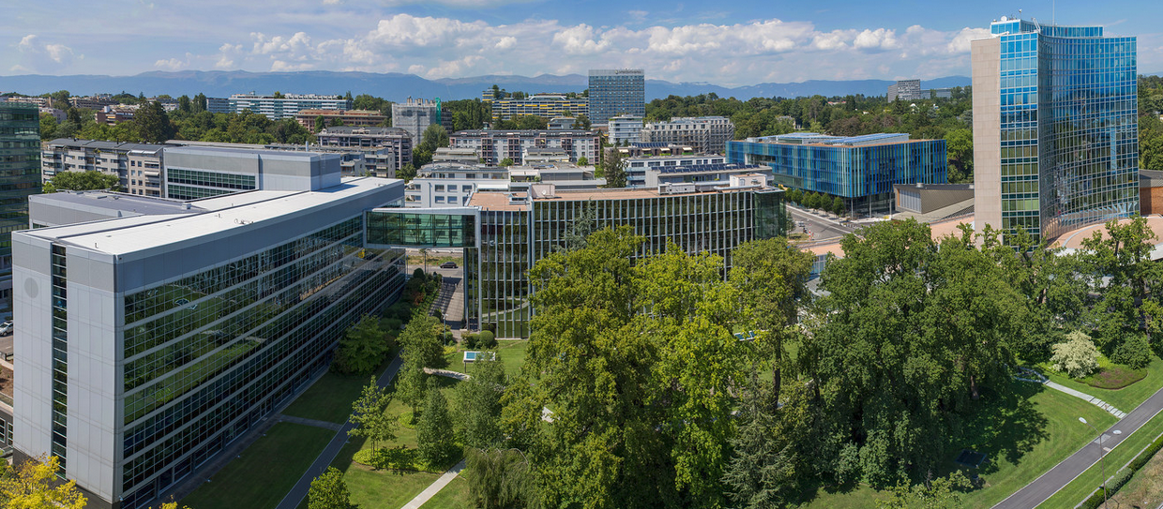
Thank you!

