Slide 1

PCT Statistics
Meeting of International Authorities
Twenty-Fourth Session
Reykjavík
February 8 to 10, 2017

Slide 2
Outline
International Applications Filed
  Overall Trends and Forecasts
  Medium of Filing
  Languages
National Phase Entries
International Authorities
  International Search
  Supplementary International Search
  International Preliminary Examination

Slide 3
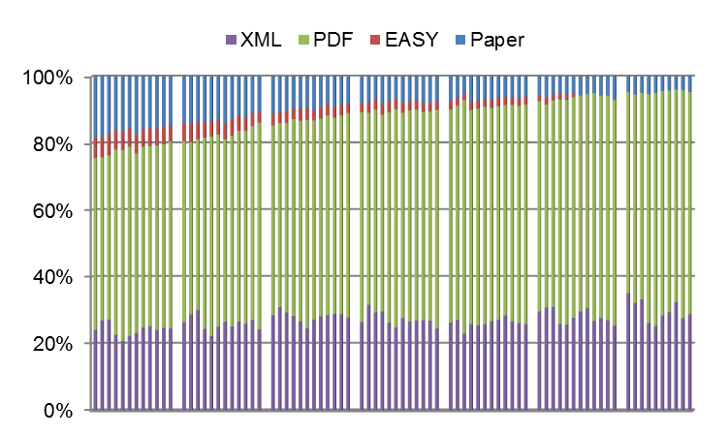
Medium of Filing
2010
2011
2012
2013
2014
2015
2016
Distribution in 2016 – 2015 distribution in parenthesis:
4.5% paper (5.6%),
95.4% (93.6%) fully electronic [PDF 65.6% (65.5%), XML 29.9% (28.1%)]

Slide 4
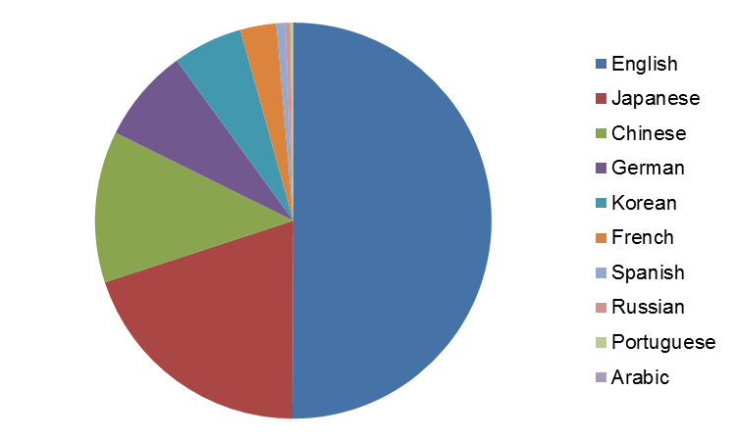
Publication Languages in 2016
Source: WIPO statistics database. January 2017

Slide 5
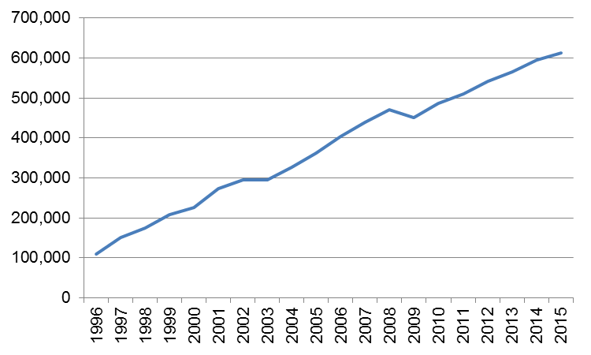
PCT National Phase Entries
612,300 total national phase entries in 2015 (+2.75%)
521,000 non-resident national phase entries in 2015 (+5.5%)
57.0% of all non-resident patent applications (57.1% in 2014)
Source: WIPO statistics database. November 2016

Slide 6
International Authorities
International Search Reports
  Distribution by International Authority
  Timeliness of Transmission to International Bureau
Supplementary International Search Reports
International Preliminary Examination Reports
  Demand
  Distribution by International Authority
  Timeliness of Transmission to International Bureau

Slide 7
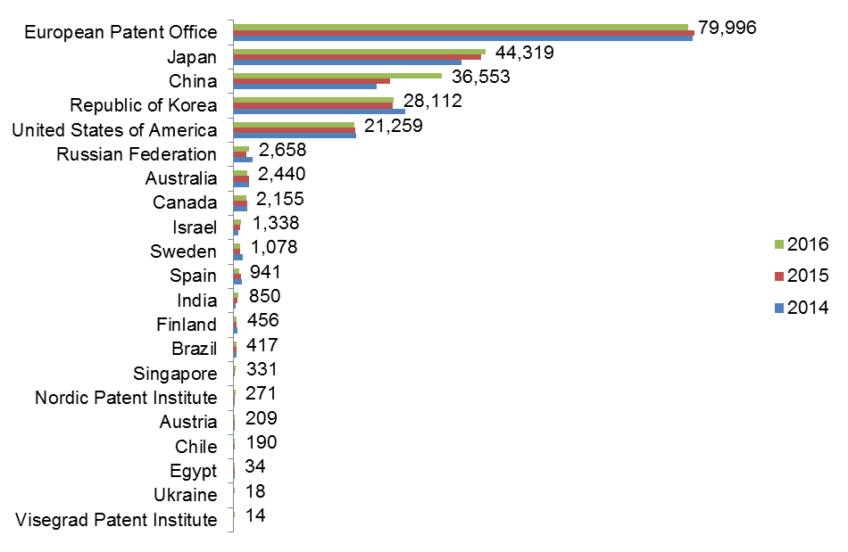
Distribution of ISRs established by ISA
Data based on international filing year of application
Data for 2016 are incomplete
Source: WIPO statistics database. January 2017

Slide 8
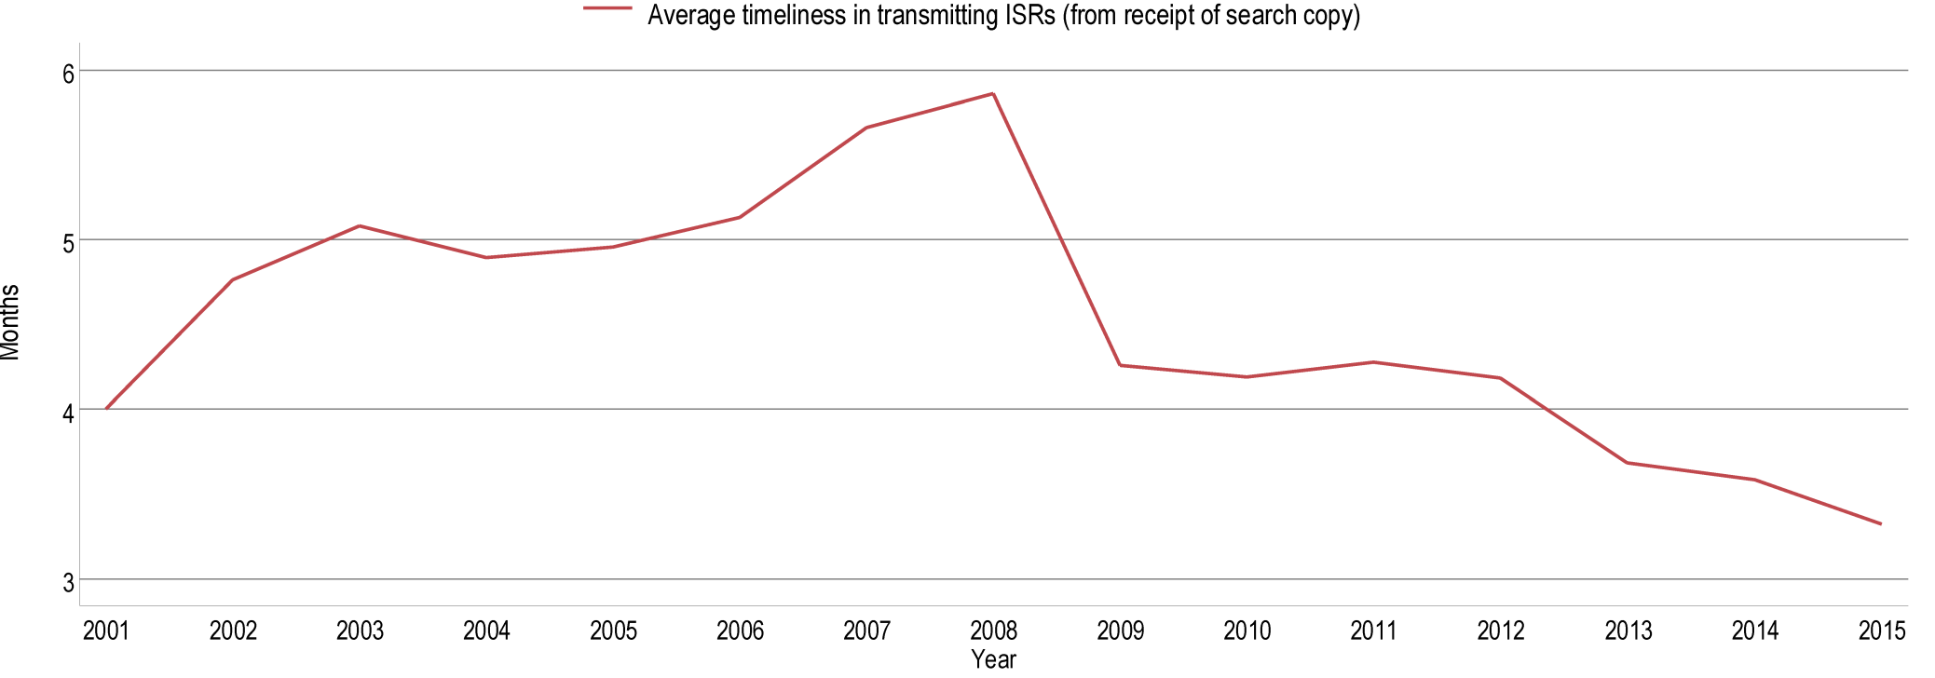
Average Timeliness in transmitting ISRs to the IB from Date of Receipt of Search Copy
Source: WIPO statistics database, May 2016 and January 2017. Excludes cases where the time limit of 9 months from the priority date applies.
Average timeliness in transmitting ISRs to the IB was 3.3 months in 2015 - shortest time since 2001
76.3% of PCT applications transmitted to IB within 3 months from date of receipt of search copy in 2015 – expected to rise to about 80% for 2016

Slide 9
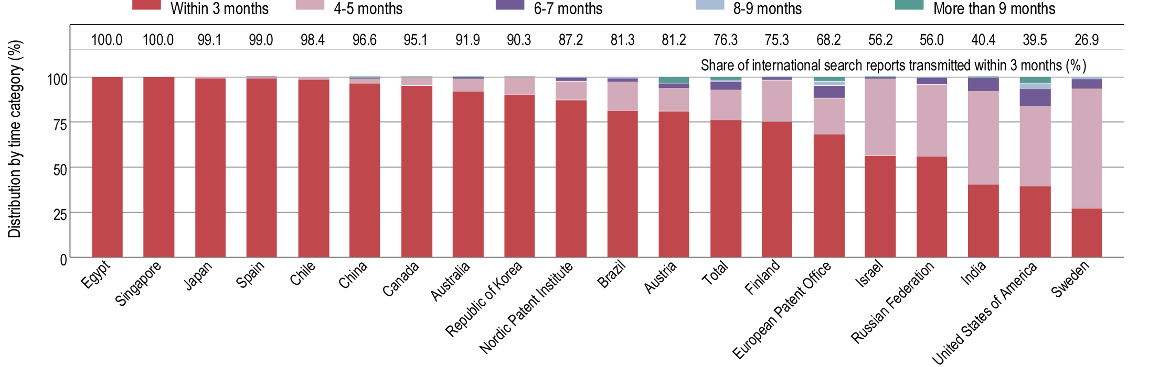
Timeliness in Transmitting ISRs to the IB measured from Date of Receipt of Search Copy by ISA for 2015
Provisional share transmitted within 3 months for 2016
68.2
99.6
99.2
95.9
78.0
83.6
80.4
74.8
52.0
52.8
99.3
98.1
98.4
90.7
91.8
81.4
76.3
89.8
53.9
62.5
Source: WIPO statistics database, May 2016 and January 2017. Excludes cases where the time limit of 9 months from the priority date applies.

Slide 10
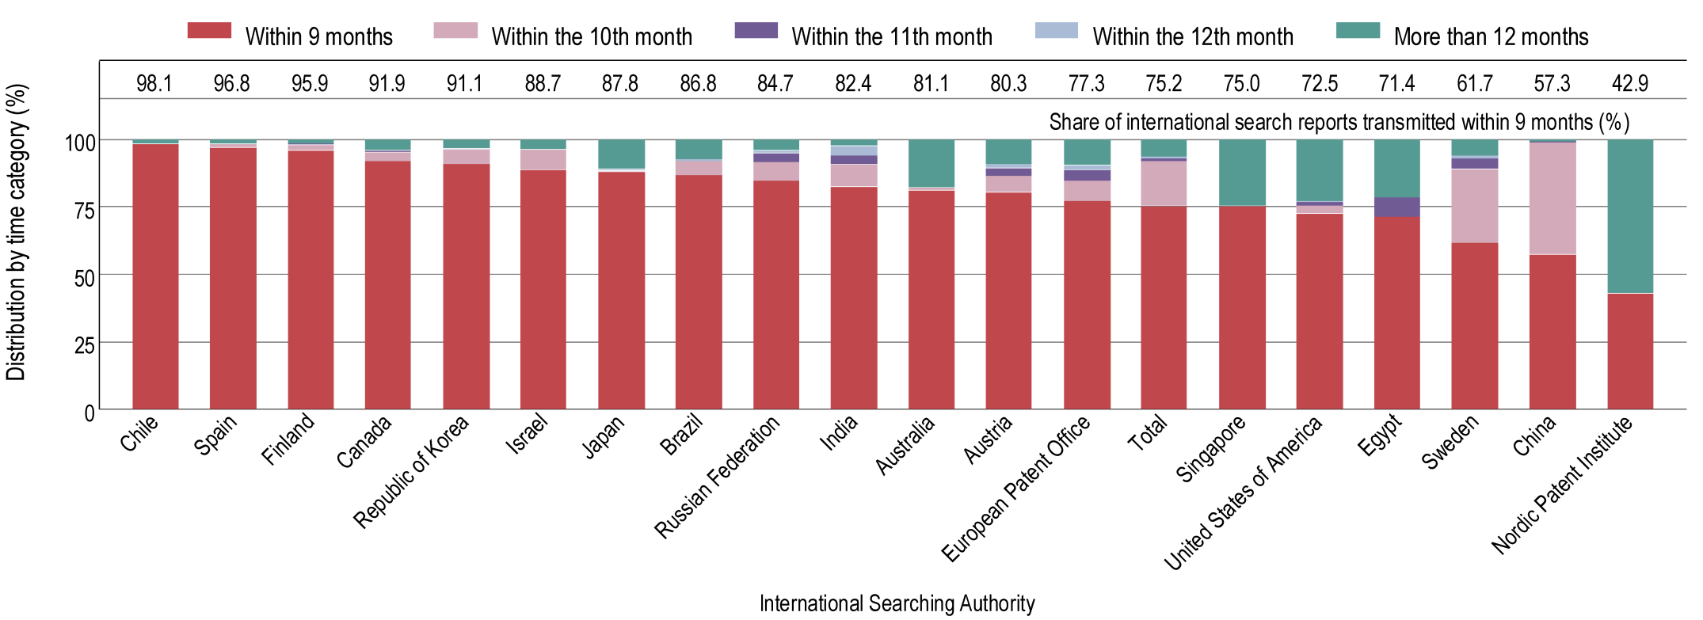
Timeliness in Transmitting ISRs to the IB measured from Priority Date by ISA for 2015
Provisional share transmitted within 9 months for 2016
97.2
97.6
81.1
87.0
95.0
85.4
45.6
75.8
88.1
82.9
94.7
83.3
63.0
98.7
93.3
94.6
77.0
79.4
80.1
30.8
Source: WIPO statistics database, May 2016. Excludes cases where the time limit of 3 months from receipt of search copy applies.
75.2% of PCT applications transmitted to IB within 9 months from priority date in 2015 – expected to rise to about 77% for 2016

Slide 11
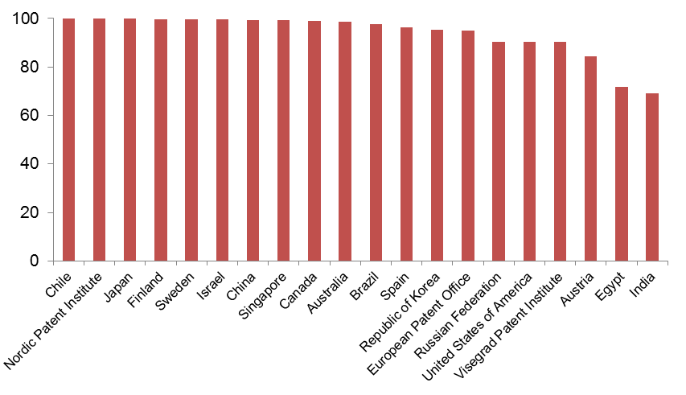
PCT A1 Publication Percentage by ISA in 2016
Overall Percentage of A1 International Publications = 96.2%
(93.4% in 2015)
Source: WIPO statistics database January 2017.

Slide 12
Supplementary International Search Requests
 | 2012 | 2013 | 2014 | 2015 | 2016
Total | 46 | 67 | 109 | 64 | 47
Austria | 2 | 2 | 2 | 2
European Patent Office | 21 | 30 | 61 | 40 | 44
Finland | 1
Nordic Patent Institute | 3
Russian Federation | 19 | 32 | 46 | 22 | 2
Singapore |  |  |  |  | 1
Sweden |  | 3
Source: WIPO statistics database January 2017.

Slide 13
International Preliminary Examination Demands
2016 figures are incomplete
Source: WIPO statistics database. January 2017

Slide 14
International Preliminary Examination Reports
2016 figures are incomplete
Source: WIPO statistics database. January 2017

Slide 15
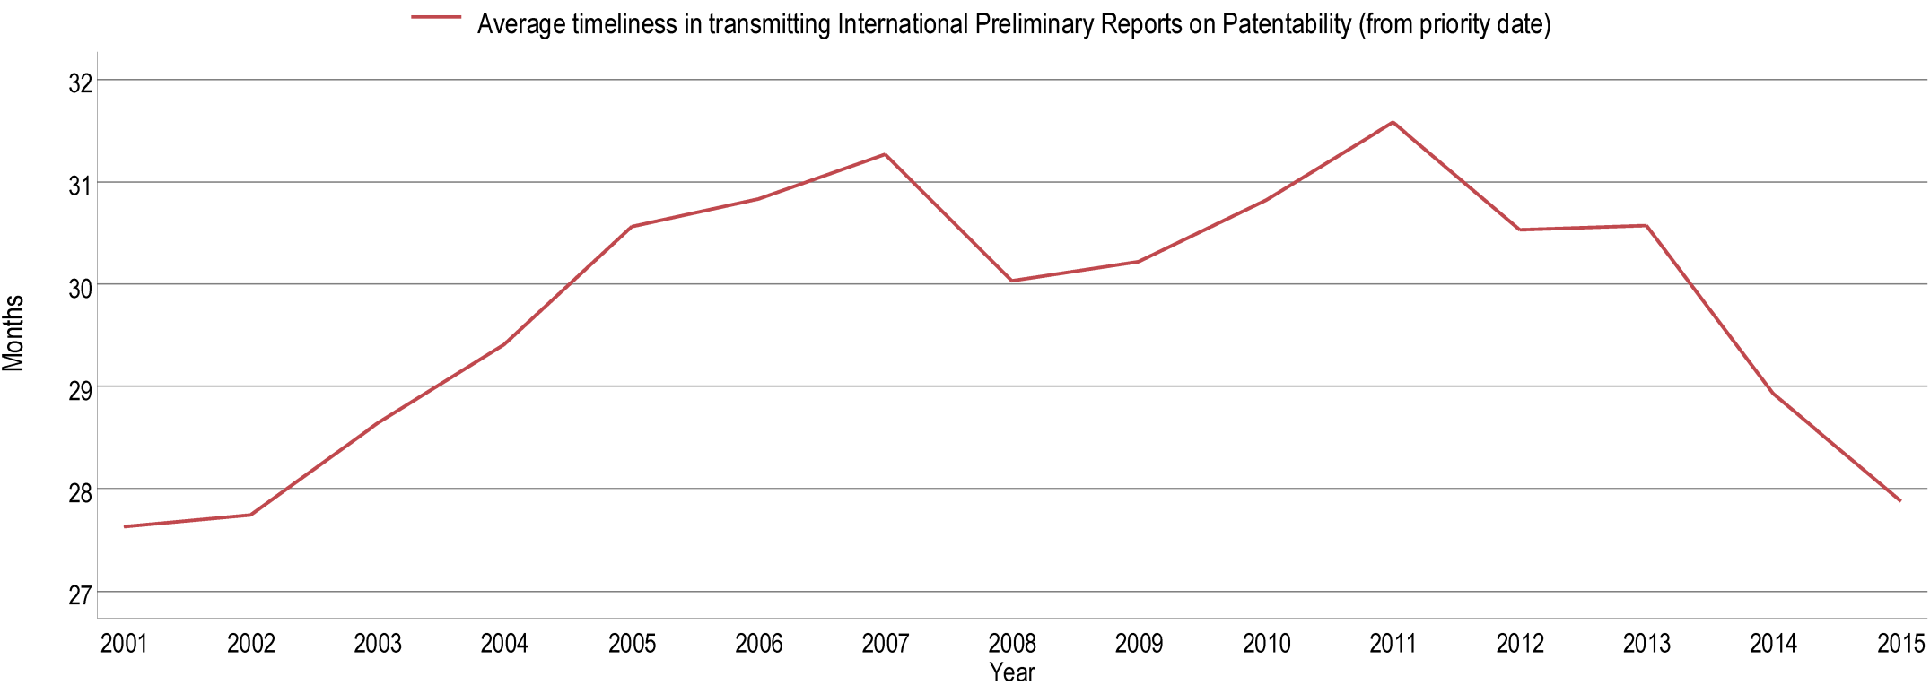
Average Timeliness in transmitting IPRPs
Average time in transmitting IPRPs fell to 27.9 months in 2015, similar to level observed in 2001
80.4% of all IPRPs were transmitted to the IB within 28 months of priority date in 2015 (expected to rise to about 85% for 2016)
Source: WIPO statistics database, May 2016

Slide 16
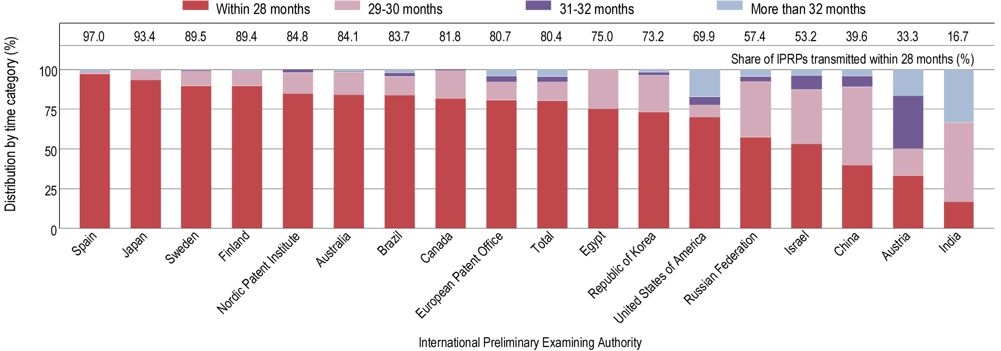
Timeliness in Transmitting IPRPs by IPEA in 2015
Provisional share transmitted within 28 months for 2016
98.3
95.9
91.1
88.2
74.5
81.0
86.9
81.7
51.4
75.0
93.6
83.4
85.8
74.5
77.5
47.8
20.0
Timeliness calculated as time elapsed between priority date and date on which International Bureau receives IPRP form the IPEA.
Source: WIPO statistics database, May 2016 and January 2017.

Slide 17
Further information:
2016 PCT Yearly Review
The International Patent System
WIPO Publication No. 901E/2016
2016 World Intellectual Property Indicators
WIPO Publication No. 941E/2016
WIPO IP Statistics Data Center
http://www.wipo.int/ipstats/en/

