Slide 1
Find documents published in languages you don’t know in PATENTSCOPE
Cyberworld
August
2019
Sandrine Ammann
Marketing & Communications Officer

Slide 2
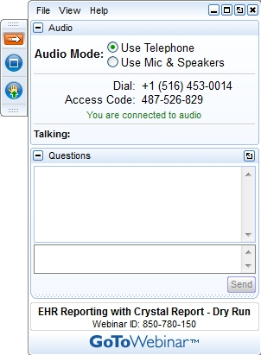
If you can hear me and see my screen, please click the raise hand button

Slide 3


Slide 4
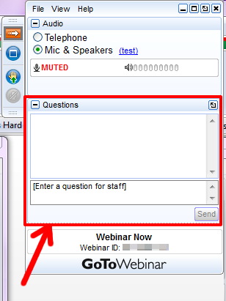

Slide 5
Questions/concerns
patentscope@wipo.int

Slide 6


PATENTSCOPE
可生物降解
박테리아
バクテリア
生分解性
생분해 성
사용하기 쉬운
可生物降解
使いやすい
方便使用的
菌

Slide 7
CLIR
Cross-Lingual Information Retrieval

Slide 8
What is it?
1. Finds synonyms:
container receptacles/ reservoir/tank
2. Translates into 13 languages
container
emballage
conteneurs
contenants
Verpackung
Transportbehälter
Behältnisses
behaallare
viravattenbehållare
pappersmaskins
集装箱
容器
盒
Zbiorników
Pojemnika
kontenerowego
envase
contenedor
tanque
contentor
receptáculo
embalagem
용기
기
탱크
recipienti
serbatoio
riserva
Контейнера
Емкости
резервуара
toevoertank
watervat
opslagtank
コンテナ
タンク
貯槽
Fartøj
Påfyldningsindretning

Slide 9
CLIR – 14 languages available
NON-ASIAN
Danish
Dutch
English
French
German
Italian
Polish
Portuguese
Russian
Spanish
Swedish
ASIAN
Chinese
Japanese
Korean

Slide 10
Q:1 How many of you are already familiar with CLIR?
A
yes
B
no

Slide 11
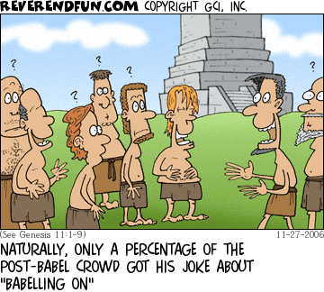
Historical background

Slide 12
Where to find it?

Slide 13
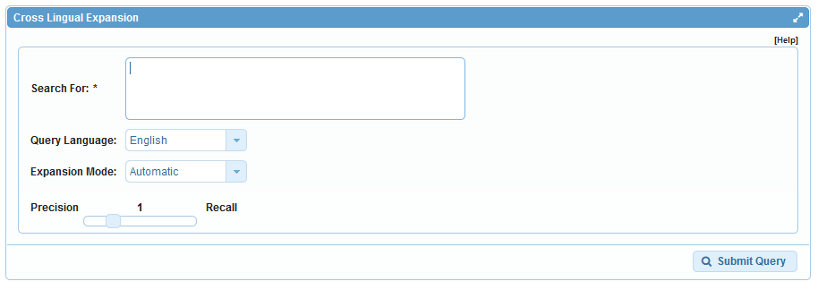
How to use it? Interface

Slide 14
Query language
Define the language of the query:

Slide 15
Expansion mode
2 modes:
  Automatic = 1 step
  Supervised = 4 steps

Slide 16
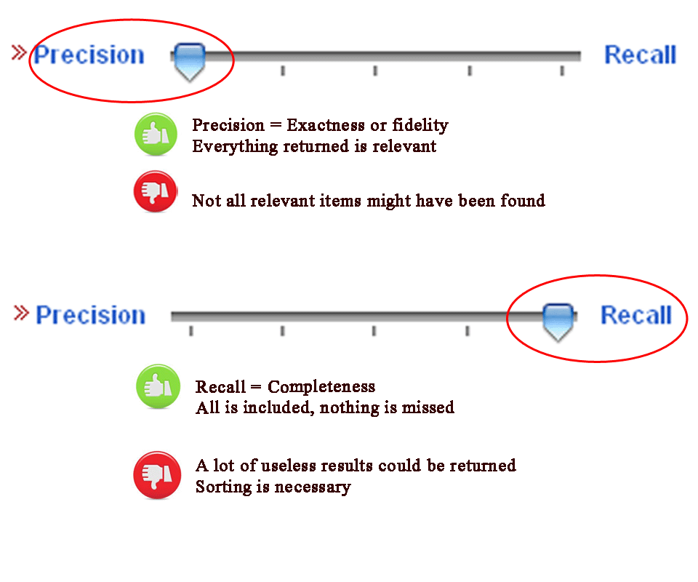
CLIR: precision vs recall

Slide 17
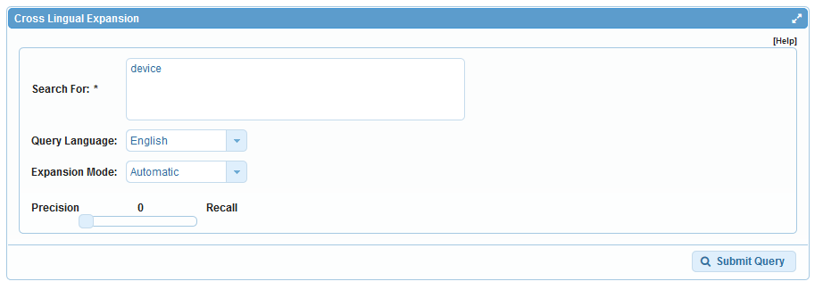
Example: precision

Slide 18
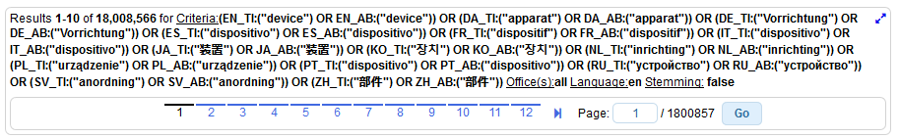
Results for «precision»

Slide 19
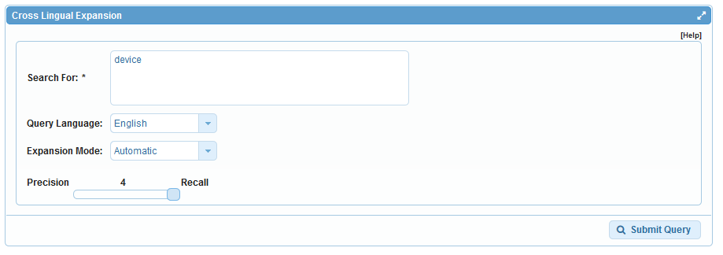
Example: recall

Slide 20
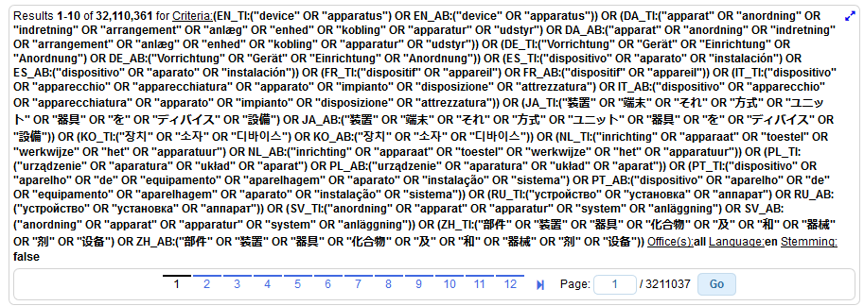
Results for «recall»

Slide 21

Photo by Emmy Smith on Unsplash

Slide 22
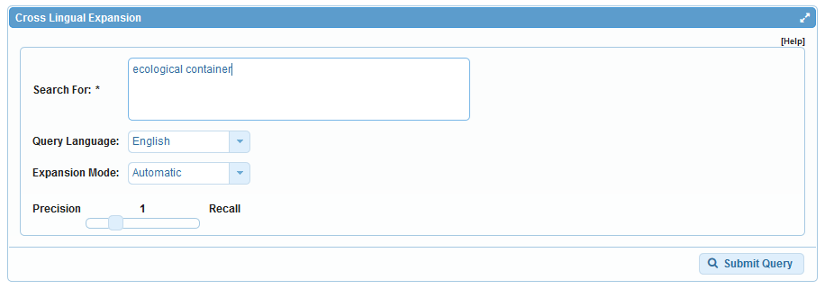
Automatic mode

Slide 23
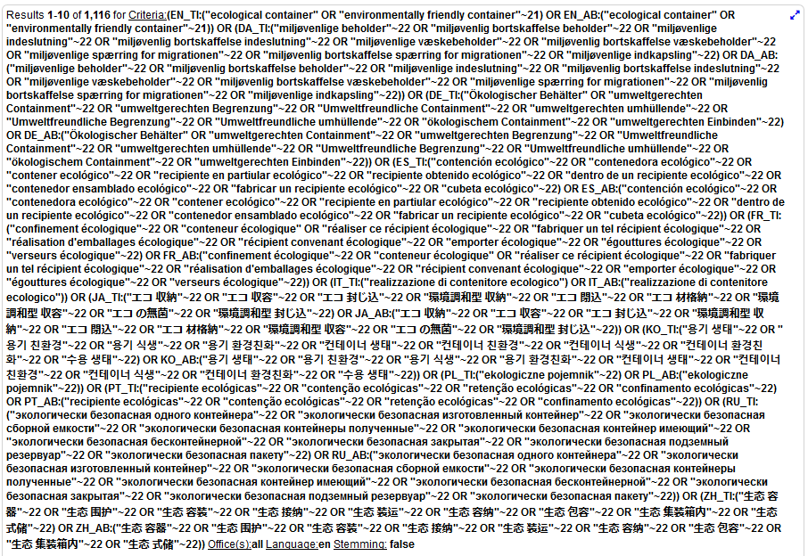

Slide 24
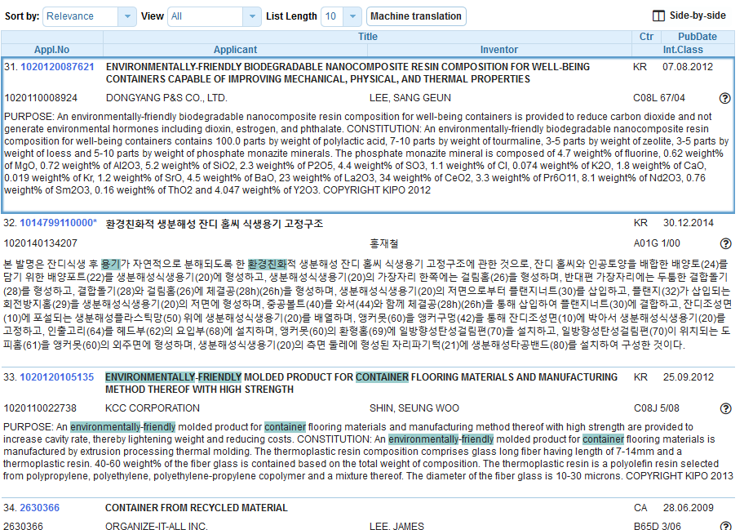

Slide 25
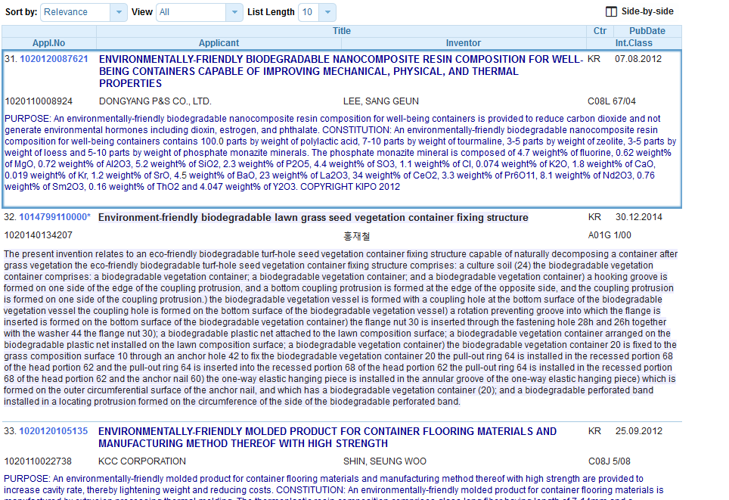

Slide 26
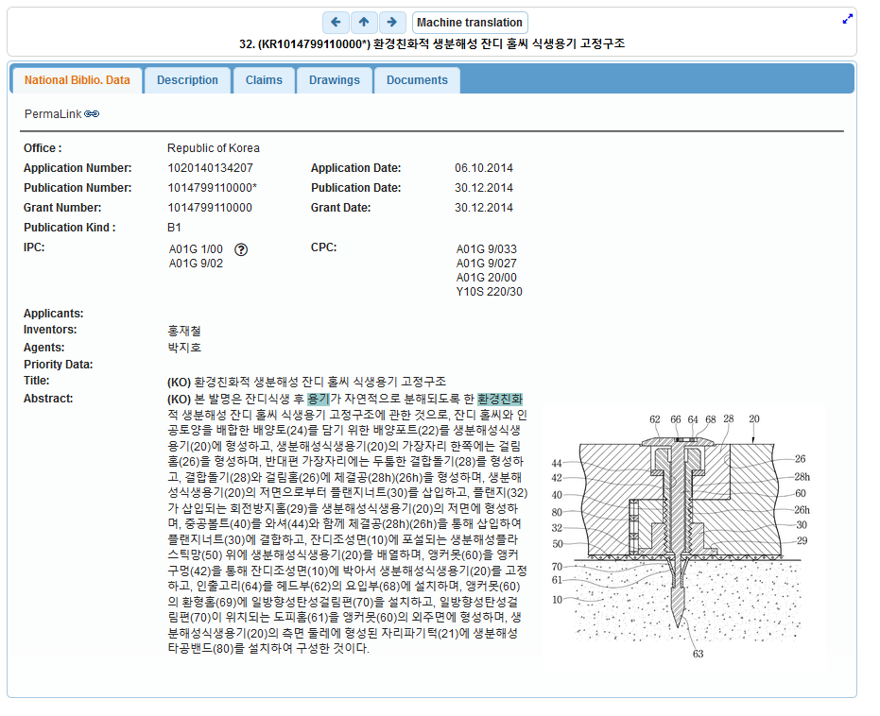
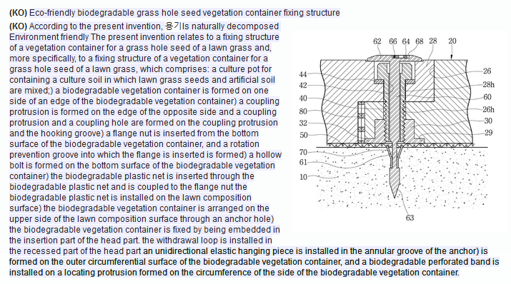

Slide 27
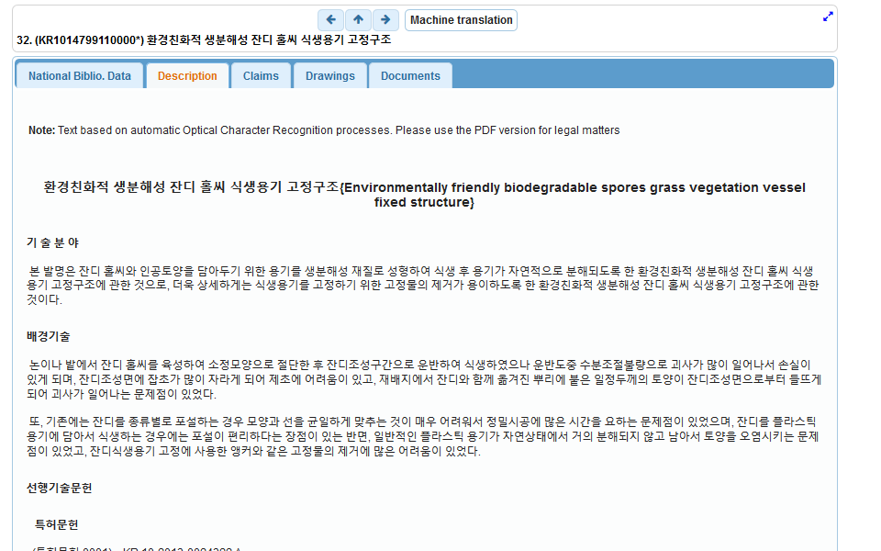

Slide 28
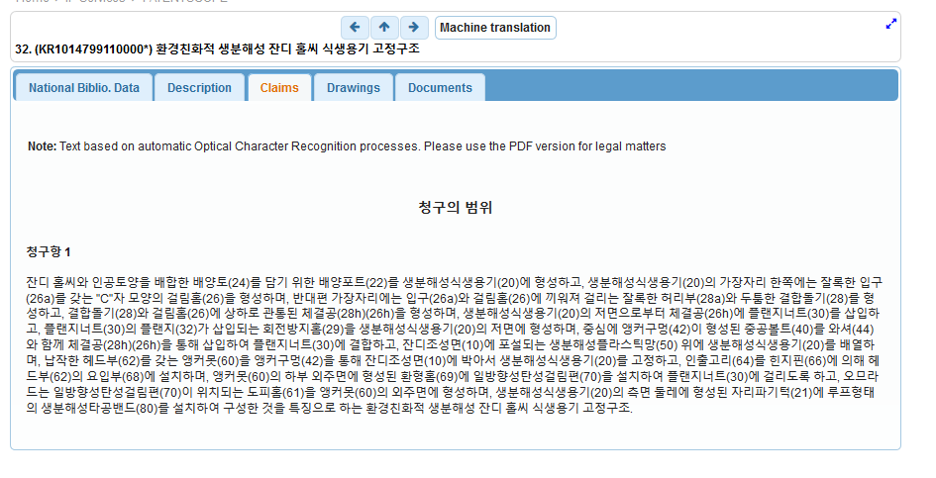

Slide 29
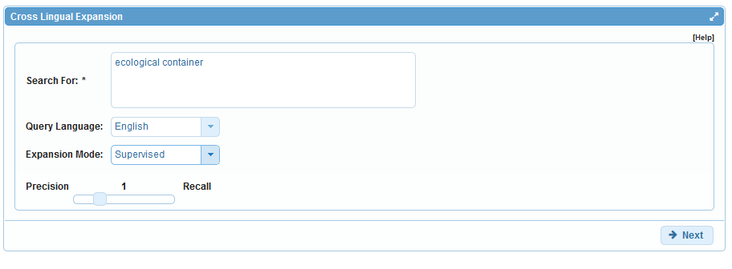
Supervised mode

Slide 30
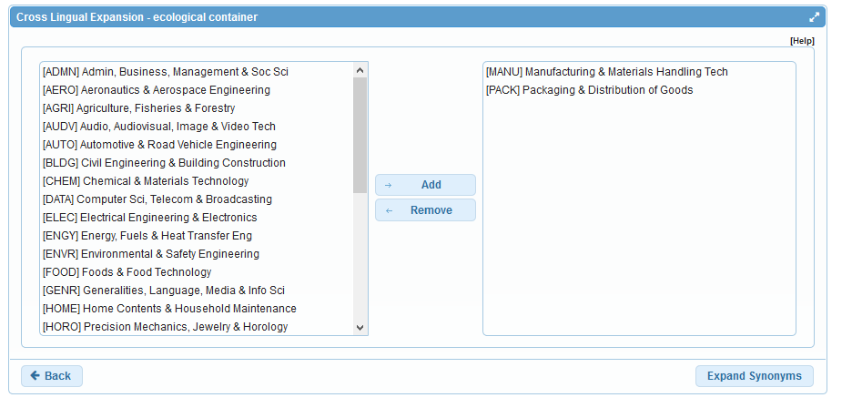
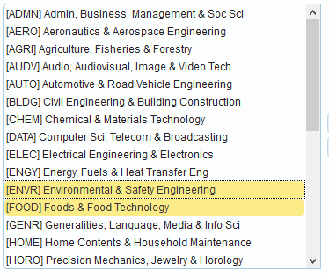
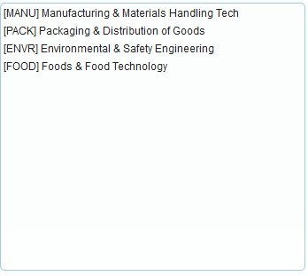
Step 1: technical field selection

Slide 31
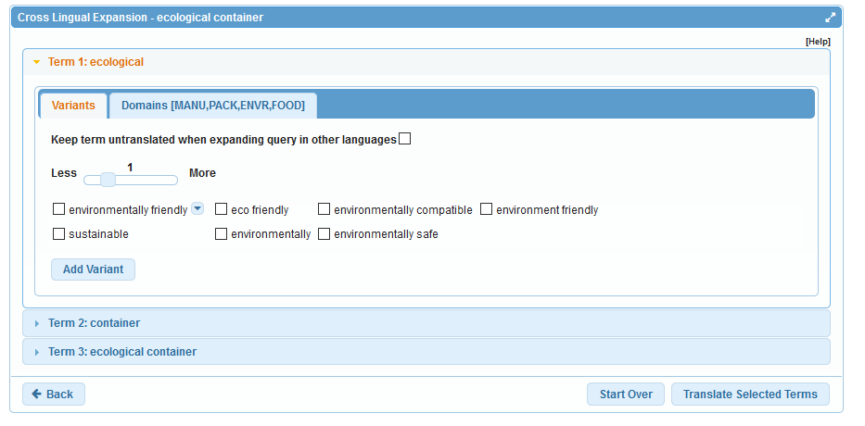
Step 2: synonym selection

Slide 32
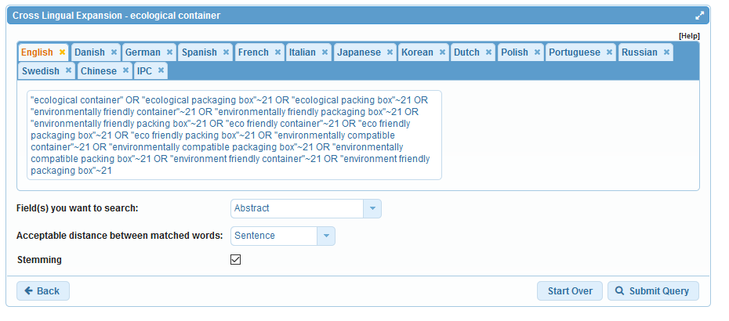
Step 3: translated term selection

Slide 33
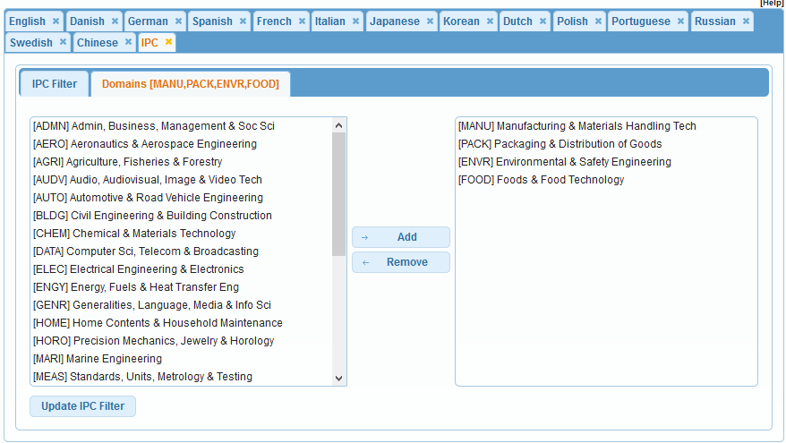
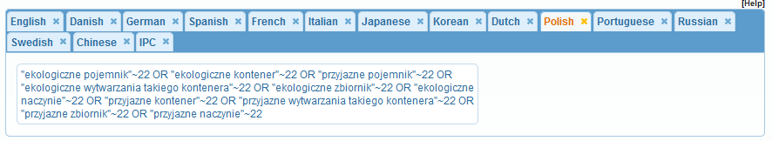
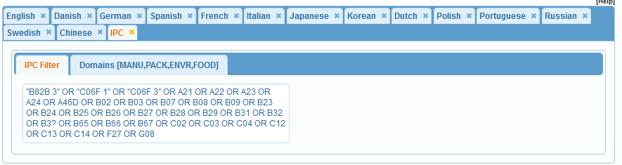
Relevance/IPC checking

Slide 34
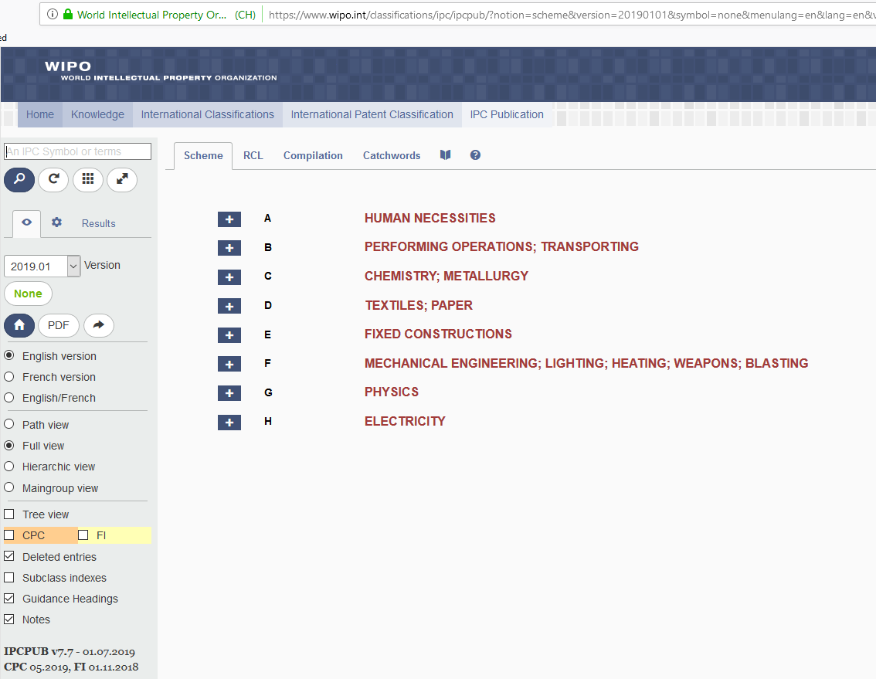

Slide 35
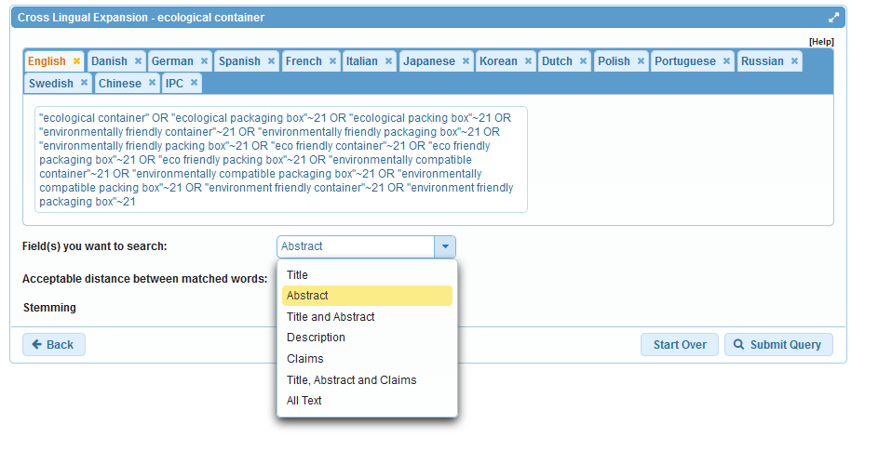
Search fields

Slide 36
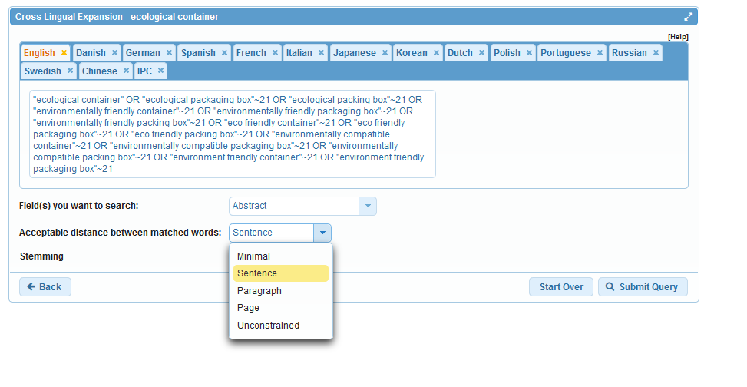
Acceptable distance

Slide 37
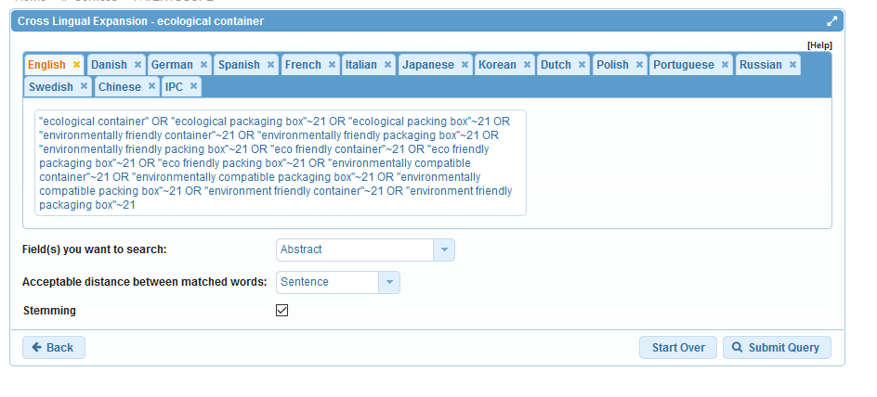
Stemming

Slide 38
Stemming
Use of the root form of a word:
        displayed
        Display displaying
        displays

Slide 39
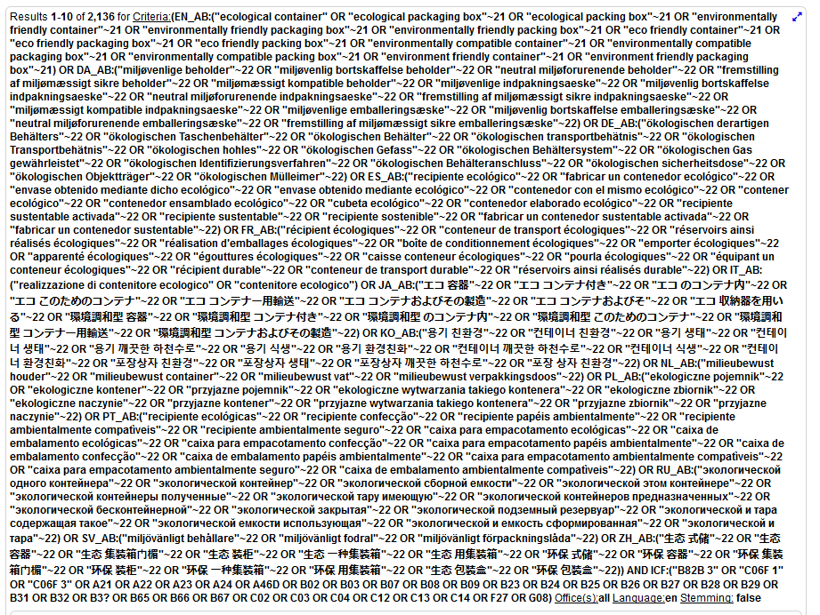

Slide 40
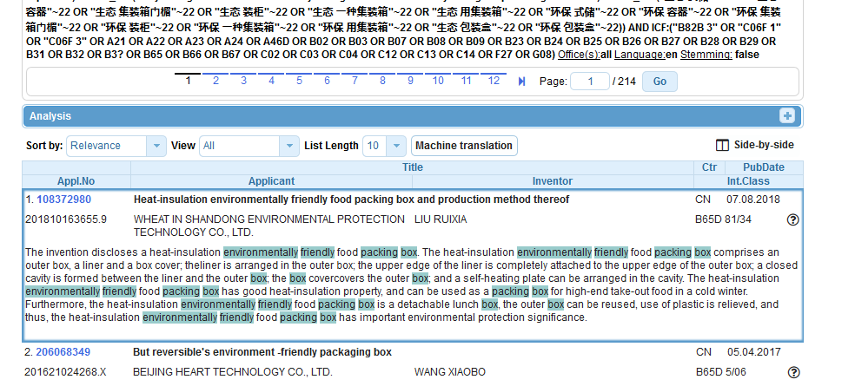
Refine search

Slide 41
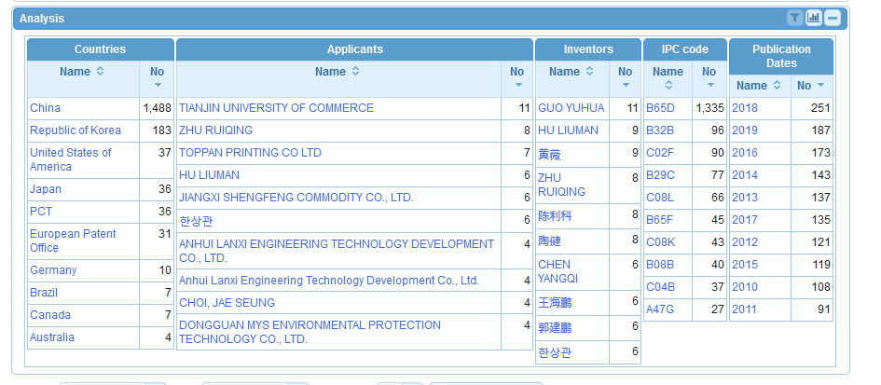

Slide 42
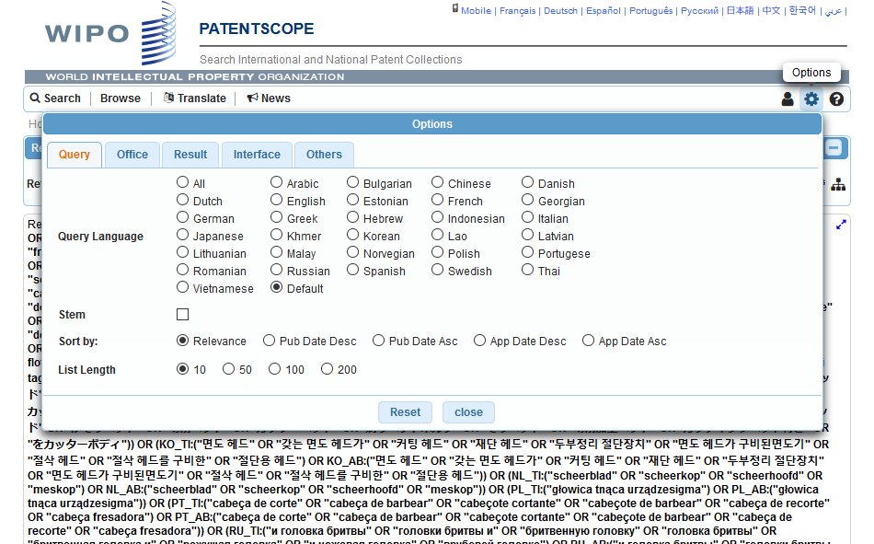
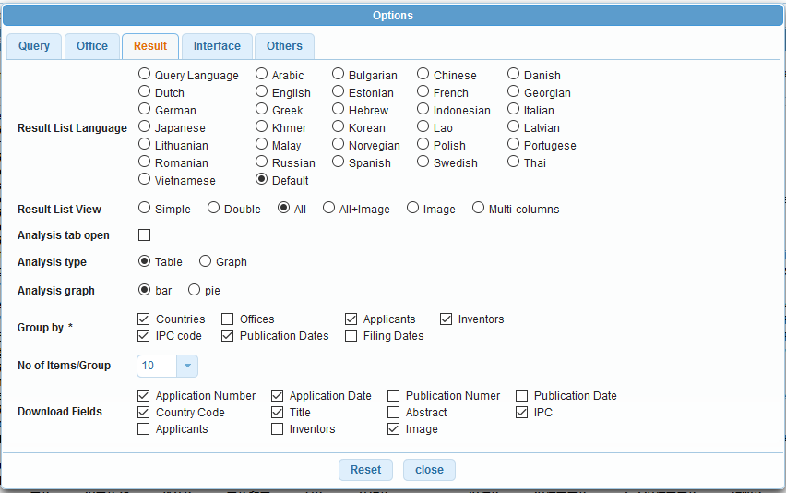


Slide 43
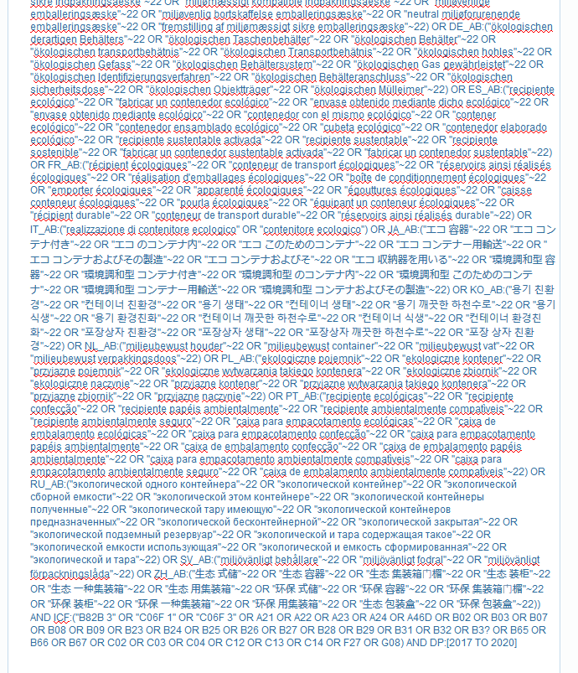

Slide 44
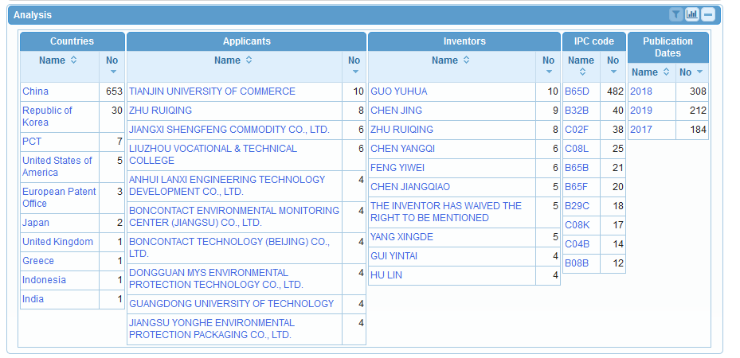

Slide 45
Why is CLIR useful?
Multilanguage search
Higher number of relevant results
No black box
D) Complex queries

Slide 46
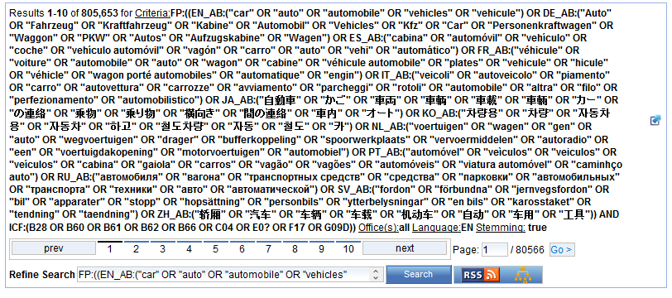

Slide 47
Q:3 which expansion mode was used to obtain this result list?
A
Automatic
B
Supervised

Slide 48

Q:3: which expansion mode was used to obtain this result list?
A
Automatic
C
Supervised

Slide 49
Q:2: which languages are supported by CLIR?
A
Chinese
B
Swedish
C
Korean
D
French

Slide 50
Q:2: which languages are supported by CLIR?
A
Chinese
B
Swedish
C
Korean
D
French
Spain

Slide 51
How to make the most of out CLIR?
Expansion modes:
  1 meaning keyword = AUTOMATIC
  All other queries = SUPERVISED
Variants/synonyms
  words to be included in search results
  too many results delete generic variants

Slide 52
How to make the most of out CLIR?
Parameters:
  1. Title and abstract: unconstrained distance
  2. Claims: sentence/paragraph distance
  3. Description: sentence/paragraph distance
Stemming recommended

Slide 53
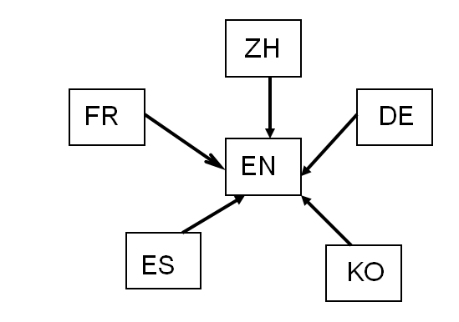
How was it developed?
Compilation of long lists of titles in language pairs
Creation of in-house extraction methodology
Tool learns statistical bilingual dictionaries of titles

Slide 54



Quality of dictionaries
  Chinese Korean Dutch
  English Portuguese Italian
  French Russian Swedish
  German Spanish Polish
  Japanese Danish

Slide 55
Disambiguation
Process of identifying the sense of a word in a sentence. http://en.wikipedia.org/wiki/Disambiguation_%28disambiguation%29
Applied to keywords:
  technical domains
  variants

Slide 56


Slide 57
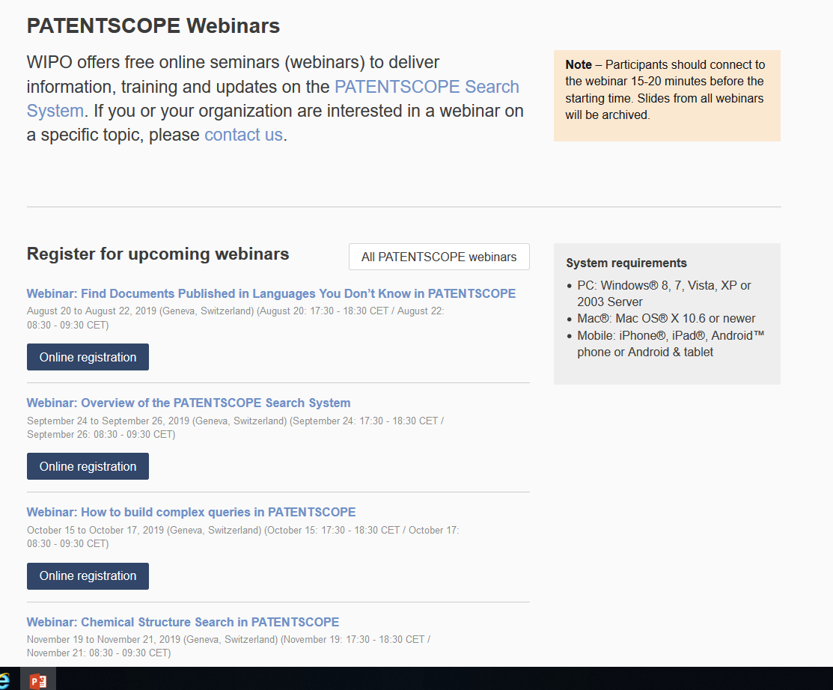
Future/past webinars:
wipo.int/patentscope/en/webinar

Slide 58
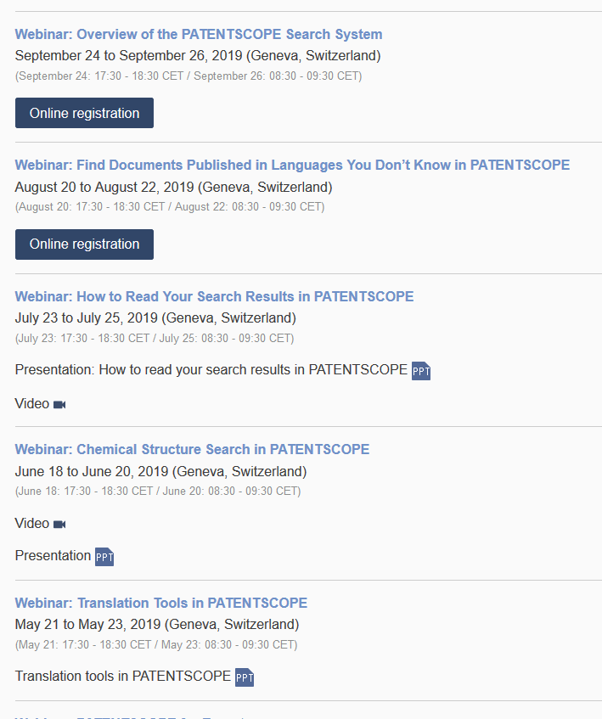

Slide 59
Global Design Database: webinar
How to read, save & share your results in the Global Design Database
  August 27 at 5:30pm CEST
  https://attendee.gotowebinar.com/register/7193558519342710018

Slide 60
Global Brand Database: webinar
How to perform a search in the Global Brand Database
  September 10 at 5:30pm CEST
  https://attendee.gotowebinar.com/register/4261005976924616962

Slide 61
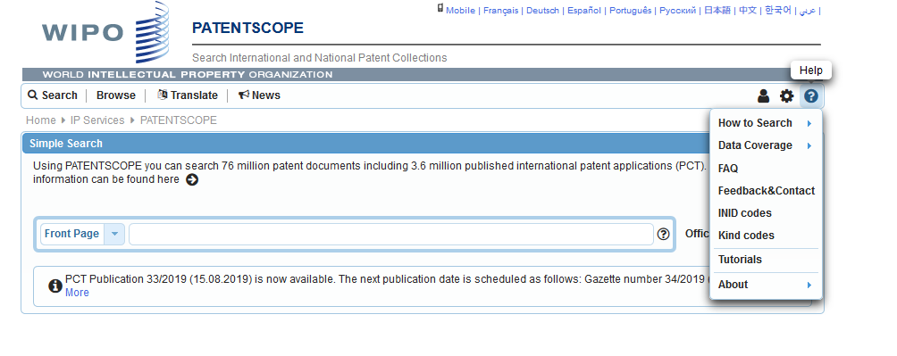
Forum

Slide 63
Q: How frequently patent application data is updated in CLIR? Is it up-to-date?
Yes CLIR takes into account all the documents currently available in PATENTSCOPE. The detailed coverage is available here.
Q: Are the results organized by patent families?
Not at the moment but we are working on a project to offer family information in the near future.
Q: What happens if the term does not exist?
The system will not retrieve any result.
Q: Is it possible to submit a query in German?
Yes

Slide 64
Q: What does the number of results represents?
The number of matching documents found in PATENTSCOPE. A patent application, its successive publications, and the potential patent count as 1 document in PATENTSCOPE.
Q: Can we build our query directly in other languages, such as Chinese?
Yes, it is possible. At the moment, you can search in all the filing languages of the documents contained in PATENTSCOPE, such as Arabic, Bulgarian, Cambodian, Chinese, Danish, English, Estonian, French, German, Greek, Hebrew, Italian, Japanese, Korean, Laotian, Portuguese, Romanian, Russian, Spanish, Thai, Vietnamese.

Slide 65
Q: Can we find legal status information in PATENTSCOPE?
In order to determine the current legal status of a national patent application or PCT international patent application that has entered the national phase, it is necessary to refer to the information provided by the competent national authority. A non-exhaustive list of patent databases made available by national offices can be found at: http://www.wipo.int/patentscope/en/national_databases.html.
Through the PATENTSCOPE search service https://patentscope.wipo.int/ , you can obtain national phase entry data for published international applications including reference numbers for national phase entries. This data can be accessed by selecting the "National Phase" tab from the record view for a particular international application. These reference numbers can be used to assist you in obtaining further status information from the competent national authority. Please also read the restrictions related to the availability of the national phase information in PATENTSCOPE: https://patentscope.wipo.int/search/en/nationalphase.jsf. For example, absence of information – as it is the case for this specific IA- does not mean that the application has not been granted anywhere; it means that the information is not currently available.

Slide 66

patentscope@wipo.int

