Slide 1
The PATENTSCOPE search system
2015 Retrospective
Cyberworld
December
2015
Sandrine Ammann
Marketing & Communications Officer

Slide 2
To the PATENTSCOPE search system webinar
Retrospective of 2015

Slide 3
Agenda
Retrospective 2015
New collections
New section in Documents tab
https
Machine translation/WIPO Translate
Arabic interface
Tutorials
Future plans: 2016
Q&A

Slide 4
50 Million
Notes:
50 million the total number of patent documents 5 the number of IP5 offices whose full-text is searchable

Slide 5
New collection added

Slide 6
UK national collection
Bibliographic data from 05.07.1782 to 23.07.2015
Abstract from 15.08.1855 to 23.07.2015

Slide 7
Full-text search
Notes:
Over 34,000 records – descriptions and claims – of the national patent collection of Portugal, published since 2007, are now searchable in PATENTSCOPE. The bibliographic records of the national collection of Portugal were already added in December 2014.

Slide 8
Data in Korean
Patent data in Korean of the national patent collection of the Republic of Korea is now available
About 3,400,000 records: bibliographic data, searchable full-text and drawings in Korean
Front file data in the new WIPO standard ST96
New data will become available within a month after their first publication in KIPRIS

Slide 9
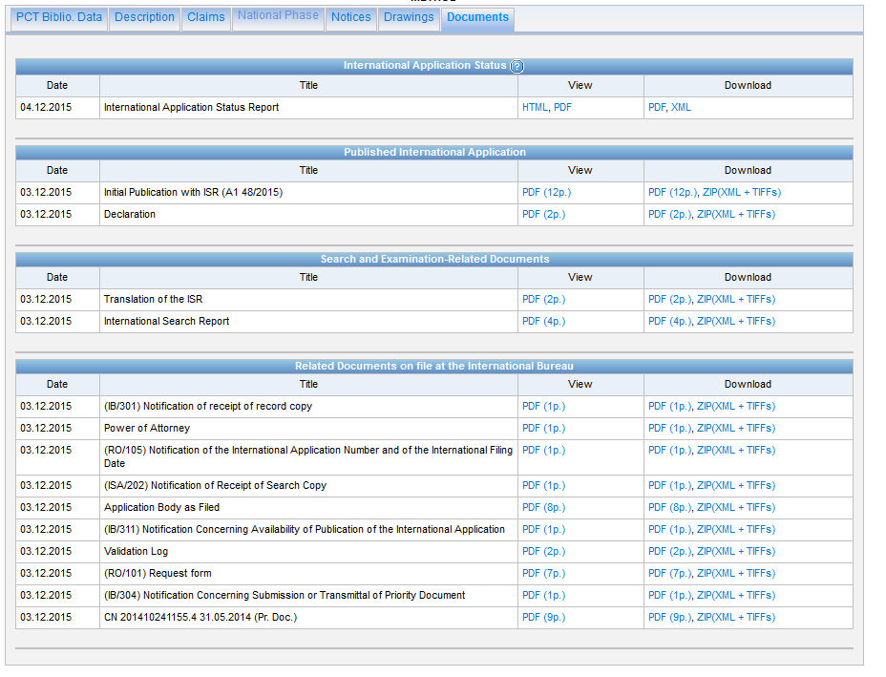
New section
Notes:
The “documents” tab for international applications published on PATENTSCOPE has been updated to include a new section: “Search and Examination-Related Documents”.
Previously, this tab had sections for the international application status report, the documents considered part of the international publication (including declarations, sequence listings and references to biological deposit published as documents separate from the main publication document), and all other “related documents”.
The new section is intended to help users interested in assessing the likely patentability of the claimed invention by bringing together all available search and examination-related documents, including the international search report, search strategies, written opinions, international preliminary reports on patentability, English translations of reports and opinions, and third party observations, to the extent that they have been received or prepared by the International Bureau.

Slide 10
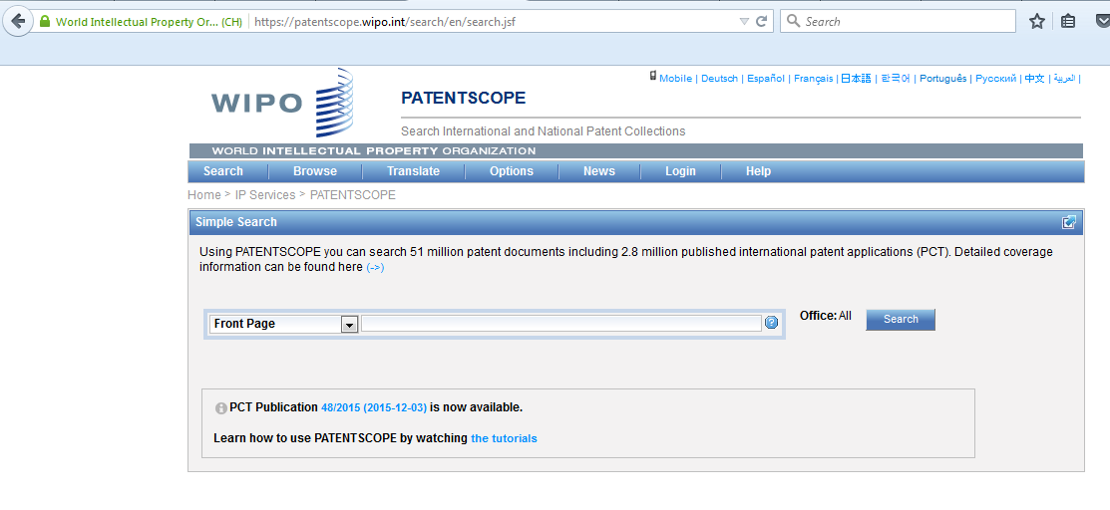
Secure https
Notes:
Access to the PATENTSCOPE website and all of the associated functionality is now made via the secure http protocol https. This ensures a strong encryption of our patent search and translation services and ensures the users of our systems such as PATENTSCOPE and Translation Assistant for Patent Titles and Abstracts (TAPTA) ¹ automatically have a secure connection.
This encryption provides users with search confidentiality, ensuring search queries and results lists remain confidential, their browsing activity remains hidden and integrity of all user data which protects account data, identity data, search data and results from being modified or monitored.
The presence of the https lock icon in the address field of the web browser, as shown below, also ensures that our users are connected to the genuine PATENTSCOPE web site and not to a fraudulent site. This new feature brings PATENTSCOPE into line with the highest standards of search confidentiality for all users automatically.

Slide 11
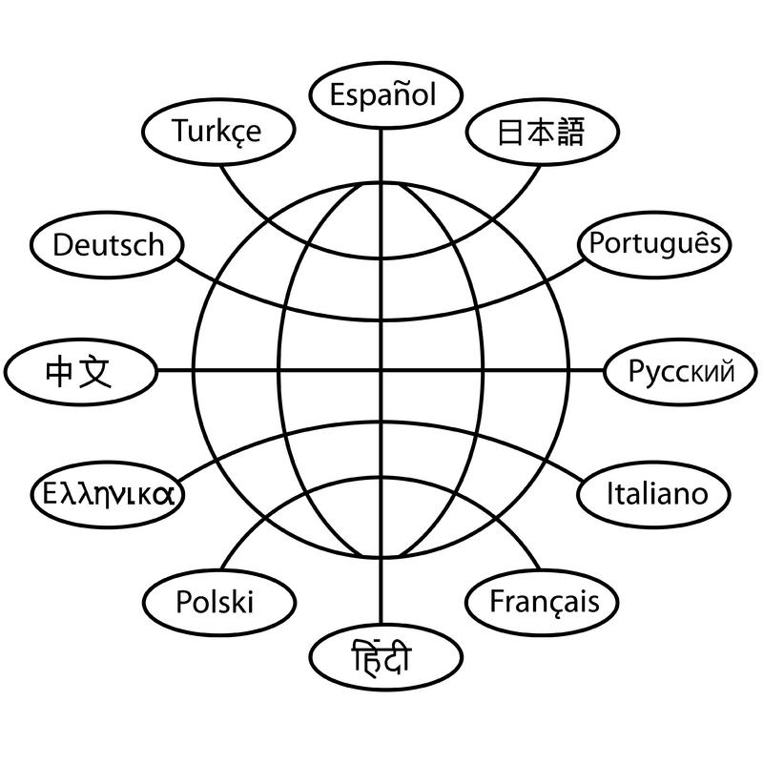
Translation tools

Slide 12
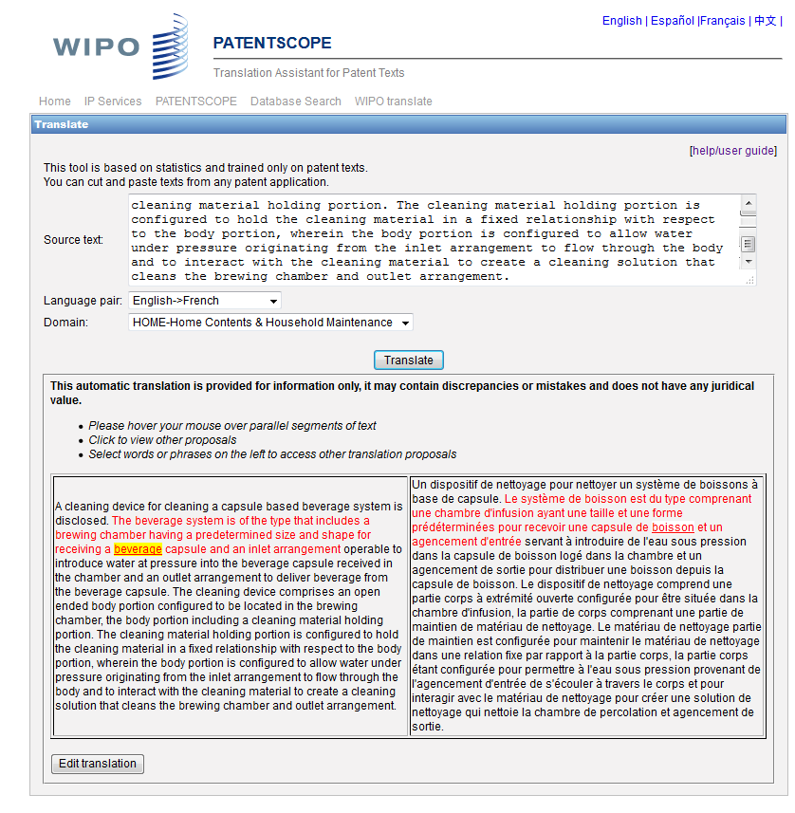
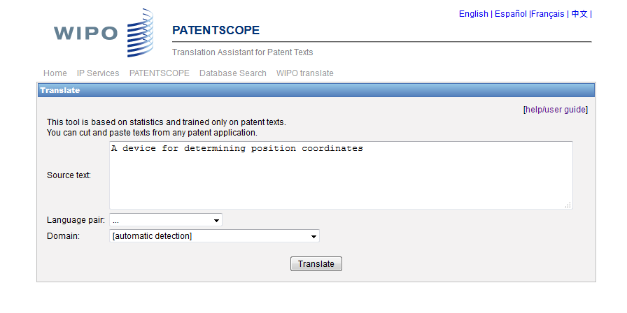
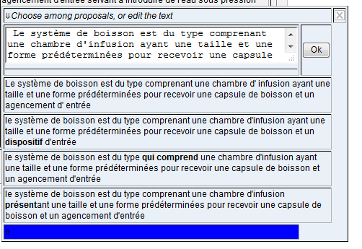
Tapta became WIPO Translate
Notes:
IPO Translate is the extended version of the former TAPTA tool which was developed in-house for the translation of patent titles and abstracts of patent documents.
The good results obtained by the TAPTA technology in other UN agencies for administrative documents, as well as the relevant results obtained for the translation of patent abstracts and titles, led to the extension of the tool for the translation of other parts of patent documents; the tool was therefore renamed WIPO Translate.
It is now possible to translate the search result list in PATENTSCOPE, as well as description and claims in Chinese, using WIPO Translate. Users wishing to use it have to activate it in the “Options” menu, under the “Translate” tab.
The translation of description, claims and full-text in other languages will be available in the future.

Slide 13
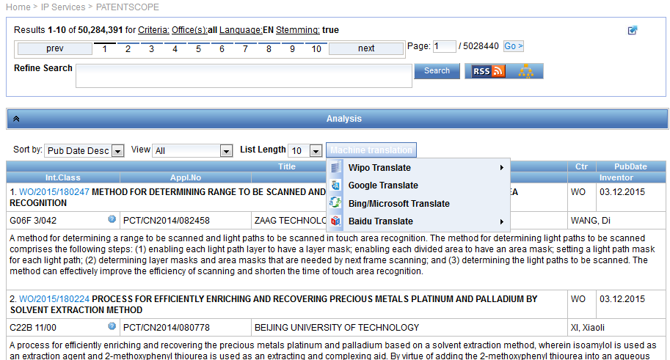
Machine translation tools
Notes:
The PATENTSCOPE result list includes now a new “machine translation” button which will allow users to choose between Google Translate, Bing/Microsoft Translate and recently Baidu Translate for the translation of the result list into any of the languages supported by those three machine translation tools

Slide 14
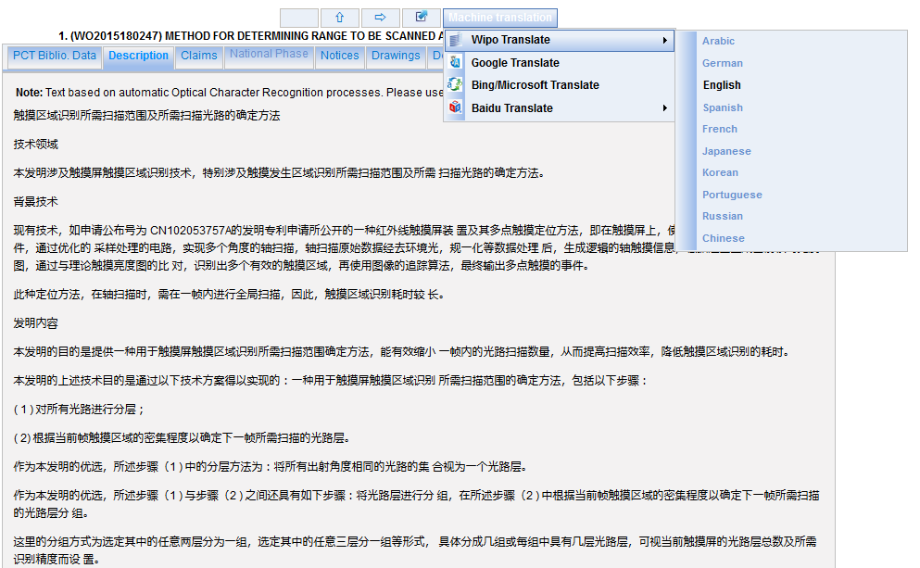
Notes:
This same button is available in the Description, Claims and Fulltext tabs to translate the description and claims in any of the languages supported by Google Translate, Bing/Microsoft Translate and Baidu Translate.
WIPO Translate is available for the result list but only for Chinese descriptions and claims).
Users can now benefit from real-time, automatic translation of long documents. Moreover, WIPO translate has been trained exclusively on Chinese/English patent texts and independent evaluation tools such as BLEU show that it is more accurate than other publicly available solutions (e.g.Google Translate, Microsoft-Bing translate or Baidu translate). As a result, users can get a better, clearer idea of the nature of an invention than may be possible with external translation tools.
WIPO Translate operates with a secure https protocol, meaning that translation activity remains private and cannot be accessed by any third party.

Slide 15
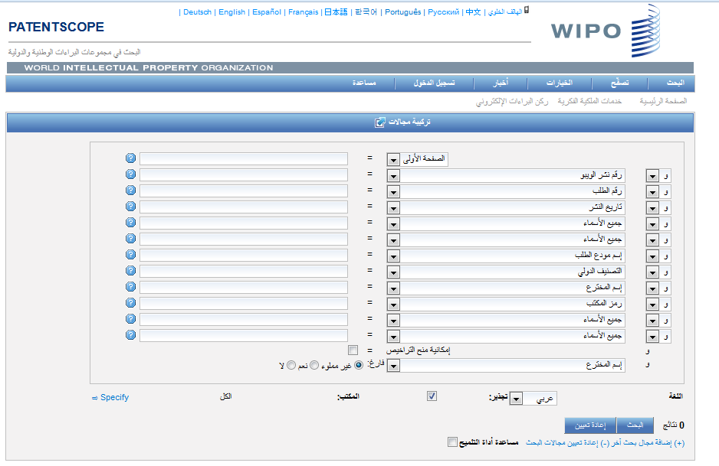
Arabic interface
Notes:
he PATENTSCOPE search system is now available in Arabic in addition to the nine existing languages. It is now possible to do the following exclusively in Arabic:
Carry out searches
Browse search results
Log into your user account
Browse help and supporting pages
More advanced search features (e.g. stemming) will gradually become available in Arabic.

Slide 16
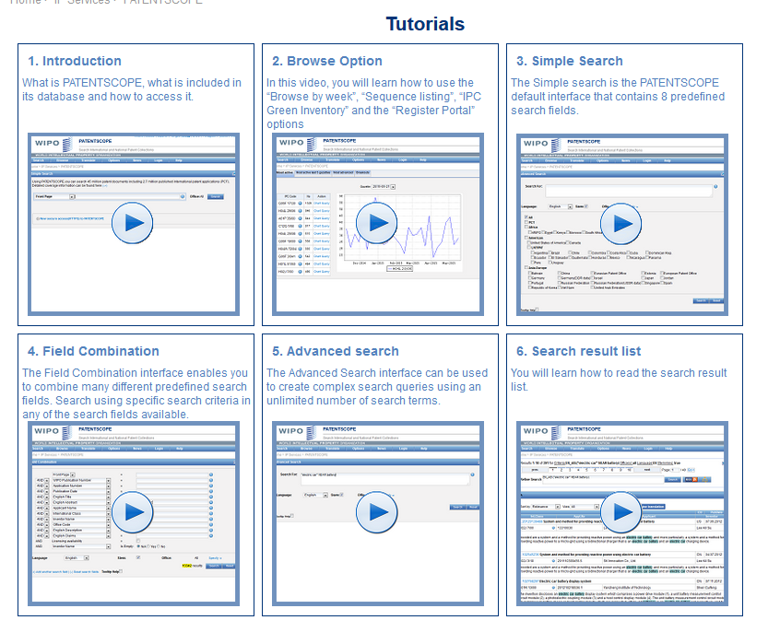
Tutorials: https://patentscope.wipo.int/search/en/tutorial.jsf

Slide 17
Future plans: 2016
New national/regional collections
Improve current features
New language for WIPO Translate
Chemical search

Slide 18
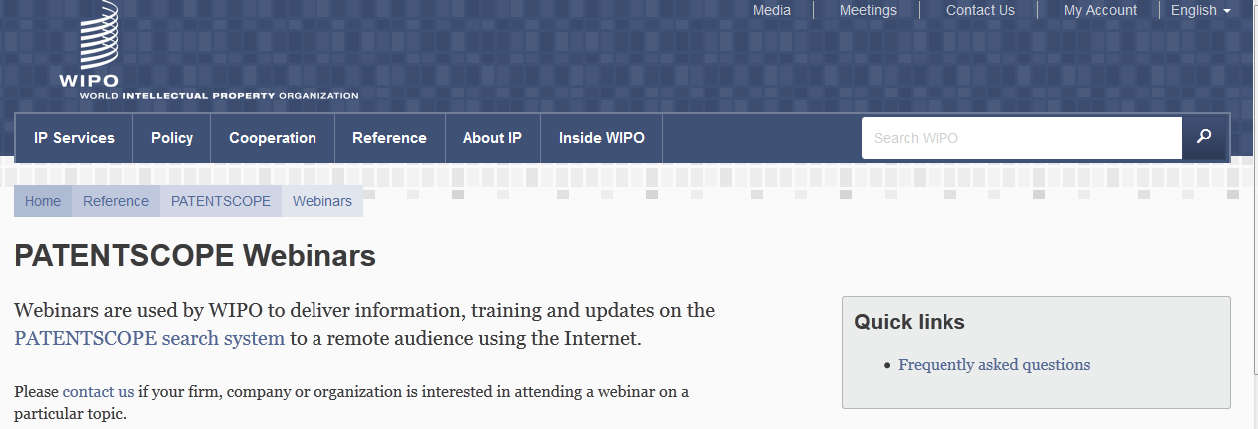
Monthly webinar

Slide 20
patentscope@wipo.int

Slide 21
SEASON’S GREETINGS
WITH
ALL GOOD WISHES FOR THE NEXT YEAR

Slide 22
mulțumesc
mulțumesc

