Slide 1
How to search using PATENTSCOPE
Online
October
2015
Sandrine Ammann
Marketing & Communications Officer

Slide 2


To the PATENTSCOPE search system webinar
How to search…

Slide 3
Questions/concerns
patentscope@wipo.int

Slide 4
Agenda
Latest developments
Search strategies:
  Date
  Number
  Keywords
  Classification
Quiz
Q&A

Slide 5

New national collection

Slide 6
UK national collection
Bibliographic data from 05.07.1782 to 23.07.2015
Abstract from 15.08.1855 to 23.07.2015

Slide 7
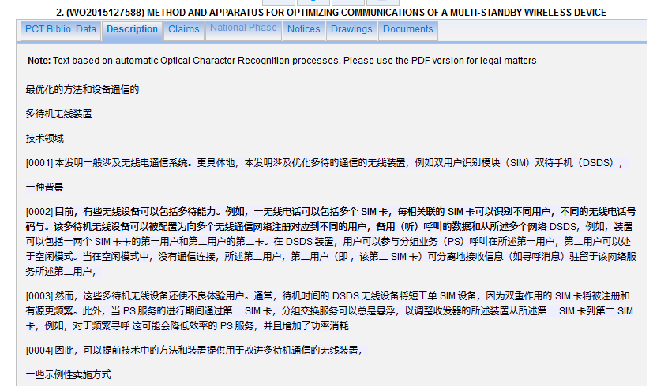
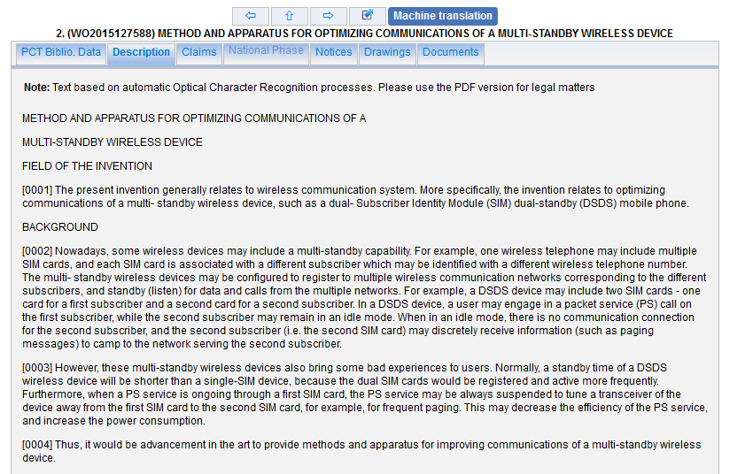
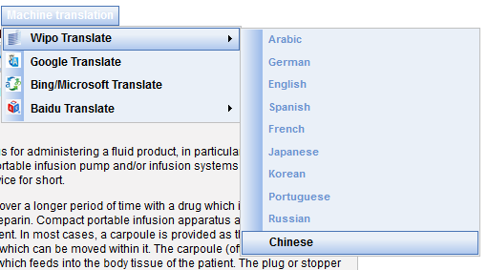
WIPO translate Chinese full-text

Slide 8

How to search

Slide 9
Search strategies
Depend: Area of technology, availability of useful information, classifications
Step by step, evolving process depending on results and what is effective

Slide 10
Search strategies
Dates
Number
Keyword
Classification

Slide 11

Date searches

Slide 12
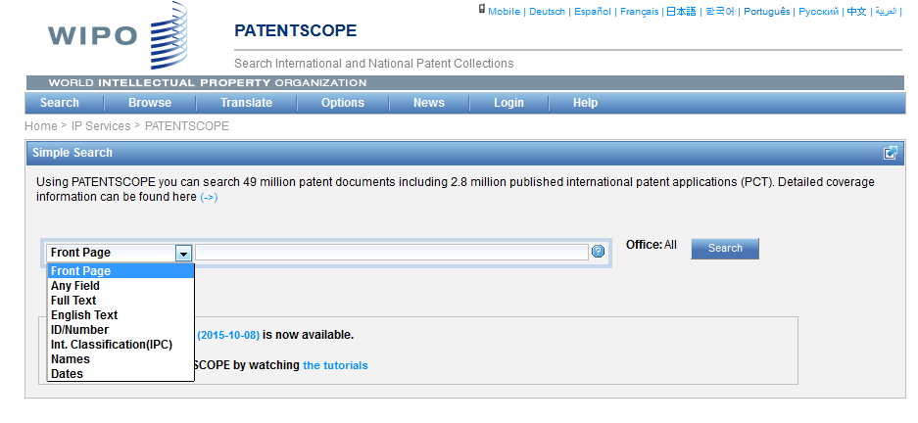

Date search – Simple search interface

Slide 13
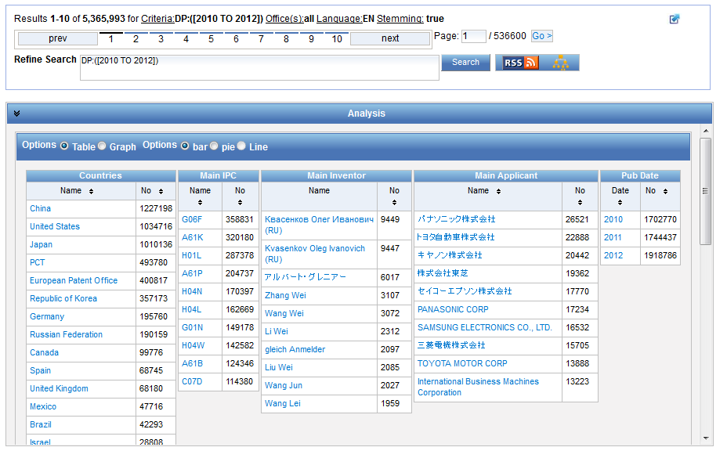
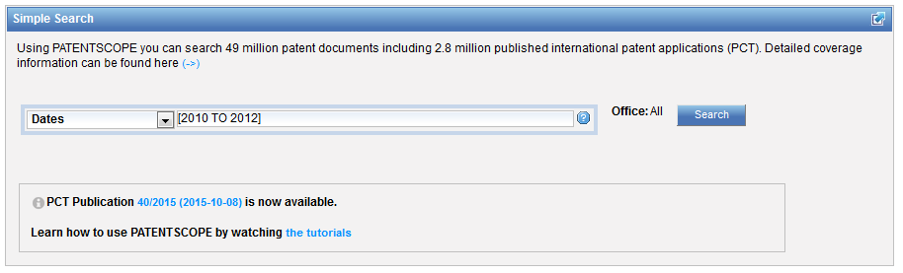
Date range

Slide 14
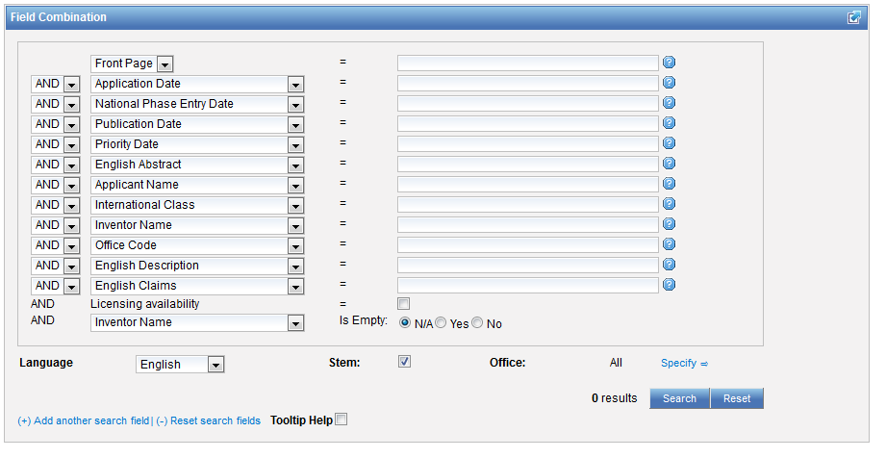
Date + other search criterias

Slide 15
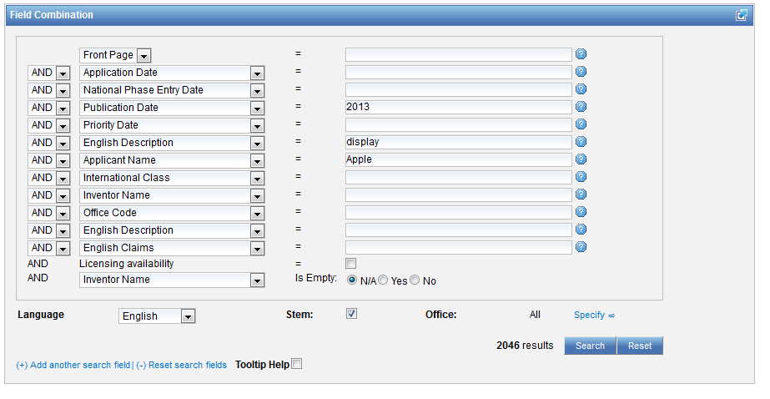
An example

Slide 16
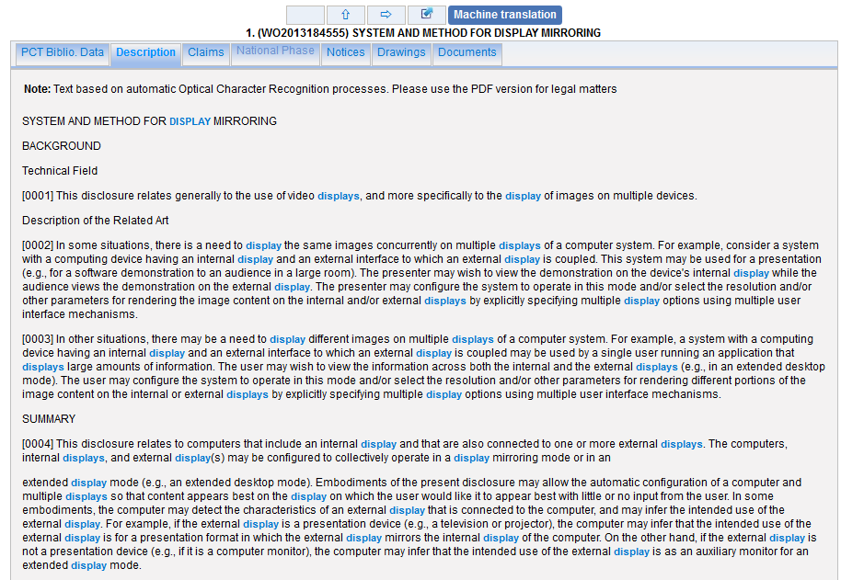
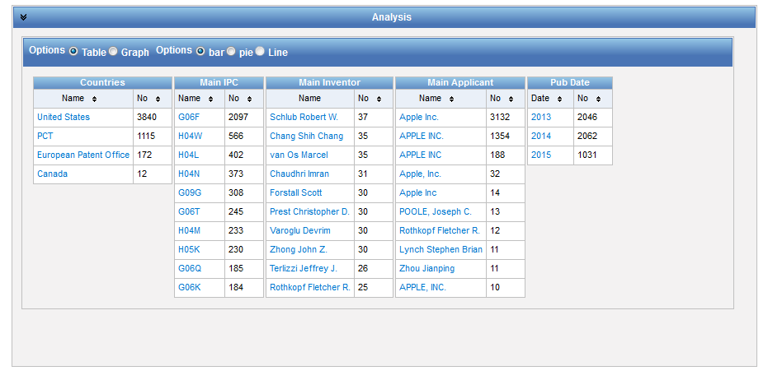
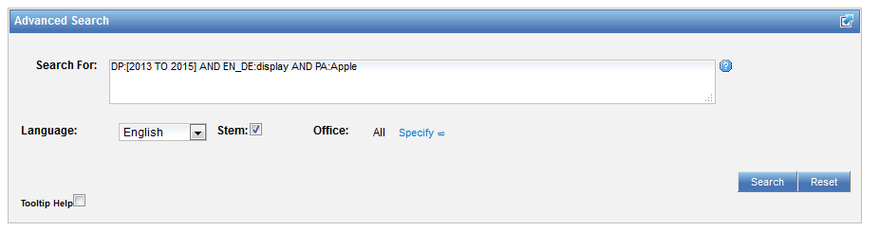
Date range + other search criterias

Slide 17
Ranges – include/exclude numbers
DP:[01.01.2000 TO 01.01.2001] = inclusive
DP:{01.01.2000 TO 01.01.2001} = exclusive

Slide 18
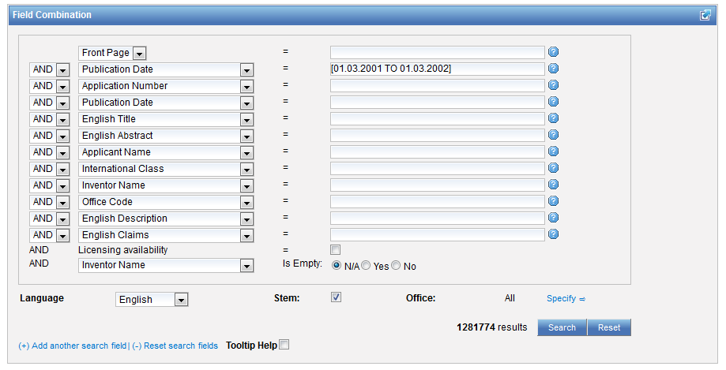
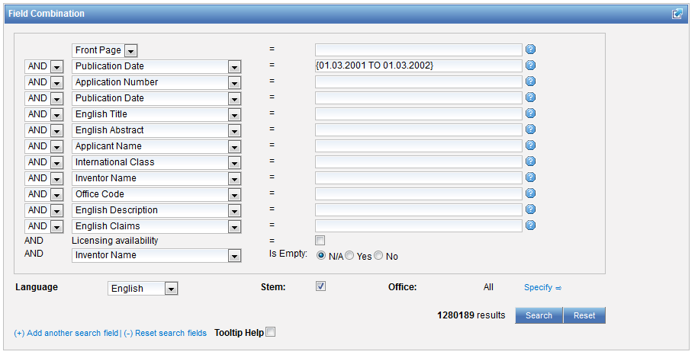

Slide 19

Number searches
https://inanemathgeek.wordpress.com/tag/prime-numbers

Slide 20
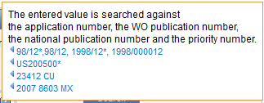
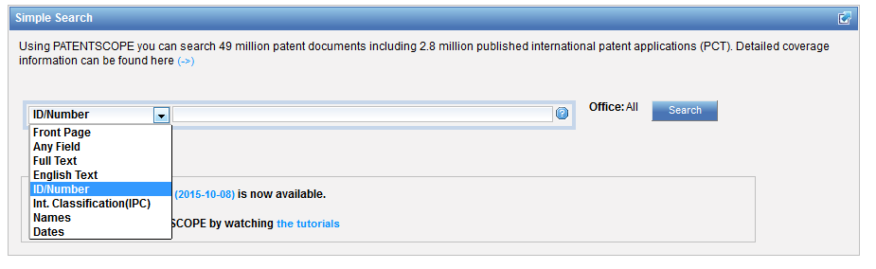
Number search – Simple search interface

Slide 21
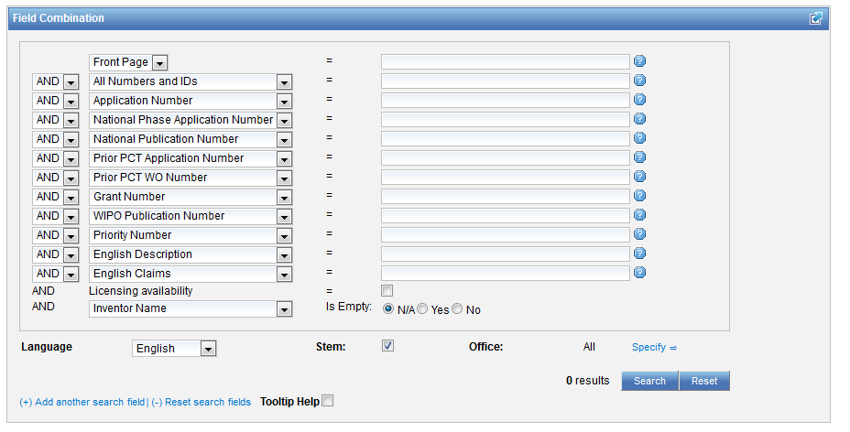
Number search in the Field Combination interface

Slide 22
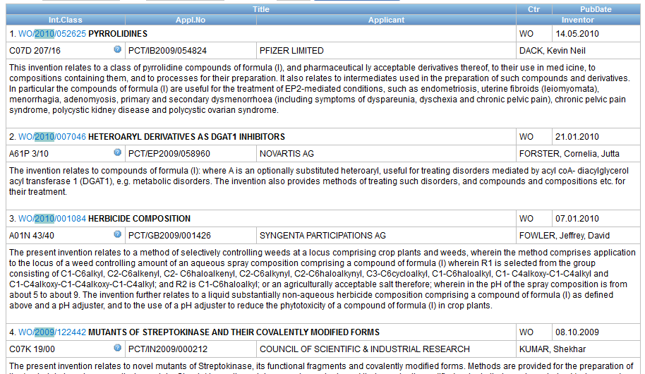
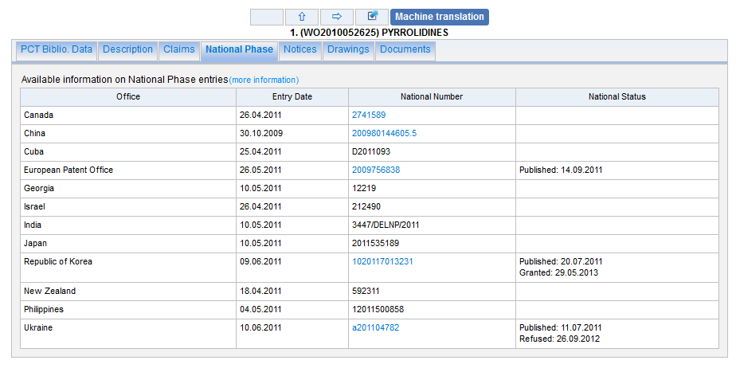
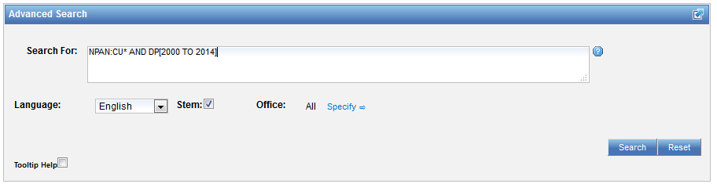
And in the Advanced search interface

Slide 23

Search strategy
Dates
Number
Keyword
Classification

Slide 24
Keywords – Pros
Simple
Flexible

Slide 25

Keywords – Cons
Use and misuse of a language:
  Non-native users
  Poor translation
  Many synonyms
Different point of view
Generic vs specific
Newly created terminology by applicant
Mistakes

Slide 26

Keyword search
Spelling/syntax variation
Variation of root word
Plural/singular forms
Acronyms
Homonyms
Possible permutation and combination
Synonyms to be found in dictionaries or in CLIR

Slide 27
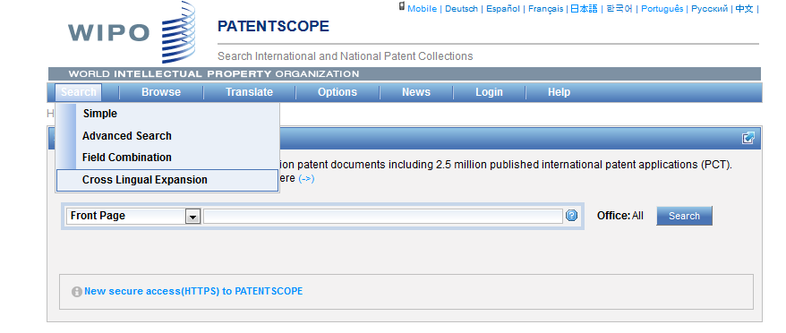
CLIR

Slide 28
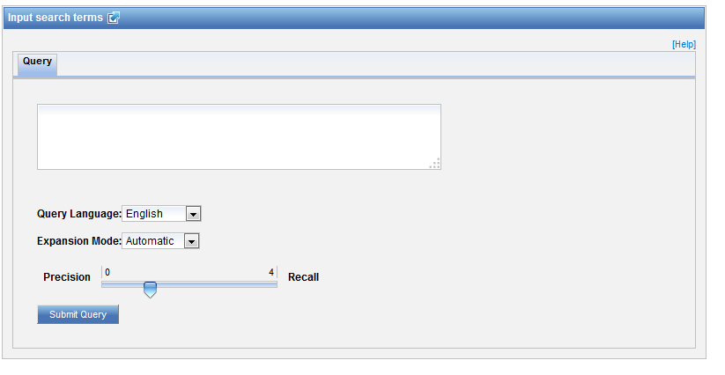
CLIR: interface

Slide 29
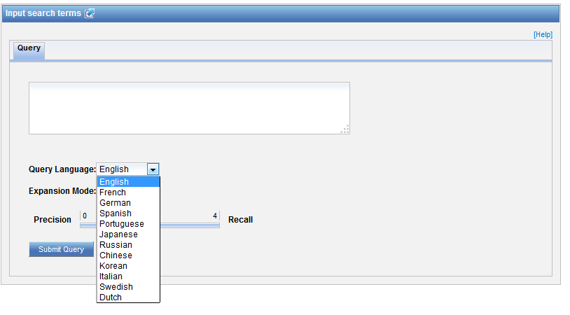
CLIR: query language

Slide 30
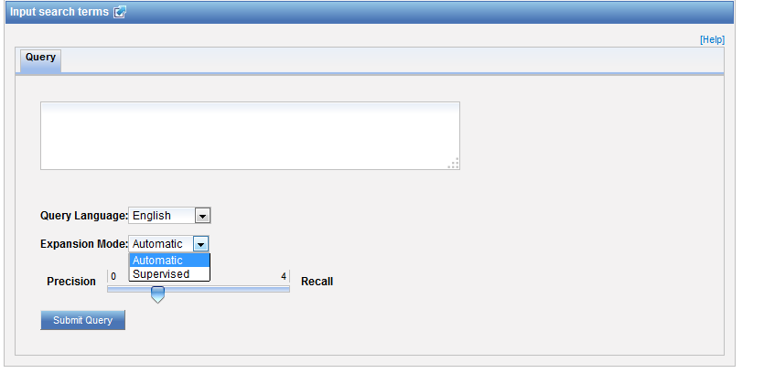
CLIR: expansion mode

Slide 31
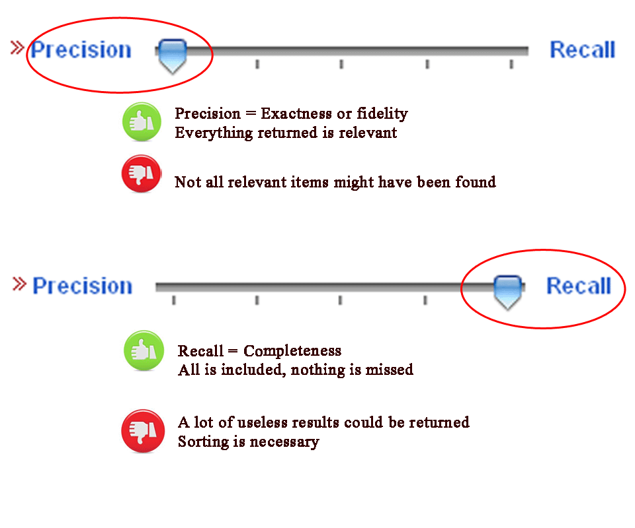
CLIR: precision vs recall

Slide 32
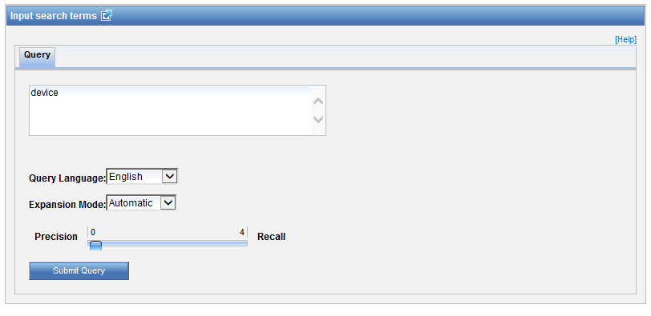
Example: precision

Slide 33
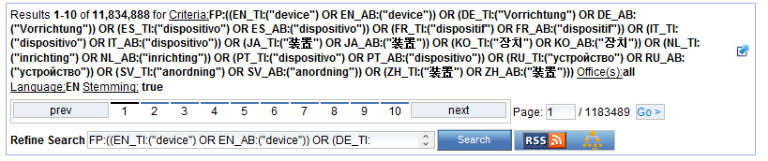
Results for «precision»

Slide 34

Example: recall

Slide 35
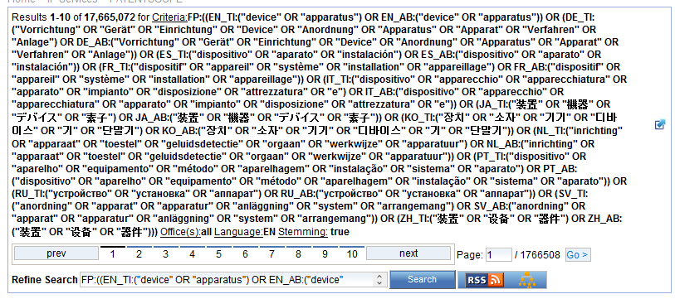
Results for «recall»

Slide 36
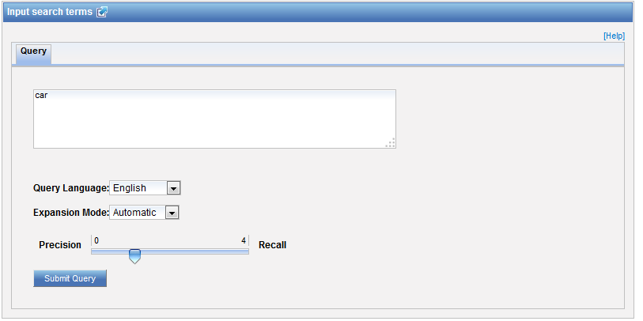
CLIR: an example

Slide 37
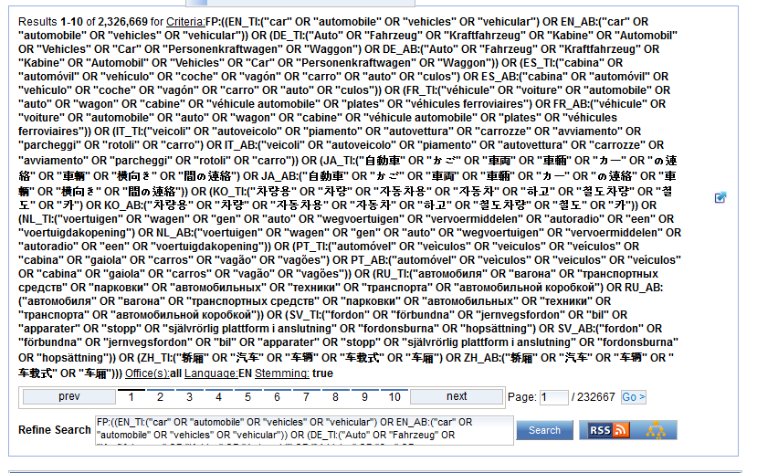
CLIR: an example

Slide 38
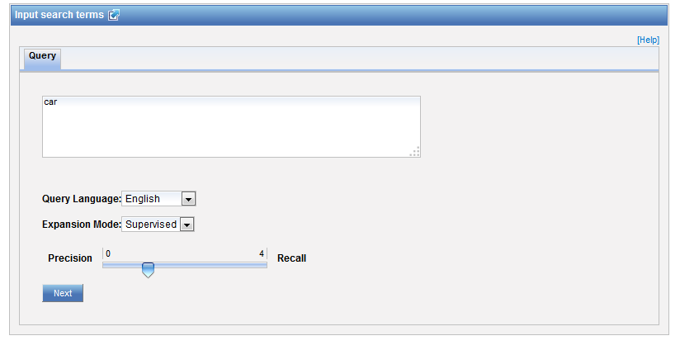
CLIR: supervised

Slide 39
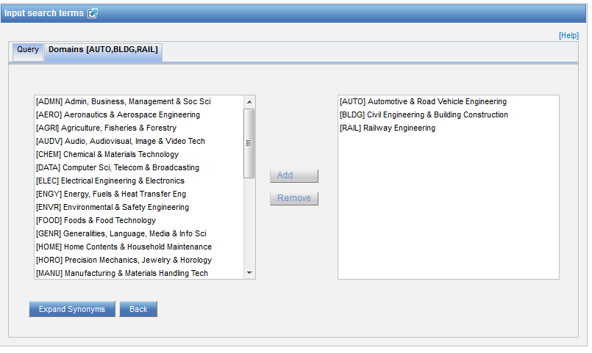
Domain selection

Slide 40
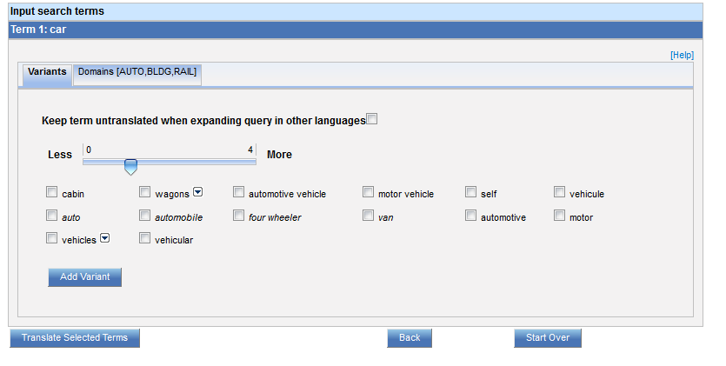
Variants selection

Slide 41
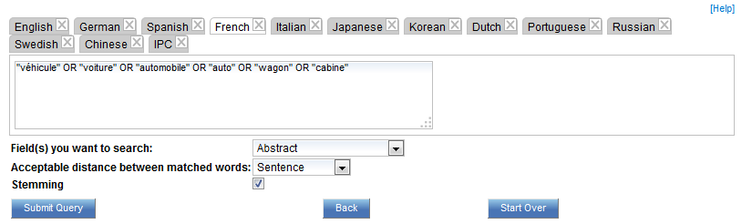
Summary of variants

Slide 42
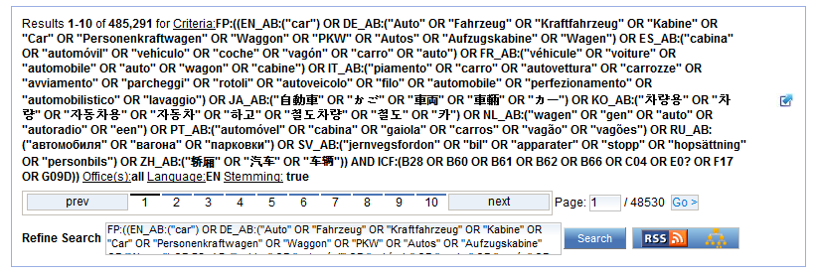
Results

Slide 43
Structure
Narrow, broad and related terms grouped together in proximity and related to other groups of terms expressing functionality or application
Are some words required to be in your results?
Are any words to be excluded?
Should words be close to each other?
Should words be near? How near?

Slide 44
To help you fine-tune your search
1. Boolean operators
2. Proximity operators
3. Field codes
4 .Stemming/wildcard/fuzzy searches
5. Grouping/nesting
6. Date searches

Slide 45
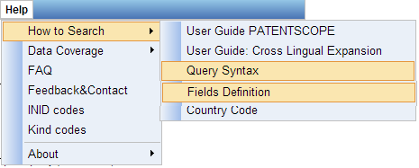
Help menu

Slide 46
Boolean operators
AND
OR
NOT
ANDNOT

Slide 47
NEAR: an example
carbon AND wheel 99,235 results
"wheels made of carbon", or "carbon may be used to make said wheel“????
carbon NEAR10 wheel 940 results

Slide 48
Proximity search: BEFORE
the order of terms is significant.
trunk BEFORE cutting

Slide 49
Wildcards – truncation: ? *
plural form of a word, or alternative spellings
* stands for 0 or more characters
? stands single character
te?t = test or text
electric* = electrical; electricity
behavi*r = behaviour or behavior
micro?p* = microspeaker, microsporidial

Slide 50
Wildcards - Stemming
elect* would search for words like elect, elects, electron, electrons, electric, electrical, electricity, electoral
electric stemmed will find electricity electrical

Slide 51
Fuzzy searches
Use of the tilde: ~
Examples:
roam~ foam / roams
Roam~0.8
Notes:
Smilar in spelling

Slide 52
^ caret = weighting factor
Same result but ranking will be different
touch^3 AND polarize

Slide 53

Grouping

Slide 54
Grouping/nesting
Solar OR (wind AND turbine)
(solar OR wind) AND turbine
EN_TI: electric car
electric will be searched in English title but car in all fields
EN_TI: (electric car)
Both electric and car will be searched in the English title

Slide 55

Grouping/nesting
Not all combinations work:
(electric AND car) NEAR power X
power NEAR (electric AND car) X
power NEAR (vehicle OR car)
EN_AB: hearing NEAR aid X
EN_AB: (hearing NEAR aid)
Notes:
Composition rules of operators
Avoid ambiguity

Slide 56
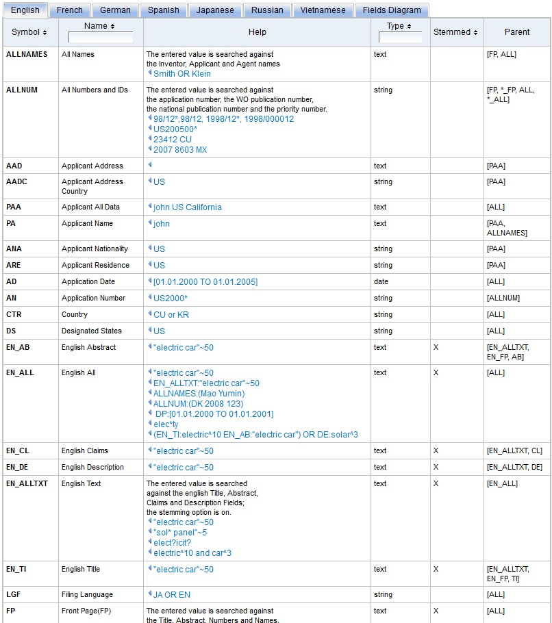
Fields: http://patentscope.wipo.int/search/en/help/fieldsHelp.jsf

Slide 57
Examples
FP = front page
ALL = all fields
ALL_NAMES = all names
IC = IPC
DP = publication date
CTR = country either WO or country from national collection
NPCC= national phase entry
AN = origin of PCT
NPCC:US and NPEDD:Last1Year

Slide 58
Intuitive queries
PCTHavingThirdPartyObservations
PCTPublishedLastWeek
PCTHavingApplicantFromUS
DP:Last1Year
DP:[Today-1Week TO Today]

Slide 59
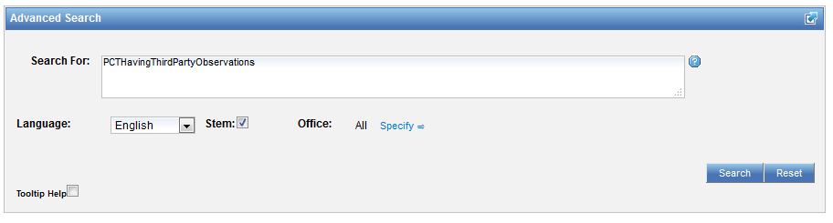
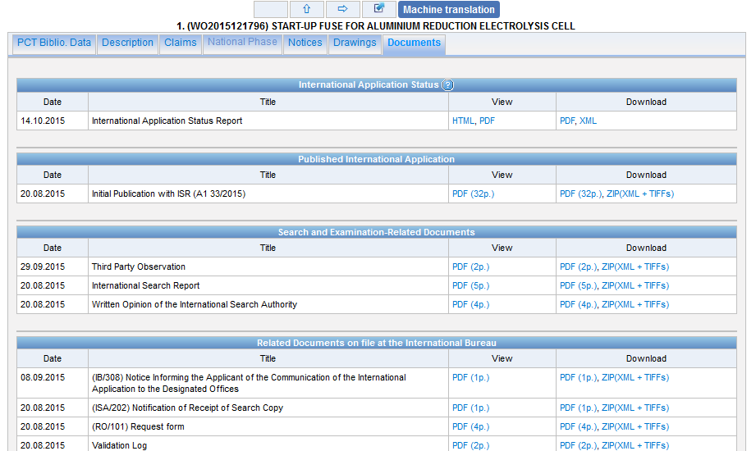
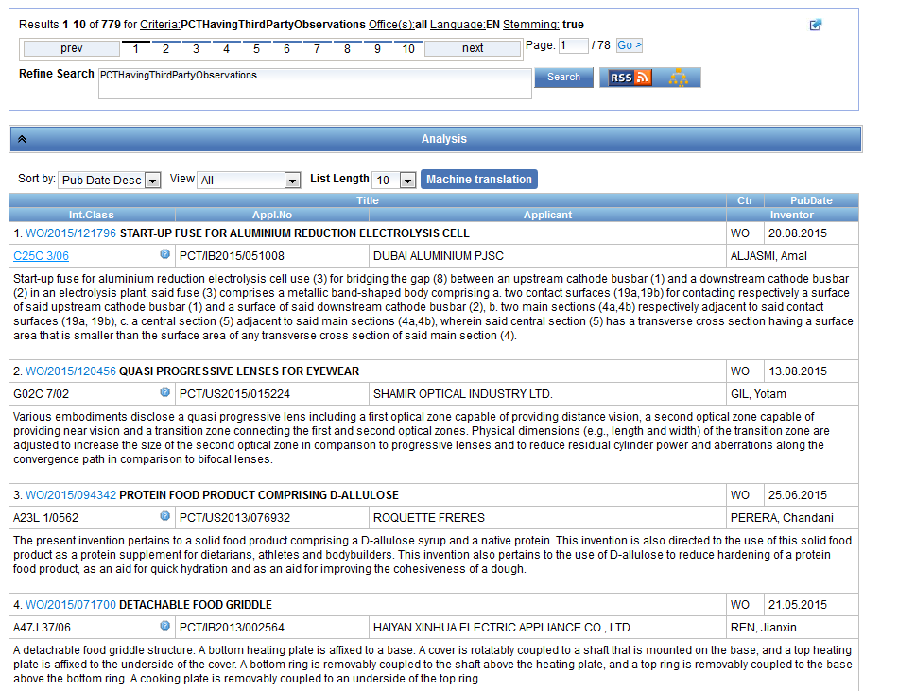

Slide 60
Fields rules
Basic fields: elements of a patent document
Derived fields
2 letter code = individual field
EN_TI FR_AB ES_DE_S
Convention: language specified by 2 letters
if not specified all languages
S = stemmed
: to separate term without any space

Slide 61
Fields: golden rules
EN_ALL = default field field indicator not required
Field name followed by : ":" or "/"
The field is only valid for the term that it directly precedes, so the query:
EN_TI:("wind turbine" AND electric) solar
Results: "wind turbine" AND electric in the title field. "solar" in the default field (EN_ALL ).

Slide 62
Empty field
! Field_Name:[* TO *]
!RU_TI:[* TO *]
Notes:
For example, to search for all the documents where the russian title is not empty, you can use the search:

Slide 63
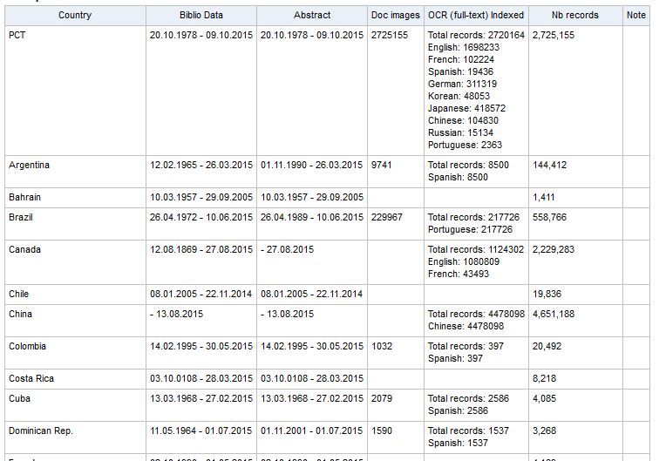
Where to search
Text version for keyword display
Advantages of full-text: abstracts superficial and badly done, real stuff hidding in description, claims

Slide 64
Most common errors
(….) "…"
" not “
Field name
No space
No wildcard at the beginning of a word

Slide 65

If you retrieve 0 result, be suspicous!
Pay attention to spelling

Slide 66
Search strategy
Dates
Number
Keyword
Classification

Slide 67
Classification: pros
Independent of language
Comprehensive and detailed

Slide 68
Classification: cons
Complex and challenging
Not applied universally (different levels (animal, mineral, etc.)
No guaranteed fit
Years behind technology
Subjective classifier

Slide 69
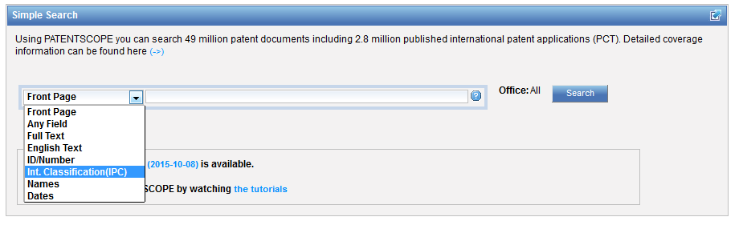

Simple search interface

Slide 70
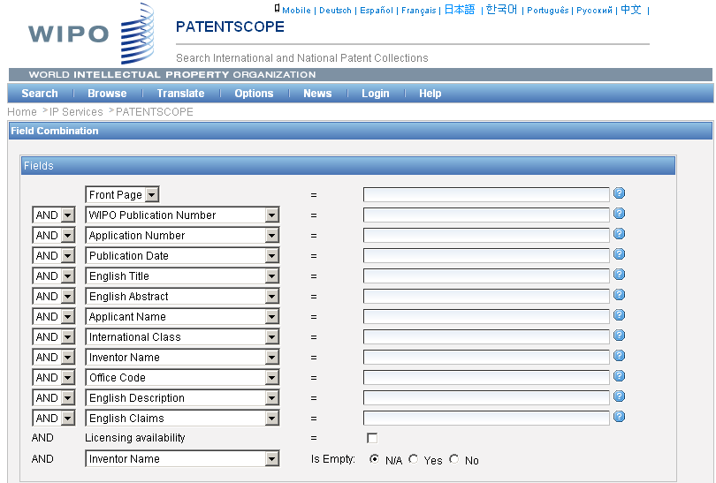
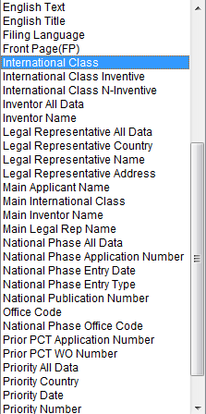
IPC search: Field combination

Slide 71
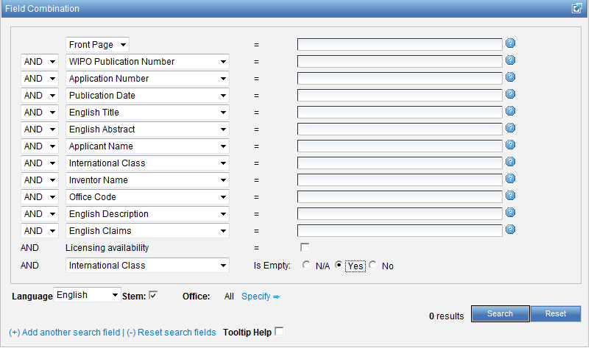

Slide 72
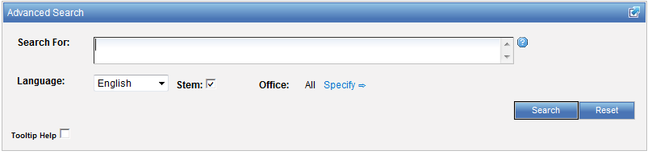
IPC search: Advanced search

Slide 73
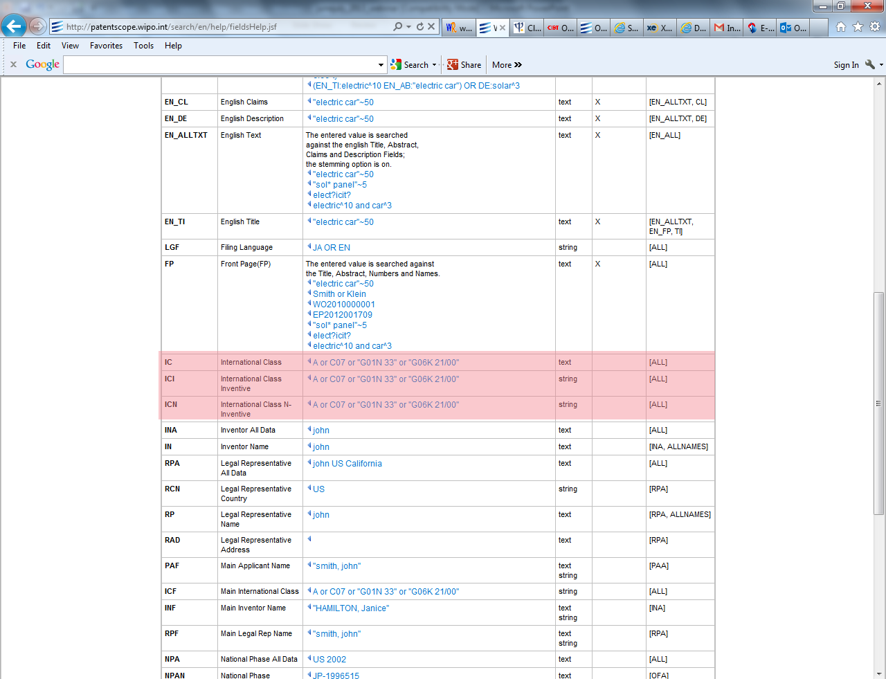

Slide 74
IC / ICI / ICN
IC = International Classification
ICI = International Classification Inventive
ICN = International Classification Non-inventive
IC_EX ICI_EX ICN_EX = no subgroup

Slide 75
IPC group symbols
A23G 9/02
► complete group symbol; consists of different components
A ....................... Section (A, B, ... H)
A23 ....................... Class (any 2 digits)
A23G ....................... Subclass (any letter)
A23G 9/02 ............ Group
Main group part
Subgroup part
Notes:
A23G 9/02 is a symbol representing an IPC group. Any group symbol consists of different components:
The first letter indicates the section of the IPC to which it belongs; there are 8 sections represented by the letters A, B,..H.
The section letter and the following two digits represent a class symbol.
Adding another letter to the class symbol generates the symbol of a subclass being part of the class.
After this subclass part of the symbol follows the group part which consist of two different elements separated by a stroke: the main group part and the subgroup part.
The formatting shown above with a space between the subclass part and the group parts and a slash between the two group parts is the offical format of IPC symbols that should be used for presenting IPC symbols. However, sometimes different presentations can be found or used for searching databases, e.g. no space after the subclass part, or a dash instead of a stroke.

Slide 76

WIPO Homepage

Slide 77
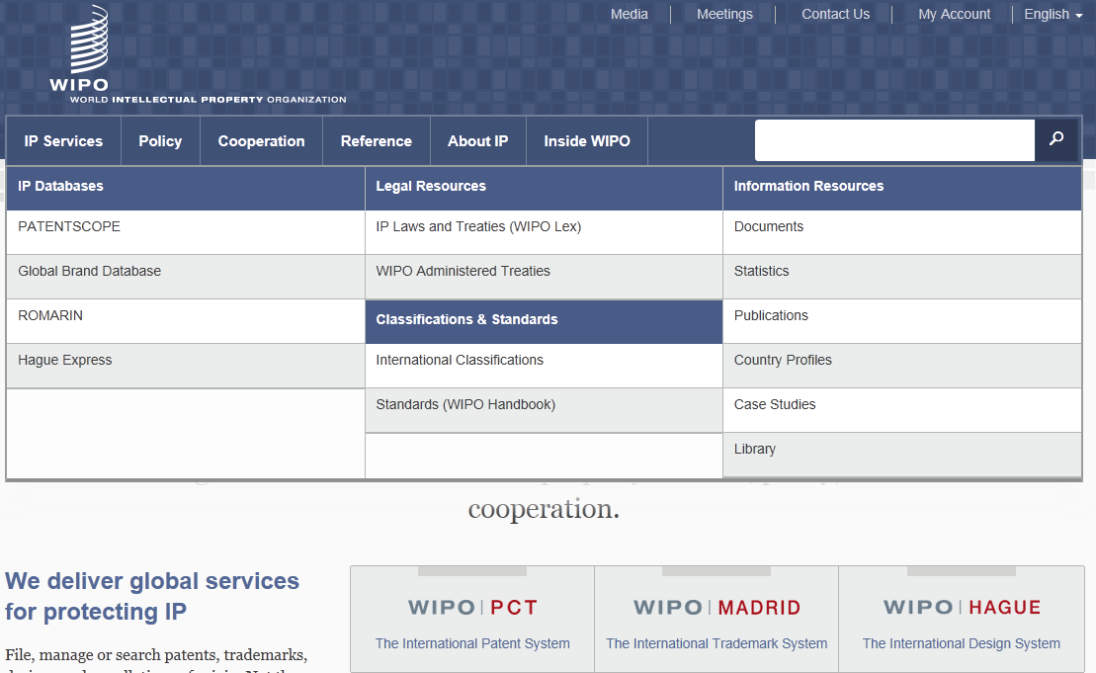
WIPO Homepage > Reference

Slide 78
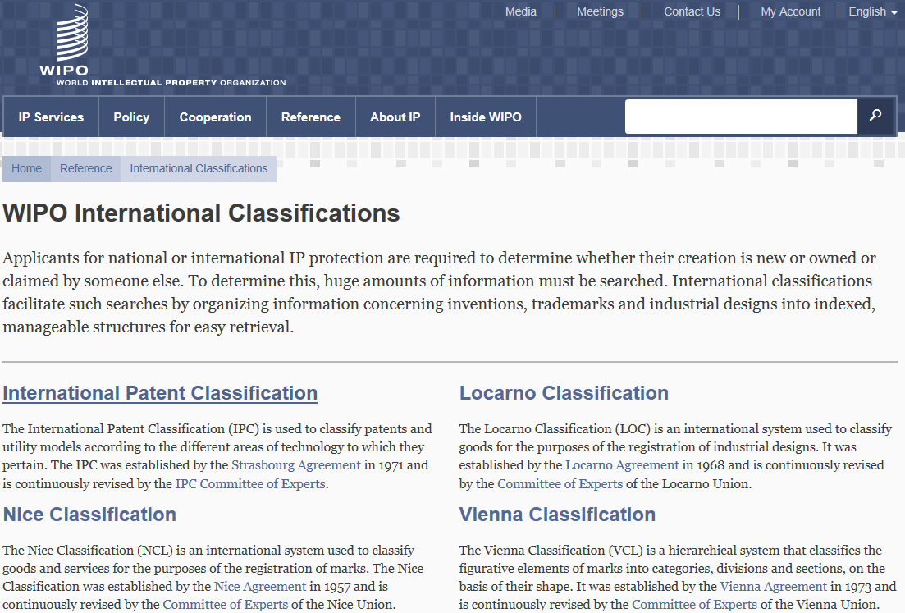
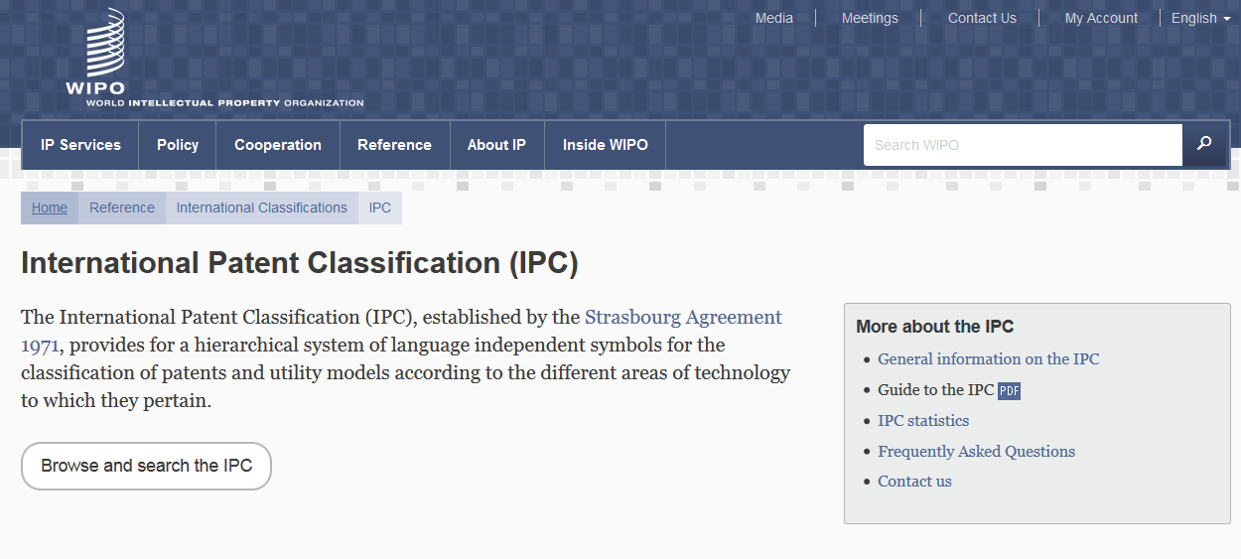
International Classifications

Slide 79
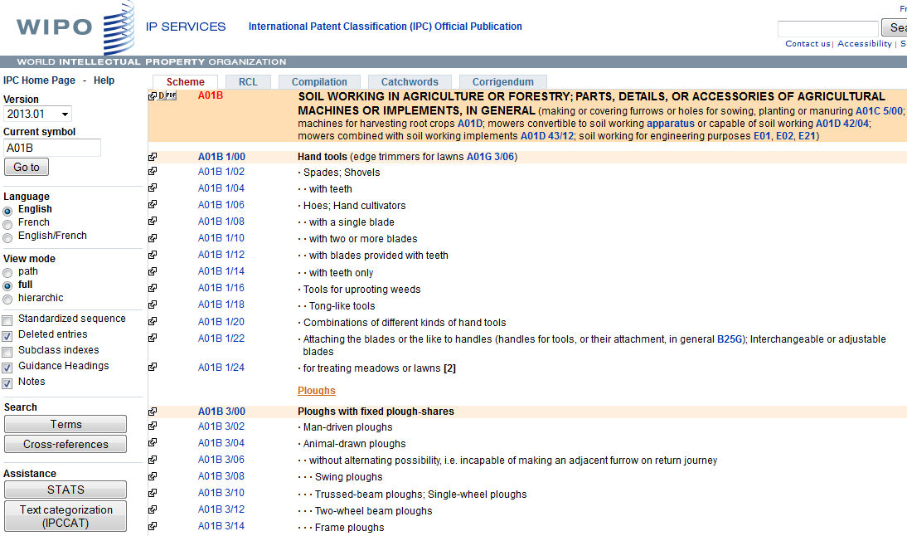
IPC Official Publication: http://web2.wipo.int/ipcpub/#refresh=page
Scheme tab (default)
Help
IPC version and IPC symbol
View mode (path/full/hierarchic)
Display option (Subclass indexes, Guidance Headings, Notes, etc.)

Slide 80


Definitions

Slide 81


Bridge

Slide 82

Catchword Index

Slide 83


Terms (text search of the IPC)

Slide 84

IPCCAT

Slide 85

IPCCAT

Slide 86



STATS

Slide 87


Parallel Viewer
Show CPC/FI

Slide 88

Parallel Viewer
FI entries
CPC entries
CPC/FI version

Slide 89
Guide to the IPC
The official Guide to the IPC provides comprehensive information on the IPC. It is available for download on the WIPO website of the IPC at:
http://www.wipo.int/classifications/ipc/en/general/
Notes:
see the slide

Slide 90

A patient data-miner
                www.doodlero.com
Notes:
Volume and complexity of today’s data

Slide 91


Slide 92
Q1: What are relevant search criteria?
A
Date
B
Number
C
Keyword
D
Classification

Slide 93

Q1: What are relevant search criteria?
A
Date
B
Number
C
Keyword
D
Classification
Spain

Slide 94
Q2: How to specify that the search mouse is related to computer technology?
A
Adding the definition of mouse
B
Using IPC codes

Slide 95
Q2: How to specify that the search mouse is related to computer technology?
A
Adding the definition of mouse
B
Using IPC codes

Slide 96
Q3: what is the rulebook to carry out a perfect search?
A
Keyword search
B
Classification search
C
No such rule exists!
D
Number search

Slide 97
Q3: what is the rulebook to carry out a perfect search??
A
Keyword search
B
Classification search
C
No such rule exists!
D
Number search

Slide 98


Slide 99


patentscope@wipo.int

Slide 100
November webinar:
How to build complex queries in PATENTSCOPE
Tue, November 24
5:30 PM - 6:30 PM CEST
Thu, November 26
8:30 AM - 9:30 AM CEST
To sign up: http://www.wipo.int/patentscope/en/webinar/

Slide 101

mulțumesc
mulțumesc

