Slide 1
PATENTSCOPE
Analysis and translation tools
September
2014
Sandrine Ammann
Marketing & Communications Officer

Slide 2
Agenda
Collections
Analysis tools
IPC statistics
Translation tools
  Google, Bing
  In-house: Tapta
Q&A session

Slide 3
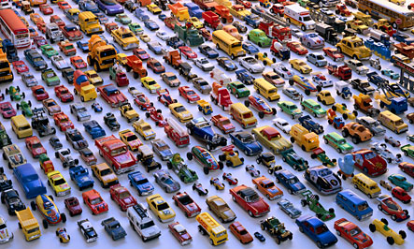
Collections
              Source:Traffic Jam ©Walter Wick, 2004

Slide 4

Pursuing a global coverage
39 national/regional collections including big offices like:
PCT, China, EPO, Japan, Korea, Russia, US …
Next: Canada, Australia, UK, Germany, Portugal

Slide 5
Coverage – Recently added
United States of America
from 1790 to 2013, 10.6 million records, full text from 1976
Japan
From 1993 to 2013, 8.3 million patent records, 7.9 million patent full text records
China
4.1 million patents and applications

Slide 6
Coverage – Full text OCR
OCR is performed weekly for the PCT applications; worse cases verified and analyzed by human operators afterwards.
OCR for the national collections is performed on a regular basis.
http://patentscope.wipo.int/search/en/help/data_coverage.jsf

Slide 7
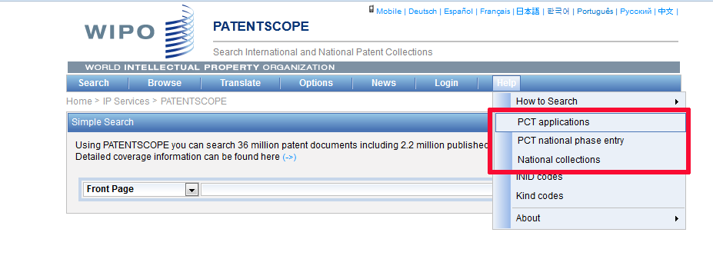
Data coverage

Slide 8
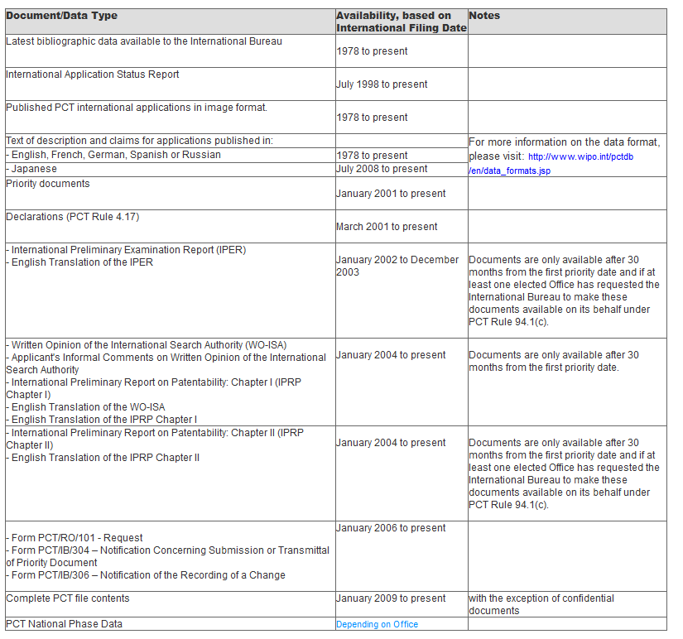
PCT applications

Slide 9
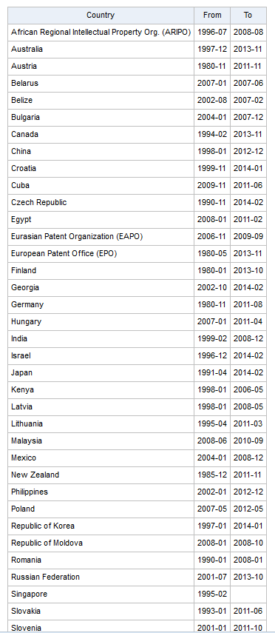
PCT national phase entry

Slide 10
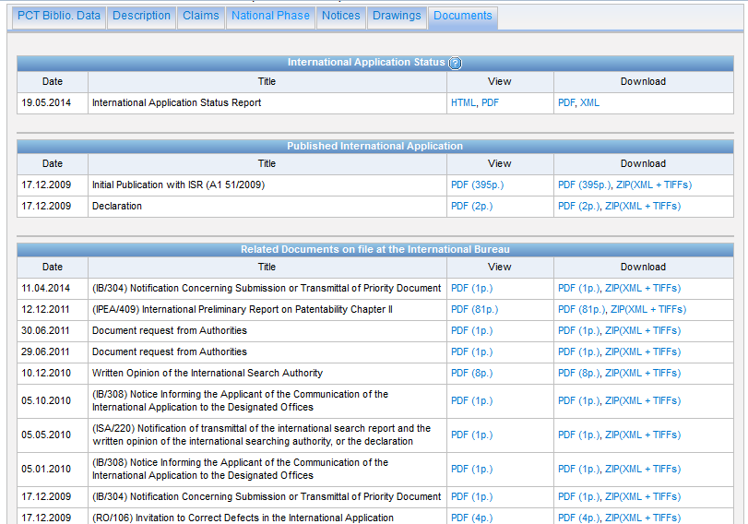
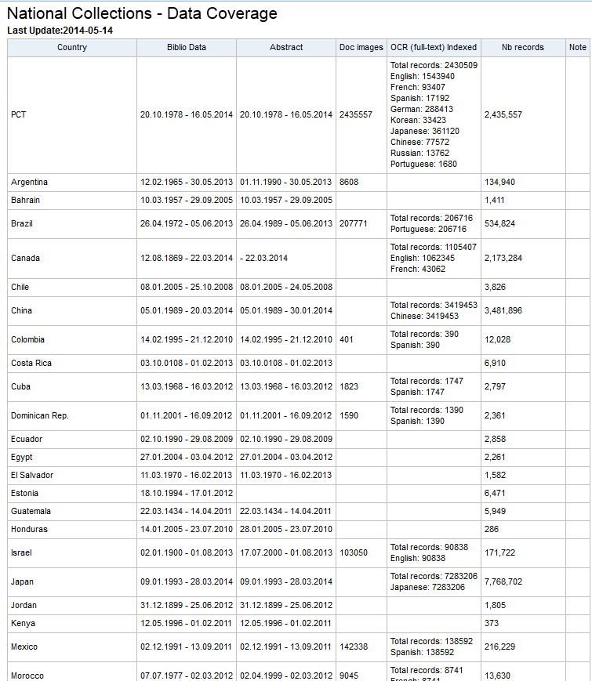
National collections

Slide 11
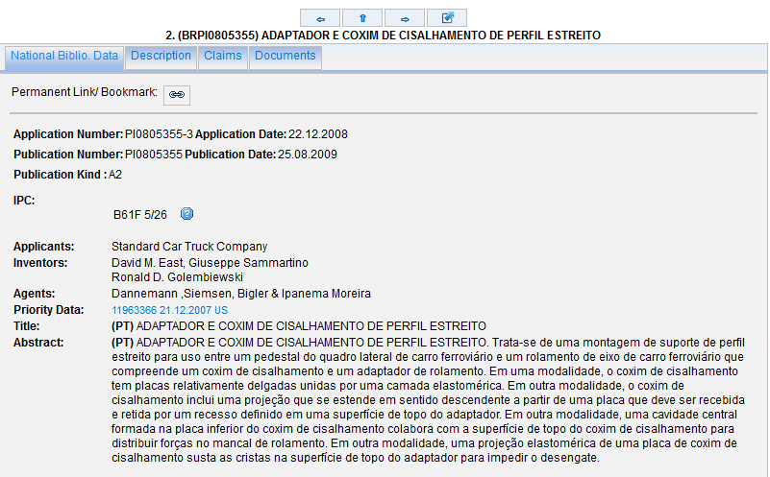
National collections

Slide 12
National collections vs national phase entry
National/regional collections = data from national/regional offices
National phase entry = PCT procedure

Slide 13
PCT procedure steps
Filing: you file an international application, complying with the PCT formality requirements, in one language, and you pay one set of fees.
International Search: an “International Searching Authority (ISA)” (one of the world’s major patent Offices) identifies the published documents which may have an influence on whether your invention is patentable and establishes an opinion on your invention’s potential patentability.
International Publication: as soon as possible after the expiration of 18 months from the earliest filing date, the content of your international application is disclosed to the world.
Supplementary International Search (optional): an ISA which is willing to carry out supplementary searches and which did not carry out the main search, identifies published documents which may not have been searched by the ISA which carried out the main search because of the diversity of prior art in different languages and different technical fields.
International Preliminary Examination (optional): one of the ISAs, at your request, carries out an additional patentability analysis, after international publication, usually on an amended version of your application.
National Phase: after the end of the PCT procedure, you start to pursue the grant of your patents directly before the national (or regional) patent Offices of the countries in which you want to obtain them.
Source: http://www.wipo.int/pct/en/faqs/faqs.html

Slide 14
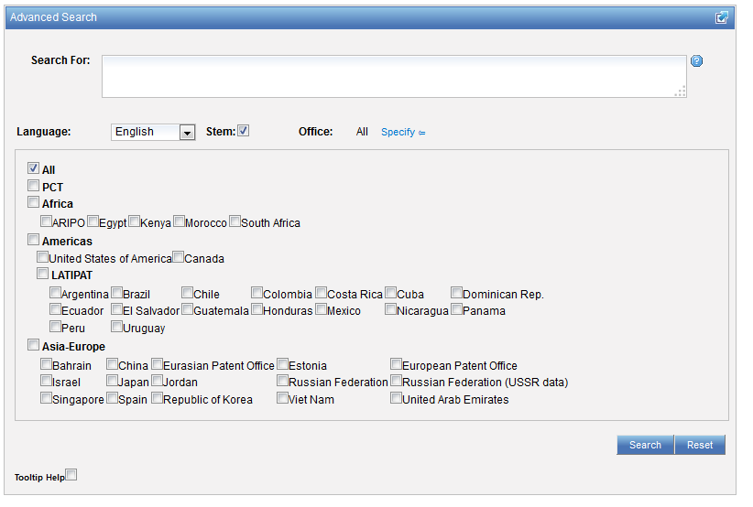
Collection selection

Slide 15
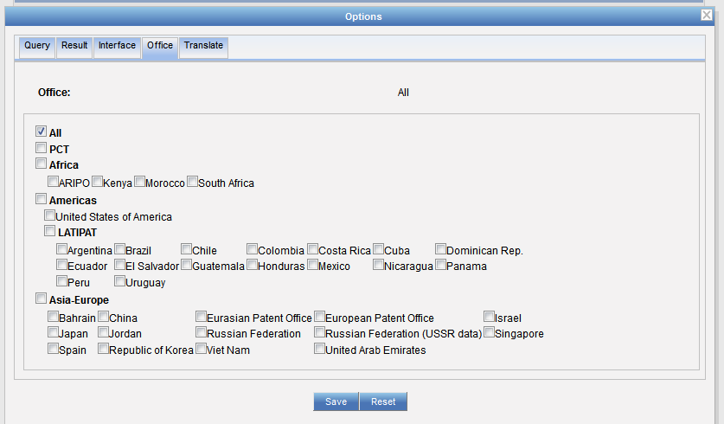
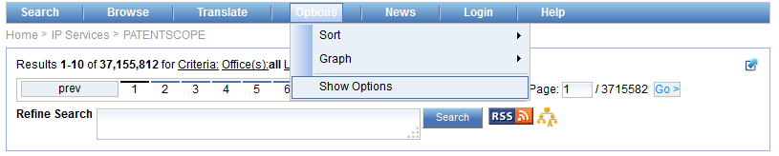
Collection selection

Slide 16

Analysis tools in the search results list

Slide 17
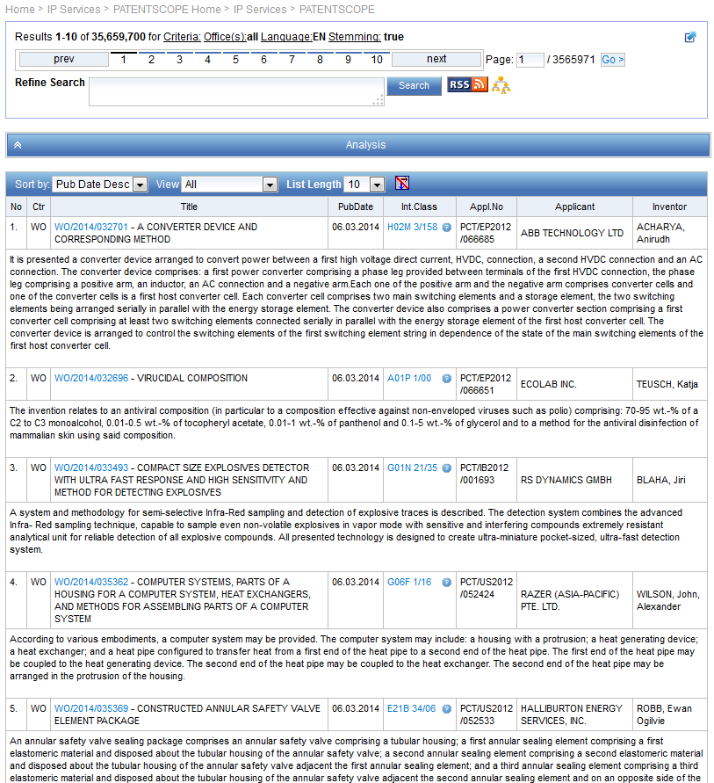
Search result list

Slide 18
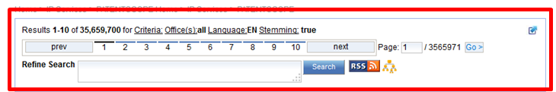

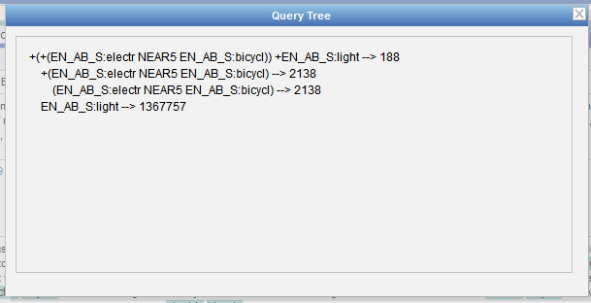

Slide 19
Stemming
Process that removes common ending from words by English Snowball algorithm
electric¦al = electric
electric¦ity = electric
electron¦ics = electron
More accurate results than wildcards:
elect* electoral, etc.

Slide 20
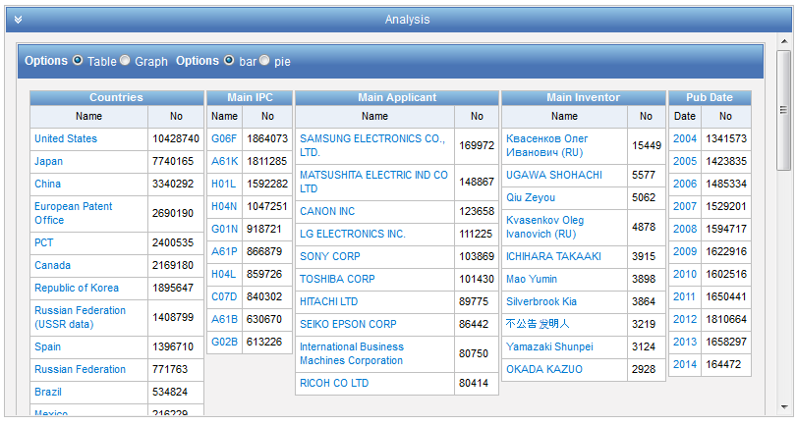

Slide 21
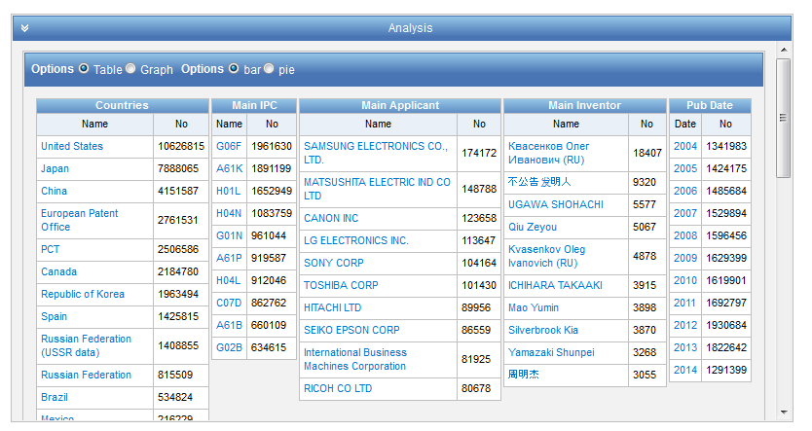
Analysis - customization

Slide 22
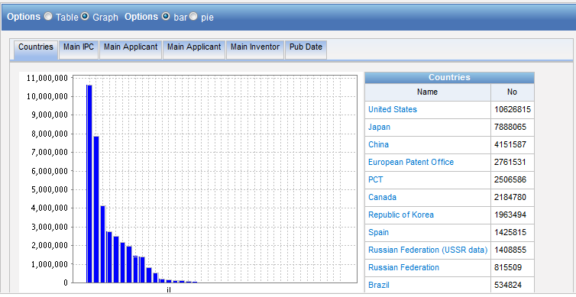
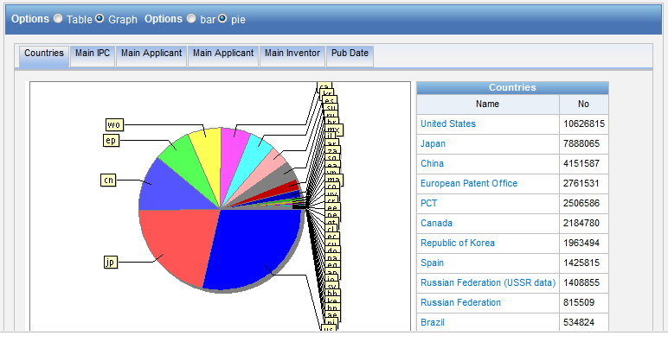
Table – Graph: pie or bar

Slide 23
Table/graph customization

Slide 24
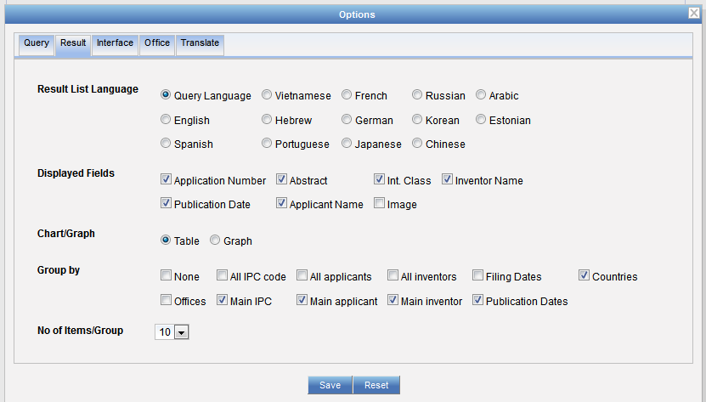
Table/graph customisation

Slide 25
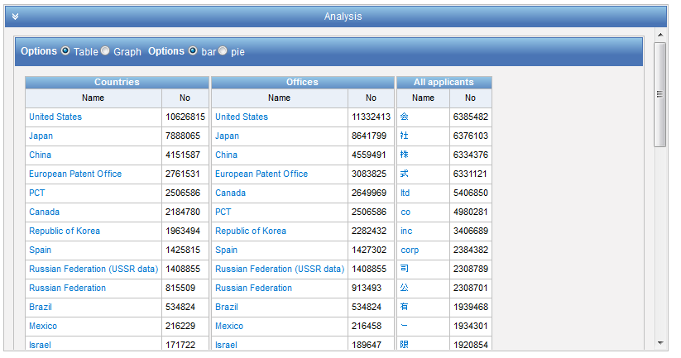

Slide 26

PATENTSCOPE account

Slide 27
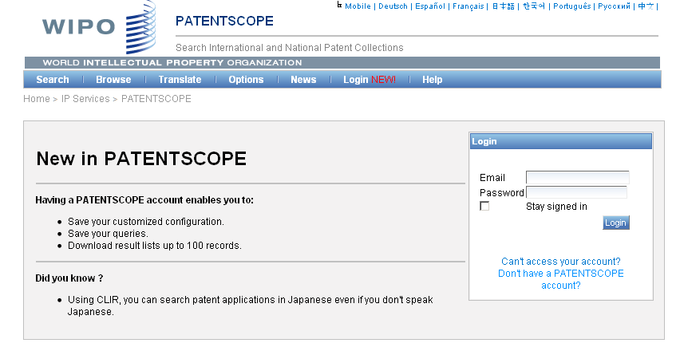
Notes:
Why would users create an account?
1
2
3
Here at the bottom you see the Did you know question referring to CLIR this leans me to our main focus in 2011 which is

Slide 28
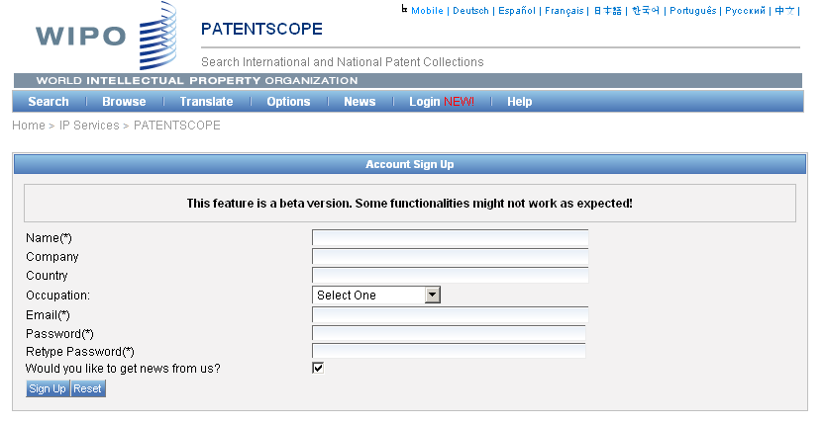
Signing up

Slide 29
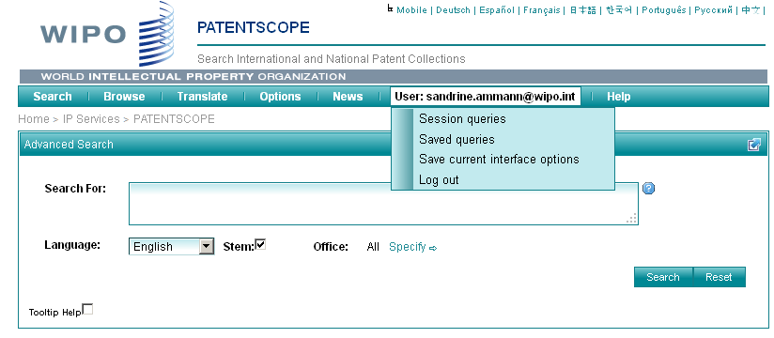
Once logged-in

Slide 30
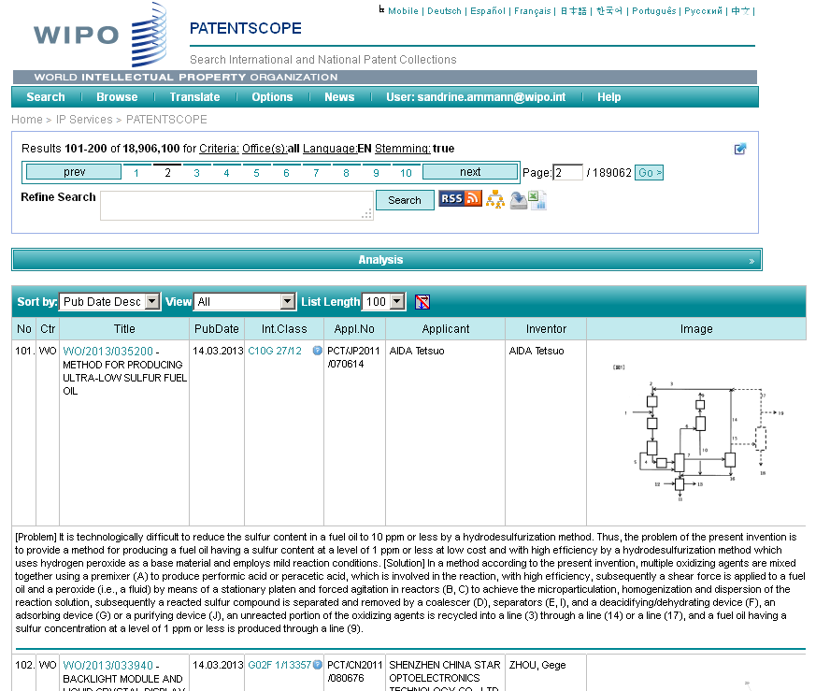
Downloading the results/Saving the query

Slide 31
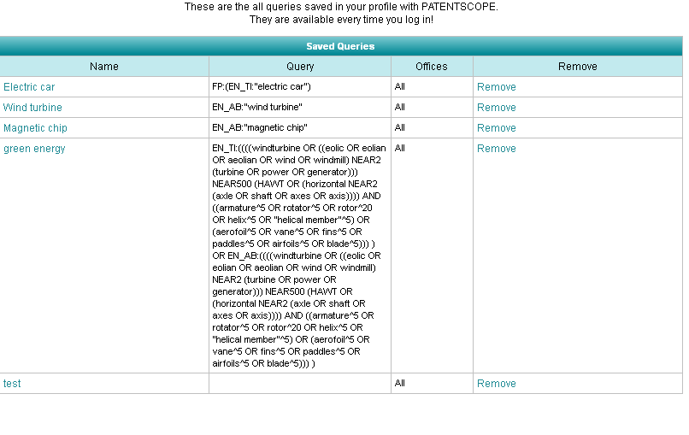
Saving a query

Slide 32
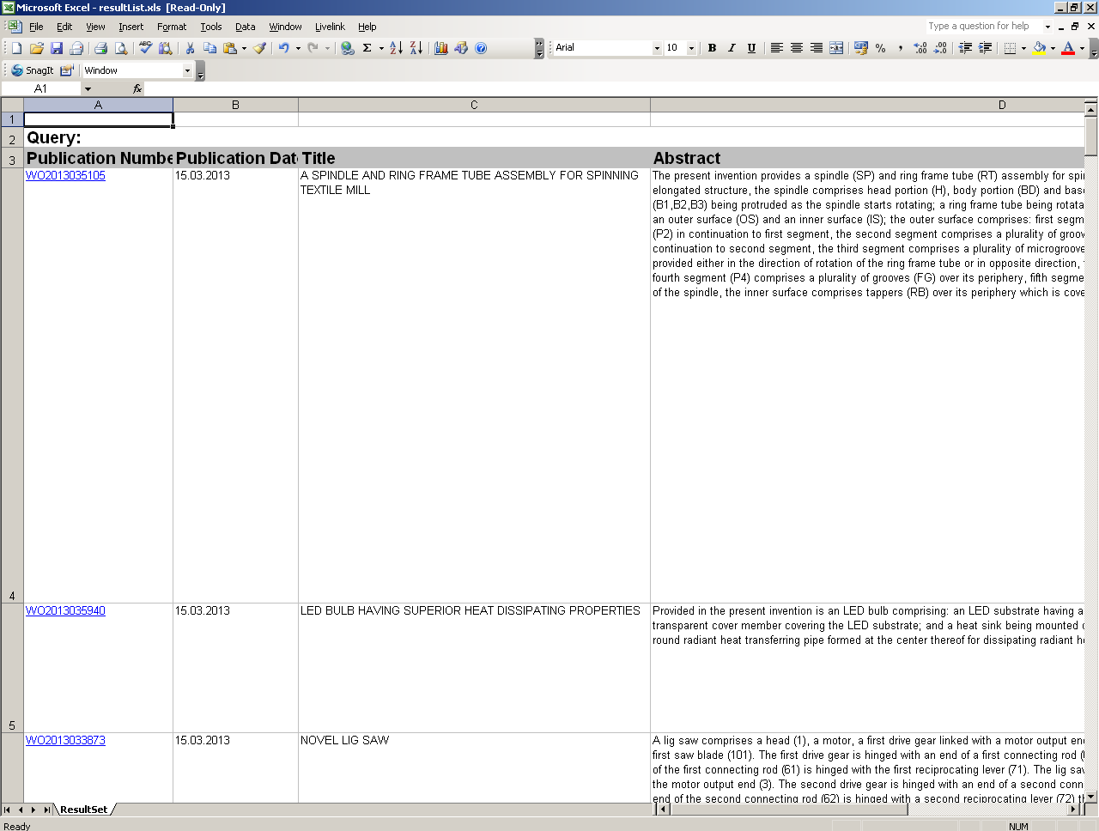

Slide 33

Analysis tools

Slide 34
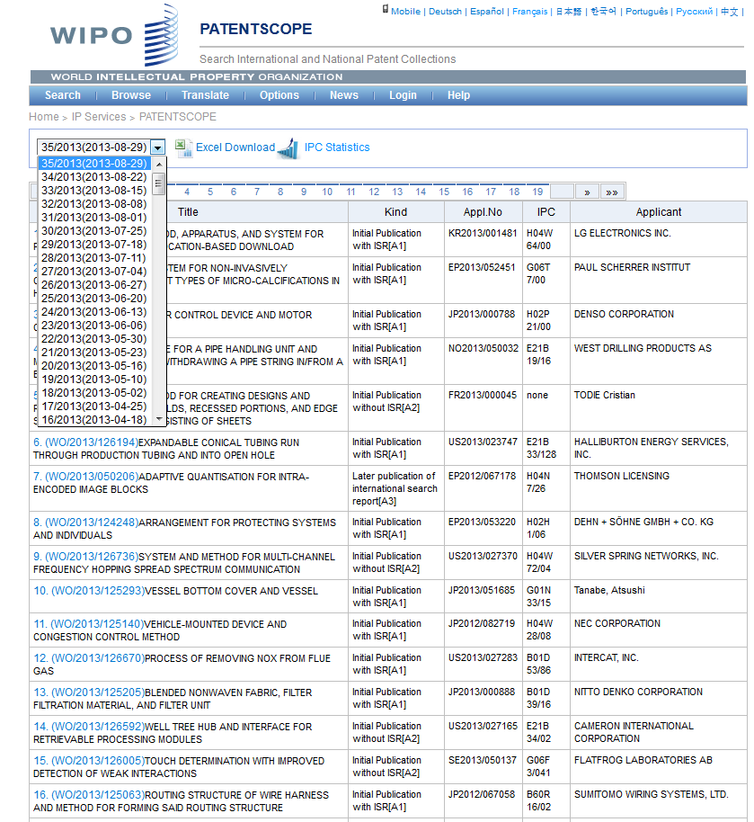

Slide 35
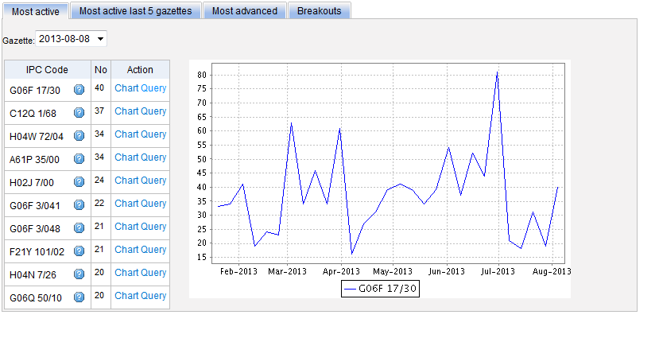
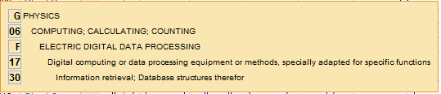
Most active

Slide 36
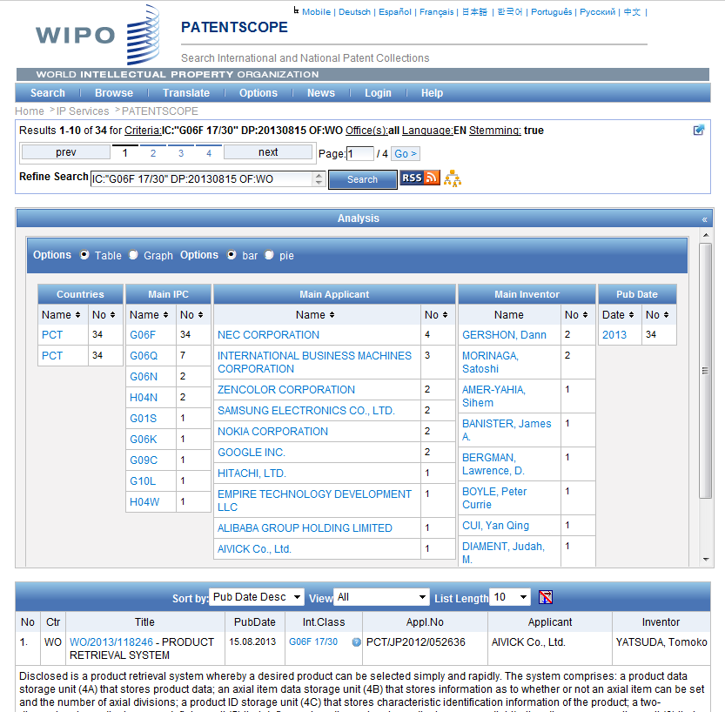

Slide 37
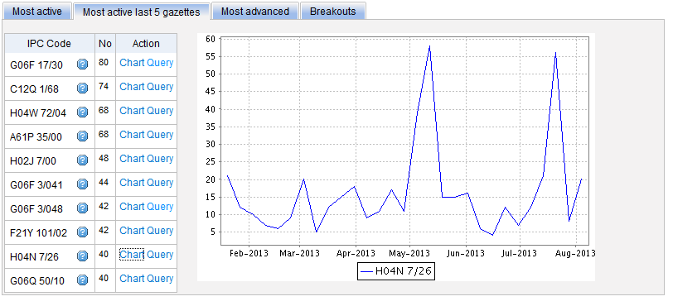
Most active last 5 gazettes

Slide 38
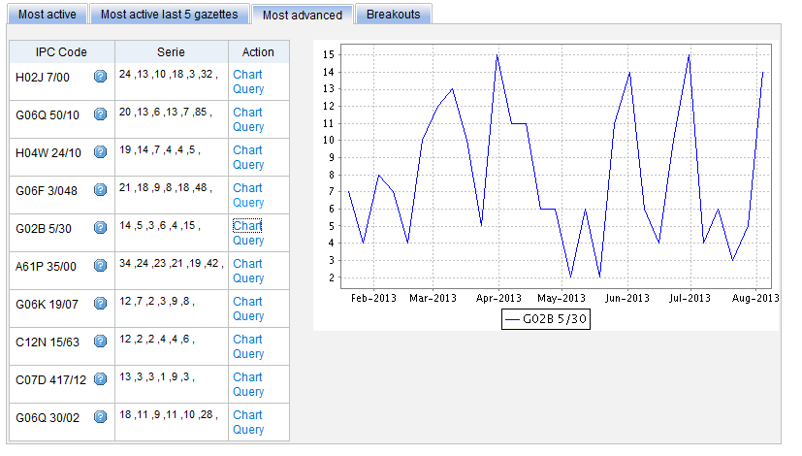
Most advanced

Slide 39
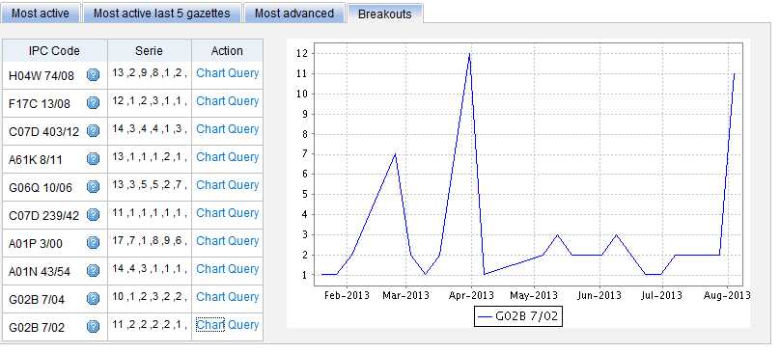
Breakouts

Slide 40

IPC
IPC
Green
Inventory

Slide 41
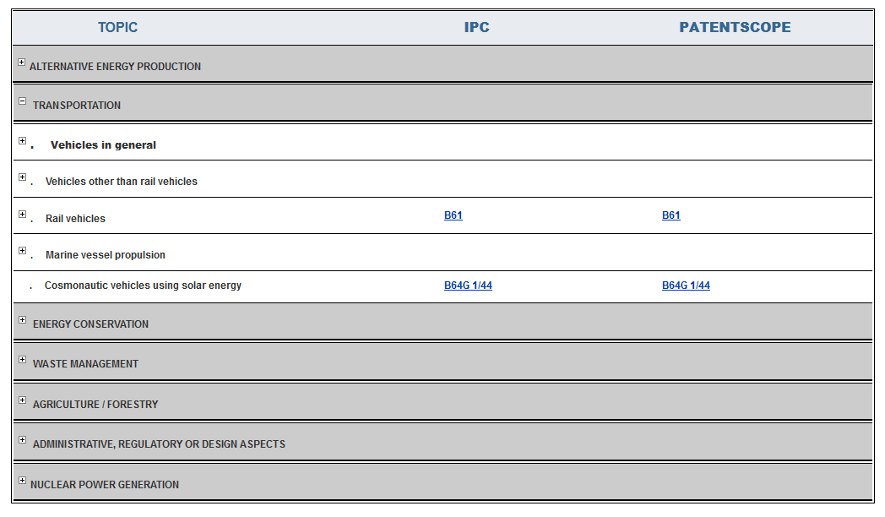
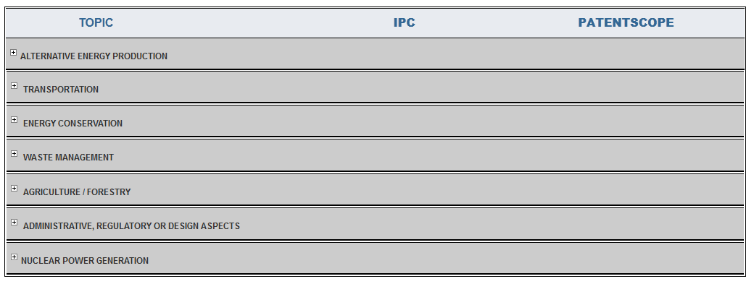

Slide 42
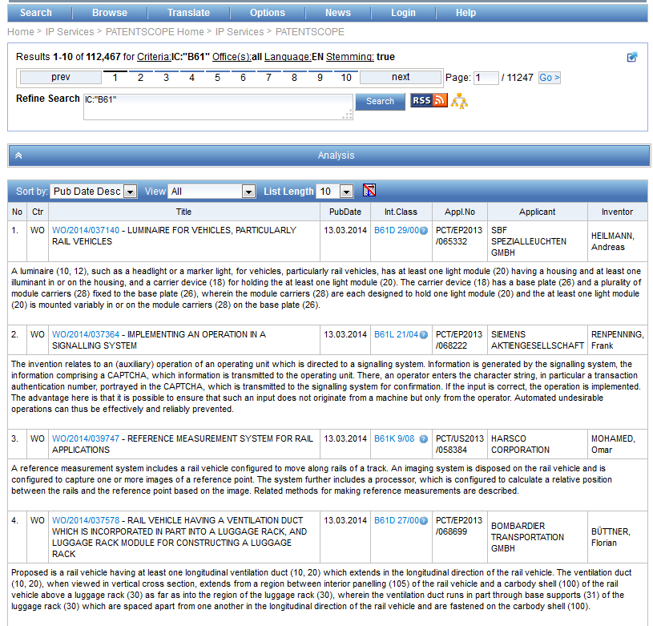

Slide 43
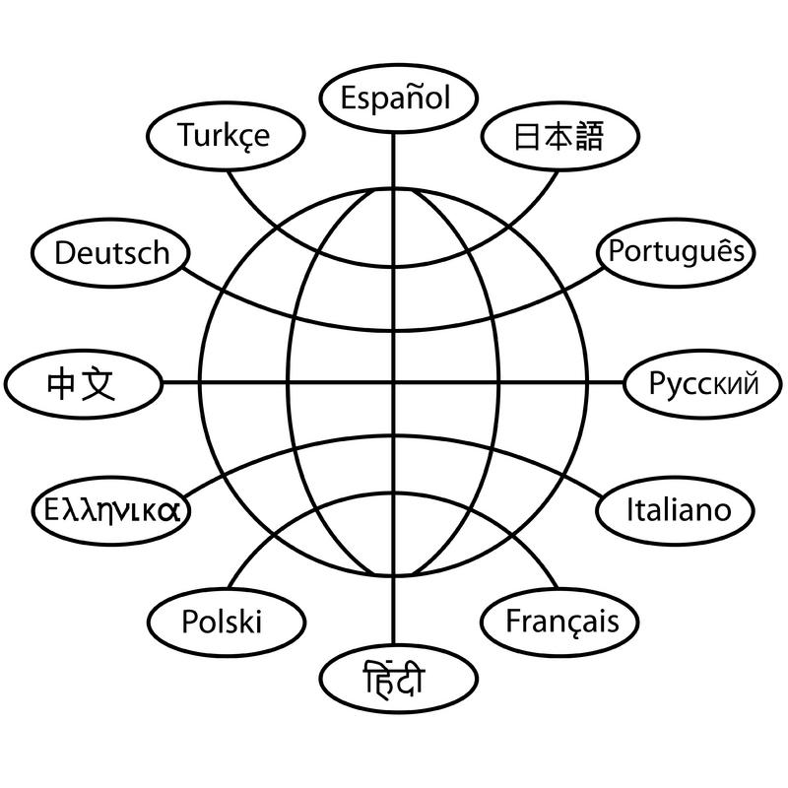
Translation tools

Slide 44



Slide 45
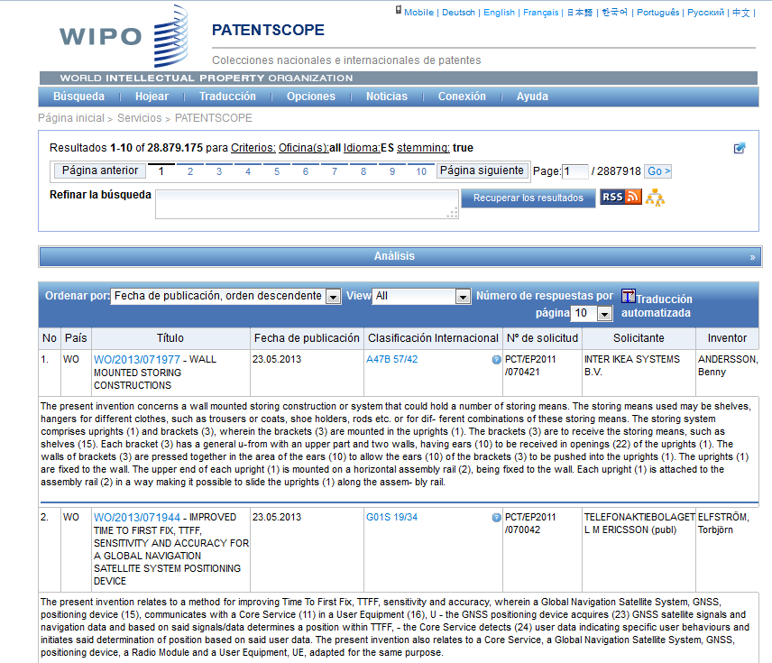
MT in result list

Slide 46
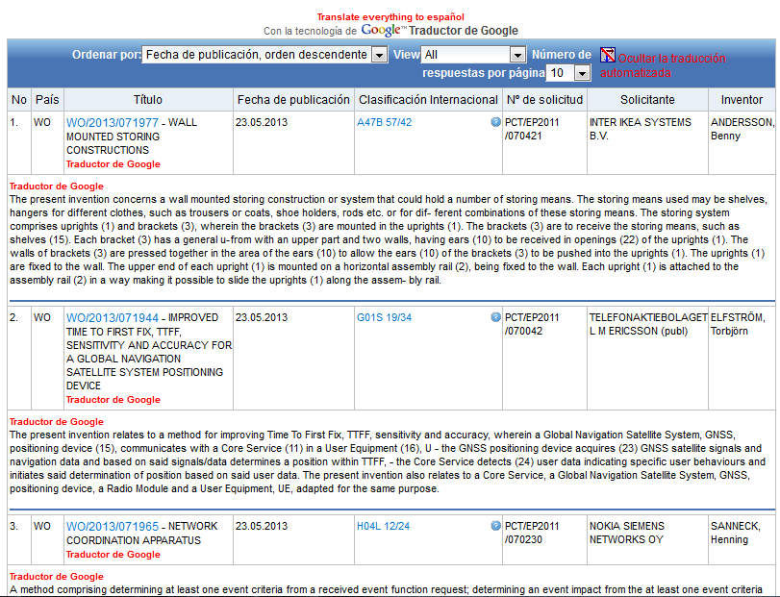

Slide 47
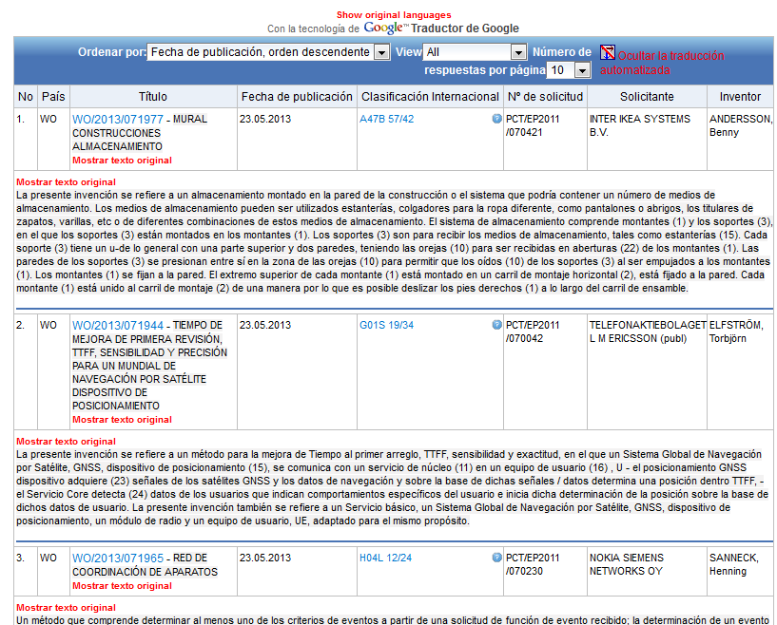

Slide 48
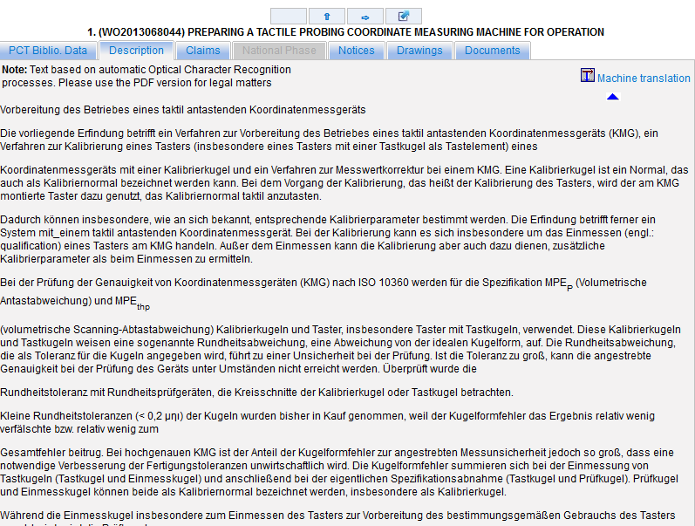
MT in description/claims/full-text

Slide 49
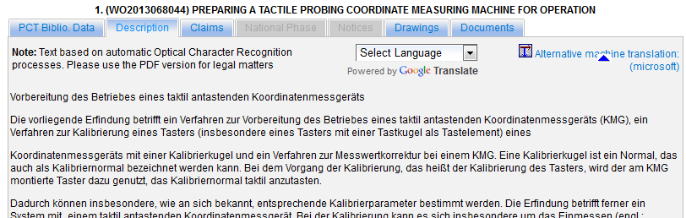

Slide 50
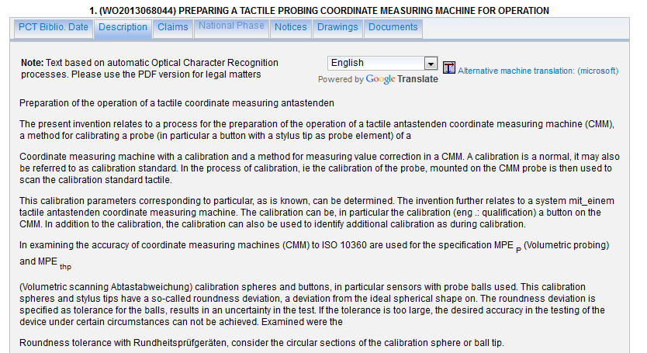
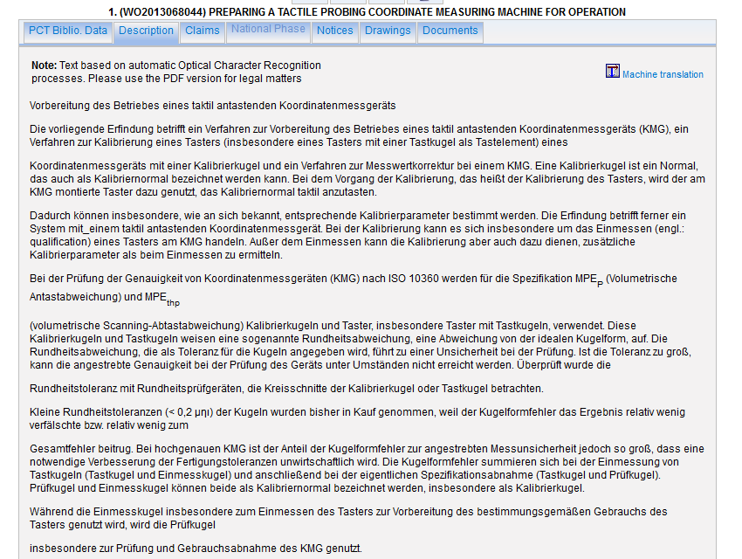
Google

Slide 51
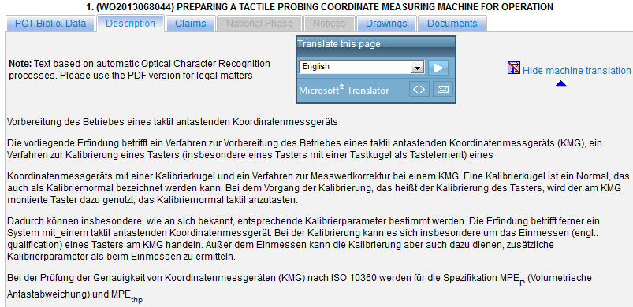
Microsoft

Slide 52
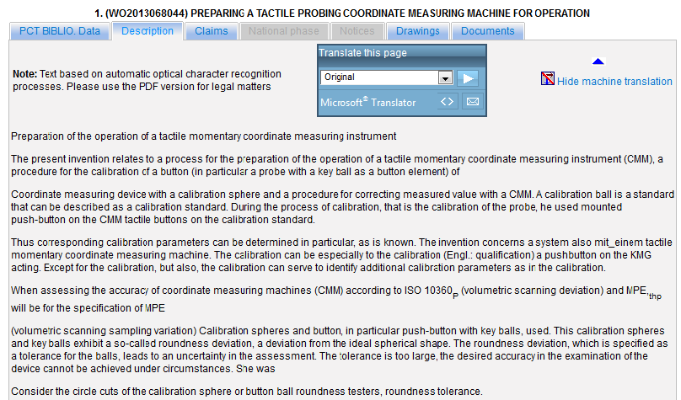

Slide 53
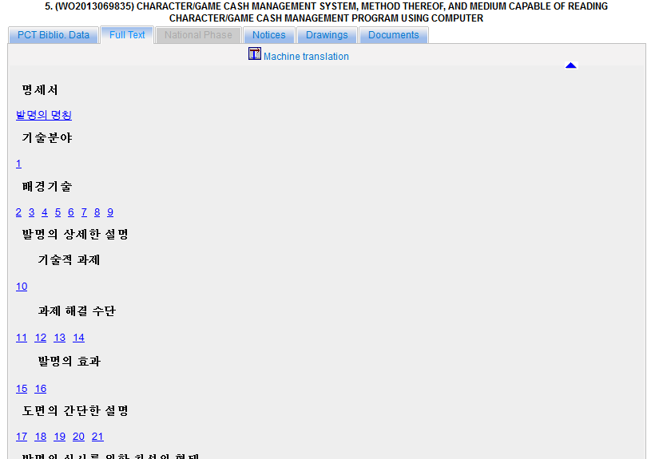
Full-text

Slide 54
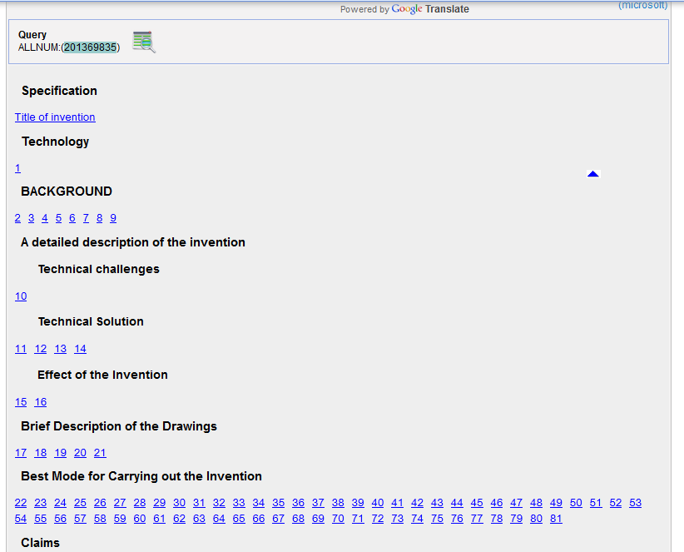

Slide 55
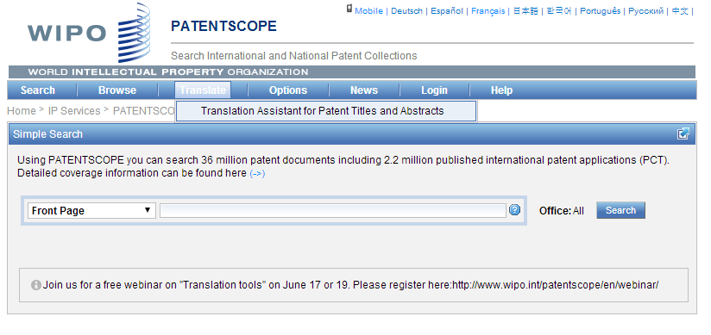
TAPTA

Slide 56

32 Technical domains from the IPC
[ADMN] Admin, Business, Management & Soc Sci
[AERO] Aeronautics & Aerospace Engineering
[AGRI] Agriculture, Fisheries & Forestry
[AUDV] Audio, Audiovisual, Image & Video Tech
[AUTO] Automotive & Road Vehicle Engineering
[BLDG] Civil Engineering & Building Construction
[CHEM] Chemical & Materials Technology
[DATA] Computer Sci, Telecom & Broadcasting
[ELEC] Electrical Engineering & Electronics
[ENGY] Energy, Fuels & Heat Transfer Eng
[ENVR] Environmental & Safety Engineering
[FOOD] Foods & Food Technology
[GENR] Generalities, Language, Media & Info Sci
[HOME] Home Contents & Household Maintenance
[HORO] Precision Mechanics, Jewelry & Horology
[MANU] Manufacturing & Materials Handling Tech
[MARI] Marine Engineering
[MEAS] Standards, Units, Metrology & Testing
[MECH] Mechanical Engineering
[MEDI] Medical Technology
[METL] Metallurgy
[MILI] Military Technology
[MINE] Mining, Oil & Gas Extraction & Minerals
[NANO] Nano Technology
[PACK] Packaging & Distribution of Goods
[PRNT] Printing & Paper
[RAIL] Railway Engineering
[SCIE] Optical Engineering
[SPRT] Sports, Leisure, Tourism & Hospitality
[TEXT] Textile & Clothing Industries
[TRAN] Transportation

Slide 57
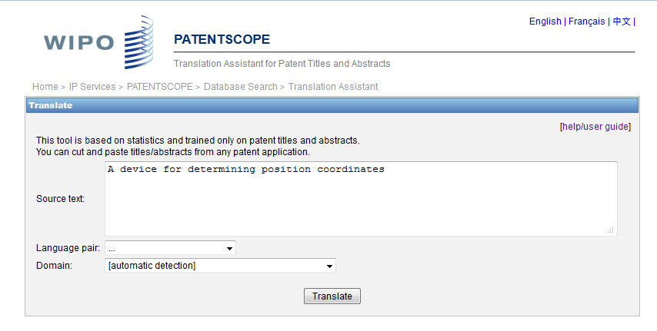
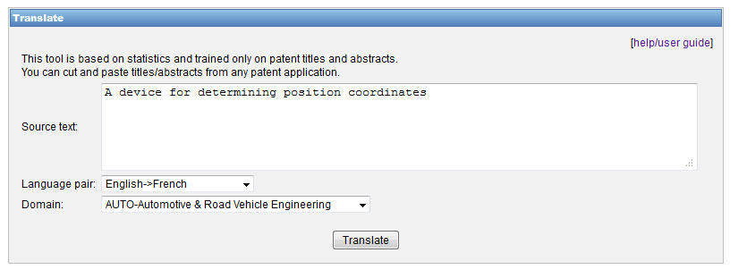
TAPTA: how does it work?

Slide 58


Slide 59

TAPTA: post-editing & exporting

Slide 60

TAPTA

Slide 61


Slide 62


Slide 63


Slide 64


Slide 65

New!

Slide 66


Slide 67


Slide 68


Slide 69


Slide 70



Slide 71


Slide 72


Slides and recording
+
www.wipo.int/patentscope/en/webinar/index.html

Slide 73

Next webinar:
PATENTSCOPE & IPC
October 28 or 30 http://www.wipo.int/patentscope/en/webinar/

Slide 74


patentscope@wipo.int

Slide 75

mulțumesc
mulțumesc

