Slide 1
The PATENTSCOPE search system
Cyberspace
October
2013
Sandrine Ammann
Marketing & Communications Officer

Slide 2
Agenda
Coverage
Overview of the PATENTSCOPE search system (live or ppt)
Q & A

Slide 3
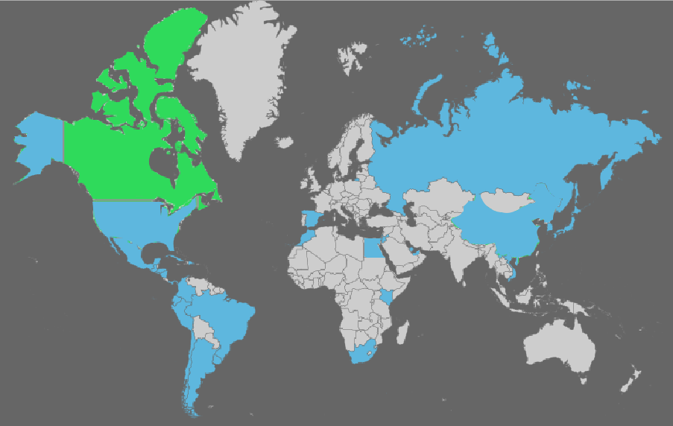
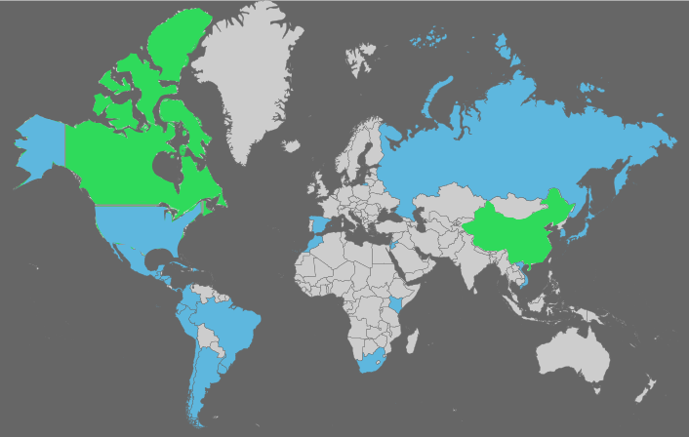
Coverage : Collections
As well as PCT applications, the ARIPO, EPO and LATIPAT collections
Notes:
ARIPO: African Regional IP Org
PCT: 1st publication worldwide

Slide 4

Estonia
Added today!

Slide 5
Last collection added: China
From 1985 to 1995 included:
  Bibliographic data in English
From 1996
  Bibliographic data in English and Chinese
  Claims in Chinese
  Description in Chinese
  = about 2.8 million full-text

Slide 6
Also: Bahrain, UAE & Egypt
Bahrain and UAE: complete collections
Egypt: partial collection
All granted patents
Plans to make available full text information of these patents.

Slide 7
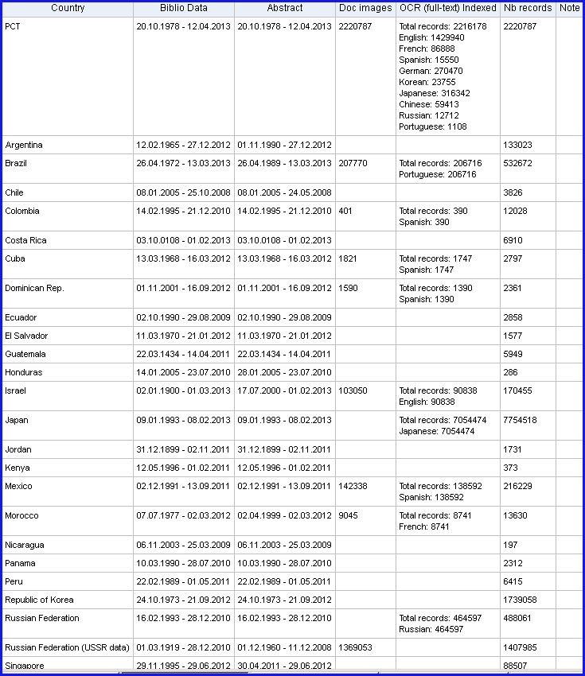
Coverage : Details of collections

Slide 8
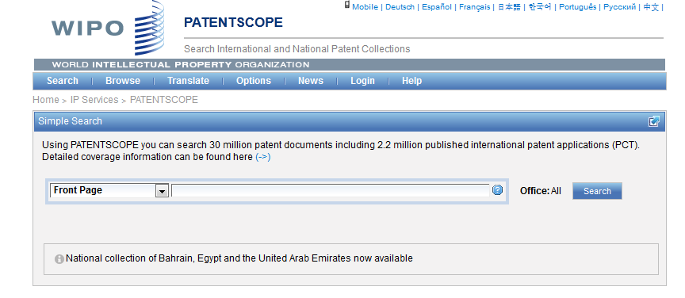
Languages of the interface

Slide 9
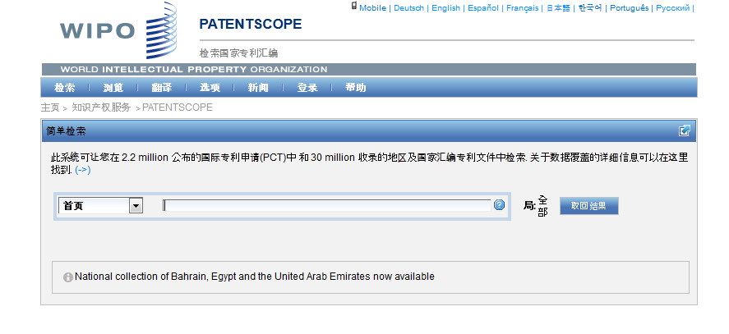
Interface in Chinese

Slide 10
Mobile interface

Slide 11
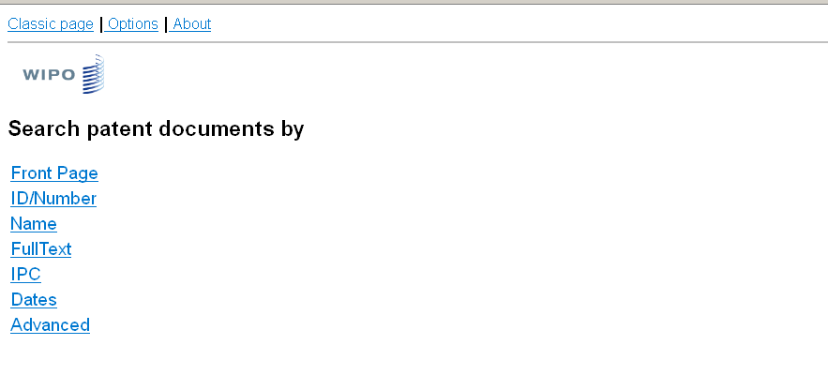
Mobile interface

Slide 12
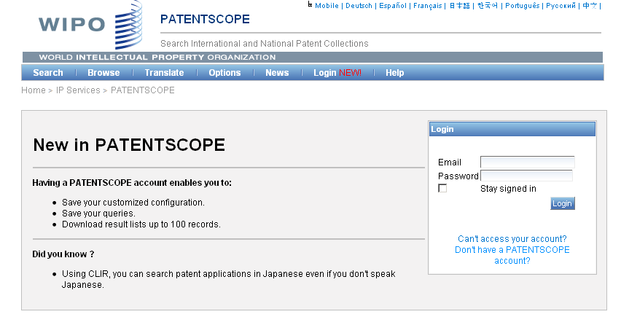
PATENTSCOPE account

Slide 13
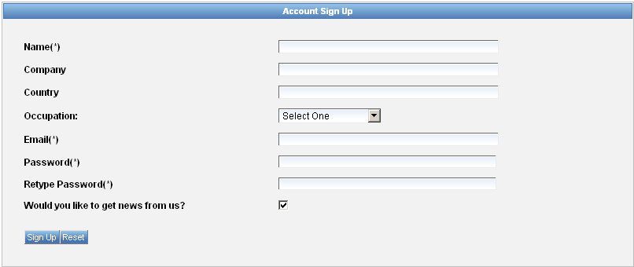
Signing up

Slide 14
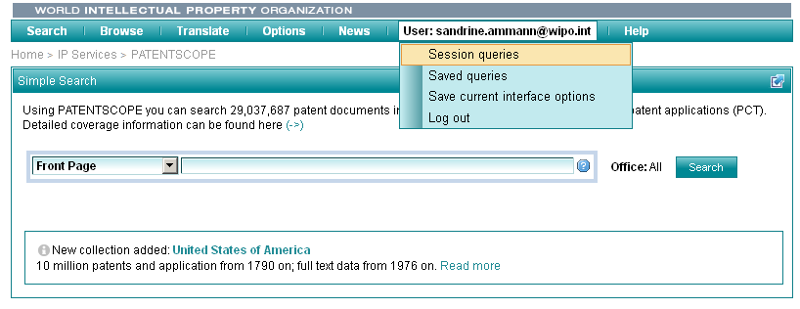
Once logged-in

Slide 15
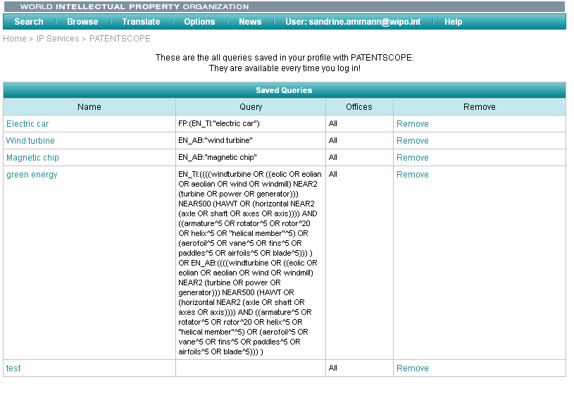
Saved queries

Slide 16
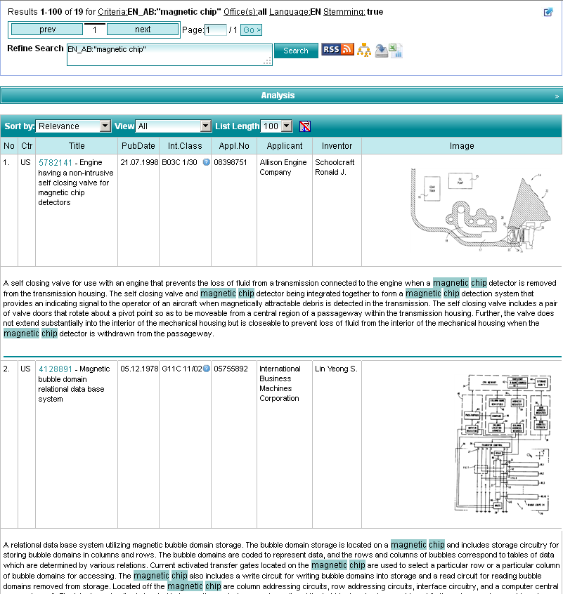
Downloading the results

Slide 17
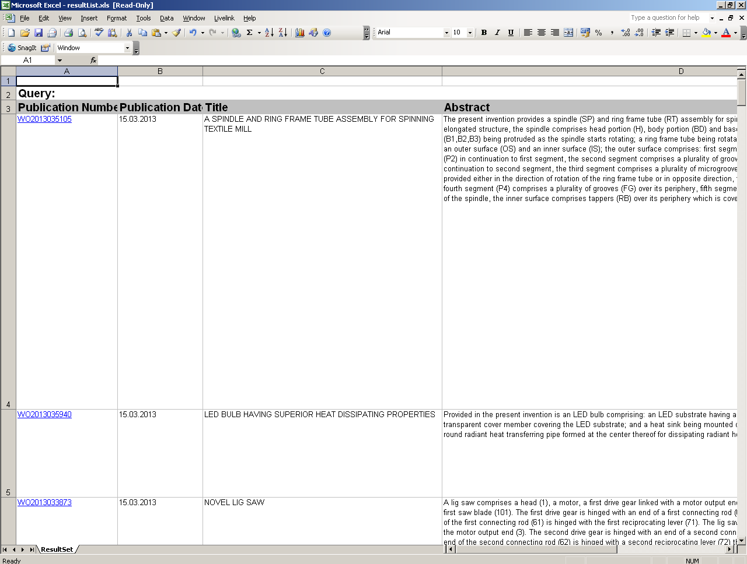
Downloaded results

Slide 18
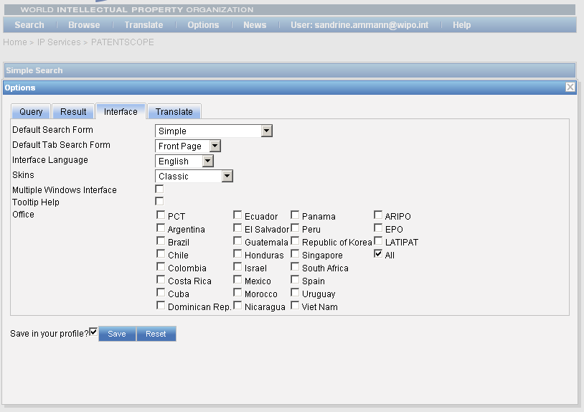
Account customization

Slide 19
PATENTSCOPE: how to search
Browse by week or sequence listing
Search patent documents:
  Simple
  Advanced
  Field combination
  CLIR

Slide 20
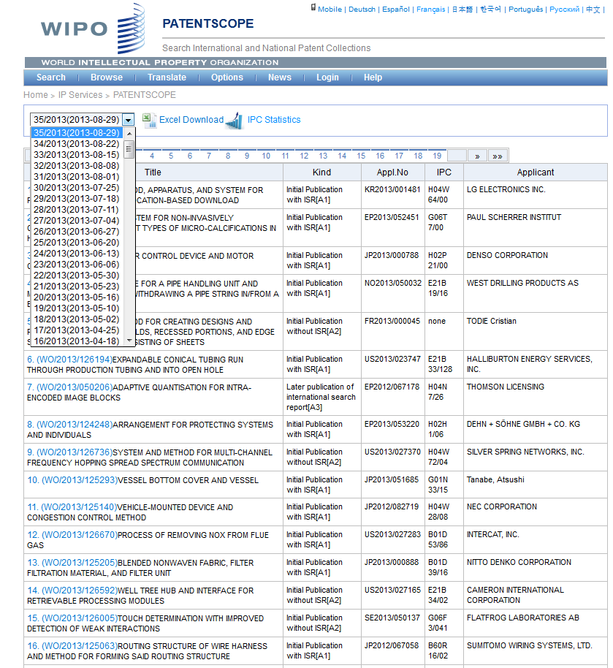

Slide 21
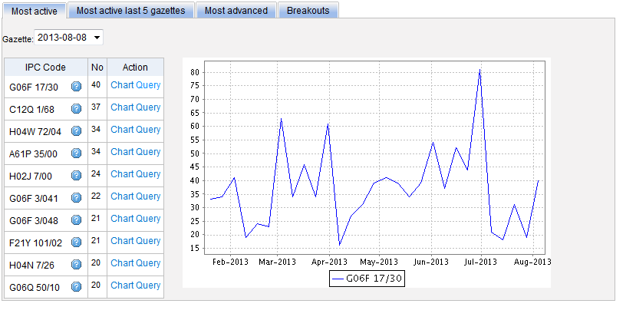
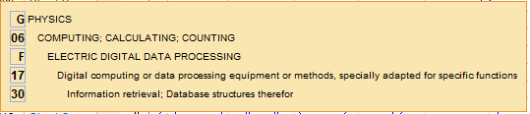
Most active

Slide 22
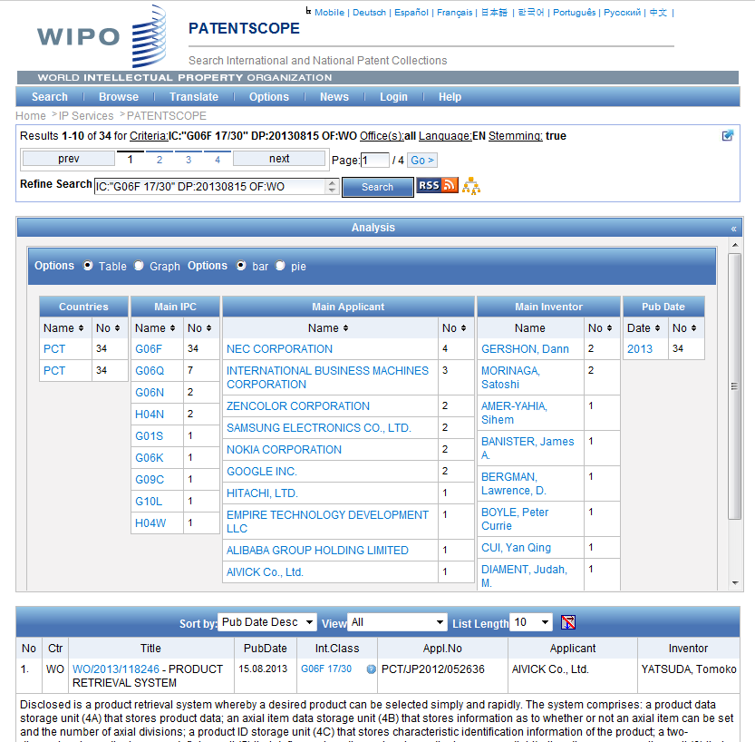

Slide 23
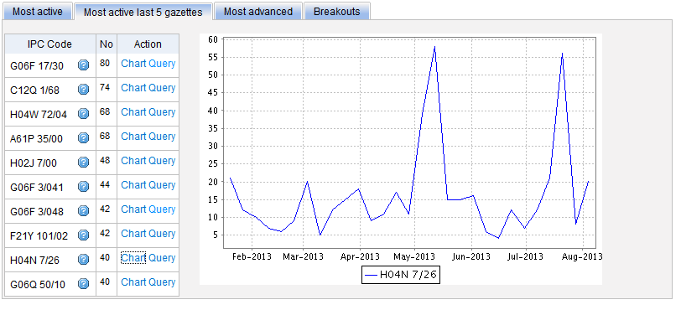
Most active last 5 gazettes

Slide 24
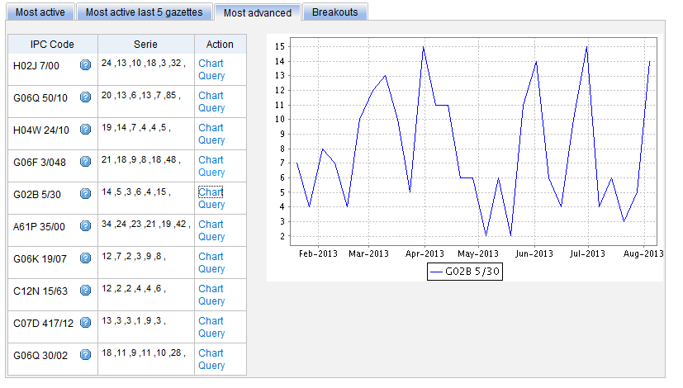
Most advanced

Slide 25
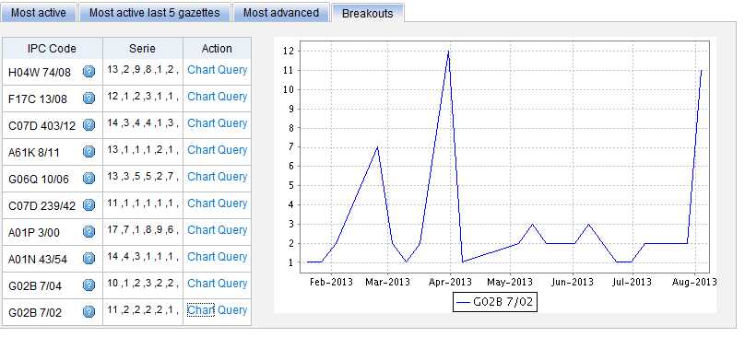
Breakouts

Slide 26

IPC search in PATENTSCOPE
Searching and Grouping now by complete IPC codes:
H04B 1/06 will include by default
H04B 1/08
1/10
1/16

Slide 27
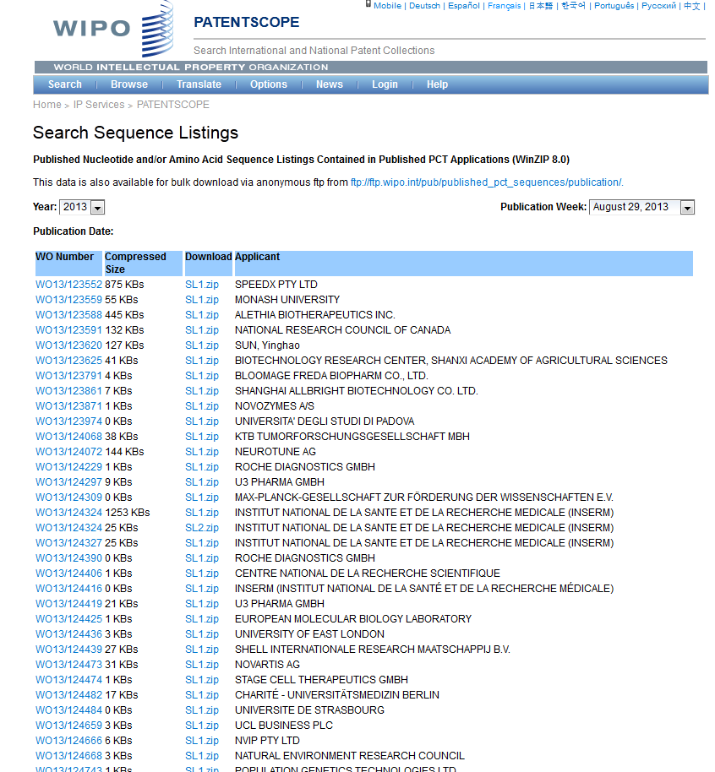

Slide 28
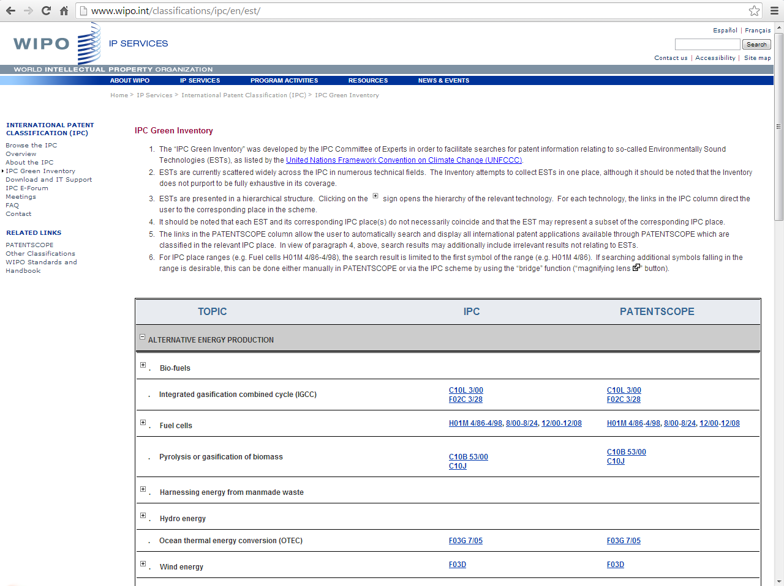
IPC Green Inventory

Slide 29
PATENTSCOPE: how to search
Browse by week or sequence listing
Search patent documents:
  Simple
  Advanced
  Field combination
  CLIR

Slide 30
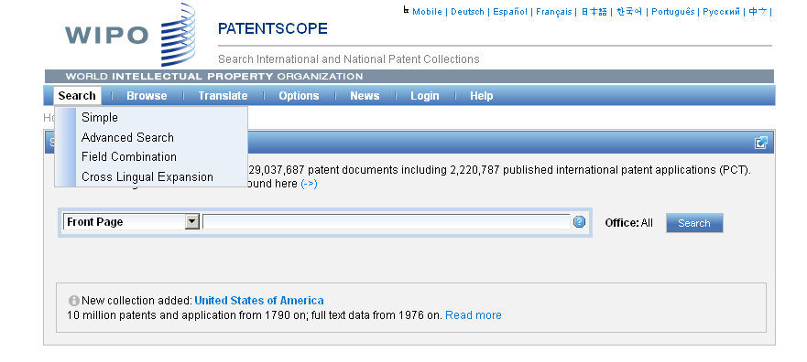
4 ways to search

Slide 31
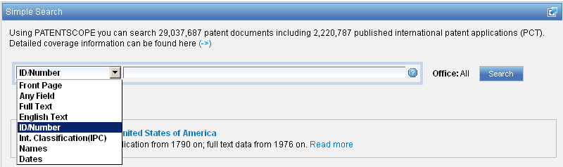
Interface : Simple
Basic search fields are provided

Slide 32
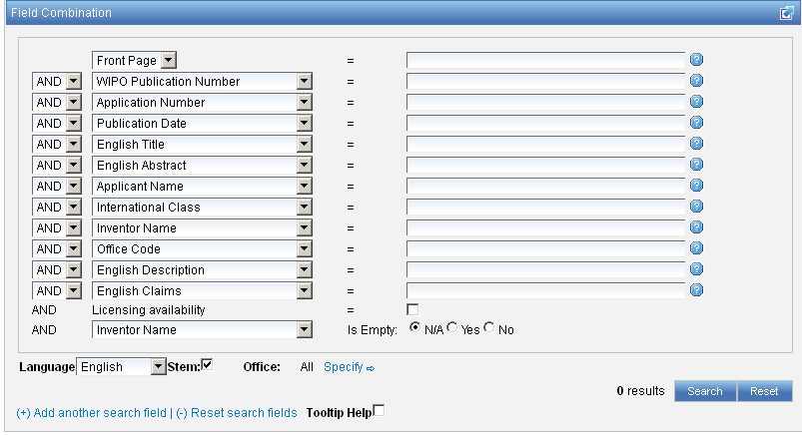
Interface : Field Combination - Structured
Additional search fields can be selected

Slide 33

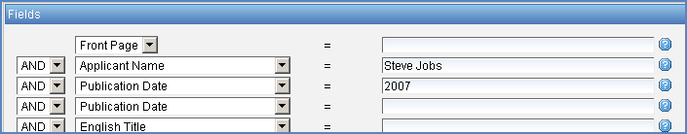
Search examples
Inventions by Steve Jobs in 2007
Patent documents containing microchip with licensing availability.
Notes:
33
In the drop-down box, select the field Applicant name and enter Steve Jobs; select AND and the field Publication date and enter 2007
In the drop-down boy, select English description and enter microchip, then tick the Licensing availability box (one before last in the Field Combination interface).

Slide 34

Search examples
Patent documents without an IPC code
Notes:
34
3. there is also the option to select a field that is empty: for example you could search. On the last line, select the IPC in the drop-down box and tick yes next to empty.

Slide 35
Stemming
Process that removes common ending from words by English Snowball algorithm
electric¦al = electric
electric¦ity = electric
electron¦ics = electron

Slide 36
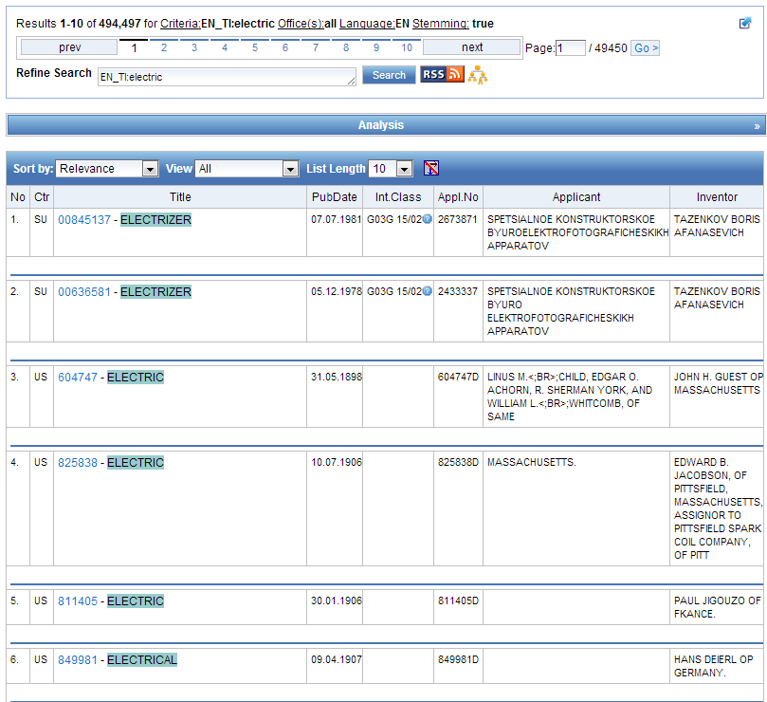
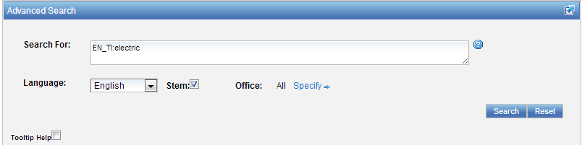

Slide 37
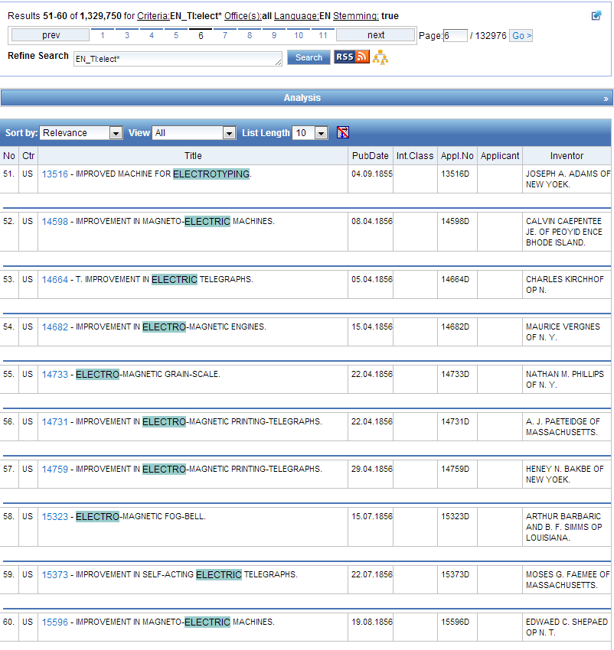
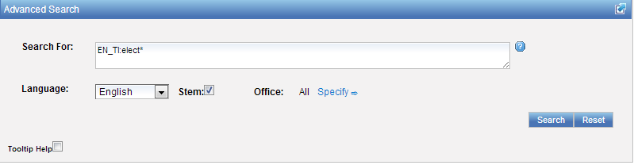

Slide 38
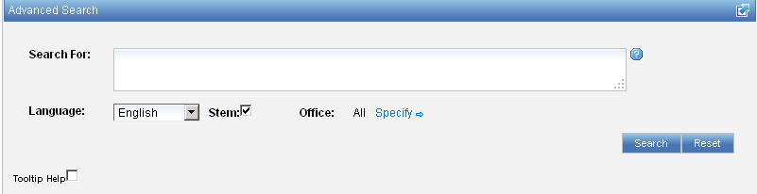
Interface : Advanced
Full flexibilities are enabled

Slide 39
To help you fine-tune your search
1. Boolean operators
2. Proximity operators
3. Field codes
4 .Stemming/wildcard/fuzzy searches
5. Grouping/nesting
6. Date searches

Slide 40
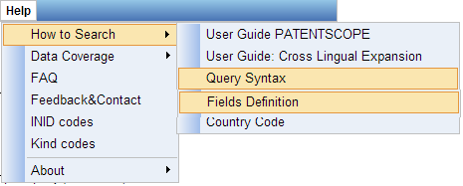
Help menu

Slide 41
Search examples: field code, Boolean and range operator
Inventions made by Steve Jobs published during the period from 2007 to 2009 comprising the keyword “touch” in the description.
IN:(Jobs) AND PD:[2007 TO 2009] AND EN_DE:(touch)
This search query uses field codes, a Boolean operator, and a range operator.
The field codes are IN for inventor, PD for publication date, and EN_DE for English description.
The Boolean operator AND is used to ensure that all search terms are included in the search results (i.e. that the results are for Jobs as inventor, within the given publication date range, and using the word “touch”).
The range operator TO is used to define a range of publication date values.
Notes:
41
Searching for..

Slide 42
CLIR
CLIR stands for Cross Lingual Information Retrieval and will allow you to search a term or a phrase and its variants in:
Chinese
Dutch
English
French
German
Italian
Japanese
Korean
Portuguese
Russian
Spanish and
Swedish
Notes:
42
You will use this tool in order to:
-Find synonyms in order to retrieve comprehensive results
-To search in a language that one does know

Slide 43
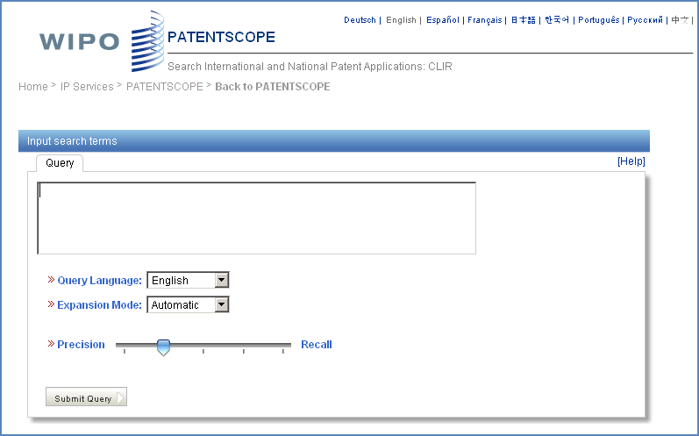
CLIR: the interface
Notes:
43
There is query box
Query language
Expansion mode

Slide 44
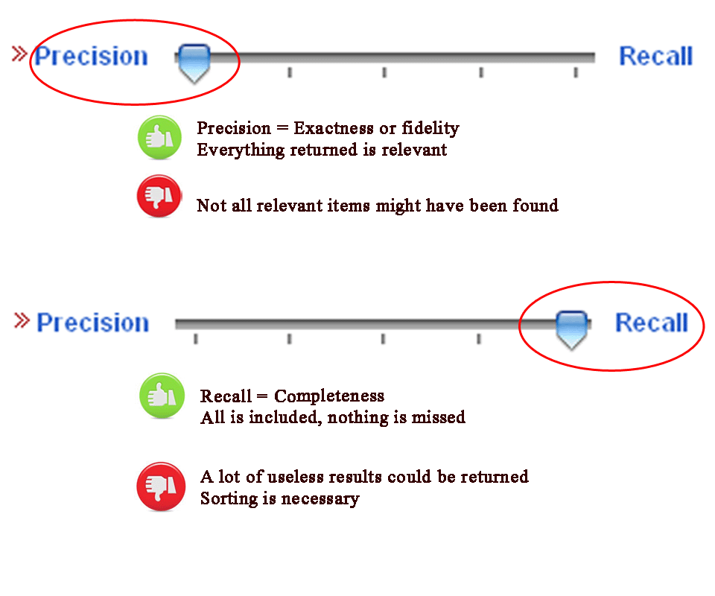
CLIR: precision vs recall

Slide 45
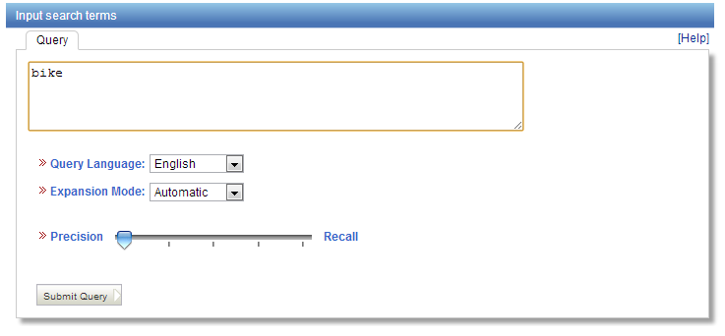
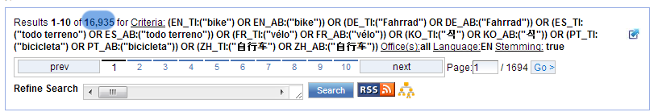
Example: precision

Slide 46
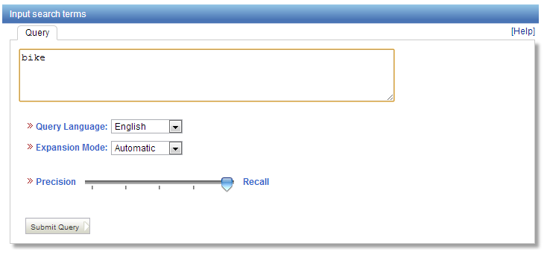
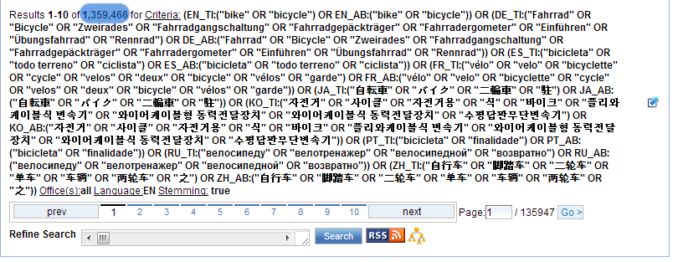
Example: recall

Slide 47
CLIR: supervised mode
2 modes: automatic and supervised
Automatic: 1 step
Supervised: 4 steps

Slide 48
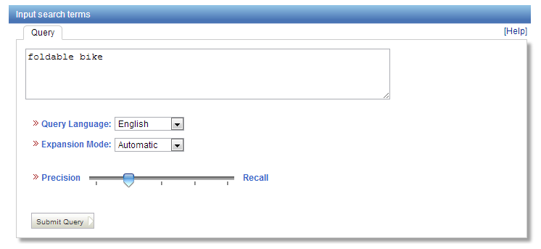
Automatic mode

Slide 49
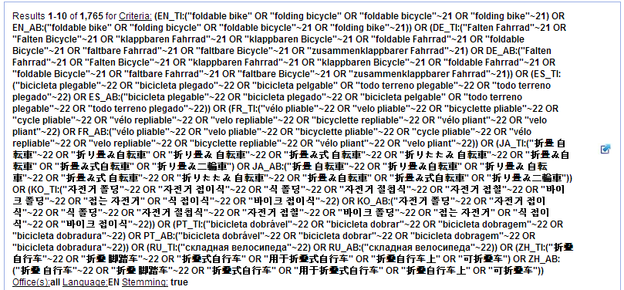
Automatic mode: results

Slide 50
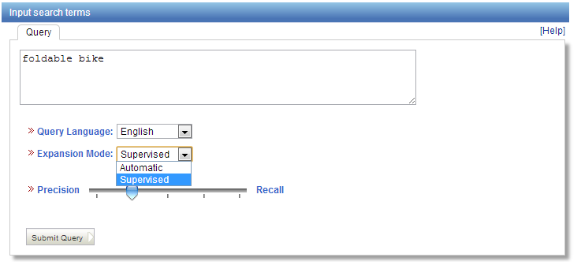
Supervised mode: 1 of 4 steps

Slide 51
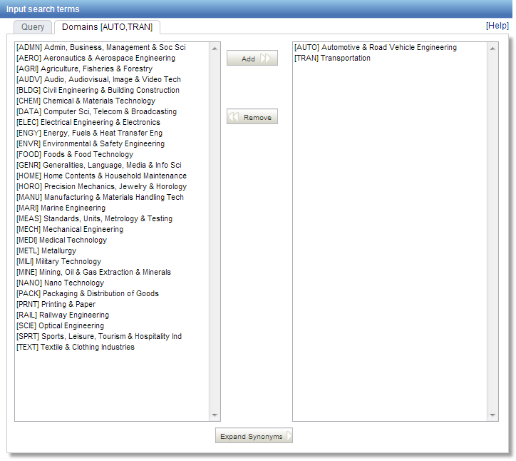
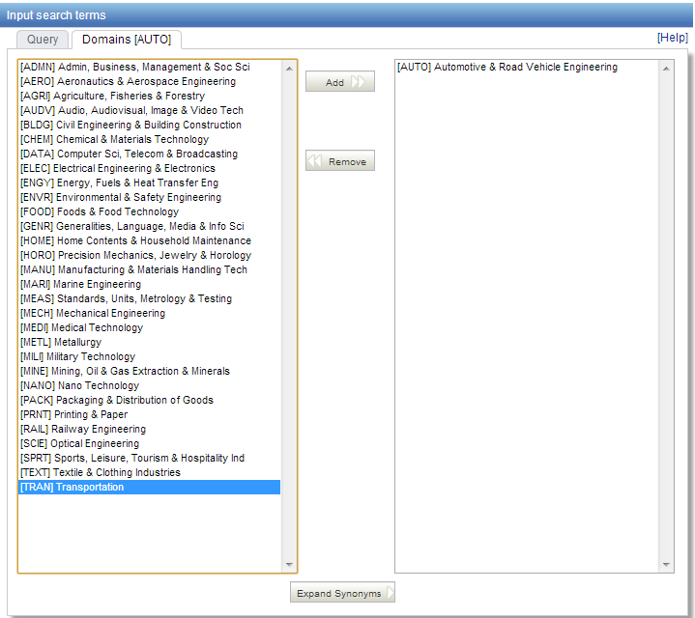
Supervised mode : 2 of 4 steps

Slide 52
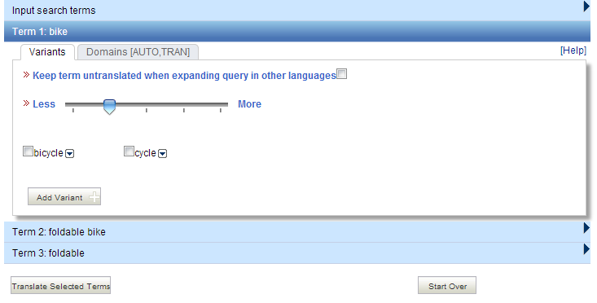
Supervised mode : 3 of 4 steps

Slide 53
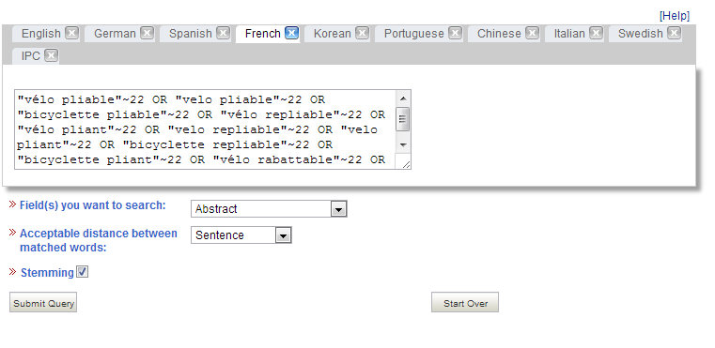
Supervised mode : 4 of 4 steps

Slide 54
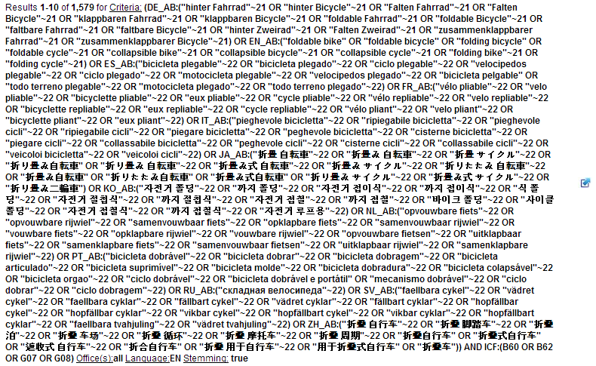
Supervised mode: results

Slide 55
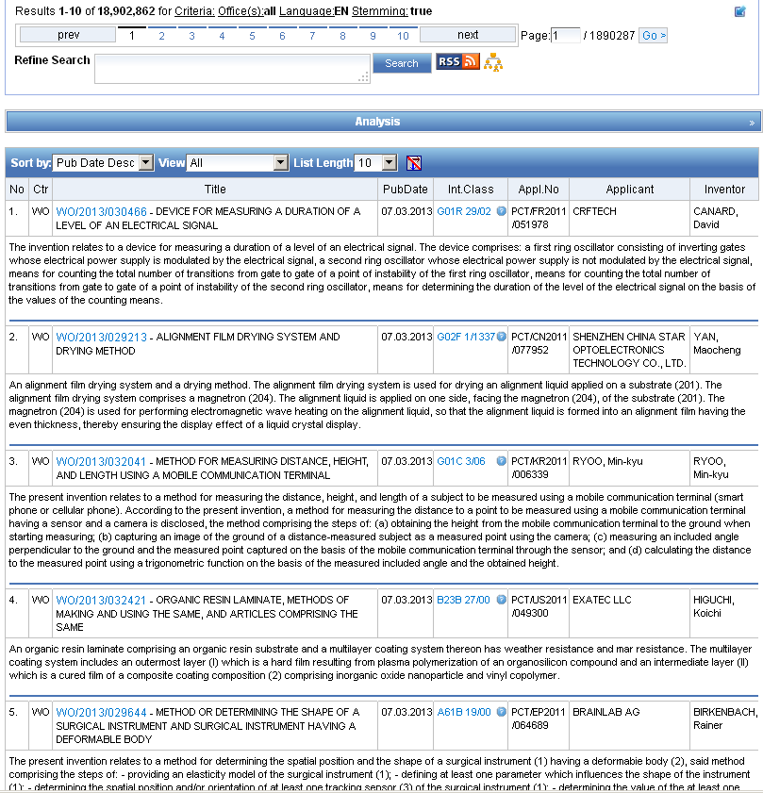
Reading the result list

Slide 56
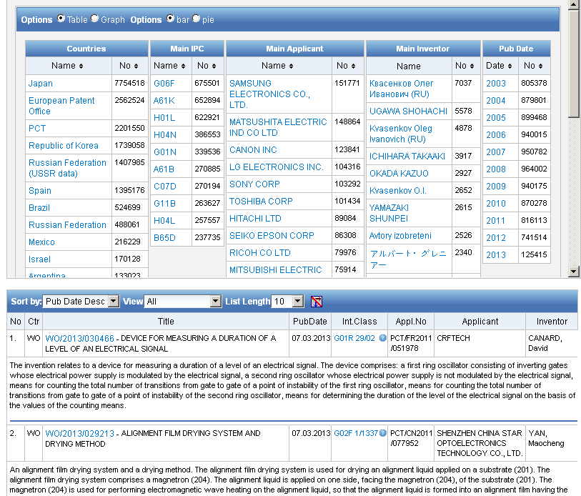
Analysis

Slide 57
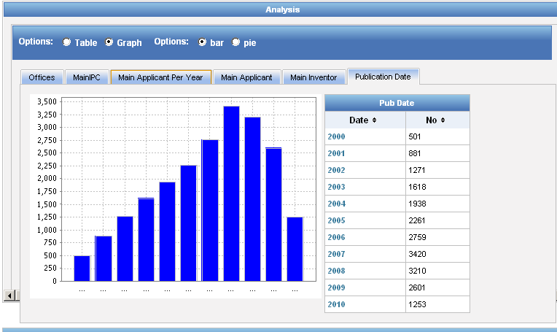
Display options: table/graph –bar/pie

Slide 58
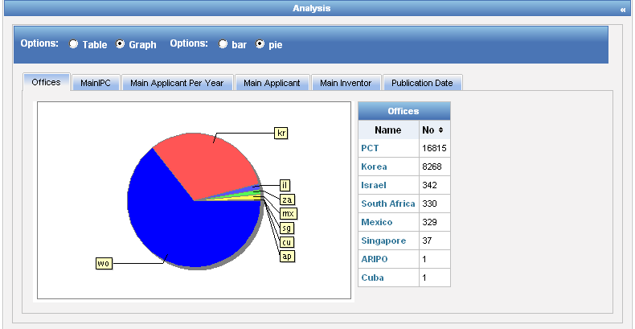
Display options: table/graph –bar/pie
Notes:
58
In both bar and pie options, the tabs allow you to see the information graphically for the Offices, Main IPC, Main Applicant, Main Inventor and Publication Date.
The charts can be saved in GIF format for inclusion in documents or reports by right-clicking in a corner of the image and selecting “Copy image” or “Save image”.

Slide 59



Options

Slide 60

Tabs

Slide 61




Documents tab

Slide 62

PDFs

Slide 63

Multilingual tools

Slide 64

Translation Assistant for Patent Titles and Abstracts (TAPTA)
Notes:
64
Language pairs available: EN=>FR, FR=>EN, EN=>ZH, ZH=>EN
Technical domain aware system using 32 domains derived from the International Patent Classification

Slide 65

32 Technical domains from the IPC
[ADMN] Admin, Business, Management & Soc Sci
[AERO] Aeronautics & Aerospace Engineering
[AGRI] Agriculture, Fisheries & Forestry
[AUDV] Audio, Audiovisual, Image & Video Tech
[AUTO] Automotive & Road Vehicle Engineering
[BLDG] Civil Engineering & Building Construction
[CHEM] Chemical & Materials Technology
[DATA] Computer Sci, Telecom & Broadcasting
[ELEC] Electrical Engineering & Electronics
[ENGY] Energy, Fuels & Heat Transfer Eng
[ENVR] Environmental & Safety Engineering
[FOOD] Foods & Food Technology
[GENR] Generalities, Language, Media & Info Sci
[HOME] Home Contents & Household Maintenance
[HORO] Precision Mechanics, Jewelry & Horology
[MANU] Manufacturing & Materials Handling Tech
[MARI] Marine Engineering
[MEAS] Standards, Units, Metrology & Testing
[MECH] Mechanical Engineering
[MEDI] Medical Technology
[METL] Metallurgy
[MILI] Military Technology
[MINE] Mining, Oil & Gas Extraction & Minerals
[NANO] Nano Technology
[PACK] Packaging & Distribution of Goods
[PRNT] Printing & Paper
[RAIL] Railway Engineering
[SCIE] Optical Engineering
[SPRT] Sports, Leisure, Tourism & Hospitality
[TEXT] Textile & Clothing Industries
[TRAN] Transportation

Slide 66

TAPTA: how does it work?

Slide 67


Slide 68


Slide 69

TAPTA: post-editing & exporting

Slide 70


Slide 71


Slides and recording
+
www.wipo.int/patentscope/en/webinar/index.html

Slide 72


patentscope@wipo.int

Slide 73


mulțumesc
mulțumesc

