Slide 1




Roving Seminar on WIPO Services and Initiatives
organized by the World Intellectual Property Organization (WIPO)
in cooperation with IP Australia
Melbourne, Australia - March 10, 2015
Sydney, Australia - March 11, 2015
Brisbane, Australia - March 13, 2015

Slide 2
Introduction to WIPO
Major Intellectual Property Economic Studies- WIPO SMEs Programs and Success Stories and Challenges in Australia
Speaker : Victor Vazquez Lopez, Head
Section for Coordination of Developed Countries

Slide 3
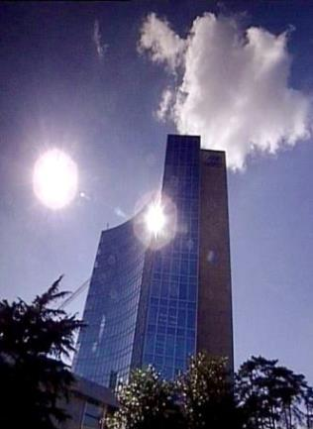
Facts about WIPO
MISSION: Our mission is to lead the development of a balanced and effective international intellectual property (IP) system that enables innovation and creativity for the benefit of all.
MEMBER STATES: 188
OBSERVERS: + 390
STAFF: 1240
ADMINISTERED TREATIES: 26
MAIN BODIES: GA, CC, WIPO CONFERENCE

Slide 4

Economic Development
Norm Setting
Services to Industry
Global Infrastructure

Slide 5



Norm Setting
Development of international IP law that is:
  balanced
  responsive
  effective
  Flexible
Strong connection of norm-setting to WIPO services.

Slide 6

Standing Committees and Other Fora
PATENTS (SCP)
COPYRIGHT & RELATED RIGHTS (SCCR)
TRADEMARKS, DESIGNS & GEOGRAPHICAL INDICATIONS (SCT)
AIM:
      Build consensus on topical issues
      Consider interests of stakeholders for a balanced, efficient, user-friendly, cost-effective system
      Issues discussed in other fora:
      Enforcement issues are discussed in the Advisory Committee on Enforcement
      Traditional knowledge (TK), traditional cultural expressions (TCEs) and genetic resources (GRs)

Slide 7

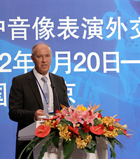
Beijing Treaty on Audiovisual Performances, 26 June 2012

Slide 8
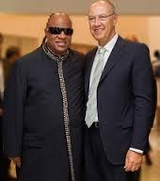
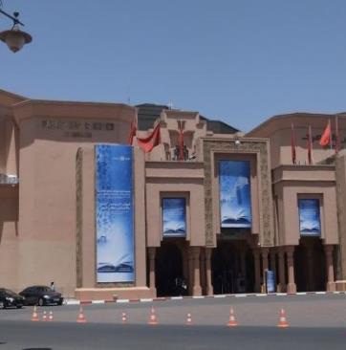
Marrakesh Treaty to Facilitate access to Published Works for Persons who are Blind, Visually Impaired or Otherwise Print Disabled

Slide 9
Other Normative Developments
GA September 2013 decided to convene a diplomatic conference for the adoption of a revised Lisbon Agreement on Appellations or Origins and Geographical Indications, to take place in Geneva from May 11 to 21, 2015.

Slide 10

WIPO HELPS YOU ACCESS INTERNATIONAL MARKETS

Slide 11
Provider of Premier Global IP Services
Core business areas:
  Patent Cooperation Treaty (Patents)
  Madrid System (Trademarks)
  Hague System (Industrial Designs)
  WIPO Arbitration and Mediation Center

Slide 12
Budget 2014 – 2015 : CHF 713.3 Million

Slide 13

Intellectual Property Infrastructure
“Just as participation in the physical economy requires access to roads, bridges, and vehicles to transport goods, similar infrastructure is needed in the virtual and knowledge economy…

Slide 14
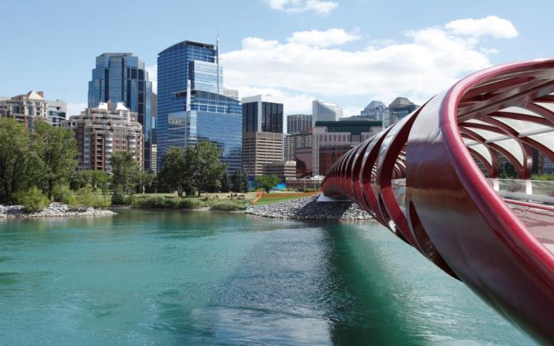
“…However, here the highway is the Internet and other networks, the bridges are interoperable data standards, and the vehicles are computers and databases.” Francis Gurry, Director General of WIPO

Slide 15
Global IP Infrastructure
  Databases
  Common platform for e-data exchange among IPOs
  Other platforms
  Tools
  Standards & technical agreements
  Capacity building & networking by Technology Innovation Support Centers (TISCs)

Slide 16




Major Economic Studies on IP
WIPO Unit – THE ECONOMICS AND STATISTICS DIVISION – Reflects the Growing Consensus on the importance of the Economic Dimension of IP.
The Division applies statistic and Economic analysis to the use of WIPO services.
This structure also improves WIPO economic insight on IP Development.

Slide 17
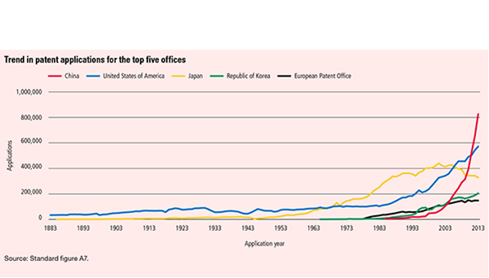
Demand for IP Rights has grown

Slide 18
Studies and Reports
World Intellectual Property Indicators (WIPI): This is our flagship IP statistics publication. It provides an overview of latest trend in IP filings and registrations covering more than 100 offices : http://www.wipo.int/ipstats/en/wipi/index.html
The PCT Yearly Review provides an overview of the performance and development of the PCT system. It includes a comprehensive set of statistics for the latest available year See: http://www.wipo.int/ipstats/en/statistics/pct/
Madrid Yearly Review: http://www.wipo.int/ipstats/en/
Hague Yearly Review: http://www.wipo.int/ipstats/en/
The WIPO IP Facts and Figures provides an overview of intellectual property (IP) activity based on the latest available year of statistics. It serves as a quick reference guide for statistics: http://www.wipo.int/ipstats/en/
WIPO IP Statistics Data Center is an on-line service enabling access to WIPO’s statistical data. Users can select from a wide range of indicators and view or download data according to their needs: http://ipstatsdb.wipo.org/ipstatv2/ipstats/patentsSearch

Slide 19

Studies and Reports
World Intellectual Property Report 2013 Brands – Reputation and Image in the Global Marketplace The report looks at how branding behavior and trademark use have evolved in recent history, how they differ across countries, what is behind markets for brands, what lessons economic research holds for trademark policy and how branding strategies influence companies’ innovation activities
For further information and the full report :
http://www.wipo.int/econ_stat/en/economics/wipr

Slide 20
WIPO’s SMEs Initiative
Promote a more active and effective use of the intellectual property system by SMEs
Strengthen the capacity of national governments to develop strategies, policies and programs to meet the intellectual property needs of SMEs
Improve the capacity of relevant public, private and civil society institutions, such as business and industry associations, to provide
IP-related to SMEs
Provide comprehensive web-based information and basic advice on IP issues to SME support institutions worldwide.

Slide 21
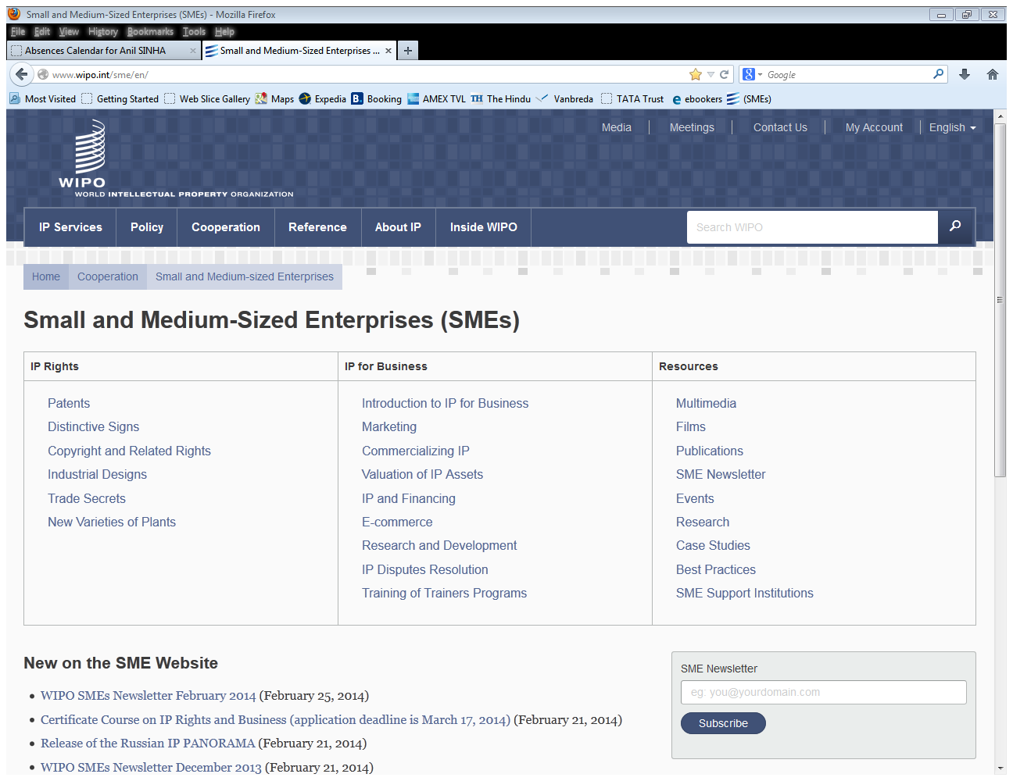

Slide 22
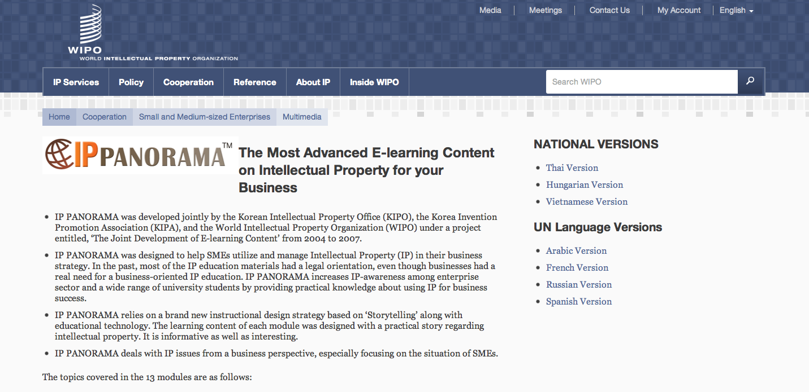
http://www.wipo.int/sme/en/multimedia/

Slide 23

Australia Profile
12-09-13 © alexskopje
istockphotos/Aidas85

Slide 24
The Global Innovation Index
RANKING 2013
RANKING 2014
1. SWITZERLAND
2. SWEDEN
3. UNITED KINGDOM
4. NETHERLANDS
5. UNITED STATES OF AMERICA
6. FINLAND
7. HONG KONG (CHINA)
8. SINGAPORE
9. DENMARK
10. IRELAND
11. CANADA
12. LUXEMBOURG
13. ICELAND
14. ISRAEL
15. GERMANY
…………..
19. AUSTRALIA
1. SWITZERLAND
2. UNITED KINGDOM
3. SWEDEN
4. FINLAND
5. NETHERLANDS
6. UNITED STATES OF AMERICA
7. SINGAPORE
8. DENMARK
9. LUXEMBOURG
10. HONG KONG (CHINA)
11. IRELAND
12. CANADA
13. GERMANY
14. NORWAY
15. ISRAEL
16. KOREA, REPUBLIC OF
17. AUSTRALIA

Slide 25
Australia : Success Stories and Challenges
  Australia is ranked 17th in the 2014 Global Innovation Index, up two positions from 19th in 2013
  Australia ranks better on the Innovation Input Sub-index (10th) than in the Output Sub-index (22d).
  Input Sub-index: It enjoys top 10 rankings on three pillars: Human capital and research (7th), Infrastructure (7th), and Market sophistication (10th). Its strengths are in the Tertiary education (7th), Research and development (8th), ICTs (9th), General infrastructure (9th), and Trade and competition (1st) sub-pillars.

Slide 26
Australia : Success Stories and Challenges
  Output sub-index: Australia scores better in the Creative output sub-pillar (12th) than the Knowledge & Technology outputs sub-pillar (31st).
  The results within the Creative goods and services sub-pillar are mixed, with two strengths and two weaknesses. Australia’s weak variables include cultural and creative services exports (52nd) and national feature films produced (49th); the country’s strengths include global entertainment and media output (3rd) as well as printing and publishing output (5th).
  High scores in the knowledge & Technology outputs include New Business (8th) and scientific and technical articles (12th). Opportunities for growth are found in High and Medium-high Tech Manufacturing and Communications, Computer and information Services exports.

Slide 27
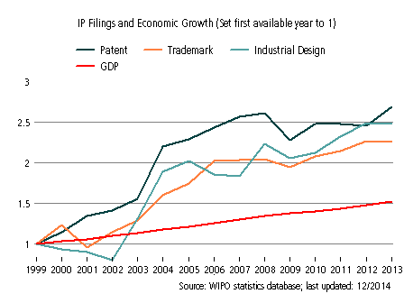
Australia ’s evolution with respect to IP filings and Economic Growth from 1998 to 2012
Filings for trademarks have increased strongly since 1998 despite slow-downs in the period around 2008. This growth has greatly outpaced corresponding growth in GDP.
Growth in industrial designs filings has been strong despite slow-down in the period around 2009.
Filings for patent have grown more slowly since 2007, but maintain a good level of activity with a noticeable uptick seen in 2013.
Notes:
GDP : GROSS DOMESTIC PRODUCT

Slide 28
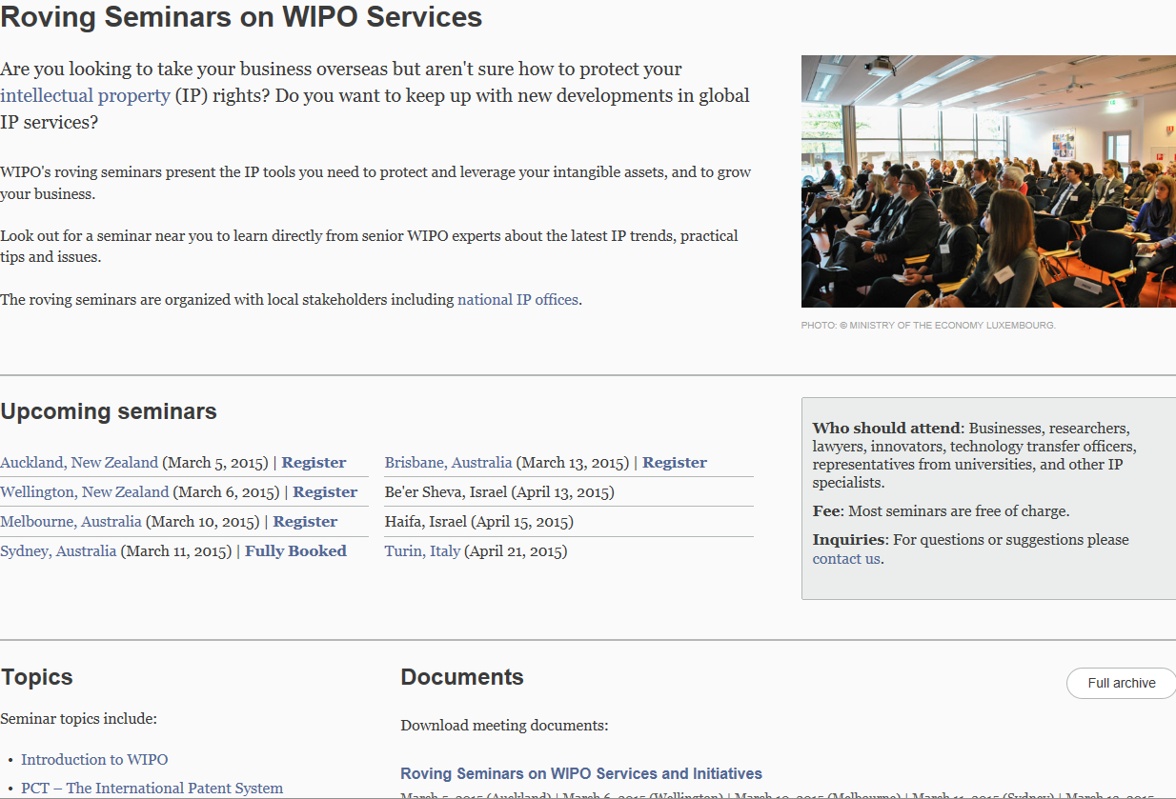
Further Information: http://www.wipo.int/dcea/en/roving_seminars/

Slide 29


The Patent Cooperation Treaty (PCT) and its advantages for business
Speaker: Christine Bonvallet, Senior Legal Officer,
PCT Legal Division

Slide 30
Seeking patents multinationally: Traditional patent system (“Paris Route”) vs. PCT system
(months)
File
applications
abroad
0
12
Traditional
File local
application
176 States
Enter
national
phase
(months)
International
publication
PCT
0
12
16
18
22
28
30
File local
application
File PCT
application
International
search report & written opinion
(optional)
demand for International
preliminary
examination
(optional)
International
preliminary report on patentability
148 States

Slide 31
Using the traditional patent system to seek multinational patent protection
(months)
0
12
File
applications
abroad
File
application
locally
Local patent application followed within 12 months by multiple foreign applications claiming priority under Paris Convention:
  - multiple formality requirements
  - multiple searches
  - multiple publications
  - multiple examinations and prosecutions of applications
  - translations and national fees required at 12 months
Some rationalization because of regional arrangements:
  ARIPO, EAPO, EPO, OAPI

Slide 32
The PCT System
--typical use, in more detail
(optional)
Supplementary international
search report
International
publication
(months)
0
12
16
18
19
22
28
30
File local
application
File PCT
application
International
search report & written opinion
(optional)
demand for International
preliminary
examination
(optional)
International
preliminary report on patentability
(optional)
Request for supplementary international
search

Slide 33
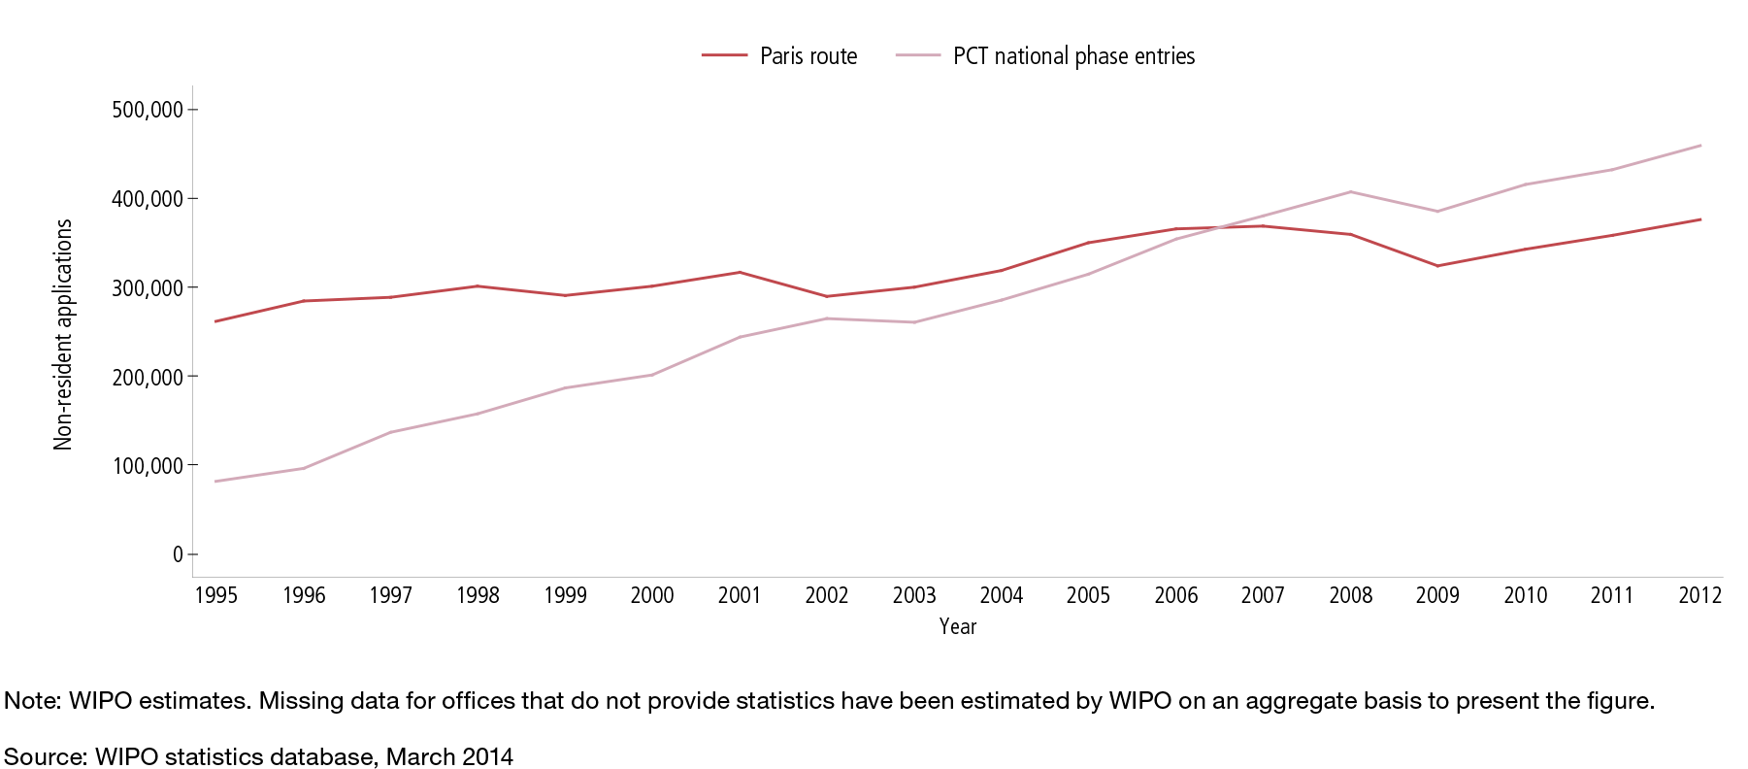

Paris route vs. PCT national phase
*

Slide 34
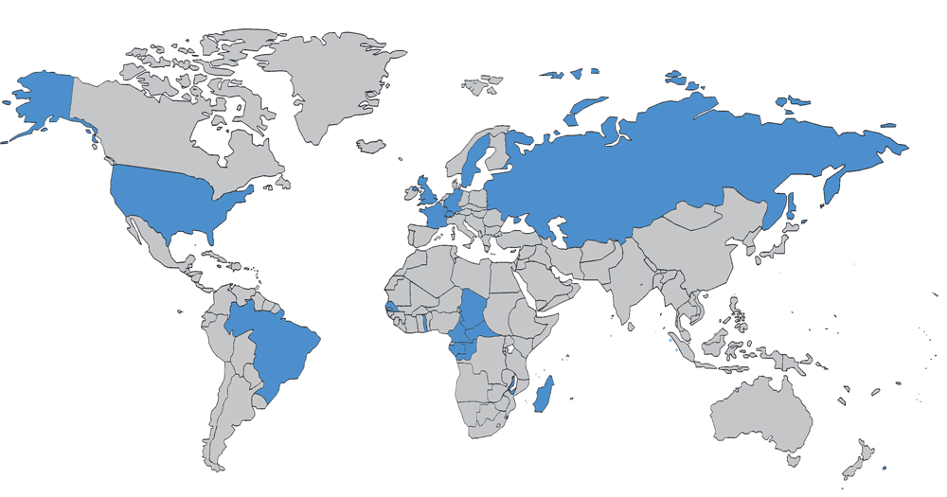
PCT in 1978: 18 Contracting States

Slide 35
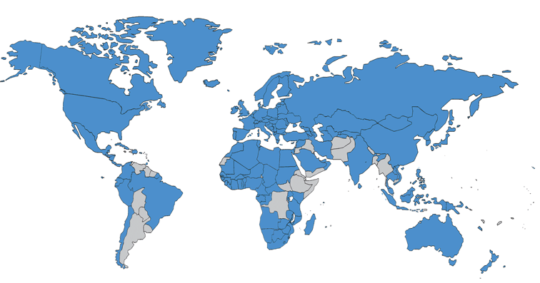
PCT Coverage Today:
148 Contracting States (1)

Slide 36
148 PCT Contracting States (2)
Albania
Algeria
Angola
Antigua and Barbuda
Armenia
Australia
Austria
Azerbaijan
Bahrain
Barbados
Belarus
Belgium
Belize
Benin
Bosnia and Herzegovina
Botswana
Brazil
Brunei Darussalam
Bulgaria
Burkina Faso
Cameroon
Canada
Central African Republic
Chad
Chile
China
Colombia
Comoros
Congo
Costa Rica
Côte d'Ivoire
Croatia
Cuba
Cyprus
Czech Republic
Democratic People's
Republic of Korea
Denmark
Dominica
Dominican Republic
Ecuador
Egypt
El Salvador
Equatorial Guinea
Estonia
Finland
France
Gabon
Gambia
Georgia
Germany
Ghana
Greece
Grenada
Guatemala
Guinea
Guinea-Bissau
Honduras
Hungary
Iceland
India
Indonesia
Iran
Ireland
Israel
Italy
Japan
Kazakhstan
Kenya
Kyrgyzstan
Lao People’s Dem Rep.
Latvia
Lesotho
Liberia
Libya
Liechtenstein
Lithuania
Luxembourg
Madagascar
Malawi
Malaysia
Mali
Malta
Mauritania
Mexico
Monaco
Mongolia
Montenegro
Morocco
Mozambique
Namibia
Netherlands
New Zealand
Nicaragua
Niger
Nigeria
Norway
Oman
Panama
Papua New Guinea
Peru
Philippines
Poland
Portugal
Qatar
Republic of Korea
Republic of Moldova
Romania
Rwanda
Russian Federation
Saint Kitts and Nevis
Saint Lucia
Saint Vincent and
the Grenadines
San Marino
Sao Tomé e Principe
Saudi Arabia
Senegal
Serbia
Seychelles
Sierra Leone
Singapore
Slovakia
Slovenia
South Africa
Spain
Sri Lanka
Sudan
Swaziland
Sweden
Switzerland
Syrian Arab Republic
Tajikistan
Thailand
The former Yugoslav
Republic of Macedonia
Togo
Trinidad and Tobago
Tunisia
Turkey
Turkmenistan
Uganda
Ukraine
United Arab Emirates
United Kingdom
  United Republic of Tanzania
  United States of America
Uzbekistan
Viet Nam
Zambia
Zimbabwe

Slide 37
Countries not yet in PCT
Afghanistan
Andorra
Argentina
Bahamas
Bangladesh
Bhutan
Bolivia
Burundi
Cambodia*
Cape Verde
Democratic Republic of Congo
Djibouti
Eritrea
Ethiopia
Fiji
Guyana
Haiti
Iraq
Jamaica
Jordan
Kiribati
Kuwait
Lebanon
Maldives
Marshall Islands
Mauritius
Micronesia
Myanmar*
Nauru
Nepal
Pakistan
Palau
Paraguay
Samoa
Solomon Islands
Somalia
South Sudan
Suriname
Timor-Leste
Tonga
Tuvalu
Uruguay
Vanuatu
Venezuela
Yemen
(45)
*required under ASEAN IPR action plan to join PCT by 2015

Slide 38
PCT Applications
2013: 205,300 PCT applications (+5.1%)
WIPO Chief Economist predicting +6% for 2014

Slide 39
International applications received in 2013 by country of origin
CN: +15.6%
US: +10.8%
SE: +10.4%
Together, these 15 Offices received almost 96% of all applications filed in 2013
PCT fees=73.2% of WIPO’s revenue in 2013

Slide 40
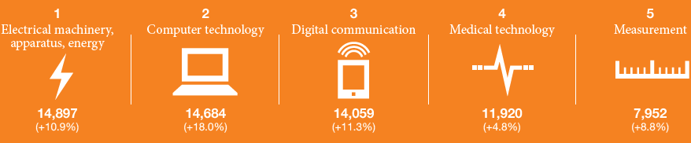
Main PCT technology fields: 2013

Slide 41
PCT use in AU
Joined PCT effective March 31, 1980
1,610 PCT applications filed by AU applicants in 2014 with RO/AU

Slide 42
The PCT… and business
Most businesses worldwide which seek and use patents wish to:
  Control costs while preserving options
  Make informed business decisions
  Use the best tools available when seeking protection
The PCT responds to these objectives

Slide 43
Certain PCT Advantages
The PCT, as the cornerstone of the international patent system, provides a worldwide system for simplified filing and processing of patent applications, which—
  1. postpones the major costs associated with internationalizing a patent application

Slide 44
Traditional patent system
vs. PCT system
Fees for:
--Translations
--Office fees
--Local agents
(months)
0
12
File
applications
abroad
Fees for:
--Translations
--Office fees
--Local agents
Traditional
File local
application
Enter
national
phase
(months)
International
publication
PCT
0
12
16
18
22
28
30
File local
application
File PCT
application
International
search report & written opinion
(optional)
demand for International
preliminary
examination
(optional)
International
preliminary report on patentability

Slide 45
Certain PCT Advantages
The PCT, as the cornerstone of the international patent system, provides a worldwide system for simplified filing and processing of patent applications, which—
  1. postpones the major costs associated with internationalizing a patent application
  2. provides a strong basis for patenting decisions

Slide 46
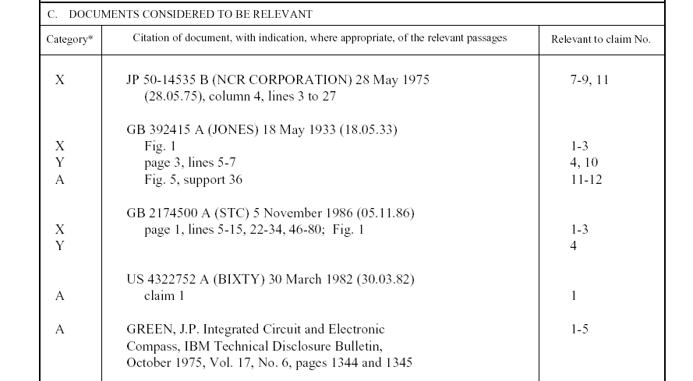
Example: PCT International Search Report
Symbols indicating
which aspect of patentability
the document cited is
relevant to (for example, novelty, inventive step, etc.)
The claim numbers
in your application to
which the document is
relevant
Documents relevant to whether or not your invention may be patentable

Slide 47
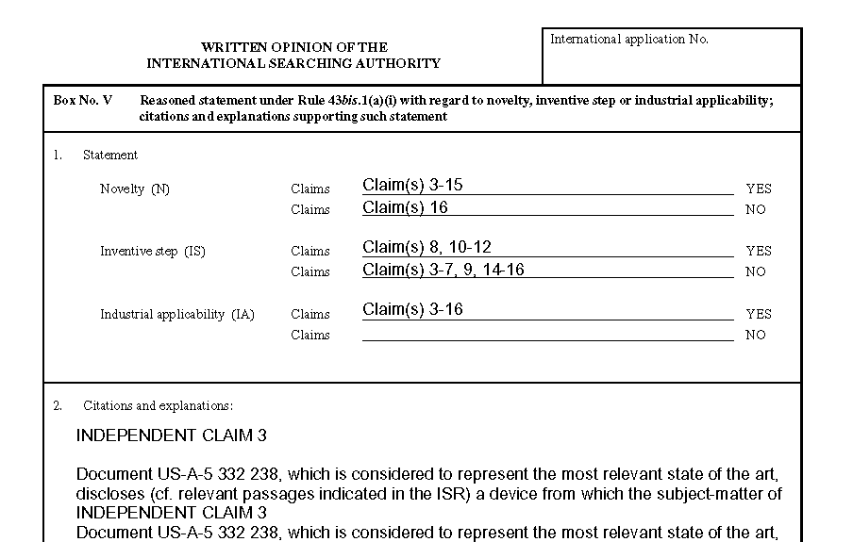
Example: PCT Written opinion of the International Searching Authority
Patentability assessment
of claims
Reasoning supporting the assessment

Slide 48
International Searching Authorities
(20 in total, 18 in operation)
AU – Australia
AT – Austria
BR – Brazil
CA – Canada
CL – Chile
CN – China
EG – Egypt
ES – Spain
FI – Finland
IN – India
IL – Israel
JP – Japan
KR – Republic of Korea
RU – Russian Federation
SE – Sweden
SG – Singapore (appointed in 2014)
UA – Ukraine (appointed in 2013)
US – United States of America
EP – European Patent Office
XN – Nordic Patent Institute (Denmark, Iceland, Norway)
* Office of filing (Receiving Office) decides on which ISAs is/are available

Slide 49
ROs/ISAs for AU applicants
Competent Receiving Offices:
  RO/AU (IP Australia)
  RO/IB
Competent ISAs:
  IP Australia (ISA/AU)
  Korean IP Office (ISA/KR)
Notes:
49

Slide 50
Certain PCT Advantages
The PCT, as the cornerstone of the international patent system, provides a worldwide system for simplified filing and processing of patent applications, which—
  1. postpones the major costs associated with internationalizing a patent application
  2. provides a strong basis for patenting decisions
  3. harmonizes formal requirements

Slide 51
Harmonization of formal requirements
Only one application filed, containing, by default, the designation of all States (for all types of protection available)
Has the effect of a regular national filing in each designated State: the international filing date is the filing date in each designated State
PCT Article 27(1): “No national law shall require compliance with requirements relating to the form or contents of the international application different from or additional to those which are provided for in this Treaty and Regulations.”
PCT Applicant’s Guide, paragraph 4.011: “There is a prescribed form for the international application. This form must be accepted by all designated Offices for the purposes of the national phase, so that there is no need to comply with a great variety of widely differing formal requirements in the many countries in which protection may be sought.”

Slide 52
Certain PCT Advantages
The PCT, as the cornerstone of the international patent system, provides a worldwide system for simplified filing and processing of patent applications, which—
  1. postpones the major costs associated with internationalizing a patent application
  2. provides a strong basis for patenting decisions
  3. harmonizes formal requirements
  4. protects applicant from certain inadvertent errors

Slide 53
Protection from inadvertent errors
Invited corrections of defects & fee payments
Non-competent receiving Office
Double formality review
Restoration of the right of priority
Missing parts/incorporation by reference
Rectification of obvious mistakes
Excuse of national phase entry delay

Slide 54
Certain PCT Advantages
The PCT, as the cornerstone of the international patent system, provides a worldwide system for simplified filing and processing of patent applications, which—
  1. postpones the major costs associated with internationalizing a patent application
  2. provides a strong basis for patenting decisions
  3. harmonizes formal requirements
  4. protects applicant from certain inadvertent errors
  5. is used by the world’s major corporations, universities and research institutions when they seek multinational patent protection

Slide 55
Distribution of PCT Applicants in 2013
Top Applicants
Businesses: Panasonic Corporation JP – 2,839 applications published
Universities: University of California US – 398 applications published
Government and Research Institutions – Commissariat à l’Energie
Atomique et aux Energies Alternatives FR – 419 applications published

Slide 56
Top 20 PCT Applicants 2013
Panasonic—JP (2,839)
ZTE—CN (2,309)
Huawei—CN (2,110)
Qualcomm—US (2,050)
Intel—US (1,871)
Sharp—JP (1,839)
Bosch—DE (1,809)
Toyota—JP (1,698)
Ericsson—SE (1,468)
Philips—NL (1,423)
Siemens—DE (1,348)
Mitsubishi Electric—JP (1,313)
Samsung Electronics—KR (1,198)
NEC—JP (1,189)
LG Electronics—KR (1,178)
Fujifilm Corporation—JP (1,003)
Sony—JP (916)
17. Shenzhen China Star Optoelectronics—CN (916)
19. Hitachi—JP (855)
20. Nokia—FI (808)
() of published PCT applications

Slide 57
Top 20 PCT University Applicants 2013
University of California (US) (398)
MIT (US) (219)
Columbia University (US) (133)
Harvard University (US) (121)
University of Texas (US) (119)
Johns Hopkins (US) (116)
Korea Advanced Institute of Science and Technology (KR) (104)
Leland Stanford University (US) (101)
Cornell University (US) (95)
Cal Tech (US) (91)
University of Florida (US) (89)
Postech Foundation (KR) (83)
Seoul National University (KR) (80)
Peking University (CN) (77)
University of Tokyo (JP) (76)
15. Isis Innovation Limited (UK) (76)
17. Nanyang Technological University (SG) (75)
18. University of Pennsylvania (US) (72)
19. University of Michigan (US) (71)
20. National University of Singapore (SG) (69)

Slide 58
Certain PCT Advantages
The PCT, as the cornerstone of the international patent system, provides a worldwide system for simplified filing and processing of patent applications, which—
  1. postpones the major costs associated with internationalizing a patent application
  2. provides a strong basis for patenting decisions
  3. harmonizes formal requirements
  4. protects applicant from certain inadvertent errors
  5. is used by the world’s major corporations, universities and research institutions when they seek multinational patent protection
  6. can result (if PCT reports are positive) in accelerated national phase processing (PCT-PPH)
  7. evolves to meet user needs

Slide 59
Meeting Users’ business needs
Licensing availability: feature introduced in January 2012
  Goal: flagging willingness of applicants to conclude license agreements
Third Party Observations: Allows third parties to submit prior art observations relevant to novelty and inventive step as to published PCT applications
  Goal: Improve patent quality--give national offices (and PCT Authorities) better/more complete information on which to base their decisions
  ePCT: https://pct.wipo.int/ePCT
  WIPO online service that provides secure electronic access to/interaction with IB’s PCT application files by applicants/agents
  Web-based electronic filing of new PCT applications: 15 ROs accepting ePCT filings (including NZ and AU)

Slide 60
Recent Developments & Services
PCT and PPH: accelerated national prosecution based on positive “PCT work products” of PCT International Authority (written opinion of the ISA or the IPEA, IPRP II))
  MANY individual PCT-PPH pathways:
  http://www.wipo.int/pct/en/filing/pct_pph.html
  PCT-PPH user experience/strategy: http://www.youtube.com/watch?v=XnSShsUHXss (Carl Oppedahl video)
New ISAs/IPEAs: ISA/UA & ISA/SG
PCT Brief
PATENTSCOPE
WIPO Pearl: WIPO’s multilingual terminology portal
Arbitration and Mediation Center: Fee Reductions for PCT Users

Slide 61
PCT training options
29 PCT training videos on WIPO’s Youtube channel and WIPO’s PCT page
PCT distance learning course content available in the 10 PCT publication languages
PCT webinars
  providing free updates on developments in PCT procedures, and PCT strategies—previous webinars are archived and freely available
  upon request also for companies or law firms, for example, for focused training on how to use ePCT
In-person PCT seminars and training sessions
Advanced PCT Seminar on WIPO premises (in Fall)

Slide 62
PCT Resources/Information
For further information about the PCT, see
http://www.wipo.int/pct/en/
For general questions about the PCT, contact the PCT Information Service at:
      Telephone: (+41-22) 338 83 38
      Facsimile: (+41-22) 338 83 39
      E-mail: pct.infoline@wipo.int

Slide 63

Global Databases for Intellectual Property Platforms and Tools for the Connected Knowledge Economy Australia
Speaker: Yo Takagi, Assistant Director General, Global Infrastructure Sector

Slide 64
Benefits to Stakeholders
For Innovators/IP Professionals/Business/Research:
  IP intelligence
    Is it worthwhile to protect my innovation? Is there any similar brand? Who are potential competitors?
  Partnering
    Who may be interested in my innovation? Who can provide me with a chance to produce/market new things as a partner?
For IP Offices:
  Providing digital workflow and online environment
    Efficiency and timeliness with quality service

Slide 65
Global Databases, Tools, and Platforms for IP Business (free)
PATENTSCOPE
Global Brand Database
Global Design Database
WIPO Lex
WIPO IPAS, WIPO DAS
WIPO CASE
WIPO GREEN, WIPO Re:Search

Slide 66
Background: Patent Information
More patent applications (& families) are filed in multiple countries
More non-resident applications are filed
More foreign applications filed in Asian languages (Chinese, Korean and Japanese)
Prior art search needs to cover global patent data
PCT (international publications) accounts for more than 50% of non-resident applications
Notes:
When SIPO data are excluded from the world totals data, the non-resident share has been increasing since the mid-1990’s to reach 42.3% in 2012.

Slide 67
Patentscope
2.6 million PCT data (first publish every week, high quality full text)
43 million records from 41 countries or regions
Full text data
Analyze results by graphs and charts
Search and read in your language
How to use it?

Slide 68
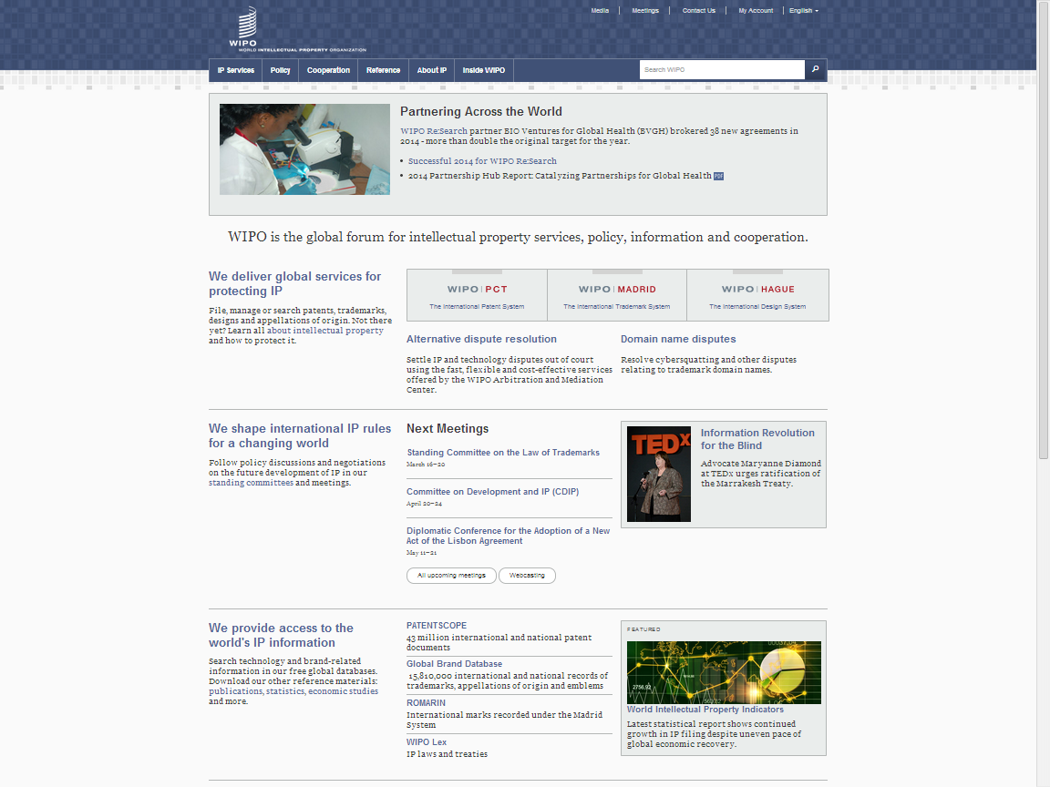
www.wipo.int

Slide 69
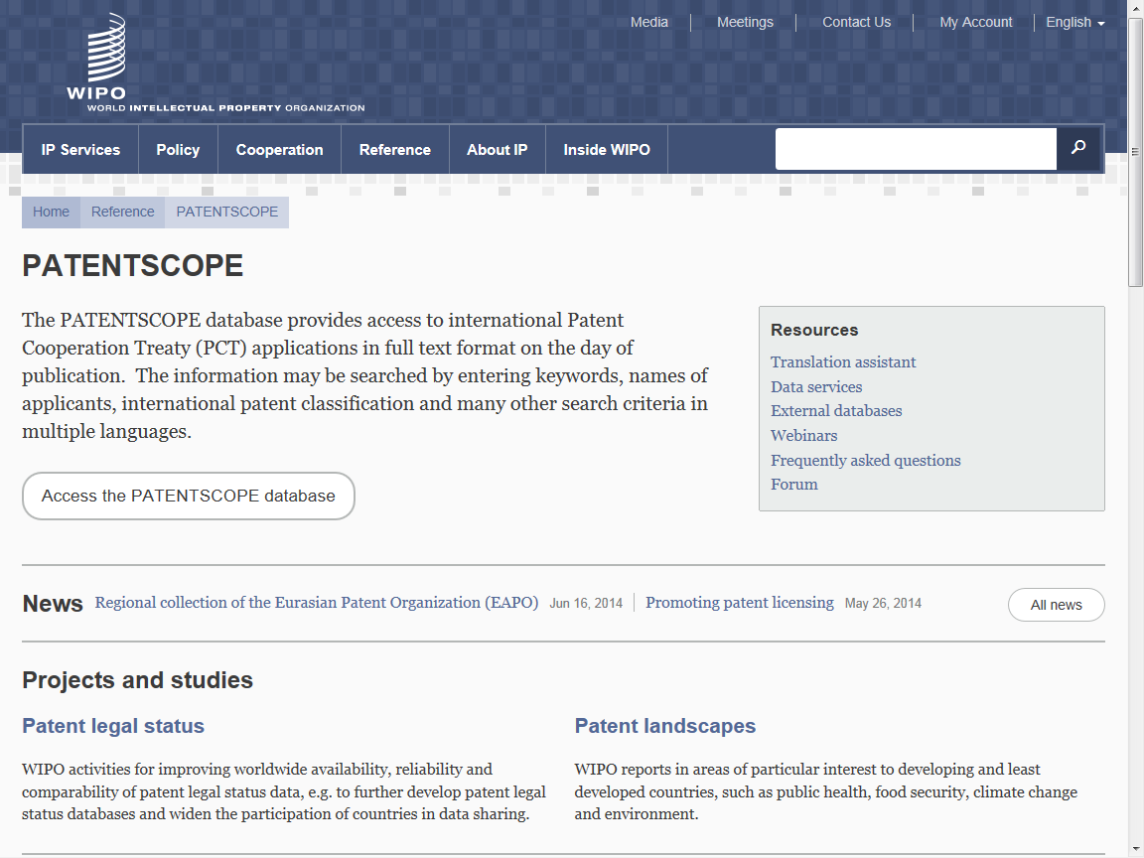

Slide 70
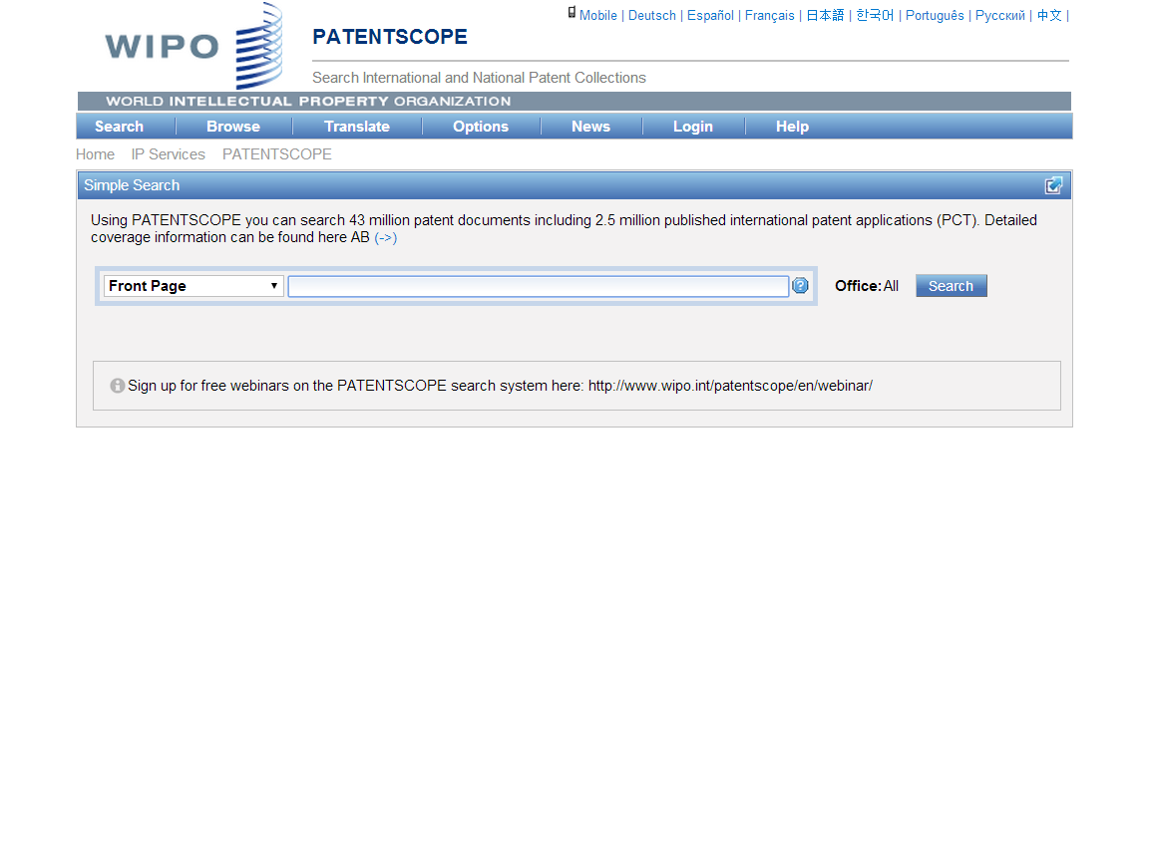

Slide 71
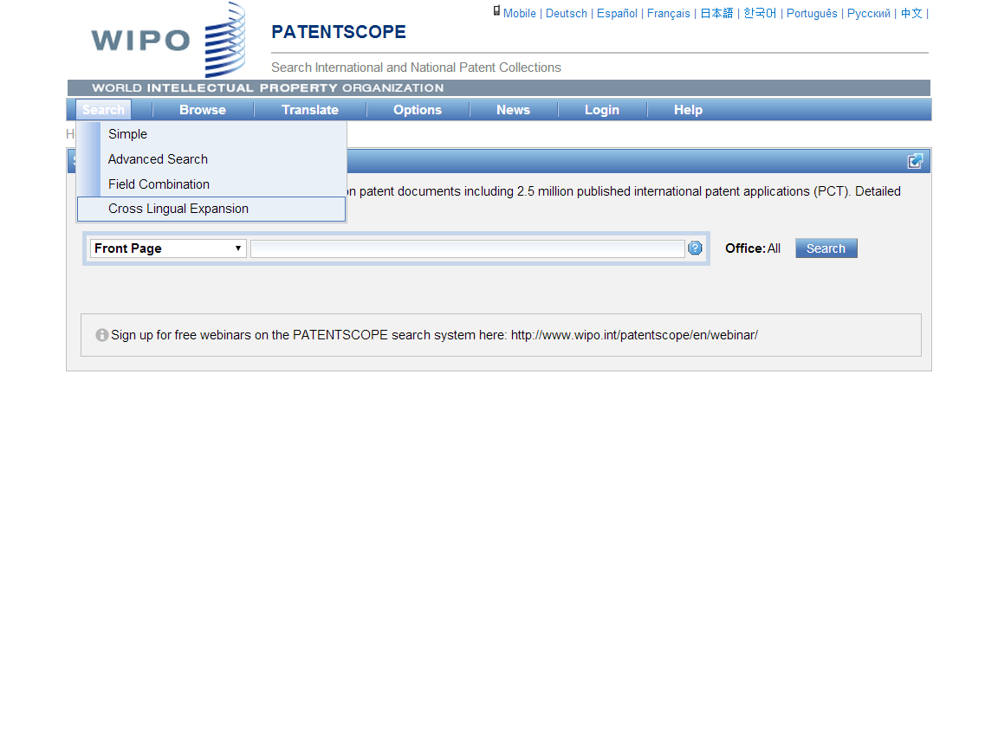
If you want to search prior art in PATENTSCOPE by key words in multiple languages, go to “Cross Lingual Expansion”

Slide 72
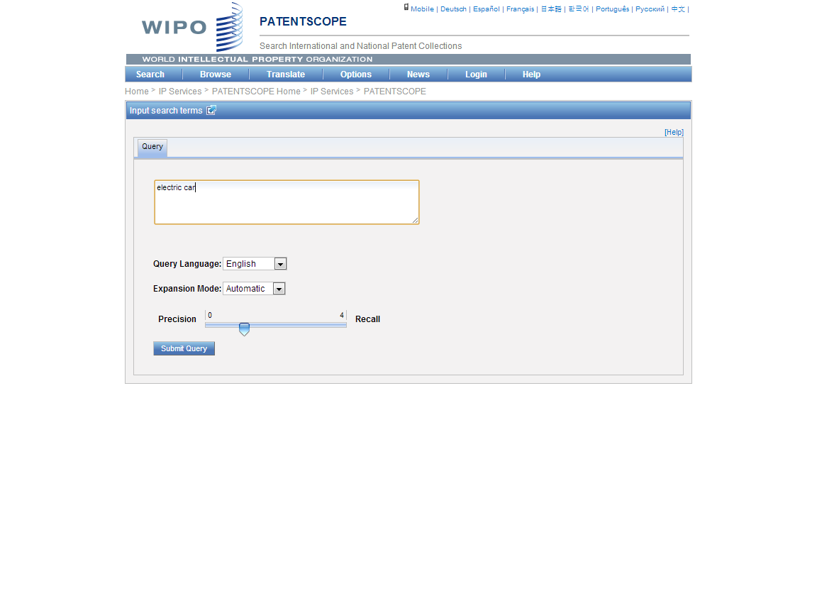
TIP: Use a key term in English. Why?
TIP; Search words – in English (best for Machine translation)

Slide 73
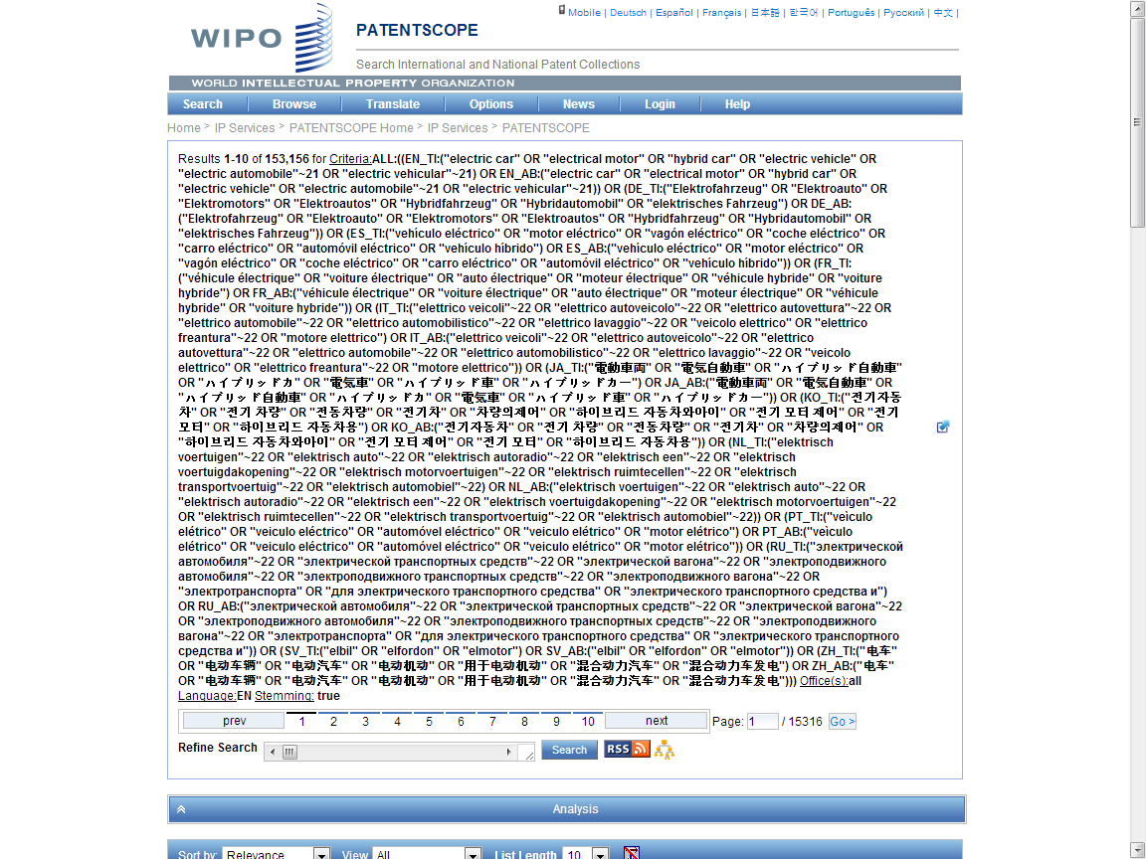
130k to 153k; 20% plus
Search Query
(synonyms & technologically related terms)

Slide 74
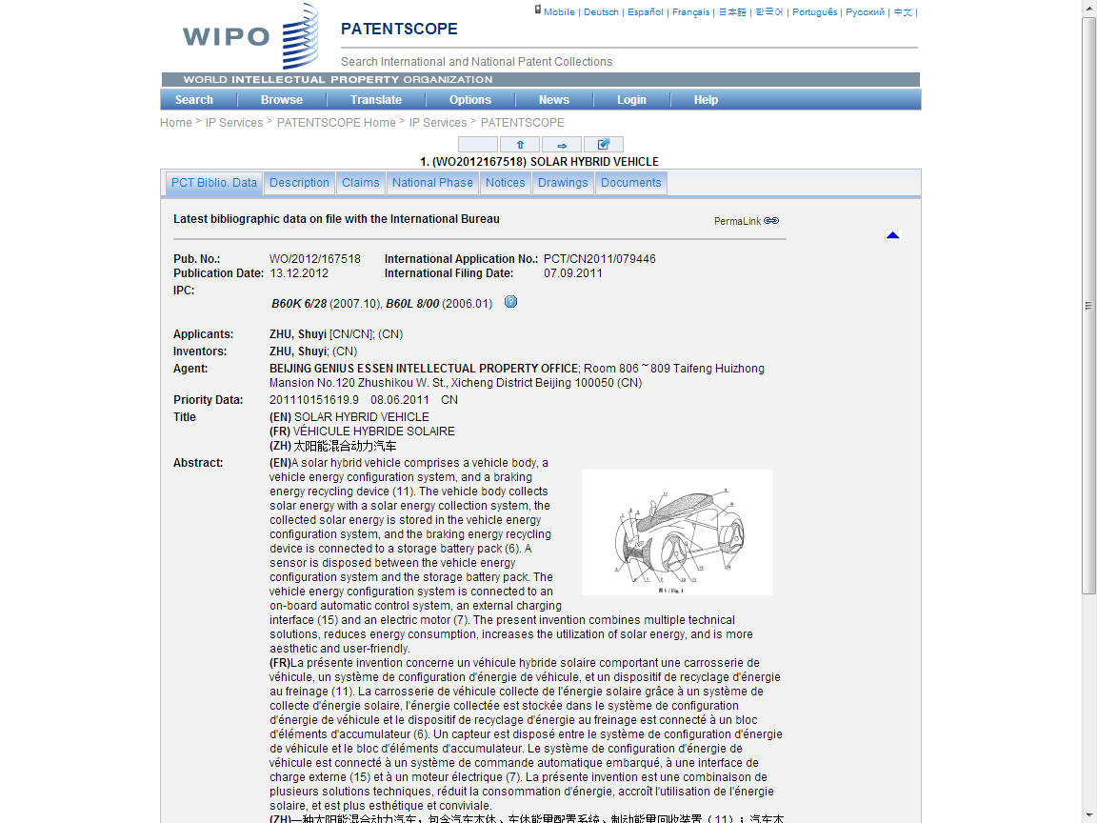

Slide 75
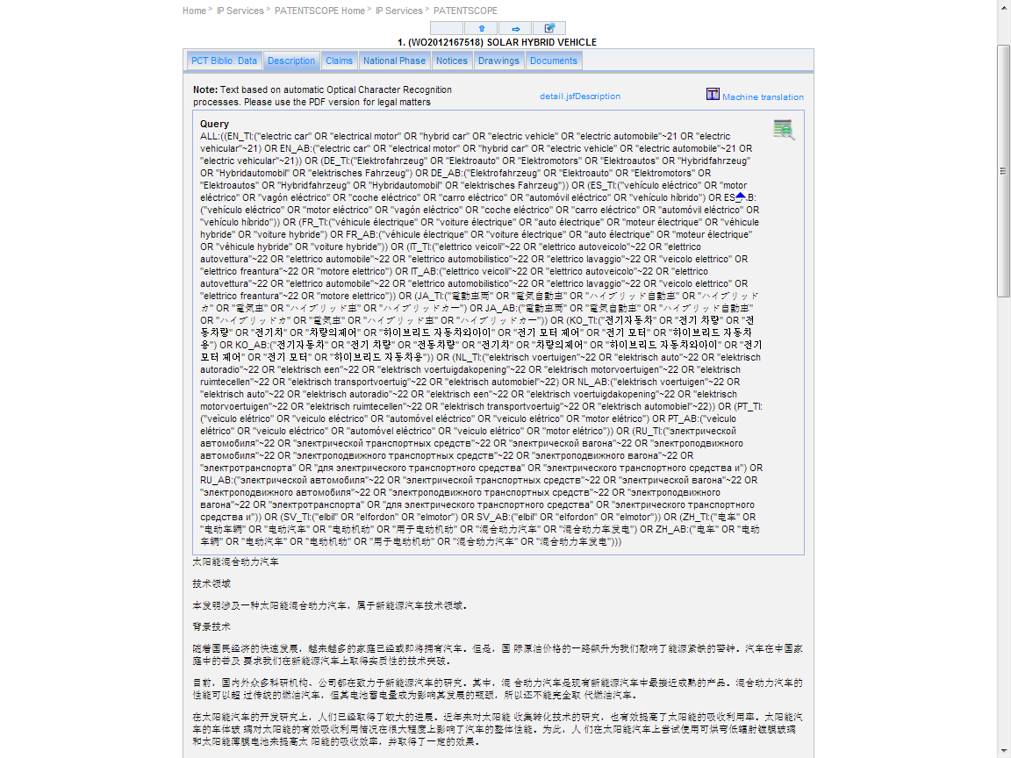

Slide 76
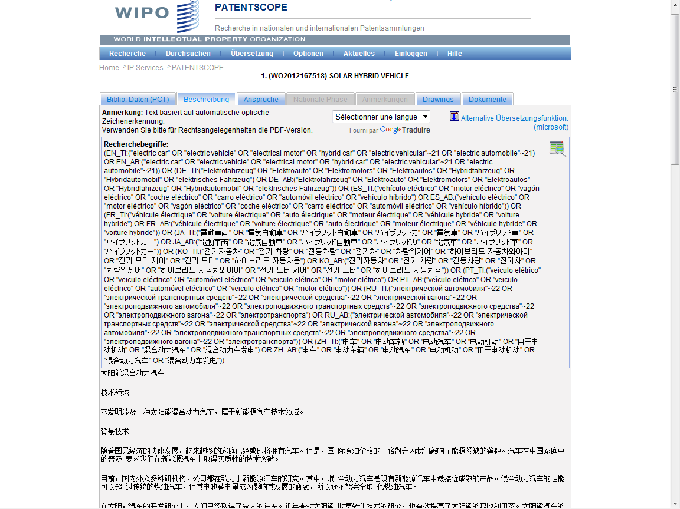

Slide 77
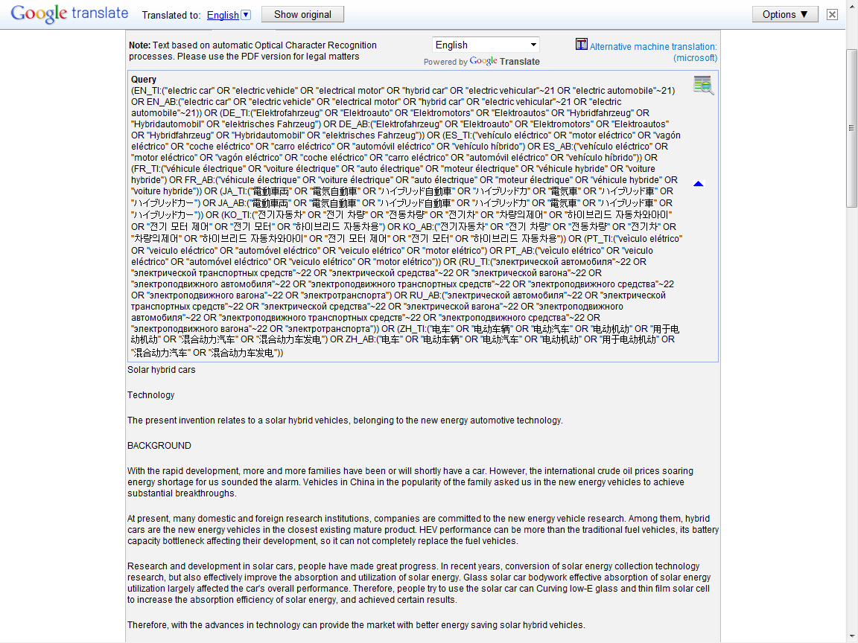

Slide 78
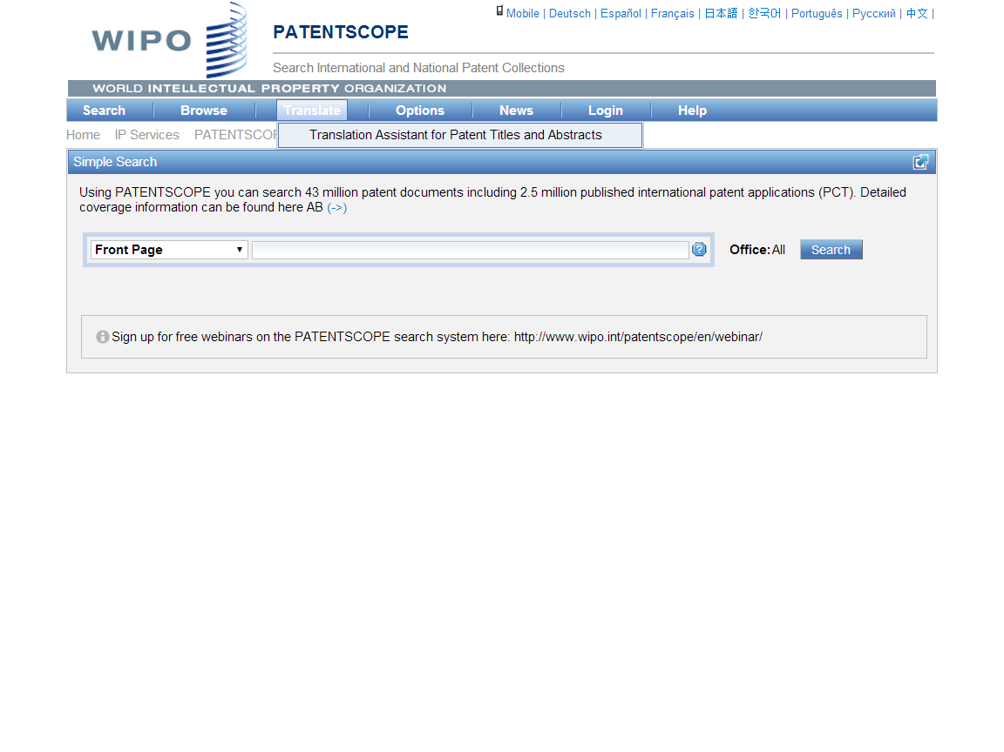

Slide 79
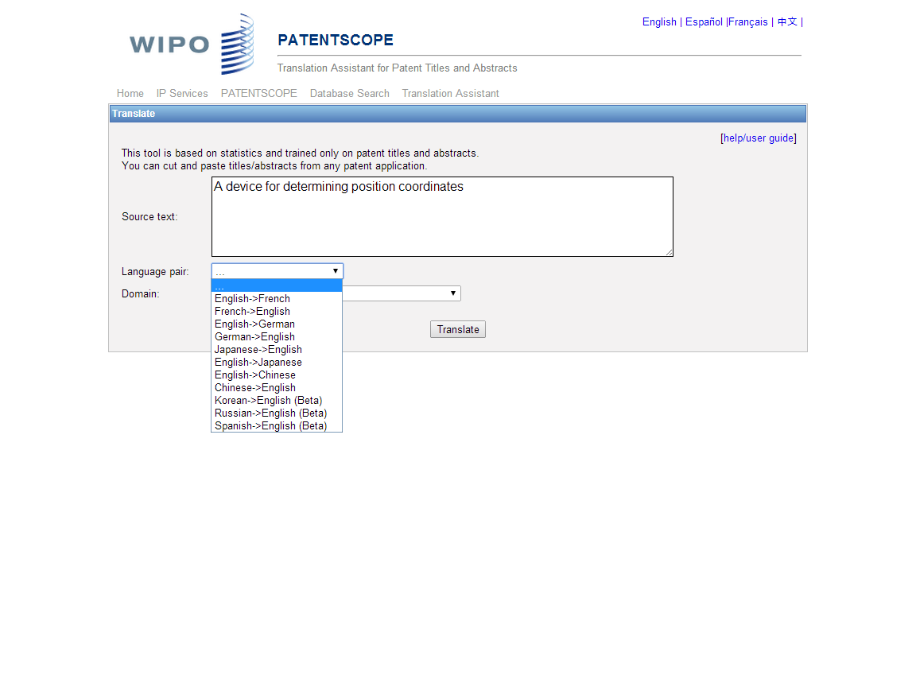
For patent abstracts and titles, WIPO’s TAPATA has a better performance than Google and Microsoft MT, measured by BLEU (Bilingual Evaluation Understudy) score.

Slide 80
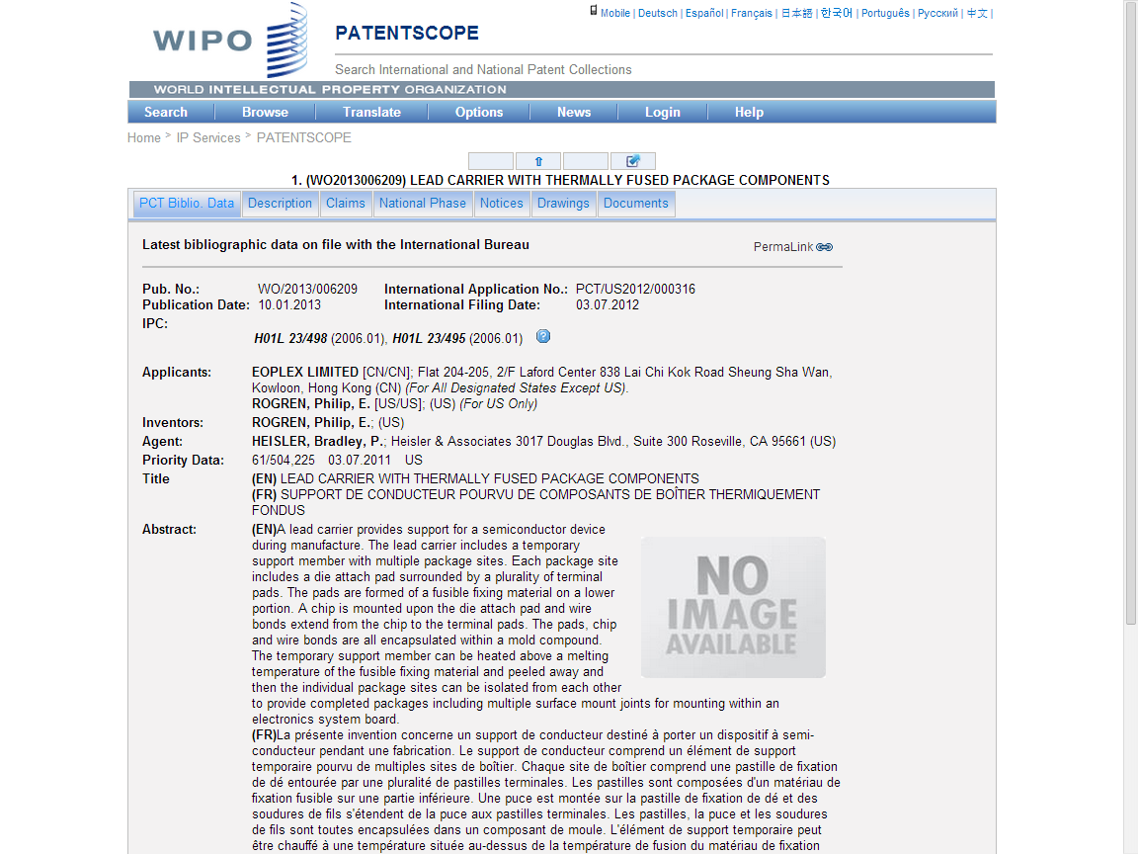

Slide 81
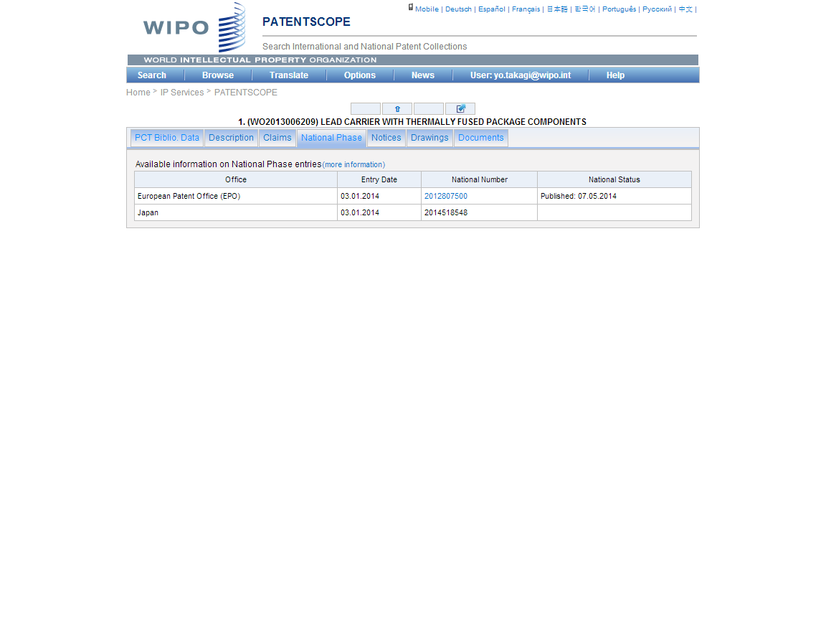

Slide 82
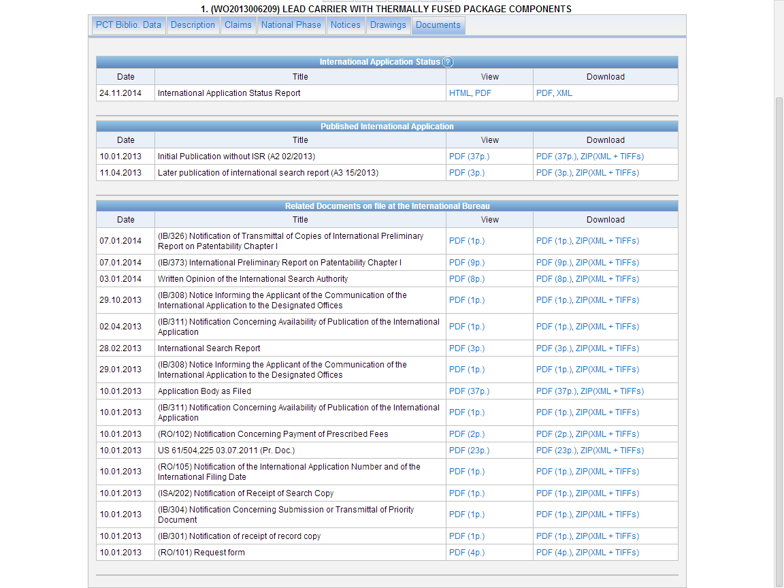

Slide 83
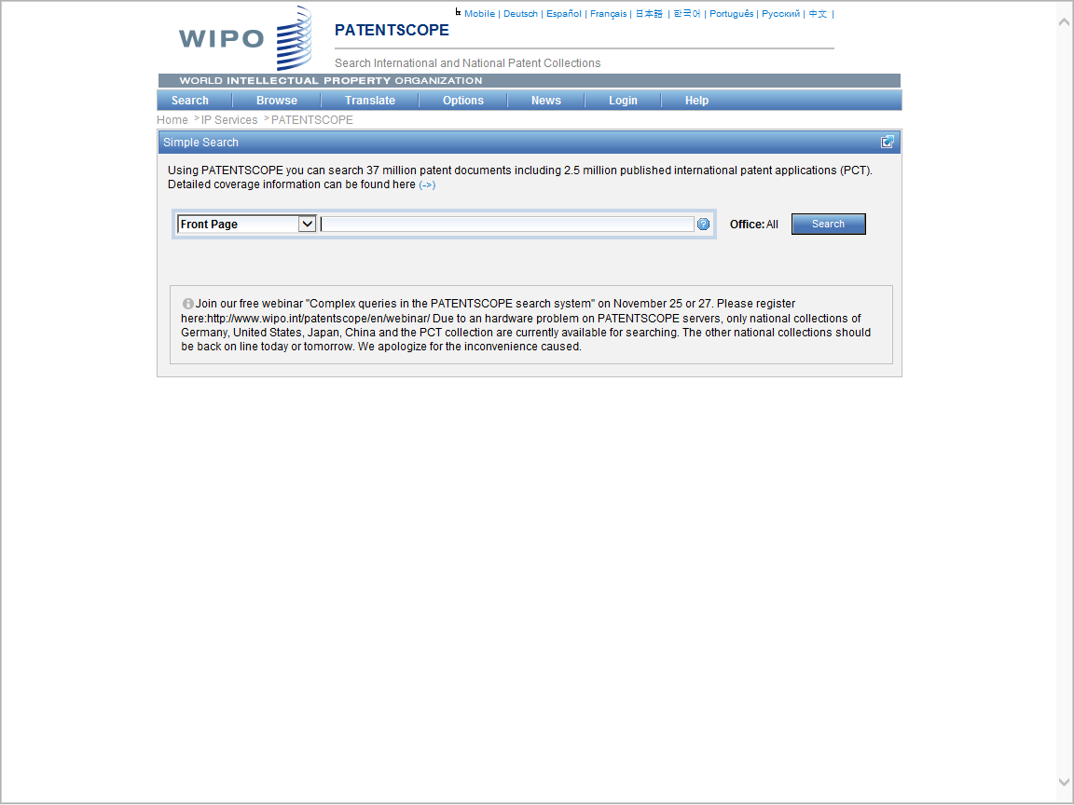
Login (free-of-charge by your e-mail) allows users to:
save search queries;
download search results to excel sheets for printout

Slide 84
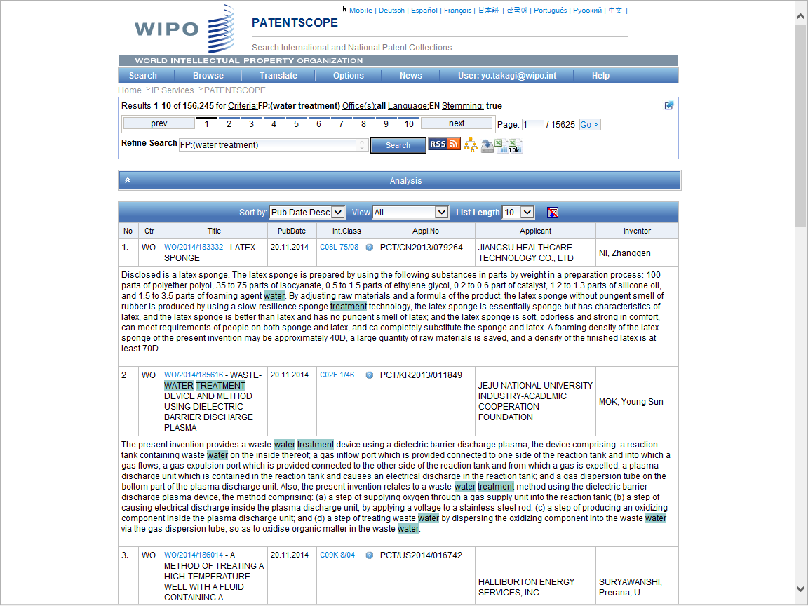
Various charts can be generated by Analysis button
Download the result to spread sheets (up to 10,000 results
Save search queries

Slide 85
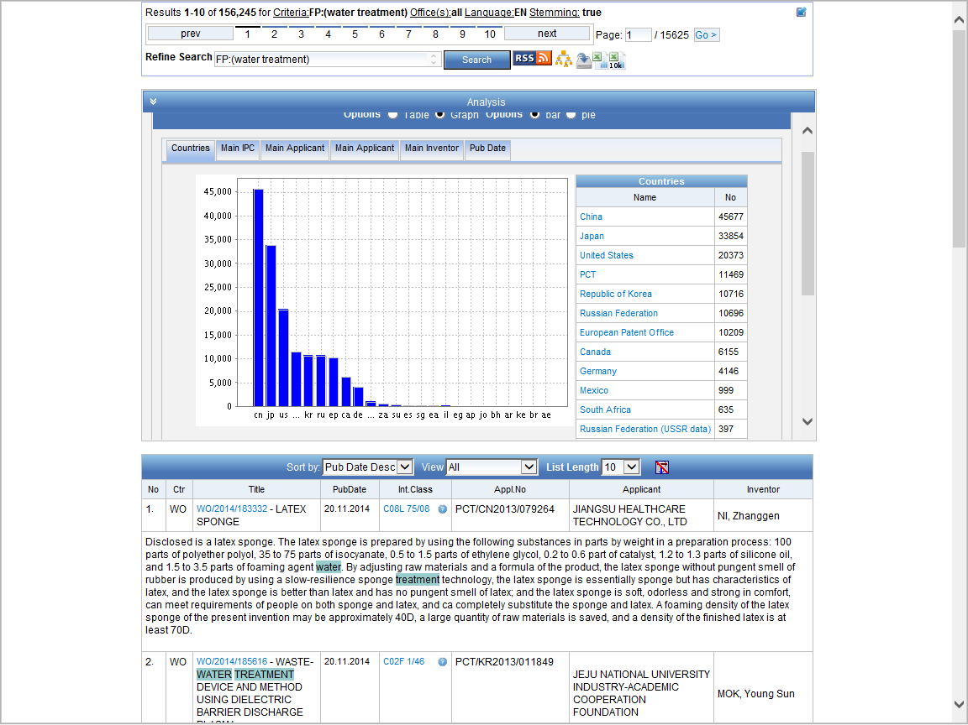

Slide 86
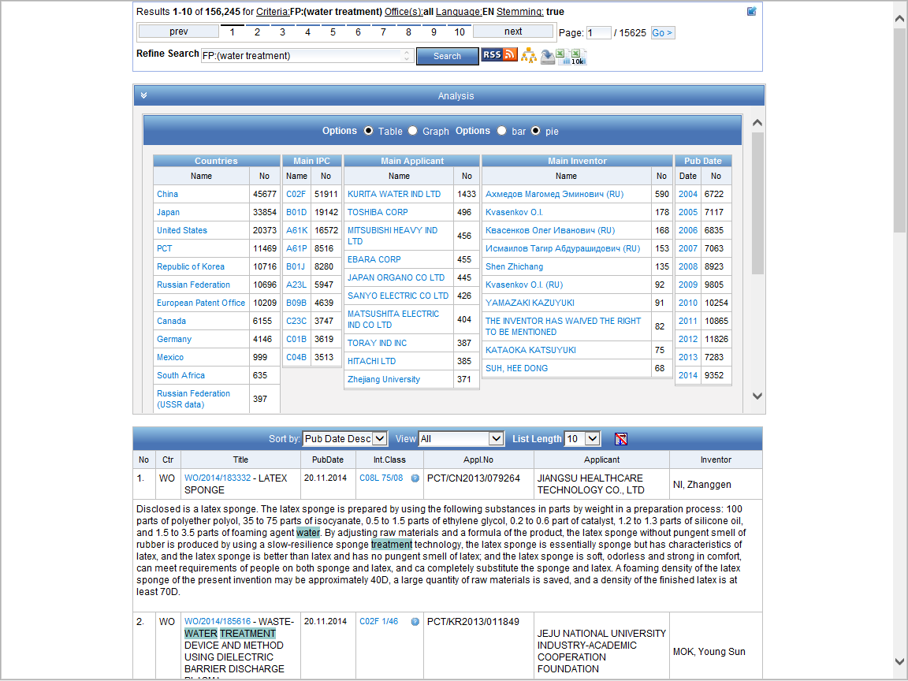

Slide 87
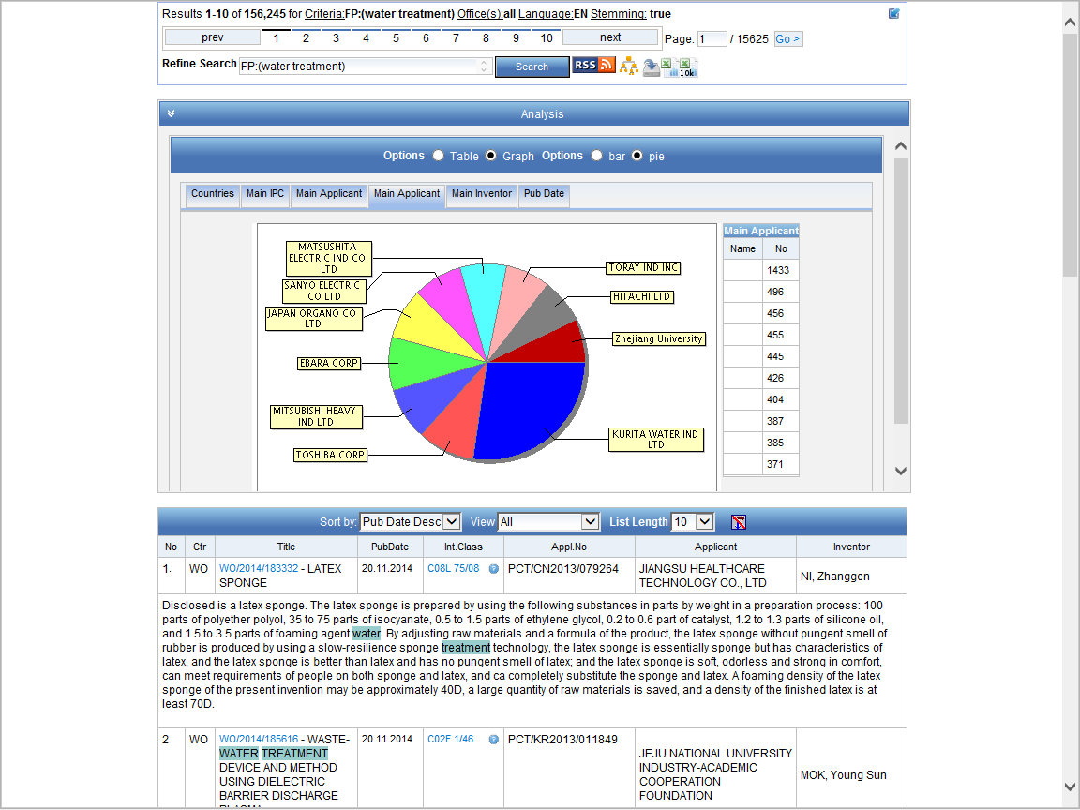

Slide 88
WIPO Pearl
WIPO’s multilingual terminology portal gives access to scientific and technical terms derived from patent documents
currently contains 14,951 concepts and 91,152 terms - and is constantly growing
10 languages: Arabic, Chinese, English, French, German, Japanese, Korean, Portuguese, Russian and Spanish
Integrated with PATENTSCOPE so you can search the entire PATENTSCOPE corpus for terms and their equivalents in other languages
Key words search and Concept map search are possible

Slide 89
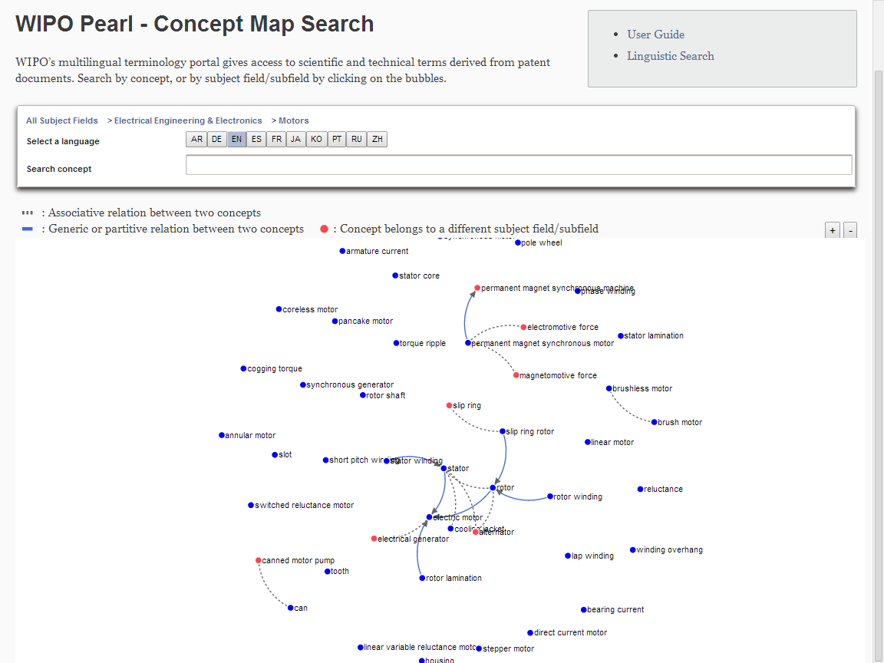

Slide 90
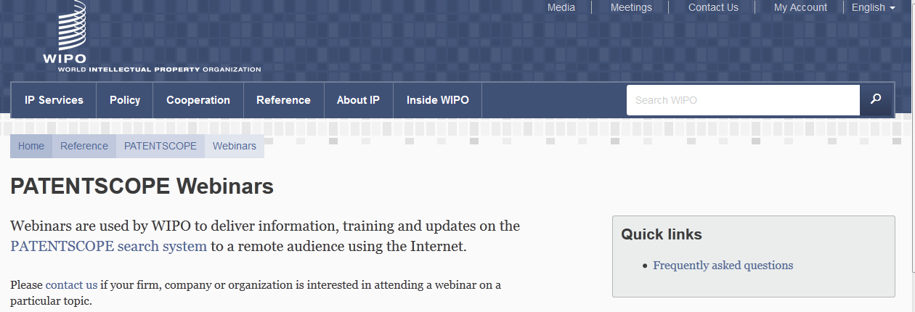
Monthly webinar

Slide 91
Global Databases, Tools, and Platforms for IP Business (Free)
PATENTSCOPE
Global Brand Database
Global Design Database
WIPO Lex
WIPO IPAS, WIPO DAS
WIPO CASE
WIPO GREEN, WIPO Re:Search

Slide 92
GLOBAL BRANDS DATABASE
17 million records relating to internationally-protected brands (trademarks) and selected national data
Simultaneous searches across multiple collections:
  Trademarks registered under Madrid System
  Appellations of Origin registered under Lisbon System
  Emblems protected under the Paris Convention 6ter
  20 national data collections
Link and cross search to EU/OHIM TMView
World premier image search tool for device marks

Slide 93
www.wipo.int

Slide 94
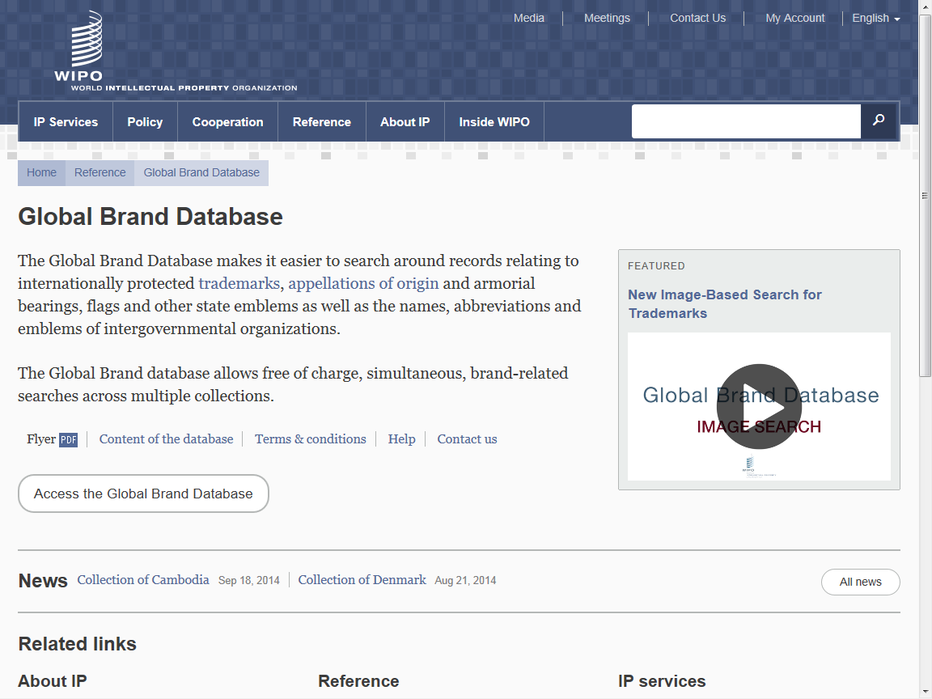

Slide 95
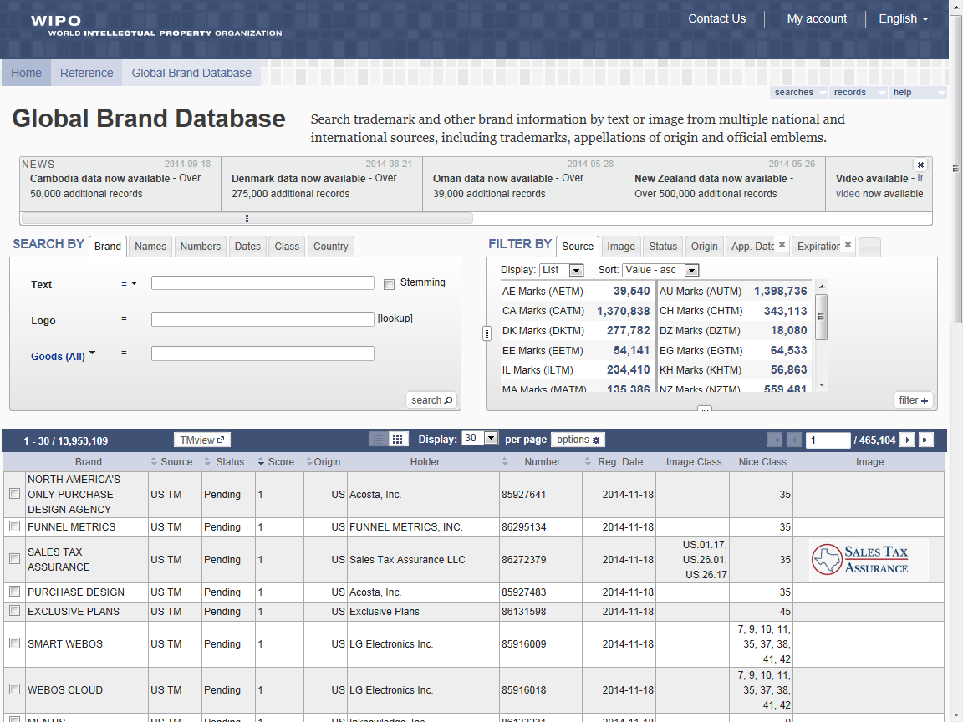

Slide 96
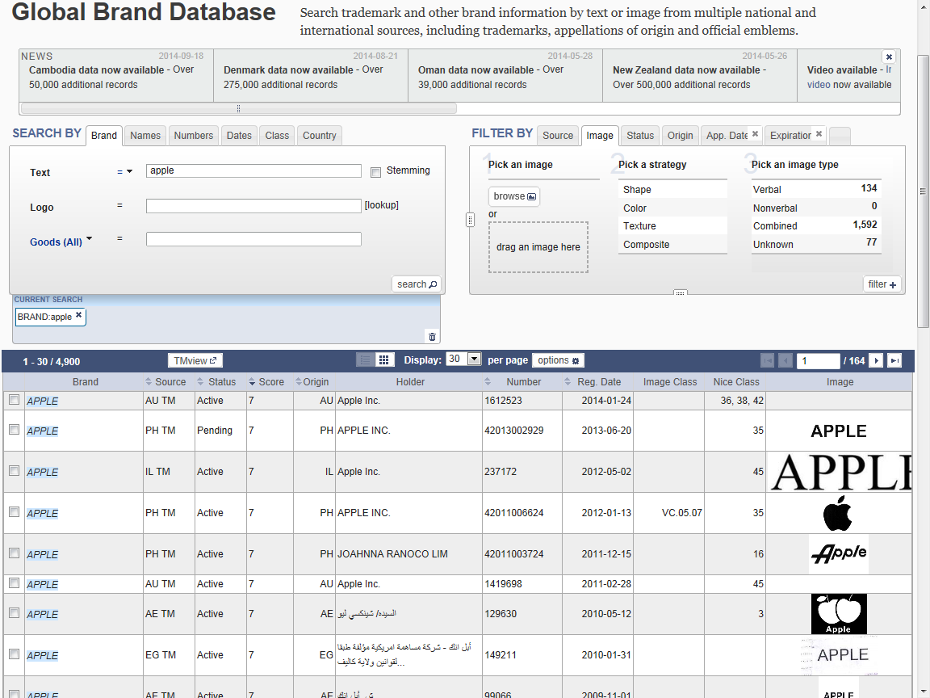

Slide 97
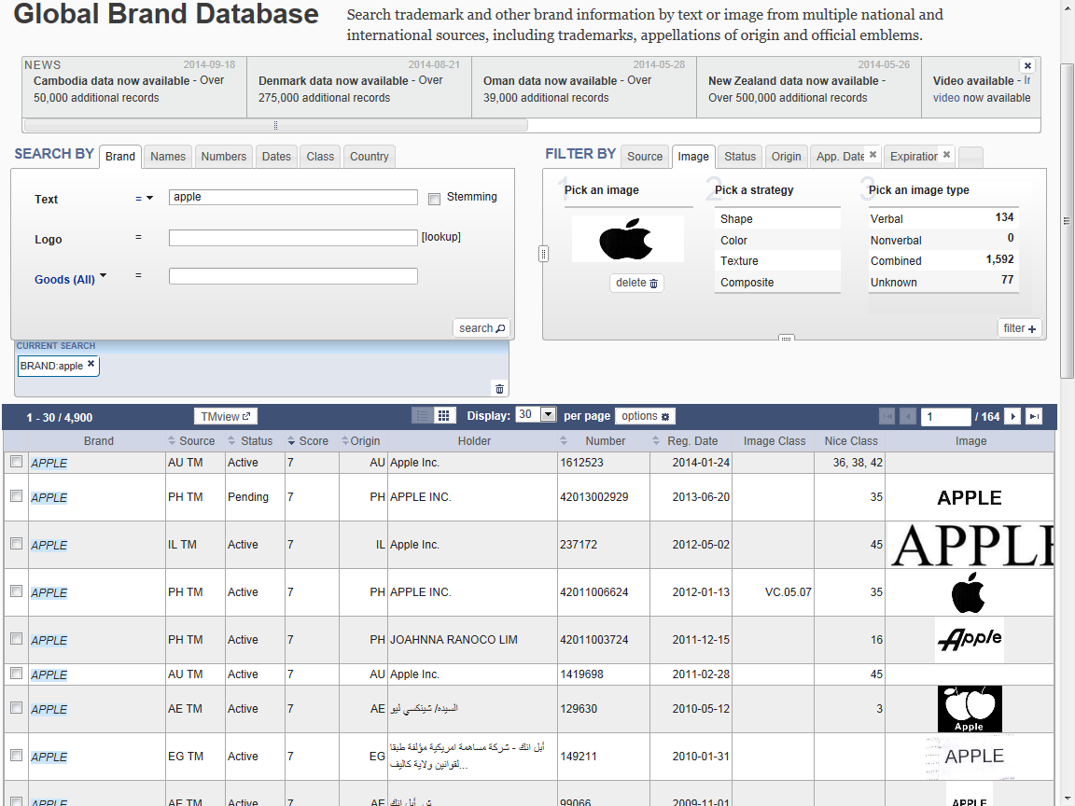

Slide 98
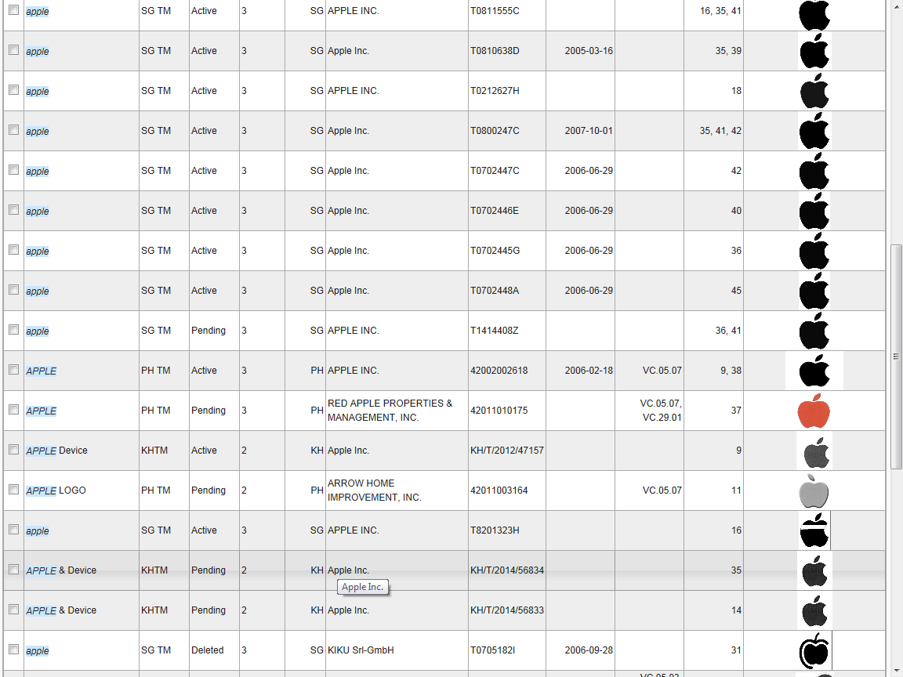

Slide 99
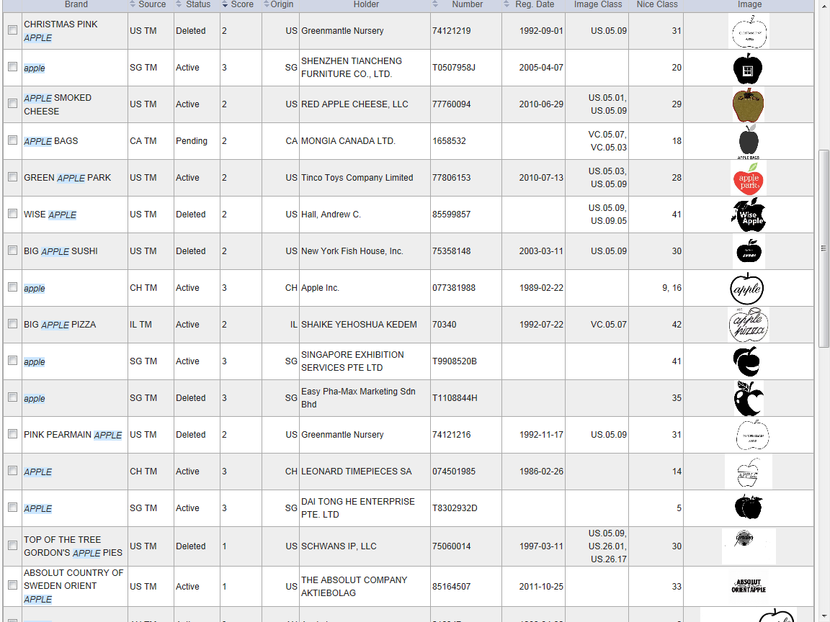

Slide 100
Global Databases, Tools, and Platforms for IP Business (Free)
PATENTSCOPE
Global Brand Database
Global Design Database
WIPO Lex
WIPO IPAS, WIPO DAS
WIPO CASE
WIPO GREEN, WIPO Re:Search

Slide 101
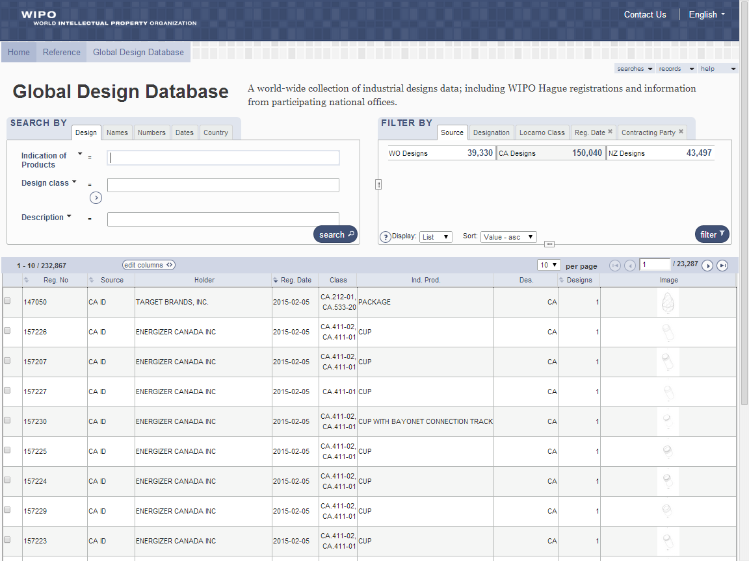

Slide 102
Global Databases, Tools, and Platforms for IP Business (Free)
PATENTSCOPE
Global Brand Database
Global Design Database
WIPO Lex
WIPO IPAS, WIPO DAS
WIPO CASE
WIPO GREEN, WIPO Re:Search

Slide 103
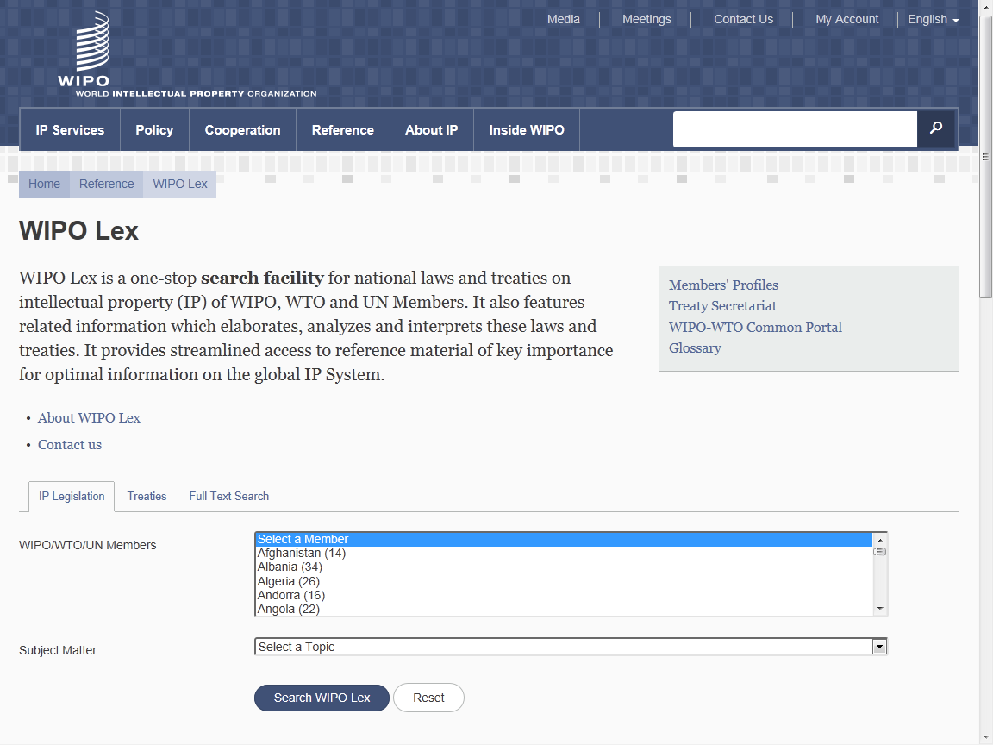

Slide 104
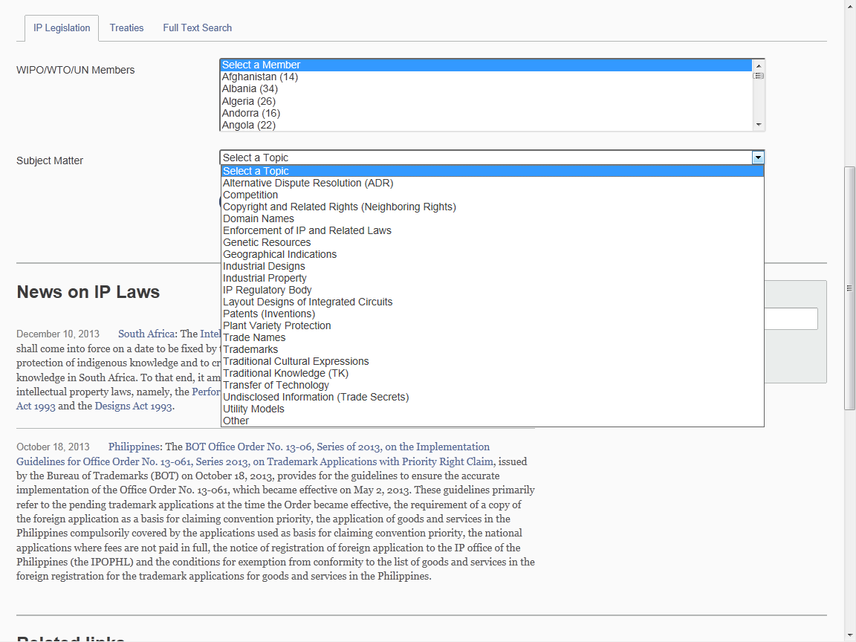

Slide 105
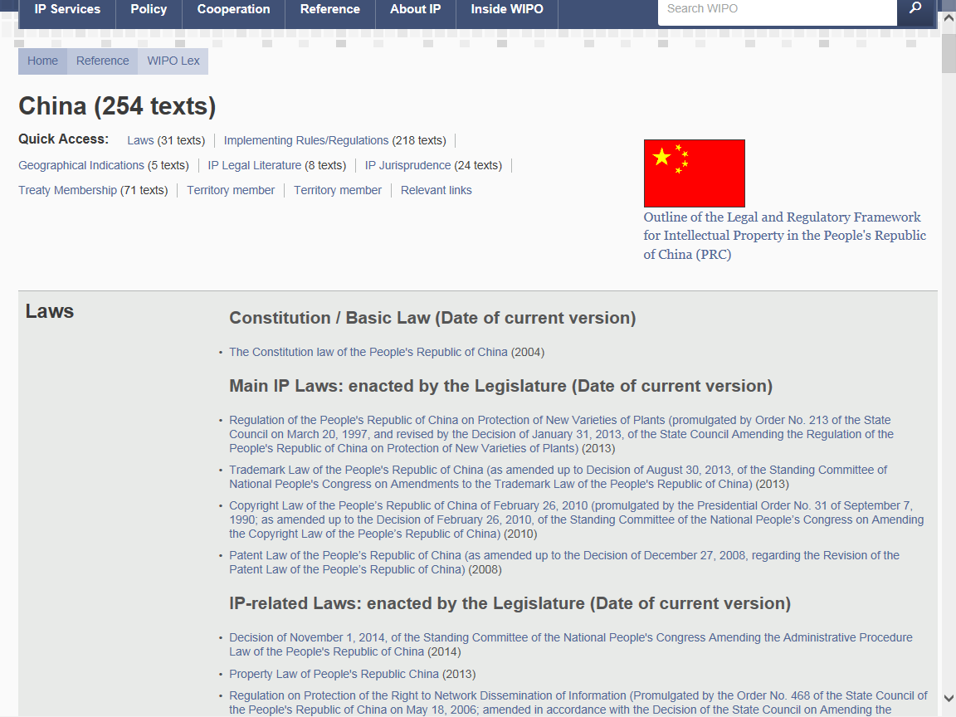

Slide 106
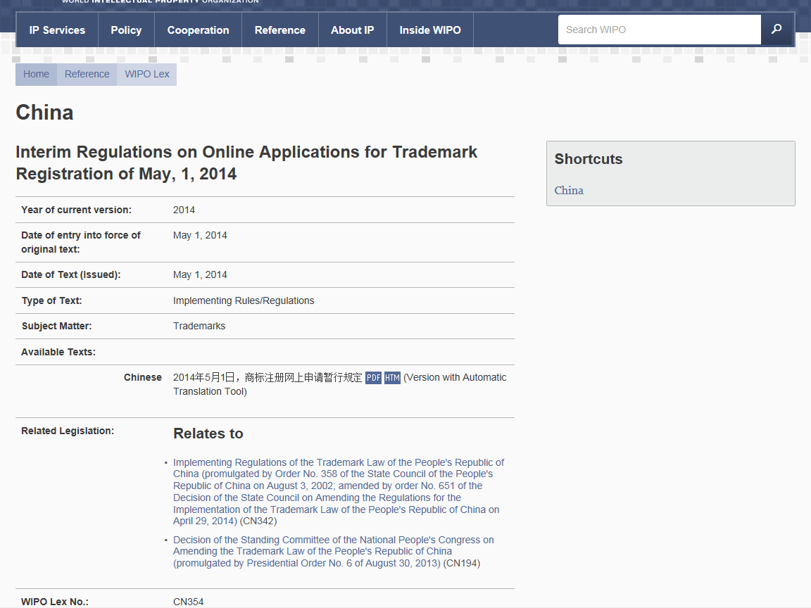

Slide 107
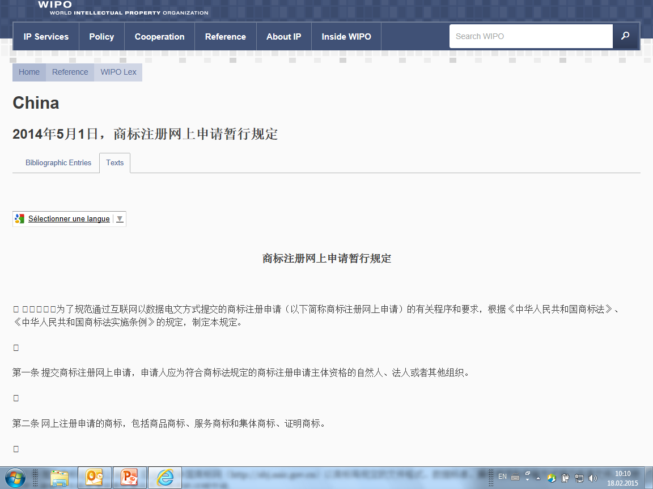

Slide 108
Global Databases, Tools, and Platforms for IP Business (Free)
PATENTSCOPE
Global Brand Database
Global Design Database
WIPO Lex
WIPO IPAS, WIPO DAS
WIPO CASE
WIPO GREEN, WIPO Re:Search

Slide 109
WIPO IPAS, WIPO DAS
IPAS (IP Office Administration System) is an electronic system that supports all the major business processes of an IPO in developing countries. (Used in about 60 countries)
IPAS enables IPOs to develop a patent / trademark DB with minimum errors.
DAS (Digital Access System) used by 11 IPOs
DAS enables IPOs to exchange priority documents securely among themselves.

Slide 110
Global Databases, Tools, and Platforms for IP Business (Free)
PATENTSCOPE
Global Brand Database
Global Design Database
WIPO Lex
WIPO IPAS, WIPO DAS
WIPO CASE
WIPO GREEN, WIPO Re:Search

Slide 111
WIPO CASE
“Centralized Access to Search and Examination Reports”
Started with an initiative of the Vancouver Group (UK, AU, CA)
Online patent work-sharing platform for patent examiners worldwide—secure sharing search and examination documentation
IPOs can enhance quality and efficiency of patent examination
CASE will be linked to Open Portal Dossier of IP5 to become the Global Portal Dossier
How will it work?

Slide 112



WIPO CASE Examiners Portal
Search
Tabs for patent family members
Biblio data
Documents list
Document viewer
Patent family and citations
❶
❷
❸
❺
❹
❻

Slide 113
Two Groups and Candidates
Accessing (only) Offices (AO)
Providing/Depositing Offices (PO)
Australia
Canada
China (via dossier linkage)
Israel
Japan (via dossier linkage)
Rep. of Korea (via dossier linkage)
UK
Brunei
India (to become PO)
Indonesia
Lao
Mongolia
Vietnam
Malaysia
New Zealand (to become PO)
Philippines
Singapore (to become PO)
Candidates:
European offices (Germany in progress, Sweden,…)

Slide 114
WIPO CASE and Global Dossier Databases/Platforms
Public
Public Users
PTO’s internal information
IP5 Global Dossier
PATENTSCOPE
CASE PTOs
Dossier data
Australia
Malaysia
EPO
PCT published biblio. & dossier data
Dossier data(plan)
Biblio &
Dossier data
Canada
Mongolia
China
Indonesia
NZ
Linkages
WIPO CASE
Japan
Israel
Philippines
UK
Singapore
Rep. of
Korea
IP5
PCT(ePCT)
India
Brunei
US
Lao
Viet Nam
Applicant’s filing

Slide 115
Global Databases, Tools, and Platforms for IP Business (Free)
PATENTSCOPE
Global Brand Database
Global Design Database
WIPO Lex
WIPO IPAS, WIPO DAS
WIPO CASE
WIPO GREEN, WIPO Re:Search

Slide 116

Broad aims:
  Match-making for technology transfer and collaborations
  Reduce transaction costs
  Build on comparative advantages of multi-stakeholder approaches
  Demonstrate practical means for the global policy issues
Recognition:
    Users want access to technologies, not just patent rights
    Collaboration (e.g. training) is crucial to tech transfer
Launched in November 2013
as of February 2015, over 1,800 offers
Partners include companies, universities, UN agencies, governments, IPOs, NGOs, etc.

Slide 117
































Partners of WIPO GREEN

Slide 118


Slide 119

Example: Product to license or sell

Slide 120
WIPO Re:Search
Broad aims:
  Match-making for technology transfer and collaborations
  catalyzes the development of medical products for neglected tropical diseases, malaria, and tuberculosis
  Global Public Private Partnerships and sharing knowledge (IP, compounds, expertise, facilities and know-how) royalty-free with qualified researchers worldwide
Launched in 2011
the Partnership Hub (BVGH) has facilitated 81 research collaborations between members across a wide range of neglected and tropical diseases, mainly for pre-clinical research
As of today, 94 members

Slide 121


Slide 122
Conclusion
WIPO Global Databases and Platforms will promote/are promoting global partnerships among multiple stakeholders
Databases, Tools, Services and Platforms need to be easy to search, up to date, interactive/dynamic, multilingual, and robust
WIPO is helping to establish critical elements of global IP infrastructure, tools and services necessary so that innovators, patent professionals and IP Offices in all countries can derive maximum benefit from the global IP system

Slide 123
Alternative Dispute Resolution – Practical tips
Speaker : Victor Vazquez Lopez, Head
Section for Coordination of Developed Countries

Slide 124
Top Ten Considerations in Choice of Dispute Resolution Clause
Domestic Contracts | International Contracts
Costs – 71% | Costs – 71%
Time – 59% | Time – 57%
Quality Outcome – 44% | Enforceability – 53%
Confidentiality – 33% | Quality Outcome – 44%
Enforceability – 33% | Neutral Forum – 36%
Business Solution – 30% | Confidentiality – 32%
Neutral Forum – 18% | Business Solution – 29%
None in Particular – 9% | Support Provided by Institution – 9%
Setting Precedent – 6% | None in Particular – 6%
Support Provided by Institution – 6% | Setting Precedent – 5%
WIPO Center Report on International Survey of Dispute Resolution
in Technology Transactions (2013)
www.wipo.int/amc/en/center/survey/results.html

Slide 125
WIPO Arbitration and Mediation Center
Facilitates the resolution of commercial disputes between private parties involving IP and technology, through procedures other than court litigation (alternative dispute resolution: ADR)
  Offices in Geneva and Singapore
ADR of IP disputes benefits from a specialized ADR provider
  WIPO mediators, arbitrators and experts experienced in IP and technology - able to deliver informed results efficiently
Competitive WIPO fee structure
International neutrality
Services include mediation, arbitration, expedited arbitration, expert determination, and domain name dispute resolution

Slide 126
WIPO ADR
Mediation, Arbitration, Expert Determination
Mediation: informal consensual process in which a neutral intermediary, the mediator, assists the parties in reaching a settlement of their dispute. The mediator cannot impose a decision.
Arbitration: consensual procedure in which the parties submit their dispute to one or more chosen arbitrators, for a binding and final decision (award) enforceable under arbitral law.
Expert Determination: consensual procedure in which the parties submit a specific matter (e.g., technical question) to one or more experts who make a determination on the matter.

Slide 127
Routes to WIPO ADR
ADR contract clause electing WIPO Rules administered by WIPO Center
  WIPO Rules updated in 2014
Model clauses: www.wipo.int/amc/en/clauses/index.html
  Parties can shape the process via the clause (e.g., location, language, law, extent of discovery)
  Allows for combination of procedures (e.g., mediation followed by expedited arbitration)
Submission agreements for non-contractual disputes
Court referrals

Slide 128
WIPO ADR Options
WIPO Contract Clause/ Submission Agreement
Party Agreement
(Negotiation)
First Step
Mediation
Expert Determination
Expedited Arbitration
Arbitration
Procedure
Determination
Settlement
Award
Outcome

Slide 129
WIPO Center Case Administration
  Active time and case management
  WIPO ECAF (optional online document management)
  WIPO list of mediators, arbitrators, experts
  Specialized in different areas of IP and IT
  1,500+ from numerous countries in all regions
  (significant US presence)

Slide 130

WIPO Electronic Case Facility (ECAF)
  Easy; Instant; Centralized; Location-independent; Secure

Slide 131
WIPO Arbitration
WIPO Expedited Arbitration
Request for Arbitration
Request for Arbitration
and Statement of Claim
Answer to Request for Arbitration
Answer to Request for Arbitration and Statement of Defense
Appointment of Arbitrator(s)
Appointment of Arbitrator(s)
Statement of Claim
Hearing
Statement of Defense
Closure of Proceedings
Further Written Statements and Witness Statements
Final Award
Hearings
One exchange of pleadings
Shorter time limits
Sole arbitrator
Shorter hearings
Fixed fees
Closure of Proceedings
Final Award
Notes:
131

Slide 132
Areas of WIPO Mediation, Arbitration and Expert Determination Cases
Contractual: patent licenses, software/IT, R&D and technology transfer agreements, patent pools, distribution agreements, joint ventures, copyright collecting societies, trademark coexistence agreements, settlement agreements, as well as general commercial issues
Non-contractual: infringement of IP rights
Domestic and international disputes (25/75%)
Amount in dispute from USD 50,000 to USD 1 billion
WIPO case examples
  www.wipo.int/amc/en/mediation/case-example.html
  www.wipo.int/amc/en/arbitration/case-example.html

Slide 133
WIPO Case Subject Matter and Business Areas

Slide 134
Examples of Tailored WIPO ADR for Specific Sectors
  Domain Names (45,000+ cases since 1999)
  Film and Media
  Intellectual Property Offices (ADR options for parties in administrative procedures before the Office)
  Research and Development/Technology Transfer
  http://www.wipo.int/amc/en/center/specific-sectors/

Slide 135
How Are Technology Disputes Resolved?
WIPO Center Report on International Survey of Dispute Resolution
in Technology Transactions (2013)
www.wipo.int/amc/en/center/survey/results.html

Slide 136
Relative Time and Cost of Technology Dispute Resolution
WIPO Center Report on International Survey of Dispute Resolution
in Technology Transactions (2013)
www.wipo.int/amc/en/center/survey/results.html

Slide 137
Relative Costs of Dispute Resolution Options
Court litigation of IP disputes in foreign jurisdiction
  Average of 3.5 years
  Cost slightly over USD 850,000
Arbitration
  Average just over 1 year
  Average cost USD 400,000 (WIPO cases, USD 165,000)
Expedited Arbitration
  Average 9 months (WIPO cases, 7 months)
  Average cost under USD 50,000
Mediation
  Average of 8 months (WIPO cases, 5 months)
  91% of Respondents stated costs typically under USD 100,000
  (WIPO cases USD 21,000)
WIPO Center Report on International Survey of Dispute Resolution
in Technology Transactions (2013)
www.wipo.int/amc/en/center/survey/results.html

Slide 138

Fee Calculator
www.wipo.int/amc/en/calculator/adr.jsp

Slide 139
Why Consider IP ADR?
Cost of IP court litigation
  Calls for expedient solutions
Internationalization of creation/use of IP
  Calls for cross-border solutions; consolidate in one procedure
Technical and specialized nature of IP
  Calls for specific expertise of the neutral
Short product and market cycles in IP
  Calls for time-efficient procedures
Confidential nature of IP
  Calls for private procedures
Collaborative nature of IP creation and commercialization
  Calls for mechanisms that preserve relations

Slide 140


Contacting the WIPO Center
Queries: arbiter.mail@wipo.int
Department contacts: www.wipo.int/amc/en/contact/
ADR: www.wipo.int/amc/en/
Domain Names: www.wipo.int/amc/en/domains/

Slide 141
Madrid and Hague Systems
Introduction and Online Tools
Speaker : Neil Wilson, Director
Registries Support Division Brands and Designs Sector

Slide 142
















The Madrid story beings with a product

Slide 143
How to protect your trademark?
The National Route: Filing trademark application with the Trademark Office of each country in which protection of the mark is sought
The Regional Route: Apply for protection in countries which are members of a regional trademarks registration system with effect in the territories of all Member States (ARIPO, Benelux Trademark Office, OHIM and OAPI)
The International Route: The Madrid Protocol

Slide 144
What is the Madrid System?
A centralized filing and management procedure
A one-stop shop for trademark holders to obtain and maintain trademark protection in export markets
An alternative to the national or the regional route
The domestic legislations of the designated Contracting Parties set the conditions for protecting a trademark and determine the rights which result from protection

Slide 145
Members of the Madrid System
1 Agreement only
39 Protocol only (including EU and OAPI)
54 Agreement and Protocol
94 Members

Slide 146
Accessions
Recent accessions
  2012: Colombia, Mexico, New Zealand and Philippines
  2013: India, Rwanda and Tunisia
  2014: OAPI and Zimbabwe
Future accessions:
  ASEAN countries by 2015
  Canada
  Caribbean countries
  African countries
  Latin American countries?

Slide 147
Key Features of the Madrid System
A centralised filing system for 94 Contracting Parties
Entitlement and basic mark (application or registration)
One application – one language – one set of fees
One registration covering multiple territories
Fixed time limit for refusal – 12 or 18 months
The international procedure: Only formal examination by WIPO

Slide 148
The International Procedure
Office of Origin
Designated Contracting Party
Designated Contracting Party
Designated Contracting Party
WIPO
Applicant
Certifies the application and forwards it to WIPO
Conducts the formal examination; records the mark in the International Registry and publishes the IR in the Gazette. Issues a certificate of registration and notifies the dCPs
Entitlement
Basic Mark
Scope of protection of the IR will be determined by the substantive examination under domestic law, within 12/18 months

Slide 149
Key Features of the Madrid System
Expand protection to new export markets
Tailor the list of goods and services for the different markets
Continued processing (relief measure) available
Centralized management of portfolio
  Recording of changes and renewal are done centrally with WIPO

Slide 150
Madrid General Profile - 2014
42,430 International Registrations
Average Number of Designations | 6.9
Average Number of Classes | 2.5
Average Fee | CHF 3,102
All Fees | 67% < 3,000 CHF
Notes:
150

Slide 151
Madrid Top Offices of Origin
Contracting Parties | 2013 | 2014
European Union | 6,814 | 6,996
United States of America | 5,893 | 5,414
Germany | 4,357 | 3,883
France | 3,514 | 3,377
Switzerland | 2,885 | 2,994
Italy | 2,118 | 2,070
Benelux | 1,784 | 1,838
China | 2,455 | 1,738
Japan | 1,855 | 1,729
United Kingdom | 1,580 | 1,560

Slide 152
Madrid Online Tools
Madrid Portfolio Manager (MPM): To allow the holders and representatives to view and modify their portfolio
Madrid Real-Time Status (MRS): To inform of the status of an international application/registration
Madrid Electronic Alerts (MEA): To allow users to submit a list of IRs for the IB to monitor and inform of changes
Madrid Goods and Services Manager (MGS): To use correct specifications of goods and services

Slide 153
Madrid Online Tools
Fee Calculator http://www.wipo.int/madrid/en/fees/calculator.jsp
E-subsequent designation https://www3.wipo.int/osd/
Madrid Search http://www.wipo.int/romarin
Global Brands Database http://www.wipo.int/branddb/en/
All free of charge at http://www.wipo.int/madrid/en/services/

Slide 154












The Hague story beings with a design

Slide 155

Hague in a Nutshell
“The Hague Agreement provides creators and holders of designs with a simple, rapid and economical procedure to secure and maintain the protection of industrial designs, through a single international registration"

Slide 156


WIPO Director General Francis Gurry:
“Design is one of the principal means of differentiating a range of mass produced household and consumer items, such as chairs and tables, for which the technological possibilities for development have been exhausted.”
DM/075065 DM/076022
« Chair » « Chair »

Slide 157
The Hague System
A centralized filing mechanism
A closed system
A one-stop shop to obtain and maintain design protection in export markets
An option to the national route
Notes:
157

Slide 158
Key features of the Hague System
Entitlement, but no basic design
Direct filing with WIPO, electronically or on paper
One application – one language – one set of fees
Can include up to 100 different designs (same Locarno class)
One registration covering multiple territories
«Self-designation» is possible

Slide 159
Key features of the Hague System
Only formal examination in the International Bureau
Substantive examination by the designated CPs only
Fixed time limit for refusal – 6 or 12 months from the publication of the IR on the WIPO website
Renewal – every 5 years – 15 years for the 1999 Act
Centralized management of portfolio

Slide 160
Geographical Scope of the Hague System
47 Geneva Act (1999) (including EU and OAPI)
15 Hague Act (1960)
62 Contracting Parties

Slide 161
Foreseen Expansion of the Hague System
Coming soon?

Slide 162
Accessions
2012: Montenegro, Tajikistan, Tunisia
2013: Brunei Darussalam
2014: Republic of Korea
2015: Japan & USA
Future accessions?
  China
  Russian Federation and Belarus
  ASEAN countries by 2015
  Barbados and Trinidad & Tobago
  Madagascar and Morocco
Notes:
162

Slide 163
IP Filing Trends Worldwide 2004-2013
Patents: +64%
Trademarks: +71%
Designs: +170%
http://www.wipo.int/ipstats/en/

Slide 164
The use of the Hague System in 2014
2,924 international applications filed (14,441 designs)
2,703 international registrations recorded (13,504 designs)
Largest filers: Swatch AG, The Proctor and Gamble Company, Daimler AG, Koninklijke Philips Electronics, Volkswagen Aktiengesellschaft.
Approximately 27,722 international registrations in force,
  Equivalent to over 191,711 designations in force
  Involving 8,468 holders
  81% SMEs (holders with 1 or 2 international registrations in force)
Notes:
164

Slide 165
Hague - General Profile 2014
2,703 International Registrations
Average Number of Designations | 4.95
Average Number of Designs | 4.99
Average Fee | 1,552 CHF
All Fees | 80.2% < 2,000 CHF
Notes:
165

Slide 166
Hague Online services / tools
http://www.wipo.int/hague/en/
  E-Filing Portfolio Manager
  E-Renewal
  E-Payment
  Hague Express Database
  Fee calculator

Slide 167

Thank you
for your attention

