Slide 1
Opening Remarks
Mr. Antonios Farassopoulos, Director, International Classifications and Standards Division, Global Infrastructure Sector (GIS), WIPO

Slide 3
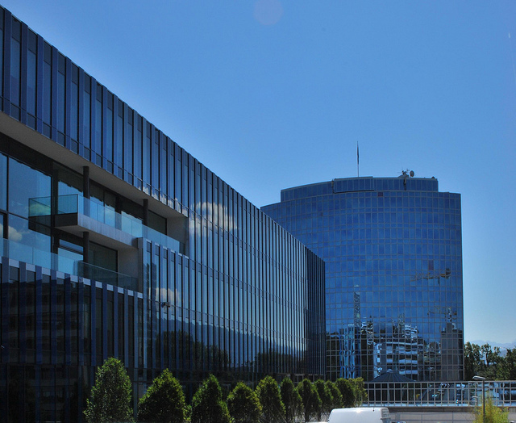
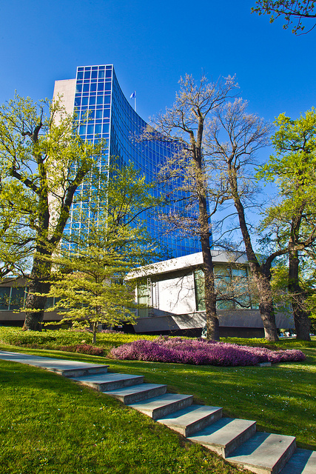
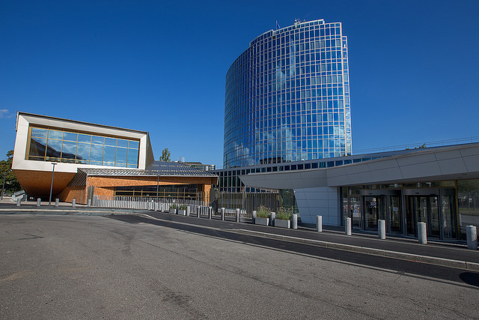
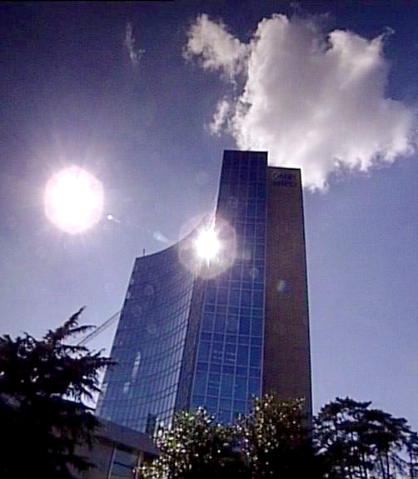

WIPO
Roving Seminar on WIPO Services and Initiatives
Organized by the World Intellectual Property Organization (WIPO)
in cooperation with the Hellenic Industrial Property Organization (OBI)

Slide 4


Introduction to WIPO:
Major Intellectual Property Economic Studies
Victor Vázquez López, Head Section for Coordination of Developed Countries
Athens, Greece
March 8, 2016

Slide 5
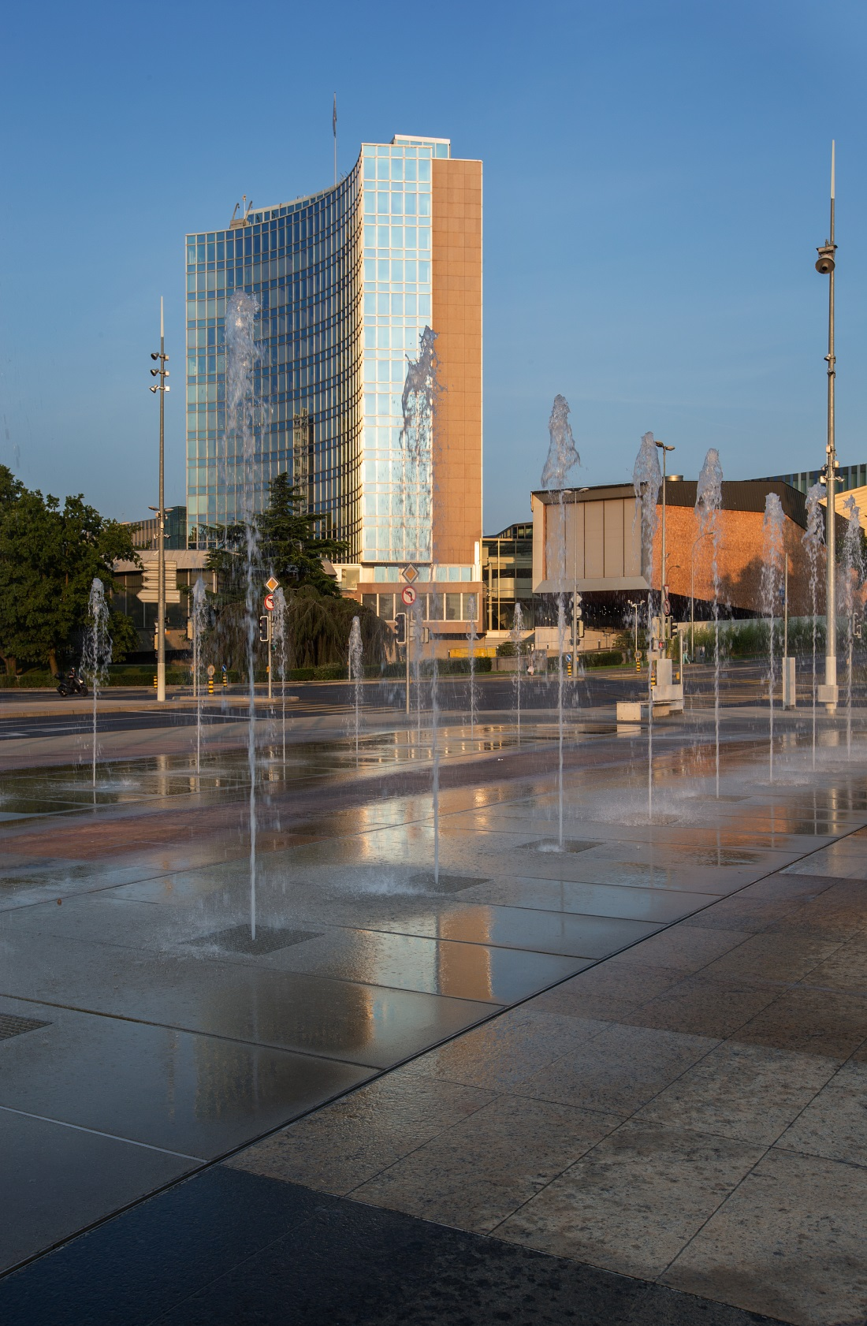
WIPO
MISSION: To lead the development of a balanced and effective international intellectual property (IP) system that enables innovation and creativity for the benefit of all.
MEMBER STATES: 188
OBSERVERS: more than 390 (NGOs, IGOs, industry groups, etc.)
STAFF: more than 1. 200
ADMINISTERED TREATIES: 26
MAIN BODIES: General Assembly, CC, WIPO CONFERENCE

Slide 6
WIPO is Service and Development oriented
Economic Development
Norm Setting
Services to Industry
Global Infrastructure

Slide 7
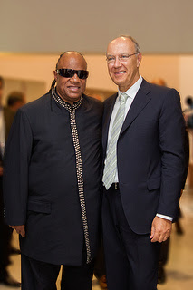
A dynamic norm- setting approach
Legacy
Beijing and Marrakesh Treaties
Beijing: It deals with the intellectual property rights of performers in audiovisual performances.
26 Treaties in all fields of IP.
Oldest Treaties in XIX century and newest in XXI
5 Treaties in the XXI century, including PLT, STLT.
Marrakesh: It deals with access to books by the visually impaired.
WIPO Director General
Dr. Francis Gurry and
Mr. Stevie Wonder

Slide 8
WIPO: Provider of Premier Global IP Services
WIPO Arbitration and Mediation Center
Hague System (Industrial Designs)
Madrid System (Trademarks)
Patent Cooperation Treaty (Patents)

Slide 9
WIPO’s Budget: 756,3 Million CHF for 2016 - 2017

Slide 10
Repositories of Information
International Classification Systems (Organize into indexed, manageable structures for easy retrieval)
Databases e.g. Patentscope and Global Brand Database
Platforms
Common platform for e-data exchange among IPOs: IPAS, DAS
Other platforms: WIPO GREEN and WIPO Re:Search
Treatment of Information
Standards for IP Offices (Help streamline data processing)
Global IP Infrastructure

Slide 11
Major Economic Studies on IP
WIPO Unit – THE ECONOMICS AND STATISTICS DIVISION – Reflects the Growing Consensus on the importance of the Economic Dimension of IP.
The Division applies statistic and Economic analysis to the use of WIPO services.
This structure also improves WIPO economic insight on IP Development.

Slide 12






World Intellectual Property Report (2015): Breakthrough Innovation and Economic Growth
The PCT Yearly Review provides an overview of the performance and development of the PCT system: http://www.wipo.int/ipstats/en/statistics/pct/
Madrid Yearly Review: http://www.wipo.int/ipstats/en
Hague Yearly Review: http://www.wipo.int/ipstats/en/
The WIPO IP Facts and Figures provides an overview of IP activity based on the latest available year of statistics. It serves as a quick reference guide for statistics: http://www.wipo.int/ipstats/en/
World Intellectual Property Indicators (WIPI) provides an overview of latest trends in IP filings and registrations covering more than 100 offices: http://www.wipo.int/ipstats/en/wipi/index.html
WIPO IP Statistics Data Center http://ipstatsdb.wipo.org/ipstatv2/ipstats/patentsSearch

Slide 13
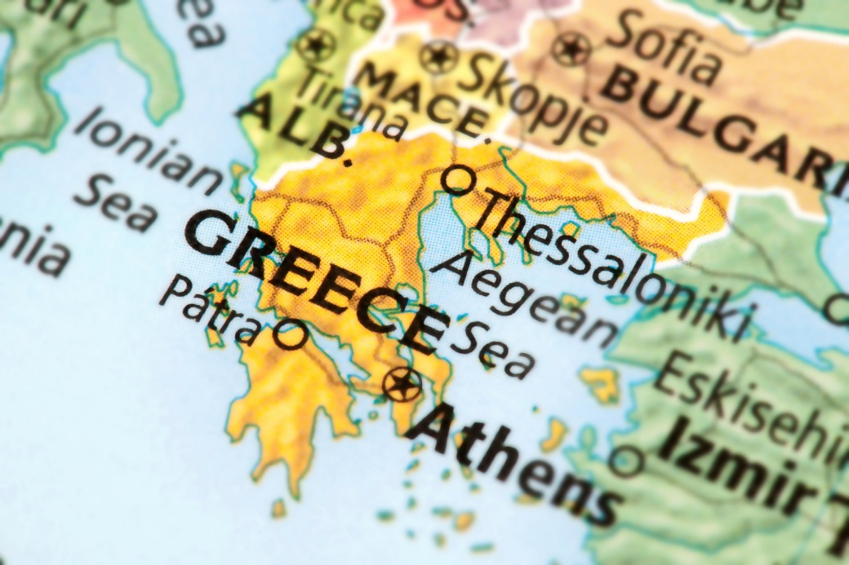

Country Profile

Slide 14
Greece in WIPO Systems
PCT applications in 2014: Greece made 133 patent applications, a 18.02 % increase from 2013
Madrid applications in 2014: Greece made 110 trademark applications, a 2.80% growth from 2013
Hague System: in 2014; 3 Industrial Design Applications were made in Greece, a decrease of 25% from 2013 (4)
* University and PRO patents are not automatically identified in patent data – that keyword searches need to be applied, with potential institutions missed

Slide 15
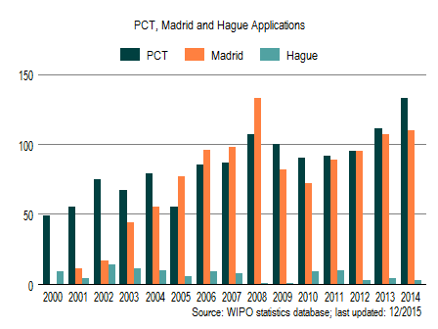
International Applications via WIPO Administered Treaties

Slide 16
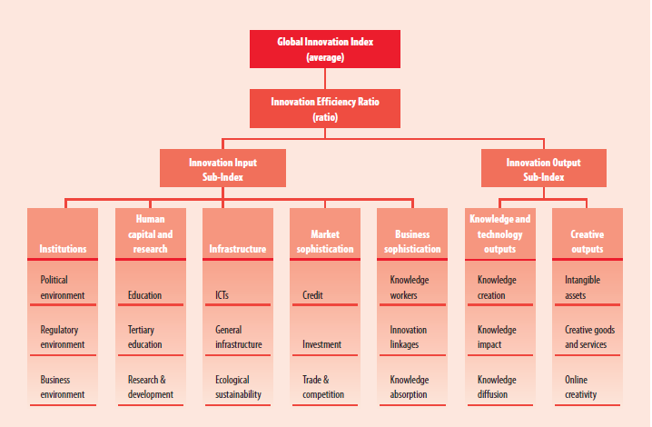
Framework of the Global Innovation Index (GII) 2015

Slide 17
The GII
RANKING 2014
RANKING 2015
1. SWITZERLAND
2. UNITED KINGDOM
3. SWEDEN
4. FINLAND
5. NETHERLANDS
50. GREECE
1. SWITZERLAND
2. UNITED KINGDOM
3. SWEDEN
4. NETHERLANDS
5. UNITED STATES OF AMERICA
45. GREECE
Improved GII ranking from 2014
Gross Domestic Expenditure on R&D: below crisis levels in 2013:
 | 2008 | 2009 | 2010 | 2011 | 2012 | 2013
GERD | 100 | 90 | 82 | 83 | 80 | 88

Slide 18
Greece in the GII
Strengths |  | Weaknesses
2.1.3 | School life expectancy | 3.2.3 | Gross capital formation
2.1.5 | Pupil-teacher ratio, secondary | 5.2.2 | State of cluster development
2.2 | Tertiary education | 5.3.4 | Foreign direct investment net inflows
2.2.1 | Tertiary enrolment | 6.1.3 | National office resident utility model application
2.2.2 | Graduates in science and engineering | 6.2.1 | Growth rate of GDP per person engaged
3.1.4 | E-participation | 6.3.4 | Foreign direct investment net outflows
3.3.2 | Environmental performance | 7.1 | Intangible assets
4.1.2 | Domestic credit to private sector | 7.1.3 | ICTs and business model creation
6.1.4 | Scientific and technical publications | 7.1.4 | ICTs and organizational model creation
6.2.4 | ISO 9001 quality certificates
7.2 | Creative goods and services
7.2.4 | Printing and publishing output

Slide 19
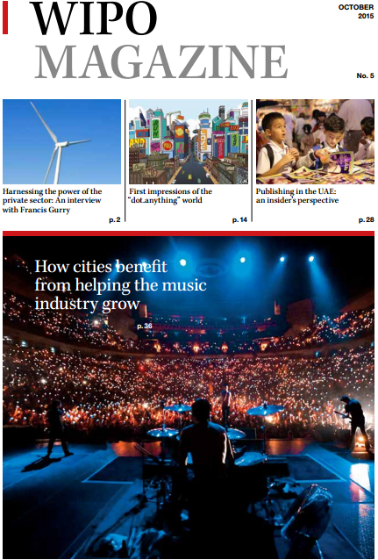
Follow us
Twitter: @wipo
WIPO Magazine
  www.wipo.int/wipo_magazine/en/
WIPO Wire:
  www.wipo.int/newsletters/en
Press releases
  www.wipo.int/pressroom/en/

Slide 20
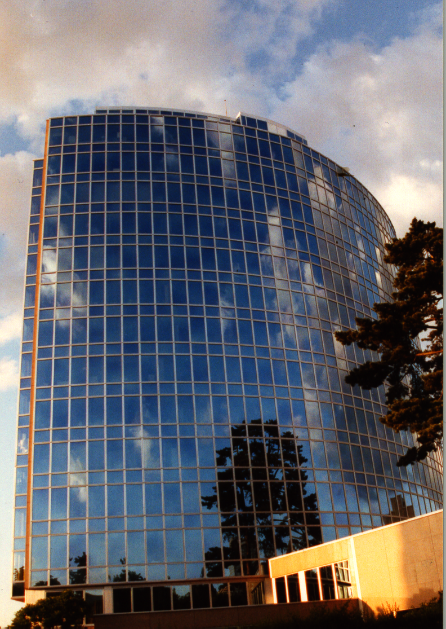
Thank you for your attention
E-mail: Victor.Vazquez-Lopez@wipo.int

Slide 22

Patent Cooperation Treaty (PCT)
Introduction and Future Developments
Claus Matthes
Director, PCT Business Development Division
Athens
March 8, 2016

Slide 23
What is Intellectual Property?
Intellectual property refers to creations of the mind: inventions; literary and artistic works; and symbols, names and images used in commerce
Intellectual property is divided into two categories:
  Industrial Property includes patents for inventions, trademarks, industrial designs and geographical indications.
  Copyright covers literary works (such as novels, poems and plays), films, music, artistic works (e.g., drawings, paintings, photographs and sculptures) and architectural design

Slide 24
What are Intellectual Property Rights?
Intellectual property rights are like any other property right
They allow creators, or owners, of patents, trademarks or copyrighted works to benefit from their own work or investment in a creation
These rights are outlined in Article 27 of the Universal Declaration of Human Rights:
  the right to benefit from the protection of moral and material interests resulting from authorship of scientific, literary or artistic productions

Slide 25
Why Promote and Protect
Intellectual Property?
Progress and well-being of humanity rest on its capacity to create and invent new works in the areas of technology and culture
Legal protection of new creations encourages the commitment of additional resources for further innovation
Promotion and protection of intellectual property spurs economic growth, creates new jobs and industries, and enhances the quality and enjoyment of life

Slide 26
Why Promote and Protect
Intellectual Property?
An efficient and equitable intellectual property system can help all countries to realize intellectual property’s potential as a catalyst for economic development and social and cultural well-being
The intellectual property system helps strike a balance between the interests of innovators and the public interest, providing an environment in which creativity and invention can flourish, for the benefit of all

Slide 27
Why Promote and Protect
Intellectual Property?
Intellectual property rights reward creativity and human endeavor, which fuel the progress of humankind
Examples:
  the multibillion dollar film, recording, publishing and software industries – which bring pleasure to millions of people worldwide – would not exist without copyright protection
  without the rewards provided by the patent system, researchers and inventors would have little incentive to continue producing better and more efficient products for consumers

Slide 28
What is a Patent?
A patent is an exclusive territorial right granted for an invention – a product or process that provides a new way of doing something, or that offers a new technical solution to a problem
A patent provides patent owners with protection for their inventions:
  right to prevent others from making, using, distributing, selling or importing the invention without the patent owner’s consent
  protection is granted for a limited period, generally
  20 years

Slide 29
Why are Patents Necessary?
Patents provide incentives to individuals by recognizing their creativity and offering the possibility of material reward for their marketable inventions
These incentives encourage innovation, which in turn enhances the quality of human life
In return for patent protection, all patent owners are obliged to publicly disclose information on their inventions in order to enrich the total body of technical knowledge in the world
This ever-increasing body of public knowledge promotes further creativity and innovation

Slide 30
So: Are Many Patent Applications Filed?

Slide 31
VIDEO

Slide 32
How To File a Patent Application?
Traditional system: Paris Convention
Alternative: Patent Cooperation Treaty (PCT)

Slide 33
Traditional Patent System
Local patent application followed within 12 months by multiple foreign applications claiming priority under the Paris Convention
Multiple formality requirements, searches, publications, examinations, prosecutions
Translations and national fees at 12 months
(months)
0
12
File
application
locally

Slide 34
What is the PCT?
An international treaty facilitating the process of seeking patents internationally
An efficient and advantageous procedure for users of the patent system and patent Offices
Signed in June 1970 and became operational in June 1978 with 18 Contracting States

Slide 35
General Remarks on the PCT
The PCT system is a patent “filing” system, not a patent “granting” system
The PCT system consists of an international and national phase
The decision on granting patents is taken exclusively by national or regional Offices in the national phase

Slide 36
The PCT ─ 1970
Basic idea: simplify the procedure for obtaining patent protection in many countries, making it more efficient and economical
  filing tool for applicants; and
  work sharing tool for Offices

Slide 37
PCT Basics
Filing Tool for applicants:
  one application, one language, one set of formality requirements, filed with one Office
  containing, by default, the designation of all Member States, for every kind of protection available, and usual priority claim(s)
  effect of a regular national filing (including establishment of a priority date) in each designated State
  delays national processing until 30 months from priority date
  international search and examination reports improve basis for decision making

Slide 38
PCT Basics
Work sharing tool for Offices:
  central formality checking
  central international publication
  international search report (ISR)
  international Preliminary Reports on Patentability
    preliminary, non-binding opinion on novelty, inventive step (non-obviousness) and industrial applicability

Slide 39
Traditional Patent System
vs. PCT System
Filing of national applications
& processing by national Offices
Fees for translations, Offices, local agents
(months)
Traditional
0
12
File local
application
176 States
Entering of national phase before
& processing by national Offices
Fees for translations, Offices, local agents
delay of processing by national Offices
(months)
International
publication
PCT
0
12
16
18
22
28
30
File local
application
File PCT
application
International
search report & written opinion
(optional)
File
demand for
International
preliminary
examination
(optional)
International
preliminary report on patentability
148 States

Slide 40
The PCT System
Express intention and take steps to pursue to grant in various states
Typically filed in same national patent office--one set of fees, one language, one set of formality requirements--and legal effect in all PCT States
Disclosing to world content of application in standardized way
Enter
national
phase
International
publication
(months)
0
12
16
18
22
28
30
File local
application
File PCT
application
International
search report & written opinion
(optional)
File
demand for
International
preliminary
examination
(optional)
International
preliminary report on patentability
Typically a national patent application in the home country of the applicant
Report on state of the art (prior art documents and their relevance) + initial patentability opinion
Additional patentability analysis, designed to assist in national phase decision-making
Request an additional patentability analysis on
basis of amended application

Slide 41
International Searching Authorities
Australia
Austria
Brazil
Canada
Chile
China
Egypt
Finland
India
Israel
Japan
Republic of Korea
Russian Federation
Singapore
Spain
Sweden
Ukraine
United States of America
European Patent Office
Nordic Patent Institute (Denmark, Iceland, Norway)
Visegrad Patent Institute (not yet operating)
(Czech Republic, Hungary, Poland, Slovakia)

Slide 42
Prior Art for International Search
Prior art:
  everything which has been made available to the public,
  anywhere in the world,
  by means of written disclosure,
  which is capable of being of assistance in determining that the claimed invention is or is not new and that it does or does not involve an inventive step,
  provided the making available to the public occurred prior to the international filing date.

Slide 43
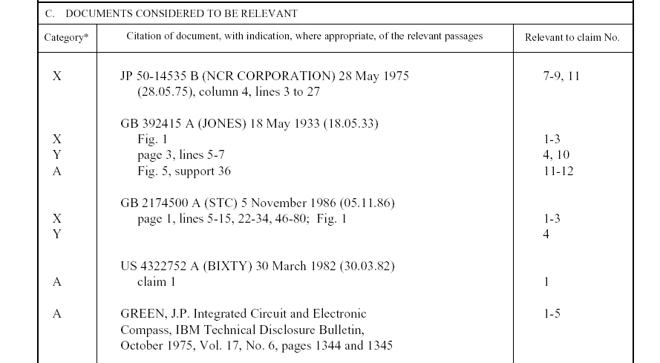
Example: PCT International Search Report
Symbols indicating
which aspect of patentability
the document cited is
relevant to (for example, novelty, inventive step, etc.)
The claim numbers
in your application to
which the document is
relevant
Documents relevant to whether or not your invention may be patentable

Slide 44
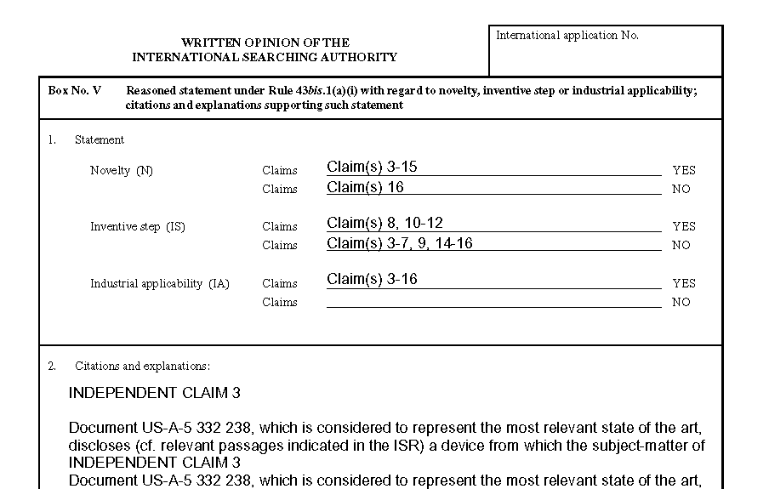
Example: PCT Written opinion of the International Searching Authority
Reasoning supporting the assessment
Patentability assessment
of claims

Slide 45
The PCT System
Express intention and take steps to pursue to grant in various states
Typically filed in same national patent office--one set of fees, one language, one set of formality requirements--and legal effect in all PCT States
Disclosing to world content of application in standardized way
Enter
national
phase
International
publication
(months)
0
12
16
18
22
28
30
File local
application
File PCT
application
International
search report & written opinion
(optional)
File
demand for
International
preliminary
examination
(optional)
International
preliminary report on patentability
Typically a national patent application in the home country of the applicant
Report on state of the art (prior art documents and their relevance) + initial patentability opinion
Additional patentability analysis, designed to assist in national phase decision-making
Request an additional patentability analysis on
basis of amended application

Slide 46

The PCT
filing tool for applicants with global reach
harmonized formalities
work-sharing tool for Offices
allows for
correction of errors
ePCT filing
and processing
buys time
patentability analysis
flexibility,
keeps options open

Slide 47
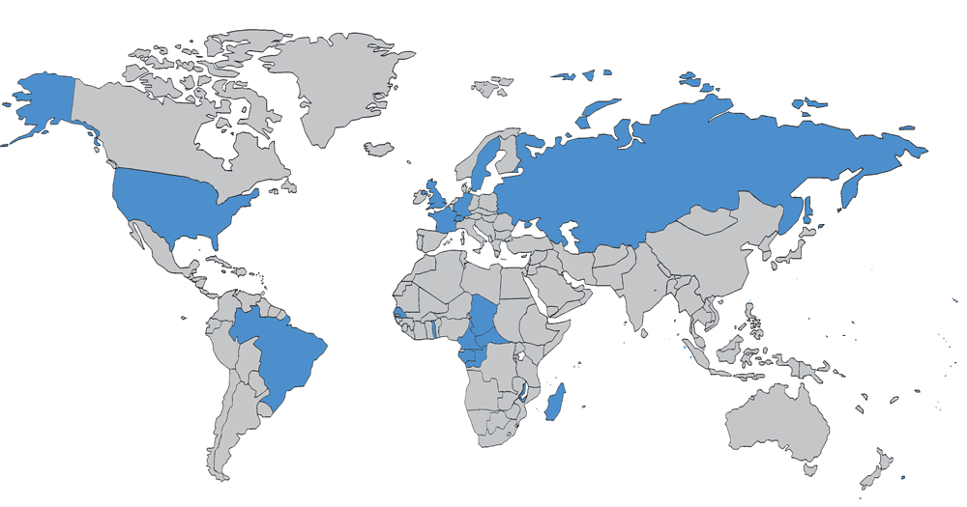
The PCT in 1978

Slide 48
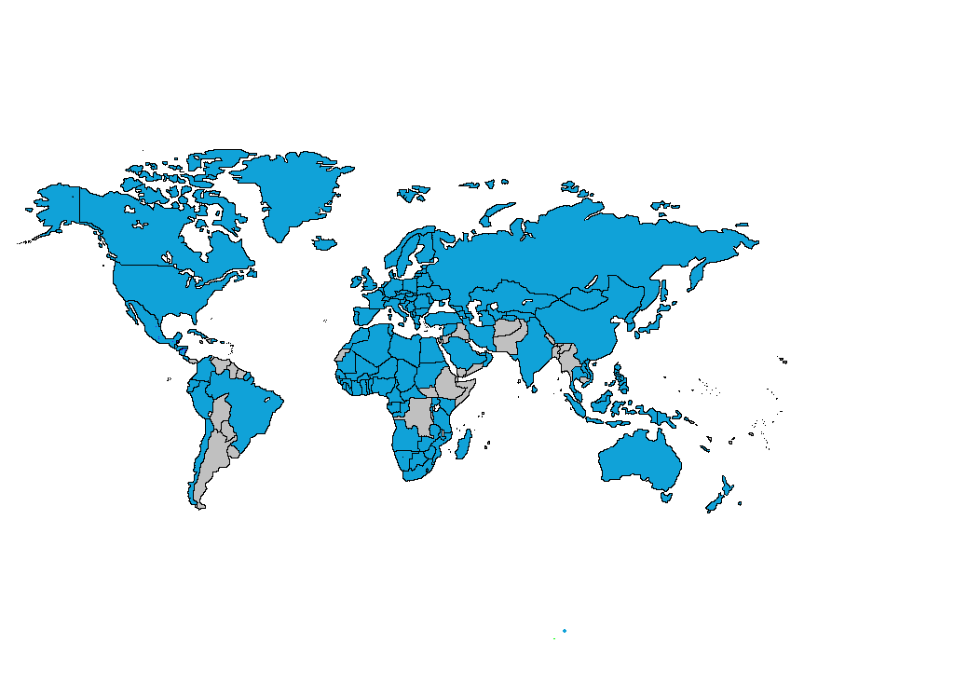
PCT Coverage Today

Slide 49

148 PCT States
=PCT
Albania
Algeria
Angola
Antigua and Barbuda
Armenia
Australia
Austria
Azerbaijan
Bahrain
Barbados
Belarus
Belgium
Belize
Benin
Bosnia and Herzegovina
Botswana
Brazil
Brunei Darussalam
Bulgaria
Burkina Faso
Cameroon
Canada
Central African Republic
Chad
Chile
China
Colombia
Comoros
Congo
Costa Rica
Côte d'Ivoire
Croatia
Cuba
Cyprus
Czech Republic
Democratic People's
Republic of Korea
Denmark
Dominica
Dominican Republic
Ecuador
Egypt
El Salvador
Equatorial Guinea
Estonia
Finland
France,
Gabon
Gambia
Georgia
Germany
Ghana
Greece
Grenada
Guatemala
Guinea
Malawi
Malaysia
Mali
Malta
Mauritania
Mexico
Monaco
Mongolia
Montenegro
Morocco
Mozambique
Namibia
Netherlands
New Zealand
Nicaragua
Niger
Nigeria
Norway
Oman
Panama
Papua New Guinea
Peru
Philippines
Poland
Portugal
Qatar
Republic of Korea
Republic of Moldova
Romania
Rwanda
Russian Federation
Saint Lucia
Saint Vincent and
the Grenadines
San Marino
Sao Tomé e Principe
Saudi Arabia
Senegal
Serbia
Seychelles
Sierra Leone
Singapore
Slovakia
Slovenia
South Africa
Spain
Sri Lanka
Sudan
Swaziland
Guinea-Bissau
Honduras
Hungary
Iceland
India
Indonesia
Iran
Ireland
Israel
Italy
Japan
Kazakhstan
Kenya
Kyrgyzstan
Lao People’s Dem Rep.
Latvia
Lesotho
Liberia
Libyan Arab Jamahiriya
Liechtenstein
Lithuania
Luxembourg
Madagascar
St. Kitts and Nevis
Sweden
Switzerland
Syrian Arab Republic
Tajikistan
Thailand
The former Yugoslav
Republic of Macedonia
Togo
Trinidad and Tobago
Tunisia
Turkey
Turkmenistan
Uganda
Ukraine
United Arab Emirates
United Kingdom
  United Republic of Tanzania
  United States of America
Uzbekistan
Viet Nam
Zambia
Zimbabwe
Notes:
49

Slide 50
Countries not yet in PCT
Afghanistan
Andorra
Argentina
Bahamas
Bangladesh
Bhutan
Bolivia
Burundi
Cambodia
Cape Verde
Democratic Republic of Congo
Djibouti
Eritrea
Ethiopia
Fiji
Guyana
Haiti
Iraq
Jamaica
Jordan
Kiribati
Kuwait
Lebanon
Maldives
Marshall Islands
Mauritius
Micronesia
Myanmar
Nauru
Nepal
Pakistan
Palau
Paraguay
Samoa
Solomon Islands
Somalia
South Sudan
Suriname
Timor-Leste
Tonga
Tuvalu
Uruguay
Vanuatu
Venezuela
Yemen
(45)

Slide 52
PCT Applications
+4.5% for 2014

Slide 53

International applications received in 2014 by country of origin
CN: +18.7%
GB: +9%
US: +7.8%
These 15 Offices received almost 92% of all applications filed in 2014
PCT fees=78% of WIPO’s revenue in 2014

Slide 54
Trend in PCT national phase entries

Slide 55
PCT national phase entries by office – 1-10

Slide 56
PCT national phase entries by office – 11-20

Slide 57
Top PCT Applicants 2014
Huawei Technologies—CN (3,442)
Qualcomm—US (2,409)
ZTE—CN (2,179)
Panasonic—JP (2,881)
Mitsubishi Electric—JP (1,593)
Intel—US (1,852)
Ericsson—SE (1,467)
Microsoft—US (1,460)
Siemens—DE (1,399)
Philips—NL (1,391)
Samsung—KR (1,381)
Toyota—JP(1,378)
Bosch—DE (1,371)
Sharp—JP (1,227)
NEC—JP (1,215)
LG Electronics—KR (1,138)
Tencent—CN (1,086)
Fujifilm—JP (1,072)
United Technologies—US (1,013)
Hitachi—JP (996)
() of published
PCT applications

Slide 58
Top University PCT Applicants 2014
University of California (US)
MIT (US)
University of Texas (US)
Harvard University (US)
Johns Hopkins (US)
Leland Stanford University (US)
Columbia University (US)
Cal Tech (US)
University of Pennsylvania (US)
Seoul National University (KR)
Cornell University (US)
Nanyang Technological University (SG)
University of Florida (US)
Kyoto University (JP)
Danemarks Tekniske Universitet (DK)
University of Tokyo (JP)
University of Michigan (US)
Korea University (KR)
Peking University (CN)
University of Washington (US)

Slide 59
PCT Applications
Greece: Joined PCT in 1990
  international application received in 2014 (RO/GR): 68
  international application filed by Greek applicants in 2014: 166
  top Greek applicants (2014):
Applicant | Publication | Rank
PHARMATHEN S.A. | 11 | 1926
BIC-VIOLEX SA | 8 | 2491
ICR IOANNOU ABEE | 2 | 8263
INTRACOM S.A. TELECOM SOLUTIONS | 2 | 8263
ATLANTIC - P. PECHLIVANIDES, IKE | 1 | 13744
BIOMEDICAL RESEARCH FOUNDATION OF THE ACADEMY OF ATHENS | 1 | 13744
BOUTSINIS I - BAFALOUKAS I. G.P. - VIOMETALOUMIN | 1 | 13744
CHEMICAL & BIOPHARMACEUTICAL LABORATORIES OF PATRAS S.A. | 1 | 13744
CHIPITA INDUSTRIAL AND COMMERCIAL COMPANY S.A. | 1 | 13744
DIGITAL VERIFICATION SERVICES LTD | 1 | 13744

Slide 60
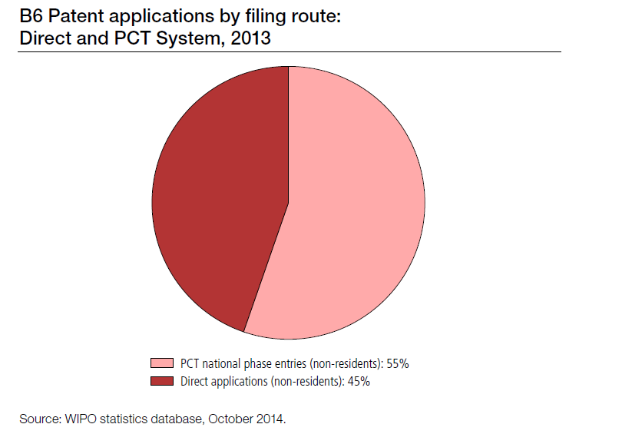
The PCT “Market Share”
*

Slide 61
PCT Key Advantages
Postpones major costs of internationalizing a patent application
Provides a strong basis for patenting decisions
Harmonizes formal requirements
Helps applicants to correct errors
Evolves to meet user needs

Slide 62
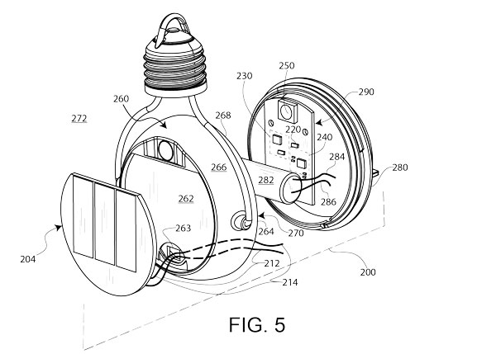
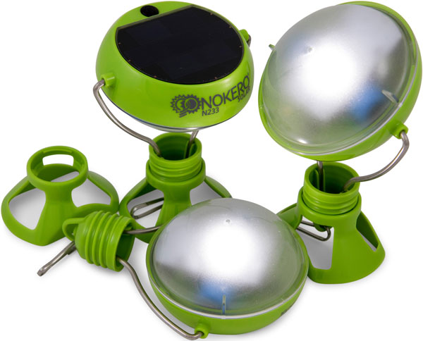
PCT Key Advantages
Nokero stands for "No Kerosene". Its solar-powered lights replace kerosene lamps and candles. It is the only solar company to win the United States Patent and Trademark Office's Patents for Humanity Award. It has so far distributed over 1.4 million lights in 120 countries. The idea for the light came from a US patent agent.
  “When it comes to patenting, because we operate in so many different markets, we use WIPO’s Patent Cooperation Treaty (PCT). Every start-up has limited funds and the PCT is a great mechanism for delaying patent filing costs, allowing time to test the market and overcome any unforeseen technical problems. Without the PCT, protecting an invention in international markets would be a high-risk strategy with huge upfront costs.
  “In 2013, we even won the Patents for Humanity award from the United States Patent and Trademark Office (USPTO). We hold around 20 patents and have successfully sued a number of infringing companies. Our patent and trademark rights enable us to protect our inventions and our brand as well as the interests of our investors and the efforts of our distributors.”*
photo: Nokero Intl. Ltd.
Launched in October 2015, Nokero’s patented N233 lamp (above) can produce 700 lumen-hours per watt. The industry standard is 300 lumen-hours per watt. Intellectual property plays a critical role in Nokero’s business strategy enabling it to protect its inventions and its brand as well as the interests of investors and distributors.
Source: WIPO Magazine, February 2016

Slide 63
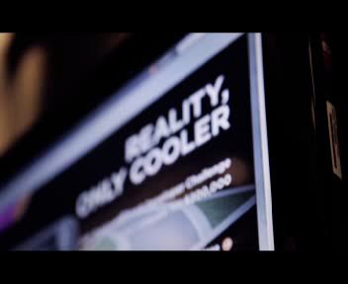
VIDEO QUALCOMM

Slide 64
The PCT ─ 1970 to Today
As filing tool: PCT extremely successful
  preferred route for international patenting (> 200,000 applications in in 2013, > 54% “market share”)
  harmonization of formal and procedural requirements, beyond PCT (national laws; Patent Law Treaty (PLT))

Slide 65
The PCT ─ 1970 to Today
However: as work sharing tool not as effective in practice for addressing national quality of examination and (for some Offices) backlogs
  expectation was: “flying start” for offices; completing, checking
  and criticizing …
  reality is: many Offices start “from scratch”, perhaps not in complete isolation, but …
What is needed: building trust between patent offices, so that duplicative international phase and national phase processing can
be reduced

Slide 66
PCT Areas of Work
Improve the quality and consistency of PCT international phase
work products
Develop quality metrics for measuring usefulness of work products and identifying areas of further work
Develop quality feedback system for offices
Help designated Offices to better understand reports
  search strategies, standardized clauses, explanations of relevance of cited documents, …
Explore collaborative search and examination
Third party observations system

Slide 67
PCT Areas of Work
Improve timeliness of actions in international phase
Develop metrics for entire PCT system
Create incentives for applicants to use system efficiently
  encourage high quality applications and early correction of defects and filing of amendments
  PCT/PPH
Improve access to national search and examination reports
  Patentscope, CASE, Global Dossier

Slide 68
PCT Areas of Work
Helping developing countries benefit from the PCT
  top 10 countries responsible for 87% of IAs published in 2013;
  top 15 countries = 92%; top 20 countries = 96%
  improve training for examiners, better coordinate training already offered
  improve access to affordable online search systems
Making PCT accessible to applicants of all types from all Contracting States
  fee reductions (SMEs, universities, research institutes, individual applicants)

Slide 69
PCT Areas of Work
ePCT: Seeks to provide electronic interface to entire PCT international phase process (RO, ISA, IPEA, IB):
  real time access to IB files and bibliographic data
  flexible applicant-controlled access rights system
  increasing access to RO, ISA, IPEA documents not traditionally held by IB
  increasing transmission of documents to RO, ISA, IPEA
  where possible, replace letters with directly usable information
  notifications of significant events and approaching deadlines

Slide 70
PCT Training Options
29 video segments on WIPO’s Youtube channel and WIPO’s PCT page about individual PCT topics
PCT Distance learning course content available in the 10 PCT publication languages
PCT Webinars
  free updates on developments in PCT procedures and PCT strategies
  also for companies or law firms
In-person PCT Seminars and training sessions

Slide 71
PCT Resources/Information
For further information about the PCT, see
http://www.wipo.int/pct/en/
For general questions about the PCT, contact the PCT Information Service at:
      Telephone: (+41-22) 338 83 38
      Facsimile: (+41-22) 338 83 39
      E-mail: pct.infoline@wipo.int

Slide 72
Thank You!
Claus Matthes
Director, Patent Cooperation Treaty (PCT) Business Development Division
World Intellectual Property Organization (WIPO)
34 chemin des Colombettes, 1211 Geneva 20, Switzerland
T + 41 22 338 98 09; claus.matthes@wipo.int; www.wipo.int

Slide 74

Overview of the Madrid System and the Hague System
Diego Carrasco Pradas
Deputy Director, Madrid Operations Division
Athens
8th of March 2016

Slide 75










It begins with a trademark and a plan to export…

Slide 76
Protection Options
…Then a choice must be made regarding the best way to protect your trademark/s abroad:
  The national route - file trademark application/s with the IP Office of each country in which you want protection
  The regional route - apply through a regional trademark registration system with effect in all member states (ARIPO, Benelux Office for IP, OHIM and OAPI)
  The international route - file through the Madrid System

Slide 77
The Madrid System Convenient
Access a centralized filing and management procedure
File one application, in one language and pay one set of fees for protection in multiple markets
Expand protection to new markets as your business strategy evolves

Slide 78
The Madrid System Cost-effective
File an international application, which is the equivalent of a bundle of national applications, effectively saving time and money
Avoid paying for translations into multiple languages or working through the administrative procedures of multiple IP Offices
Notes:
Saving in currency exchange rate costs?

Slide 79
Members of the Madrid System
  42 Protocol only (including EU and OAPI)
  55 Agreement and Protocol
  97 Members covering 113 countries

Slide 80

… More than 1.25 Million International Registrations
This LONGINES mark is the oldest trademark still in effect
Originally registered in Switzerland in 1889, then internationally in 1893
MICROMAX is international trademark registration 1.25 million
Originally registered in India in 2011, then internationally in 2014

Slide 81
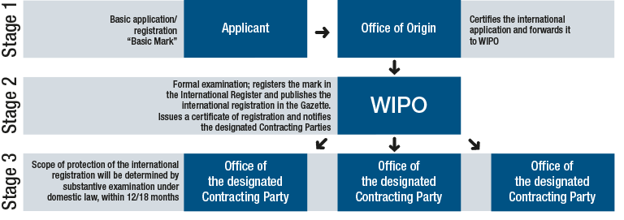
How the Madrid System Works
The International Trademark Registration Process

Slide 82
Stage 1
Application through your National or Regional IP Office (Office of origin)
To be entitled to use the Madrid System, you must:
  Have a real and effective industrial or commercial establishment in, or
  Be domiciled in, or
  Be a national of a member of the Madrid System
Before filing an international application, you need to have registered or filed an application (basic mark) in your Office of origin
Submit an international application through this same IP Office, which will certify and forward it to WIPO

Slide 83
Stage 2
Formal examination by WIPO
WIPO conducts a formalities examination of your international application
Once approved, the mark is recorded in the International Register
WIPO sends a certificate of international registration and notifies the IP Offices, of the designated Contracting Parties, in which protection is sought
The scope of protection is not known at this stage. It is only determined after substantive examination and decision by the IP Offices, as outlined in Stage 3

Slide 84
Stage 3
Substantive examination by IP Offices (Office of the designated Contracting Party)
IP Offices make a decision within 12 or 18 months in accordance with their legislation. WIPO records the decisions and notifies you
If an IP Office refuses to protect your mark, it will not affect the decisions of other offices. You can contest a refusal decision before the IP Office concerned
If an IP Office accepts to protect your mark, it will issue statement of grant of protection
The international registration is valid for 10 years. Renew directly with WIPO with effect in the designated Contracting Parties

Slide 85
Costs
Fees are payable to WIPO in Swiss francs
Basic fee*, which includes 3 classes of goods/services
  653 Swiss francs - b/w reproduction of mark
  903 Swiss francs - color reproduction of mark
Fees for designating Contracting Parties (dCP)
  Standard fees - complementary (100 Swiss francs per dCP and supplementary (100 Swiss francs per class beyond 3)
  OR
  Individual fees where this is declared
* Applicants from Least Developed Countries
benefit from a 90% reduction in the basic fee

Slide 86
Timeline
The International Trademark Registration Process
Decision of designated Office: Grant or Refusal
Office of Origin
WIPO
Designated Office
Substantive examination
Basic application or registration
2 months
2 – 3 months
12 or 18 months
Time limit for provisional refusal
Date of International Registration
IRN Certificate
Recorded at WIPO and communicated
Maintenance:Renewal every 10 years
10 years

Slide 87
WIPO Resources and E-Services
SEARCH ROMARIN – database of international registrations Member Procedures Global Brand Database – search marks by text and image from national/international sources, including trademarks, appellations of origin and official emblems (over 24,000,000 records) | FILE Forms and E-Forms Madrid Goods & Services Manager – correct good & service specifications and translation International Application Simulator Fee Calculator E-Payment – online payment system by credit card/WIPO current account
MONITOR Madrid Real-Time Status of international applications and progress of requests being processed by WIPO Madrid Electronic Alert monitor changes to international registrations (third party tool) | MANAGE Madrid Portfolio Manager access registration documents, uploading of requests for recording, payments Forms and E-Forms – E-Subsequent Designation and E-Renewal Extracts from the International Register

Slide 88
WIPO Resources and E-Services
CONSULT E-Services overview and tutorials Legal texts – Agreement/Protocol, Regulations, Administrative Instructions Declarations made under the Madrid Agreement and the Madrid Protocol Guide to the International Registration of Marks | WIPO Gazette of International Marks Office practices on replacement Statistics Making the Most of the Madrid System – Web publication Warning – misleading invoices
UPDATES Information Notices Madrid Highlights – quarterly newsletter for Madrid System users | Subscribe to receive news and updates on the Madrid System by e-mail

Slide 89
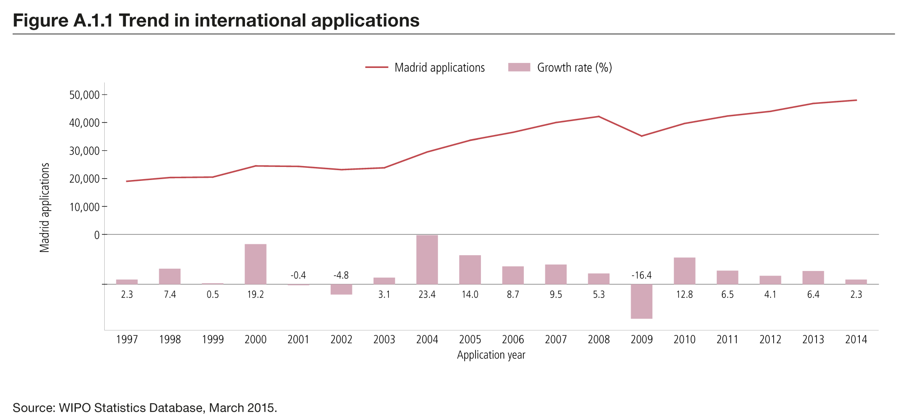
International Applications
Notes:
To be updated in March 2016
Source: Madrid Yearly Review 2015, WIPO publication No. 940

Slide 90
Top Offices of origin (OO)
Contracting Parties | 2013 | 2014 | 2015
United States of America | 5,893 | 5,414 | 8,486
European Union | 6,814 | 6,996 | 8,131
Germany | 4,357 | 3,883 | 4,603
France | 3,514 | 3,377 | 3,718
Switzerland | 2,885 | 2,994 | 3,128
Japan | 1,855 | 1,729 | 2,407
China | 2,455 | 1,738 | 2,231
Australia | 1,195 | 1,246 | 2,229
Italy | 2,118 | 2,070 | 2,165
United Kingdom | 1,580 | 1,560 | 2,068
Notes:
International registration by Office of origin, 2013 -2015
Source: Statistics under the Madrid System, January 2016 (http://www.wipo.int/madrid/en/statistics/)
http://www.wipo.int/madrid/en/statistics/annual_stats.jsp?type=EN&name=1

Slide 91
Top designated Contracting Parties
Contracting Parties | 2013 | 2014 | 2015
China | 20,275 | 20,309 | 24,849
United States of America | 17,322 | 17,268 | 21,996
European Union | 17,598 | 17,270 | 21,721
Russian Federation | 18,239 | 16,573 | 17,436
Japan | 13,179 | 12,814 | 15,776
Switzerland | 13,215 | 12,759 | 14,584
Australia | 11,675 | 11,533 | 14,292
Republic of Korea | 10,967 | 10,402 | 12,997
India | 1,916 | 8,138 | 11,391
Mexico | 5,095 | 8,533 | 10,569
Notes:
Designations in international registrations and subsequent designations by designated Contracting Parties, 2013 -2015
Source: Statistics under the Madrid System, January 2016 (http://www.wipo.int/madrid/en/statistics/)
http://www.wipo.int/madrid/en/statistics/annual_stats.jsp?type=ENEX&name=2

Slide 92
Applications and Registrations from Greece

Slide 93
Designations of Greece
(Greece and via the EU)

Slide 94
Top 10 Contracting Parties designating
Greece in 2015
Total designations: 1.371

Slide 95
Short-term Future of the System
  Enlarging Membership
  ASEAN countries - Brunei Darussalam, Indonesia, Malaysia and Thailand
  Canada
  Caribbean countries – Trinidad and Tobago, and Jamaica
  African countries – Malawi and South Africa
  Latin American countries
  Arab Countries
  Broad-based review of E-Services and development of an online Customer Resources Center
Notes:
To be updated accordingly

Slide 96
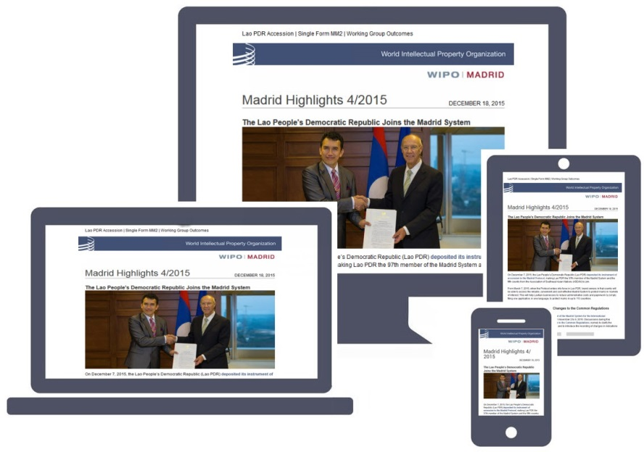
Keep Updated on the Madrid System
Visit the Madrid Website www.wipon.int/madrid/en
Subscribe to
Madrid Notices,
our regular legal
and news updates
Sign up for
Madrid Highlights,
our quarterly newsletter
Notes:
Top level navigation and messaging of the Madrid web site recently revamped.
For regular users, tools and resources grouped according to the lifecycle of a mark – Search, File, Monitor and Manage. For prospective users, new pages created at the top of the homepage, including benefits, how the System works and FAQs. For new users, set of pages created on searching before filing and the pages on filing an application have been updated.
New Madrid web pages (key/basic information and resources) and Madrid news items NOW available in Arabic, Chinese, Russian and Japanese, in addition to English, French and Spanish.
WIPO e-newsletter distribution platform to subscribe to Madrid Notices and Madrid Highlights.
Madrid Highlights received in English, French and Spanish. Online version now available in Arabic, Chinese and Russian.

Slide 97

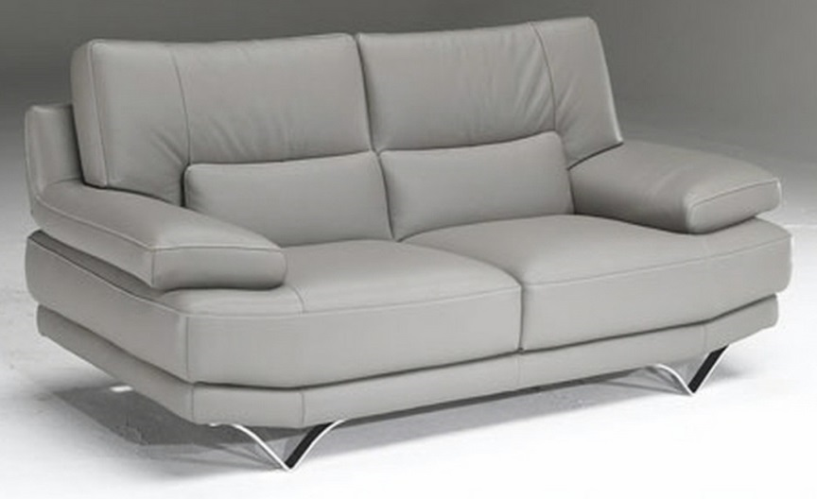
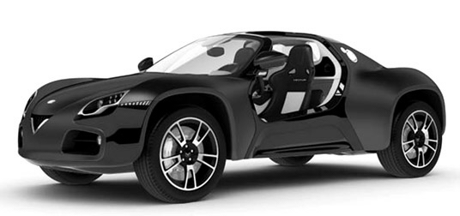
Industrial Designs
DM/074502 DM/083330 DM/081900

Slide 98
Independent filings vs. Hague Route
Direct/Paris Route
The Hague System

Slide 99
Hague Union
50 Geneva Act (1999) (including EU and OAPI)
15 Hague Act (1960)
65 Contracting Parties

Slide 100
Hague Union Members according to the most recent applicable Act
Geneva Act (1999)
African Intellectual Property Organization, Albania, Armenia, Azerbaijan, Bosnia and Herzegovina, Botswana, Brunei Darussalam, Bulgaria, Croatia, Denmark, Egypt, Estonia, European Union, Finland, France, Georgia, Germany, Ghana, Hungary, Iceland, Japan, Kyrgyzstan, Latvia, Liechtenstein, Lithuania, Monaco, Mongolia, Montenegro, Namibia, Norway, Oman, Poland, Republic of Korea, Republic of Moldova, Romania, Rwanda, Sao Tome and Principe, Serbia, Singapore, Slovenia, Spain, Syrian Arab Republic, Switzerland, Tajikistan, the former Y.R. of Macedonia, Tunisia, Turkey, Turkmenistan, Ukraine and the United States of America
Hague Act (1960)
Belgium, Belize, Benin, Côte d’Ivoire, D.P.R. of Korea, Gabon, Greece, Italy, Luxembourg, Mali, Morocco, Netherlands, Niger, Senegal and Suriname

Slide 101
Geneva Act (1999)
Recent Accessions
Potential accessions
United States of America
(May, 2015)
Japan
(May, 2015)
Republic of Korea
(July 2014)
Turkmenistan
(as from March 16, 2016)
China
Russian Federation
Morocco
ASEAN countries
Israel
Belize
Mexico
Madagascar

Slide 102
Total of Greece designations
Contracting Party of the Holder | 2013 | 2014 | 2015
Bulgaria | 1 | 1 | 1
European Union | 31 | 23 | 31
France | 3 | 5 | 6
Germany | 13 | 16 | 3
Republic of Moldova | 0 | 1 | 0
Serbia | 3 | 5 | 6
Switzerland | 3 | 0 | 1
The former Yugoslav Republic of Macedonia | 1 | 0 | 1
Ukraine | 0 | 0 | 2
Total of Greece designations | 55 | 51 | 51

Slide 103
Total designations: Greece and the European Union
Designated Contracting Party | 2010 | 2011 | 2012 | 2013 | 2014 | 2015
European Union | 1,586 | 1,825 | 1,809 | 2,026 | 2,049 | 2,720
Greece | 55 | 46 | 55 | 55 | 51 | 51
Total | 1,641 | 1,871 | 1,864 | 2,081 | 2,100 | 2,771

Slide 104
Thank you
for your attention

Slide 106
WIPO’s Arbitration and Mediation Center
Víctor Vázquez Presenter Name
Head, Section for the Coordination of Developed Countries.
World Intellectual Property Organization
Seminar on WIPO Services and Initiatives
Athens 8 March, 2016

Slide 107
Top Ten Priorities in Choice of Dispute Resolution Clause (WIPO Survey)
WIPO Center Report on International Survey of Dispute Resolution in Technology Transactions

Slide 108
WIPO Arbitration and Mediation Center
Facilitates the resolution of commercial disputes between private parties involving IP and technology, through procedures other than court litigation (alternative dispute resolution: ADR)
  Offices in Geneva and Singapore
ADR of IP disputes benefits from a specialized ADR provider
  WIPO mediators, arbitrators and experts experienced in IP and technology - able to deliver informed results efficiently
Competitive WIPO fees
International neutrality
Services include mediation, (expedited) arbitration, expert determination, and domain name dispute resolution

Slide 109
WIPO ADR
Mediation, Arbitration, Expert Determination
Mediation: informal consensual process in which a neutral intermediary, the mediator, assists the parties in reaching a settlement of their dispute, based on the parties’ respective interests. The mediator cannot impose a decision. The settlement agreement has force of contract. Mediation leaves open available court or agreed arbitration options.
Arbitration: consensual procedure in which the parties submit their dispute to one or more chosen arbitrators, for a binding and final decision (award) based on the parties’ rights and obligations and enforceable internationally. Arbitration normally forecloses court options.
Expert Determination: consensual procedure in which the parties submit a specific matter (e.g., technical question) to one or more experts who make a determination on the matter, which can be binding unless the parties have agreed otherwise.

Slide 110
Why Consider IP ADR?
Cost of IP court litigation
  Calls for expedient solutions
Internationalization of creation/use of IP
  Calls for cross-border solutions; consolidate in one procedure
Technical and specialized nature of IP
  Calls for specific expertise of the neutral
Short product and market cycles in IP
  Calls for time-efficient procedures
Confidential nature of IP
  Calls for private procedures
Collaborative nature of IP creation and commercialization
  Calls for mechanisms that preserve relations

Slide 111
Routes to WIPO ADR
ADR contract clause electing WIPO Rules
    WIPO Mediation, and/or
    WIPO (Expedited) Arbitration, and/or
    WIPO Expert Determination
  Model clauses: www.wipo.int/amc/en/clauses/index.html
    Parties can shape the process via the clause (e.g., location, language, law)
ADR submission agreement electing WIPO Rules, e.g., in existing non-contractual disputes
Court referrals

Slide 112
WIPO ADR Options
WIPO Contract Clause/ Submission Agreement
Party Agreement
(Negotiation)
First Step
Mediation
Expert Determination
Expedited Arbitration
Arbitration
Procedure
Determination
Settlement
Award
Outcome

Slide 113
WIPO Model Clause Example: Mediation followed by Expedited Arbitration
"Any dispute, controversy or claim arising under, out of or relating to this contract and any subsequent amendments of this contract, including, without limitation, its formation, validity, binding effect, interpretation, performance, breach or termination, as well as non-contractual claims, shall be submitted to mediation in accordance with the WIPO Mediation Rules. The place of mediation shall be [specify place]. The language to be used in the mediation shall be [specify language]”
If, and to the extent that, any such dispute, controversy or claim has not been settled pursuant to the mediation within [60][90] days of the commencement of the mediation, it shall, upon the filing of a Request for Arbitration by either party, be referred to and finally determined by arbitration in accordance with the WIPO Expedited Arbitration Rules. Alternatively, if, before the expiration of the said period of [60][90] days, either party fails to participate or to continue to participate in the mediation, the dispute, controversy or claim shall, upon the filing of a Request for Arbitration by the other party, be referred to and finally determined by arbitration in accordance with the WIPO Expedited Arbitration Rules. The place of arbitration shall be [specify place]. The language to be used in the arbitral proceedings shall be [specify language]. The dispute, controversy or claim referred to arbitration shall be decided in accordance with [specify jurisdiction] law."
www.wipo.int/amc/en/clauses/index.html
Notes:
113

Slide 114
WIPO Center Case Role
  Administering cases
    Under WIPO Rules, or under special procedures
    Active management: containing time and costs
      WIPO ECAF (optional online case management)
  Facilitating selection and appointment of mediators, arbitrators, experts
    WIPO list of 1,500+ neutrals
      From numerous countries in all regions
      Specialized in different areas of IP and IT

Slide 115
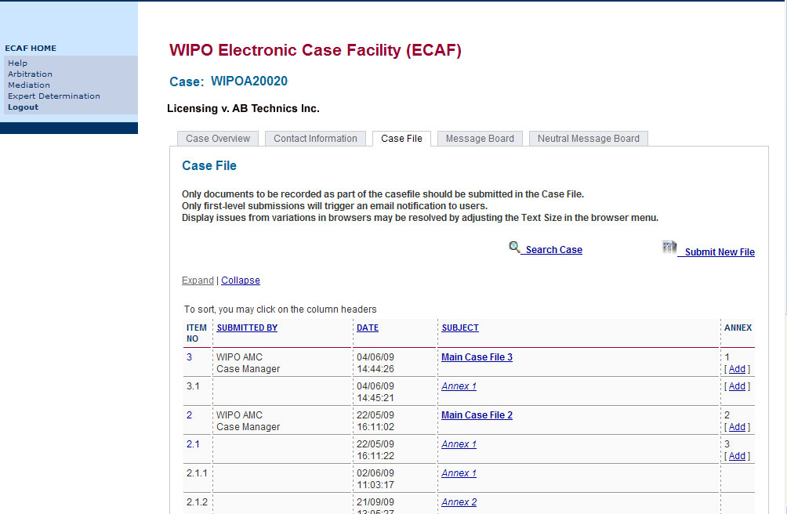
WIPO Electronic Case Facility (ECAF)
Simple; secure; instant; location-independent; optional

Slide 116
116
WIPO Arbitration
WIPO Expedited Arbitration
Request for Arbitration
Request for Arbitration
and Statement of Claim
Answer to Request for Arbitration
Answer to Request for Arbitration and Statement of Defense
Appointment of Arbitrator(s)
Appointment of Arbitrator(s)
Statement of Claim
Hearing
Statement of Defense
Closure of Proceedings
Further Written Statements and Witness Statements
Final Award
Hearings
One exchange of pleadings
Shorter time limits
Sole arbitrator
Shorter hearings
Fixed fees
Closure of Proceedings
Final Award
Notes:
116

Slide 117
Taxonomy of WIPO Cases
IP/IT disputes and commercial disputes
  Contractual: patent licenses, software/ICT, R&D and technology transfer agreements, patent pools, distribution agreements, joint ventures, copyright collecting societies, trademark coexistence agreements, settlement agreements
  Non-contractual: infringement of IP rights
Domestic and international disputes (25/75%)
Amounts in dispute from USD 50,000 to USD 1 billion

Slide 118
Dispute Areas in WIPO Mediation and Arbitration Cases
PATENTS
Cross-licensing
Infringements
Licenses
Ownership
Patent Pools
R&D / Tech Transfer
Royalty Payment
TRADEMARKS
Coexistence
Infringements
Licenses
Oppositions
Revocations
COPYRIGHT
Art
Broadcasting
Entertainment
Film and Media
Infringements
TV Formats
COMMERCIAL
Distribution
Energy
Franchising
Marketing
Sports
ICT
Mobile Apps
Outsourcing
Systems Integration
Software Development
Software Licensing
Telecommunications

Slide 119
How Are Technology Disputes Resolved?
WIPO Center Report on International Survey of Dispute Resolution in Technology Transactions

Slide 120
Relative Time and Cost of Technology Dispute Resolution
WIPO Center Report on International Survey of Dispute Resolution in Technology Transactions

Slide 121
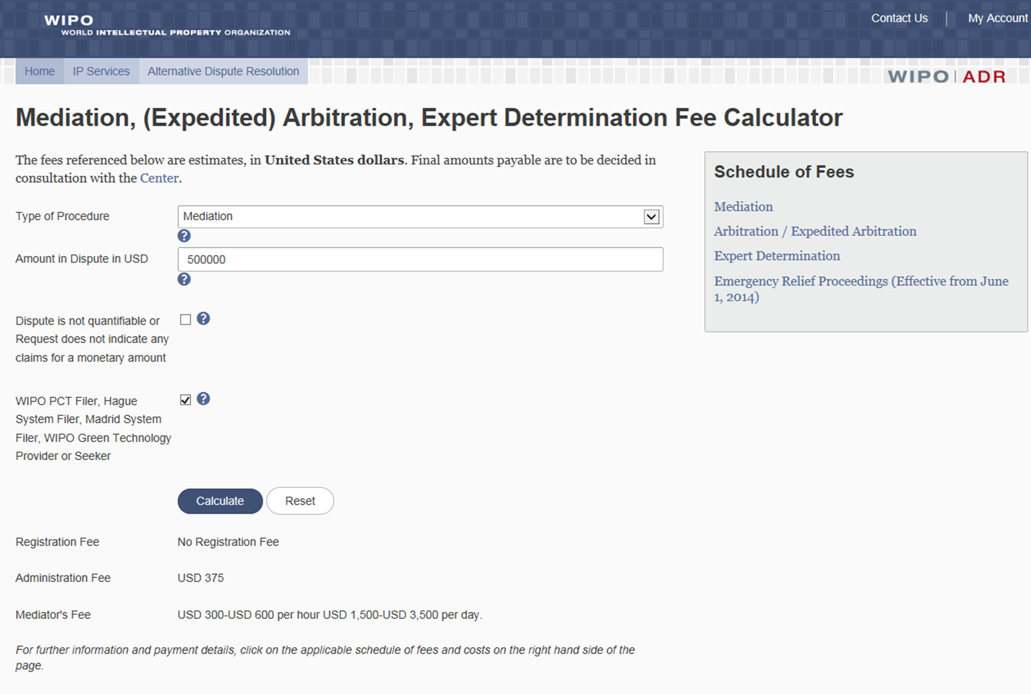
Fee Calculator
www.wipo.int/amc/en/calculator/adr.jsp

Slide 122
Uniform Domain Name Dispute
Resolution Policy (UDRP)
1999: WIPO-created international administrative ADR procedure
Allows trademark owners to resolve “clear cut” cases of abusive domain name registration and use (“cybersquatting”)
Operates outside the courts, but preserves party court option
Uniform: applicable to all gTLDs “old” (.com, .net, .org, etc.) and “new” (.bike, .fail, .nyc, etc.)
Applicable via mandatory “contract web” between ICANN, registrars, and registrants

Slide 123
  UDRP: Principal Advantages
  Significantly quicker and cheaper than court litigation
    Two-month average; fixed fees (USD 1,500)
  Predictable criteria and results
  Decision (transfer) implemented directly by registrar
  Prevents consumer confusion/brand abuse

Slide 124
The UDRP Test – Three Elements
  Trademark must be identical or confusingly similar to the domain name; and
  The registrant of the domain name must have no rights or legitimate interests in the domain name; and
  The domain name must have been registered and used in bad faith.

Slide 125
Domain Name Dispute Filing with WIPO
15 years’ experience as the global leader in domain name dispute resolution
  32,000+ cases covering 60,000+ domain names
    2014 total: 2,634 cases
  Involving parties based in 177 countries
  Multilingual case administration (21 languages to date)
  Paperless filing: WIPO-initiated eUDRP
  US first-ranked for WIPO case parties and panelists

Slide 126
WIPO UDRP Complainant Areas of Activity

Slide 127
Key WIPO UDRP Resources
WIPO Guide to the UDRP
www.wipo.int/amc/en/domains/guide
Model pleadings (complaint and response)
www.wipo.int/amc/en/domains/complainant
Legal Index of UDRP Decisions
www.wipo.int/amc/en/domains/search/index.html
WIPO Jurisprudential Overview of Selected UDRP Questions
www.wipo.int/amc/en/domains/search/overview/index.html

Slide 128
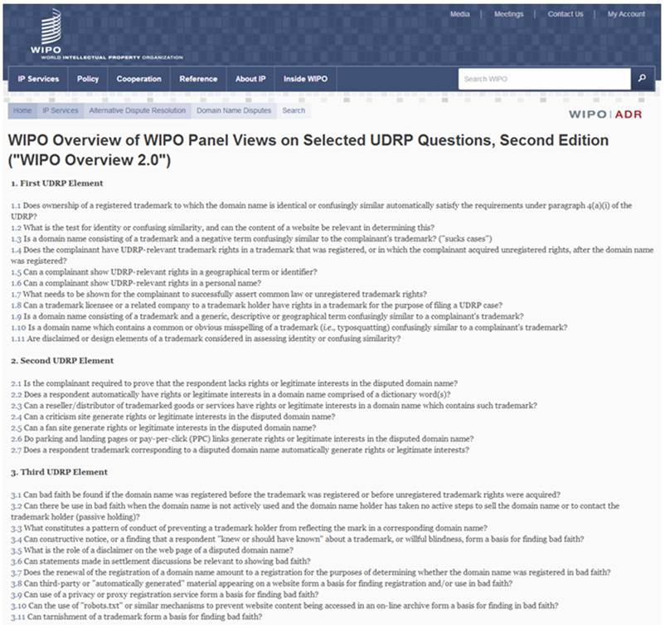

Slide 129

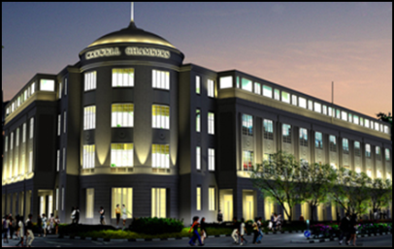
Further Information
WIPO Arbitration and Mediation Center Offices
  Geneva, Switzerland
  Singapore, Singapore
WIPO External Offices
  Rio de Janeiro, Brazil
  Beijing, China
  Tokyo, Japan
  Moscow, Russia
  Singapore, Singapore

Slide 130
Further Information
Queries and case filing:
arbiter.mail@wipo.int
Model clauses:
www.wipo.int/amc/en/clauses/
Info on procedures, neutrals and
case examples:
www.wipo.int/amc/

Slide 132

Παγκόσμιες βάσεις δεδομένων Βιομηχανικής Ιδιοκτησίας (ΒΙ) Εργαλεία για την οικονομία συνδυασμένης γνώσης
Ομιλητής: Αντώνιος Φαρασόπουλος
Διευθυντής, Διεύθυνση Διεθνών Ταξινομήσεων και Προτύπων, Τομέας Παγκόσμιων Υποδομών

Slide 133
Στρατηγικοί στόχοι των παγκοσμίων βάσεων δεδομένων και των αντιστοίχων εργαλείων
2 σχετικοί στόχοι:
  “Συντονισμός και ανάπτυξη παγκόσμιας υποδομής ΔΙ”
  “Παγκόσμια πηγή αναφοράς για πληροφορίες και ανάλυση ΔΙ”

Slide 134
Πλεονεκτήματα για τους ενδιαφερόμενους
Για τις επιχειρήσεις/έρευνα:
  Παροχή δυνατοτήτων αναζήτησης σε συλλογές ΒΙ (διπλώματα ευρεσιτεχνίας, εμπορικά σήματα, βιομηχανικά σχέδια)
  Απλοποίηση των διαδικασιών αιτήσεων σε πολλαπλές αρχές ΒΙ
  παροχή υπηρεσιών ΒΙ σχετιζόμενου συντονισμού
Για τα γραφεία ΒΙ:
  Υποβοήθηση του αυτοματισμού, διάχυση πληροφοριών ΒΙ στο κοινό, και ανταλλαγή των εγγράφων τους με άλλα γραφεία

Slide 135

Δωρεάν παγκόσμιες βάσεις δεδομένων, εργαλεία, και πλατφόρμες ΒΙ του WIPO
PATENTSCOPE
Global Brand Database
Global Design Database
WIPO Lex
WIPO Pearl
WIPO IPAS, WIPO DAS
WIPO CASE
WIPO RE:SEARCH
WIPO GREEN

Slide 136
Η βάση δεδομένων διπλωμάτων ευρεσιτεχνίας του WIPO PATENTSCOPE
2,7 εκατομμύρια δημοσιευμένες PCT αιτήσεις (πρώτη δημοσίευση κάθε εβδομάδα, πλήρες κείμενο υψηλής ποιότητας)
51 εκατομμύρια αιτήσεις διπλωμάτων ευρεσιτεχνίας από 41 χώρες ή περιοχές
Δεδομένα πλήρους κειμένου από 20 χώρες ή περιοχές
15000 αναγνώσεις σελίδων ανά ώρα
Αναζήτηση και ανάγνωση στη προτιμώμενη γλώσσα σας
Ανάλυση αποτελεσμάτων μέσω γραφημάτων και διαγραμμάτων

Slide 137
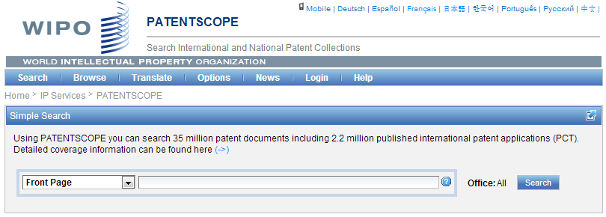
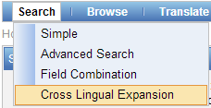
Δυνατότητες αναζήτησης – αρχάριοι έως προχωρημένοι χρήστες
Εάν θέλετε να κάνετε αναζήτηση προηγούμενης τεχνικής στο Patentscope με λέξεις-κλειδιά σε πολλαπλές γλώσσες, πηγαίνετε στη «Διασταυρωμένη Γλωσσική Επέκταση» (CLIR)

Slide 138
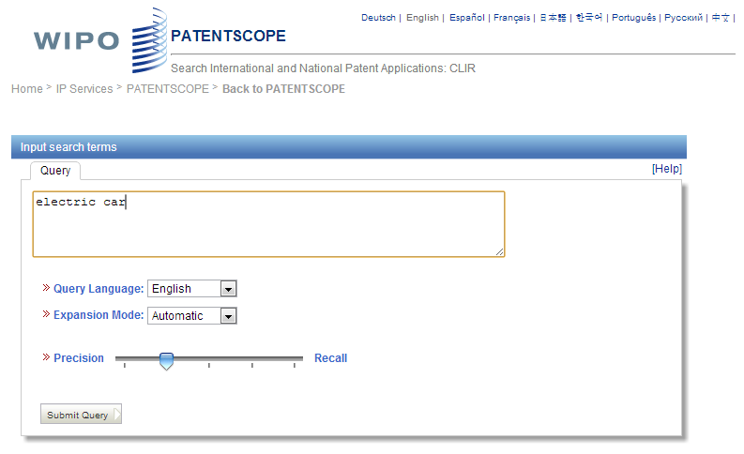

Aναζήτηση με τη βοήθεια του CLIR

Slide 139
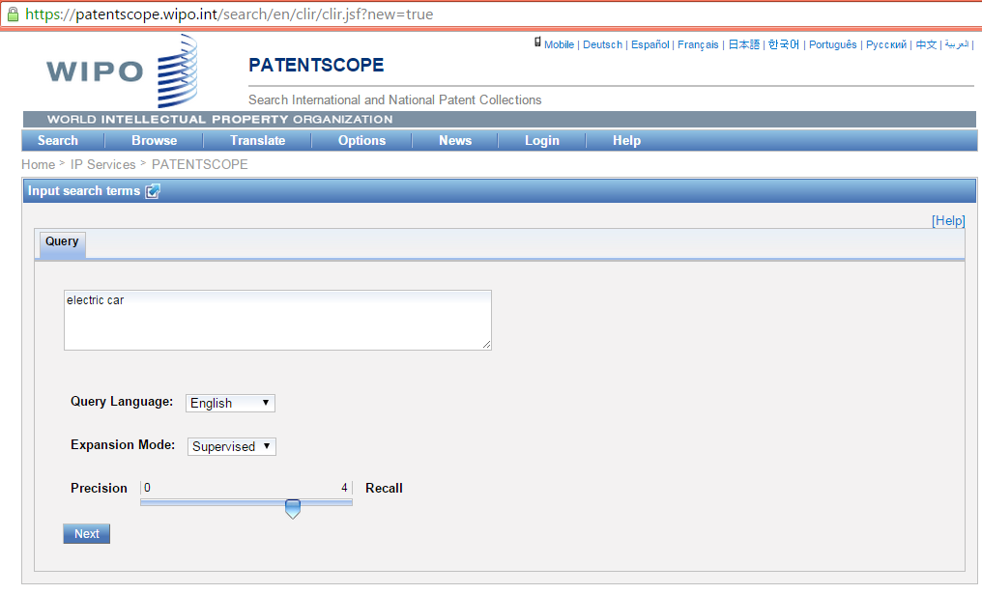
TIP: Use a key term in English. Why?
Αναζήτηση δυνατή σε 14 γλωσσες
Συμβουλή: λέξεις αναζήτησης – στα αγγλικά (καλύτερη για αύτόματη μετάφραση)

Slide 140
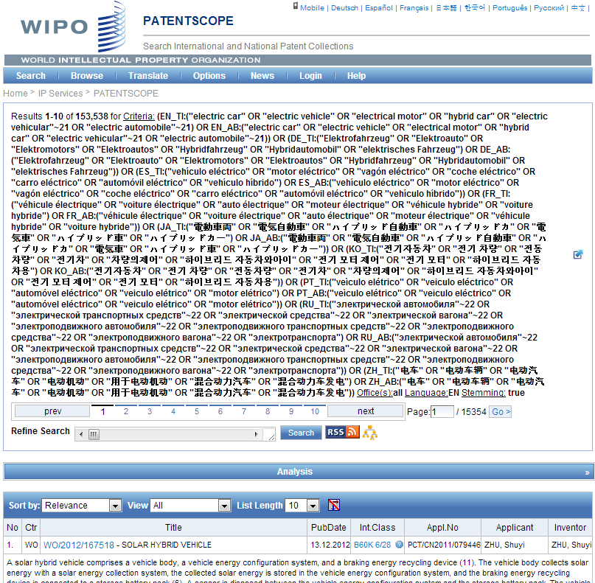

Όροι αναζήτησης:
Συνώνυμα και τεχνολογικά συναφείς όροι
Electric car - αποτελέσματα αναζήτησης μόνο στα Αγγλικά: 16,000 αποτελέσματα.
Αναζήτηση με τη βοήθεια του CLIR: πάνω από 153.000 αποτελέσματα

Slide 141
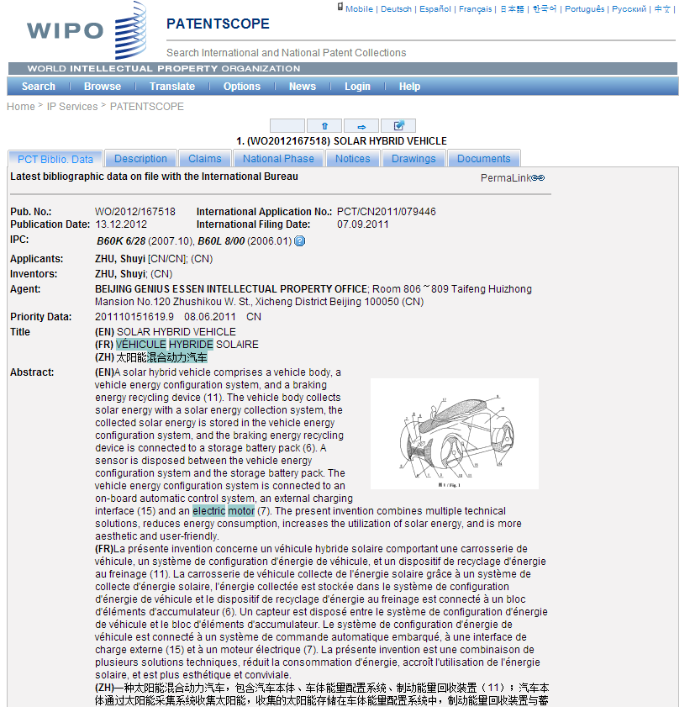

Slide 142
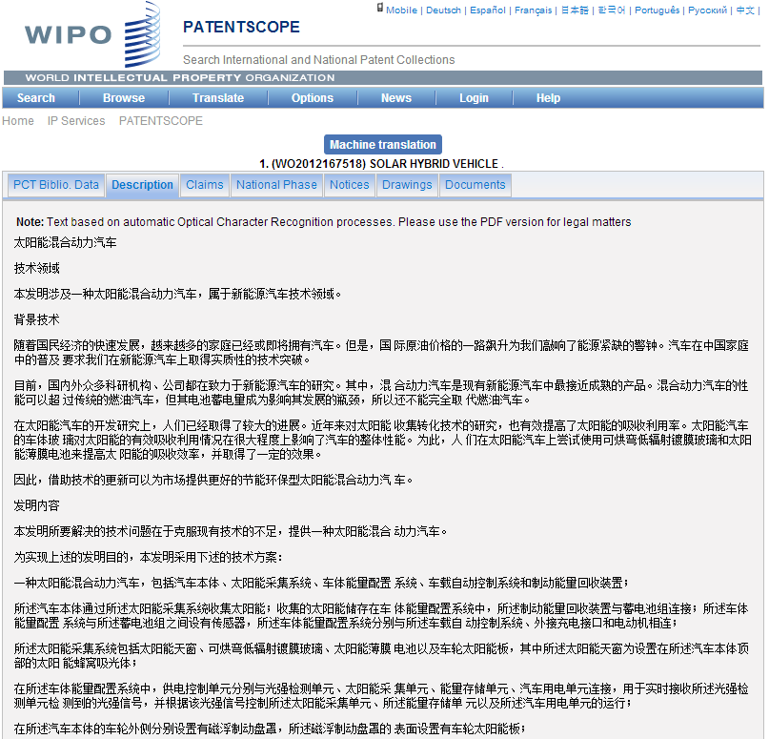
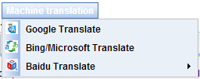
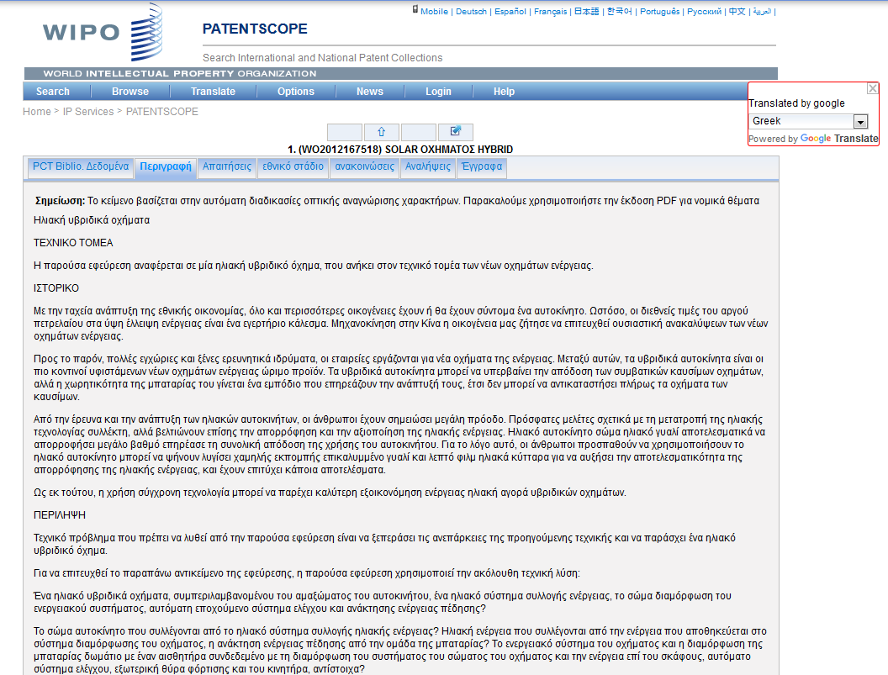
Εργαλεία μετάφρασης – πρόσβαση σε ξενόγλωσσες δημοσιεύσεις
???

Slide 143
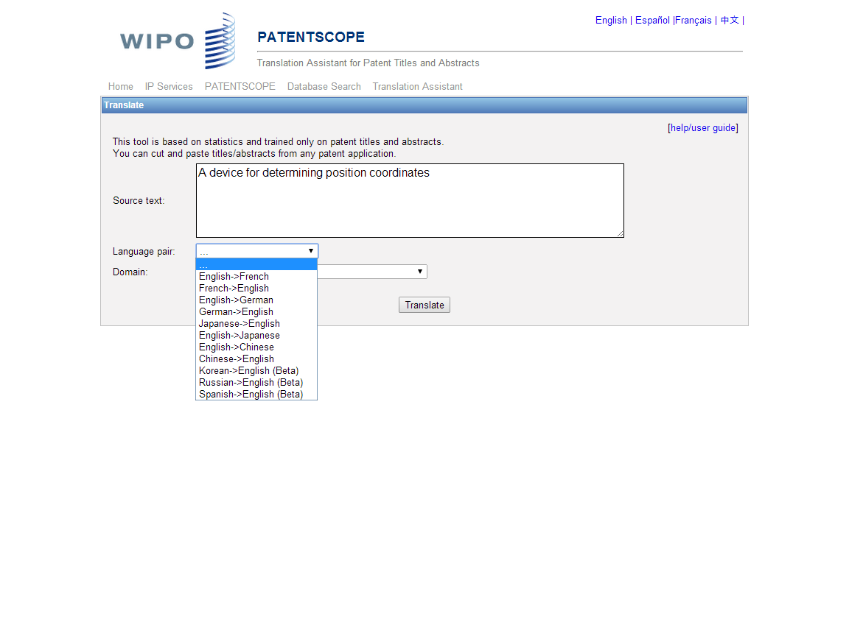
Για περιλήψεις και τίτλους διπλωμάτων ευρεσιτεχνίας, το WIPO TRANSLATE είναι ανώτερο από το Google Translate και το Microsoft Translate, όπως μετρήθηκε με τη βαθμολογία BLEU (Bilingual Evaluation Understudy)

Slide 144
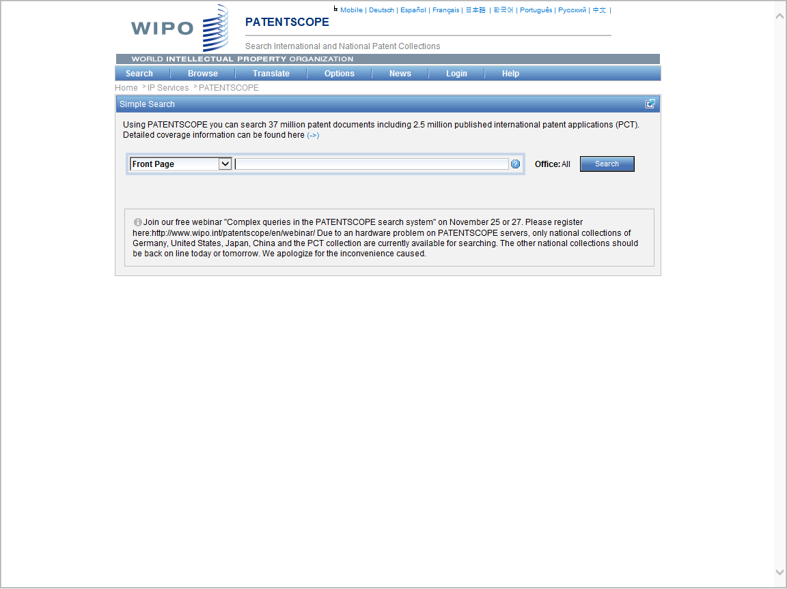
Login (δωρεάν μέσω του e-mails σας) επιτρέπει στους χρήστες:
να αποθηκευσουν προηγούμενες αναζητήσεις
να εξάγουν τα αποτελέσματα αναζήτησης σε φύλλα
Εxcel για εκτύπωση ή για ανάλυση των αποτελεσμάτων

Slide 145
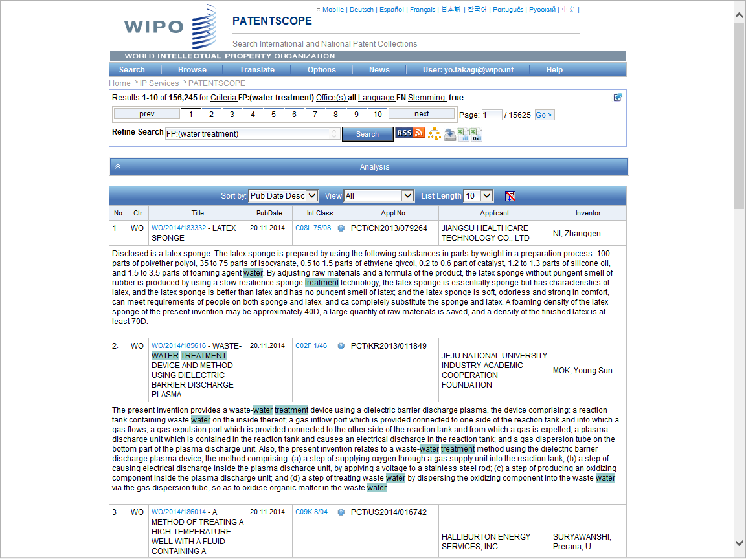
Διάφορα γραφήματα μπορούν να δημιουργηθούν μέσω της « Ανάλυσης»
κατέβασμα αποτελεσμάτων αναζήτησης σε φύλλα excel
αποθήκευση αποτελεσμάτων αναζήτησης

Slide 146
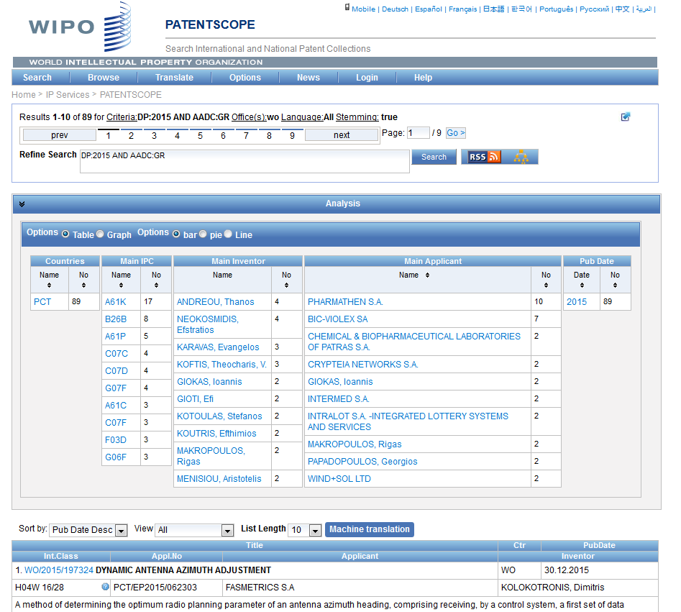

Slide 147
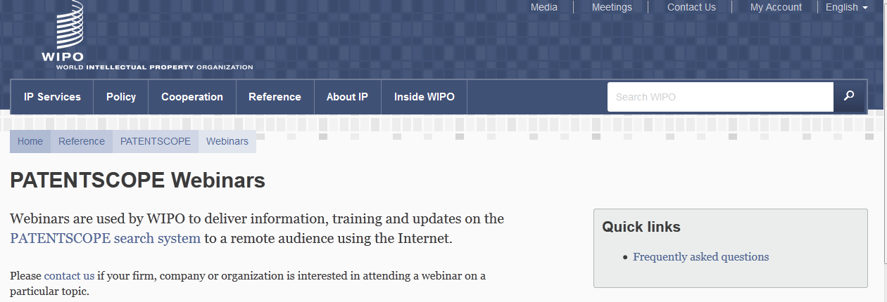
Μηνιαία σεμινάρια PATENTSCOPE στο δίκτυο

Slide 148
ΔΩΡΕΑΝ ΠΑΓΚΟΣΜΙΕΣ ΒΑΣΕΙΣ ΔΕΔΟΜΕΝΩΝ, ΕΡΓΑΛΕΙΑ ΚΑΙ ΠΛΑΤΦΟΡΜΕΣ ΠΟΥ ΠΡΟΣΦΕΡΕΙ ΤΟ WIPO
PATENTSCOPE
Global Brand Database
Global Design Database
WIPO Lex
WIPO Pearl
WIPO IPAS, WIPO DAS
WIPO CASE
WIPO RE:SEARCH
WIPO GREEN

Slide 149
GLOBAL BRAND DATABASE
25 εκατομμύρια εγγραφές σχετιζόμενες με διεθνώς προστατευμένα εμπορικά σήματα κλπ
Δωρεάν ταυτόχρονες αναζητήσεις σχετιζόμενες με εμπορικό σήμα σε πολλαπλές συλλογές, μεταξύ αυτών:
  Εμπορικά σήματα καταχωρημένα στο πλαίσιο του συστήματος Μαδρίτης
  Ονομασία προέλευσης καταχωρημένη στο πλαίσιο του συστήματος Λισαβώνας
  Εμβλήματα προστατευμένα στο πλαίσιο της σύμβασης του Παρισιού 6ter
  26 εθνικές συλλογές και αυτές αυξάνουν συνεχώς: AE, AU, BN, CA, CH, DE, DK, DZ, EE, EG, ID, IL, JP, KH, KR, LA, MA, MD, MX, NZ, OM, PH, SG, TO και US
Video demo:
http://www.wipo.int/pressroom/en/articles/2014/article_0007.html

Slide 150
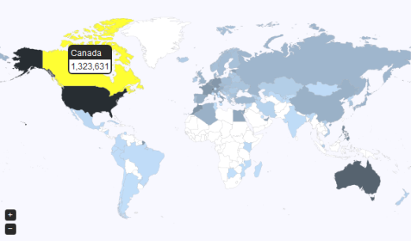
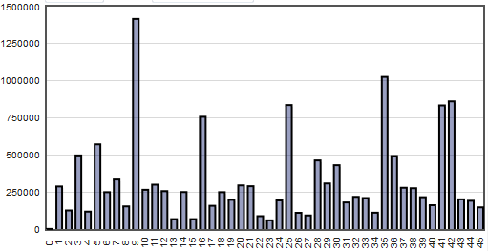
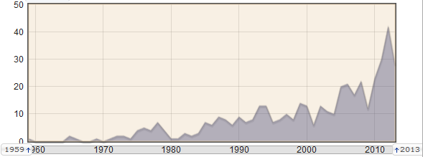
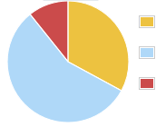
Global Brand Database – Χαρακτηριστικά
Απλή διεπαφή που επιτρέπει την αναζήτηση 23 συλλογών δεδομένων
Μοναδική δυνατότητα αναζήτησης εικόνας μέσω παραδείγματος
Διαδραστική και δυναμική αναζήτηση με άμεση απόκριση
Ασαφές ταίριασμα, φωνητικό ταίριασμα και ταίριασμα ρίζας λέξης
Αυτόματη πρόταση όρου κατά την πληκτρολόγηση της αναζήτησης
Εύκολη αναζήτηση της κατηγορίας εικόνων ΗΠΑ ή Βιέννης
Πλήρεις επιλογές Boolean, εγγύτητας και εύρους
Σώσιμο αναζητήσεων και συνόλων εγγραφών
Στιγμιαία, γραφική ανάλυση δεδομένων

Slide 151
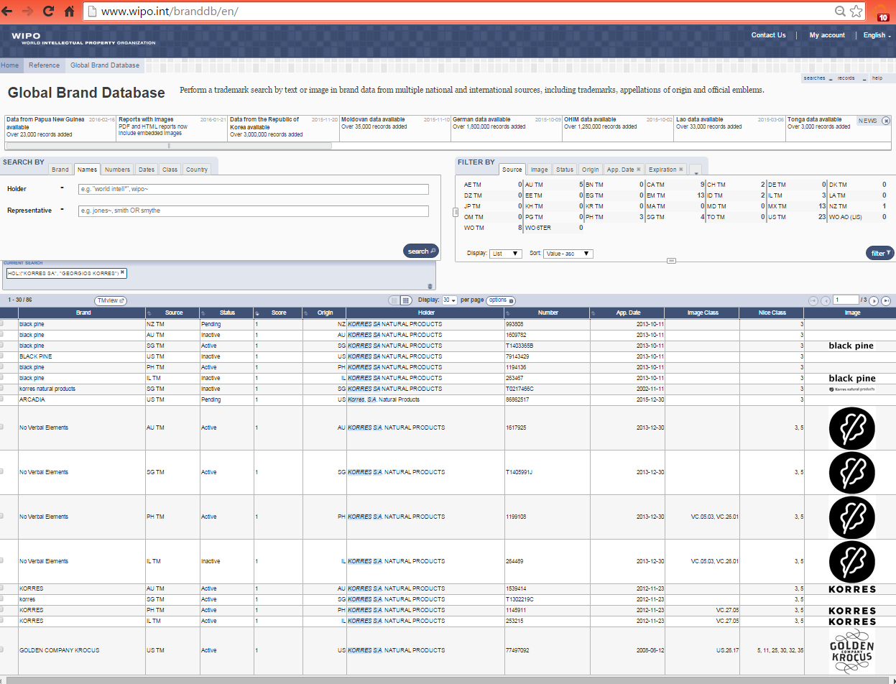
Αναζήτηση βάσει πολλαπλών κριτηρίων
Όνομα (Korres)
Χώρα: GR

Slide 152
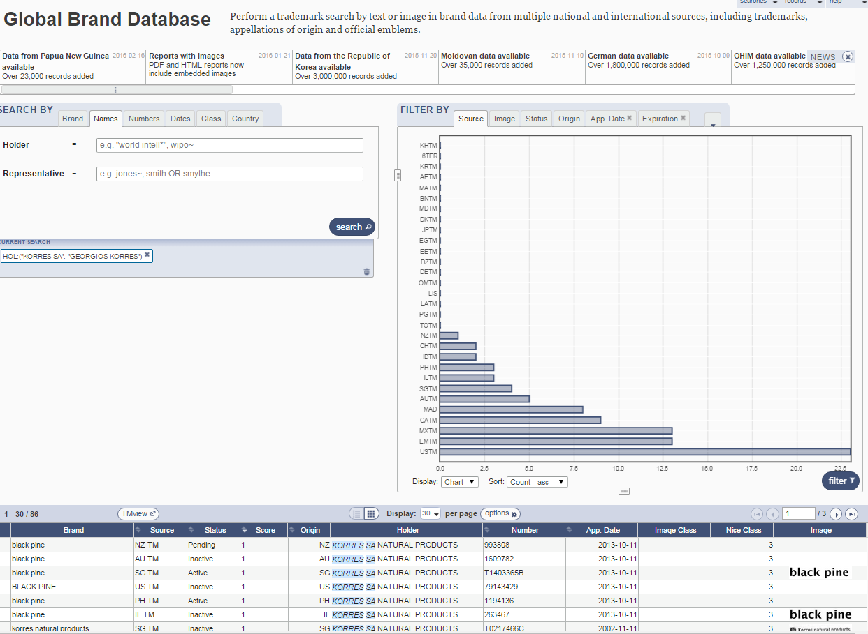
Πληροφορίες σχετικά με τη γεωγραφική διανομή των εμπορικών σημάτων

Slide 153
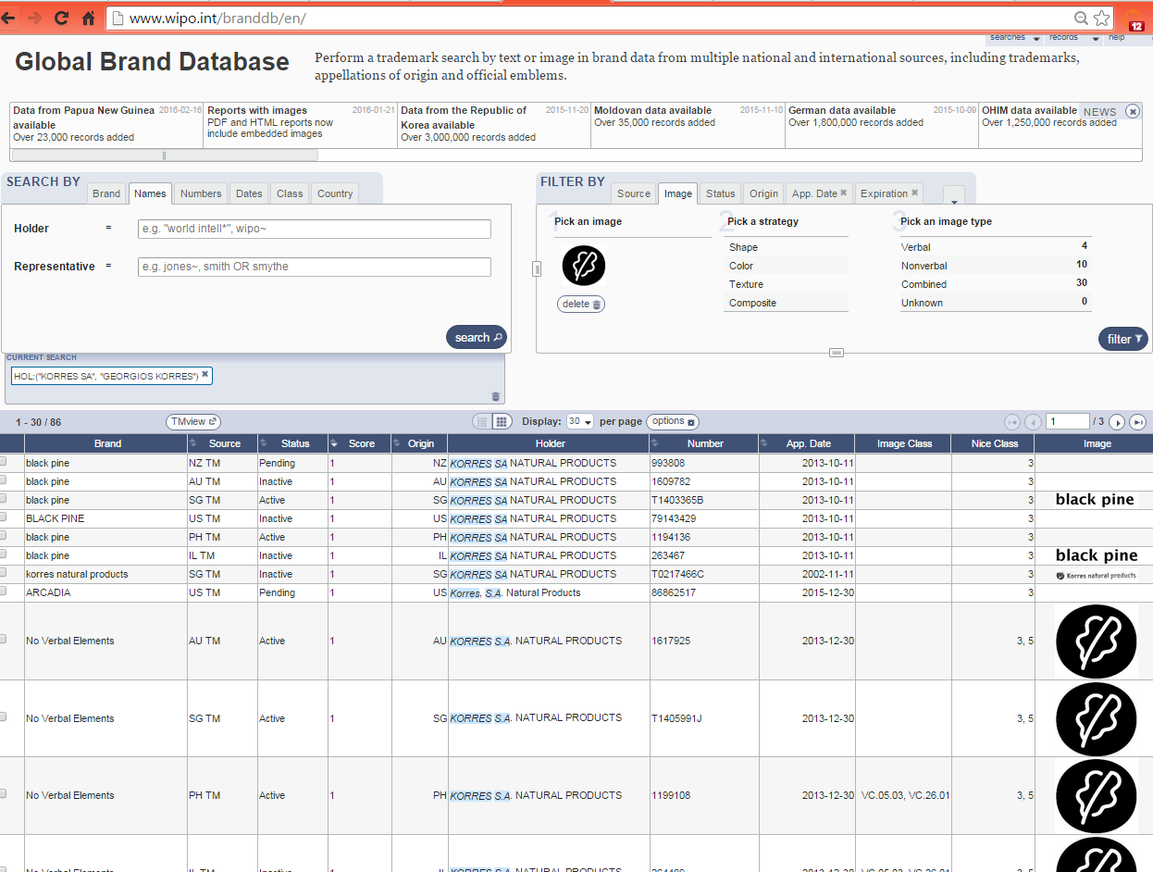
Αναζήτηση παρόμοιων σημάτων βάσει διαφόρων κριτηρίων (σχήμα, χρώμα, κείμενο)

Slide 154
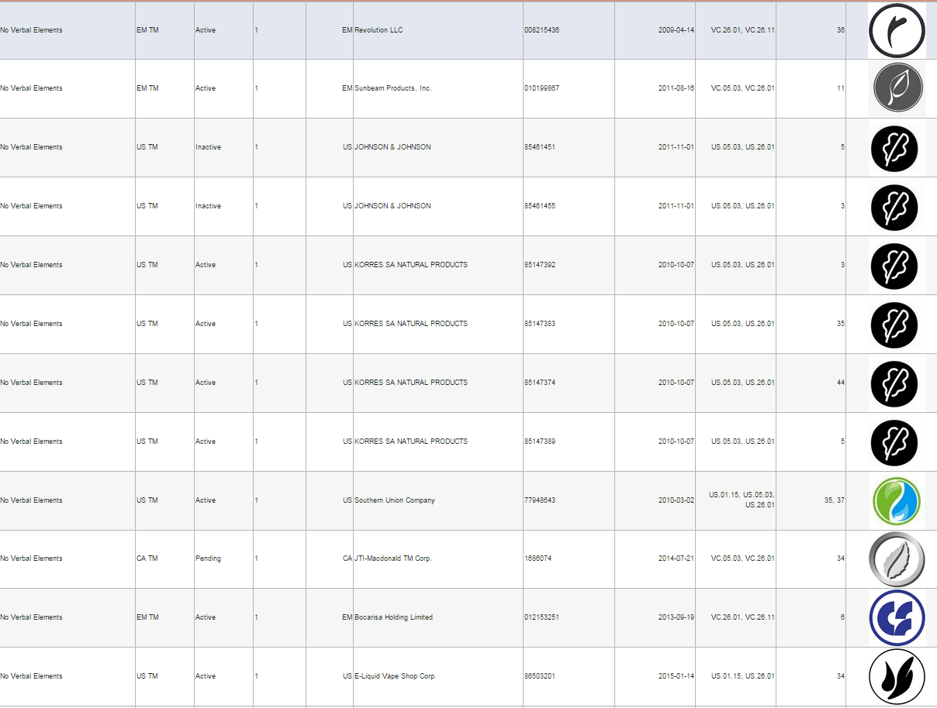
Αναζήτηση παρόμοιων σημάτων – παράδειγμα με παρόμοιο σχήμα

Slide 155
ΔΩΡΕΑΝ ΠΑΓΚΟΣΜΙΕΣ ΒΑΣΕΙΣ ΔΕΔΟΜΕΝΩΝ, ΕΡΓΑΛΕΙΑ ΚΑΙ ΠΛΑΤΦΟΡΜΕΣ ΠΟΥ ΠΡΟΣΦΕΡΕΙ ΤΟ WIPO
PATENTSCOPE
Global Brand Database
Global Design Database
WIPO Lex
WIPO Pearl
WIPO IPAS, WIPO DAS
WIPO CASE
WIPO RE:SEARCH
WIPO GREEN

Slide 156
GLOBAL DESIGN DATABASE
URL: http://www.wipo.int/designdb
Τέθηκε σε λειτουργία τον Ιανουάριο του 2015
Δωρεάν ταυτόχρονες αναζητήσεις σχετιζόμενες με σχέδια σε πολλαπλές συλλογές, μεταξύ αυτών:
  σχέδια καταχωρημένα υπό το σύστημα της Χάγης
  εθνικές συλλογές σχεδίων απο CA, ES, JP, NZ, US
  άλλες εθνικές συλλογές αναμένεται να προστεθούν στο μέλλον

Slide 157

GLOBAL DESIGN DATABASE: κριτήρια αναζήτησης

Slide 158
ΔΩΡΕΑΝ ΠΑΓΚΟΣΜΙΕΣ ΒΑΣΕΙΣ ΔΕΔΟΜΕΝΩΝ, ΕΡΓΑΛΕΙΑ ΚΑΙ ΠΛΑΤΦΟΡΜΕΣ ΠΟΥ ΠΡΟΣΦΕΡΕΙ ΤΟ WIPO
PATENTSCOPE
Global Brand Database
Global Design Database
WIPO Lex
WIPO Pearl
WIPO IPAS, WIPO DAS
WIPO CASE
WIPO RE:SEARCH
WIPO GREEN

Slide 159

WIPO LEX

Slide 160

WIPO LEX

Slide 161
ΔΩΡΕΑΝ ΠΑΓΚΟΣΜΙΕΣ ΒΑΣΕΙΣ ΔΕΔΟΜΕΝΩΝ, ΕΡΓΑΛΕΙΑ ΚΑΙ ΠΛΑΤΦΟΡΜΕΣ ΠΟΥ ΠΡΟΣΦΕΡΕΙ ΤΟ WIPO
PATENTSCOPE
Global Brand Database
Global Design Database
WIPO Lex
WIPO Pearl
WIPO IPAS, WIPO DAS
WIPO CASE
WIPO RE:SEARCH
WIPO GREEN

Slide 162

WIPO Pearl
Οnline βάση δεδομένων ορολογίας του WIPO
15.000 έννοιες, 90.000 όροι
10 γλώσσες: αραβικά, κινέζικα, αγγλικά, γαλλικά, γερμανικά, ιαπωνικά, κορεάτικα, πορτογαλικά, ρωσικά και ισπανικά
περιεχόμενα επικυρωμένα από ειδήμονες και ορολόγους γλώσσας του WIPO
Συνδεδεμένο με το PATENTSCOPE
http://www.wipo.int/wipopearl/search/home.html

Slide 163


Slide 164
ΔΩΡΕΑΝ ΠΑΓΚΟΣΜΙΕΣ ΒΑΣΕΙΣ ΔΕΔΟΜΕΝΩΝ, ΕΡΓΑΛΕΙΑ ΚΑΙ ΠΛΑΤΦΟΡΜΕΣ ΠΟΥ ΠΡΟΣΦΕΡΕΙ ΤΟ WIPO
PATENTSCOPE
Global Brand Database
Global Design Database
WIPO Lex
WIPO Pearl
WIPO IPAS, WIPO DAS
WIPO CASE
WIPO RE:SEARCH
WIPO GREEN

Slide 165
IPAS και DAS
IPAS (IP office Administration System) χρησιμοποιούμενο από 60 γραφεία ΒΙ
Λογισμικό του WIPO που επιτρέπει σε μικρά γραφεία ΒΙ να επεξεργαστούν ηλεκτρονικά αιτήσεις διπλωμάτων ευρεσιτεχνίας, εμπορικών σημάτων, σχεδίων
DAS (Digital Access System) χρησιμοποιούμενο από 11 γραφεία ΒΙ
Σύστημα που επιτρέπει σε γραφεία ΒΙ και καταθετες να ανταλλάξουν ή να υποβάλλουν με ασφάλεια ψηφιακά αντίγραφα εγγράφων προτεραιότητας σε πολλαπλά γραφεία ΒΙ
Notes:
Those are software systems developed and maintained by WIPO for IP offices of its member states.
The first one IPAS, which is an acronym for IP Office Administration System) is used by 60 small IP offices and enable them to electronically process patent, trademark and design applications.
The second one is named DAS, which stands for Digital Access System, is used by 11 IP offices and allows them and their applicants to securely exchange certified digital copies of priority documents among themselves.

Slide 166
ΔΩΡΕΑΝ ΠΑΓΚΟΣΜΙΕΣ ΒΑΣΕΙΣ ΔΕΔΟΜΕΝΩΝ, ΕΡΓΑΛΕΙΑ ΚΑΙ ΠΛΑΤΦΟΡΜΕΣ ΠΟΥ ΠΡΟΣΦΕΡΕΙ ΤΟ WIPO
PATENTSCOPE
Global Brand Database
Global Design Database
WIPO Lex
WIPO Pearl
WIPO IPAS, WIPO DAS
WIPO CASE
WIPO RE:SEARCH
WIPO GREEN

Slide 167
WIPO CASE
“Centralized Access to Search and Examination Reports”
Ξεκίνησε με πρωτοβουλία της Ομάδας Βανκούβερ (AU, CA, UK)
Πλατφόρμα καταμερισμού εργασίας online για εξεταστές διπλωμάτων ευρεσιτεχνίας παγκοσμίως
Αναζήτηση και εξέταση καταμερισμού
Τα γραφεία ΒΙ είναι σε θέση να ενισχύσουν την ποιότητα και αποτελεσματικότητα της εξέτασης διπλωμάτων ευρεσιτεχνίας
Το CASE θα συνδεθεί με το Open Portal Dossier των IP5 για να καταστεί το Global Portal Dossier

Slide 168




GLOBAL DOSSIER PLATFORM (WIPO-CASE, OPD AND PATENTSCOPE)
Δημόσιοι χρήστες (περιλαμβάνονται και χρήστες σε γραφεία ΙΡ)
Εξεταστής γραφείου ΙΡ5 που δεν συμμετέχει στο WIPO/CASE
OPD
Παροχή πληροφοριών του ντοσσιέ που δημοσιεύονται με σύμφωνη γνώμη του OPD/CASE
Ελεύθερη χρήση
OPD
WIPO CASE
Μη προσβάσιμο για ελεύθερη χρήση και μόνο για χρήση από υπαλλήλους γραφείο ΙΡ
IPAS+
CASE depositary
System
Εξεταστής γραφείου που συμμετέχει στο CASE
Εξεταστής γραφείου ΙΡ5 που συμμετέχει στο WIPO/CASE
Γραφείο κατάθεσης CASE που χρησιμοποιεί το IPAS
Γραφείο κατάθεσης CASE που χρησιμοποιεί το δικό του EDMS π.χ. Αυστραλία

Slide 169
ΔΩΡΕΑΝ ΠΑΓΚΟΣΜΙΕΣ ΒΑΣΕΙΣ ΔΕΔΟΜΕΝΩΝ, ΕΡΓΑΛΕΙΑ ΚΑΙ ΠΛΑΤΦΟΡΜΕΣ ΠΟΥ ΠΡΟΣΦΕΡΕΙ ΤΟ WIPO
PATENTSCOPE
Global Brand Database
Global Design Database
WIPO Lex
WIPO Pearl
WIPO IPAS, WIPO DAS
WIPO CASE
WIPO RE:SEARCH
WIPO GREEN

Slide 170


Γενικοί στόχοι:
  συντονισμός για μεταφορά τεχνολογίας και συνεργασίες
  ελάττωση του κόστους συναλλαγών
  αξιοποίηση συγκριτικών πλεονεκτημάτων των προσεγγίσεων πολλών ενδιαφερομένων
  παρουσίαση πρακτικών μέσων για τα θέματα παγκόσμιας πολιτικής
Με βάση την αναγνώριση ότι:
    Οι χρήστες θέλουν πρόσβαση σε τεχνολογίες, όχι απλά σε δικαιώματα διπλωμάτων ευρεσιτεχνίας
    η συνεργασία (π.χ. κατάρτιση) είναι κρίσιμη για τη μεταφορά τεχνολογίας

Slide 171

WIPO RE: SEARCH
Μία παγκόσμια βάση δεδομένων και πλατφόρμα που φέρνει κοντά συνεργάτες ώστε να χρησιμοποιήσουν ΒΙ (περιλαμβάνεται η τεχνογνωσία και δεδομένα) που θα διευκολύνει την Ε&Α πάνω σε παραμελημένες τροπικές ασθένειες, ελονοσία και φυματίωση
Δωρεάν για Ε&Α, παραγωγή και πώληση σε λιγότερο αναπτυγμένες χώρες
Εγκαινιάστηκε τον Οκτώβριο του 2011
Συνεργασία WIPO με BIO Ventures for Global Health έχει διευκολύνει 82 ερευνητικές συνεργασίες (38 συμφωνίες) μεταξύ μελών, κυρίως για προκλινική έρευνα
Επί του παρόντος, 94 μέλη από 26 χώρες

Slide 172

WIPO GREEN
Παγκόσμια βάση δεδομένων που επιτρέπει σε χρήστες να καταστήσουν διαθέσιμες πράσινες τεχνολογίες για αδειοδότηση ή συνεργασία, να εισαγάγουν ανάγκες τεχνολογίας, να αναζητήσουν τεχνολογίες και ανάγκες
Ξεκίνησε πιλοτικά με την Japan Intellectual Property Association in 2011. Εγκαινιάστηκε το Νοέμβριο του 2013
Εμπεριέχει πάνω από 2000 προσφορές, 430 καταχωρημενοι χρηστες
Εταιρίες παροχής πράσινης τεχνολογίας στη Γερμανία, Ιαπωνία, ΗΠΑ κλπ.
Στους 66 εταίρους περιλαμβάνονται εταιρίες, πανεπιστήμια, υπηρεσίες Ηνωμένων Εθνών, κυβερνήσεις, γραφεία ΔΙ, ΜΚΟ, κλπ.

Slide 173

Τομείς αγορών πράσινης τεχνολογίας

Slide 174
Καλείστε να συμμετάσχετε
Γίνετε εταίρος και διαμορφώστε την περαιτέρω ανάπτυξη του WIPO GREEN
Καταχωρηθείτε για να:
    επικοινωνήσετε τις ανάγκες σας για πράσινη καινοτομία και τεχνολογία
    διαφημίσετε τις δικές σας εφευρέσεις, τεχνολογίες, προϊόντα και υπηρεσίες
    συνδεθείτε με τις κοινότητες καινοτομίας και επιχειρηματικότητας παγκοσμίως

Slide 175































Εταίροι του WIPO GREEN

Slide 176
Σας ευχαριστώ για την προσοχή σας
Antonios.Farassopoulos@wipo.int

