Slide 1
“Decentralizing IP education to support women artisans
Training and Development Center for Copyright and Related Rights
The International Conference of WIPO Intellectual Property Training Institutions
CCDA/WSA

Slide 2
Training and Development Center for Copyright and Related Rights
Timeline:
Feb 2017
Sept 2019
Ad hoc consultant
Creation of the ONDA training center
OMPI – ONDA
Cooperation Agreement
Documentation center and library
Awarding of grants to ONDA employees for WIPO distance learning courses
Training of Trainers course
Achievements:
Technical assistance
Providing experts
Academic resources
Training plans
CCDA/WSA

Slide 3
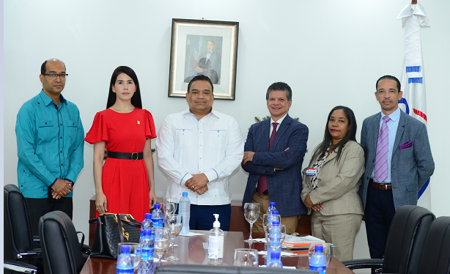
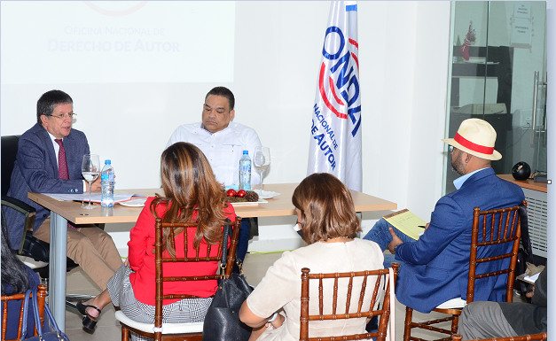
Ad hoc consultant support – since 2019
Training and Development Center for Copyright and Related Rights
Timeline:
Technical assistance for the center structure and work plan
Assistance regarding the curriculum of academic programs
Visits to countries to integrate different sectors that support our academy (judges, attorneys, collective management organizations, academies, public institutions)
CCDA/WSA

Slide 4
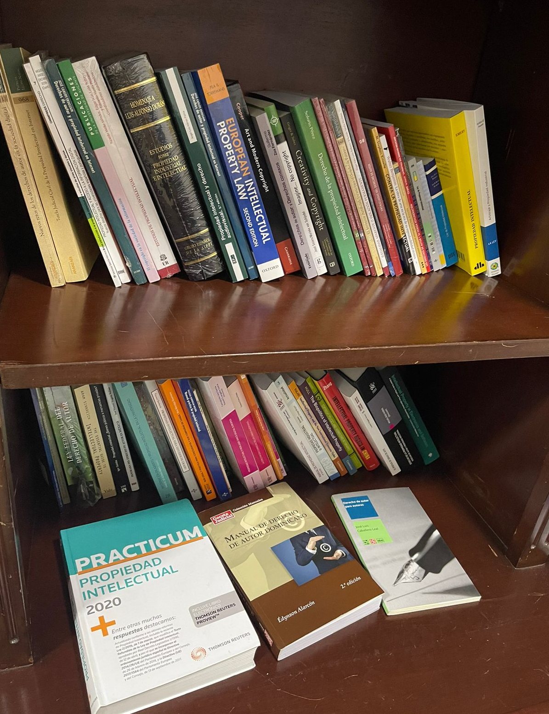
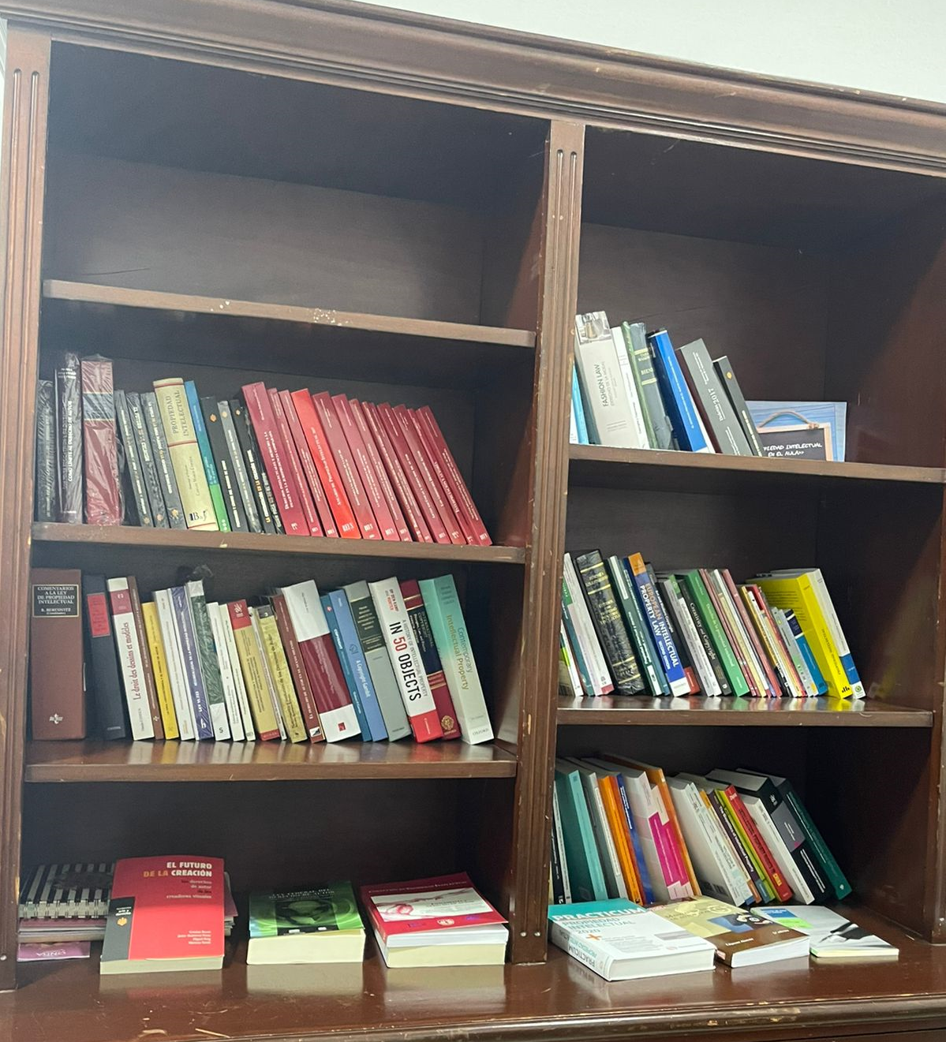
Document center and library – October 2020
Training and Development Center for Copyright and Related Rights
Timeline:
120 books on intellectual property
Updated references
Help with enquiries
CCDA/WSA

Slide 5
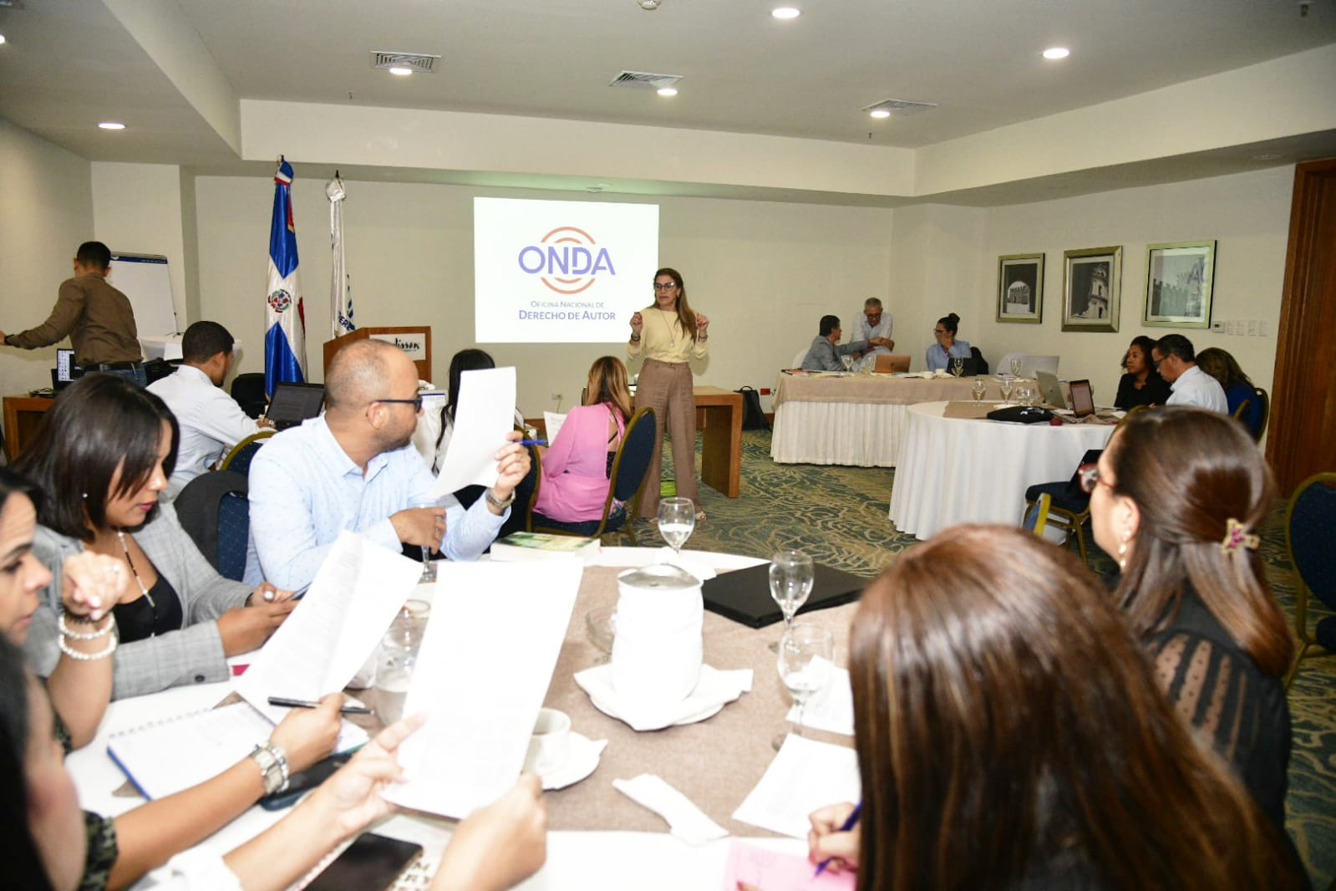
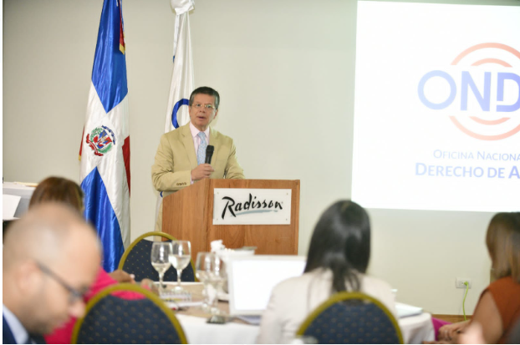
Training of Trainers course (Nov. 2020-2022)
Training and Development Center for Copyright and Related Rights
Timeline:
Four training modules (online and in-person).
Twenty-seven trainers specialized in intellectual property.
Training by specialists in IP and teaching methodology.
CCDA/WSA

Slide 6
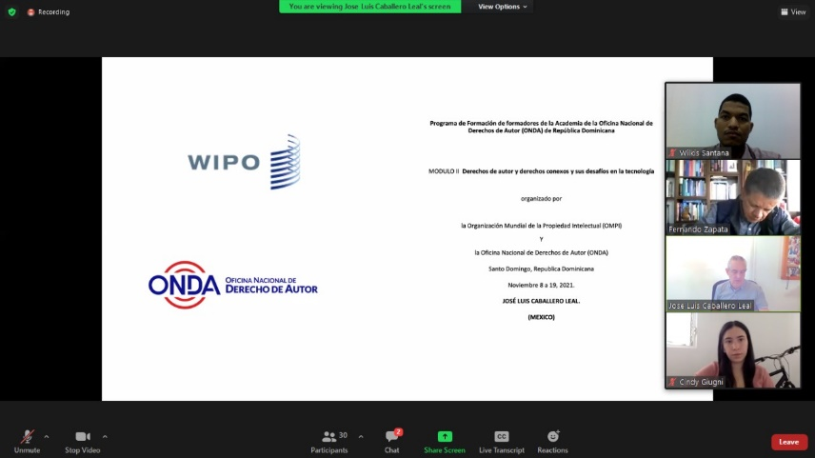
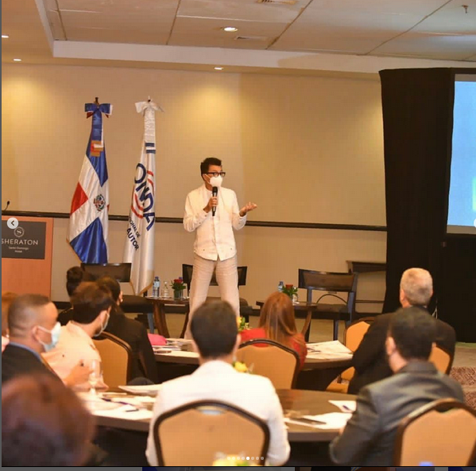
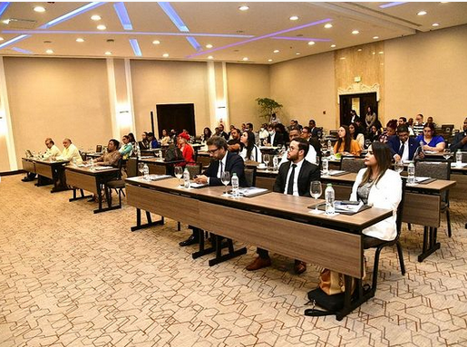
Training activities
Training and Development Center for Copyright and Related Rights
Twenty-one in-person and virtual training sessions on copyright for specialized sectors, fashion designers, craftspeople, members of collective management organizations, public institutions, universities, judges and attorneys.
CCDA/WSA

Slide 7
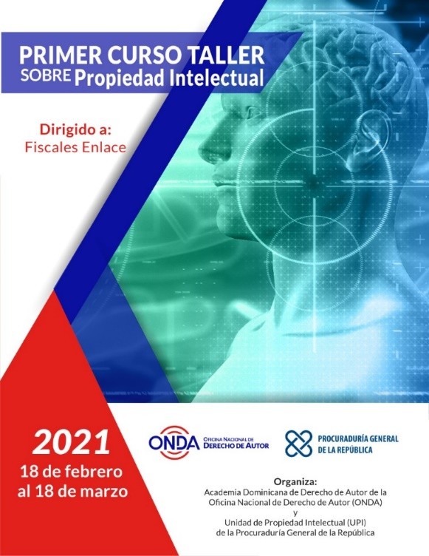
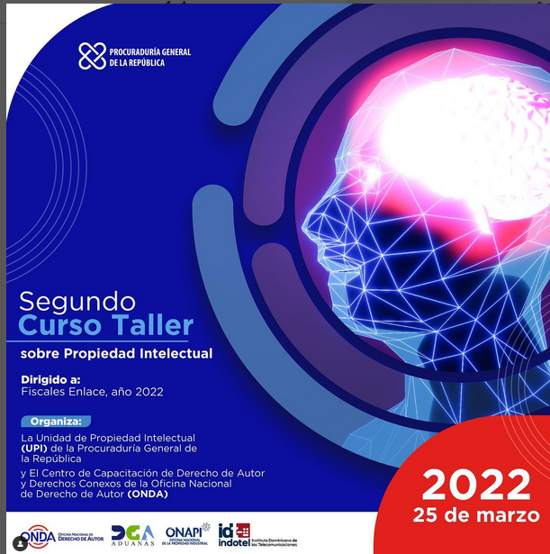
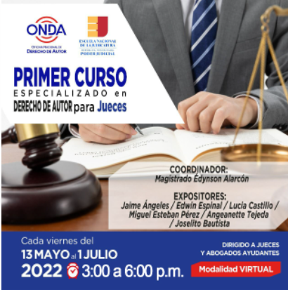
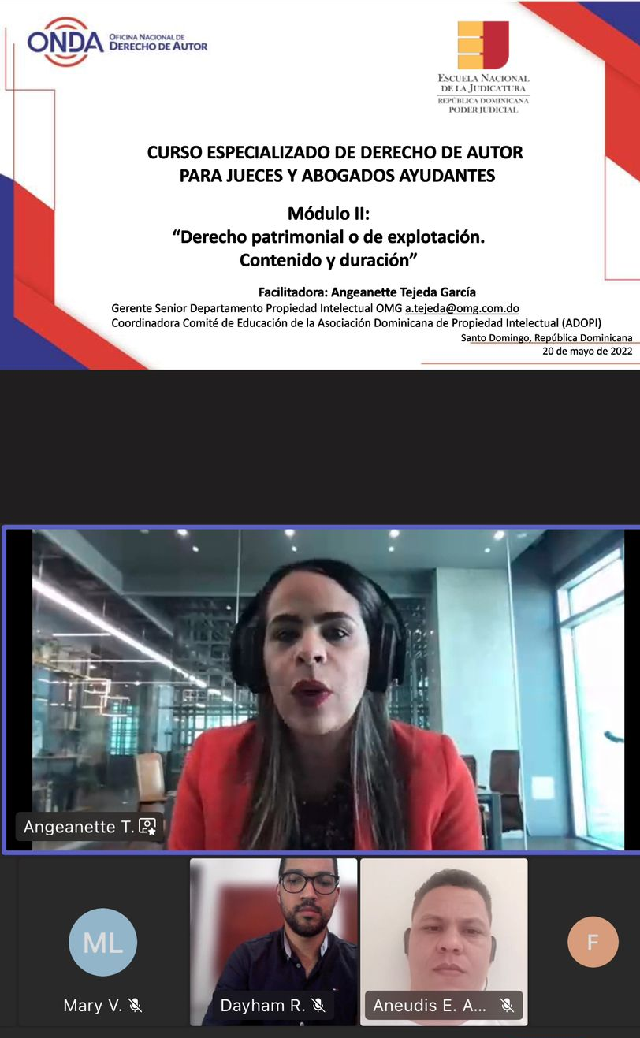
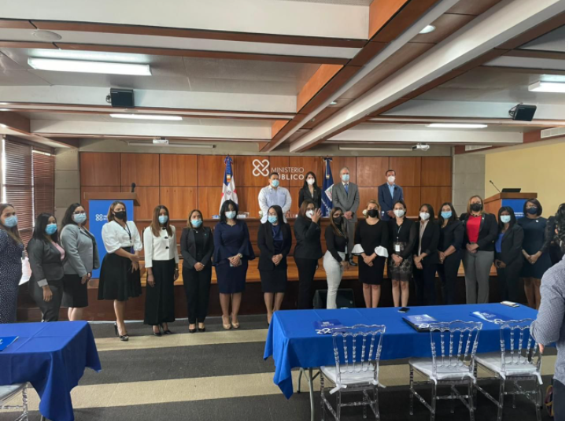
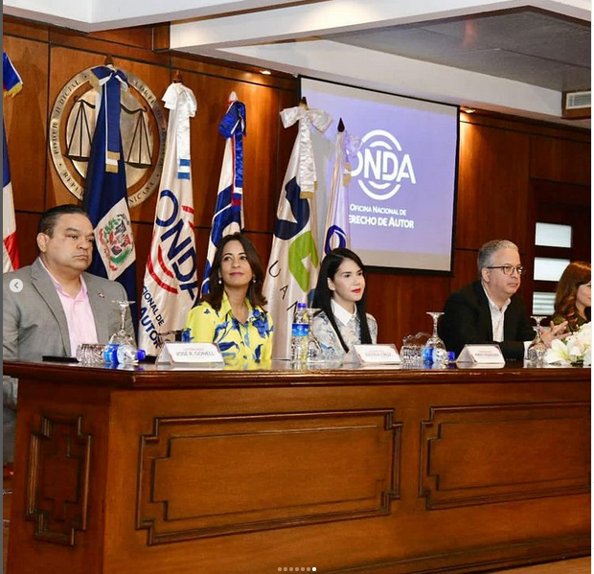
Training activities
Training and Development Center for Copyright and Related Rights
First virtual training with the group of trainers. We reached approximately 35 judges and 23 assistant attorneys.
In-person event. Approximately 125 tax, customs and telecommunications enforcement agents were present.
CCDA/WSA

Slide 8
Training activities
Training and Development Center for Copyright and Related Rights
In 2021, there were 456 participants in these 21 sector-based training sessions.
In 2022, there have been 679 participants.
Informes 2021 y 2022
CCDA/WSA

Slide 9
Training activities
Training and Development Center for Copyright and Related Rights
WIPO distance learning course for ONDA employees
General intellectual property course
Copyright and related rights
Collective management of copyright and related rights
Mediation and arbitration
CCDA/WSA

Slide 10
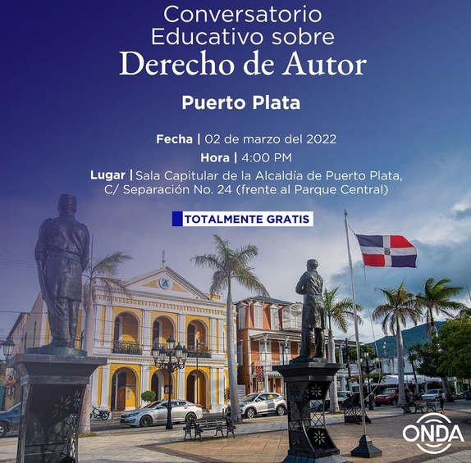
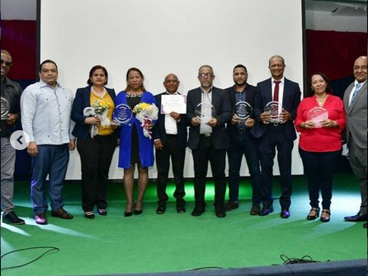
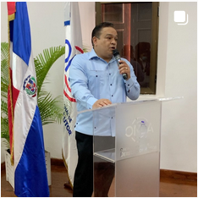
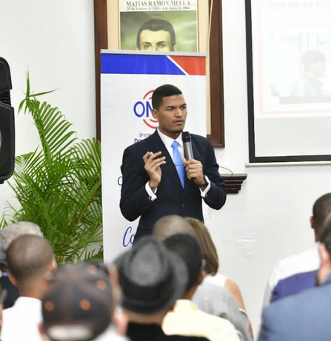
“Ponte en ONDA” campaign – since October 2020
Training and Development Center for Copyright and Related Rights
Awareness raised within society of authors’ rights and organization presented.
Six discussions held across the country.
Recognition given to Dominican authors for their national and international careers.
Advertising media: Installation of billboards with recognized artists, nationwide broadcasting through radio stations, social media and television spots.
Total: 499
CCDA/WSA

Slide 11
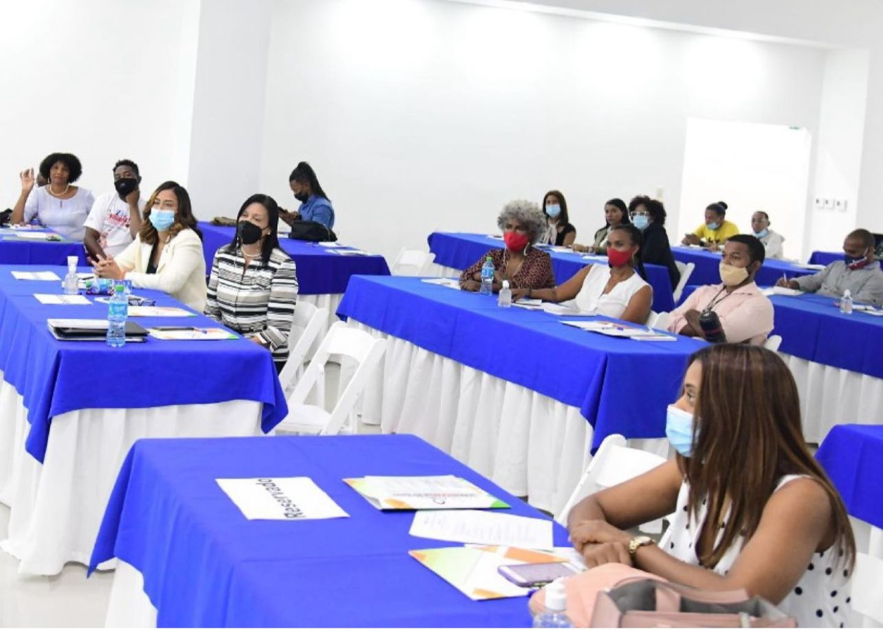
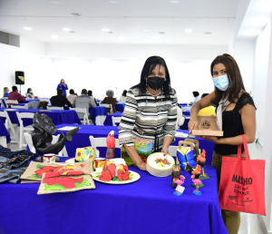
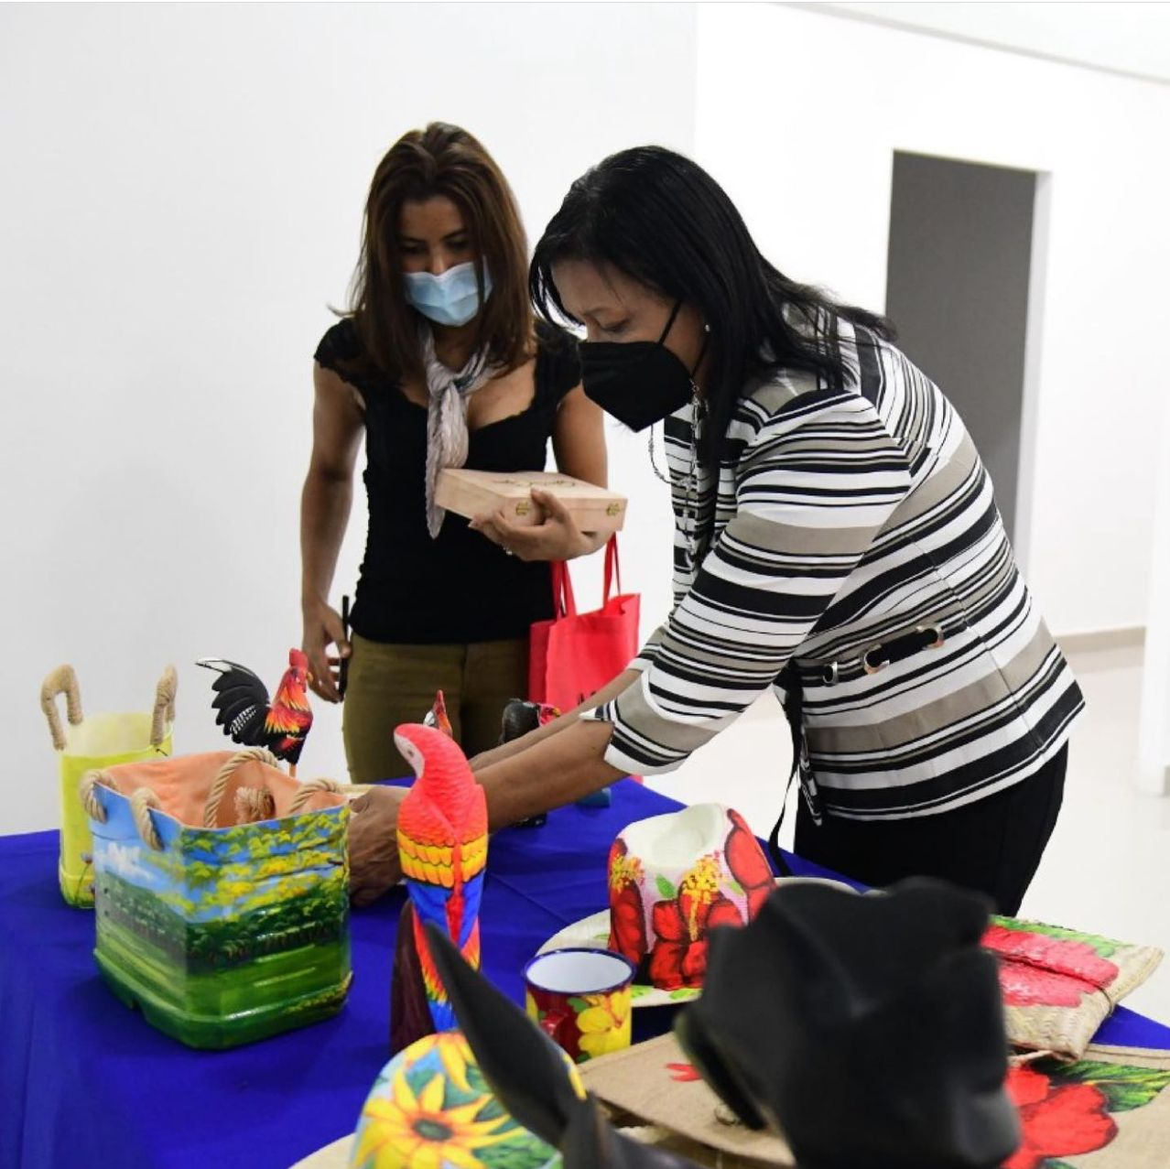
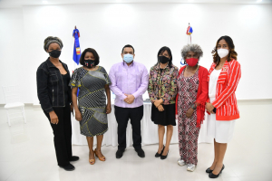
National strategy to raise awareness of copyright among women artisans
Training and Development Center for Copyright and Related Rights
Raise awareness of the importance of protecting your creations and preventing potential infringements.
Incentivize the creative handicraft industry and promote protection through registering works.
Training at different artisan associations.
National award for women artisans
More than 400 women reached.
Photographs from the first meeting
CCDA/WSA

Slide 12
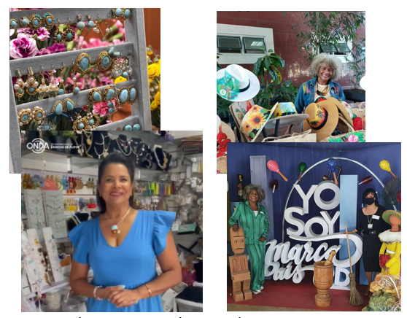
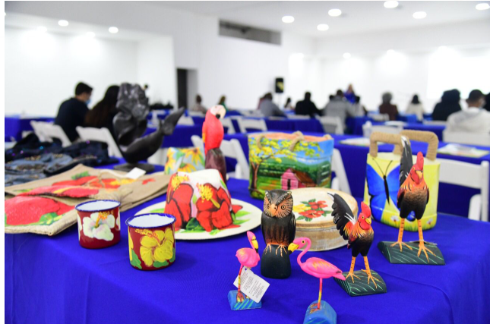
Training and Development Center for Copyright and Related Rights
Testimonials
Fatima Polanco, 3 Estilos
Daisy Campusano, Arte en Coro
CCDA/WSA

Slide 13
Thank you

