Slide 1
Topic 13:
Planning, Delivering, Disseminating and Evaluating A PLR in WIPO’s PLR Project
Rio de Janeiro
27 August 2013
Irene Kitsara
Patent Information Section, Access to Information and Knowledge Division

Slide 2
Outline
A. Introduction – WIPO’s PLR Project Framework
B. The lifecycle of a WIPO PLR:
Planning
Delivery
Dissemination
Evaluation

Slide 3
A. Introduction – PLR Project Framework
Previously at WIPO patent landscaping activity → case-by –case, various areas, not systematic way
Development Agenda Project “Developing Tools For Access to Patent Information” → WIPO patent landscape reports (PLR) a more institutionalized and systematic effort
In order to achieve results → the development of a methodology for planning, preparation, delivery, dissemination and evaluation were necessary

Slide 4
B. The lifecycle of a WIPO PLR
Delivering
Planning
Evaluating
Disseminating

Slide 5
It all starts with…Planning
Within WIPO Development Agenda, CDIP4/6 → “Project aims to provide developing countries, …upon request, with services which will facilitate the use of patent information on specific technology for facilitating their indigenous innovation and R&D in cooperation with other intergovernmental organizations”
but….
“A goal without a plan is just a wish.” Antoine de Saint-Exupéry“

Slide 6
PLR Planning
Elements to be taken into account while planning a PLR is that it should be:
Demand-driven report
Serve the needs and areas of interest of developing countries and least developed countries (public health, food and agriculture, climate change and energy)
Supporting specific policy discussions or projects

Slide 7
Planning a Patent Landscape Report
Selecting a cooperation partner
Identifying a topic
Preparing
ToR
Call for Tender
Offer evaluation & Contracting

Slide 8
1st step:Selecting a cooperation partner
“Give me six hours to chop down a tree and I will spend the first four sharpening the axe.”
Abraham Lincoln
Planning may be the most time-consuming but essential part of the PLR procedure
1st step identifying a cooperation partner
Partner profile: - WIPO Member State/IGOs/NGOs with expertise in the subject matter and having demand for info
- specific request
- specific project/policy discussion/envisaged use of the report
- engagement

Slide 9
Challenges in selection of a cooperation partner
Find the most appropriate partner for a technological area
Find the most appropriate contact person within the organization of the cooperation partner
Find a partner with IP awareness or motivation to discover the added value of patent information
Technical expertise in the subject matter
Increased engagement
“Marrying” the PLR requirements and objectives with the partner’s workplan
Timing, list of priorities, budget

Slide 10
2nd step: Identifying a topic
2nd step = identifying and selecting the topic of the report
Topic → general area of interest for developing countries (as identified in the initial project document CDIP/13), namely public health, food and agriculture, climate change and green technology.
Rationale, objectives of the report and → reflected on the Terms of Reference (ToR)

Slide 11
Challenges in selecting a topic
Difficulties in needs assessment
Requests may just need a state of the art search or be too generic
Distinguishing general interest for the IP perspective from a specific need where patent analysis can feed in

Slide 12
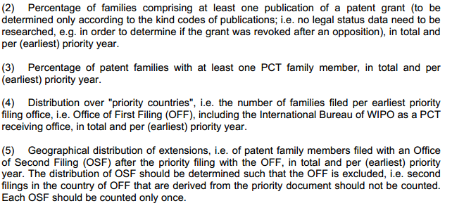
3. Preparing the Terms of Reference

Slide 13
Challenges in preparing the Terms of Reference
Too abstract understanding of what a PLR is, making discussions lengthy and not always constructive
Lack of clarity about which type of analysis that is needed or exact scope of the search makes drafting the ToR very difficult
Lengthy process of dialogue, exchange of ToR drafts, refinements, changes
The cooperation partner should be aware of the limitations of the patent information

Slide 14
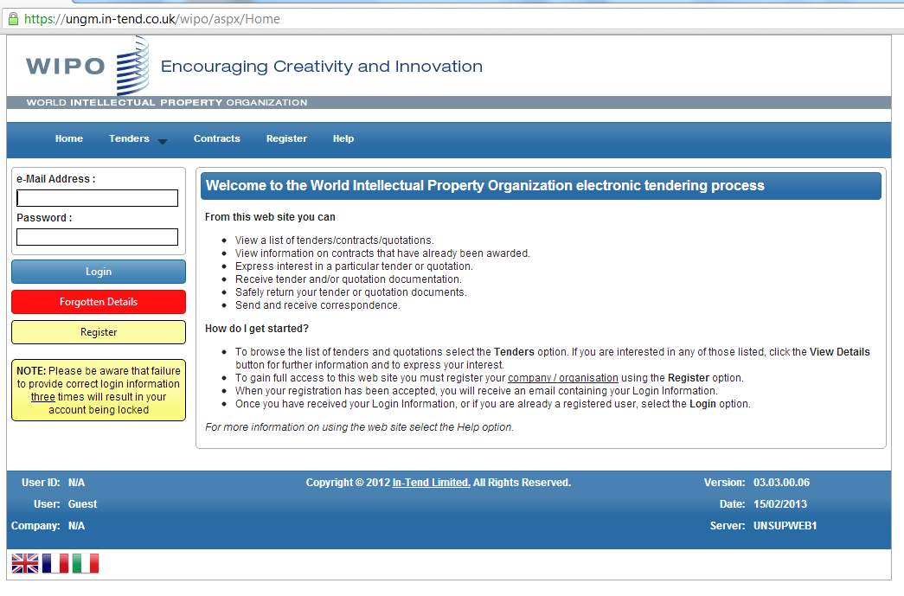
PLR e-tendering process
PLR among the first projects to use e-tender at WIPO
1st stage: Prequalification of interested patent landscaping providers through expression of interest at https://ungm.in-tend.co.uk/wipo and filling out a questionnaire

Slide 15
PLR Tendering Process
Request for Proposals (RFP) sent to prequalified candidates of the relevant area
Submission of an offer based on the attached to the RFP ToR
Evaluation process – with evaluation criteria and matrix developed for the PLR
Award of the contract – Contracting – Beginning of landscaping work

Slide 16
Delivering a WIPO PLR
Various deliverables foreseen in the ToR of each report
Teleconference with the cooperation partner and the contractor – first orientation and timeframes set
1st deliverable → patent search methodology description with a preliminary sample of search results
2nd deliverable → cleaning data, narrative and visualization of the results → discussion and feedback → refinements and changes very often necessary
3rd deliverable → final draft of the report, feedback in language, visualization
…and after publication (more about it tomorrow), the reports are ready to be disseminated!

Slide 17
Dissemination of the report
Delivery of the report to the cooperation partner
Publication of hard copies of the patent landscaping reports
Publication of the PLR on WIPO’ s dedicated website
Launching event(s) with introduction to the results
Presentation of the report in various scientific symposia/conferences
Dissemination through email to identified potential users of the reports
Mention of the existence of the reports on social media (related Linked-in groups etc)
Big challenge of making scientific world, policy makers, patent information users aware of our work to maximize the beneficiaries of the reports
Challenge in scope&dissemination of serving various needs

Slide 18
The role of WIPO throughout the patent landscaping process
Challenge: experts in subject matter ≠ experts in PI ≠ policy/decision making.
WIPO with its competence, experience & understanding of all these aspects, facilitates:
- Systematic approach
Needs assessment
Awareness raising about added value of PI and use in decision making
Finding better methodological approaches
Funding PLR
WIPO
IGOs/NGOs/MS
Contractor
Patent Information Users
Decision/Policy Makers

Slide 19
Evaluation of WIPO PLR
Evaluation → essential for getting better understanding of strengths and weaknesses of reports, project and approach to it, improvement for the future
→ required as part of a RBM
→ metrics of use, usefulness and impact of b the report
→ internal (results-based management) and external (external users)
→ End of 1st phase of the project → 1st evaluation of the WIPO PLR project

Slide 20
Evaluation of Phase I of WIPO PLR
Independent evaluation report presented to the CDIP in November 2012
http://www.wipo.int/edocs/mdocs/mdocs/en/cdip_10/cdip_10_6.pdf
Issues of objectively verifiable performance indicators, impact, systematically planned coordination with internal and external cooperation partners

Slide 21
Evaluation of Phase I of WIPO PLR
Evaluation challenges:
Apart from the direct cooperation partner, it is difficult to reach out to the PLR users to have their feedback, as there is no way to identify them
Survey that was carried out to measure the use and usefulness of the report were based on a set of users that could be identified through conferences
Impact is very difficult to measure, foremost at short-term; similarly difficult is to find objective measures for the contribution of the reports to specific decisions adopted, or contribution of the factual evidence to policy discussions
Risk mitigation difficult when many external factors involved

Slide 22
Obrigada!
Irene.Kitsara@wipo.int

