Slide 1
WIPO Green
The Market Place for Sustainable Technology
Indonesia
Ir. Rudy Abdul Rahman
+62811 220 1011

Slide 2
Unit sector And distribution case
River, 11 big contaminate rivers
Domestic Waste Water Treatment Plant, every city in Indonesia
Sanitary Landfill Leacheate, every city in Indonesia
Palm Oil Refinery, 600 mills
Rubber Refinery, 400 mills
Comunal Cow Farm/livestock, 25 farms
Hotel
Shopping Center
Elevated Domitory Building
Oil Trap Workshop
Tofu and Tempeh Industry
Steel Industry Waste Water

Slide 3
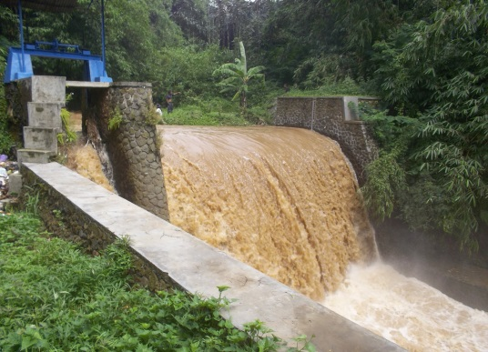
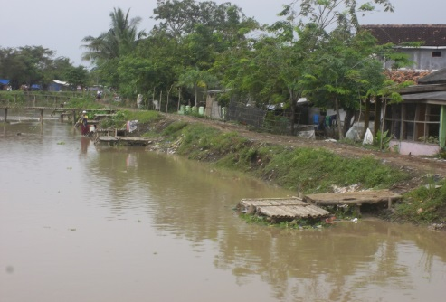
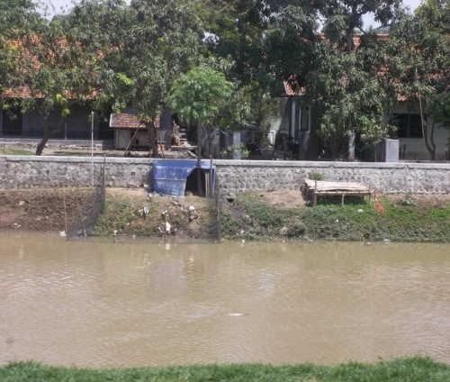
Citarum river
Row water for city water treatment plant
Contaminate resource
Industrial
Domestic
Farm
Agriculture
Technology seeker: Goverment
Need features
Technical assistance
Design aspects
Waste management
Grant
Special Need: Biologcal Patent Technology

Slide 4
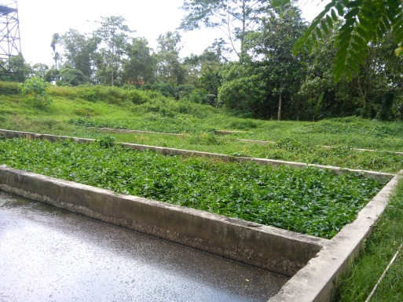
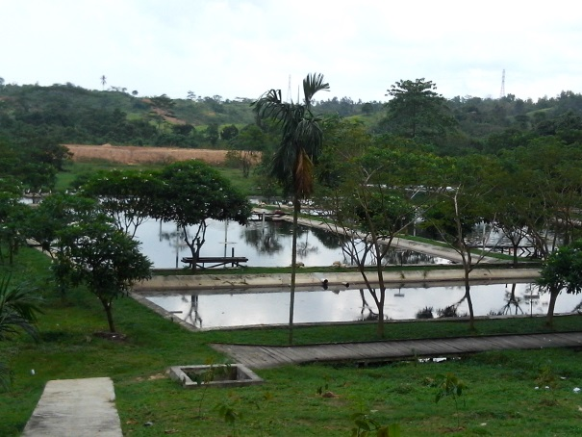
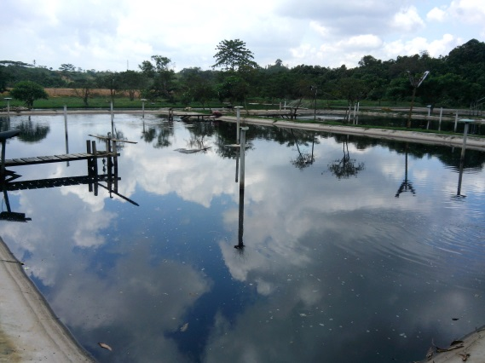
Balikpapan Domestic Waste Water Treatment Plant
Every city requires
Existing plant
Biological
Lagoons with aerobic, anaerobic and biofiltersystem
The result has not been satisfied
Technology seeker: Goverment
Need features
Technical assistance
Design aspects
Waste management
Grant
Special Need:
Biologcal Patent Technology
Provides usable output such as liquid fertilizer
Minimize energy, time and space

Slide 5
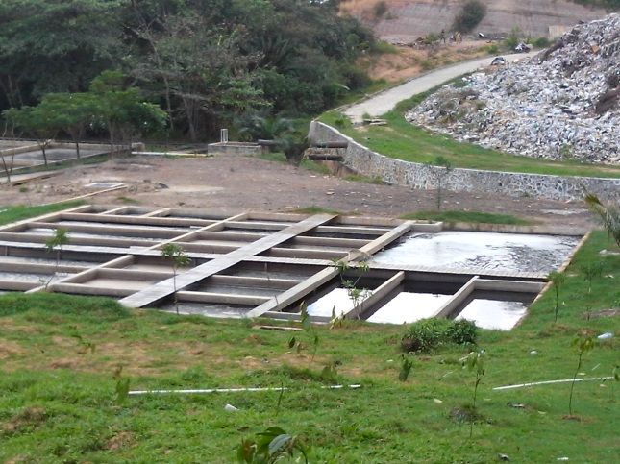
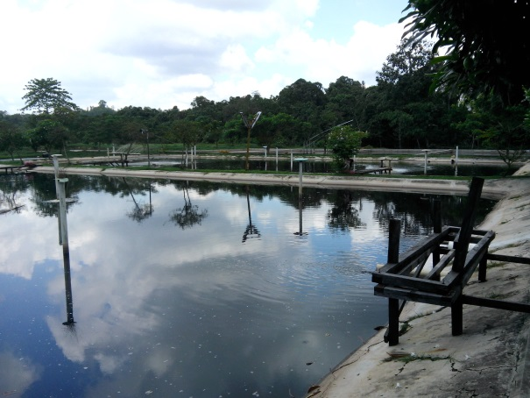
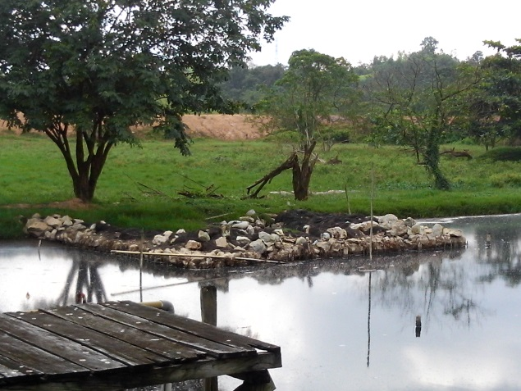
Balikpapan Sanitary Landfill Leachate
Every city requires
Existing plant
Biological
Lagoons with aerobic, anaerobic and biofiltersystem
The result has not been satisfied
Technology seeker: Goverment
Need features
Technical assistance
Design aspects
Waste management
Grant
Special Need:
Biologcal Patent Technology
Minimize energy, time and space

Slide 6
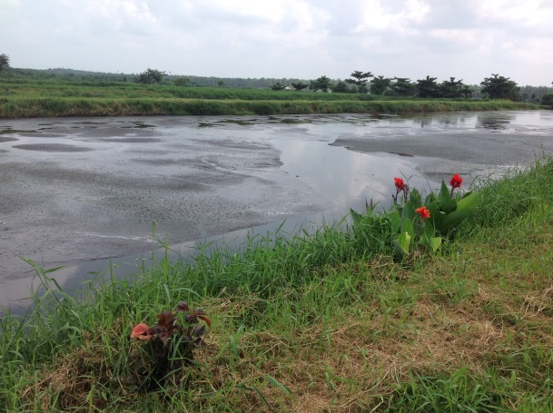
Jambi Palm Oil Refinery
Every the same plant requires
Special Need
Palm Oil Mill Effluent (POME) to electricity
Need features
Technical assistance
Design aspects
Waste management
Partners
Special Need:
Biologcal Patent Technology
Reduce energy, time and space

Slide 7
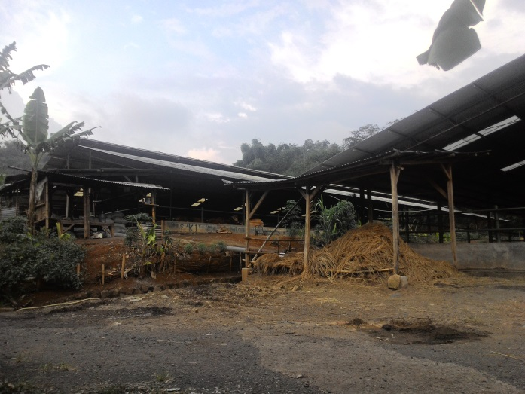
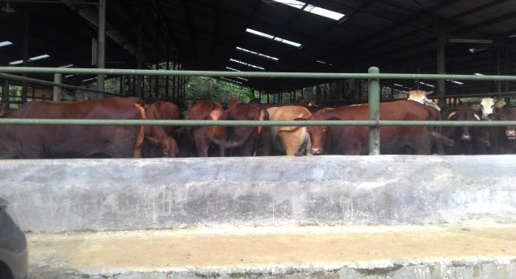
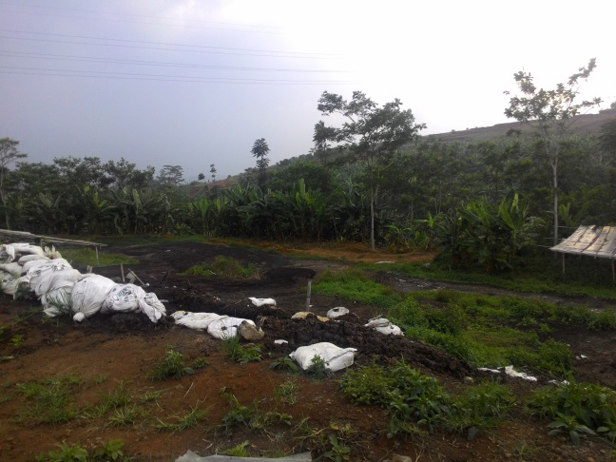
Purwakarta Comunal Cow Farm/livestock
Every the same farm/livestock requires
Special Need
Reform energy to electricity
Biologcal Patent Technology
Minimize energy, time and space
Need features
Technical assistance
Design aspects
Waste management
Partners

Slide 8
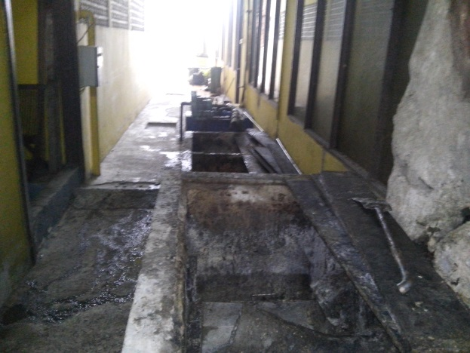
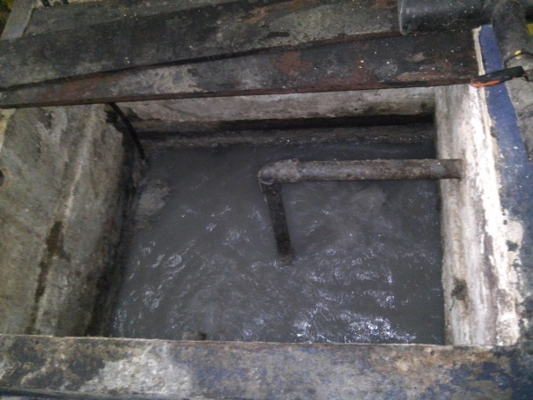
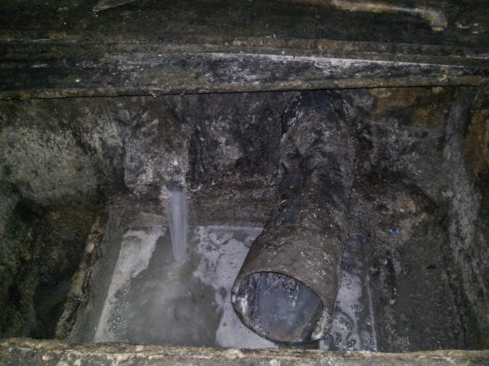
Balikpapan hotel
Every Hotel requires
Contaminate resource
Floor drain, untreated
Toilet, septic tank
Kitchen, oil trap
Laundry, untreated
Existing plant: The result has not been satisfied
Need features
Technical assistance
Design aspects
Waste management
Special Need:
Biologcal Patent Technology for oil trap
Minimize energy, time and space

Slide 9
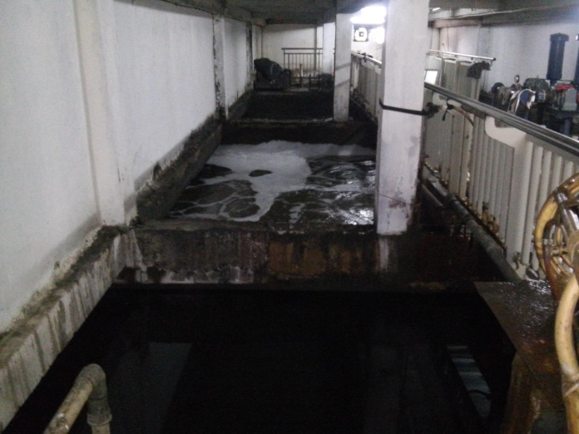
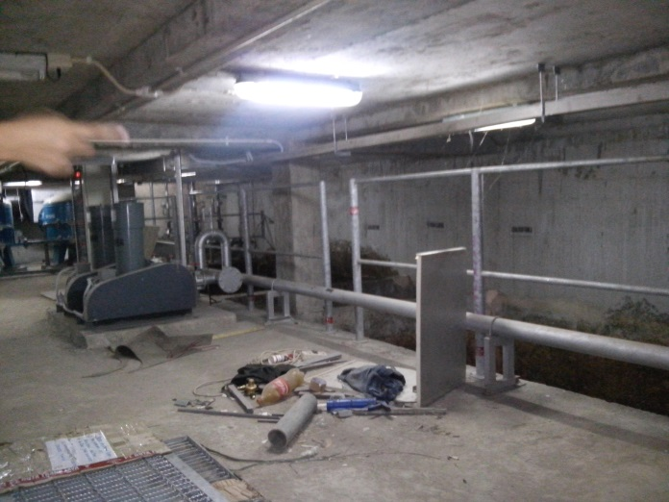
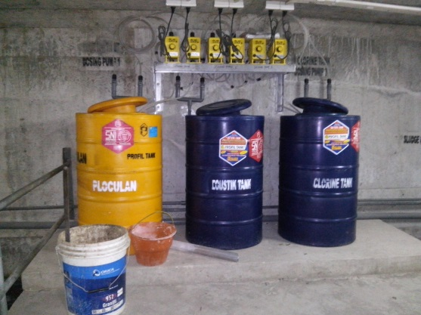
Balikpapan shopping center
Every Shopping Center requires
Contaminate resource
Wastafel
Toilet
Kitchen/food court
Existing plant: The result has not been satisfied
Need features
Technical assistance
Design aspects
Waste management
Special Need:
Biologcal Patent Technology
Minimize energy, time and space

Slide 10
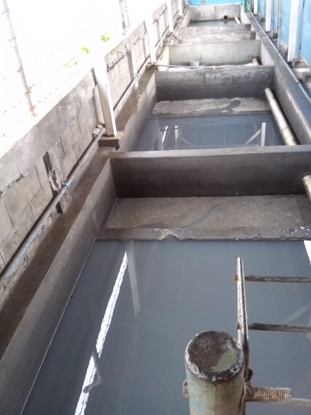
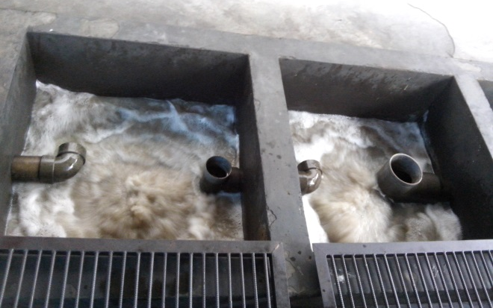
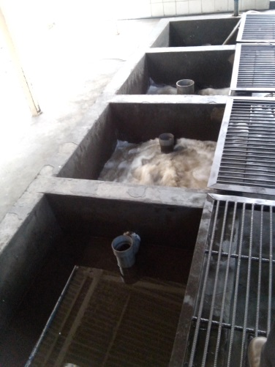
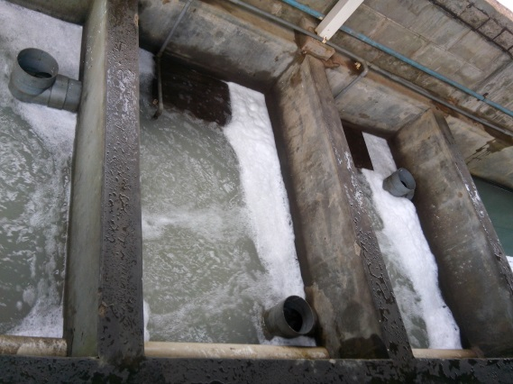
Balikpapan work shop
Every Work Shop requires
Contaminate resource
Oil from Washing machine
Oil from over flow activities area
Existing plant: The result has not been satisfied
Need features
Technical assistance
Design aspects
Waste management
Special Need:
Revitalization teatment plant
Biologcal Patent Technology
Minimize energy, chemical, time and space

Slide 11
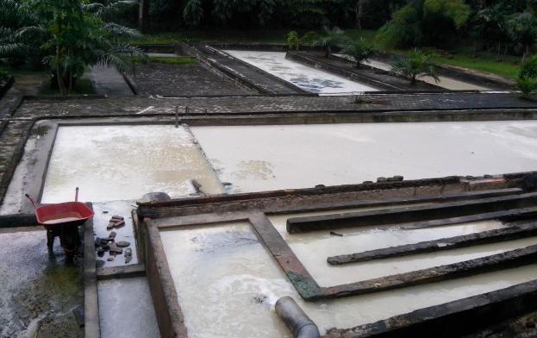
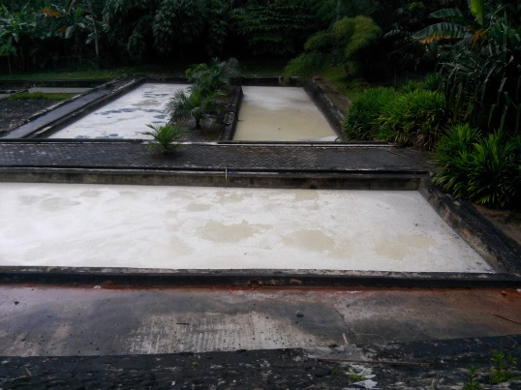
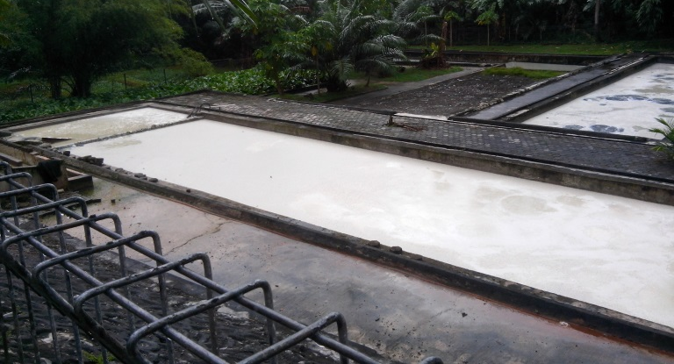
Balikpapan Tofu and Tempeh Industry
Every the activities requires
Contaminate resource
Waste water from making of Tofu
Waste water from making of Tempeh
Existing plant: The result has not been satisfied
Need features
Technical assistance
Design aspects
Waste management
Special Need:
Biologcal Patent Technology
Minimize energy, time and space

Slide 12
General Result need
Safety to remove
Recovery
Recycle
Reform to Energy or something useful
Revitalization treatment to minimize energy, chemical, time and space

Slide 13
Huge market in indonesia
11 big contaminate rivers
514 cities in Indonesia
Domestic Waste Water Treatment Plant
Sanitary Landfill Leacheate, every city in Indonesia
Hotel
Shopping Center
Workshop
Apartment
Office building
Palm Oil Refinery, 600 mills
Rubber Refinery, 400 mills
Comunal Cow Farm/livestock, 25 big farms
Elevated Domitory Building, 100
Tofu and Tempeh Industry, 100
Metal Industry Waste Water, 10

Slide 14
Ir. Rudy Abdul Rahman
Environmental Technology Expert
+62 811 220 1011
rudy.abdul.rahman@gmail.com
Ms Yesim Baykal
Senior Programme Officer, Global Challenges Division, WIPO
+41 22 3387289
yesim.baykal@wipo.int

Slide 15
thank you

