Slide 1
Patent Information: A Tool for Innovation
1 June
2022
Alex Riechel
Head, TISC Development Section

Slide 2
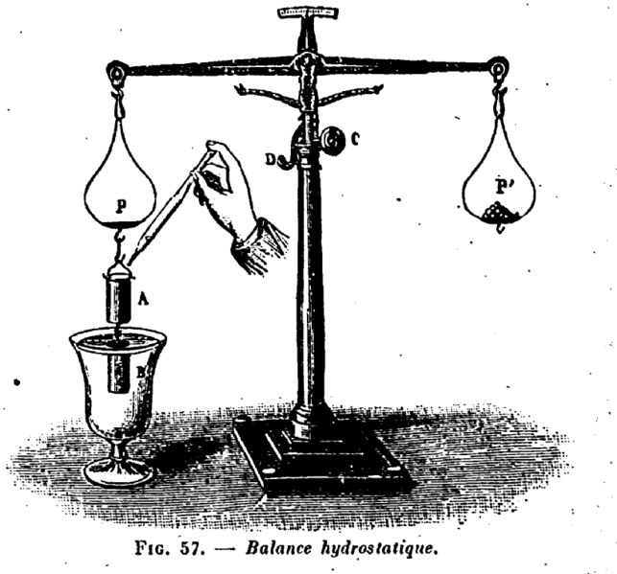
Patent system
Protection: Reward investments made in developing a new invention
Disclosure: Publish and make known technical information of a new invention
Innovation and economic growth
Image source: E. Vitte

Slide 3
Nature of patent information
Protection
Disclosure

Slide 4
Nature of patent information
Protection
Disclosure
Territorial

Slide 5
Nature of patent information
Protection
Disclosure
Territorial
Global

Slide 6
Nature of patent information
Protection
Disclosure
Territorial
Time-limited
Global

Slide 7
Nature of patent information
Protection
Disclosure
Territorial
Time-limited
Global
Permanent

Slide 8
Nature of patent information
Protection
Disclosure
Territorial
Time-limited
Claims only
Global
Permanent

Slide 9
Nature of patent information
Protection
Disclosure
Territorial
Time-limited
Claims only
Global
Permanent
Full document

Slide 10
Nature of patent information
Protection
Disclosure
Territorial
Time-limited
Claims only
→ Exclusive right
Global
Permanent
Full document
→ Learning opportunity

Slide 11
Uses of patent information
Legal
Technical
Business
Policy

Slide 12
Uses of patent information
Determine the patentability of your inventions
Draft strong patent applications
Determine the validity of existing patents and which technologies belong to the public domain
Avoid patent infringement

Slide 13
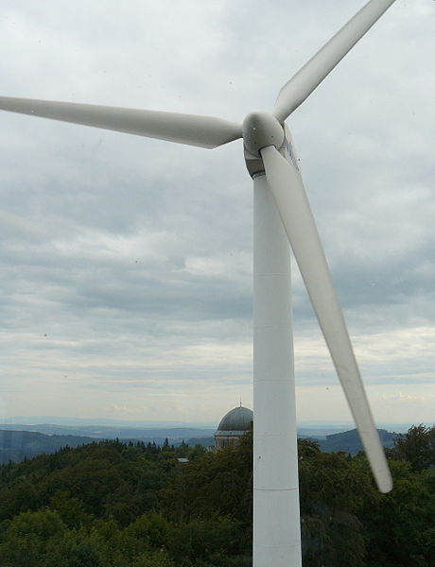
Scenario
A manufacturer of wind turbines would like to identify new technologies to incorporate into its products.
The manufacturer would also like to know whether these technologies can be exploited freely, or whether licenses must be obtained from patent holders.
→ Avoid patent infringement
Photo source: Pavel Ševela / Wikimedia Commons

Slide 14
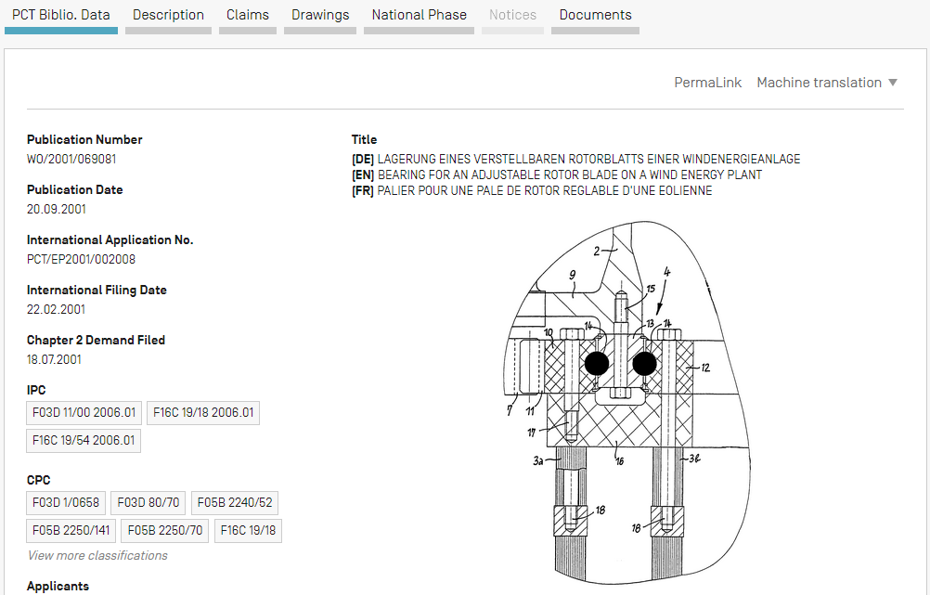
Record

Slide 15
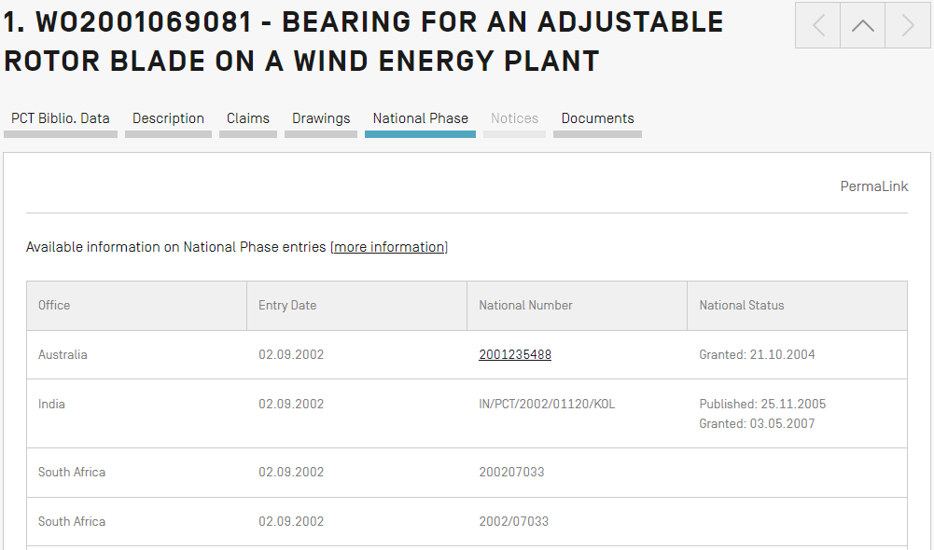
Legal status: National phase

Slide 16
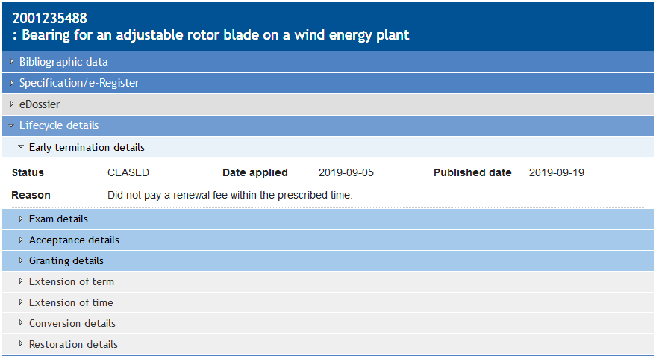
Legal status: Australia

Slide 17
Uses of patent information
Develop new solutions to technical challenges faced in the country, or adapt existing technologies to suit local conditions
Target research resources more effectively (avoid “reinventing the wheel”)

Slide 18
Uses of patent information
Develop new solutions to technical challenges faced in the country, or adapt existing technologies to suit local conditions
Target research resources more effectively (avoid “reinventing the wheel”)
Technical information must be sufficiently clear and comprehensive to be carried out by a typical expert in the field of technology (“a person having ordinary skill in the art”)

Slide 19
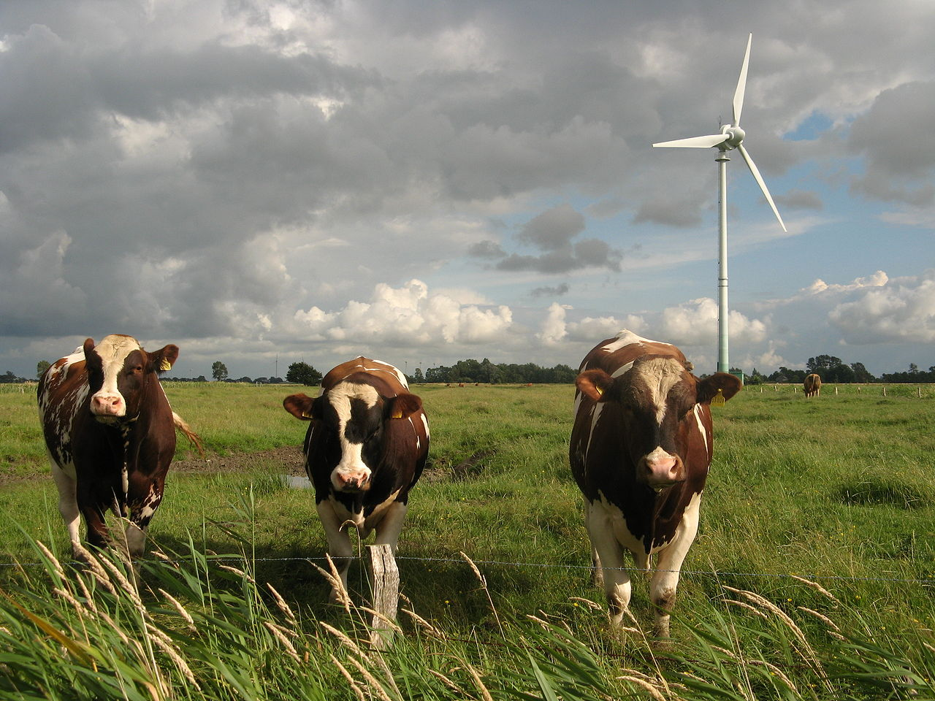
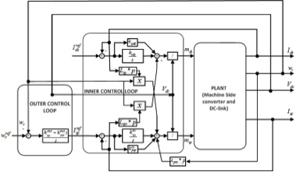
Scenario
A research laboratory aims to develop new wind turbine controller technologies and would like to know what has already been done in this area of research.
Avoid reinventing the wheel
Photo and image source: Dirk Ingo Franke, johnkonstanta (Wikimedia)

Slide 20
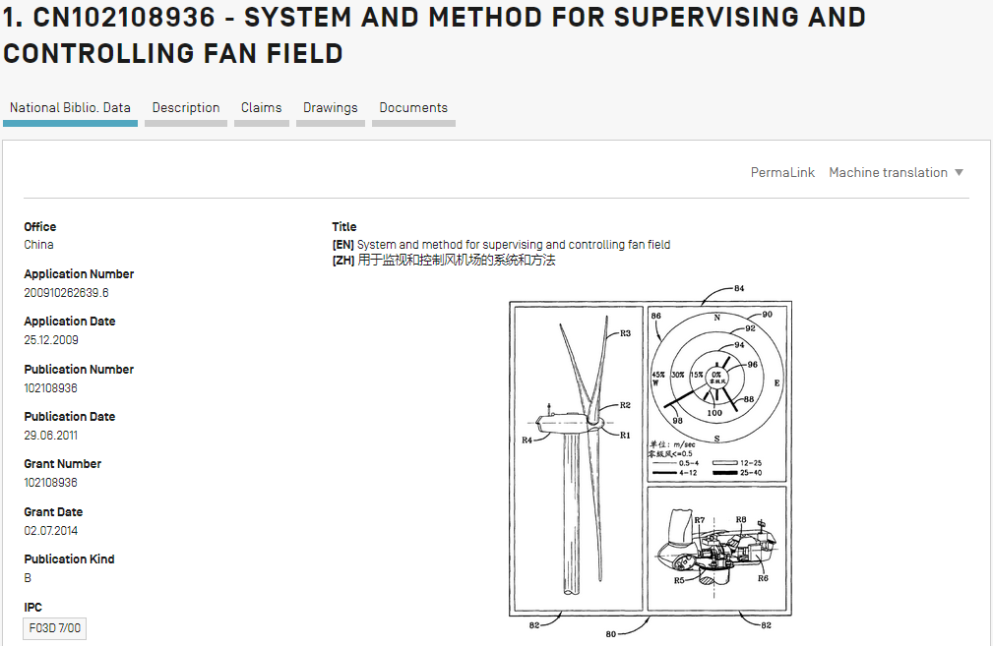
Record

Slide 21
Record

Slide 22
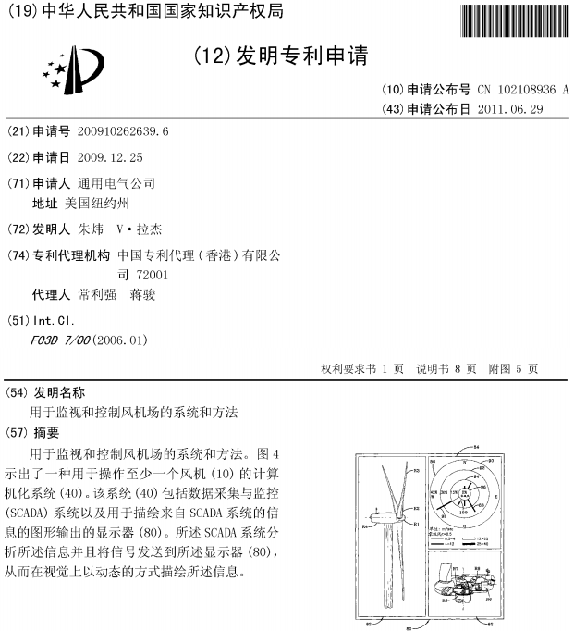
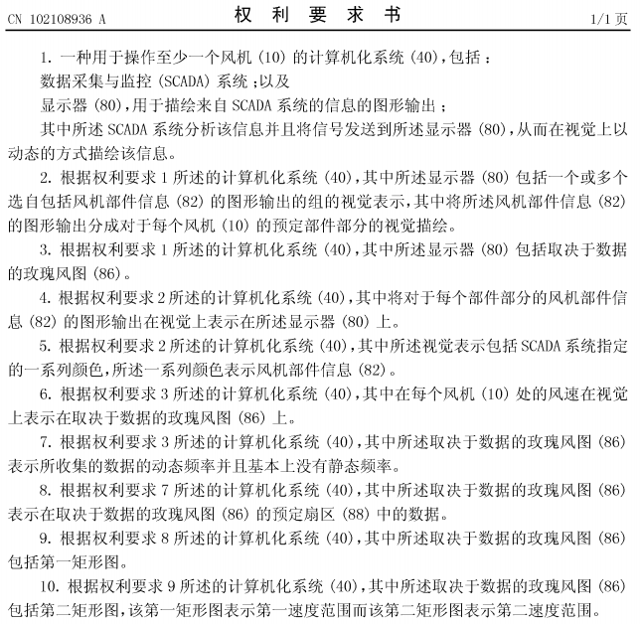
Chinese patent application

Slide 23
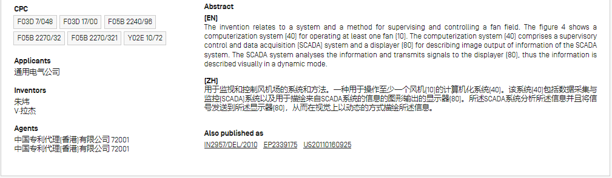
Record

Slide 24
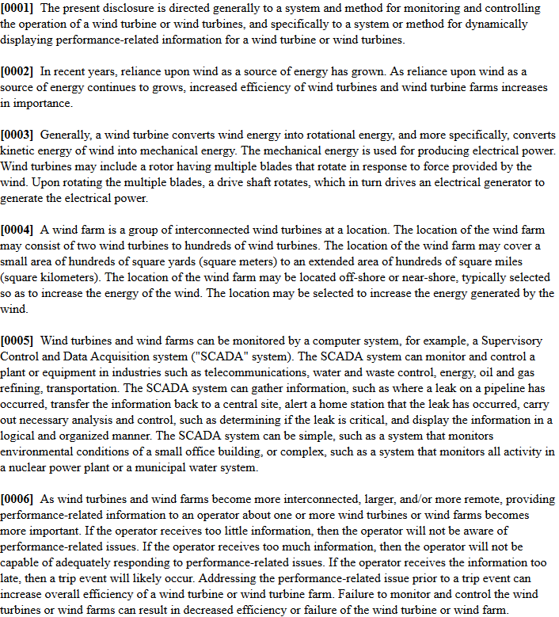
European patent application

Slide 25
Uses of patent information
Track research activities of competitors
Identify opportunity for licensing and joint ventures
Review trends in specific areas of technology

Slide 26
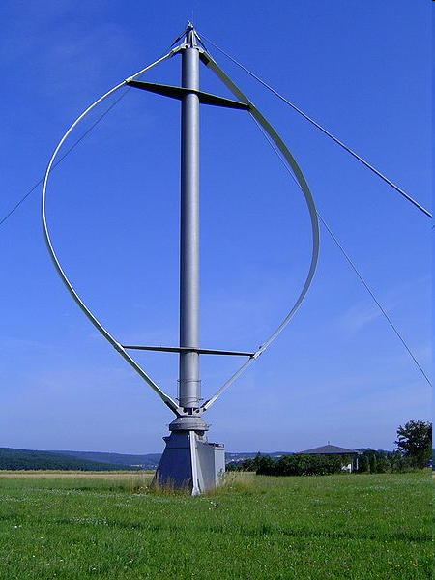
Scenario
The manufacturer of wind turbines would like to identify its major competitors and potential partners to develop new technologies and products.
Photo source: W.Wacker (Wikimedia)

Slide 27
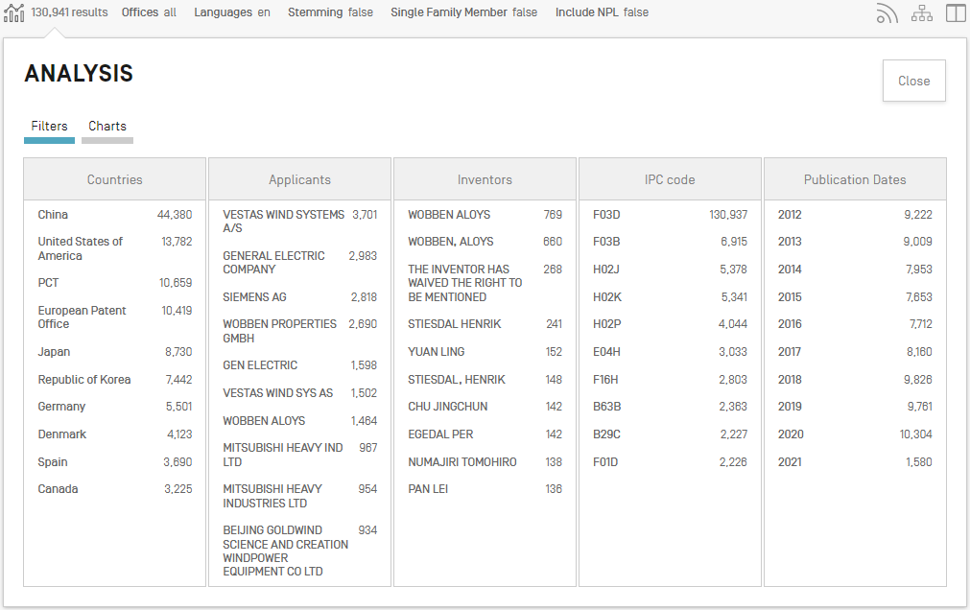
Search results

Slide 28
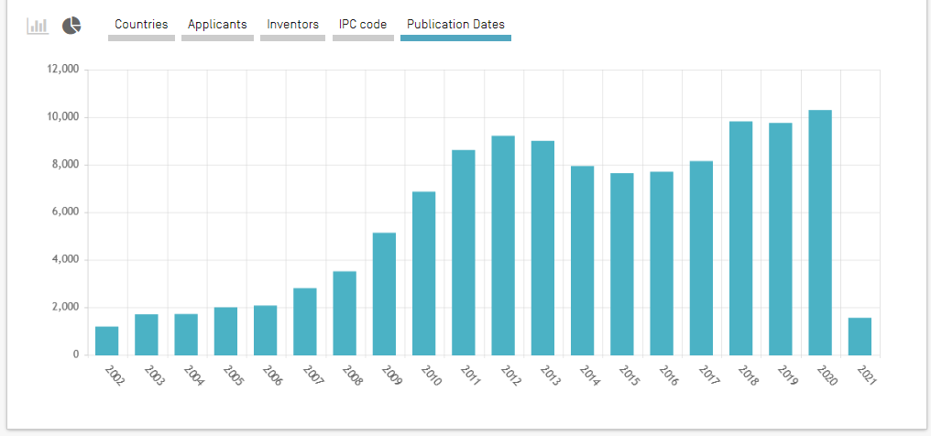

Filing trends over time
How is this technology evolving over time?

Slide 29
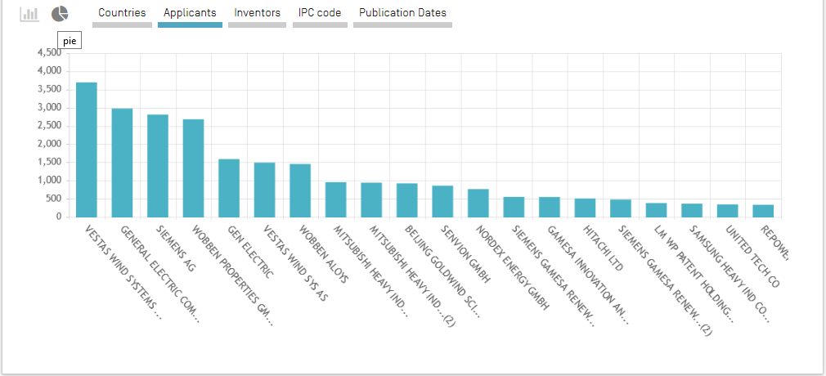
Filing trends by applicant
Who is particularly active in this field of technology?
From whom can I seek licenses, or with whom can I negotiate partnerships?

Slide 30
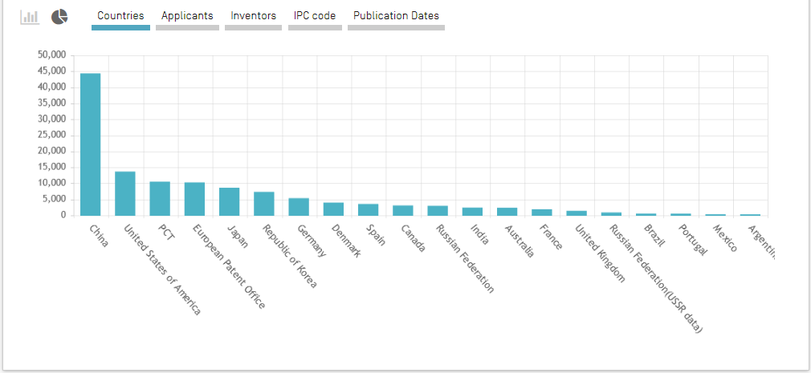
Filing trends over time
In which markets does particular interest exist in this field of technology?

Slide 31
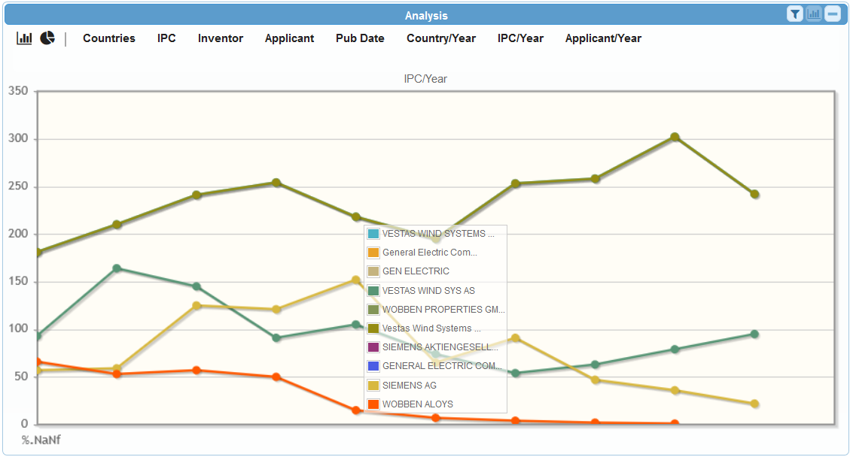
Filing trends by applicant over time
How is the patenting activity of top applicants evolving over time?

Slide 32
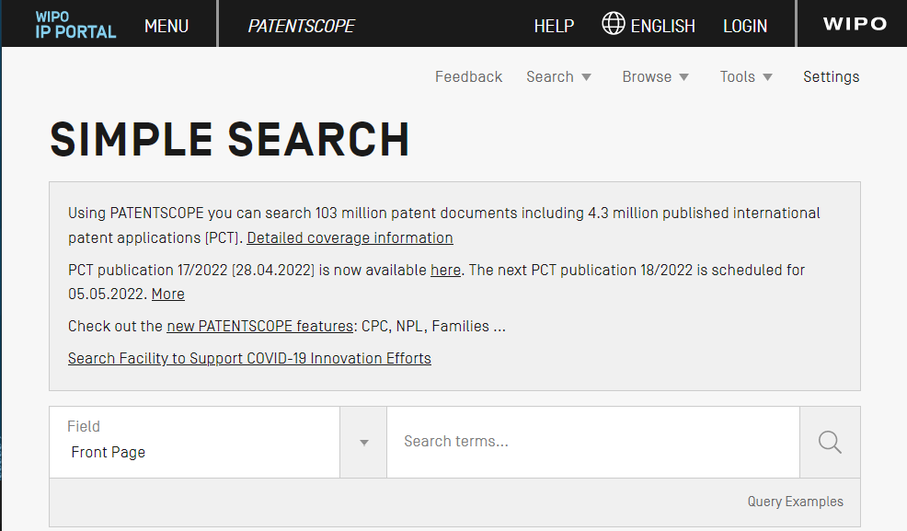
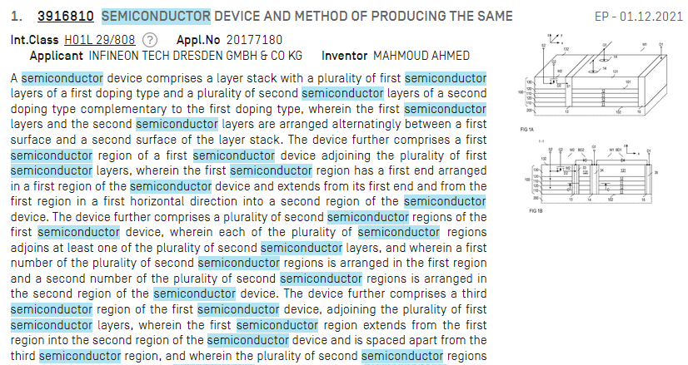
PATENTSCOPE
100+ million patent documents
74 national, regional, and international collections
Advanced search and analysis features
Free of cost!
https://patentscope.wipo.int

Slide 33
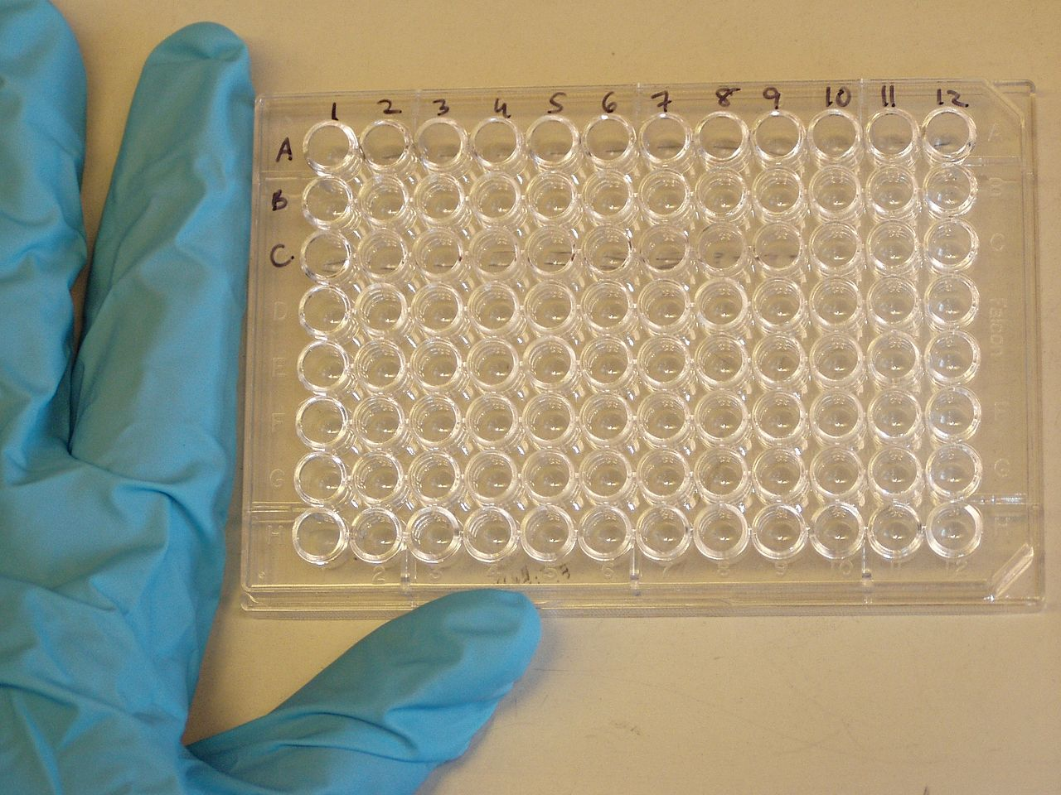
Scenario
Your company aims to develop new immunoassays (to detect leishmaniasis).
You want to know which inventions have already been made in this field.
Photo source: Jeffrey M. Vinocur

Slide 34
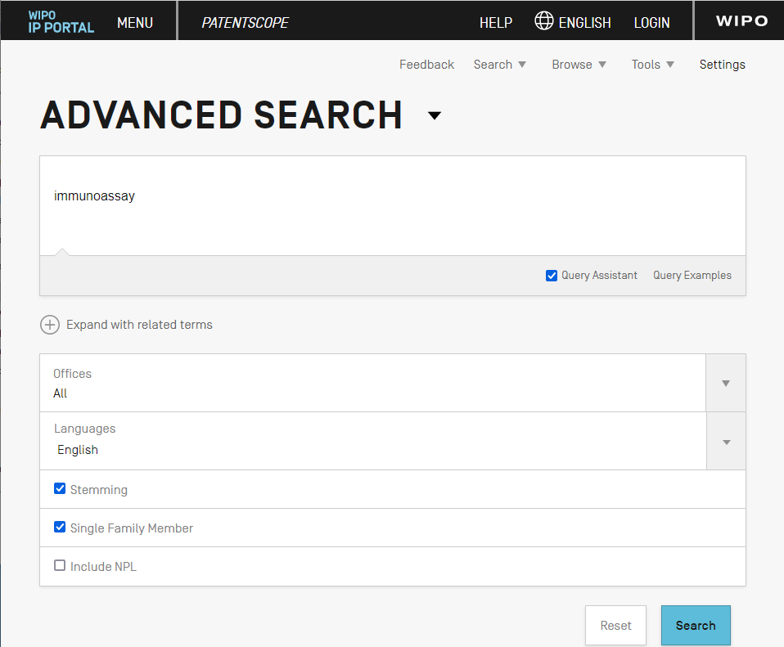

Slide 35
Term variants
Single inventions

Slide 36
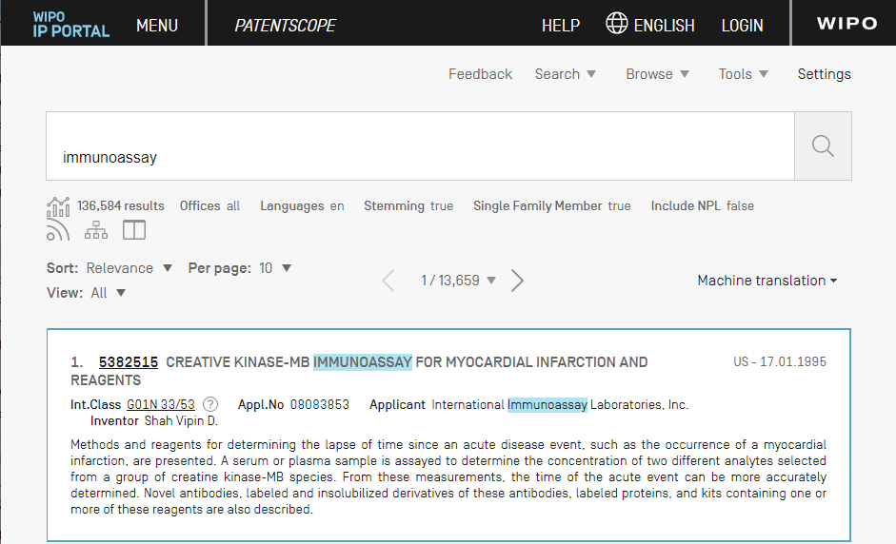

Slide 37
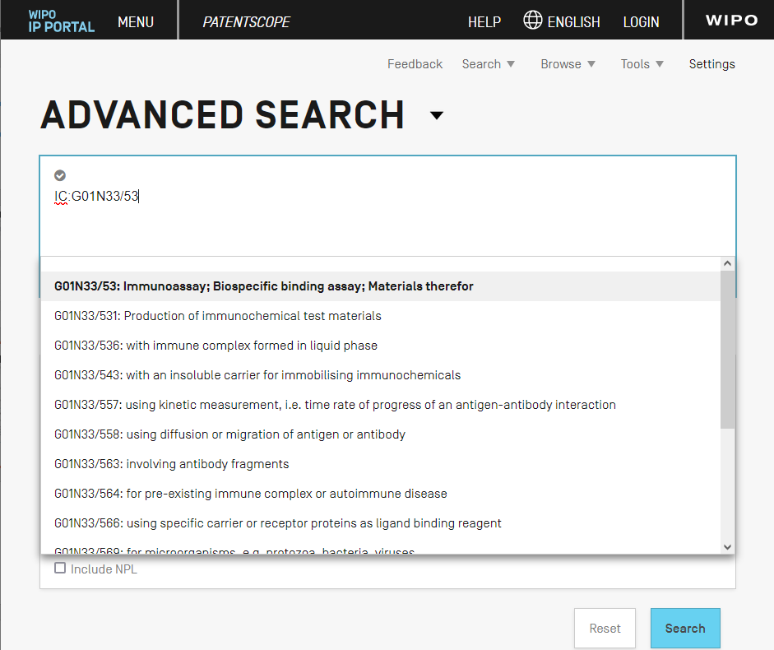

Slide 38
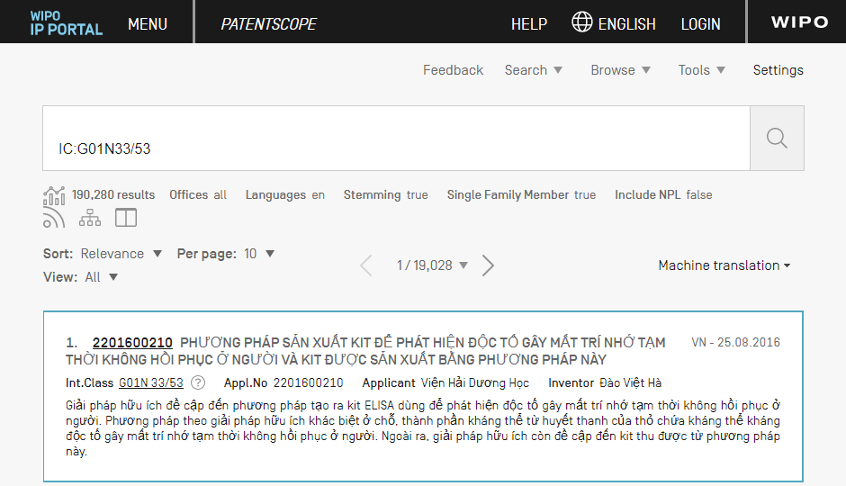

Slide 40
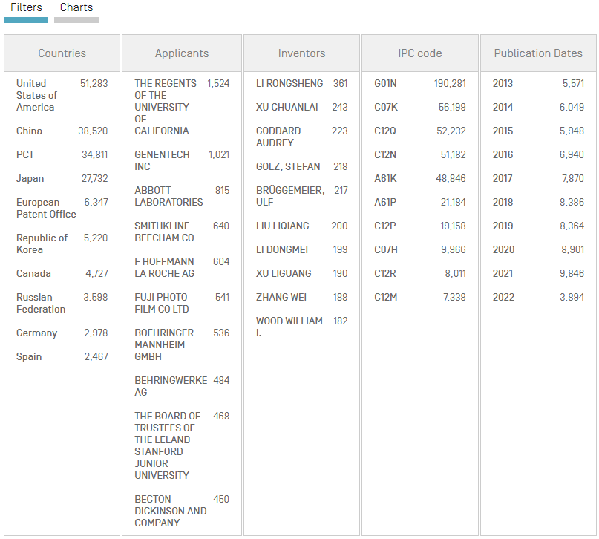

Slide 41
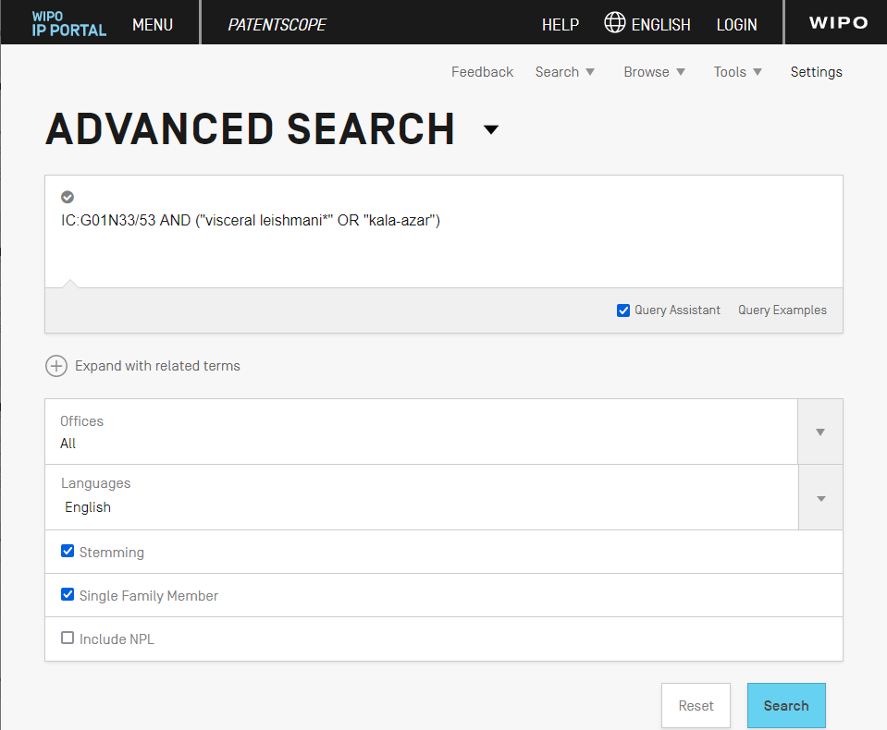

Slide 42
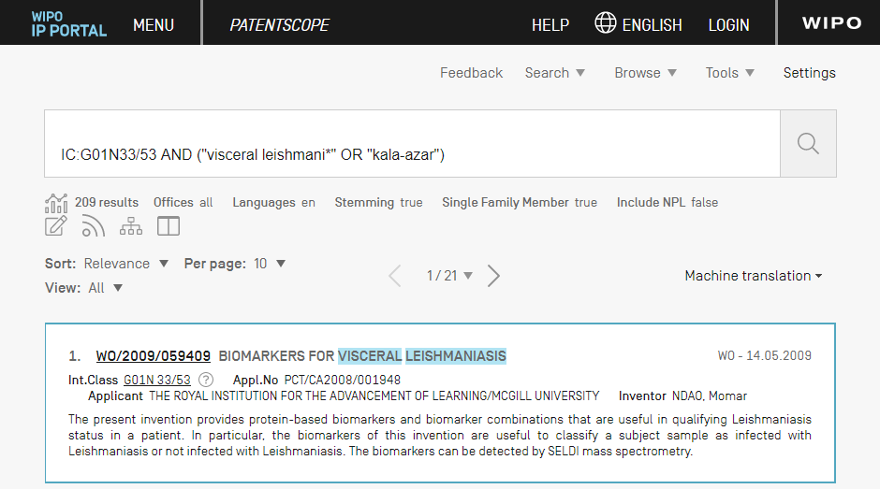

Slide 43
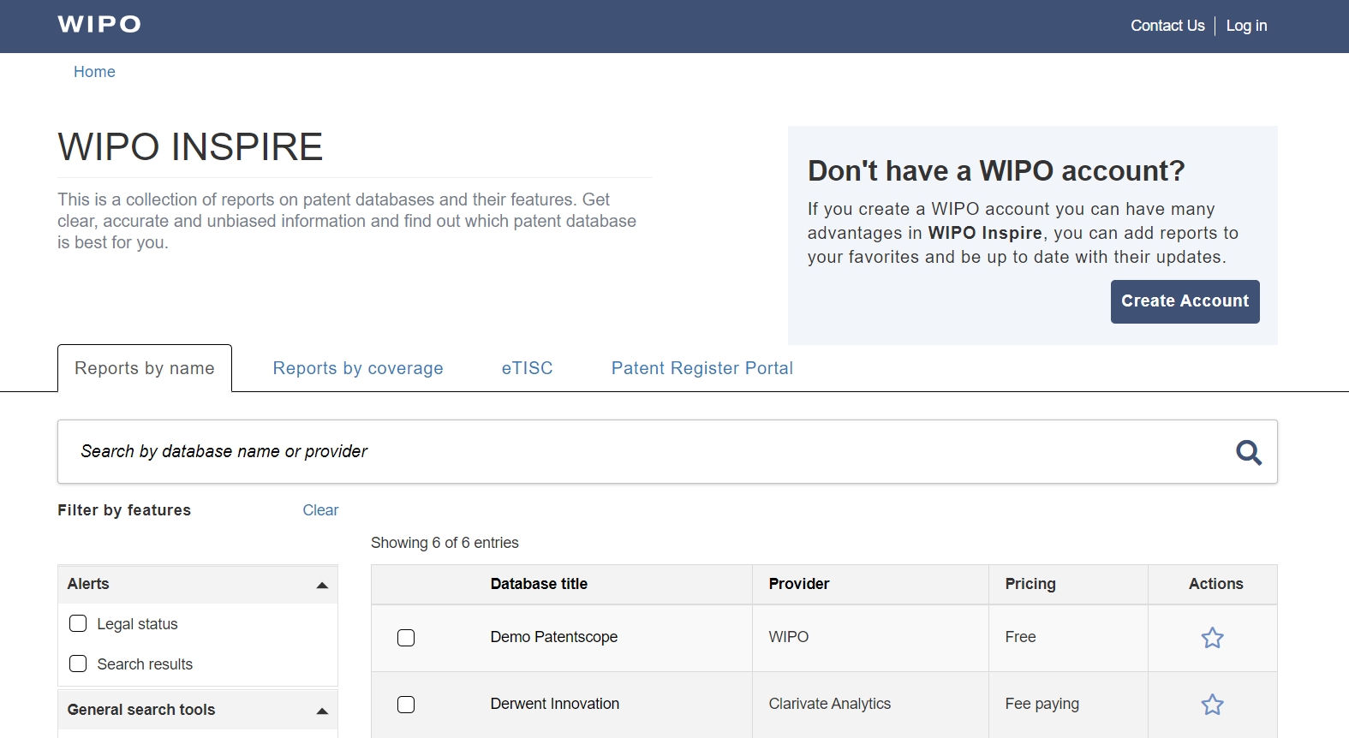
WIPO INSPIRE
https://inspire.wipo.int

Slide 44
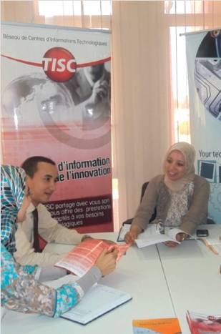
TISCs: Services
Core services
  Access to patent and non-patent databases
  Assistance in using databases
Additional services (based on user need and office capacity)
  Technology search services
  Patent analytical services
  Awareness-raising and training services
Photo source: Office Marocain de la Propriété Industrielle et Commerciale

Slide 45
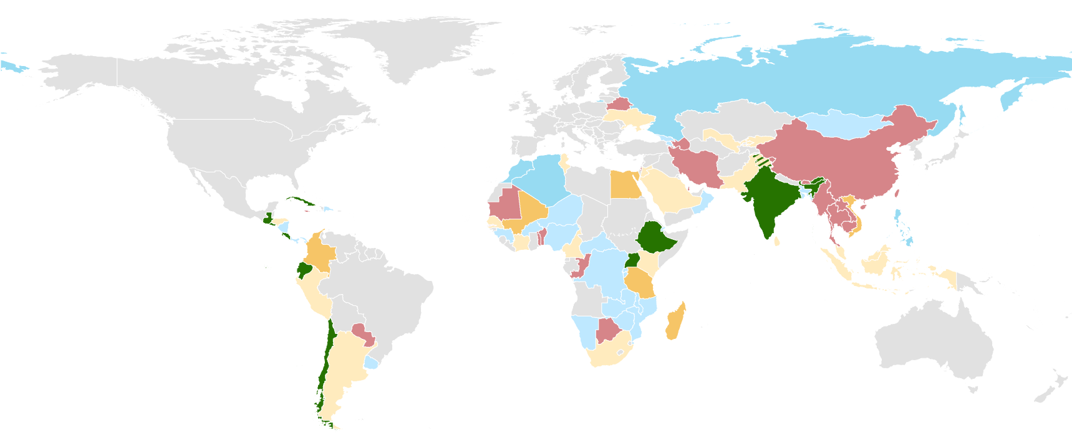
TISCs: Globally
Map Source: TISC Annual Report 2020
80+ national projects and 1300+ TISCs worldwide (May 2022)
1.8+ million inquiries supported annually (January 2022)

Slide 46
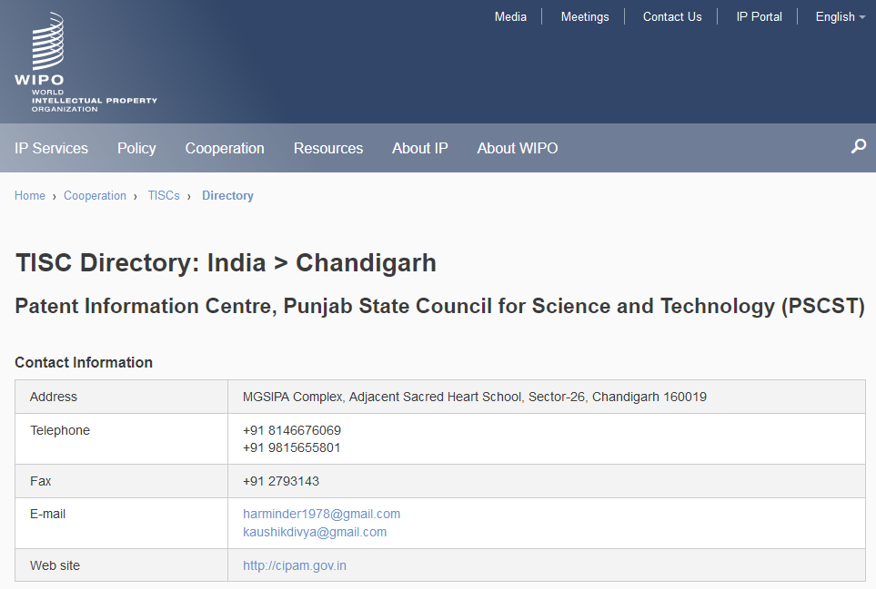
TISCs: Directory
https://www.wipo.int/tisc/en/search/

Slide 47
tisc@wipo.int

