Slide 1
Trademarks in the Textile, Fashion and Creative industries

Slide 2
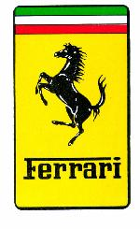
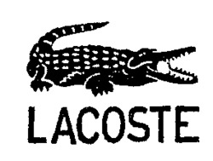
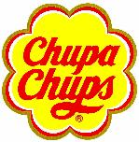

Slide 3
Basics - What is a trademark?
Sign or a combination of signs
Distinguish products/services of one undertaking from those of other undertakings
Identify the origin of the products/services – Prevent confusion

Slide 4
Trademarks in the fashion industry - Examples
Word marks (names / letters /numbers/slogans)
CHANEL
ADIDAS
LEVI’S

Slide 5
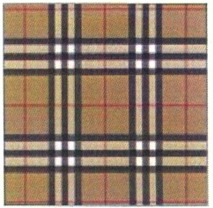
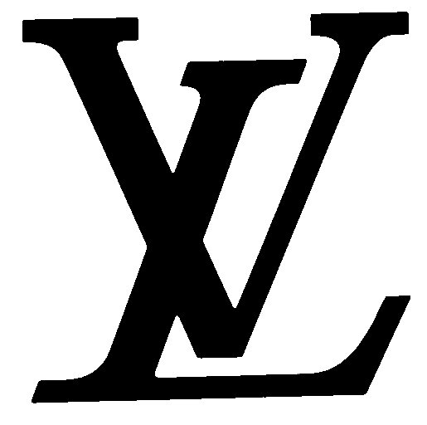
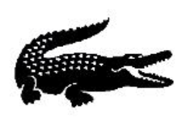
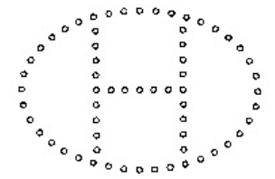
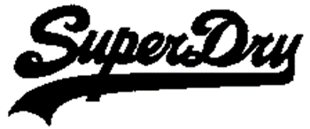
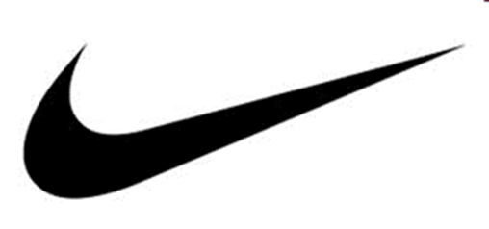
Trademarks in the fashion industry - Examples
Figurative marks (logos)

Slide 6
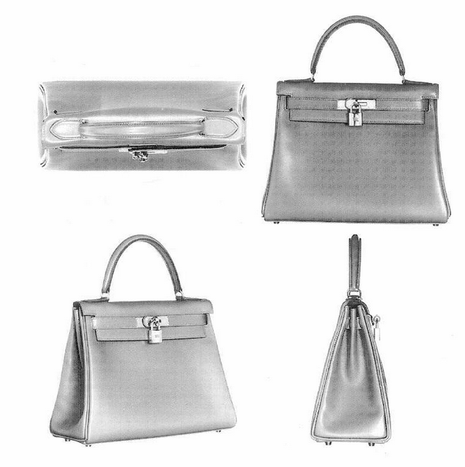
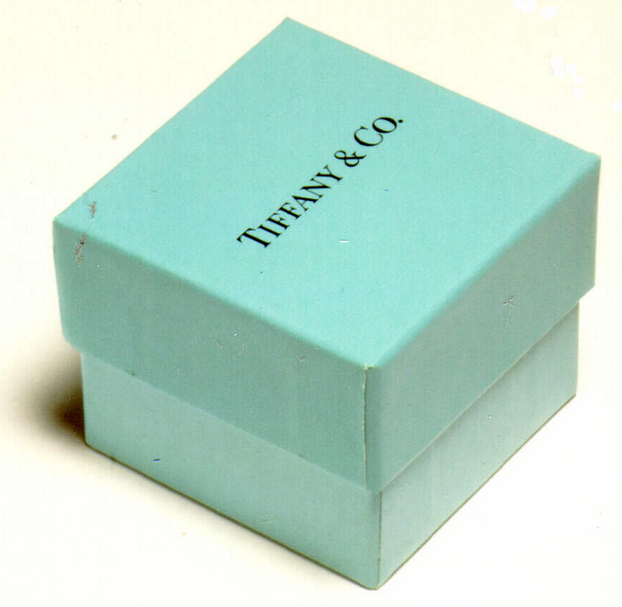
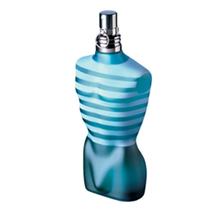
Trademarks in the fashion industry - Examples
3D marks (Shape of product/packaging)

Slide 7
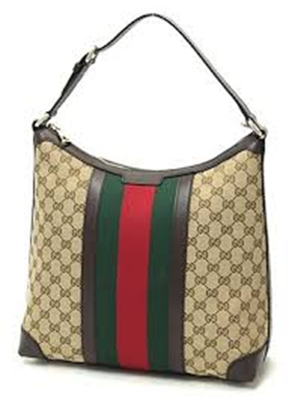
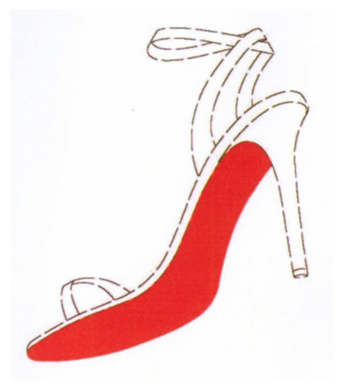
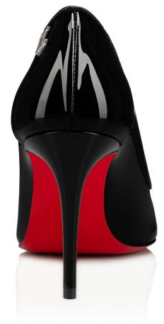
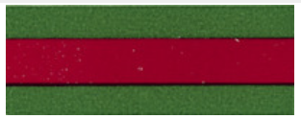
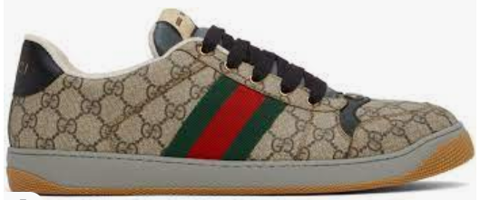
Trademarks in the fashion industry - Examples
Color marks (a single color or a combination of colors)
The mark consists of the colour red (Pantone 18‑1663TP) applied to the sole of a shoe as shown
(the contour of the shoe is not part of the trade mark but is intended to show the positioning of the mark)
https://eu.christianlouboutin.com/ch_fr/sporty-kate-black-lin-black-1221056b439.html

Slide 8
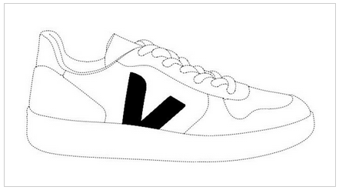
Trademarks in the fashion industry - Examples
Position marks

Slide 9
Trademarks in the fashion industry - Examples
Motion marks

Slide 10
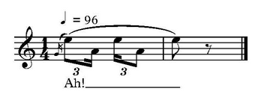
Trademarks in the fashion industry - Examples
Sound marks

Slide 11
How to protect a trademark?
Registration – Formalities + fees
Requirement – Distinctiveness
Availability of the sign (not infringing rights acquired by third parties) – Prior trademarks search in the Global Brand Database: https://branddb.wipo.int/branddb/en/

Slide 12
Where to protect a trademark?
Trademark and design rights are territorial rights
Different routes:
National
Regional (e.g., EUIPO)
International Registration of trademarks : Madrid System

Slide 13
«International» protection
One international application in which the countries where protection is sought are designated by the applicant
https://www.wipo.int/madrid/en/

