Slide 1
Synergies between IP governance and South –South Cooperation on
IP and Development
First WIPO Interregional Meeting on South-South Cooperation on IP Governance; Genetic Resources, Traditional Knowledge and Folklore; and Copyright and Related Rights
8 August 2012
Brasilia

Slide 2
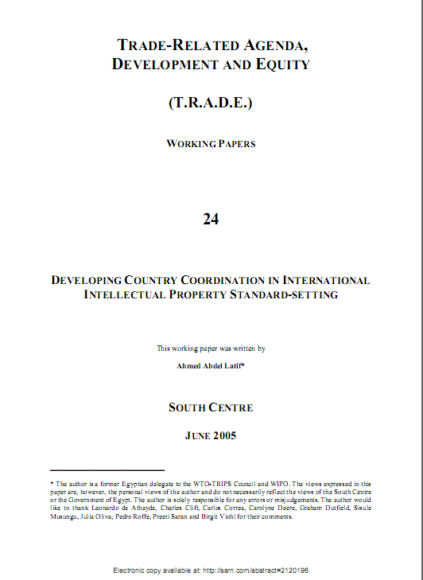
www.ictsd.org

Slide 3
South South Cooperation : Why ?
South South Cooperation (SCC) is a well established principle and priority in the United Nations system of which WIPO is a member.
1974: - First UN General Assembly resolution on SSC.
- Establishment of UNDP special unit on SSC
2009: - The High-level UN Conference on South-South Cooperation is held in Nairobi, Kenya.
- Requires UN agencies to support and implement SSC
SSC is not a substitute to North/South cooperation but a complement to it.
www.ictsd.org

Slide 4
South South Cooperation in IP : Why ? (1)
It makes sense for countries with similar levels of development and views on IP to seek to benefit from their respective experiences
This is a fundamental premise of the WIPO Development Agenda : IP should take into consideration different in levels of development:
DA recommendation 1: WIPO technical assistance shall be development-oriented, taking into account different levels of development of Member States
DA recommendation 15: Norm-setting activities shall take into account different levels of development
www.ictsd.org

Slide 5
South South Cooperation on IP : Why ? (2)
Changes in global geography/landscape of innovation provide further momentum to SSC on IP and development:
Increase of IPRs applications from a number of emerging and developing economies
Development of IP regimes in developing countries
Increase of IP expertise in developing countries
Regionalization of IP cooperation
Increase of SSC on the ground and in different fora
www.ictsd.org

Slide 6
SSC on IP and Development: What do we mean?
Two different aspects
USE OF IP FOR DEVELOPMENT
Use of IPRs for economic development
IP administration
Infrastructure supporting the use of the IP system
DEVELOPMENT ORIENTED IP
Balanced IP regimes
Use of flexibilities, limitations and exceptions in IP rules
Ensuring that IP is supportive of public policy objectives
www.ictsd.org

Slide 7
SSC on IP and Development: A mapping of issues
USE OF IP FOR DEVELOPMENT (1)
IP policies and domestic coordination
IP policies and strategies : Elaboration and implementation of IP policies and strategies
Domestic coordination on IP: Need for an institutional inter-agency mechanism to coordinate domestic and international positions on IP (Brazil GIPI model)
www.ictsd.org

Slide 8
SSC on IP and Development: A mapping of issues
USE OF IP FOR DEVELOPMENT (2)
Use of IPRs for economic development
Patents : Use of patents by industry and public research institutions
Copyright : Creative industries more advanced in some developing countries than others
GIs, Trademarks and Industrial designs: Use by local industry and stakeholders
www.ictsd.org

Slide 9
SSC on IP and Development: A mapping of issues
USE OF IP FOR DEVELOPMENT (3)
IP administration
Patents: Search and examination of patent applications (Pro Sur initiative, fast tracking of “green” patents)
Copyright: Collective management
GIs, Trademarks and Industrial designs: Processing trademark applications , Implementing GI regulations
www.ictsd.org

Slide 10
SSC on IP and Development: A mapping of issues
USE OF IP FOR DEVELOPMENT (4)
Infrastructure supporting the use of the IP system
Promoting innovation and technology transfer:
Elaboration and implementation of innovation strategies and plans
Different approaches : “frugal innovation” in India and “indigenous” innovation in China
Innovation and technology infrastructure: Strengthening scientific and R&D institutions
www.ictsd.org

Slide 11
SSC on IP and Development: A mapping of issues
DEVELOPMENT ORIENTED IP (1)
Aligning IP with development and public policy objectives
IP/public policies: Ensuring coherence and domestic coordination in formulation and implementation of IP/public policies
Participation in international fora: Ensuring coherence and coordination in (WTO/WIPO and IP fora/CBD, WHO, UNFCCC etc )
www.ictsd.org

Slide 12
SSC on IP and Development: A mapping of issues
DEVELOPMENT ORIENTED IP (2)
Use of flexibilities , limitations and exceptions
Sharing of experiences in using flexibilities and L&E: Some developing countries have more practical experience in this area (Brazil, India, China, Thailand, Malaysia etc..)
Reform of national IP laws: A number of developing countries have reformed/or are in the process of reforming their IP laws (India, Chile etc)
Public domain related issues
www.ictsd.org

Slide 13
SSC on IP and Development: A mapping of issues
DEVELOPMENT ORIENTED IP (3)
IP negotiations
International level: better coordination at the multilateral level between developing countries
Regional level and bilateral level: sharing of experiences in negotiating and implementing FTAs
www.ictsd.org

Slide 14
SSC on IP and Development: A mapping of issues
DEVELOPMENT ORIENTED IP (4)
Genetic resources, Traditional Knowledge and TCEs/Folklore
Genetic resources: implementing disclosure requirements in patent laws and use databases
Traditional knowledge and TCEs/Folklore: laws and regimes on TK protection
www.ictsd.org

Slide 15
SSC on IP and Development: A mapping of issues
DEVELOPMENT ORIENTED IP (4)
Genetic resources, Traditional Knowledge and TCEs/Folklore
Genetic resources: implementing disclosure requirements in patent laws and use databases
Traditional knowledge and TCEs/Folklore: laws and regimes on TK protection
www.ictsd.org

Slide 16
SSC on IP and Development and IP governance
Some suggestions
Annual “thematic” meeting on SSC
Further institutionalisation and mainstreaming
of SSC throughout WIPO activities
Consolidation of lessons learned and best practices
www.ictsd.org

Slide 17
Thank you
aabdellatif@ictsd.ch
www.ictsd.org

