Slide 1
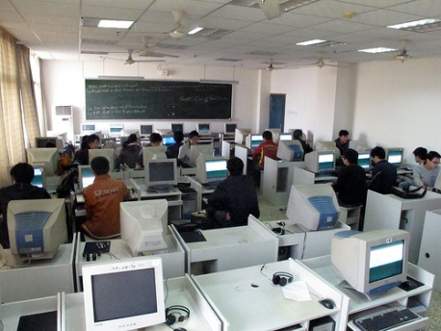



Evaluating the impact of IP:
The ICTSD experience
Christophe Bellmann
Programmes Director
WIPO seminar on evaluation of IP
6th October 2011
International Centre for Trade and Sustainable Development www.ictsd.org

Slide 2

The International Centre for Trade and Sustainable Development (ICTSD)
Independent non-partisan and non-profit NGO based in Geneva (1996)
Mission: to empower stakeholders to promote sustainable development in the international trade and intellectual property system through:
        - Non-partisan reporting
        - Multi-Stakeholder Dialogue
        - Well-targeted Policy Research
        - Capacity Building
ICTSD engages with a broad range of stakeholders, including governmental, non-governmental and inter-governmental actors.
www.ictsd.org
Notes:
2

Slide 3
General challenges in evaluating the impact of IP
1. Basic Assumption: the need for evidence-based policies
General challenge in assessing the impact of IP:
  Lack of evaluation ‘culture’
  Lack of research methodologies and measurement tools
  Challenges in obtaining reliable data
  Difficulty in carrying out cross regional comparisons
  Significant expertise and resources required
www.ictsd.org
Notes:
3

Slide 4
ICTSD’s work involving evaluating the impact of IP
Impact of patent on transfer of clean energy technologies
Impact of IP standards in FTAs on public health and prices of medicines
Evaluating the needs of LDCs in the areas of IP technical assistance and capacity building
www.ictsd.org
Notes:
4

Slide 5
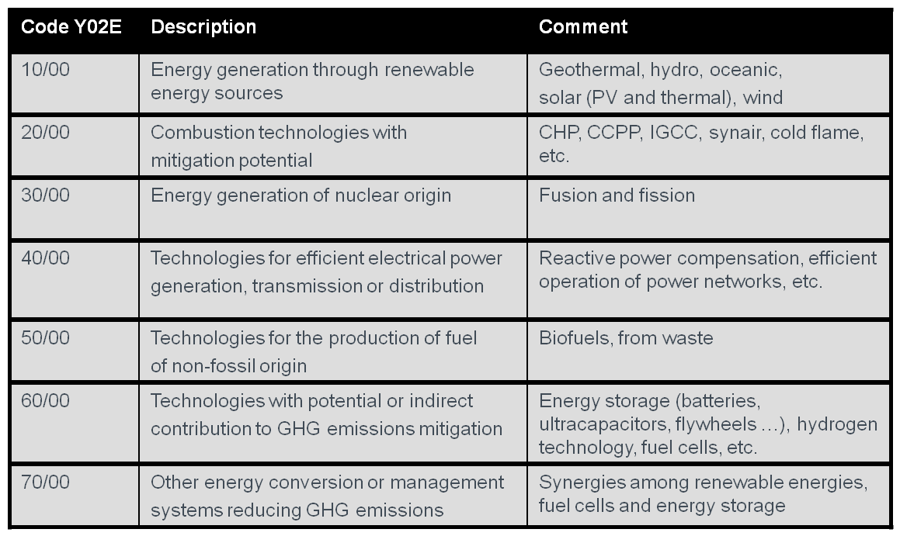
UNEP-EPO-ICTSD Report on Patents and Clean Energy
Mapping of renewable energy technologies
Patent landscape of clean energy generation technologies
New patent classification for clean energy technologies (Y02C, Y02E)
Survey of licensing practices in clean energy technologies
OECD Environment Division:
statistical analysis of patent data
Peer reviewed by IPCC experts
ERI (China)
TERI (India)
ECN
(Netherlands)
ICC
WBCSD
LESI
www.ictsd.org

Slide 6
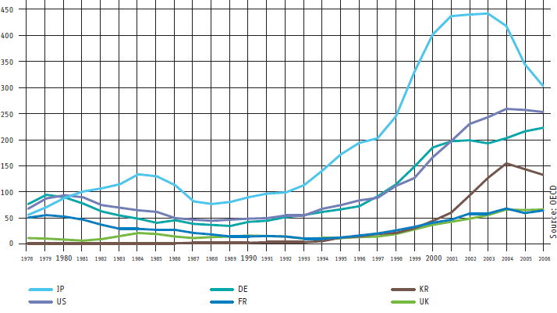
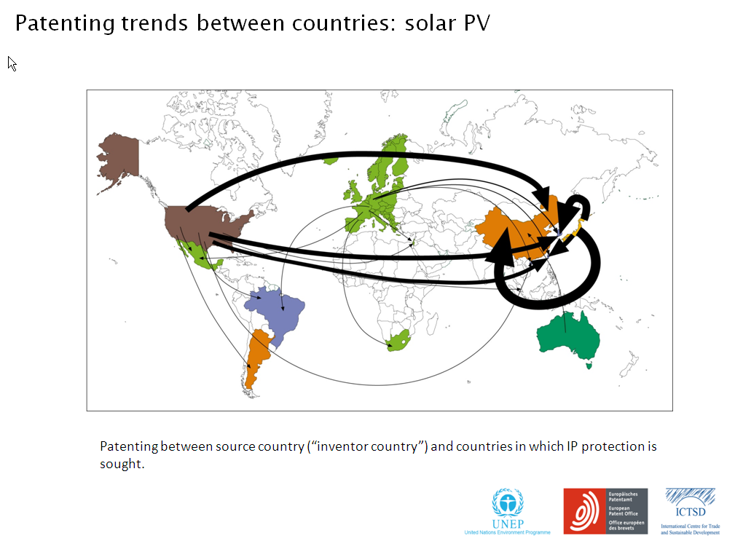
Countries leading patenting activity in clean energy technologies
Leading applicants (Wind Energy 2009)
Patenting trends, Solar PV 2009
www.ictsd.org
Notes:
6

Slide 7
Licensing Survey – Questions
Some 150 questionnaires received from 600 entities contacted (50% via on-line survey). Respondents represented a wide range of organizations (multinationals, universities, government agencies)
'To what extent has your organization entered licensing agreements that involve licensees (which are not majority-controlled subsidiaries) based in developing countries in the last three years?'
www.ictsd.org

Slide 8
Among those entering into licensing agreements in developing countries
Monetary terms when entering into an out-license agreement with parties that are based in developing countries
Developing countries important for IP and licensing
www.ictsd.org

Slide 9
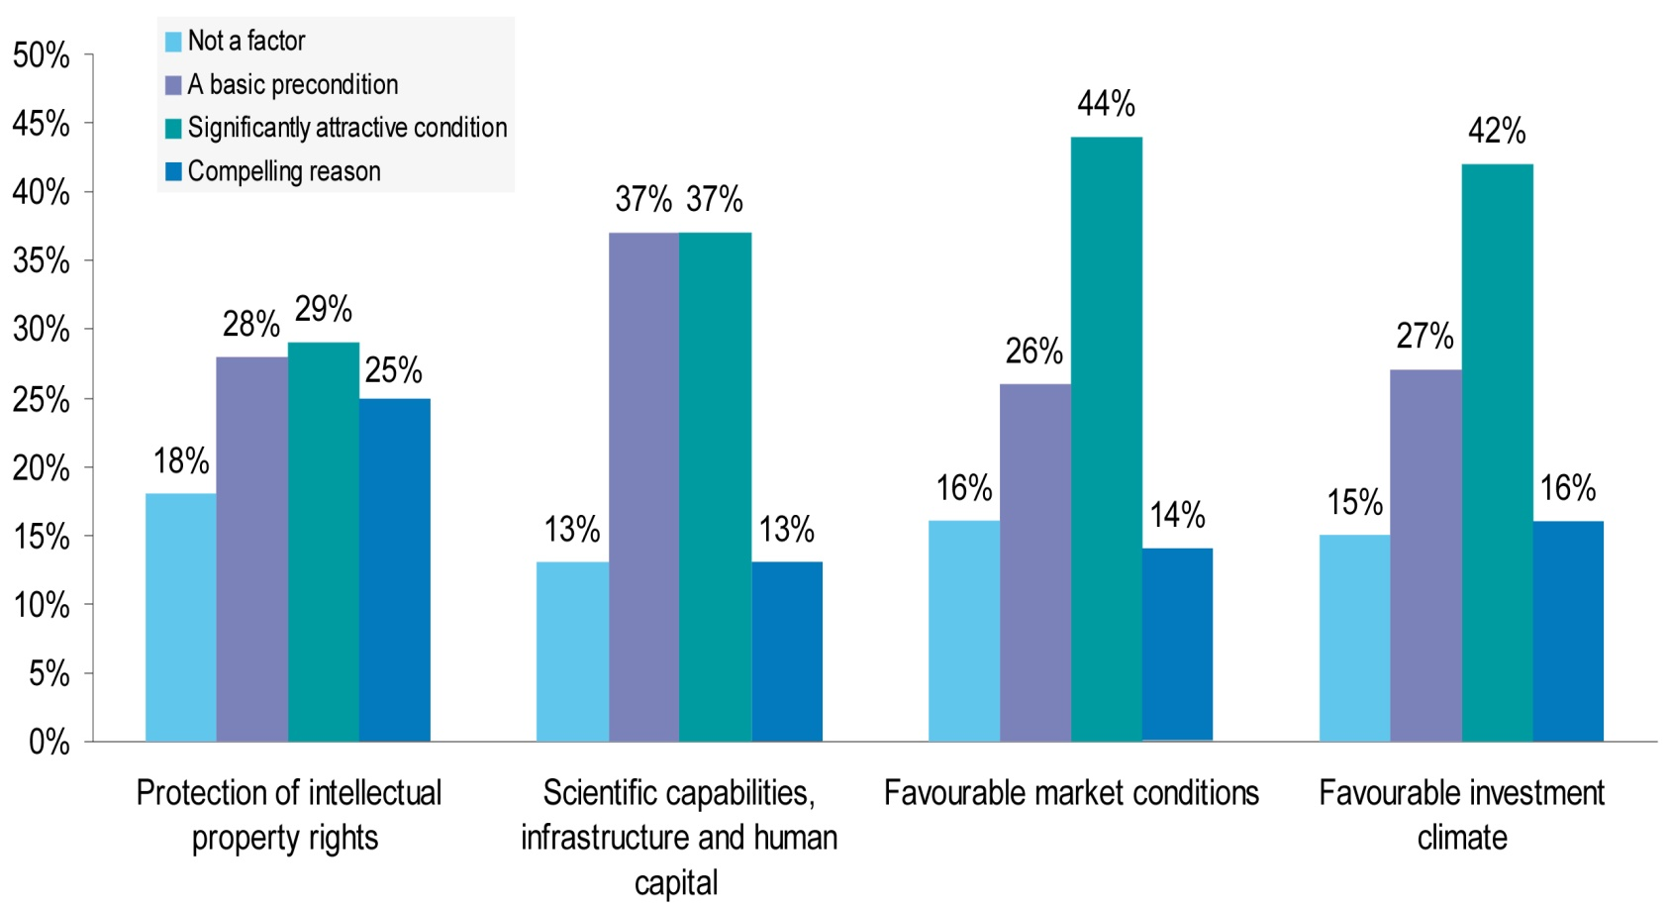

Factors affecting Licensing with developing countries
When your organisation is making a decision whether or not to enter into a licensing or co-operative development agreement with a party in a developing country, to what extent would the following factors positively affect your assessment?
www.ictsd.org
Notes:
9

Slide 10
Key Findings
Dominance of OECD countries in CET patenting
But increasing patenting activity in some emerging economies (China, Korea)
Untapped licensing potential in developing countries
Relative role of IP in licensing of CET
Need for easier access and availability of patent information
www.ictsd.org

Slide 11
Impact of IP standards in FTAs on prices of medicines
IP Authorities
NGOs
Trade Min.
Private Sector
Expert meeting
Academia
The Doha Declaration
Dominican Republic
Health Min.
ICTSD/WHO/ WBI/PAHO
Methodology
1. Aggregate
2. Disaggregate
Refined methodology
New generation of FTAs
Need to assess impact of TRIPS + on public health
Testing the methodology
Accurate data on impact assessment
WHO CIPH Report
Literature review
Costa Rica
Negotiations and implementation of new IP standards
NGOs
Private Sector
Academia
IP Authorities
Health Min.
Trade Min.
www.ictsd.org

Slide 12
Key Findings : Dominican Republic
  There will be a modest price increase of 9% to 15% in absolute terms over covered AI by 2027.
  Strongest impact per measure: data exclusivity (80% of the impact)
  Huge price differences between private and public markets (80% of the purchases today are out -of -pocket).
  If the public budget does not increase, consumption will decrease by 8% in the worst-case scenario.
  There will be a reduction of 14% in the public market share and 24% in the private market for local generic industry by 2027.
  Information asymmetries and government imperfections, have a higher impact on prices than regulatory changes in intellectual property.
www.ictsd.org
Notes:
12

Slide 13
Key Findings : Costa Rica
  By 2030, the price will increase between 18% and more than 40% yearly for covered active ingredients.
  There will be a need for increased public spending from about 2.008 to 3.357 million USD by 2030, depending on the scenario.
  Strongest impact per measure: patentability criteria (about 55% of the impact), data exclusivity (about 40%), linkage, and patent term restoration (about 5%).
  Concentration in the supply is putting at risk the sustainability of the universal access and procurement system.
  If the public budget is not increased, consumption will decrease by 24% in the worst-case scenario.
  By 2030, there will be a reduction between 24% to 27% in market share for the local generic industry.
www.ictsd.org
Notes:
13

Slide 14
Assessing LDCs technical needs assistance in the areas of IP
LDC Group in Gva
UNCTAD DDIP
Uganda, Sierra Leone, Rwanda submit IP needs assessment to TRIPS Council
ICTSD/Sanaa Consulting
Diagnostic Toolkit
Country IP needs assessments
Cambodia
Uganda
Sierra Leone
Rwanda
TRIPS Council Decision 2005
Bangladesh, Tanzania submit IP needs Assessment to TRIPS Council based on ICTSD/Sanaa Diagnostic Toolkit
DFID
National Consultations
NGOs
Private Sector
IP Authorities
Academia
Other Ministries
Trade Min.
www.ictsd.org
Notes:
14

Slide 15
Key Findings
Institutional fragmentation in dealing with IP
Coherence between IP laws and development objectives (including public health, agriculture, technology transfer, education etc. )
Different options and flexibilities available to LDCs under TRIPS not always taken into account
Need to facilitate access and use of IP system
Identification of priority sectors (agriculture, education, handicraft, TK, low-cost technologies)
Better integration and identification of IPRs related capacity building needs into EIF and AfT
Challenges in follow-up and donor mobilization
www.ictsd.org

Slide 16
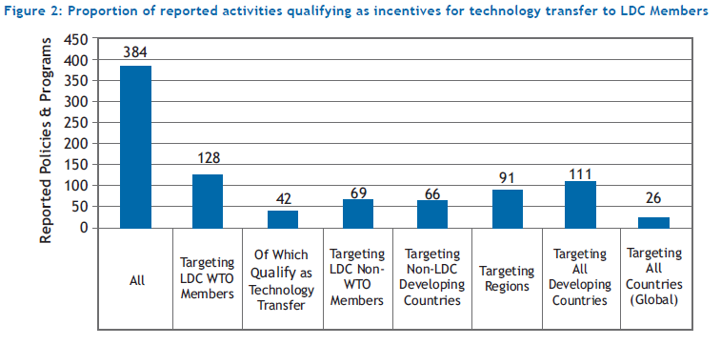
Enhancing technology transfer to LDCs through more effective implementation of TRIPS Article 66.2
www.ictsd.org

Slide 17
Lessons from ICTSD’s experience
Evaluation not an end in itself but a means to advance policy processes and to assist policy makers in making more informed decisions.
Partnerships are important to ensure diversity and complementarily of perspectives, expertise and resources.
Consultations with relevant stakeholders help ensure ownership.
Development of tailor made tools and methodologies is needed. Their elaboration should go through a sound peer review process which incorporates a diversity of views on the topic.
Findings and data are valuable but also process in terms of awareness raising, capacity building and outreach.
Evaluation is foremost a knowledge building and learning exercise.
www.ictsd.org
Notes:
17

Slide 18
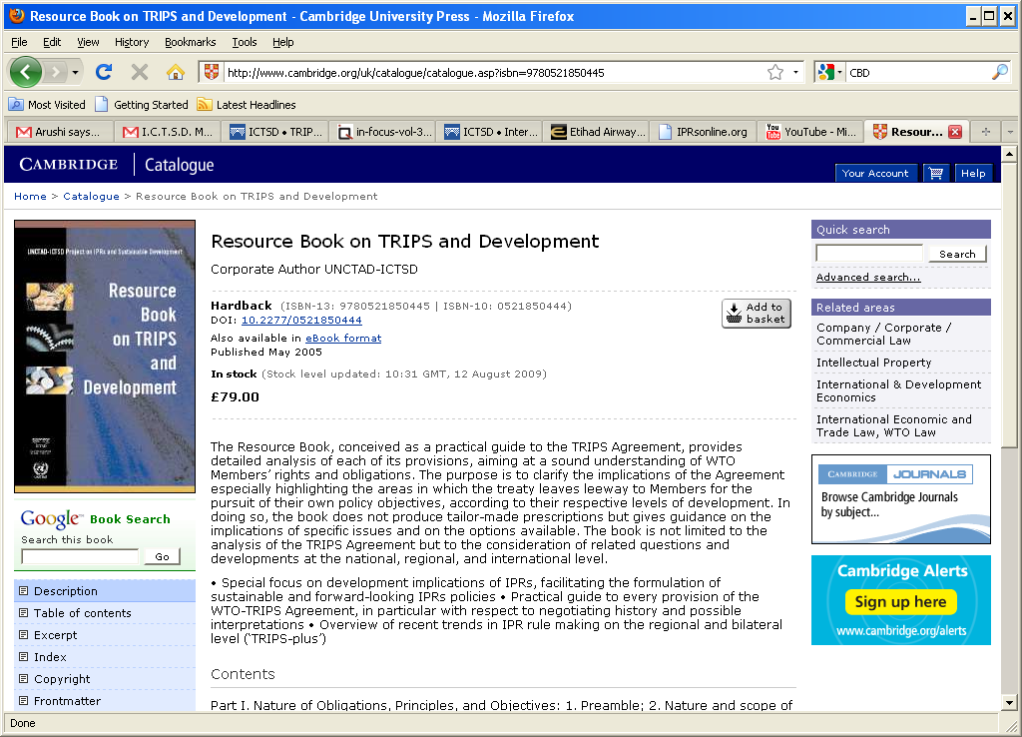
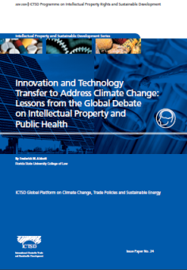
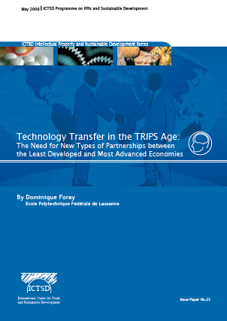
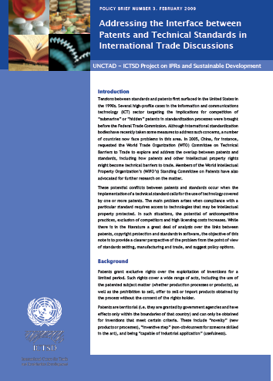
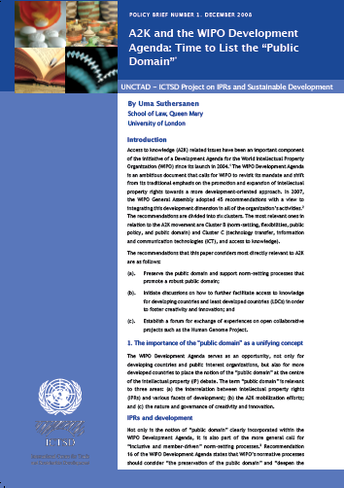
Thank you
cbellmann@ictsd.ch
Follow us on Twitter: ICTSDIP
Find us on Facebook: Innovation, Technology and IP Programme (ICTSD)
www.ictsd.org

