Slide 1
Managing Intellectual Property in the Age of Generative AI
Fernando S. Peregrino
21.09.2023
Prompt: “Please provide an image that visually represents the cutting-edge world of generative AI in a workshop setting”

Slide 2
INDEX
EUIPO Generative AI Guidelines
Application of Generative AI in IP
Conclusion
EUIPO Generative AI Guidelines
Application of Generative AI in IP
Conclusion

Slide 3
INDEX
EUIPO Generative AI Guidelines
Application of Generative AI in IP
Conclusion
EUIPO Generative AI Guidelines
Application of Generative AI in IP
Conclusion

Slide 4
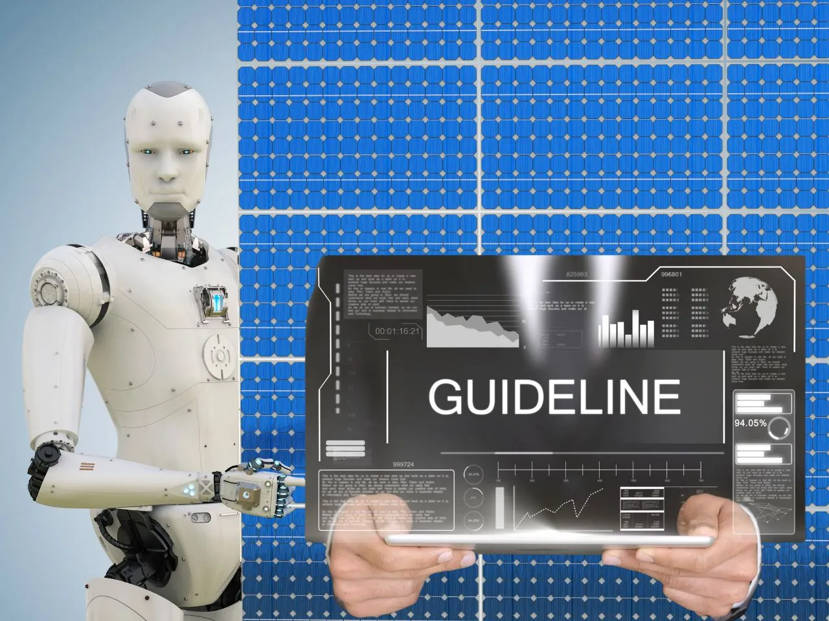
EUIPO Generative AI Guidelines
The discussed risks and limitations are not necessarily relevant for internally developed generative AI tools
Risks and Limitations

Slide 5
Risks and Limitations
5 Rules for the EUIPO staff regarding Generative AI third-party tools:
Never share any information that is not already in the public domain, nor personal data.
Always critically assess any response for potential biases and factually inaccurate information.
Always critically assess whether the outputs are not violating IP rights.
Never directly replicate the output in public documents.
Never rely on these models for critical and time-sensitive processes.

Slide 6
INDEX
EUIPO Generative AI Guidelines
Application of Generative AI in IP
Conclusion
EUIPO Generative AI Guidelines
Application of Generative AI in IP
Conclusion

Slide 7
Application of Generative AI in IP
Generation of draft text under certain conditions
Interpretation of customers feedback
Supporting pre-processing of IP translations
Guide user behaviour when filing in the G&Ss
Summarisation of long documents
Etc.

Slide 8
INDEX
EUIPO Generative AI Guidelines
Application of Generative AI in IP
Conclusion
EUIPO Generative AI Guidelines
Application of Generative AI in IP
Conclusion

Slide 9
Conclusion
Generative AI as an enabler to be used and explored in a safe mode
Staff is encouraged to explore the potential benefits of generative AI models

Slide 10
THANK YOU

Slide 11
THANK YOU
@EU_IPO
euipo
EUIPO.eu

Slide 12
Presentation | Managing Intellectual Property in the Age of Generative AI – 21.09.2023
Status | DRAFT
Approved by owner | FP | Fernando Peregrino
Authors | FP | Fernando Peregrino
Contributors
Revision history
Version | Date | Author | Description
0.2 | 18/09/2023 | FP | First draft
0.1 | DD/MM/YYYY
0.1 | DD/MM/YYYY

