Slide 1
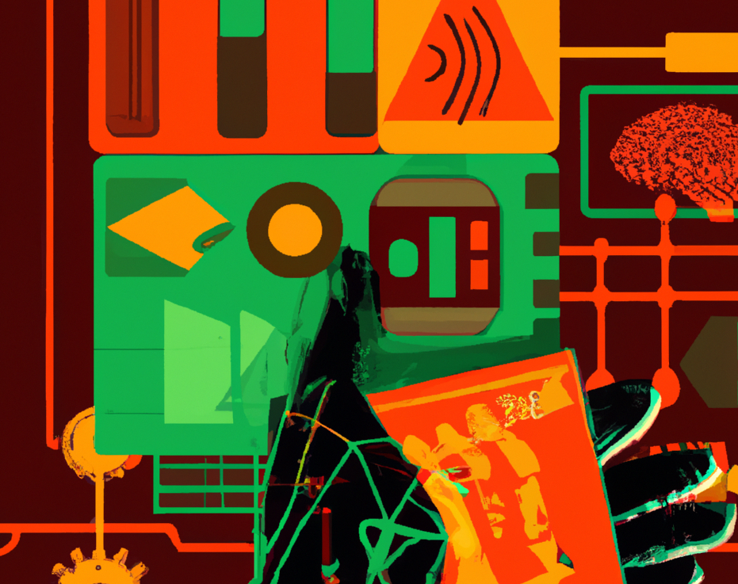
Generative AI and Copyright: An African Perspective
Akin Ifeanyi Agunbiade
Associate, AELEX
Responsible AI Fellow, Stimson Centre
aagunbiade@aelex.com
akinifeanyi5@gmail.com
@Akin_Agunbiade

Slide 2
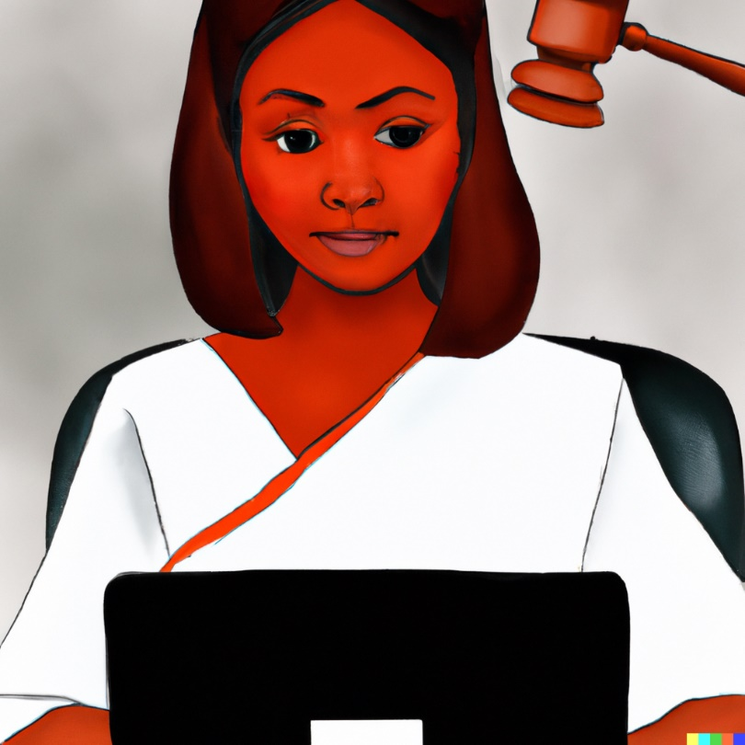
Local use cases - Nigeria
It has been projected that the market size of generative AI in Nigeria will hit $162.4 million in 2023 and grow at the rate of 26.39% annually, reaching $836.7 million by 2030.
LawPavilion, a leading legal search engine for laws and decided cases, recently launched two related generative AI tools, PrimeGPT and PrimsolGPT, integrated into their existing products, Primsol.

Slide 3
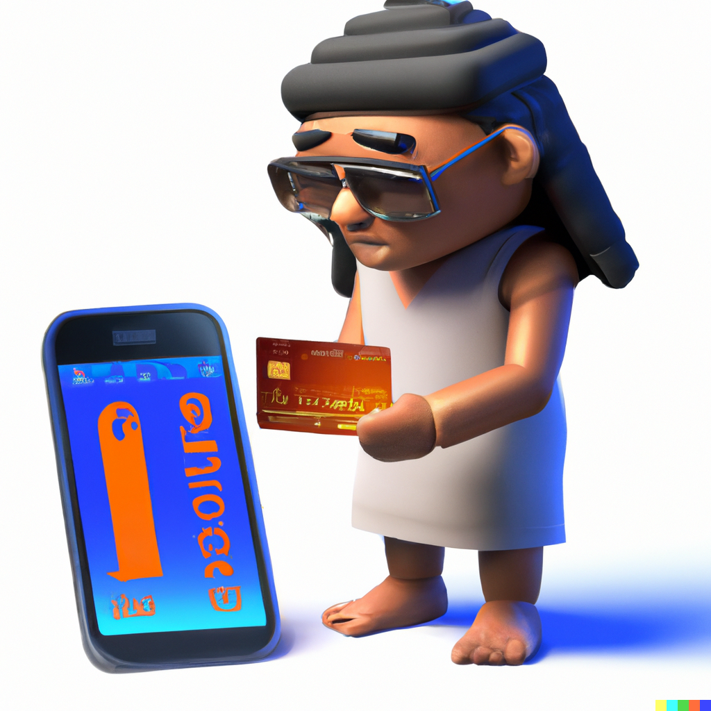
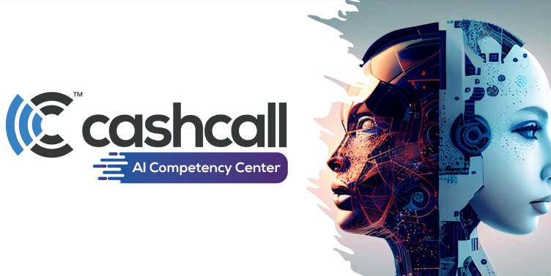
Local use cases - Egypt
It has been projected that the market size of generative AI in Egypt will hit $111.5 million in 2023, and grow at the rate of 26.48% annually, reaching $577.3 by 2030.
Cashcall, a data-driven fintech startup, announced plans in August to integrate generative AI into is services to transform digital footprint for underserved segments of the society, by offering them customized and tailored financial services that suit their needs.

Slide 4
Copyright Laws in relation to Generative AI - Nigeria
Nigeria’s Copyright Act 2022 quickly establishes in section 2(a) that literary, musical, or artistic work will not be eligible for copyright unless some effort has been expended on making the work to give it an original character.
Notably, section 86(2)(e) of this Act empowers copyright officers to demand information and access to any database relating to copyright without a warrant. While the removal of the warrant conditionality might pose the risk of abuse, this provision may prove relevant in instances where there are allegations of generative AI tools producing work that is potentially infringing on existing work by way of its similarity.

Slide 5
Copyright Laws in relation to Generative AI - Cameroon
Cameroon’s Copyright Law of 2000 offers a tricky position. It provides in section 7(1) that the author is an individual who created a literary or artistic work, and also an individual who designed the work and initiated its realization by an automatic process.
This law preserves the place of the human, but the phrasing ‘initiating realization by an automatic process’, seems to envisage the possibility that a person could create by starting a process and leaving to the automated tool to complete. Note that this is a 2000 law.

Slide 6
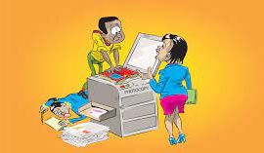
Copyright Law in relation to Generative AI - Kenya
Kenya’s Copyright Law 2012 adopts an expansive definition of who an author is, giving room for possibly extending copyright to works from generative AI tools. Section 2(1) of this law defines an author, in relation to a literary, dramatic, musical or artistic work or computer program which is computer-generated, as the person by whom the arrangements necessary for the creation of the work were undertaken.
It however comes back in section 22(3)(a) to provide that a literary, musical or artistic work shall not be eligible for copyright unless sufficient effort has been expended on making the work to give it an original character.

Slide 7
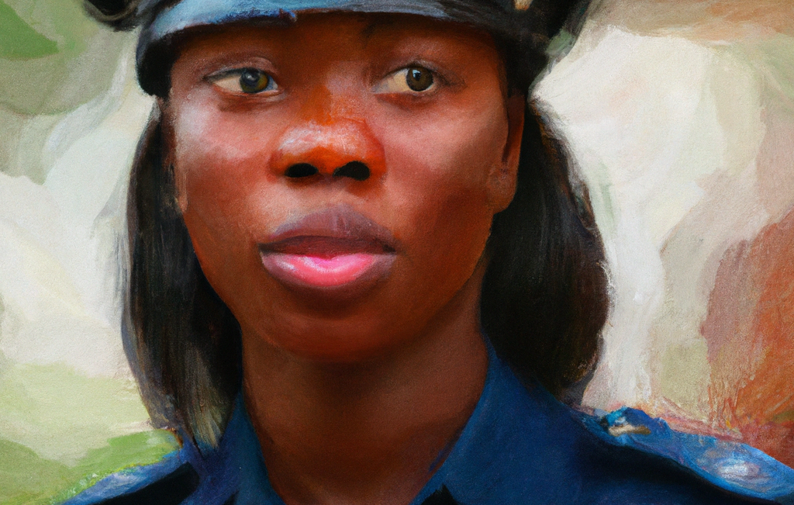
Copyright Law in relation to Generative AI – South Africa
The South African Copyright Act 1978, in section 2(2), provides that a literary, musical or artistic work shall not be eligible for copyright unless sufficient effort or skill has been expended on making the work to give it a new or original character.
Section 3(1) then goes further to establish that copyright can be conferred on a South African citizen, one who is domiciled or resident in the country, or a company incorporated in the country. This leaves no room for doubt as to the fact that the ‘sufficient effort or skill’ must come from a natural or juristic person.

Slide 8
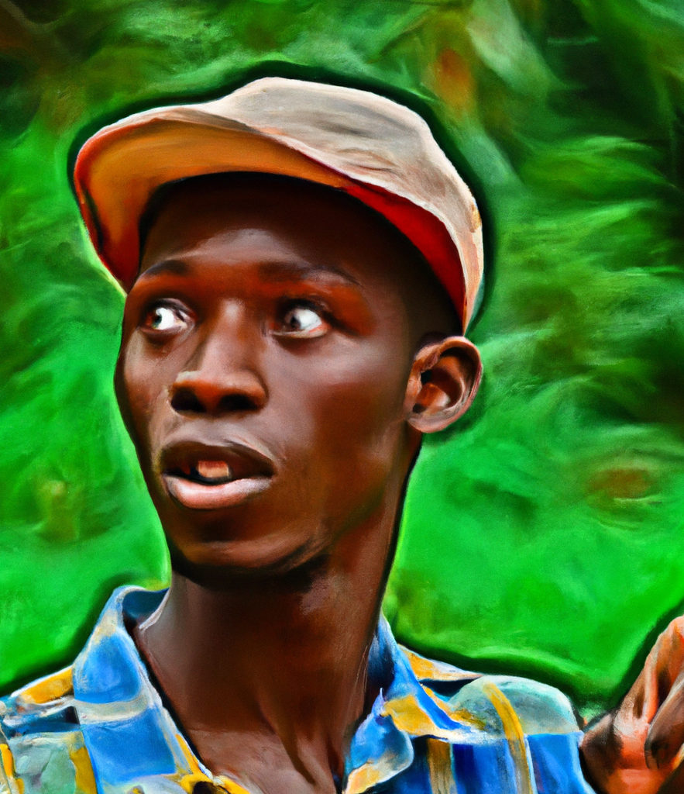
The African Context
The local generative AI industry in African countries is largely nascent and mostly driven by a young population, enthusiastic about how tools like ChatGPT, Midjourney, Bard, can be leveraged to simplify their everyday lives.
However, their capacity to build local alternatives is largely hampered by lack of access to large curated datasets relevant to their communities. Notwithstanding, the examples provided at the beginning of this presentation establish that local development of generative AI tools in Africa, will mostly tow the line of sector-specific deployment, which is relatively easier to train, deploy, and manage, compared to more omnibus generative AI models.

Slide 9
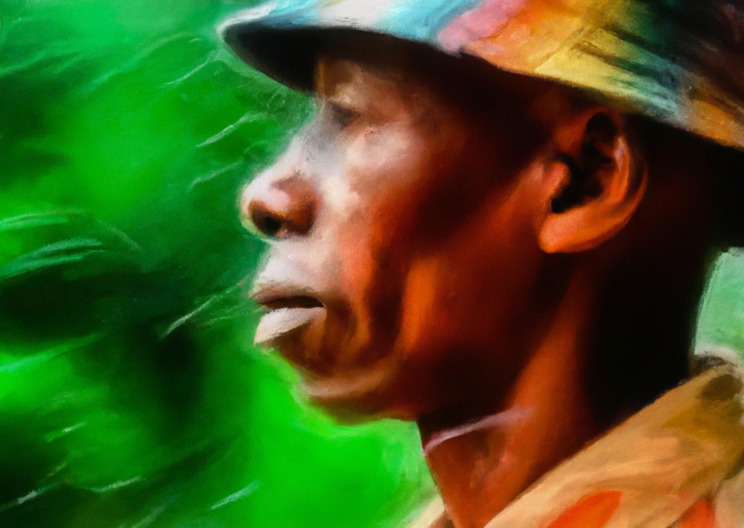
The African Context
On the side of copyright law, we find that Africa’s major economies, like most of the world, take the position that copyright can only be vested in natural or legal persons, and that such persons, must further demonstrate sufficient effort to give their works original character for copyright eligibility.
Even where some of them like Kenya and Cameroon have provisions that may seem to accommodate generative AI works, the lack of clarity on what it means to ‘initiate realization of an automatic process’ or the threshold of sufficient effort for computer-generated work, means that whatever that recognition that might have been extendable to generative AI works is largely in limbo

Slide 10
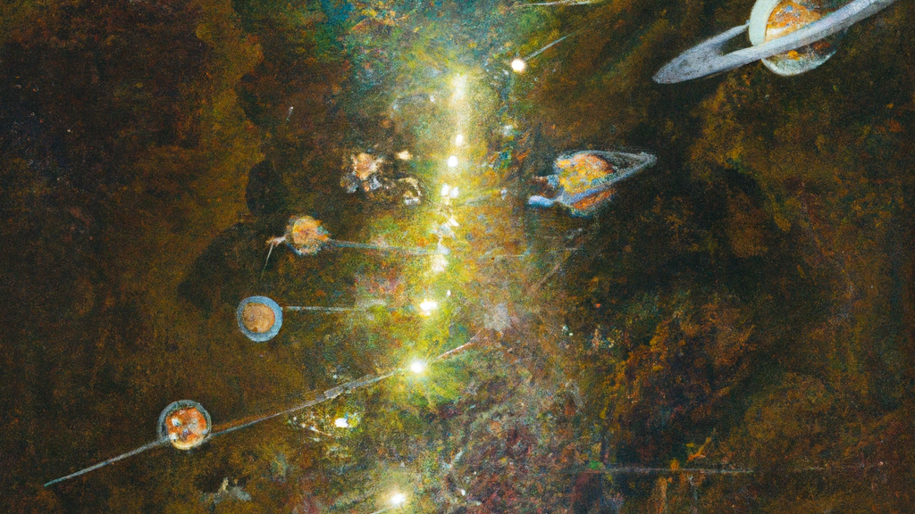
Potential Paths Forward
Copyright laws may have commonalities, but a top-down approach may not bode well;
A bottom-up approach by copyright regulators should be preferred;
Engagements may aid in developing locally relevant definitions of sufficient effort, making arrangements or initiating processes;
Generative AI is here to stay and will be subject to the AI effect eventually;
Engagements may lead to amendment or issuance of interim guidance

Slide 11
THANK YOU
aagunbiade@aelex.com
akinifeanyi5@gmail.com
@Akin_Agunbiade

