Slide 1
PERFORMANCE RIGHTS AND GENERATIVE AI
Federico Duret

Slide 2
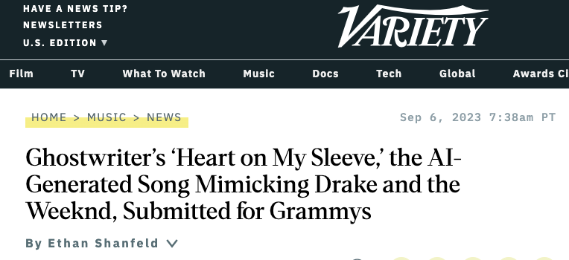
MEMBERS
AI and PERFORMANCES
https://variety.com/2023/music/news/ai-generated-drake-the-weeknd-song-submitted-for-grammys-1235714805/
https://variety.com/2023/artisans/news/indiana-jones-5-deaging-harrison-ford-1235663264/

Slide 3
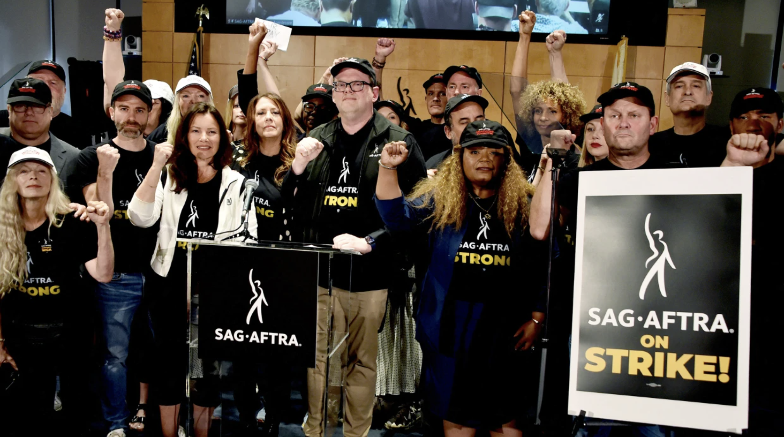
Can AI replace performers?
MEMBERS
“Artificial intelligence poses an existential threat to creative professions, and all actors and performers deserve contract language that protects them from having their identity and talent exploited without consent and pay.”
Fran Drescher.- President

Slide 4
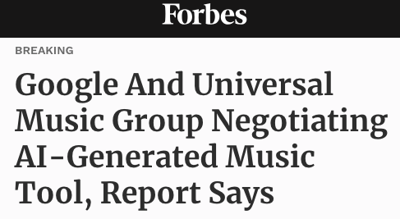
NEWS
MEMBERS

Slide 5
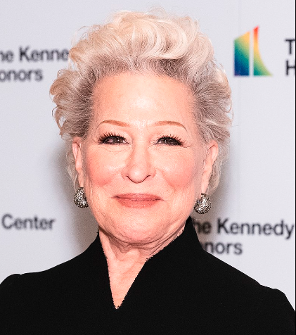
PRECEDENT CASE STUDIES
Bette Midler vs. Ford
Protectibility of the voice of an artist from commercial exploitation without her consent
Copyright Licensed, but not Publicity Rights
Impersonating Midler’s voice is the equivalent of “taking her identity”.
Photo by Shawn Miller/Library of Congress.
Creative Commons under a CC0 license

Slide 6
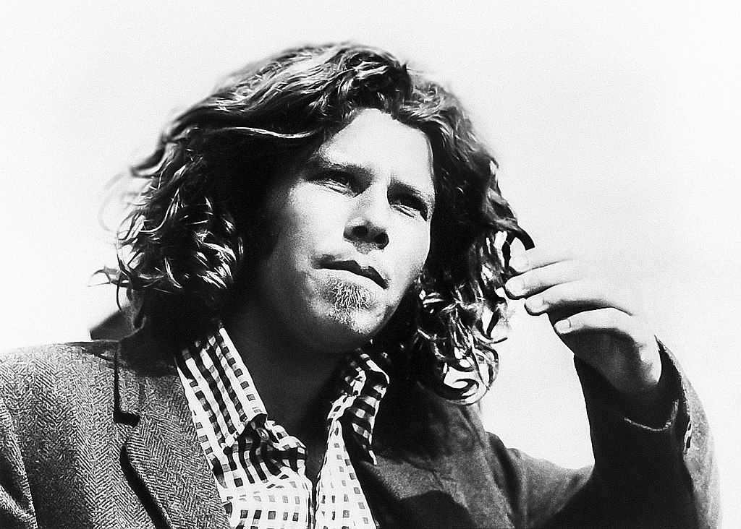
PRECEDENT CASE STUDIES
Tom Waits
vs
Frito - Lay

Slide 7
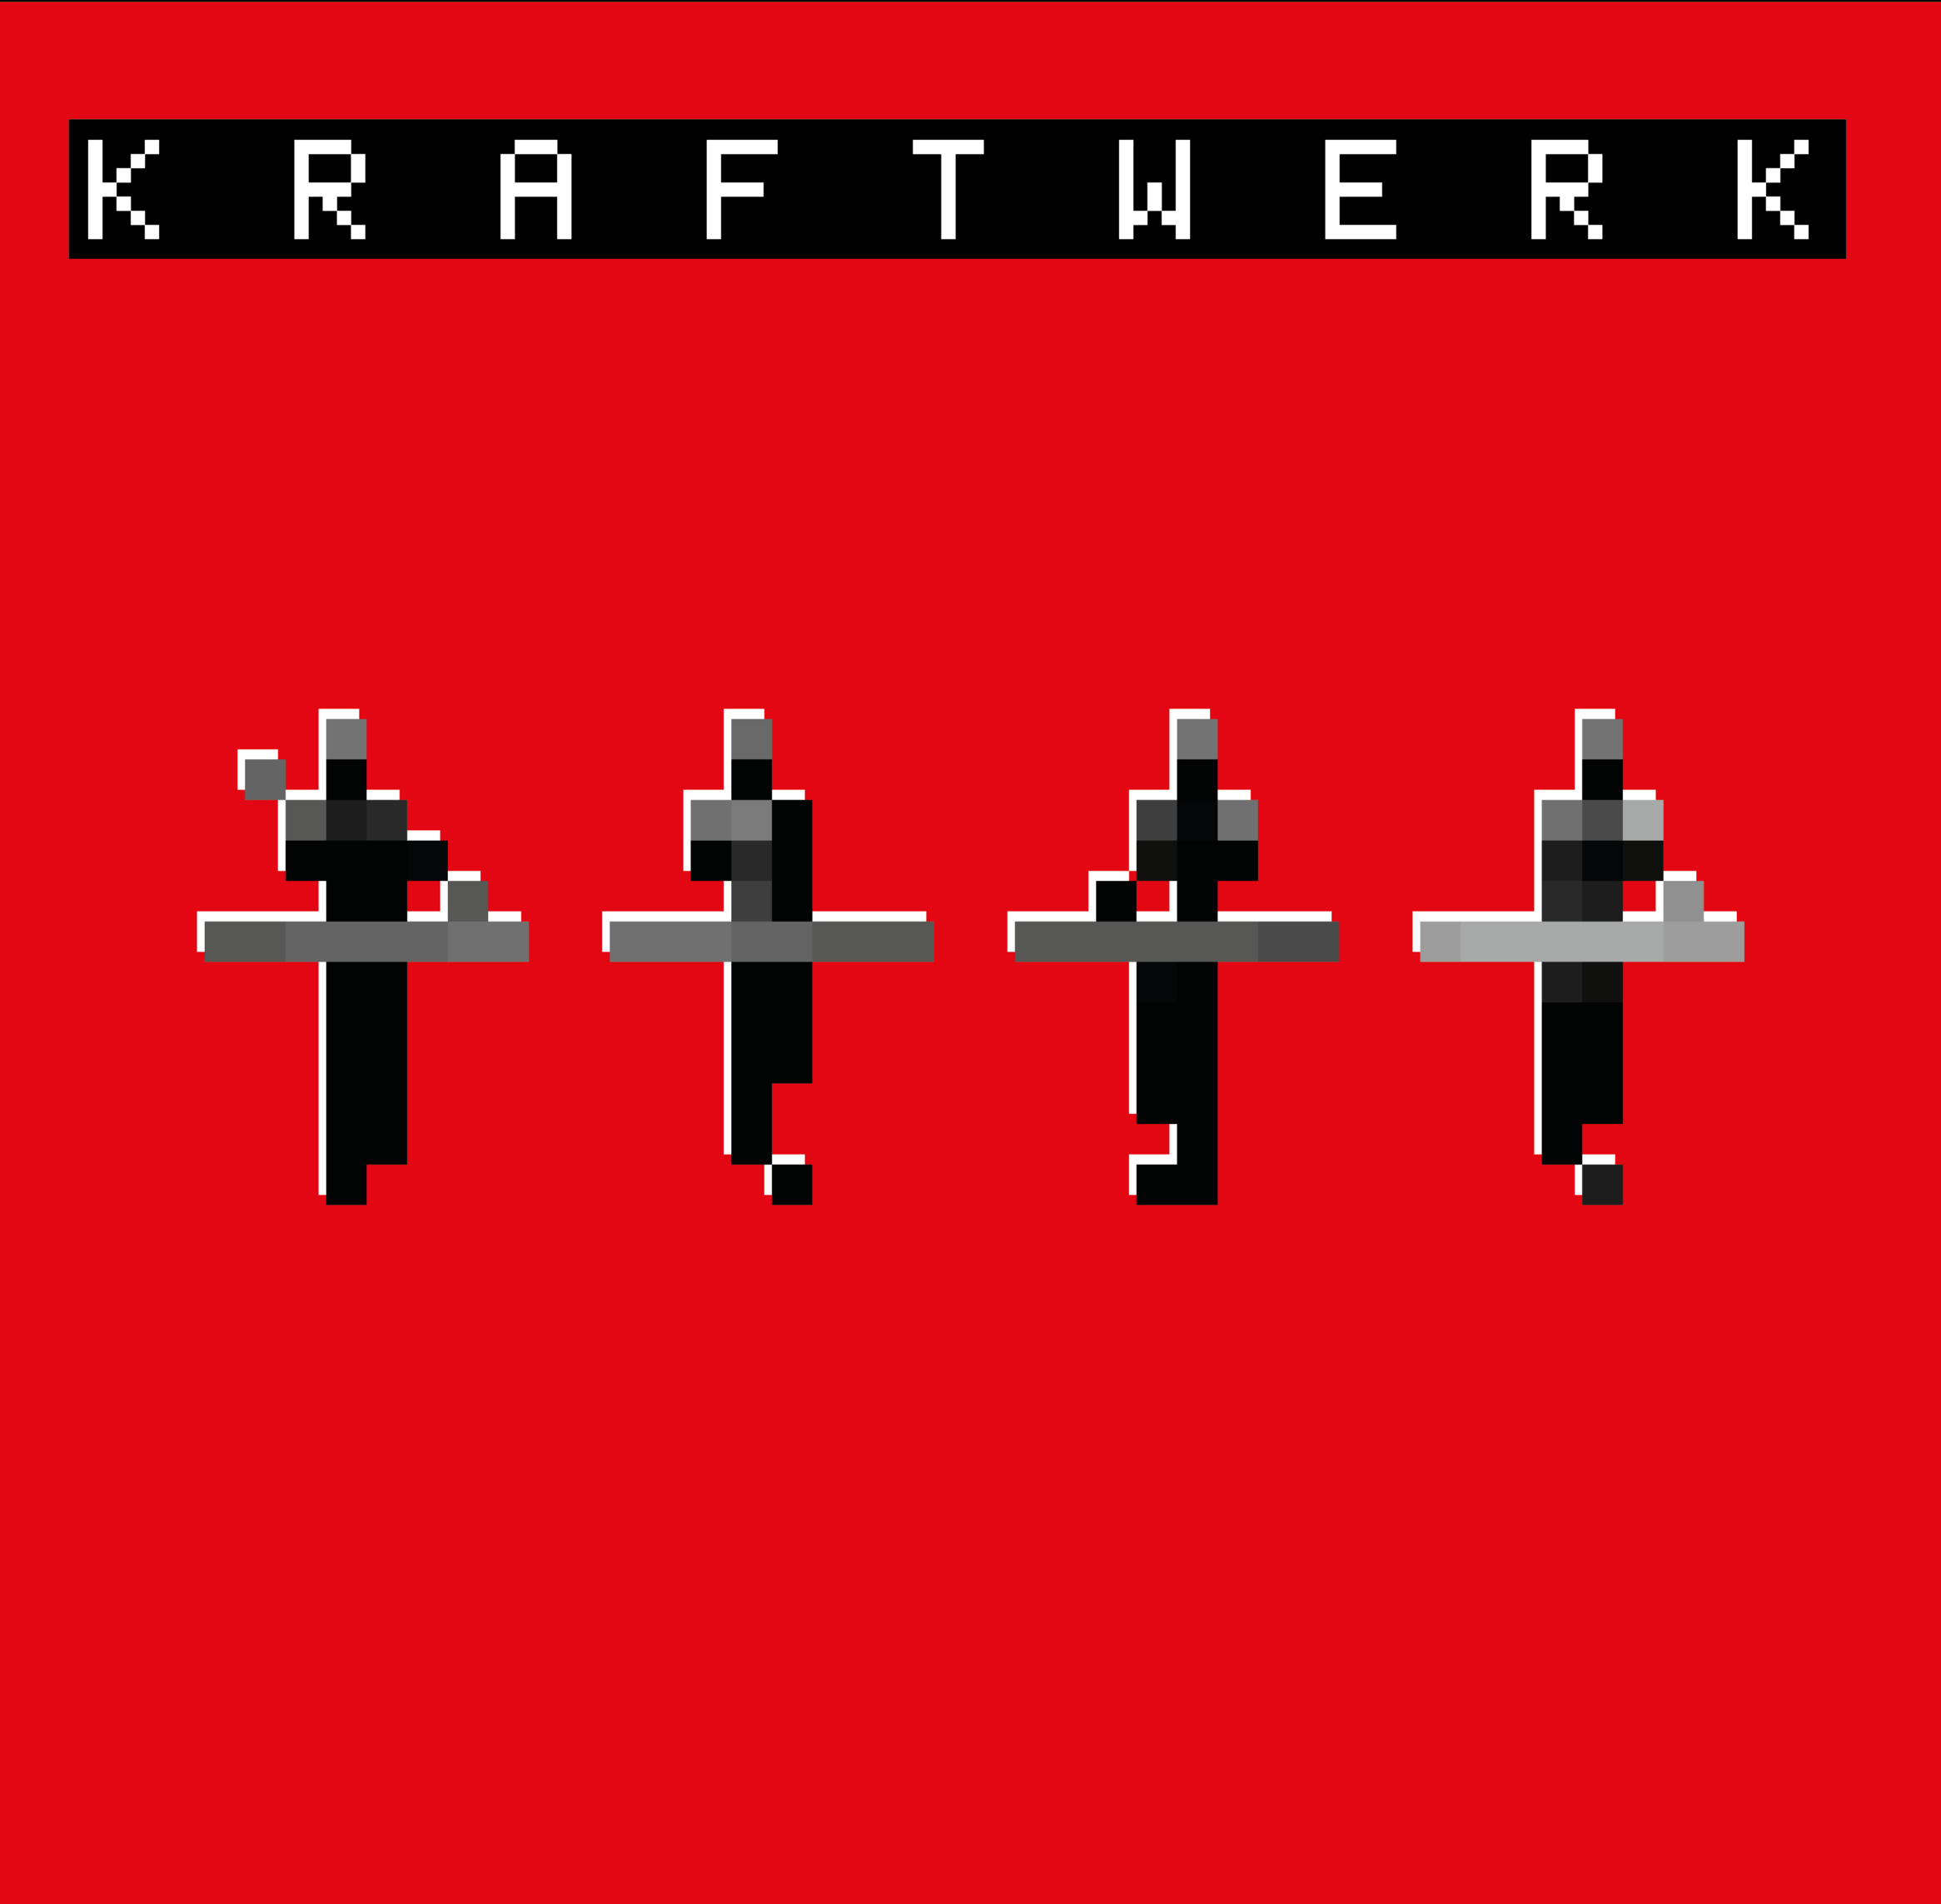
PRECEDENT CASE STUDIES
Kraftwerk vs. Moses Pelham
C-476/17
(...) where a user, in exercising the freedom of the arts, takes a sound sample from a phonogram in order to embody it, in a modified form unrecognisable to the ear in another phonogram, that is not a ‘reproduction’
Creative Commons under a CC - BY-SA 4.0 license

Slide 8
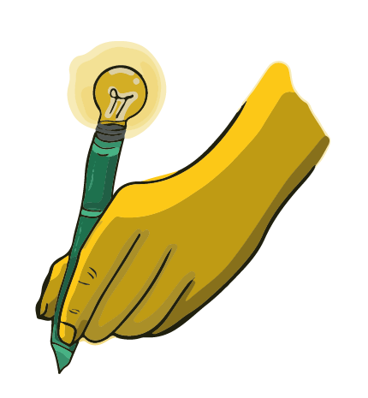
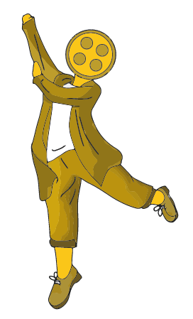
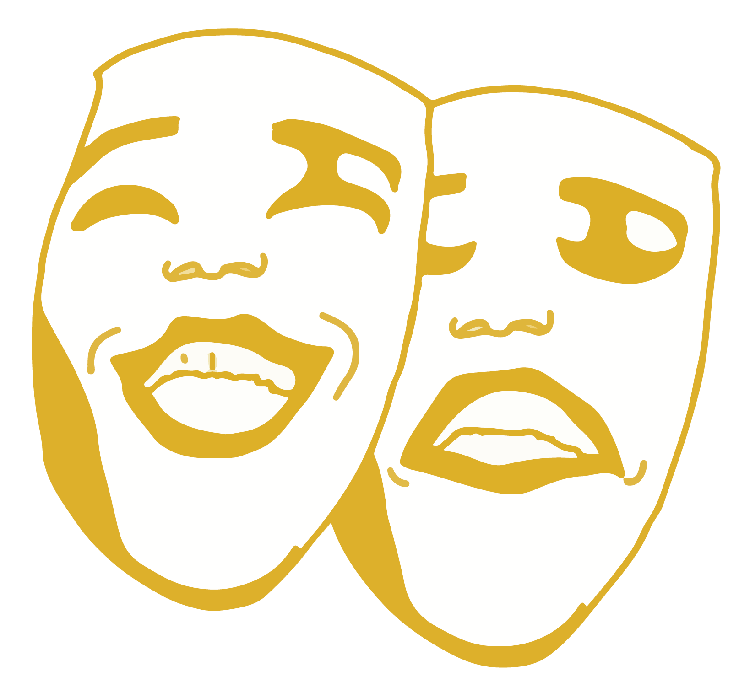
RIGHTS AT A GLANCE
Training AI with fixed performances
RIGHT OF PUBLICITY
NOT USE OF NEIGHBOURING RIGHTS
USE OF NEIGHBOURING RIGHTS

Slide 9
Right of Publicty ✅
NEIGHBOURING RIGHTS
USE OF NEIGHBOURING RIGHTS
-Exploitation of the image and voice with commercial purposes (Replicating a performer´s likeness, voice or other distinctive traits).
-Not subject to exceptions or “fair use”.

Slide 10
Right of Publicity
NEIGHBOURING RIGHTS ❌
USE OF NEIGHBOURING RIGHTS
-The generated performance it´s not a derivative performance
-Machines doesn´t understand human performances to create derivative works.
-An artist´s style is NOT “copyrightable”

Slide 11
Right of Publicity
Not use of neighbouring rights
NEIGHBOURING RIGHTS ✅
- Generative AI is trained with fixed performances
-Moral Rights and Right of Reproduction, Communication to the Public and the Rights of Translation and Adaptation.

Slide 12
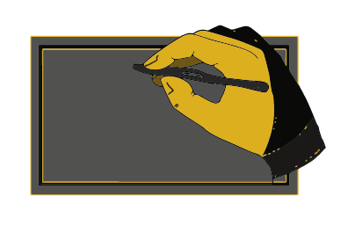
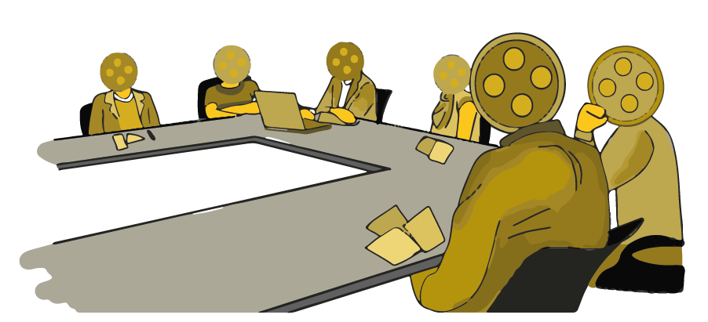
MAIN CHALLENGES & Questions
MAIN CHALLNGES
Collective Management:
Licensing & Compensation Rights?
Equitable Remuneration?
Use of fixed performances to train a generative AI is an act of reproduction?
Exceptions and limitations
(T&DM, pastiche) ?
Fair Use?

Slide 13
CHARTING THE PATH AHEAD
TEAM
Redefining Rights (IP and Publicity)
Consent and Control
Key role of the IP to protect performers: Clarification of existing exceptions and limitations
“Simulation Rights” in contracts
OPT – IN
OPT – OUT policies
Transparency
CONCLUSIONS

Slide 14
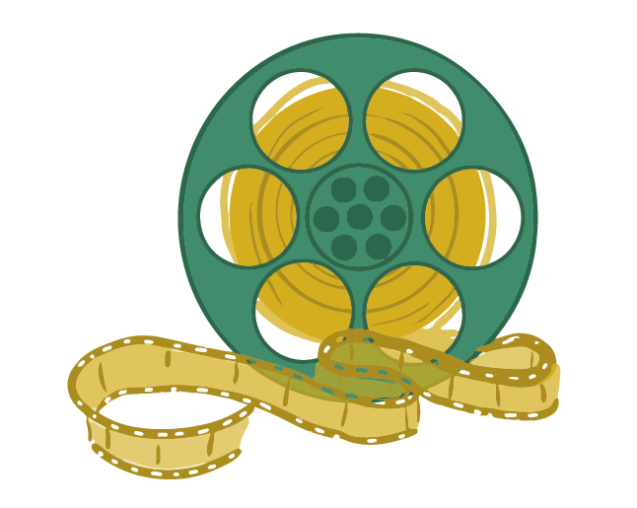
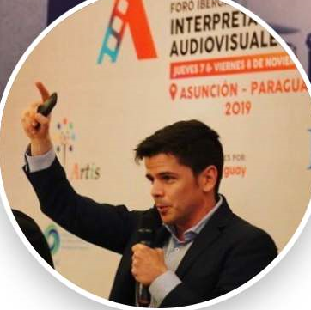
direcciongeneral@uniarte-ec.org
Quico Duret Gutiérrez
@uniarteecuador
@uniarteecuador

