Slide 1

GENERATIVE AI and IP
LITIGATION TRACKER
PRESENTED BY:
Werina Griffiths

Slide 2
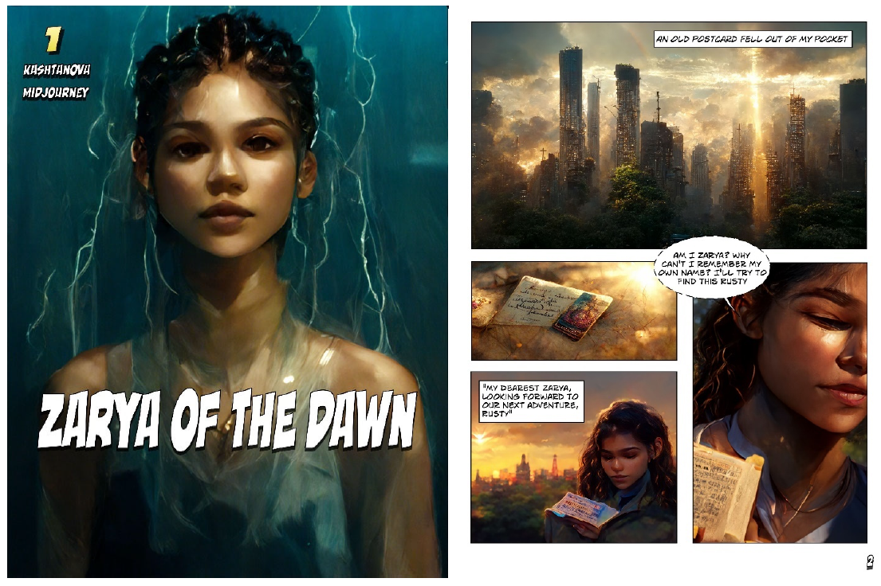
COPYRIGHT
ZARYA OF THE DAWN

Slide 3
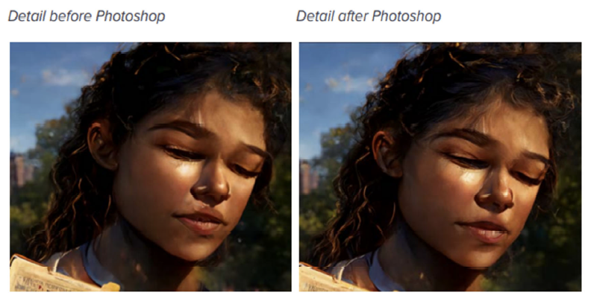
COPYRIGHT
ZARYA OF THE DAWN

Slide 4
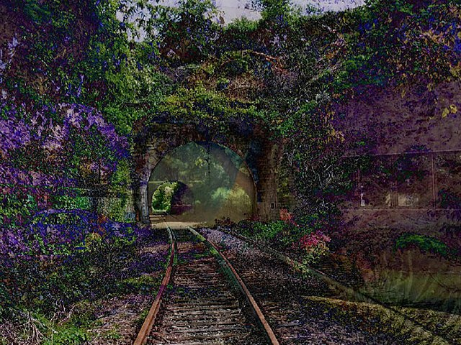
COPYRIGHT
A RECENT ENTRANCE TO PARADISE

Slide 5
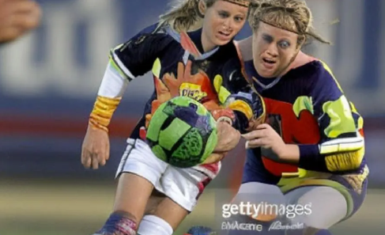
COPYRIGHT
GETTY IMAGES vs STABILITY AI

Slide 6
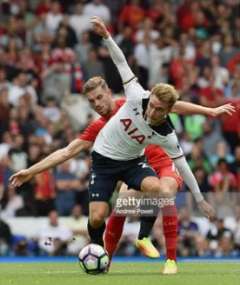
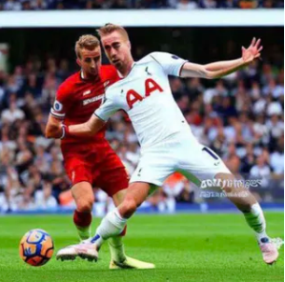
COPYRIGHT
GETTY IMAGES

Slide 7
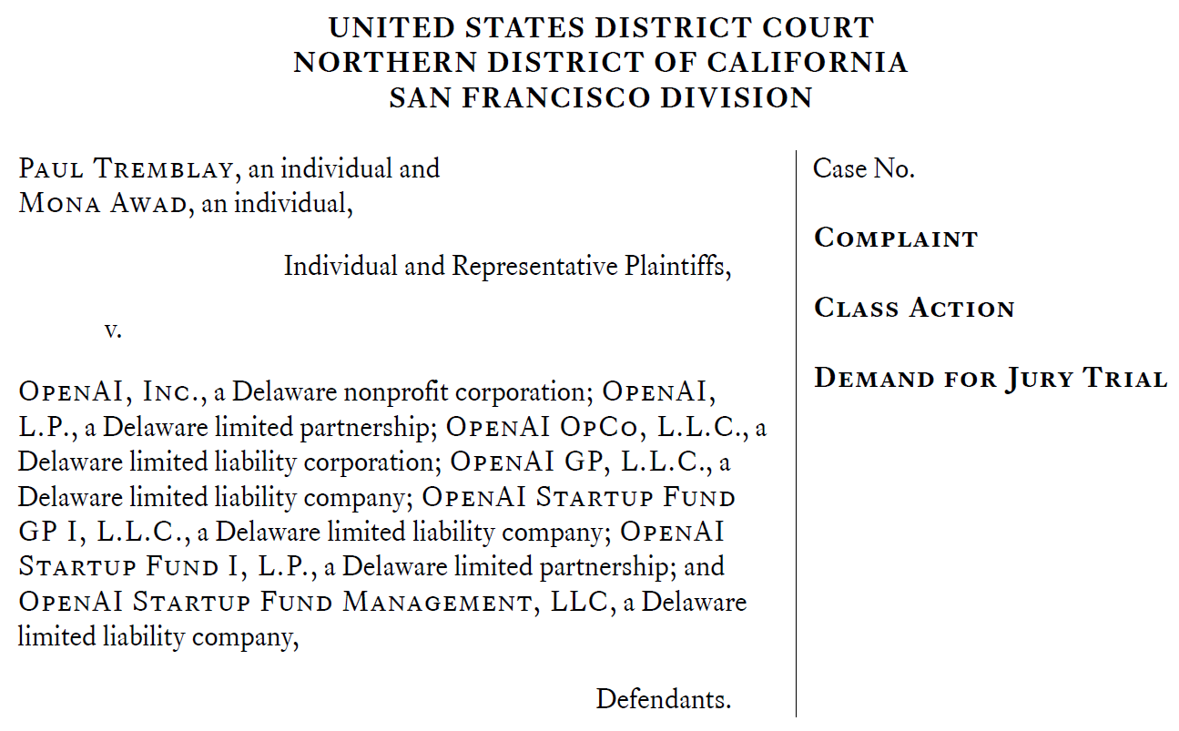
COPYRIGHT
AUTHORS’ CLASS ACTIONS

Slide 8
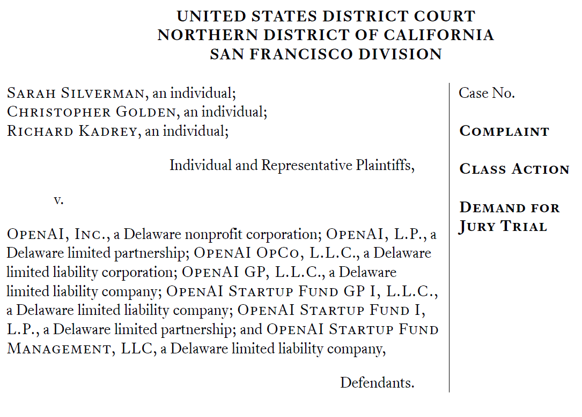
COPYRIGHT
AUTHORS’ CLASS ACTIONS

Slide 9
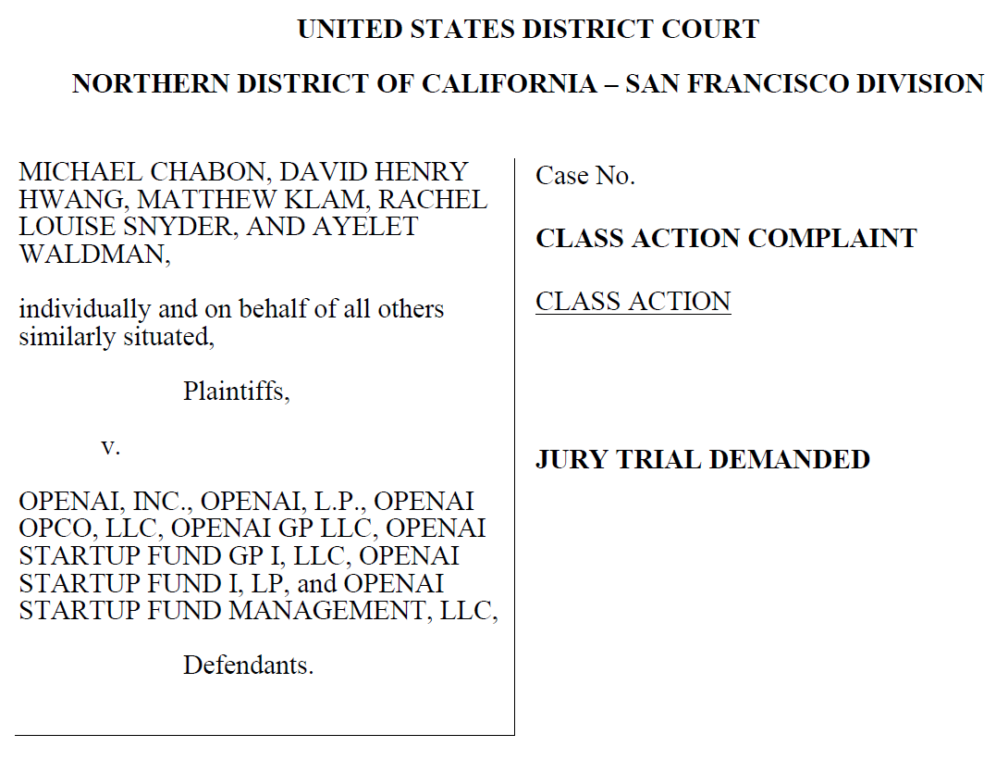
COPYRIGHT
AUTHORS’ CLASS ACTIONS

Slide 10
THANK YOU

