Slide 1
Metaverse, what is it and how should IP approach it?
Seventh Session of the WIPO Conversation
"IP and the Metaverse“ - WIPO
29, 30 March 2023
Carlos Luna García
New Technologies Service
Digital Transformation Department
EUIPO

Slide 2
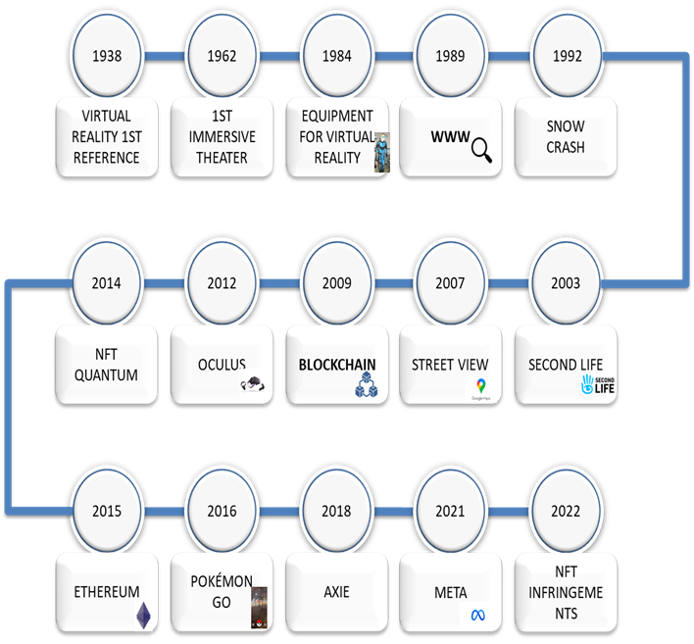
Metaverse history
And it is not a new concept but a new model of interoperable real-time rendered 3D virtual world where people may interact and engage through an avatar

Slide 3
What is not Metaverse?
Is not a single technology
Is not just gaming or a place to visit in VR
Is not for a small group of users
Is not something that can be claimed by the next technology giant
No single all-encompassing metaverse
Metaverse does not replaces real life

Slide 4
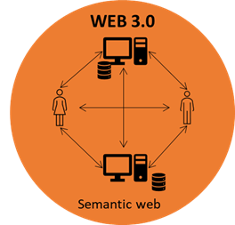
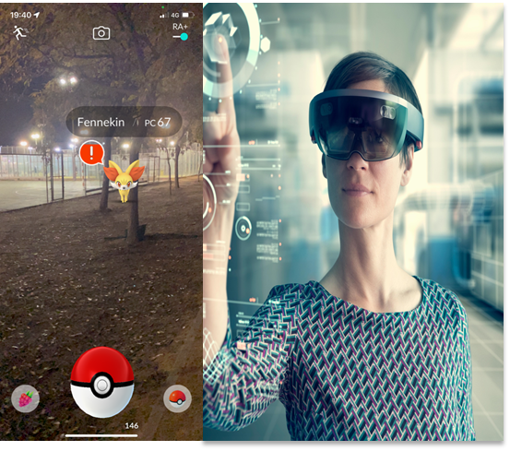
Technologies
As a distributed database storing a permanent and tamper-proof ledger of data, blockchain metaverses allow secure interactions to evolve within virtual spaces
Fungible tokens: interchangeable, divisible and non-unique
Non-Fungible Tokens (NFTs): Representing a unique, indivisible and irreplaceable
decentralize ownership and control
putting in the hands of users and community
The metaverse attempts to create a fully immersive and dynamic 3D virtual world and VR provides an immersive feel of a virtual world

Slide 5
What are we facing?

Slide 6
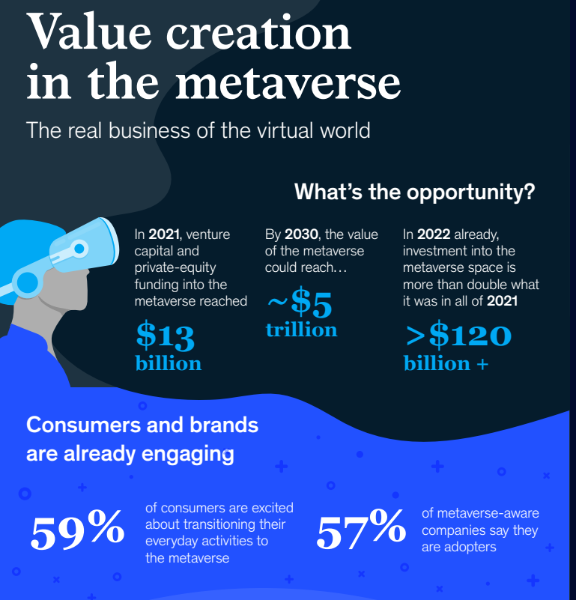
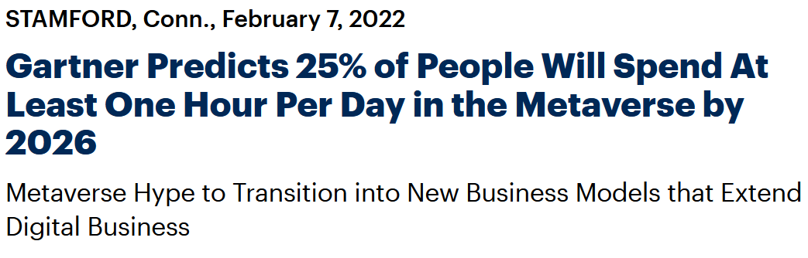
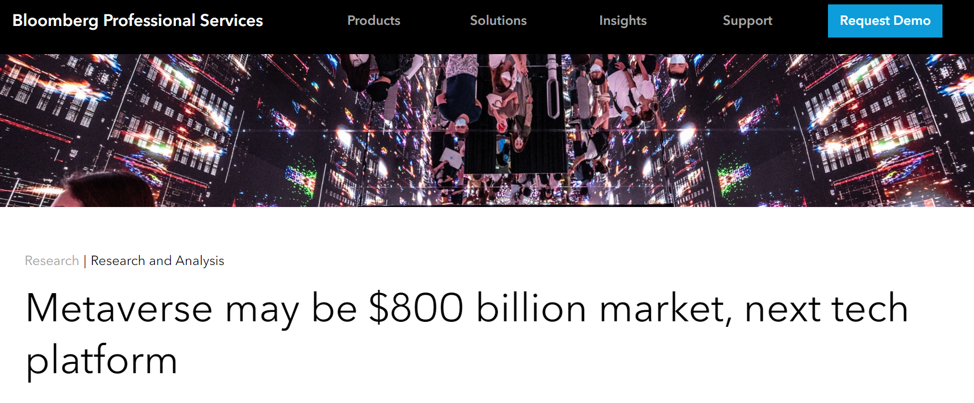
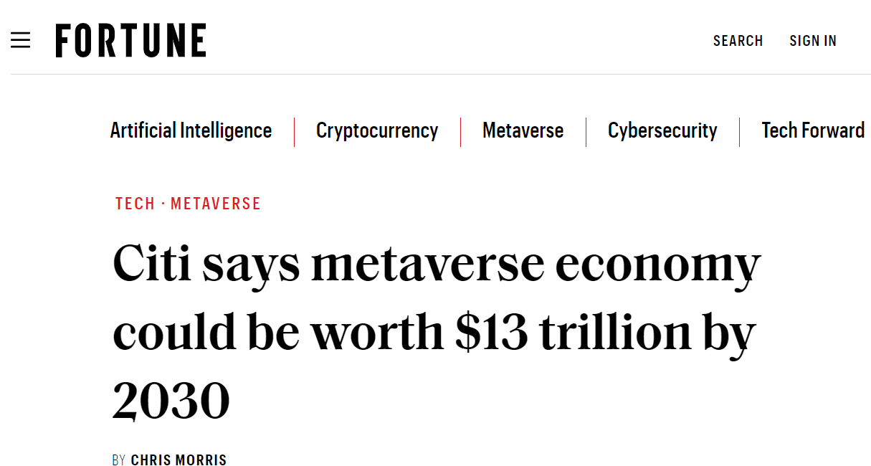
Metaverse business potential

Slide 7
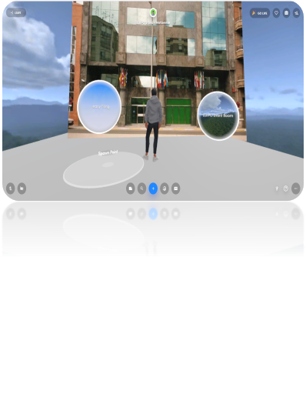
To be or not to be
Metaverse IPO
Do nothing

Slide 8
Opportunities for IP Bodies
Reputation
Awareness
Knowledge
New population
Communication

Slide 9
Challenges
Legal framework
Ownership
Infringement
Interoperability
Immaturity
Privacy
Notes:
the solution is not to just hand all the power to one big party. The idea of interoperability should be independent from any one big player controlling the entire Metaverse.
Infringement:
Today, monitoring IP infringement in not straight forward at all
In addition, the Metaverse makes it more complicated:
Many platforms, agreement to platform terms
Use of virtual investigators involving people, automated systems, and artificial intelligence
AI-powered IP protection platform
New brands may emerge and operate only in the metaverse (low costs and potentially unlimited geographical reach).
→ Detection of infringements → more challenging
Cyber-squatting of trade mark:
Monitoring can be difficult on the Internet,
Likely to become exponentially more complicated in the Metaverse
Unregistered designs and TM:
Could become a trend for the metaverse
could have commercial or disclosure effects
proof of use in the Metaverse more common.
How to enforce IP Rights in the Metaverse?
No adequate regulatory rules
More questions than answers
“Classic” means (cease and desist letters, seizure of digital assets, notice and takedown)
Blockchain-based tools to verify the authenticity of goods
Privacy : Privacy is another issue which has haunted the metaverse. Considering the fact that the metaverse uses devices such as webcams and AR & VR technology, it indeed makes the privacy of the user susceptible to being compromised. It is a known fact that hackers have in the past hacked and exploited such devices to spy on people. So, for the metaverse to be used by the masses, such risks to privacy must be addressed and solutions be addressed.
Big question mark regarding data protection:
Tracking: reward of “good” and penalization of “bad” activity (fines)
Biometric data
Facial recognition
Removal of data in blockchain is not clear

Slide 10
EUIPO approach
Consider protecting your EUTM or Community Design in the Metaverse!
Trade marks: Don’t forget to have in mind the virtual environment when composing your list of goods and services !!
Designs ONLY intended for use in virtual environments: provide physical product indication & virtual product indication !!
EUIPO webinars
The Metaverse – is it relevant for your (IP) strategy?
Trade marks and designs in the metaverse: legal aspects/EUIPO practice
Notes:
Virtual goods
Virtual worlds are around for a long time.
A specification for “metaverse” would likely have a narrower scope than one for “virtual worlds” or “online worlds”.
Market interest to have virtual goods being equivalents to actual goods → change of classification paradigms → time
Virtual goods will for the foreseeable future be in class 9 for local files and class 41 for virtual goods as a service.
Classification of NFTs
Still classification problems as it is not clear what the good or service actually is or who provides them from a current classification perspective.
NFTs not to be seen as a good in and of itself as it depends on a blockchain entry, but blockchain platforms don’t provide direct service to NFT proprietor. → NFTs ends up in classification limbo.
EUIPO is increasingly receiving applications containing terms relating to virtual goods and non-fungible tokens (NFTs).
This is the approach that the Office is taking for classification purposes:
Virtual goods are proper to Class 9 because they are treated as digital content or images.
For the EUIPO, the term non fungible token on its own is not acceptable. The type of digital item authenticated by the NFT must be specified. (e.g. downloadable virtual goods, namely, virtual clothing).
The Office’s approach will be set out in the 2023 Guidelines.
Applicability of current Nice classes
Typical classes used are 9, 35 and 41 have G&S applicable to virtual use and may act as a kind of proxy to be applied to the metaverse.
Descriptions usually use broad enumerations to describe virtual goods and services.
The Legal Department of the Office is actively involved with developing practice in this area, and helps the Operations Department with problematic lists of goods and services
Pro-active TM registration
At the EUIPO, around 800 TM applications have been received since 2020 claiming protection for either “NFTs” / “non-fungible tokens” or “virtual goods” in class 9.
Key classes covered are usually 9, 35 and 41.
For TM applications:
When you prepare the list of goods and service:
if your intention is to use your TM in virtual environments (e.g. metaverses)
consider applying for respective virtual goods and services
For designs:
If intended for use in virtual environments ONLY:
Provide the physical as well as virtual product indication
E.g. virtual interfaces

Slide 11
THANK YOU
@EU_IPO
euipo
EUIPO.eu

