Slide 1
MR. ValerIy frolov
Deputy Head,
the Federal Service for Intellectual Property (ROSPATENT)
IP and metaverse: experience and practice of the Russian federation
March 30, 2023

Slide 2



IP AND METAVERSE
METAVERSE
has not yet been legally defined, but has the potential to unlock a completely new digital economy
FRONTIER TECHNOLOGIES
ENABLING METAVERSE:
Artificial intelligence
Blockchain
NFT
Emerging AR and VR technologies
Internet of things
Data processing
IP
is a key driver fostering innovation in technologies that will build the metaverse

Slide 3











DIGITAL TRANSFORMATION OF ROSPATENT
External LAYER
Online Rospatent
Omni-channel communication with applicants
Distributed ledger for IPR Management
Blockchain-based digital ledger for IPR management
Python, Django
Block-P
Decision Support
Patent activity statistics and reports
Government
Search Platform (online since 2022)
Search in the world patent collection
Trademarks and Industrial Designs Search (available internally since 2022)
AI-based search system for trademarks and industrial designs
Foresight
PostgreSQL
Integration Service
Data exchange and management of regulatory reference information
Elasticsearch
Hadoop
Elasticsearch
Neuro nets
Apache Kafka
Single Data Storage
Centralized storage of data sets
Formal Checks Service
Verification to perform legally significant actions
Net Core
PostgreSQL
Control System for IPR Objects (available internally since 2022)
Administrative decisions
Single State Register of IPRs
State registers and official gazettes
Document Management System
Digital processing of applications
PostgreSQL
Java Tomcat
PostgreSQL
Camunda BPM
internal LAYER

Slide 4
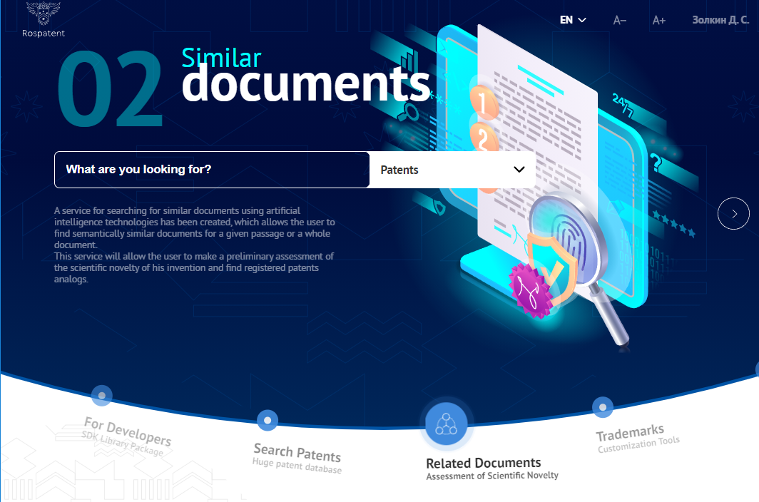
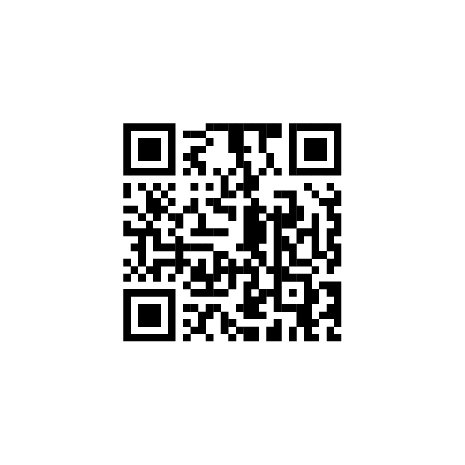
SEARCH PLATFORM OF ROSPATENT
AI allows even amateur users to carry out search for trademark and industrial design visual representations swiftly and easily
Search Platform of Rospatent
Search Platform is free of charge

Slide 5


SEARCH AND COMPARION OF 3D VISUAL REPRESENTATIONS
Applicants May
file 3D visual representations of their objects for IPRs protection
Development of the information system supporting storage, comparison and similarity search for 3D visual representations of objects for IPR protection in 3D formats
to ensure the technical capability of describing
and storing the objects for IPR protection in digital
formats, including 3D, for state registration purposes
The digital transformation is an important step towards the development of digital IP ecosystem

Slide 6
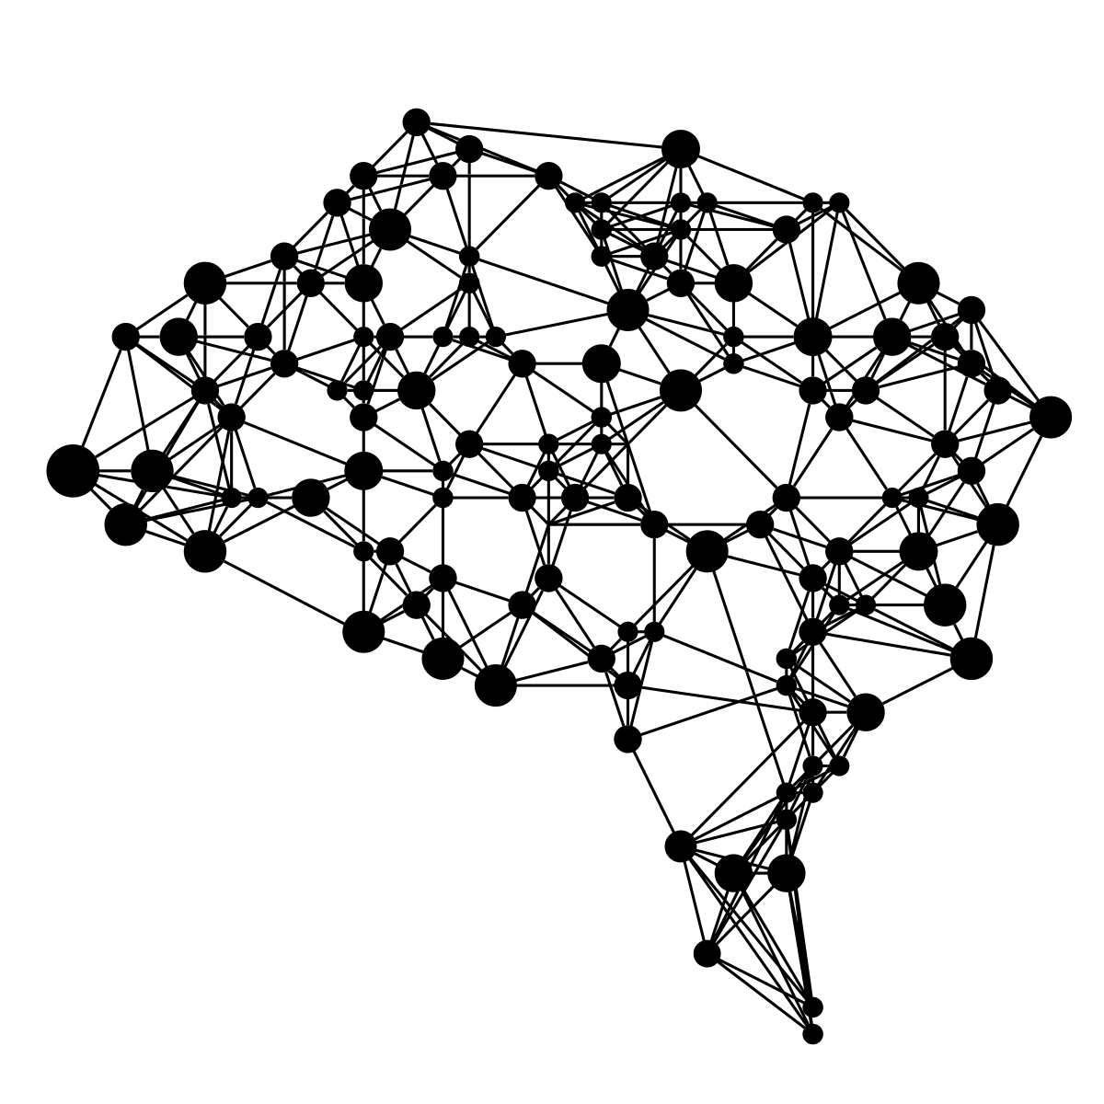

ROSPATENT CONTRIBUTION TO THE COMMITTEE ON WIPO STANDARDS
Proposal made by Rospatent to establish 3D Task Force at 6th session of the CWS
Task Force established and the Russian Federation designated as the Task Force leader
The Standard developed by the 3D Task Force led by the Russian Federation was adopted at the 9th session of the CWS and contains recommendations for managing, storing, processing, exchanging or disseminating IP data using 3D models and 3D images
Further research on search and comparison methods for 3D models and 3D images in order to provide respective updates to the WIPO Standard ST.91

Slide 7
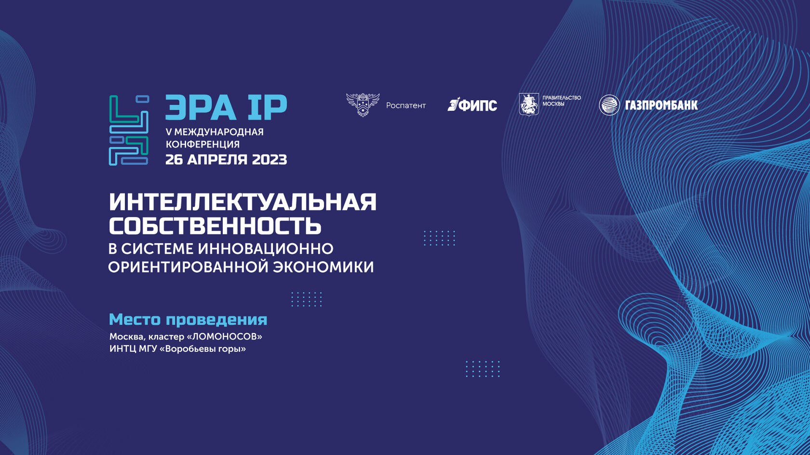

5th International Conference “IP ERA“ Intellectual Property in the Innovation Focused Economy held by Rospatent (April 26, 2023)
International Conference on Artificial Intelligence “AI Journey” held by Sberbank
(November 23-24, 2022)
RELEVANT INTERNATIONAL EVENTS IN RUSSIA

Slide 8
CHALLENGES RELATED TO METAVERSE
The digital agenda, including the metaverse and its individual components, such as AI, 3D, and blockchain, is evolving, and relevant regulatory framework is improving
But certain challenges still remain and to be discussed
legal uncertainties related to IPRs regulation in the metaverse (IPRs management, disposal, transfer, licensing, distribution)
e-commerce operation
authorship, rights ownership, various jurisdictions, cross-border transactions and applicable law

Slide 9
THANK you FOR your ATTENTION

