Slide 1
The Development of Metaverse In Indonesia Directorate General Of Intellectual Property Indonesia

Slide 2
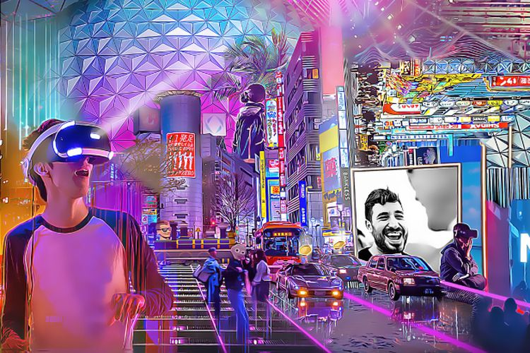
Metaverse is a technological innovation that allows interaction between individuals virtually.
Metaverse is believed to open digital economic opportunities in Indonesia in the future.
In order to build a fully functioning Metaverse it requires supporting crypto, blockchain, and NFT
several NFT marketplaces in Indonesia : Baliola, Paras, TokoMall, Kolektibel, etc

Slide 3
ISSUES ON NFT
01
02
03
Issues on the mechanism for Transferring Intellectual Property Rights in NFT in accordance with Indonesian laws
The concerns of Art Creators towards copyright violations in NFT transaction in marketplaces
No specific legal framework has been issued to regulate the the position of NFT under Indonesian law
04
05
06
Terms and Conditions have not been used to supplement the Smart Contract in NFT Transaction
Opportunities to Drive the Economy and Potential Income for the State
Lack of Government Oversight and Control in Regulating the NFT Marketplace in Indonesia

Slide 4
SEVERAL SOLUTIONS THAT MIGHT BE PROPOSED TO THE NFT ISSUES IN INDONESIA:
Drafting of Laws and Regulations related to the Position of NFT in Indonesian Law (related to Intellectual Property).
Defining Rights of Authors, Copyright Holders, and Related Rights Owners.
Curating the NFT Authenticity
Defining the Terms and Conditions in NFT Transaction

Slide 5
THANK YOU

