Slide 1
International legal framework of the Artist’s Resale Right
Leonardo de Terlizzi (CISAC)
National seminar on the Artist’s Resale Right
WIPO and the IP Office of the Republic of Serbia
March 17, 2022

Slide 2
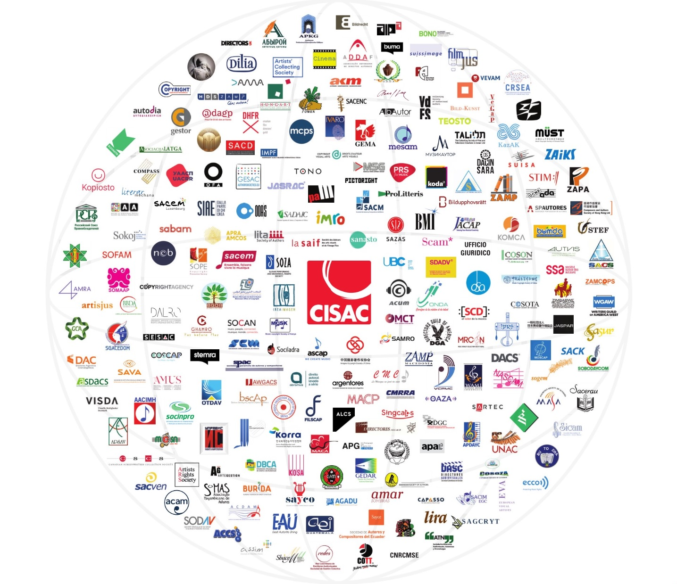
CISAC – Overview
International Confederation of Societies of Authors and Composers
Founded in 1926
A non-governmental, not-for-profit organisation
Headquarters in Paris, regional offices in Asia-Pacific, Europe, Africa, Latin America
President: Bjorn Ulvaeus (ABBA)

Slide 3
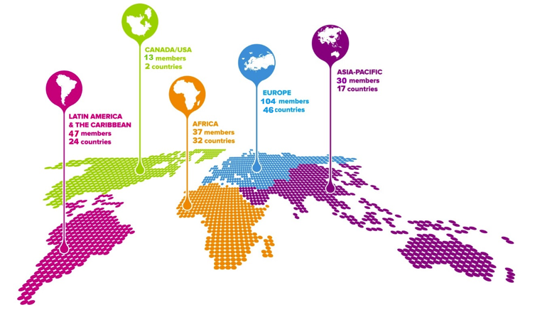
CISAC – Overview
228 authors’ societies
120 countries
+ 4 million creators

Slide 4
CISAC’s members repertoire
MUSIC
DRAMATIC
AUDIOVISUAL
LITERATURE
VISUAL ARTS

Slide 5
CISAC – What we do
1
2
3
Developing and strengthening the collective management network
Securing favorable legal and policy frameworks
Supporting societies’
operations and capacities
Helping societies improve capacities, grow revenues, reduce costs and address problems.
Strengthening and defending copyright legislation, at international and local level
Defining standards. Harmonizing data exchanges.
Providing tools, solutions, training and support to societies.

Slide 6
The Resale Right – Origins and key features

Slide 7
What is the Resale right?
The Resale right guarantees creators the ability to earn a fair share from the resale of their original works
It is paid to visual artists when their works are resold by an auction house or gallery, above a certain price
The rate is usually between 3% and 5% of the gross sales price
It allows artists to retain a share in their work as it increases in value
It promotes transparency in the art market
Management of the resale right is usually done collectively through CMOs

Slide 8
Benefits of the Resale Right
The resale right is about…
Fairness
Visual artist should be entitled to a share in the proceeds when their work increases in value, because the increase is:
due to the artist’s reputation
due to the fact that there is only one copy
Ensuring an important source of income for artists
Very relevant under the COVID crisis
Recognizing the difference between visual art and other forms of art
Music, film, literature: the creator participates in the commercial success of the work
Allowing artists to establishing a link their works
Respect

Slide 9
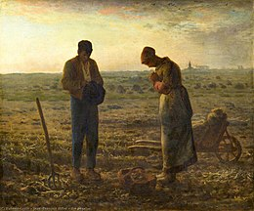
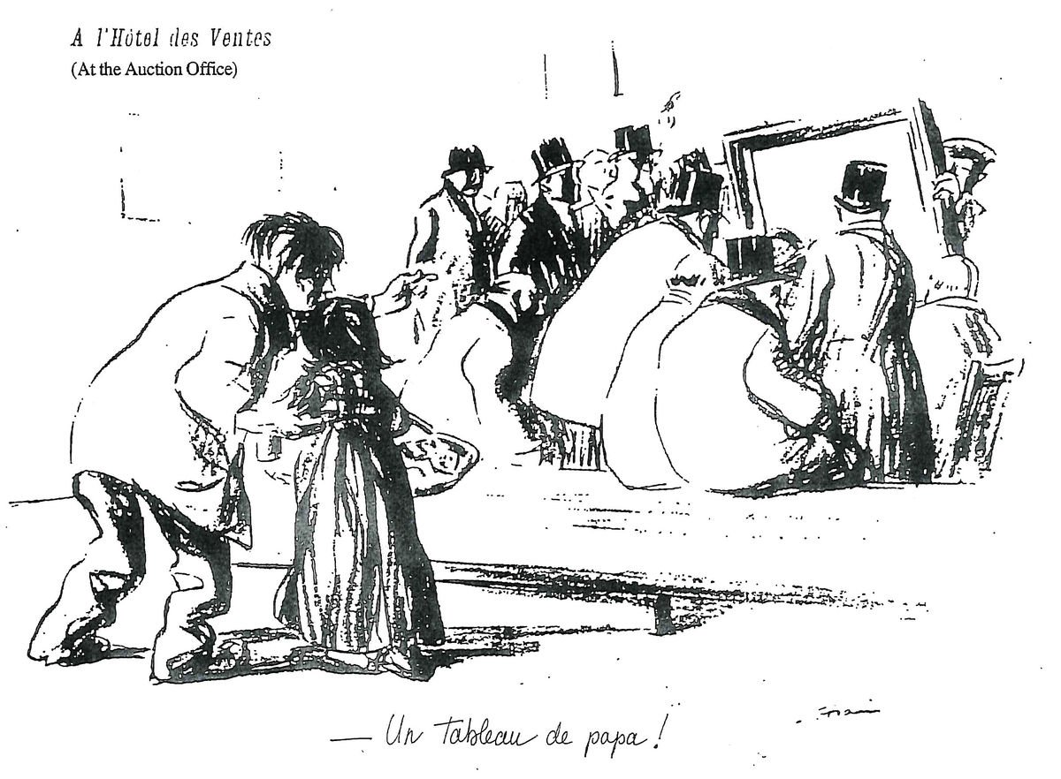
Resale right: the origins
Enshrined in the French Law in 1920
﻿The Angelus by Jean-François MILLET
- Initial selling price : 1200 francs
- Resold a few years later : 1M francs
﻿In the auction house by Jean-Louis FORAIN
Notes:
9

Slide 10
Resale Right under the International law
Introduced in the Berne Convention in 1948
Recognised under Article 14ter
“Droit de suite” in Works of Art and Manuscripts

Slide 11
The Resale Right in the Berne Convention

Slide 12
Resale Right under the International law
Article 14ter “Droit de suite” in Works of Art and Manuscripts: 1. Right to an interest in resales; 2. Applicable law; 3. Procedure
(1) The author, or after his death the persons or institutions authorized by national legislation, shall, with respect to original works of art and original manuscripts of writers and composers, enjoy the inalienable right to an interest in any sale of the work subsequent to the first transfer by the author of the work.
(2) The protection provided by the preceding paragraph may be claimed in a country of the Union only if legislation in the country to which the author belongs so permits, and to the extent permitted by the country where this protection is claimed.
(3) The procedure for collection and the amounts shall be matters for determination by national legislation.

Slide 13
Key elements
The author, … shall enjoy the inalienable right…..

Slide 14
Key elements
….to an interest in any sale of the work subsequent to the first transfer…

Slide 15
Key elements
The protection … may be claimed in a country of the Union only if legislation in the country to which the author belongs so permits, and to the extent permitted by the country where this protection is claimed.

Slide 16
Resale Right: why Berne Convention is not enough?
Not obligatory, optional
General, not detailed
Reciprocity applies
As a result:
Discrimination - RR benefits only some artists (from countries with the right)
For an artist to receive the resale royalty, the right must be enacted both in his/her home country as well as in the country where the work was re-sold
Level of protection, even where the right exists, varies and is not harmonized

Slide 17
The effect of the reciprocity requirement – An illustrative example
Because one of the biggest art market – US – has no Resale Right:
Artists from the EU cannot obtain royalties from resales in the US
Likewise
US artists cannot collect royalties even where their works are resold in the EU

Slide 18
Resale Right: the global situation
Countries that have adopted the Resale Right
Algeria Austria Australia Azerbaijan Belarus Belgium Bolivia Brazil Bulgaria Burkina Faso Chile Colombia Congo Costa Rica Croatia Cyprus | Czech Republic Denmark Ecuador Estonia Finland France Gabon Germany Georgia Greece Guatemala Guinea Honduras Hungary Iceland India | Iraq Ireland Italy Ivory Coast Kazakhstan Kyrgyzstan Laos Latvia Lichtenstein Lithuania Luxembourg Madagascar Mali Malta Mexico Monaco | Montenegro Morocco Netherlands New Zealand Nicaragua Norway Panama Paraguay Peru Philippines Poland Portugal Romania Russia Senegal Serbia | Slovakia Slovenia Spain Sweden Tunisia Turkey Ukraine UK Uruguay Venezuela

Slide 19
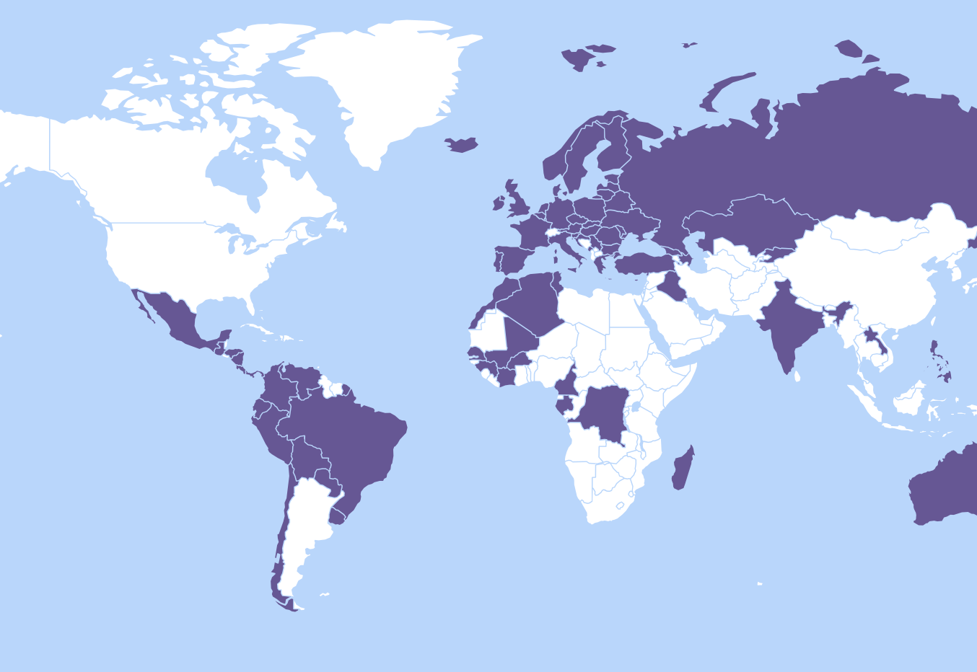
Resale Right: the global situation
Countries that have adopted the Resale Right

Slide 20
Resale Right: the global situation
EU Directive from 2001
Today the right is implemented in over 80 countries
Some major markets still don’t have the right:
US
China
Japan
Switzerland
Argentina
Major obstacle for the global implementation of the right!

Slide 21
The Resale Right initiative at the WIPO SCCR

Slide 22
Resale Right initiative at the WIPO SCCR
Resale Right is in the Agenda of the SCCR since 2017
Initiative leaded by Senegal & Congo
Supported by:
EU
African countries
Group of Central European & Baltic states
US, Japan & Switzerland: willing to participate on informal discussions but not supporting an international treaty
Aimed at introducing substantive debates towards global harmonization of the right

Slide 23
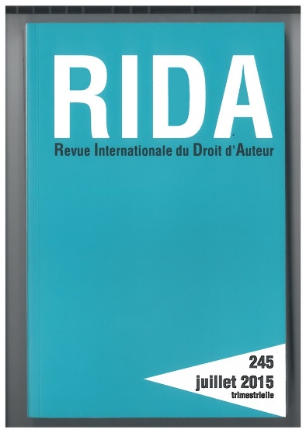
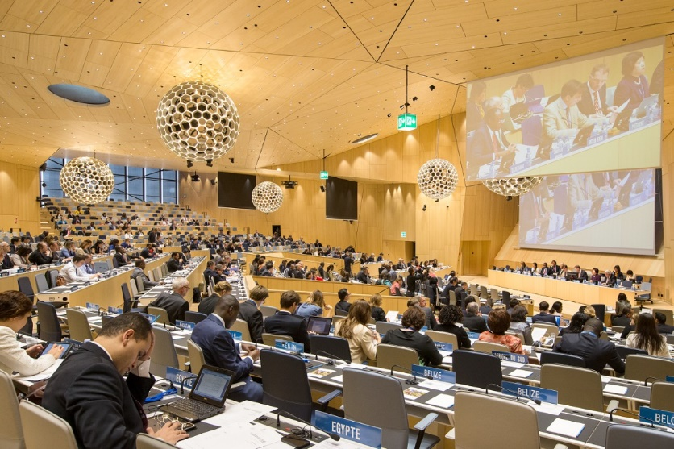
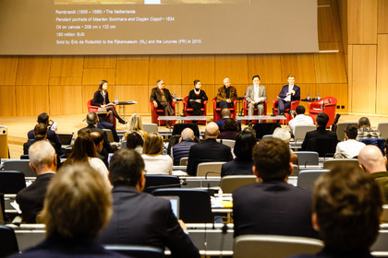
Resale Right initiative at the WIPO SCCR - Milestones
Academic study
Presented at the plenary session
Published in RIDA
Economic studies
Show that the RR has impact on the art market
Events at WIPO
April 2017: WIPO International Conference
Many side events for country delegates
With testimonies from visual artists

Slide 24
Resale Right initiative at the WIPO SCCR - Situation & next steps
Debates at the plenary session continue
A task force was created to address practical elements of the right
Impact assessment on the management of the RR around the world
﻿Basis of calculation; payment liability; compulsory or voluntary collective management)
RR and galleries
Benefit of RR for artists
Next steps
Continue gaining consensus among key countries with no Resale Right
US
Japan
Argentina

Slide 25
The role of authors’ societies and their global network

Slide 26
The role of authors’ societies
Once RR is in place, CMOs play a key role to administer the right and make sure the royalties are collected from the sellers and distributed to artists
CMOs send report requests to auction houses, dealers and galleries
CMOs calculates the share for each resale and bills the seller
Once payment is received, the money is distributed to artists
CMO distribute to foreign artists too
In many countries, CMOs distribute also to non-members
CMOs develop online tools that facilitate the distribution
Artist databases, automated royalty calculators, online sales reporting

Slide 27
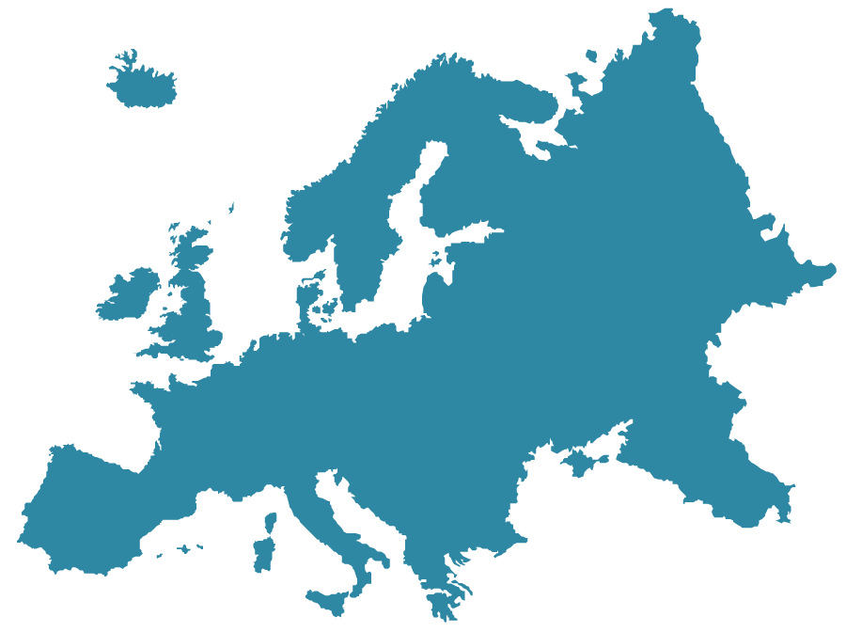
CISAC societies managing visual art repertoire
Europe
AAS (Azerbaijan)
ACS (UK)
ADAGP and SAIF (France)
AKKA-LAA (Latvia)
ALCS (UK)
BILD-KUNST (Germany)
BILDRECHT (Austria)
BILDUPPHOVSRÄTT (Sweden)
BONO (Norway)
DACS (Great Britain)
EAU (Estonia)
GCA (Georgia)
GESTOR & OOAS (Czech Republic)
HUNGART (Hungary)
IVARO (Ireland)
KOPIOSTO (Finland)
KUVASTO (Finland)
LATGA (Lithuania)
LITA (Slovakya)
OFA (Serbia)
PICTORIGHT (Netherlands) PROLITTERIS (Switzerland)
RAO (Russia)
SABAM (Belgium)
SIAE (Italy)
SOFAM (Belgium)
SPA (Portugal)
UPRAVIS (Russia)
VEGAP (Spain)
VISARTA (Rumanía)
VISDA (Denmark)
VEGAP (Spain)

Slide 28
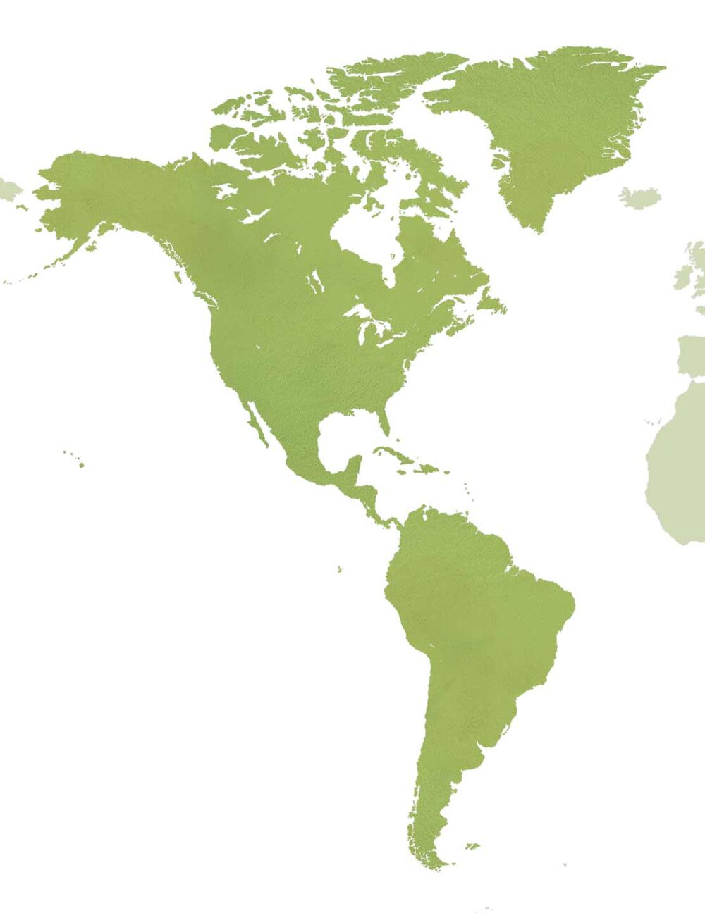
The role of authors’ societies
America
AGADU (Uruguay)
APSAV (Perú)
ARS (US)
ARTEGESTIÓN (Ecuador)
AUTVIS (Brazil)
CARCC (US)
CREAIMAGEN (Chile)
SOMAAP (Mexico)
SAVA (Argentina)
SOCAN (Canada)

Slide 29
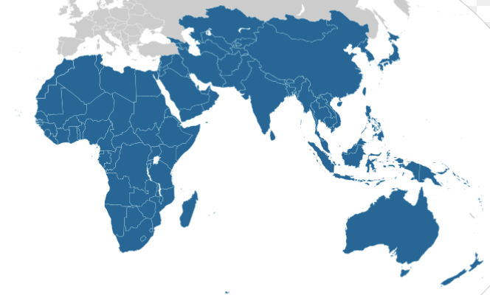
The role of authors’ societies
Africa
BBDA (Burkina Faso)
BGDA (Guinea)
BUBEDRA (Benin)
BUMDA (Mali)
BURIDA (Ivory Coast)
BUTODRA (Togo)
DALRO (South Africa)
SODAV (Senegal)
Asia Pacific
APG (Japan)
Copyright Agency (Australia)
ICSC (China)
JASPAR (Japan)
KOLAA (South Korea)
SACK (South Korea)

Slide 30
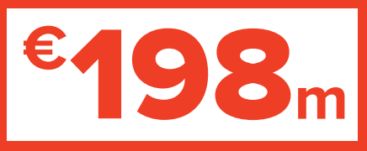
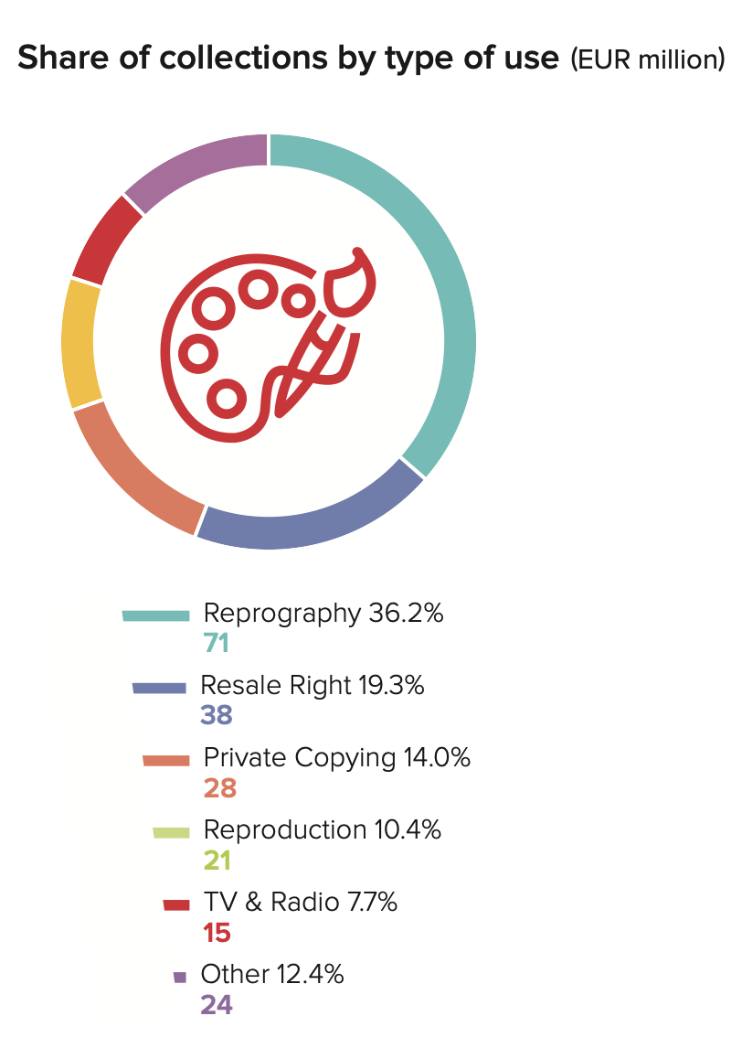
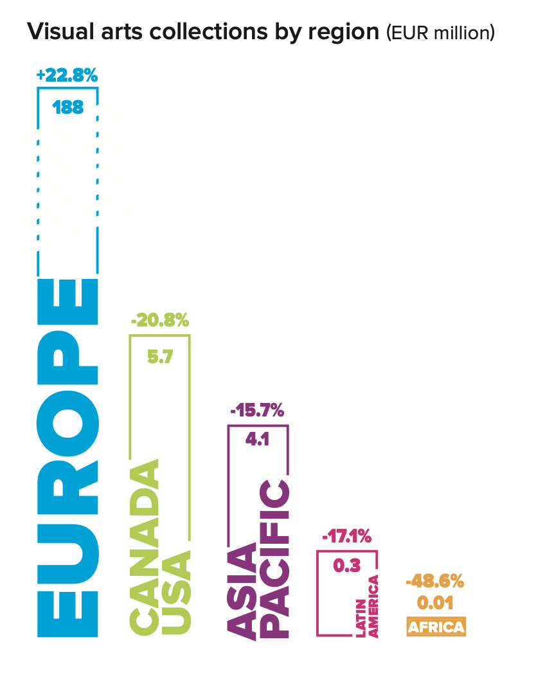
CISAC Global Collection Report 2021 – Visual Arts

Slide 31
The role of the International Council of AGP Creators

Slide 32
The role of the International Council of AGP Creators
International forum for AGP societies
Purpose:
Strengthening cooperation between visual art societies
Establishing standard rules for the harmonisation of the operations
Licensing, collection & distribution of royalties
Developing technological tools which facilitate identification & distribution
Promoting the creation of new visual art societies
Fostering the exchange of good practices
https://www.ciagp.org

Slide 33
Thanks!
Leonardo.de.terlizzi@cisac.org

