Slide 1
CURRENT METHODOLOGY FOR THE ALLOCATION OF INCOME AND EXPENDITURE BY UNION APPLIED IN THE PROPOSED PROGRAM AND BUDGET 2016/17
Briefing to all
Member States
Geneva
October 2, 2015

Slide 2
SCOPE AND PURPOSE OF THE BRIEFING
Limited to explaining and clarifying the allocation of income and expenditure to Unions as contained in the proposed 16/17 Program and Budget
Does not include:
Assessing or evaluating the current methodology or its results
Identifying or discussing alternatives

Slide 3
WIPO’s Program and Budget
Results View of Budget
Program View of Budget
Union View of Budget
Provides an overview of the estimated resources for achieving the Organizational expected results in a biennium
Includes narrative and results-framework and the resources required to achieve the results as measured by the performance indicators in a biennium (Regulation 2.5).
Provides the responsibility, authority and accountability (RAA) framework for managing the work of the Organization in a biennium
Provides biennial estimates for income and expenditure separately for each Union (Regulation 2.3)
Notes:
3

Slide 4
WIPO UNIONS
Contribution- financed (CF) Unions
PCT Union
Madrid Union
Hague Union
Lisbon Union

Slide 5
UNION VIEW OF THE BUDGET
As per FRR Regulation 2.3
All income and expenditure are accounted for in this view
Provides information on the projected operating result for each Union
Contained in Annex III of the proposed Program and Budget

Slide 6
ALLOCATION OF INCOME
Contribution- financed (CF)
Unions
PCT Union
Madrid Union
Hague Union
Lisbon Union
Member States Contributions
Publications
Arbitration
Investment revenue
Miscellaneous
PCT fees
Publications
Arbitration
Investment revenue
Miscellaneous
Madrid fees
Publications
Arbitration
Investment revenue
Miscellaneous
Hague fees
Publications
Arbitration
Investment revenue
Miscellaneous
Lisbon fees
Publications
Arbitration
Investment revenue
Miscellaneous
IPSAS adjustments to income

Slide 7
INCOME ALLOCATION KEYS
Types of Income | Allocation considerations | Allocations keys / Share of income
Publications income (Revenues from sale of publications and from subscriptions to periodicals published by the Secretariat, in paper, CD‑ROM or any other format) | Publications and subscriptions are attributed to Unions based on their content (reflected in the chart of accounts) | Share of total publication income in 16/17: CF Unions: 32.3% PCT Union: 32.3% Madrid Union: 29% Hague Union: 6.5%
Arbitration income (Fees for the arbitration of domain names, registration fees for the meetings of the WIPO Arbitration and Mediation Center, net of related currency adjustments) | Based on relative % determined by PM | Allocation keys determined at: CF Unions: 5.2% PCT Union: 63.4% Madrid Union: 30% Hague Union: 1.2% Lisbon Union: 0.2%
*

Slide 8
INCOME ALLOCATION KEYS (Cont.)
Types of Income | Allocation considerations | Allocations keys
Investment revenue (Revenues earned from investments, including interest on capital deposits) | Relative share for each Union of total investment revenue determined on the basis of each Union’s treasury balance (Reserves and WCFs) | Share of total investment revenue in 16/17: total investment revenue estimated at 0 CHF Share of total investment revenue in 14/15: CF Unions: 6.9% PCT Union: 55.6% Madrid Union: 37.6% Hague and Lisbon Unions: 0%
Miscellaneous income registration fees for conferences and training courses, support charges in respect of extra‑budgetary activities executed by WIPO and financed by UNDP and trust funds accounting adjustments (credits) in respect of prior years and currency adjustments rental of WIPO premises UPOV’s payments to WIPO for administrative support services | Rental income from the Madrid building is allocated to the Madrid Union The remaining miscellaneous income is allocated equally among the Unions | Rental income from the Madrid Building in 16/17: 340,000 CHF Remaining miscelleneous income in 16/17: 692,000 CHF per Union
*

Slide 9
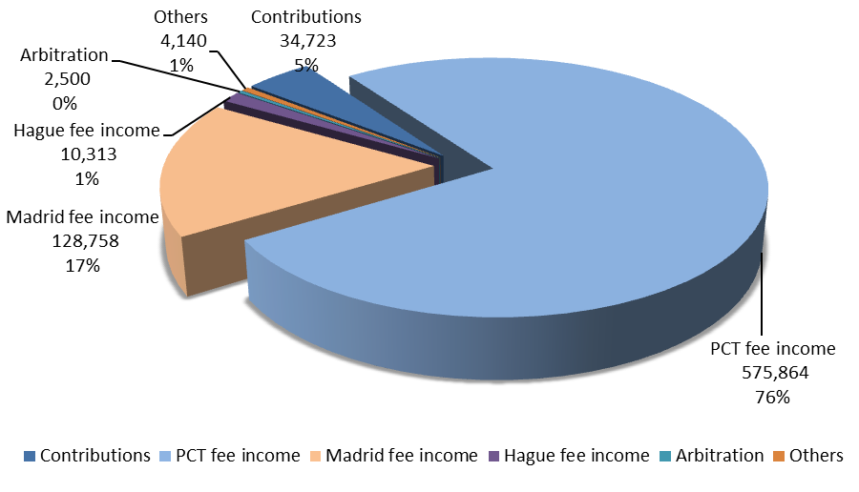
BREAKDOWN OF ESTIMATED TOTAL INCOME 2016/17

Slide 10
ALLOCATION OF EXPENDITURE
Contribution- financed (CF)
Unions
PCT Union
Madrid Union
Hague Union
Lisbon Union
Direct Union
Direct Admin
Indirect Union
Indirect Admin
Direct Union
Direct Admin
Indirect Union
Indirect Admin
Direct Union
Direct Admin
Indirect Union
Indirect Admin
Direct Union
Direct Admin
Indirect Union
Indirect Admin
Direct Union
Direct Admin
Indirect Union
Indirect Admin
IPSAS adjustments to expenditure

Slide 11
EXPENDITURE ALLOCATION CONSIDERATIONS
Types of Expenditure | Allocation considerations
Direct Union Expenditure | Expenditure for Union specific activities and the attributable share of related administrative expenditure (Programs 1(p), 2, 3(p), 4, 5, 6, 7, 12, 13, 14, 31) The costs of such activities are allocated to the Unions based on: Full attribution Where the allocation is to a single Union, the full cost of a Program is allocated to that Union (ex: Program 5 - The PCT and Program 31 – The Hague) Partial attribution Where the cost of a Program is only partially to a Union, the share of the cost of a Program is based on estimations by Program Managers (estimation done at the budget unit level) The costs of some ADG/DDG offices and unit 0046 (Program14) are allocated to the relevant Unions based on their relative share of income

Slide 12
ALLOCATION OF DIRECT UNION EXPENDITURE
Prog | Unit | Description | CF Union | PCT Union | Madrid Union | Hague Union | Lisbon Union | Comments
01 | 0001 | Law of Patents | 10% | 90% |  |  |  | As per PM
02 | 0002 | TM Law and Legislative Advice | 20% |  | 65% | 15% |  | As per PM
03 |  | Copyright and Related rights (All units except for 0108) | 100%
04 |  | TK, TCE and GR | 100%
05 |  | The PCT System |  | 100%
06 | 0128 | The Office of the DDG-Brands and Designs Sector |  |  | 91.7% | 7.8% | 0.5% | Relative income share
06 | 0244 | The Lisbon Registry |  |  |  |  | 100%
06 |  | All other units (Madrid-related) |  |  | 100%
07 |  | Arbitration and Mediation Center | 5.2% | 63.4% | 30% | 1.2% | 0.2% | As per PM
12 |  | International Classifications and Standards | 7% | 88% | 4% | 1% |  | As per PM
13 |  | Global Databases |  | 90% | 10% |  |  | As per PM
14 | 0046 | Access to Information and Knowledge |  | 80.3% | 18.1% | 1.5% |  | Relative income share
 | 0047 | Office of the ADG-Global Infrastructure Sector | 4.7% | 76.5% | 17.3% | 1.5% | 0.1% | Relative income share
31 |  | The Hague System |  |  |  | 100%

Slide 13
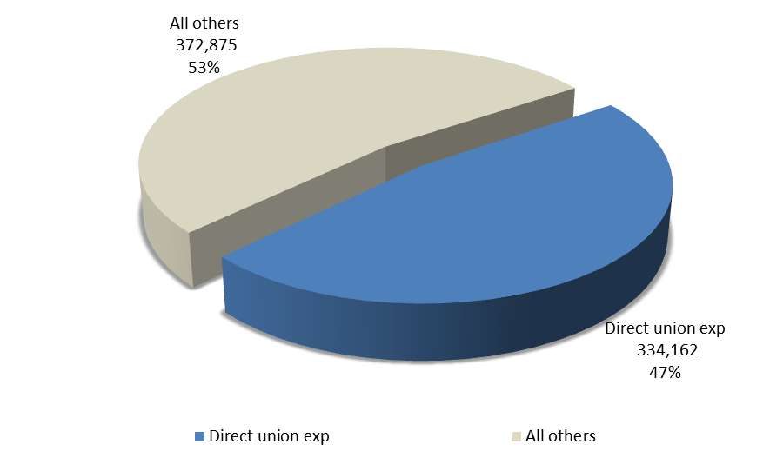
SHARE OF DIRECT UNION EXPENDITURE OF TOTAL ESTIMATED EXPENDITURE IN 2016/17

Slide 14
EXPENDITURE ALLOCATION CONSIDERATIONS
Types of Expenditure | Allocation considerations
Direct Administrative Expenditure | The share of the costs of all administration and management-related Programs under Strategic Goal IX (Programs 21-28) and Unallocated. The total share of direct administrative costs is determined based on: Direct attribution to the Unions of administrative costs (share of cost of server hosting at UNICC servers and share of cost of the Income Section in Finance) Total headcount of the direct Union-related Programs relative to the total headcount of all Programs other than Programs under Strategic Goal IX. The total share of direct administrative costs is allocated to the Unions based on: The share of each Union’s headcount relative to the total headcount of direct Union-related Programs

Slide 15
ALLOCATION OF DIRECT ADMINISTRATIVE EXPENDITURE
Total headcount of all Programs
Total Admin Exp
Total headcount of all Programs excl.SG IX
Direct Admin Expenditure allocated to Unions based on relative headcount
74% in16/17
Total headcount of direct Union related Programs
Directly attributed to the Unions (ICC&Finance)

Slide 16
ALLOCATION OF DIRECT ADMINISTRATIVE EXPENDITURE
Step 1 | Total headcount (fixed term and short term positions): |  | 1,316
 | Union Direct Headcount |  | 657
 | Headcount of Admin Programs (Programs under SG IX) |  | 425
 | Total headcount of all Programs (excl. Headcount of Admin) |  | 891
Step 2 | Relative Percentage of Union Direct Headcount to total headcount of all Programs (excl. Programs under SG IX) |  | 74%
Step 3 | Total Admin Expenditure, of which: |  | 246,151
 | a. Directly attributed to Unions (part of UNICC and Finance costs) |  | 10,385
 | b. Balance-Total Admin Expenditure |  | 235,766
Step 4 | Direct Admin Expenditure allocated on the basis of headcount (235,766x74%) |  | 173,847
 |  | CF Unions | PCT Union | Madrid Union | Hague Union | Lisbon Union | TOTAL
Step 5 | Allocation of Union Direct Admin Expenditure by Unions (using relative headcount % below):
 | Headcount:
 | Union Direct Headcount | 36 | 451 | 147 | 20 | 3 | 657
 | Relative Ratios | 6% | 69% | 22% | 3% | 0% | 100%
 | Direct Admin Expenditure by Unions:
 | Admin Expenditure Directly Attributed to Unions | - | 5,720 | 4,320 | 346 | - | 10,385
 | 2. Union Direct Admin Expenditure Allocated on Headcount | 9,634 | 119,371 | 38,808 | 5,220 | 815 | 173,847
 | Total Union Direct Admin Expenditure | 9,634 | 125,091 | 43,128 | 5,566 | 815 | 184,233
*%-ages are rounded for the purposes of the presentation

Slide 17
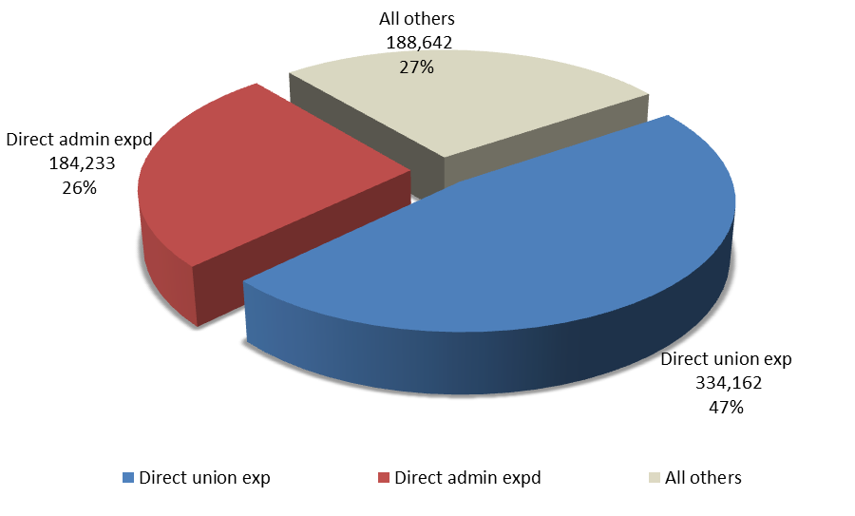
SHARE OF DIRECT ADMINITRATIVE EXPENDITURE OF TOTAL ESTIMATED EXPENDITURE IN 2016/17

Slide 18
EXPENDITURE ALLOCATION CONSIDERATIONS
Types of Expenditure | Allocation considerations
Indirect Union Expenses | Expenditure for Programs not directly related to the activities of the Unions are considered «Indirect Union» expenses (Programs 1(p), 3(p), 8, 9, 10, 11, 15, 16, 17, 18, 19, 20, 30). The costs of such Programs are allocated to the Unions based on Unions’ biennial capacity to pay A Union’s biennial capacity to pay is calculated taking into account reserve balances and biennial surplus: 1) Beginning reserve balance (+) Remaining reserve appropriations at the beginning of the period (-) = remaining reserve balance at the beginning of a biennium (A) If (A) is above the reserve target level then proceed with calculation as per 2) below 2) Income during the period (+) IPSAS adjustments to income during the period (-) Projected biennial Union Direct expenditure (-) Projected biennial Direct Administrative expenditure (-) = surplus/deficit for the biennium (B) If (B) is greater than 0 the Union has «capacity to pay»

Slide 19
CAPACITY TO PAY
STEP 1
UNION
RESERVES & WCF
STEP 2
UNION
INCOME
Beginning reserve balance
IPSAS adjustments
Surplus
Remaining reserve
appropriations
Income after IPSAS adjustments
EXPENDITURE
Union Direct Admin
Union Direct exp
Reserve target level
Remaining reserve balance
If available reserve balance is above the target level then Step 2
If surplus, then Union has capacity to pay

Slide 20
ALLOCATION OF INDIRECT UNION EXPENDITURE IN 16/17
Step 1 | Total Indirect Union Expenditure | 126,724 | (Programs 1, 3, 8, 9, 10, 11, 15, 16, 17, 18, 19, 20, 30)
 |  | CF-Unions | PCT Union | Madrid Union | Hague Union | Lisbon Union | TOTAL
Step 2 | Relative Ratios of Unions' Capacity to Pay* | 1.8% | 89.5% | 8.7% | 0% | 0% | 100%
Step 3 | Allocation of Union Indirect Expenditure by Unions (applying % in Step 2 to total Indirect Union Expenditure):
 | Indirect Union Expenditure by Union | 2,242 | 113,412 | 11,070 |  |  | 126,724
*Note: | 2016/17 Estimated income before IPSAS adj. | 35,645 | 578,241 | 130,630 | 11,055 | 727 | 756,297
 | IPSAS adjustments to income | - | (7,514) | (419) | (147) | - | (8,080)
 | 2016/17 Estimated income afte IPSAS adj. | 35,645 | 570,727 | 130,211 | 10,908 | 727 | 748,217
 | 2016/17 Direct Union expenditure | 21,858 | 235,553 | 66,577 | 8,802 | 1,372 | 334,162
 | 2016/17 Direct Admin expenditure | 9,634 | 125,091 | 43,128 | 5,566 | 815 | 184,233
 | Sub-total | 31,492 | 360,643 | 109,704 | 14,368 | 2,187 | 518,394
 | Difference (Biennial capacity to pay) | 4,153 | 210,084 | 20,507 | - | - | 234,743
 | Relative Ratios of Unions' Capacity to Pay | 1.8% | 89.5% | 8.7% | - | - | 100%
*%-ages are rounded for the purposes of the presentation

Slide 21
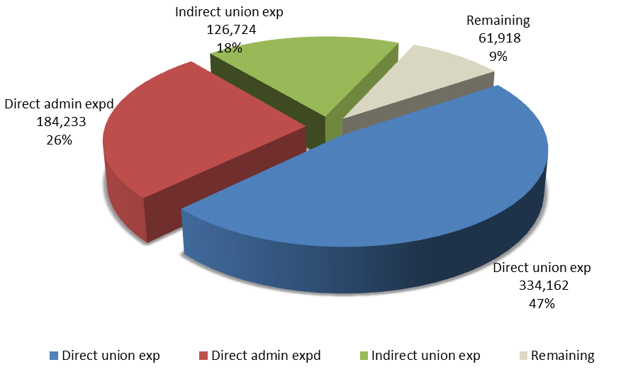
SHARE OF INDIRECT UNION EXPENDITURE OF TOTAL ESIMATED EXPENDITURE IN 2016/17
Covered 89.5% by the PCT Union, 8.7% by the Madrid Union and 1.8% by the CF-Unions

Slide 22
EXPENDITURE ALLOCATION CONSIDERATIONS
Types of Expenditure | Allocation considerations
Indirect Administrative Expenses | The share of the costs of all administration and management-related Programs under Strategic Goal IX (Programs 21-28) and Unallocated not allocated as Direct Administrative Expenses Indirect Administrative Expenditure = Total cost of Programs 21-28 and Unallocated – Union Direct Administrative Expenditure The Indirect Administrative Expenditure are allocated to the Unions based on Unions’ biennial capacity to pay

Slide 23
ALLOCATION OF INDIRECT ADMIN EXPENDITURE
Step 1 | Total Admin expenditure- Direct Admin expenditure= | 246,151 184,233
 | Indirect Admin expenditure | 61,918
 |  | CF-Unions | PCT Union | Madrid Union | Hague Union | Lisbon Union | TOTAL
Step 2 | Relative Ratios of Unions' Capacity to Pay* | 1.8% | 89.5% | 8.7% | - | - | 100%
Step 3 | Allocation of Indirect Admin Expenditure by Unions (applying % in Step 2 to total Indirect Union Expenditure):
 | Indirect Admin Expenditure by Union | 1,095 | 55,414 | 5,409 |  |  | 61,918
*Note: | 2016/17 Estimated income before IPSAS adj. | 35,645 | 578,241 | 130,630 | 11,055 | 727 | 756,297
 | IPSAS adjustments to income | - | (7,514) | (419) | (147) | - | (8,080)
 | 2016/17 Estimated income afte IPSAS adj. | 35,645 | 570,727 | 130,211 | 10,908 | 727 | 748,217
 | 2016/17 Direct Union expenditure | 21,858 | 235,553 | 66,577 | 8,802 | 1,372 | 334,162
 | 2016/17 Direct Admin expenditure | 9,634 | 125,091 | 43,128 | 5,566 | 815 | 184,233
 | Sub-total | 31,492 | 360,643 | 109,704 | 14,368 | 2,187 | 518,394
 | Difference (Biennial capacity to pay) | 4,153 | 210,084 | 20,507 | - | - | 234,743
 | Relative Ratios of Unions' Capacity to Pay | 1.8% | 89.5% | 8.7% | - | - | 100%
*%-ages are rounded for the purposes of the presentation

Slide 24
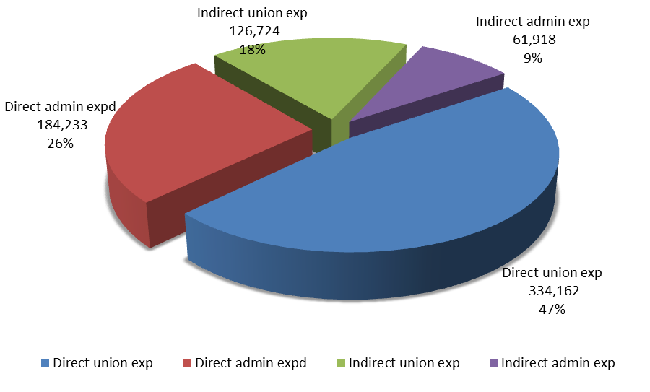
SHARE OF INDIRECT ADMINITRATIVE EXPENDITURE OF TOTAL ESTIMATED EXPENDITURE IN 2016/17
Covered 89.5% by the PCT Union, 8.7% by the Madrid Union and 1.8% by the CF-Unions

Slide 25
THANK YOU

